Slide 1
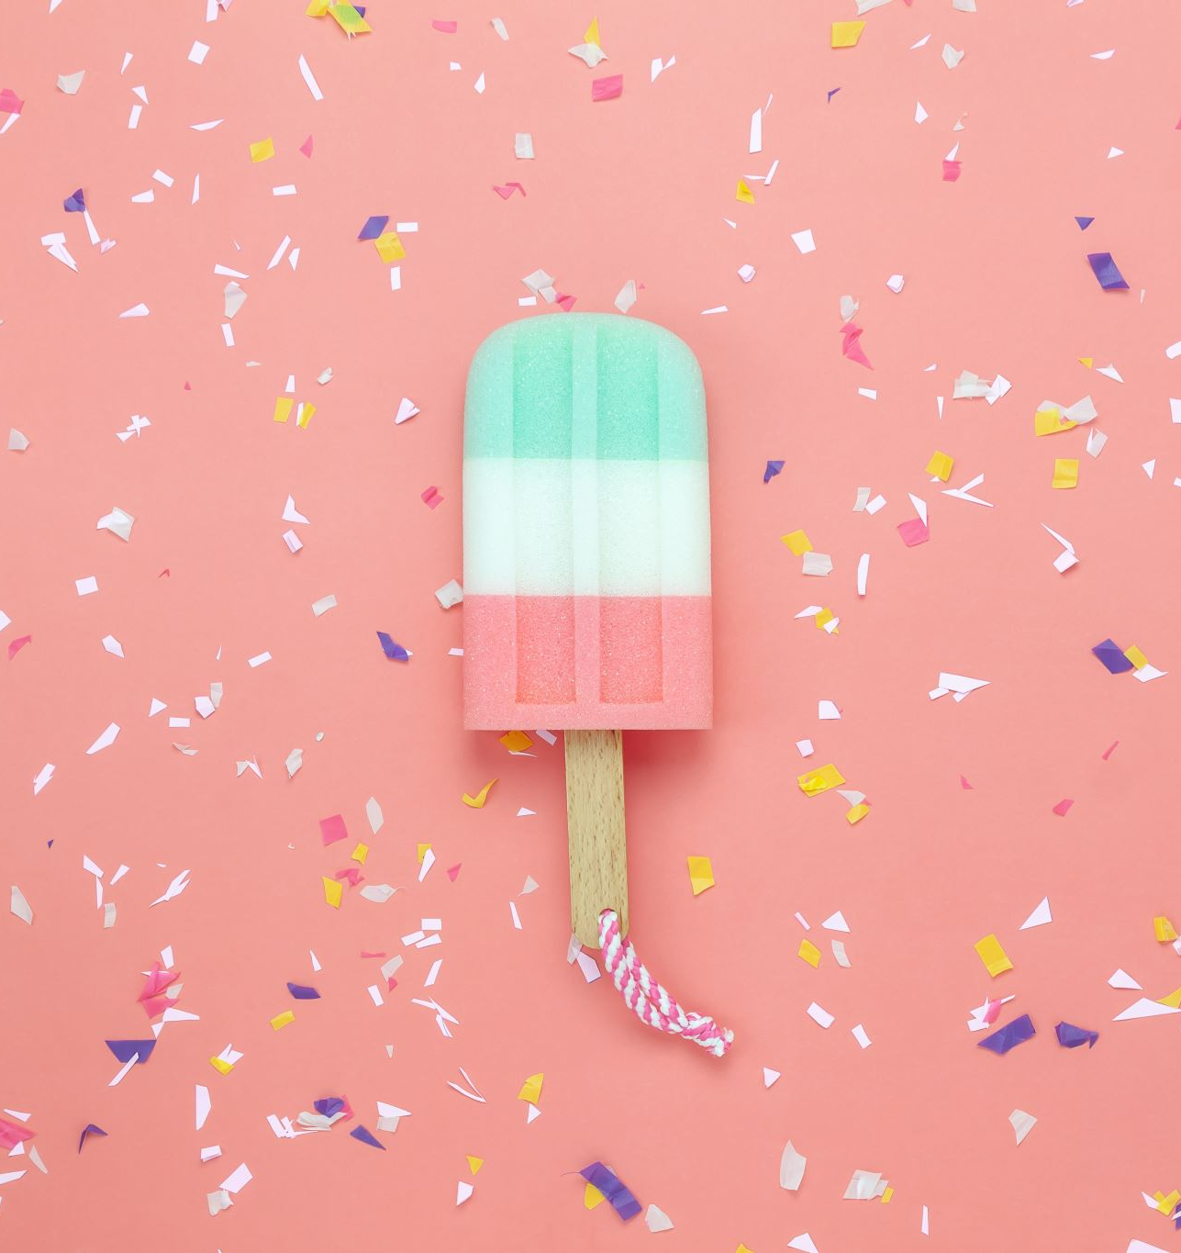
Seaside treats!

Slide 2
When I am at the seaside I love to get an ice-cream or maybe even fish and chips!
Today we are going to try and make our favourite seaside snack… this can be totally up to you in what materials and how you may like to make it.
I love seeing pictures of all your creations on SeeSaw so you could always send me a picture or a video of what you have made!

Slide 3
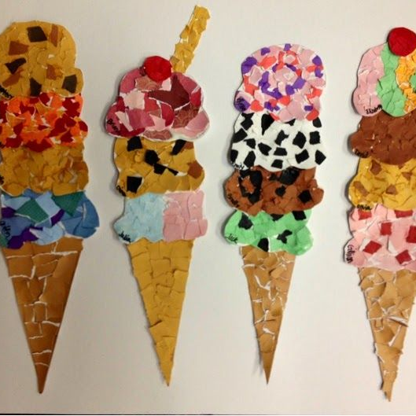
How about making your favourite ice cream or sundae? You could cut up bits of coloured paper and make a collage like this example?

Slide 4
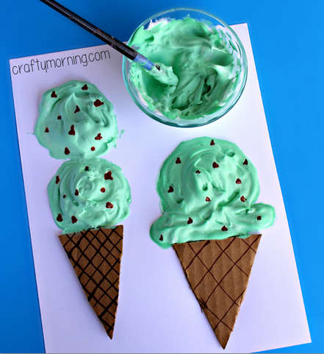
Or you could make your creation a bit more 3D or textured?

Slide 5
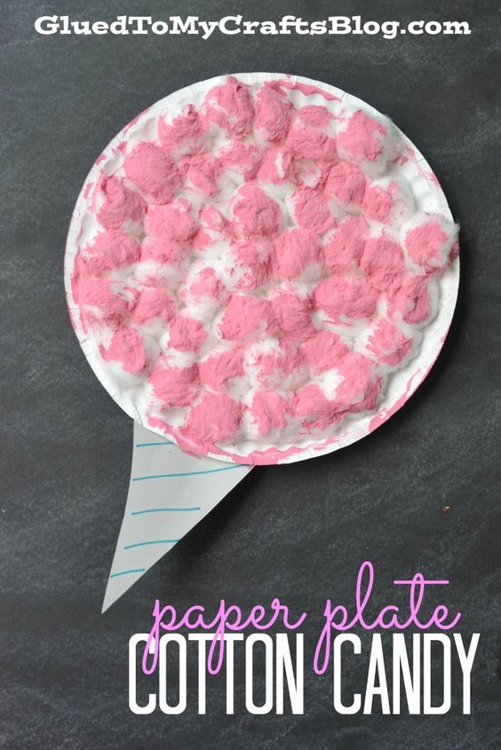
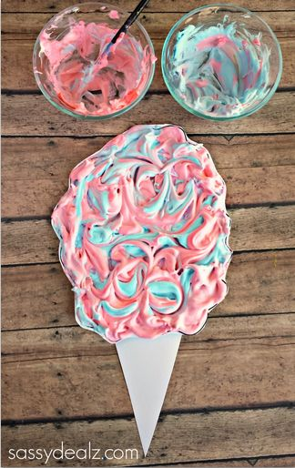
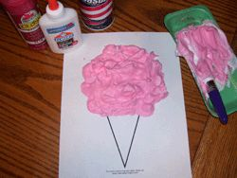

Slide 6
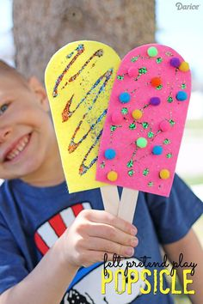
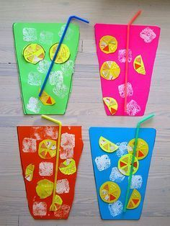
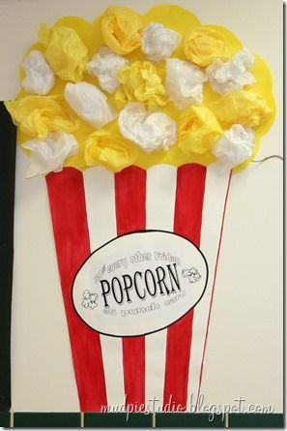

Slide 7
