Slide 1
Bill’s new Frock Author ANNE Fine
A Primary 5 Novel Study

Slide 2
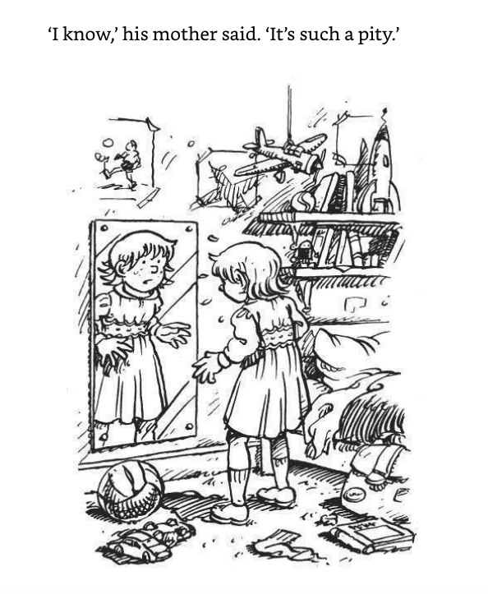

Slide 3
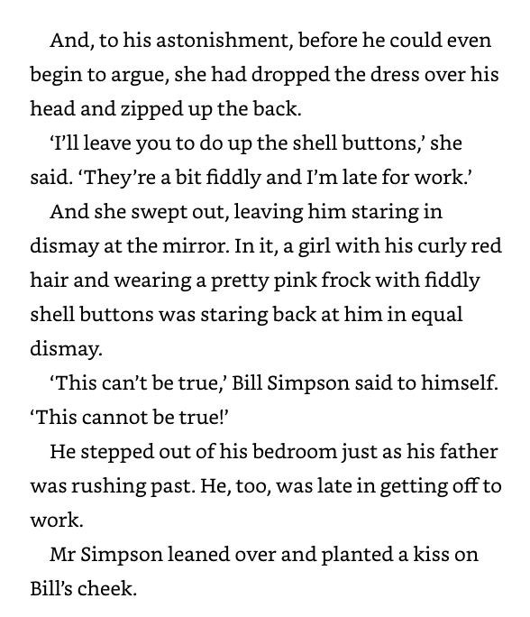

Slide 4
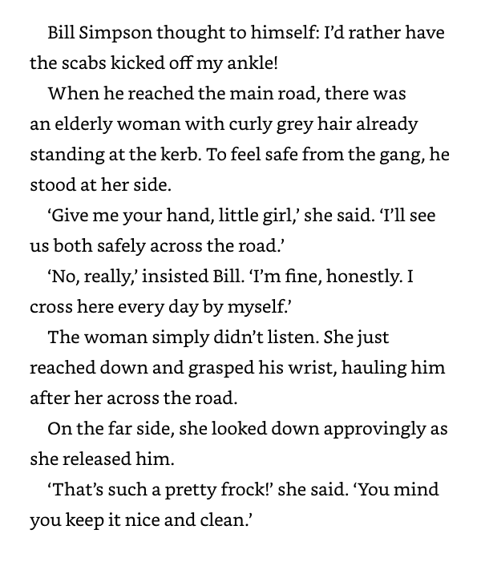

Slide 5
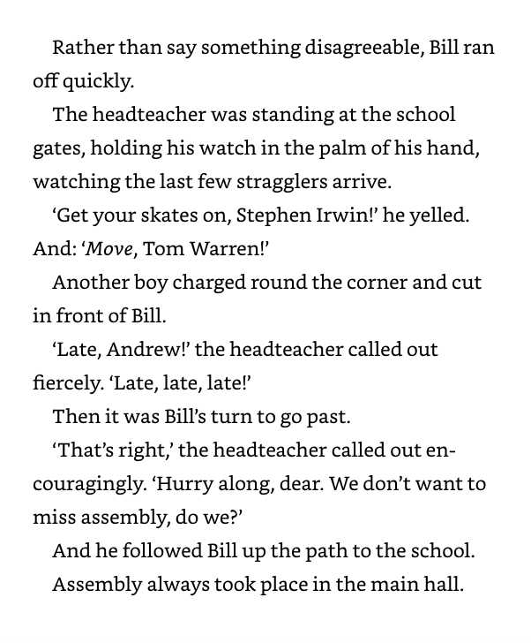
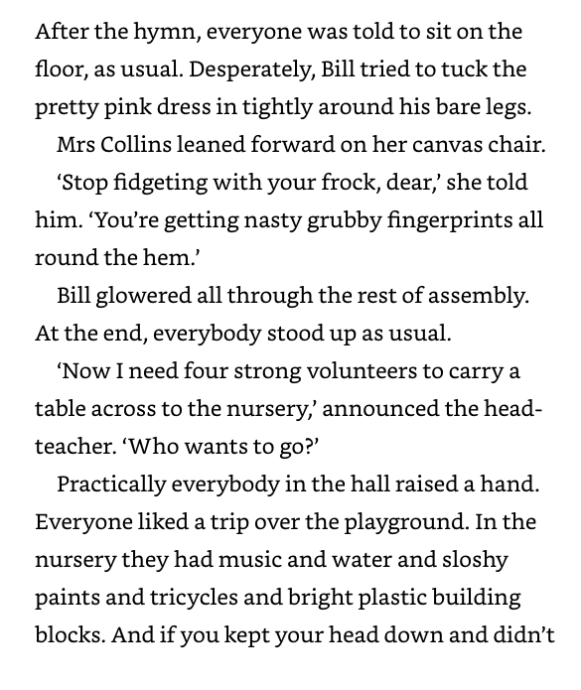

Slide 6
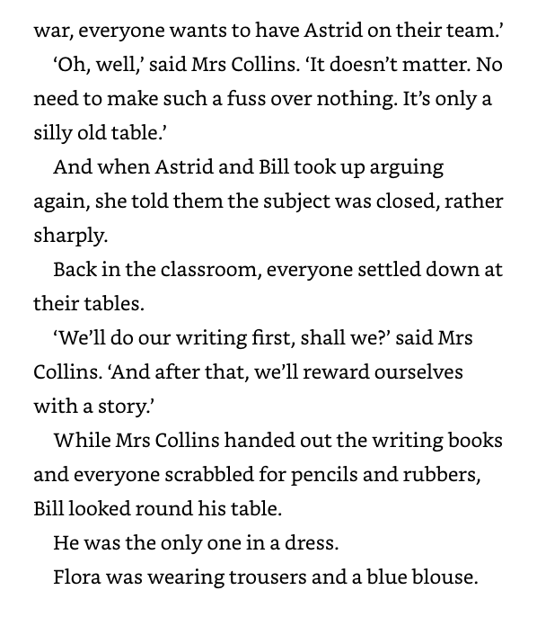

Slide 7
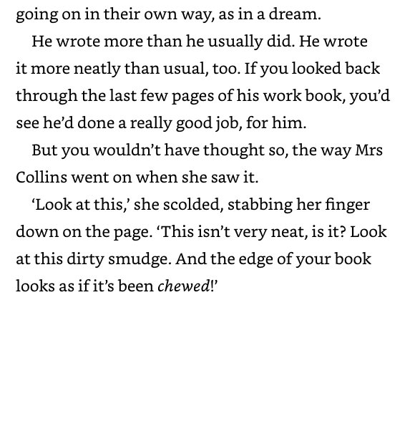

Slide 8
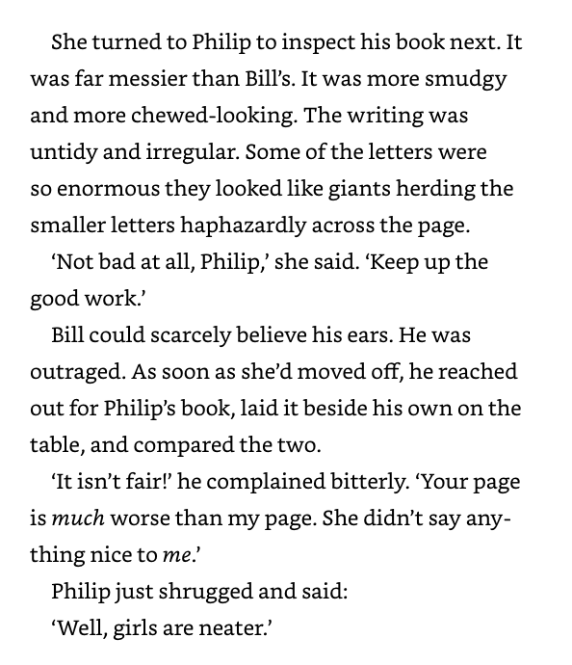

Slide 9
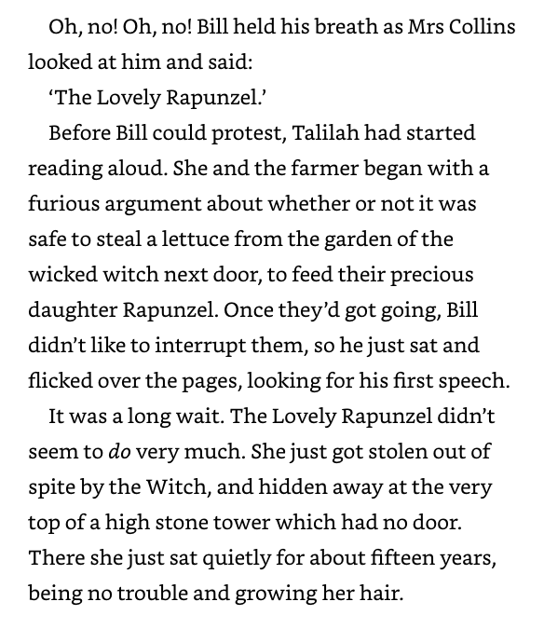

Slide 10
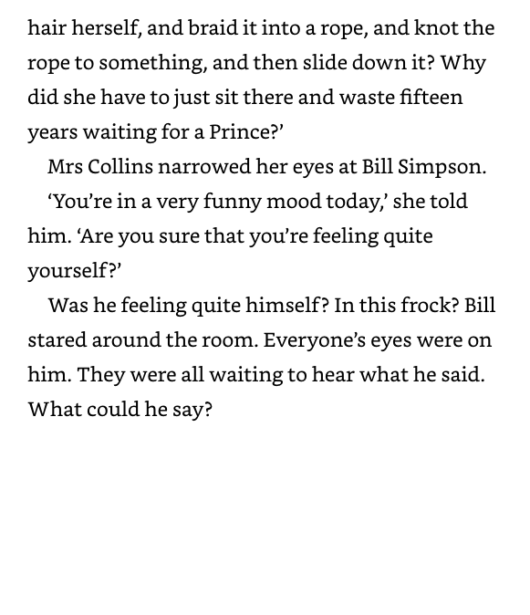

Slide 11
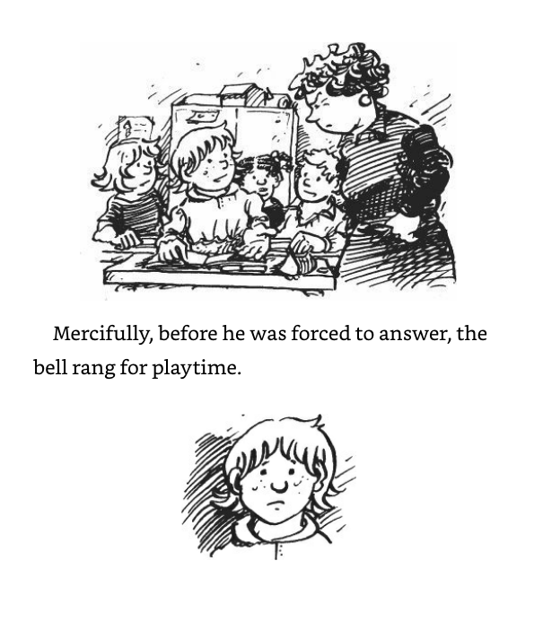

Slide 12
Chapter 1
Remember to answer these questions in your exercise book.
When we answer comprehension questions, we ALWAYS use full sentences.
What happened to Bill on Monday?
Why was Bill's Dad in a rush?
What did he say to Bill as he kissed him on cheek?
Who was whistling at Bill?
Why did Astrid complain?
What was Mrs Collins like about neat work?

