Slide 1
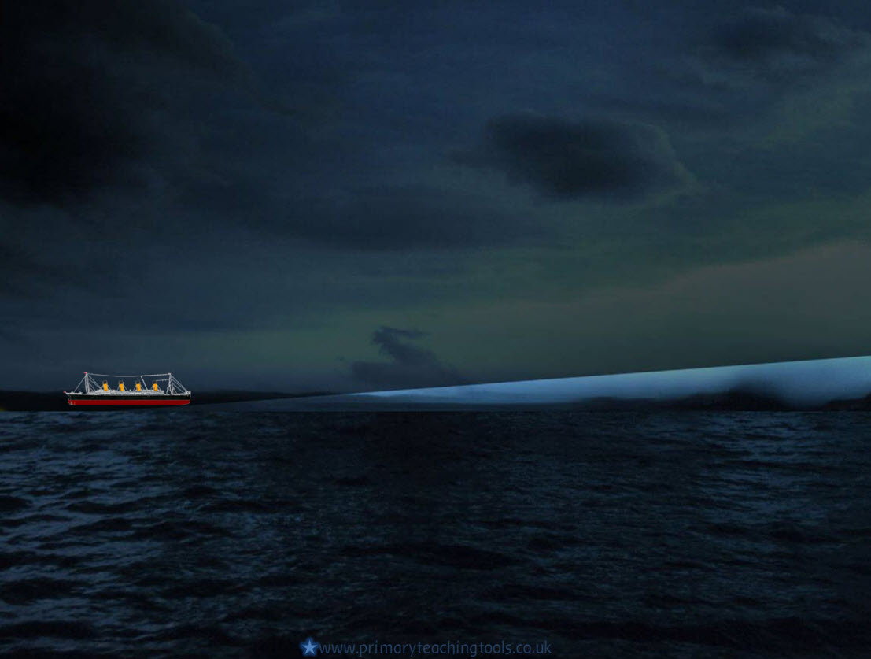
Building the Titanic

Slide 2
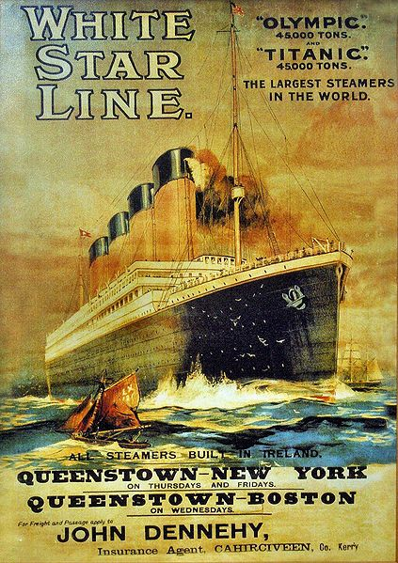
The Titanic was built by the White Star Line in England. The company wanted to build ships that were bigger and more luxurious than any others that were sailing at the time.
The building of the Titanic began in Belfast, at the Harland and Wolff shipyard in March 1909. It was famous even before it was completed.
Her sister ship, the Olympic, was finished the year before Titanic and White Star added many luxuries to the Titanic, making her a thousand tons heavier than the Olympic.

Slide 3
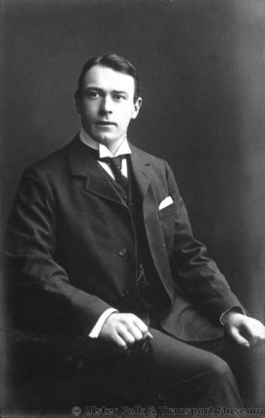
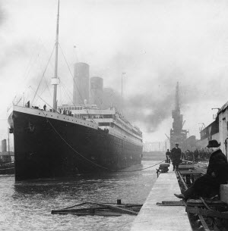
Thomas Andrews was in charge of the design. He made scale drawings of the Titanic to work from.
It took over eleven thousand people more than two years to build the Titanic.
Skilled shipyard workers were paid £2 a week and unskilled workers were paid less than £1 a week.
When the ship was finished in May 1911, she was launched into the sea, ready for the inside to be fitted out.
The final cost was almost £5 million, which today would be more like £255 million.

Slide 4
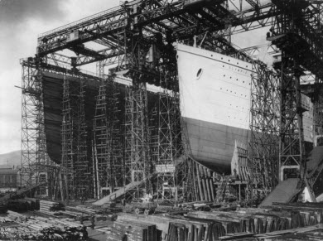
The Titanic was built using the best technologies available at the time.

Slide 5
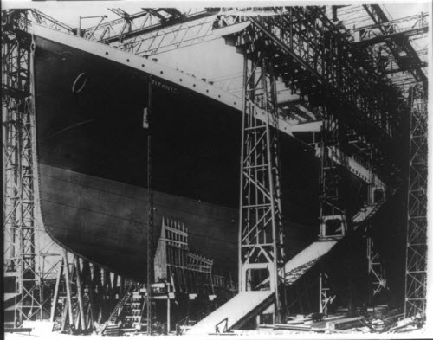
She had a double-bottomed hull that was divided into 16 watertight compartments. Four of these could be flooded without the risk of sinking. This is why the Titanic was called ‘unsinkable’

Slide 6
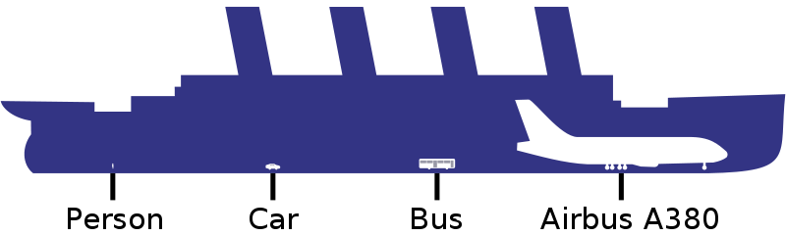
Inside, the Titanic had four electric lifts, and two Marconi radios, allowing the passengers to keep in touch with friends and relatives.
The ship was 270 metres long, almost 20 metres wide, and 30 metres high (to the level of the bridge). The picture below demonstrates just how big she was!
Image by Yzmo, GNU Free documentation licence, Wikimedia Commons

Slide 7
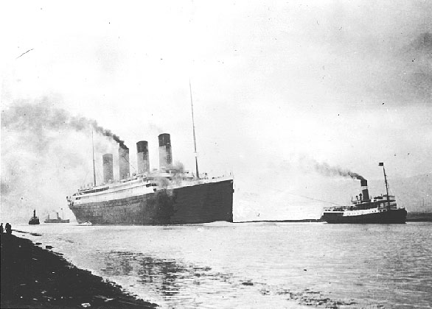
Sea trials
Before setting off on her maiden journey, the Titanic had to undergo sea trials. These happened on Tuesday 2nd April, just eight days before she was due to leave Southampton. She passed and was deemed sea-worthy. The picture shows her at the beginning of her sea trial.

Slide 8
Online link
Building the Titanic
All acknowledged images used published under a Creative Commons Licence
All other images in the Public Domain

