Slide 1
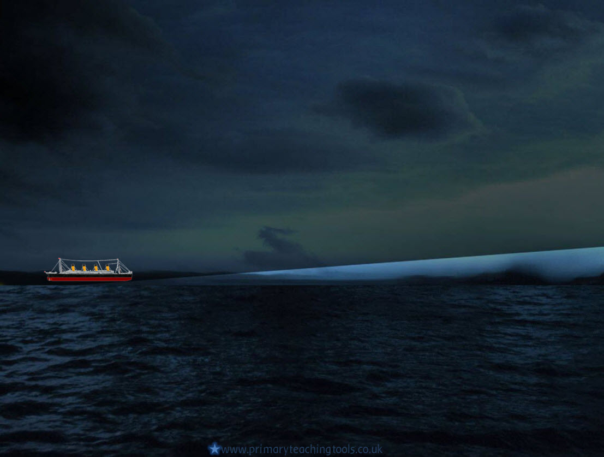
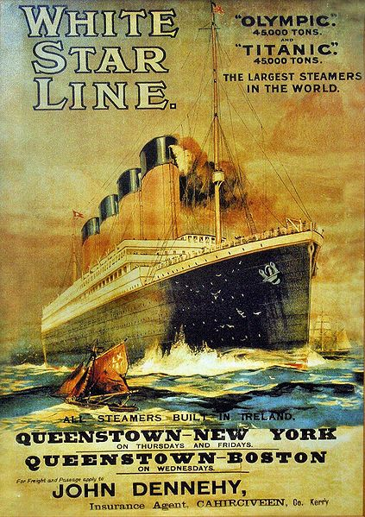
TITANIC

Slide 2
What was the Titanic?
What do you already know about
the Titanic?

Slide 3
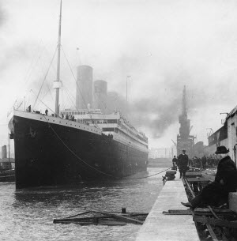
Titanic
The Titanic was a famous ship that was built around a hundred years ago.
It was known at the time as the largest, most luxurious passenger liner in the world.
The ship had three different sections: First Class, Second Class and Third Class.
What do you think these were for?

Slide 4
The 1900s
The 1900s were a time when many things were being invented. People trusted the new technology.
Many people wanted to travel to America, either to work there or to visit friends and relatives.
The only way to do this was to cross the Atlantic Ocean in a ship.
This journey would take 5 or 6 days.
How long would it take today by plane?

Slide 5
Titanic’s maiden voyage
In the early 1900s, there were many shipping companies in competition with each other.
The White Star Line, - a shipping company in Belfast - designed the Titanic to beat the competition and advertised the ship as ‘unsinkable’.
The Titanic set off from Southampton on April 10th 1912.
Her final destination was New York city but she never arrived.
Do you know why?

Slide 6
Online links
Titanic – for BBC history
All acknowledged images used published under a Creative Commons Licence
All other images in the Public Domain

