Slide 1
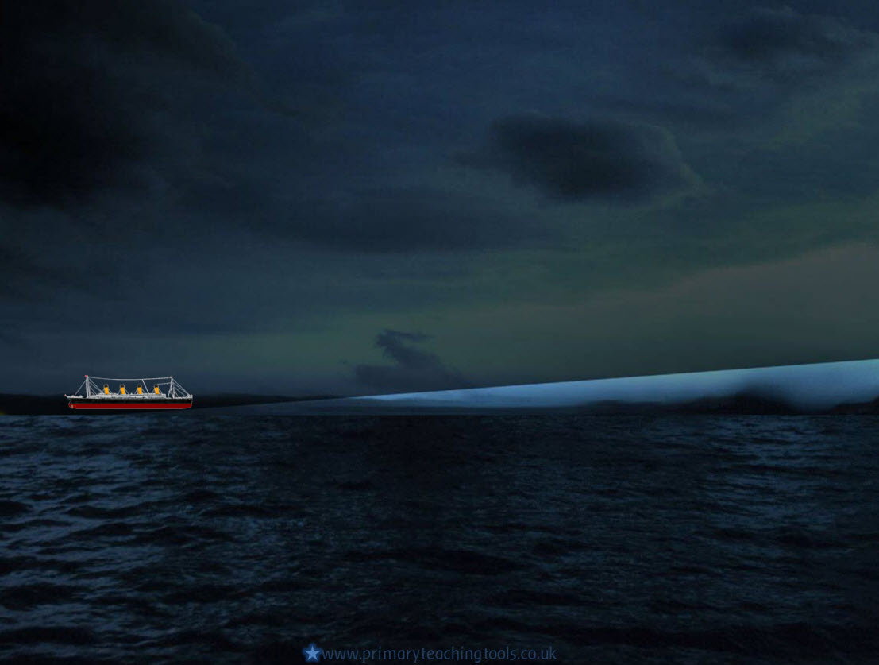
Titanic’s Maiden
Voyage

Slide 2
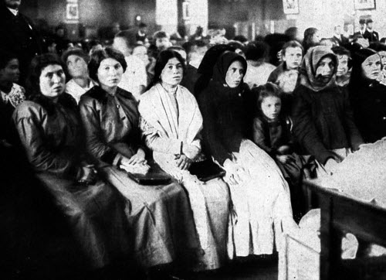
Journey to America
In the early 1900s, the only way of travelling to America was on a ship.
Many people wanted to go and live in America; they had heard it was a better life there and there were more jobs available than in their home countries: It was ‘the land of opportunity’. Richer people would also take trips to America to visit friends or relatives.
People waiting at Ellis Island
In New York city, the poorer people who wanted to live and work in America would have to go to Ellis Island, where they were screened and questioned before being allowed to live in the country.

Slide 3
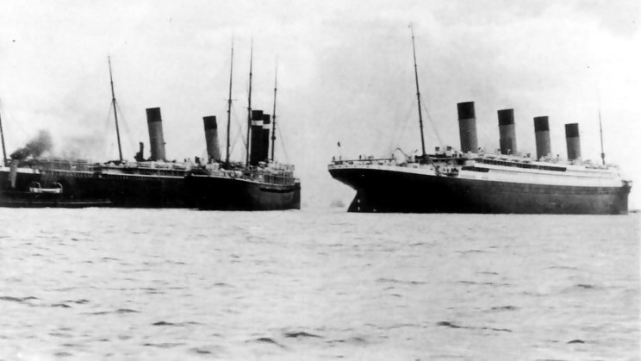
Southampton
The Titanic set off from Southampton on Wednesday 10th April 1912.
The picture shows a near accident that happened as she was setting off. Another ship in the port, the SS New York, almost collided with the Titanic after being ‘sucked’ towards her with the Titanic’s wake.

Slide 4
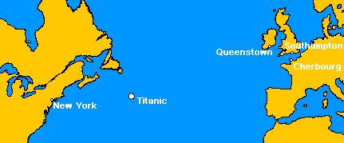
Cherbourg and Queenstown
The next stop was in Cherbourg, to pick up more passengers.
Titanic then travelled to Queenstown, Ireland, to pick up passengers. The port at Queenstown was not deep enough for the Titanic, so passengers had to be ferried in small boats.
She then set sail on her maiden voyage at 1:30 on Thursday the 11th April.

Slide 5
Across the Atlantic
Titanic sailed across the Atlantic Ocean in clear, calm weather. The passengers were enjoying their time on the ship, even though the weather was getting colder.

Slide 6
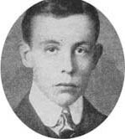
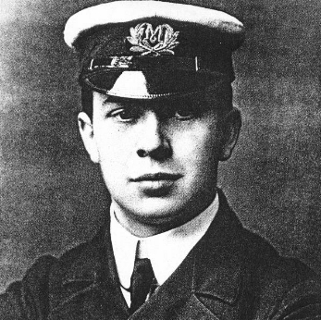
Across the Atlantic
Harold Bride
Jack Phillips
On Sunday, April 14th, the radio operators, Jack Phillips and Harold Bride started receiving messages from other ships, warning them that they had seen icebergs.

Slide 7
Icebergs
Baffin Bay
The icebergs that had been spotted had started off as glaciers around Baffin Bay. The glaciers slowly make their way across the land to the sea and break off, falling into the sea as huge chunks of ice. They then slowly float down ‘Iceberg Alley’, until they move south in the Atlantic ocean, melting slowly .

Slide 8
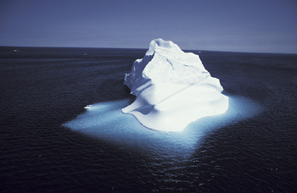
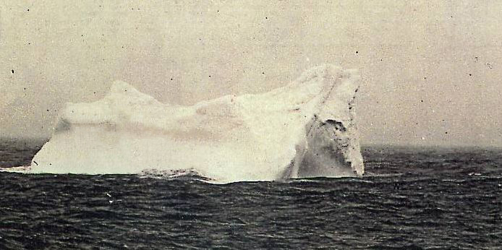
Icebergs
This may be the actual iceberg that the Titanic struck. The picture was taken close to the site of the sinking of the Titanic, by a steward on another ship. He stated that he saw red paint on it, like the paint on the Titanic’s hull.
Icebergs float, but only 10% can be seen above the water. The other 90% is difficult to see, and it is this part of the iceberg that probably struck the Titanic.

Slide 9


Icebergs
The Californian
The Carpathian
The Titanic
At 11:00 pm, Jack Phillips took a message from a ship called the Californian. They told him that they had stopped in a ‘field of icebergs’. They could not go on because it was too dangerous. Phillips was too busy to pay any attention to the message and did not pass it on.

Slide 10
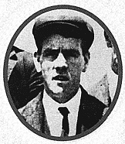
At 11:40 pm, Fred Fleet, who was the lookout, spotted a black shape in the ocean. He rang the warning bell, and telephoned the bridge, shouting: “Iceberg right ahead”
First Officer William Murdoch started turning the ship to avoid the iceberg, and ordered the engines to be turned off. The ship was travelling at over 20 knots, which was too fast to turn quickly enough.

Slide 11
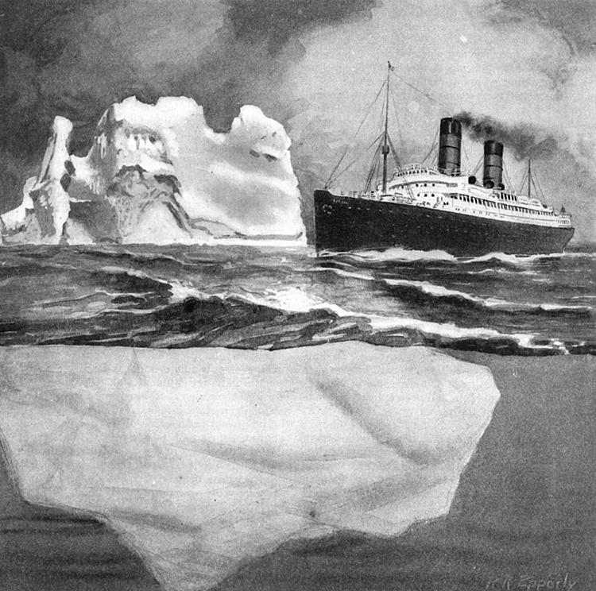
The iceberg was very large – taller than the top decks of the Titanic. As the ship went past it, ice fell on the decks, and the crew heard a strange noise. The iceberg had hit the Titanic under the water.
Captain Smith, who was in bed off duty, heard the noise, and came up to the deck. He sent an officer to check the lower decks. Fifteen minutes later they discovered that water was coming into the ship.

Slide 12
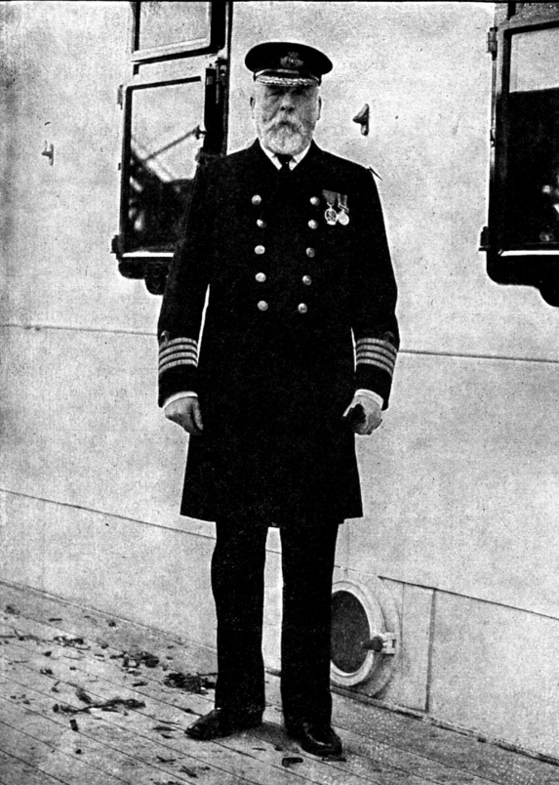
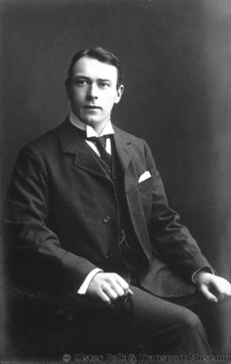
Captain Smith
Thomas Andrews
Captain Smith spoke to Thomas Andrews - the man who had designed the Titanic. Andrews told him that the ship could withstand four compartments filling with water, but there was water in five of the Titanic’s compartments.

Slide 13
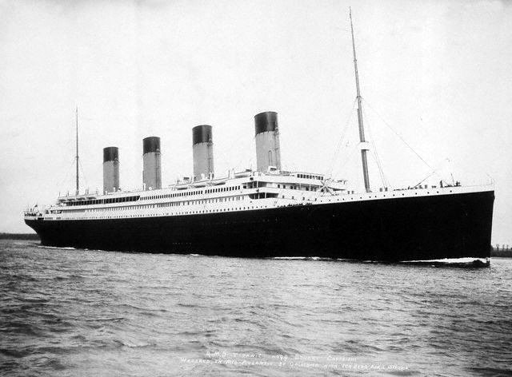
In the meantime, the passengers who were still awake were not too worried. They did not know what had happened and the Titanic was unsinkable, after all.
At 12 o’clock, Captain Smith ordered the crew to wake up the passengers and start filling up the lifeboats. The order was ‘women and children first’.

Slide 14
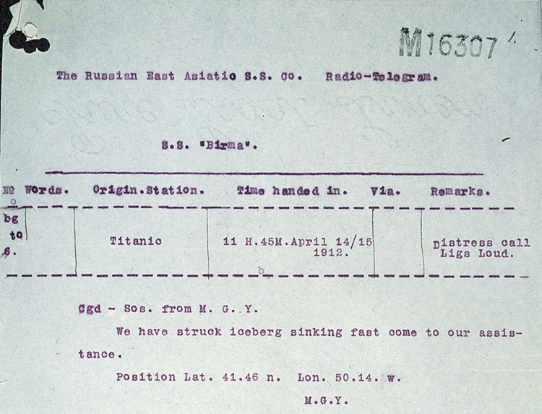
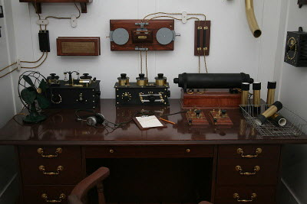
Some of the lifeboats left over half empty. Nobody understands why, but it is thought that Captain Smith believed there were many ships nearby who would come to their rescue.
SOS signals were being sent out to alert other ships in the area, and rockets were fired to warn ships that they were in immediate danger, but no other ships appeared.

Slide 15
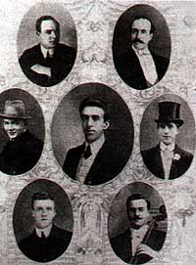
With all the drama going on around them, the Titanic’s band played on the boat deck, trying to keep the passengers calm and relaxed.
They carried on playing until the ship went down.

Slide 16
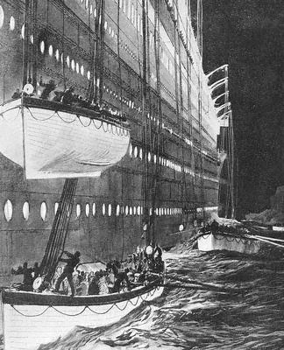
By 2:00 am, the last of the full sized lifeboats was launched. Many people were left behind; many husbands had to stay on the ship whilst their wives and children rowed away in a lifeboat.
The people in the boats noticed that the Titanic was slowly sinking. Its lights flickered and went out, then it broke into two and disappeared under the water.

Slide 17
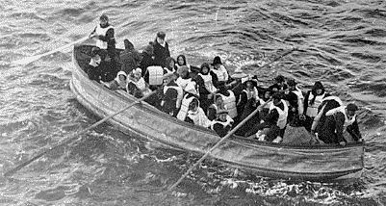
Many of the 1,500 passengers on board were thrown into the freezing sea. They died quickly of hypothermia.
The remaining passengers in the lifeboats were upset and horrified at what they had just seen and heard. They were left in the dark, freezing cold; wondering what had happened to their loved ones.

Slide 18
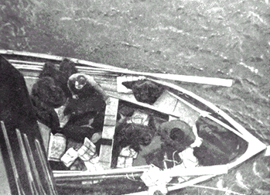
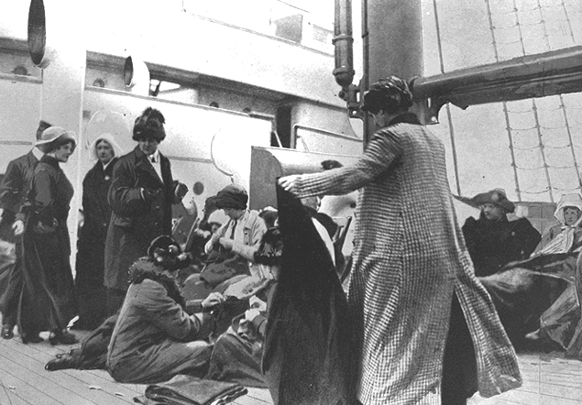
The Carpathia, which had been 80 km away from the Titanic, immediately came to help when the message was received.
It took four hours at top speed for her to get to the site. The crew picked up 705 survivors.
Bruce Ismay wired the White Star New York offices to tell them what had happened.

Slide 19
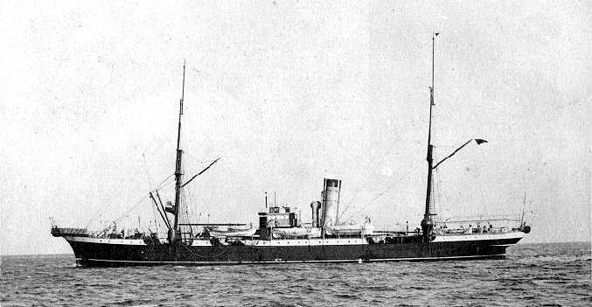
White Star hired the Mackay-Bennet to go to the site and look for bodies. Only 328 were found floating in the sea.

Slide 20
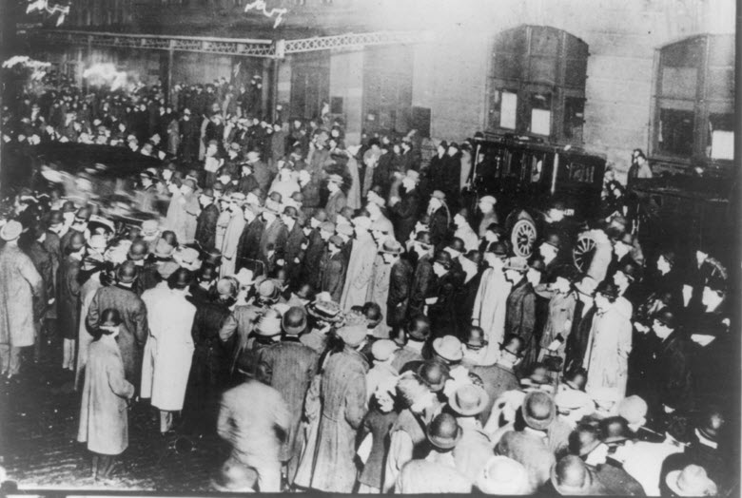
At 9:00pm on the 18th April, the Carpathia arrived in New York. Ten thousand people were there to watch.

Slide 21
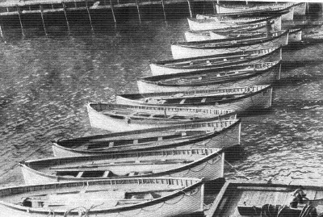
The Carpathia brought back with her the only remnants of Titanic: the lifeboats.

Slide 22
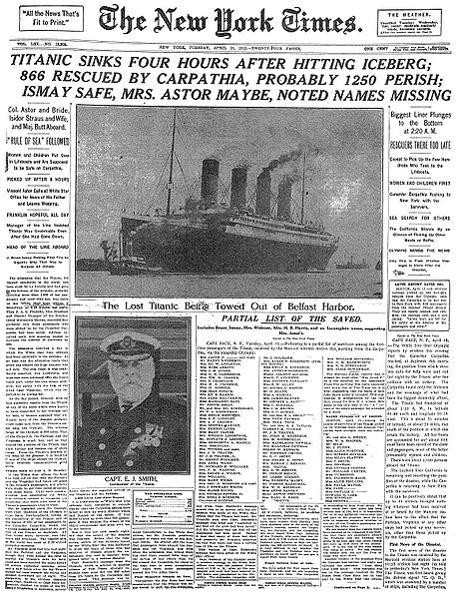
Newspapers all over the world reported on the disaster.

Slide 23
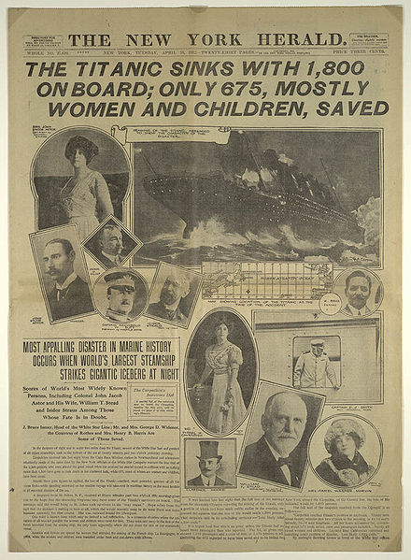

Slide 24
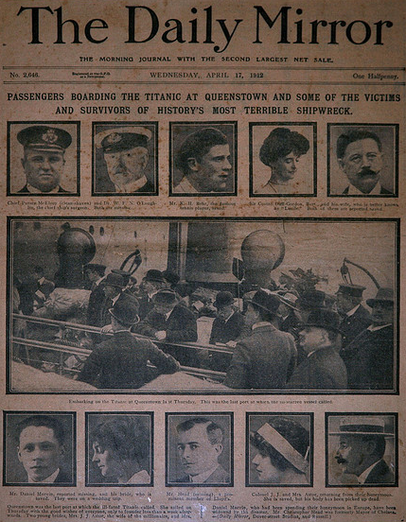

Slide 25
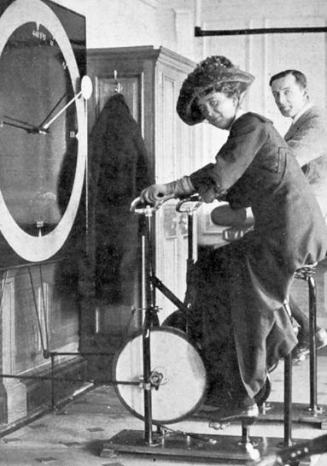
Survivors
Laurence Beesley, seen here at the back, wrote a book about his experiences aboard the Titanic, called ‘The Loss of the SS Titanic’.
It is this book which has given us information and facts about what happened that fateful night.

Slide 26
Survivors
Passengers | Number on board | Number of survivors
1st Class | 325 | 200
2nd Class | 285 | 118
3rd Class | 706 | 174
Crew | 913 | 214
TOTAL | 2229 | 706
(* These numbers may not be exact, as there are conflicting reports of numbers of survivors)
Click for online list of passengers and crew

Slide 27
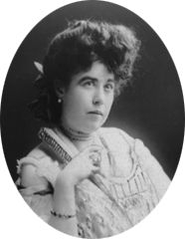
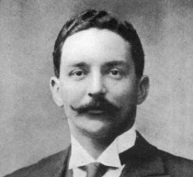
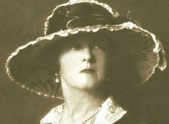
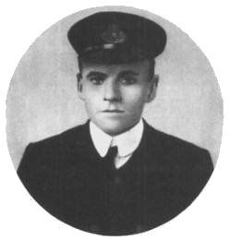
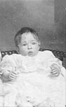
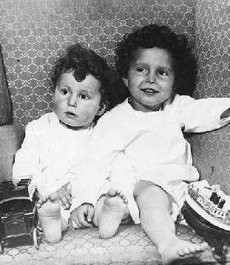
Survivors
Bruce Ismay He was the managing director of the White Star Line. After the disaster he was criticised for surviving, whilst women and children drowned. He was asked to resign.
Frederick Fleet He was the lookout on the Titanic, and was put in charge of manning the lifeboats.
Harold Bride Bride was one of the radio operators on board the Titanic. He was thrown into the sea when the Titanic sank, but ended up next to a collapsible lifeboat. He helped send messages from the rescue ship, the Carpathia.
Millvina Dean Millvina was only 2 months old when the Titanic sank. Her family were Third Class passengers. On the fateful night, her father felt the collision with the iceberg, and got his family up to the deck quickly. He did not survive, but the rest of the family did. Millvina was the last remaining survivor of the Titanic. She died in May 2009
Margaret Brown She was a First Class passenger on the Titanic, and is famous for getting her lifeboat to go back and look for survivors.
Lady Duff-Gordon She was a famous fashion designer, who designed clothes for the Royal family.
Charles Lightoller Lightoller was the most senior officer to survive the disaster. He was thrown into the sea when the Titanic sank, but managed to swim to a collapsible lifeboat.
Michel and Edmond Navratil These two brothers had been taken away from their mother by their father, who was travelling under a false name. Their father died in the tragedy, but their mother saw newspaper reports in France, and came to America to get them back.

Slide 28
Lost cargo
3,364 bags of mail
700 - 800 parcels.
A Renault 35 hp automobile.
A Marmalade Machine.
Oil painting by Blondel, "La Circasienne Au Bain"
7 parcels of parchment of the Torah.
50 cases of toothpaste .
11 bales of rubber.
A cask of china that was to be delivered to Tiffany’s.
Five grand pianos.
Thirty cases of golf clubs and tennis rackets.

Slide 29
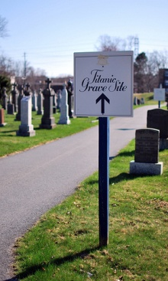
Victims of the sinking
1518 people lost their lives when the Titanic sank and only 337 of these were ever found in the sea.
Many bodies were never identified and these people were buried at Fairview Lawn Cemetery in Halifax, Canada.
Picture by meddygarnet, Flickr, Creative Commons licence

Slide 30
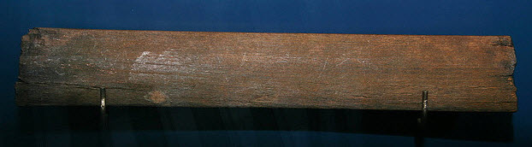
Remnants of the sinking
The Canadian ships also found objects floating in the sea.
A piece of deck chair found floating in the sea.
Picture by cliff1066, Flickr, Creative Commons licence

Slide 31
Online links
Passenger Profile: Ms Anna Sophia Turja
Titanic’s manifest
BBC – Survivors of the Titanic tell their stories
BBC :What happened to the iceberg which sank the Titanic?
All acknowledged images used published under a Creative Commons Licence
All other images in the Public Domain

