Slide 1
Family & Guardian Guide
to Microsoft Teams
Everything your student needs to know to get started with online learning.

Slide 2
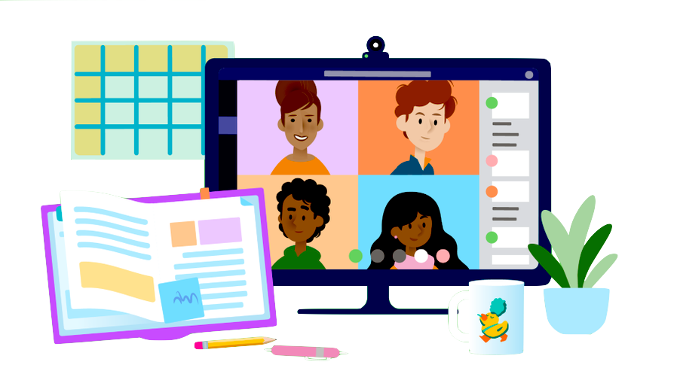
Table of Contents
Chapter 1: Get Started with Teams
Sign into Teams online
Download Teams on desktop
Download Teams on mobile device
Chapter 2: How to help your student use Teams
Join a class team
View and turn in assignments
Attend a virtual class
Find grades
Chat with teachers and classmates
Chapter 3: FAQ & Troubleshooting
My student’s login isn’t working.
I can’t find my student’s class during set-up.
My student’s assignments are missing.
My student missed a class—what now?
What if I have more than one student using Teams?
What do I do if we have low internet bandwidth?
Audio troubleshooting
Additional resources

Slide 3
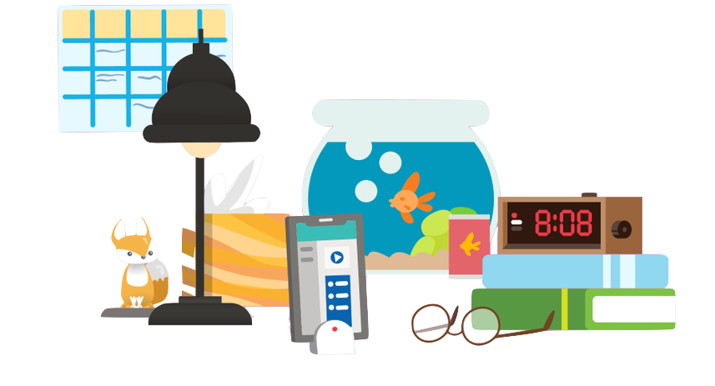
Sign into Teams online
Chapter 1
Get started with Teams
Sign into Teams online
Download Teams on desktop
Download Teams on mobile device

Slide 4

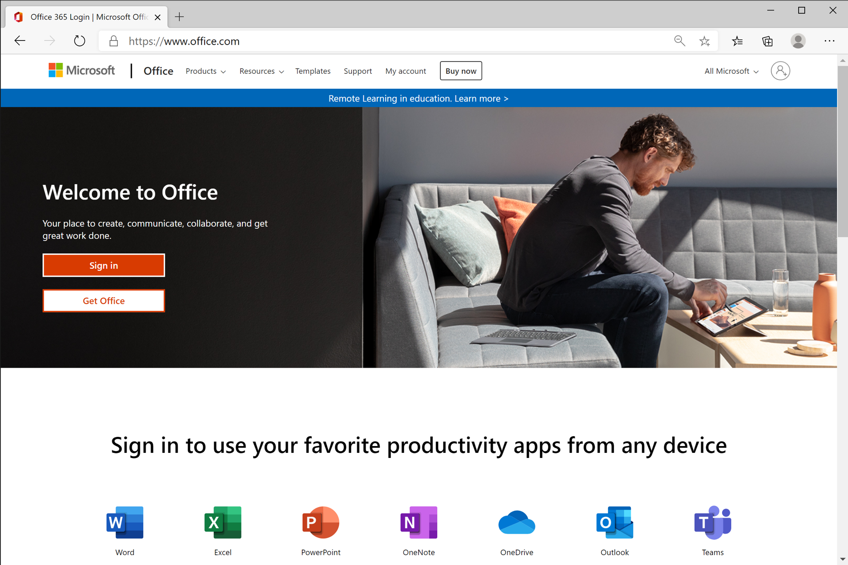
Go to Office.com and click Sign In.

Slide 5
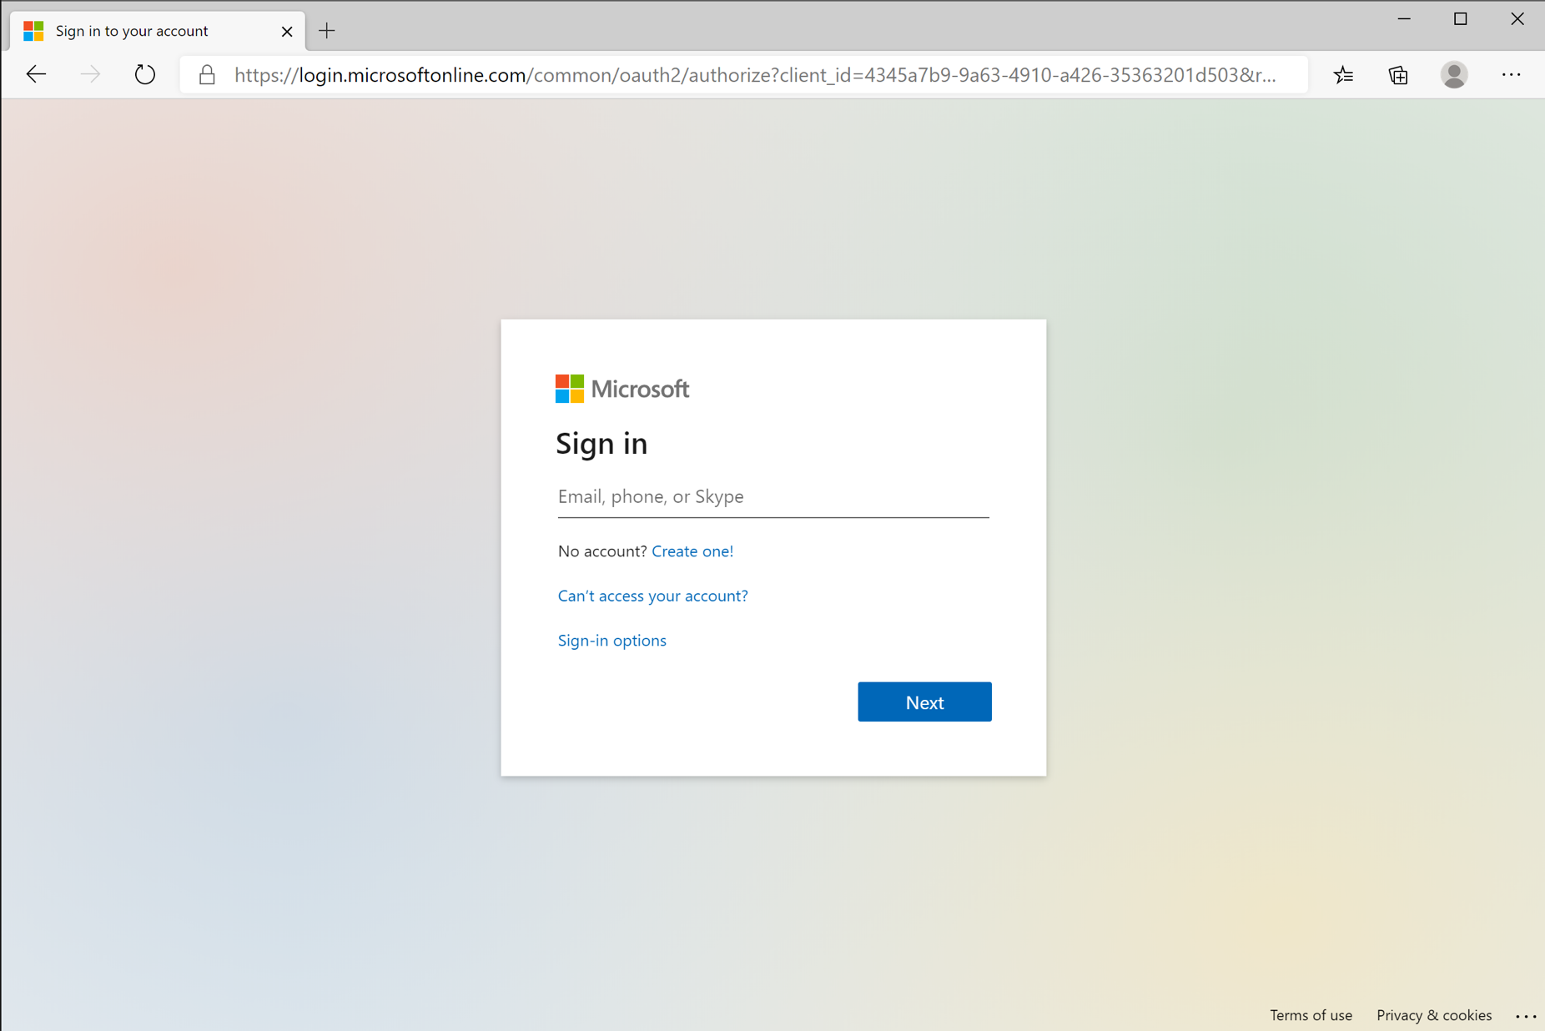
Sign in with your student’s email address using the format <username>@c2ken.net

Slide 6
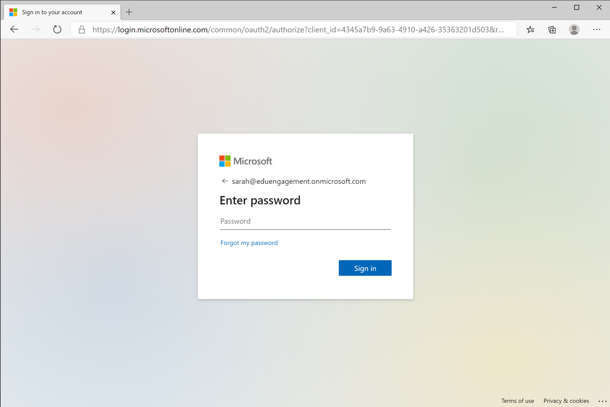
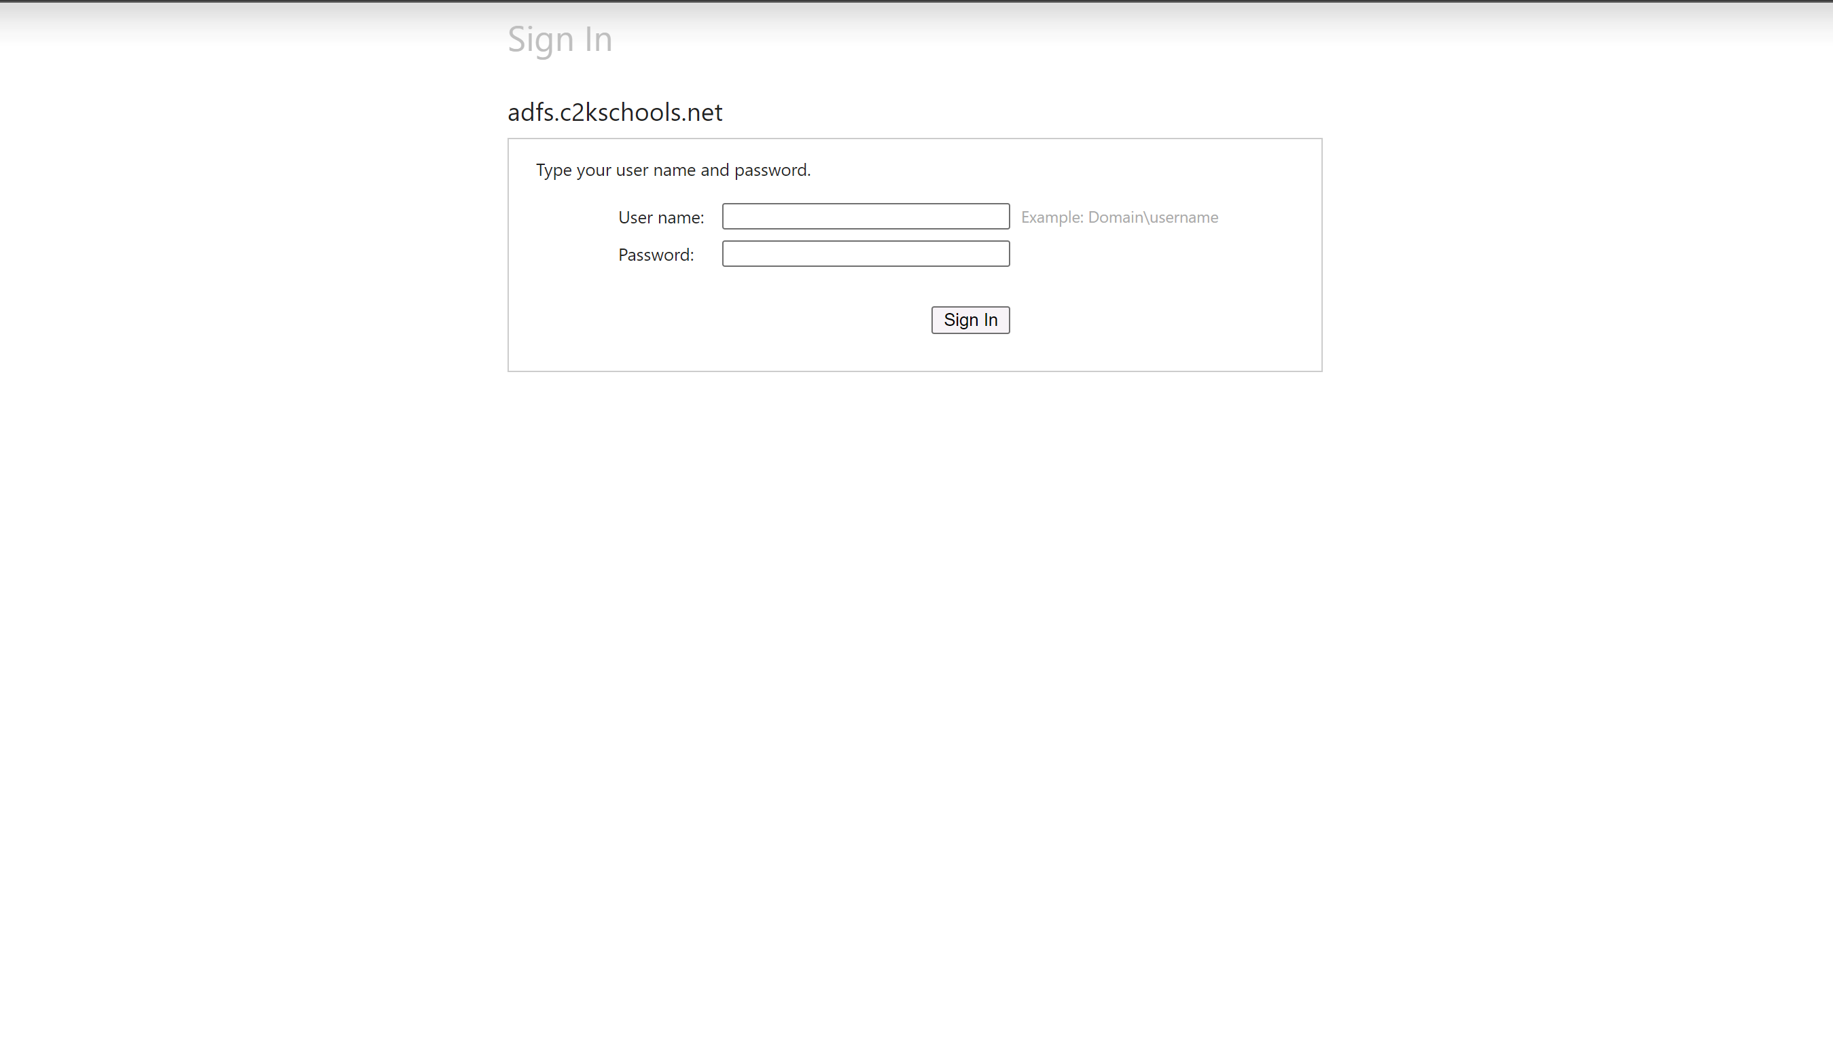
Enter your student’s C2k username and password.

Slide 7
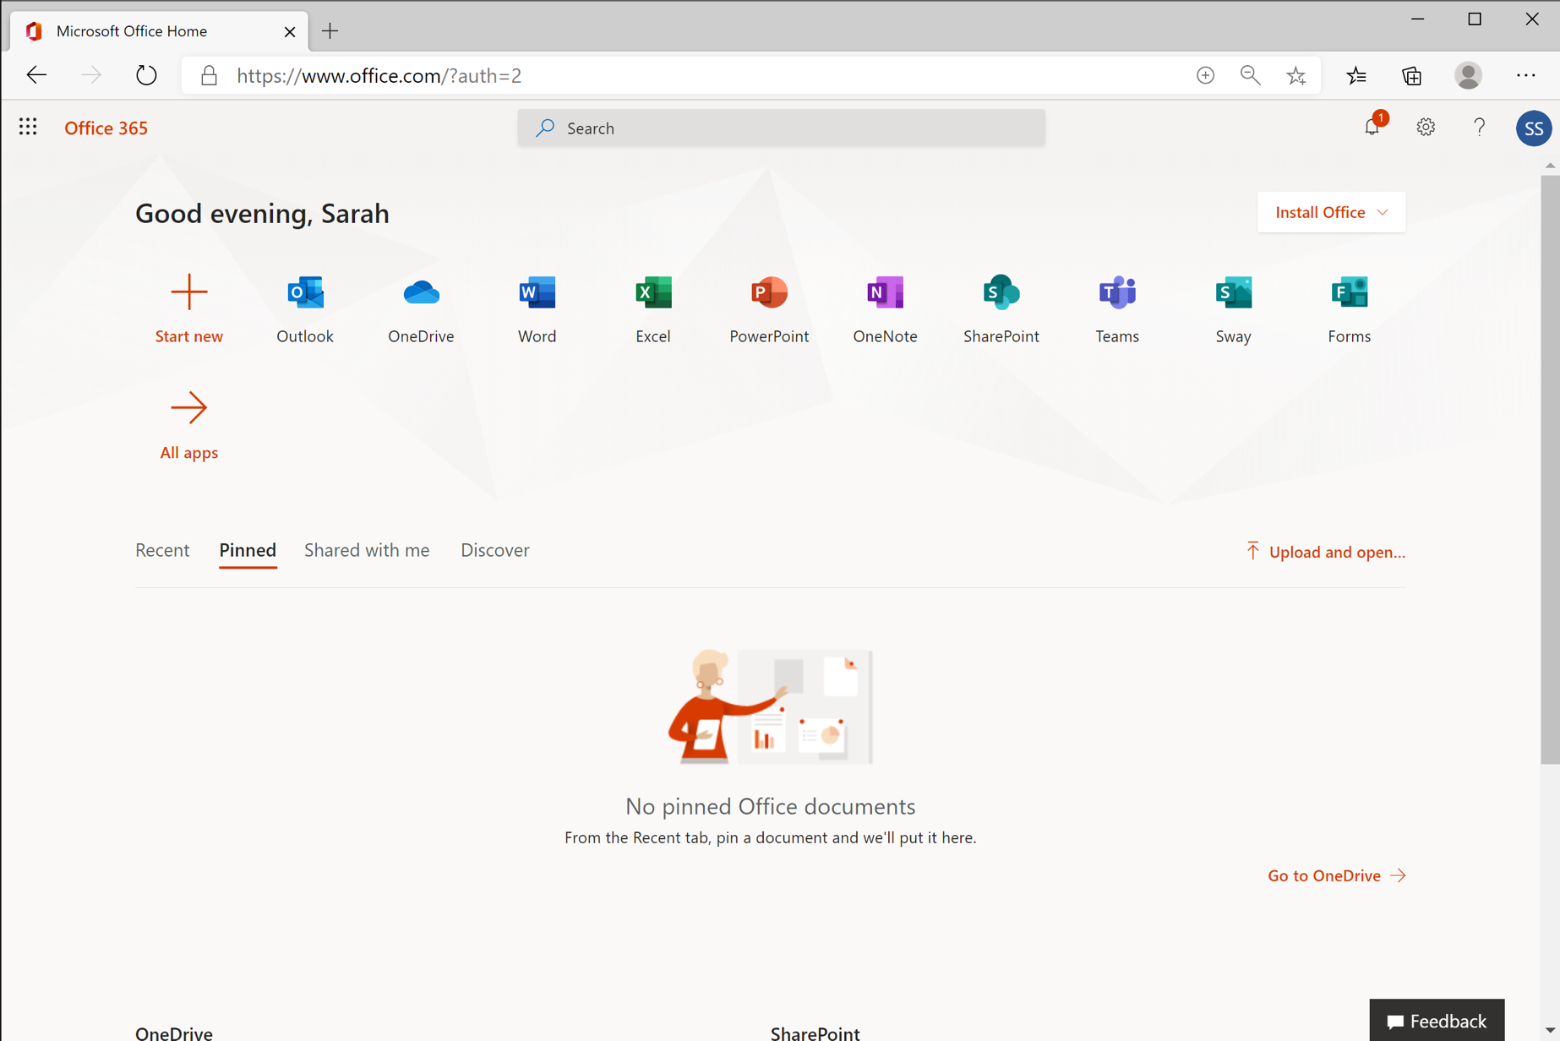
Select the Teams application to start using Teams online.

Slide 8
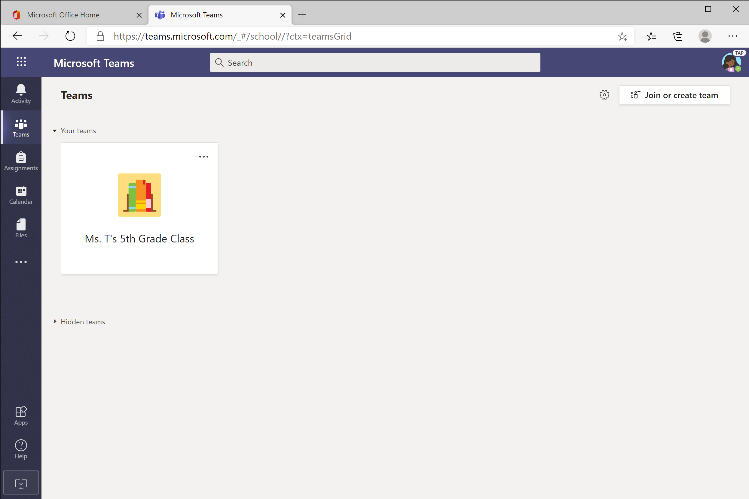


You’re ready to use Teams!

Slide 9
Download Teams on desktop
Chapter 1
Get started with Teams
Sign into Teams online
Download Teams on desktop
Download Teams on mobile device

Slide 10

Rather work on your desktop? Click this icon to download Teams. Jump to instructions for Windows or Mac.

Slide 11
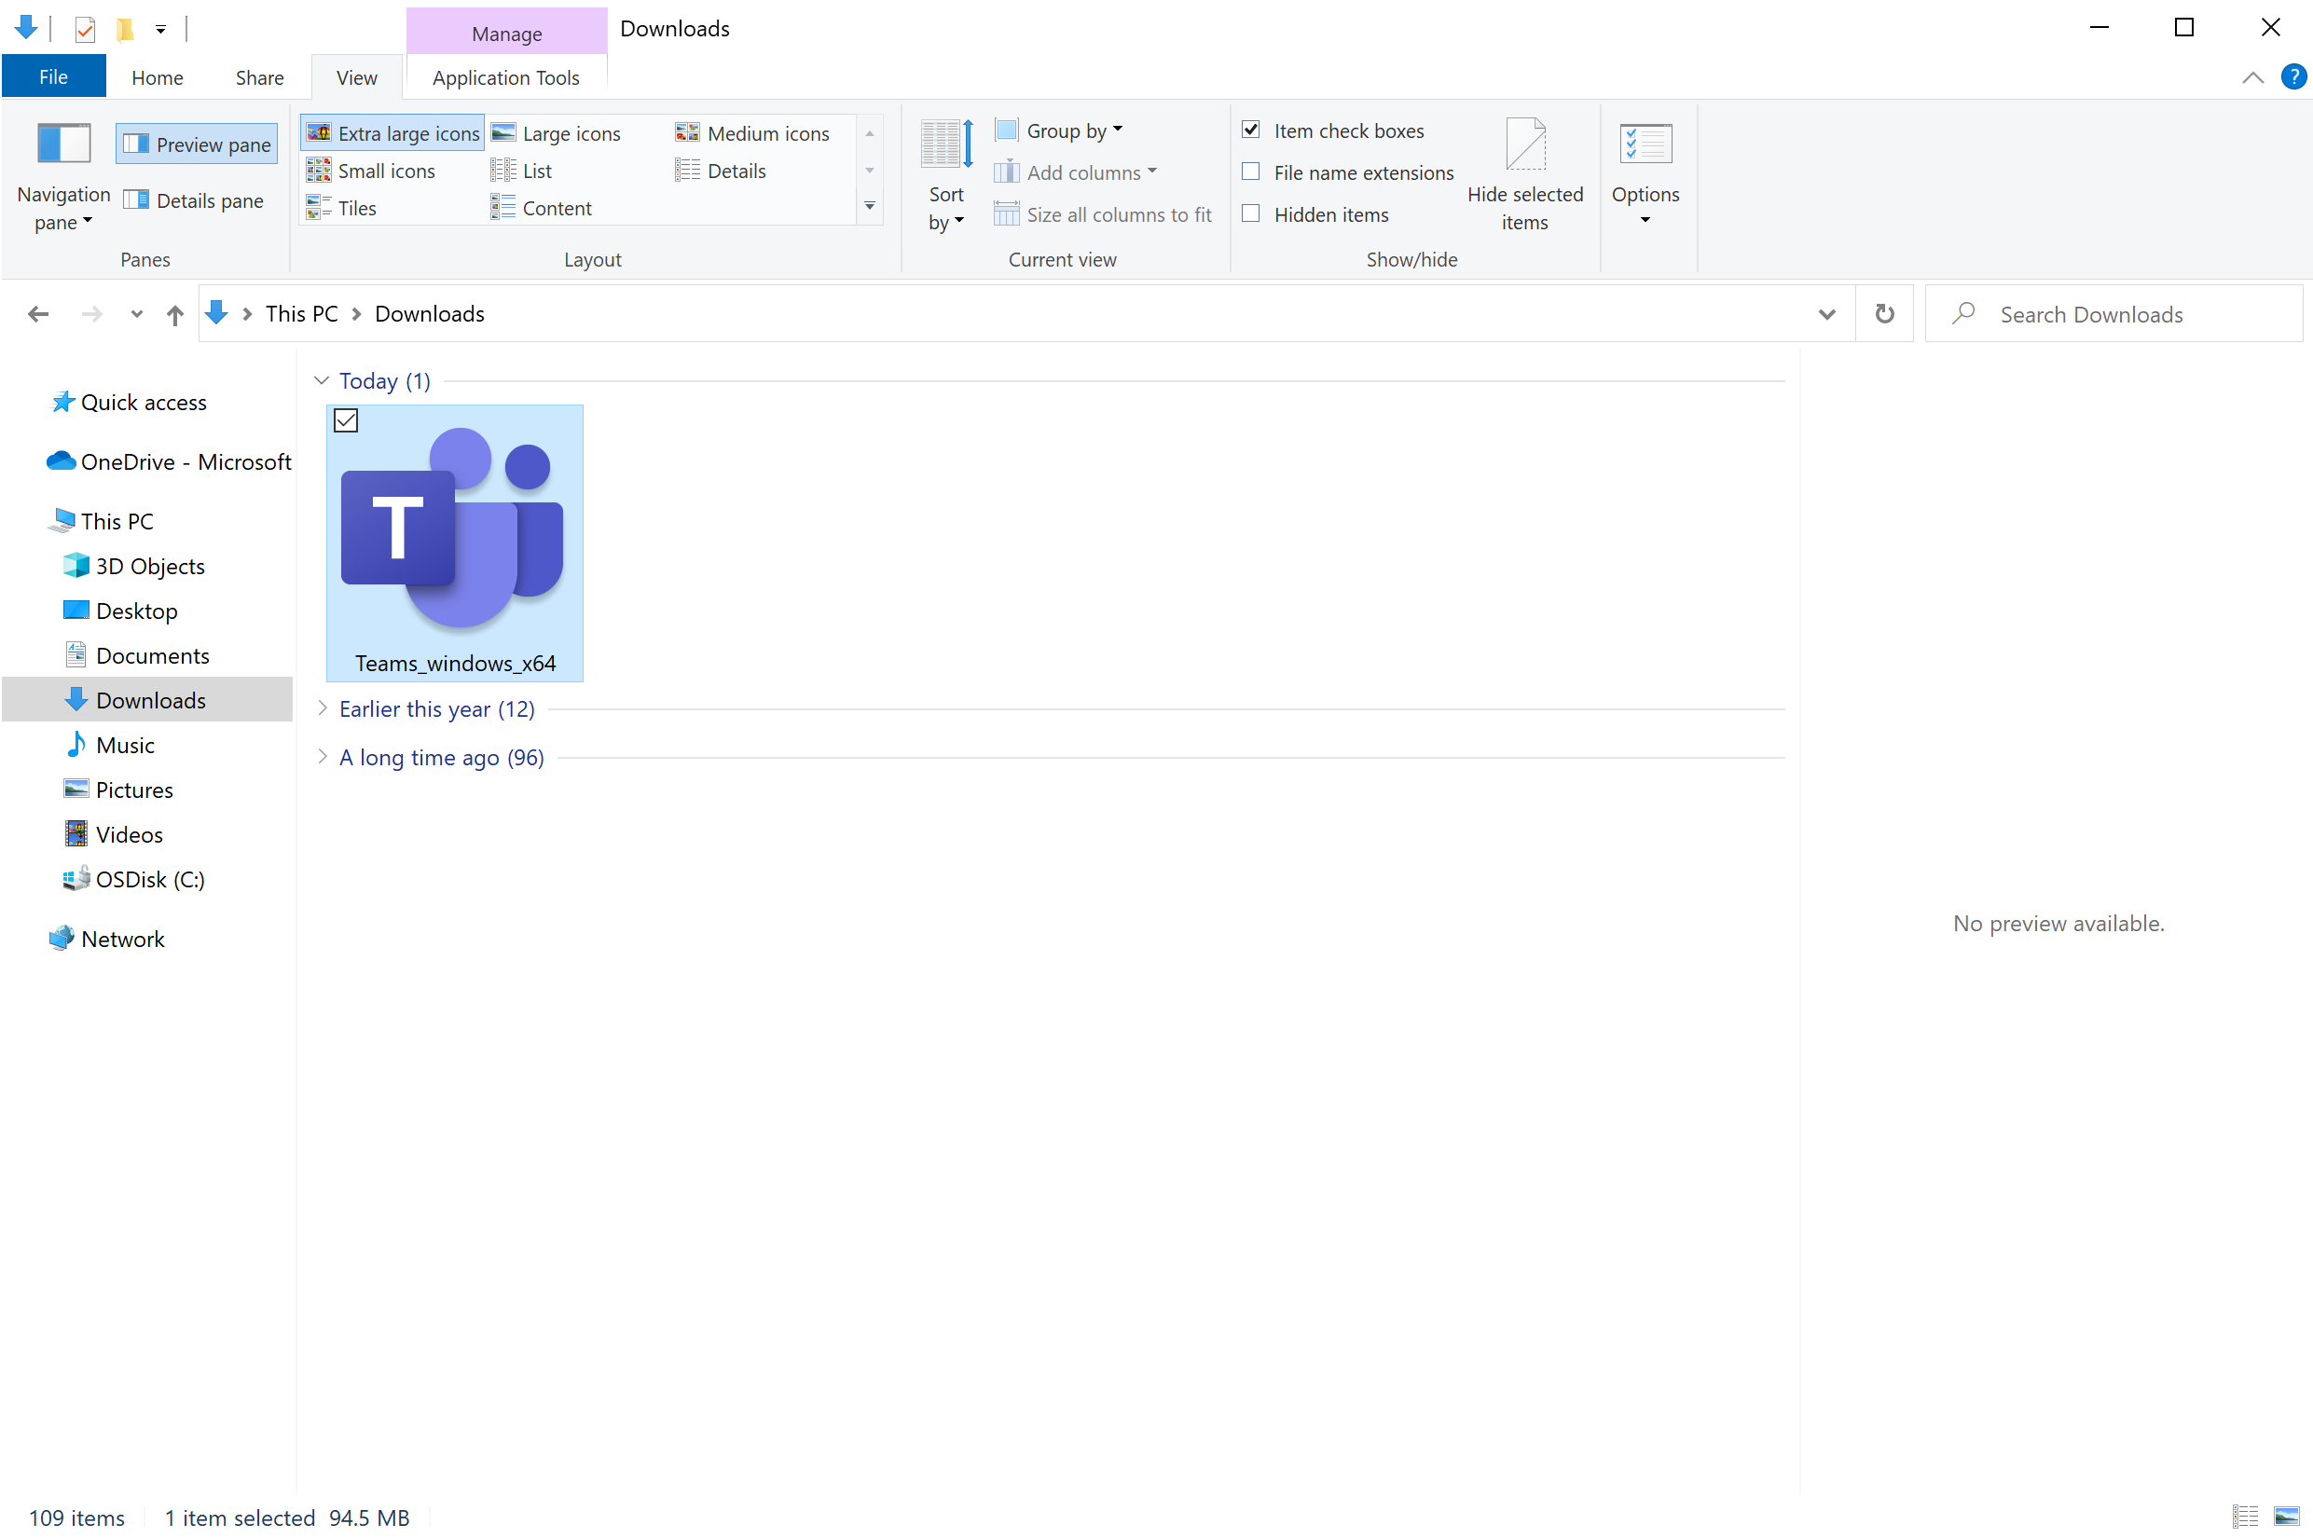
Windows: Find Teams file in Downloads folder. Double-click to launch.

Slide 12
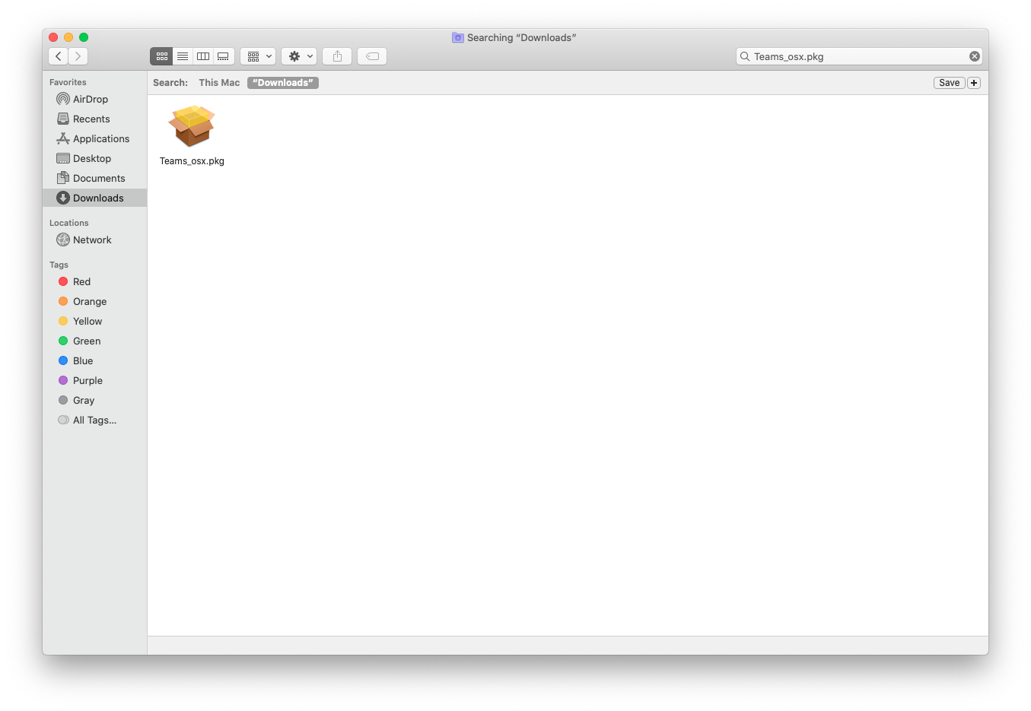
Mac: Find Teams file in Downloads folder. Double-click to launch.

Slide 13
Download Teams on mobile device
Chapter 1
Get started with Teams
Sign into Teams online
Download Teams on desktop
Download Teams on mobile device

Slide 14

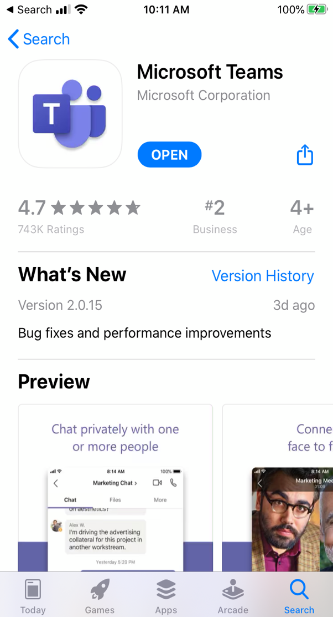
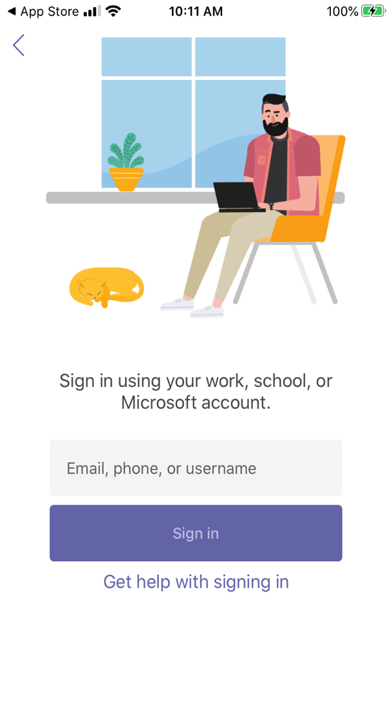
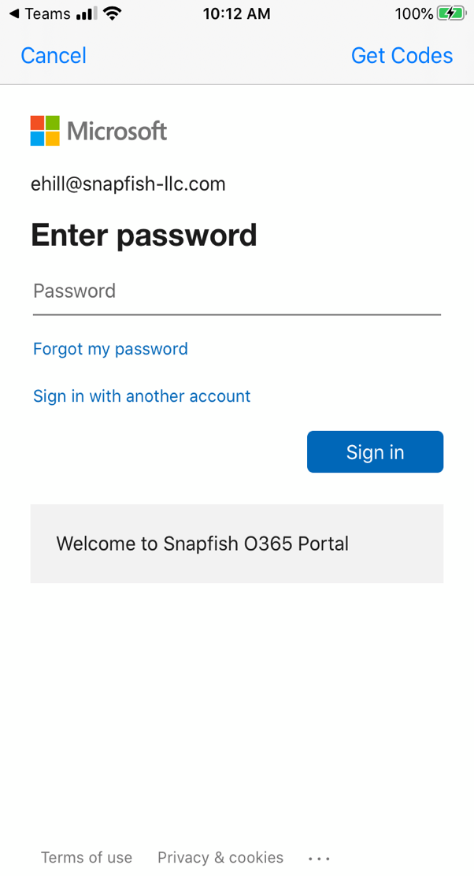


Download Teams on mobile device via the Apple App Store or Google Play.
Enter your student’s school or work account.

Slide 15

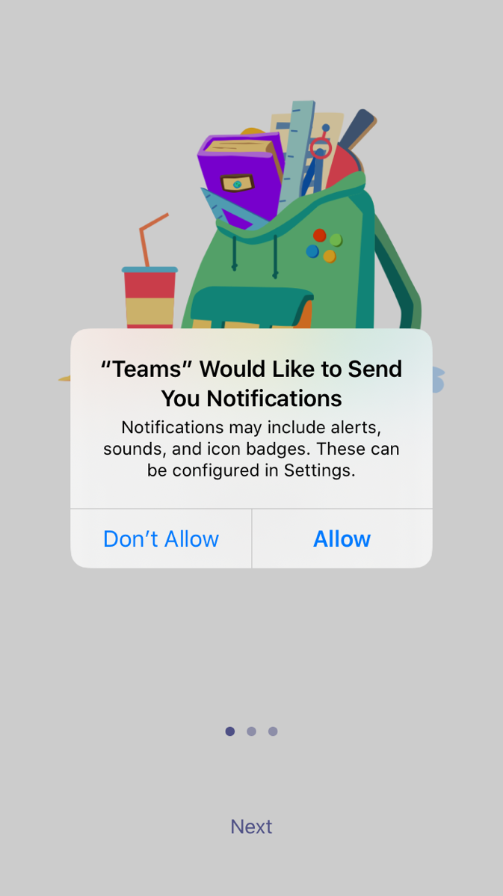
The app will ask you to allow notifications. Click Allow.
Notifications will send an alert to your mobile device when something important is going on in your student’s class, like a class meeting, new assignments, or important announcement.
You can adjust this in Settings.

Slide 16
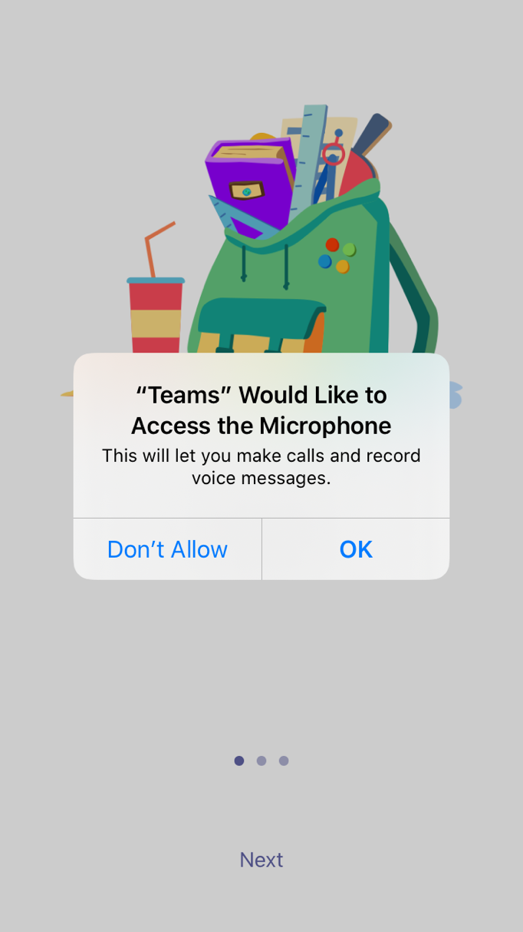
The app will also ask you to allow microphone access. Click OK.
Microphone access may enable your student to participate in class discussions with the mobile device.
You can adjust this in Settings.

Slide 17

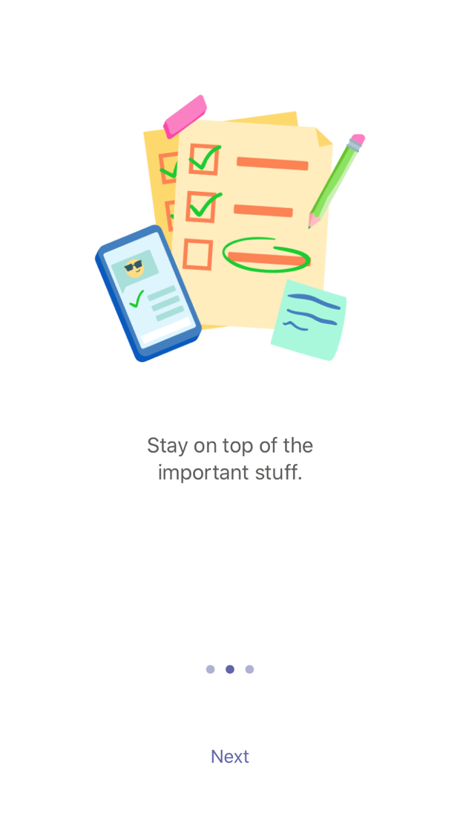
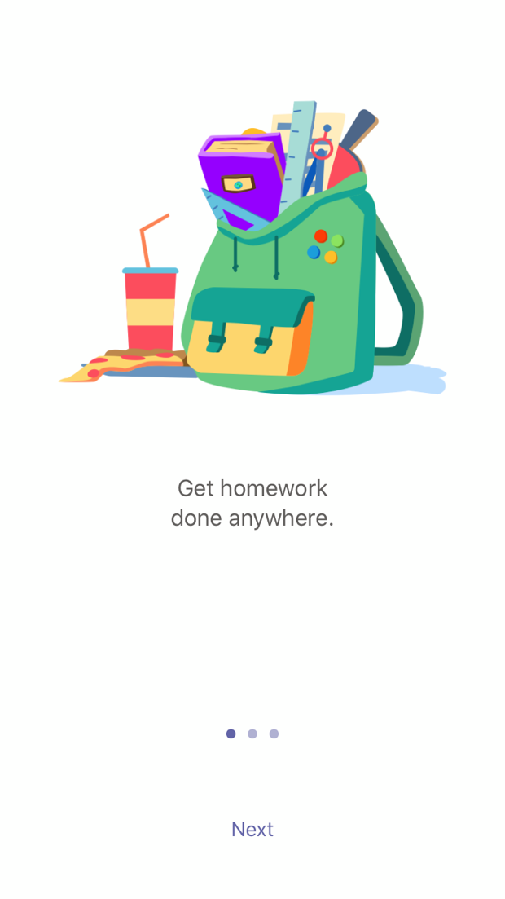
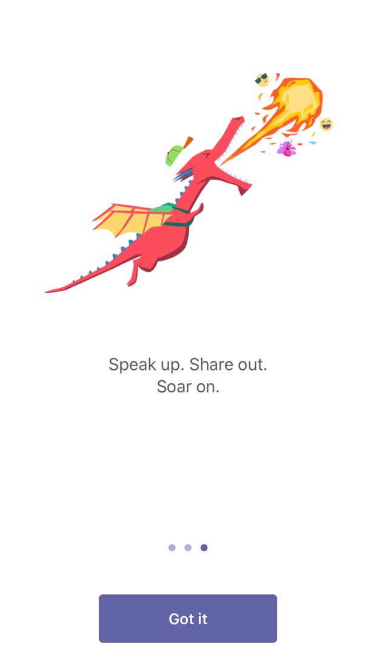
Review welcome screens and click Got it.

Slide 18

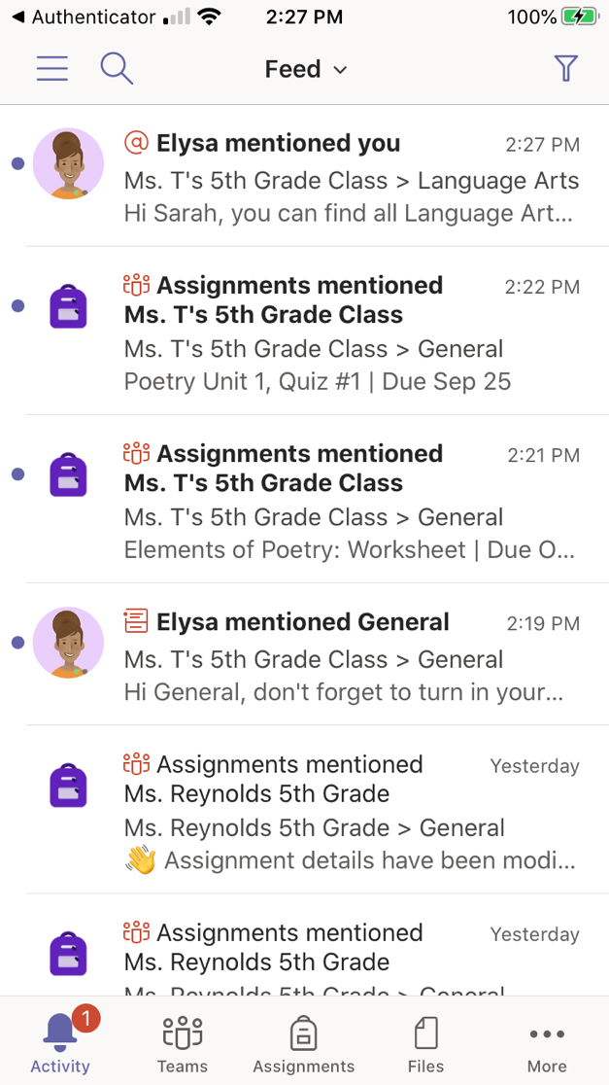
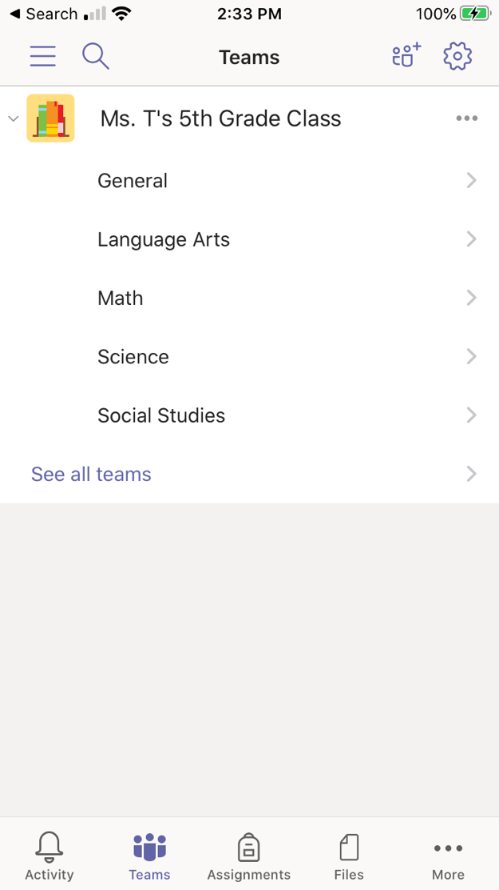

Click on Teams to see your classes.
Now you can view the channels within your class.

Slide 19

Join class team
Chapter 2
How to help your student use Teams
Join a class team
View and turn in assignments
Attend a virtual class
Find grades
Chat with teachers and classmates

Slide 20
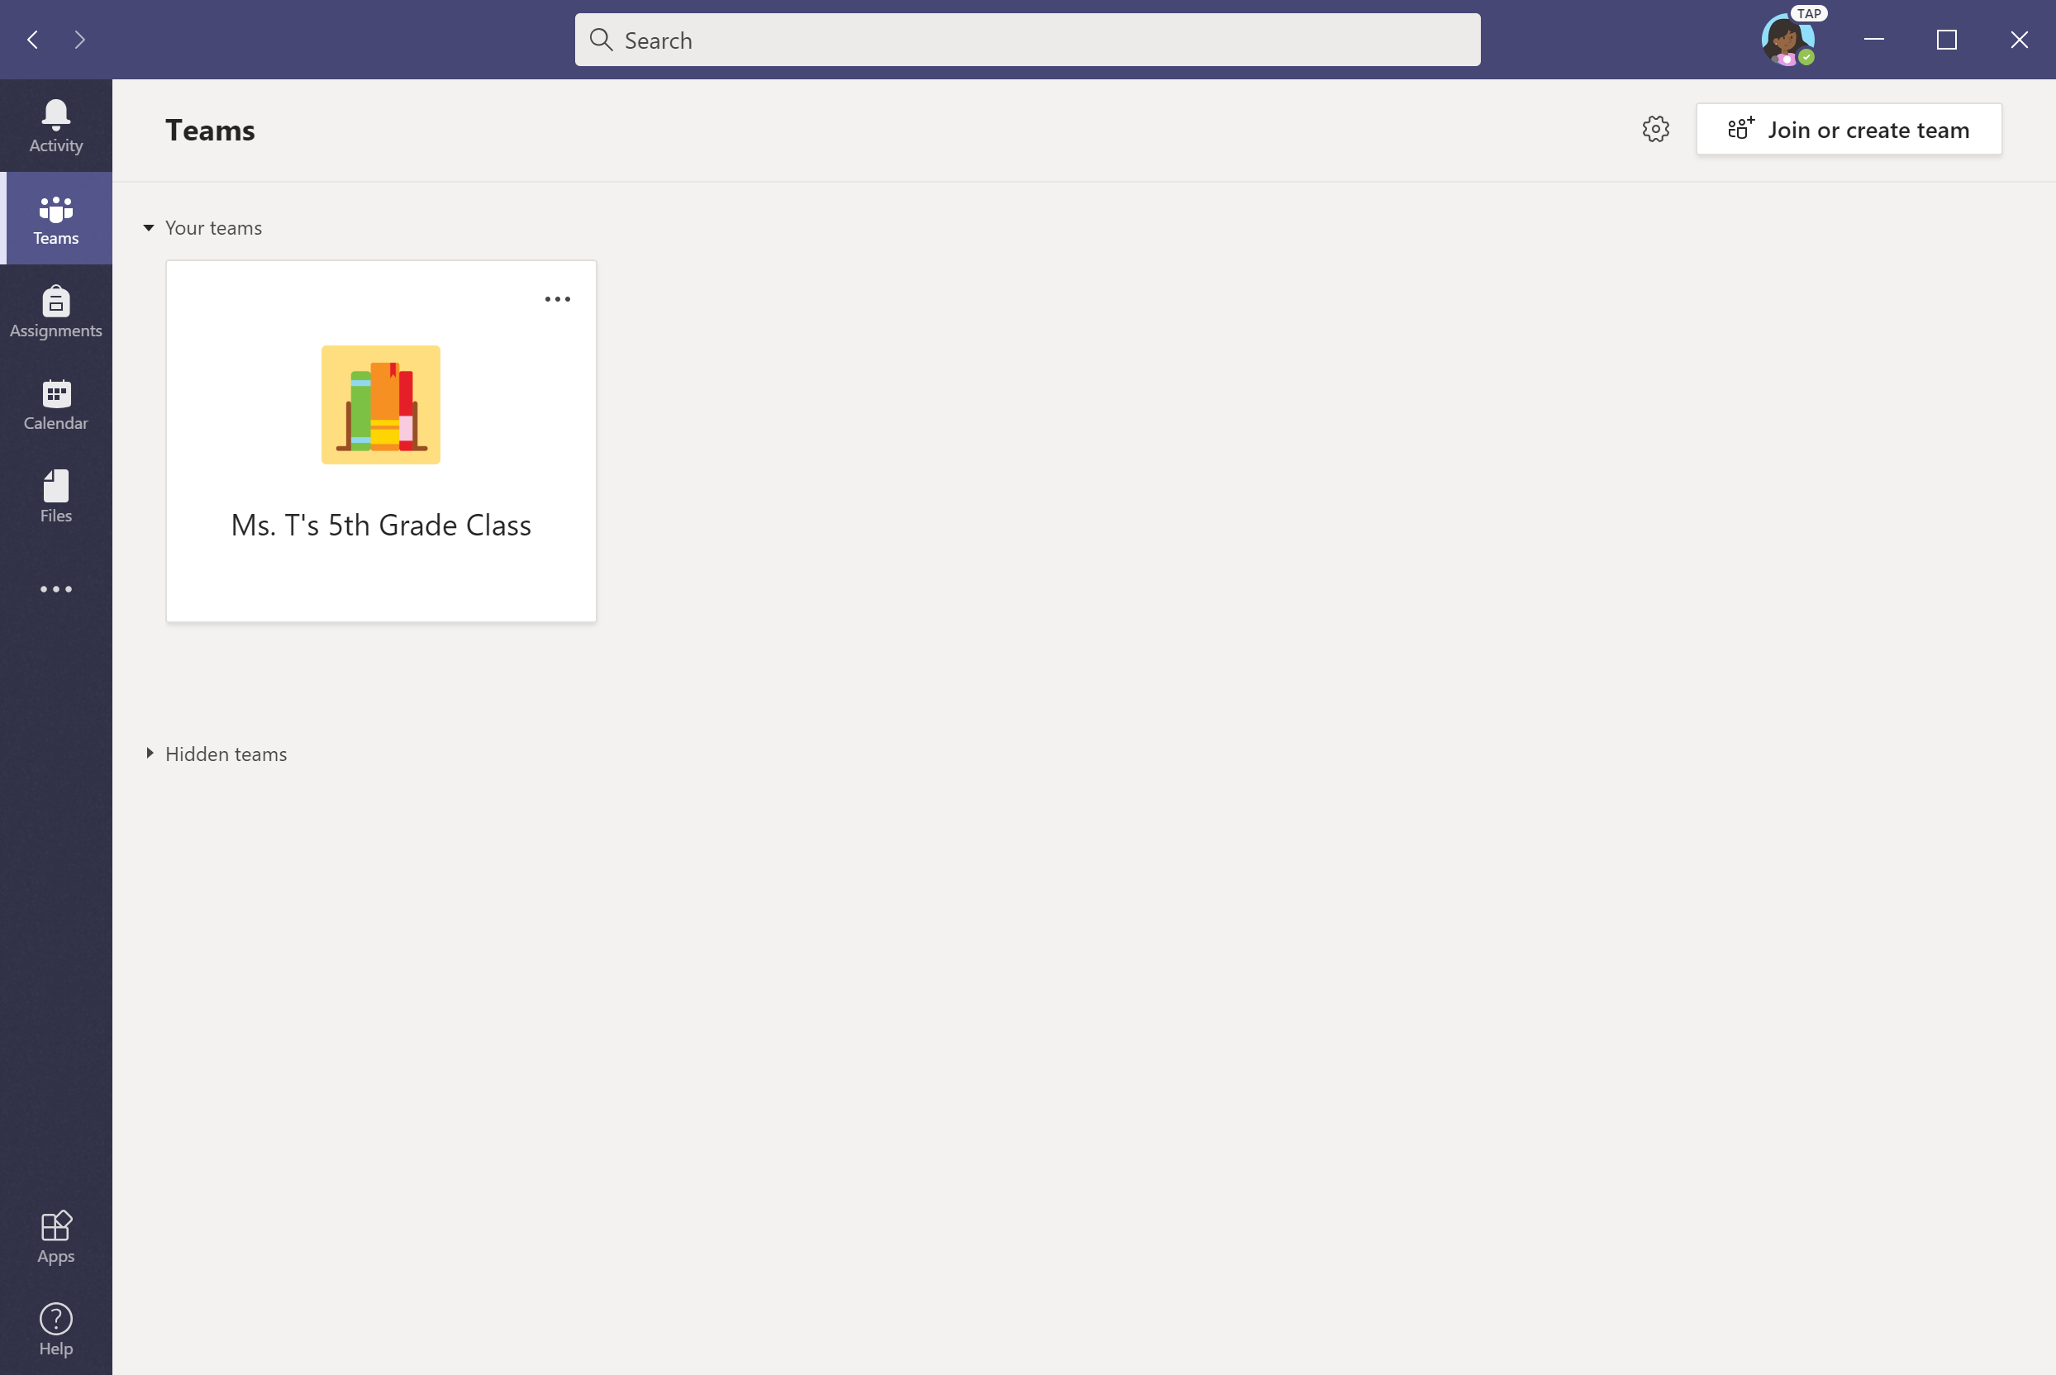

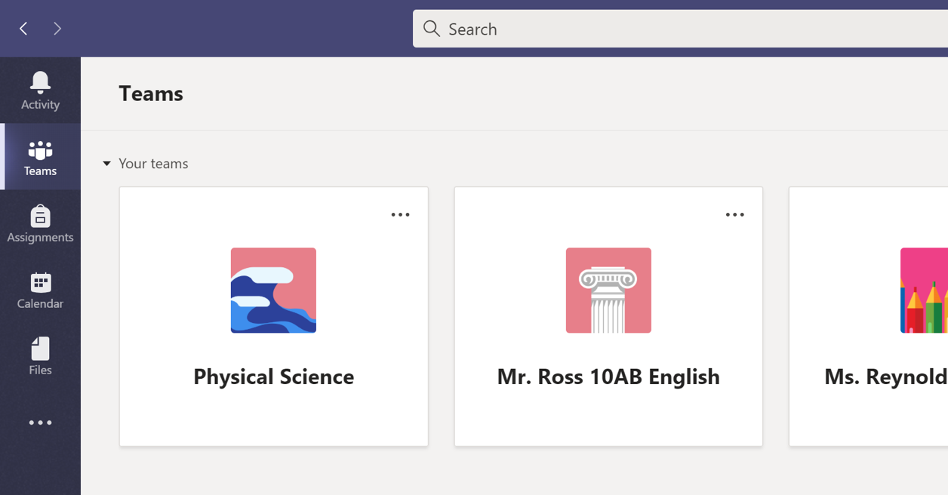
When Teams opens, click on your student’s class tile.
Upper grades may see more than one class. Click on one class to get started.

Slide 21
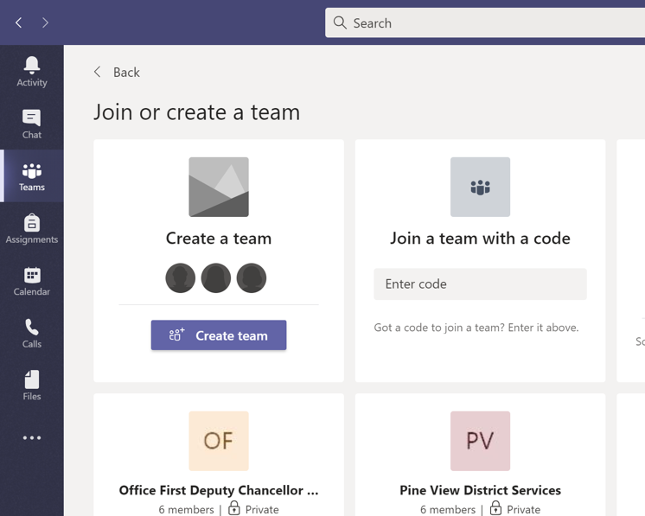

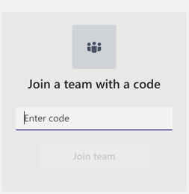
Don’t see any classes? The teacher may have invited your student to join the class team with a join code. Click Join Team.
Enter code to join your team.

Slide 22
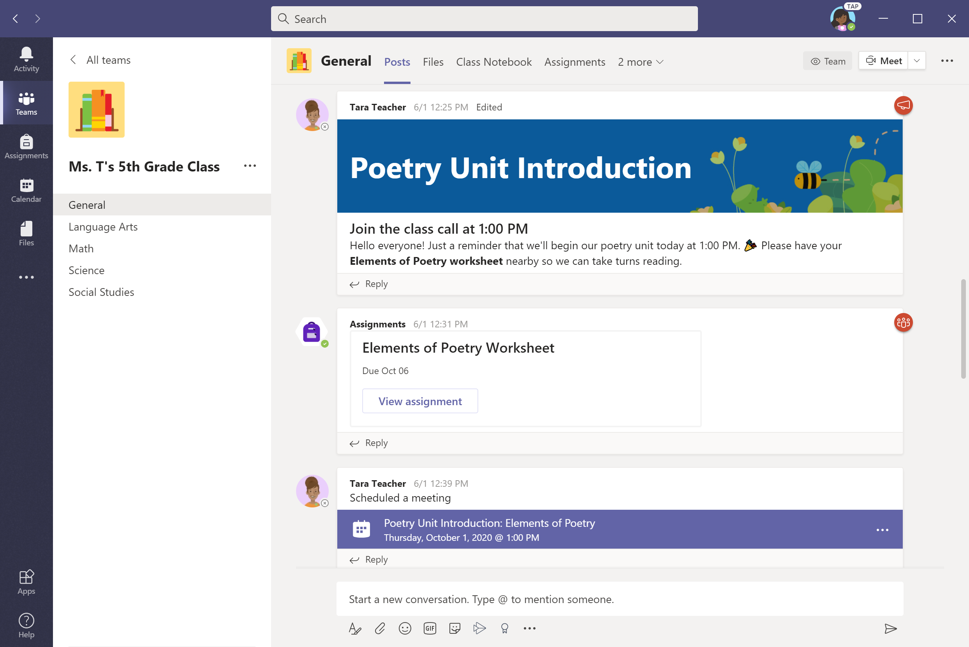
After selecting your student’s class, you’ll see channels that the teacher has created. These might be subjects, units, or other labels.

Slide 23
View and turn in assignments
Chapter 2
How to help your student use Teams
Join a class team
View and turn in assignments
Attend a virtual class
Find grades
Chat with teachers and classmates

Slide 24
Assignments can be viewed and submitted
many ways on Teams. Here are some common options.

Slide 25
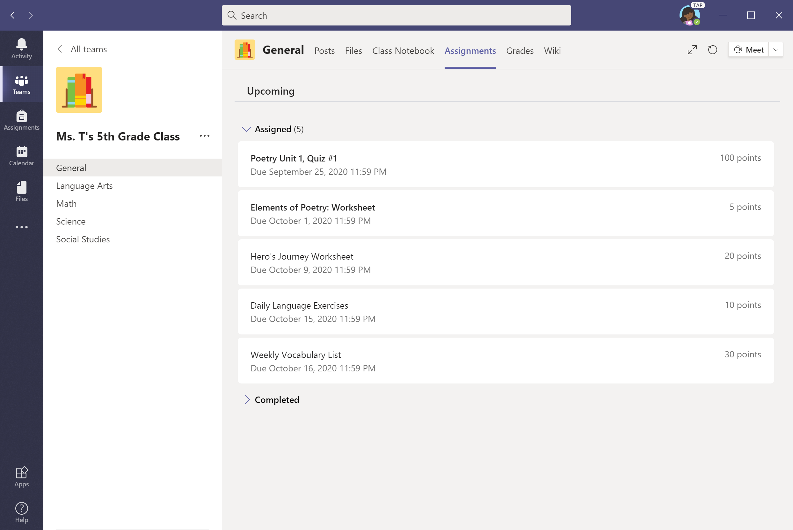
Option #1: To view all assignments, go to the General channel & select the Assignments tab.

Slide 26
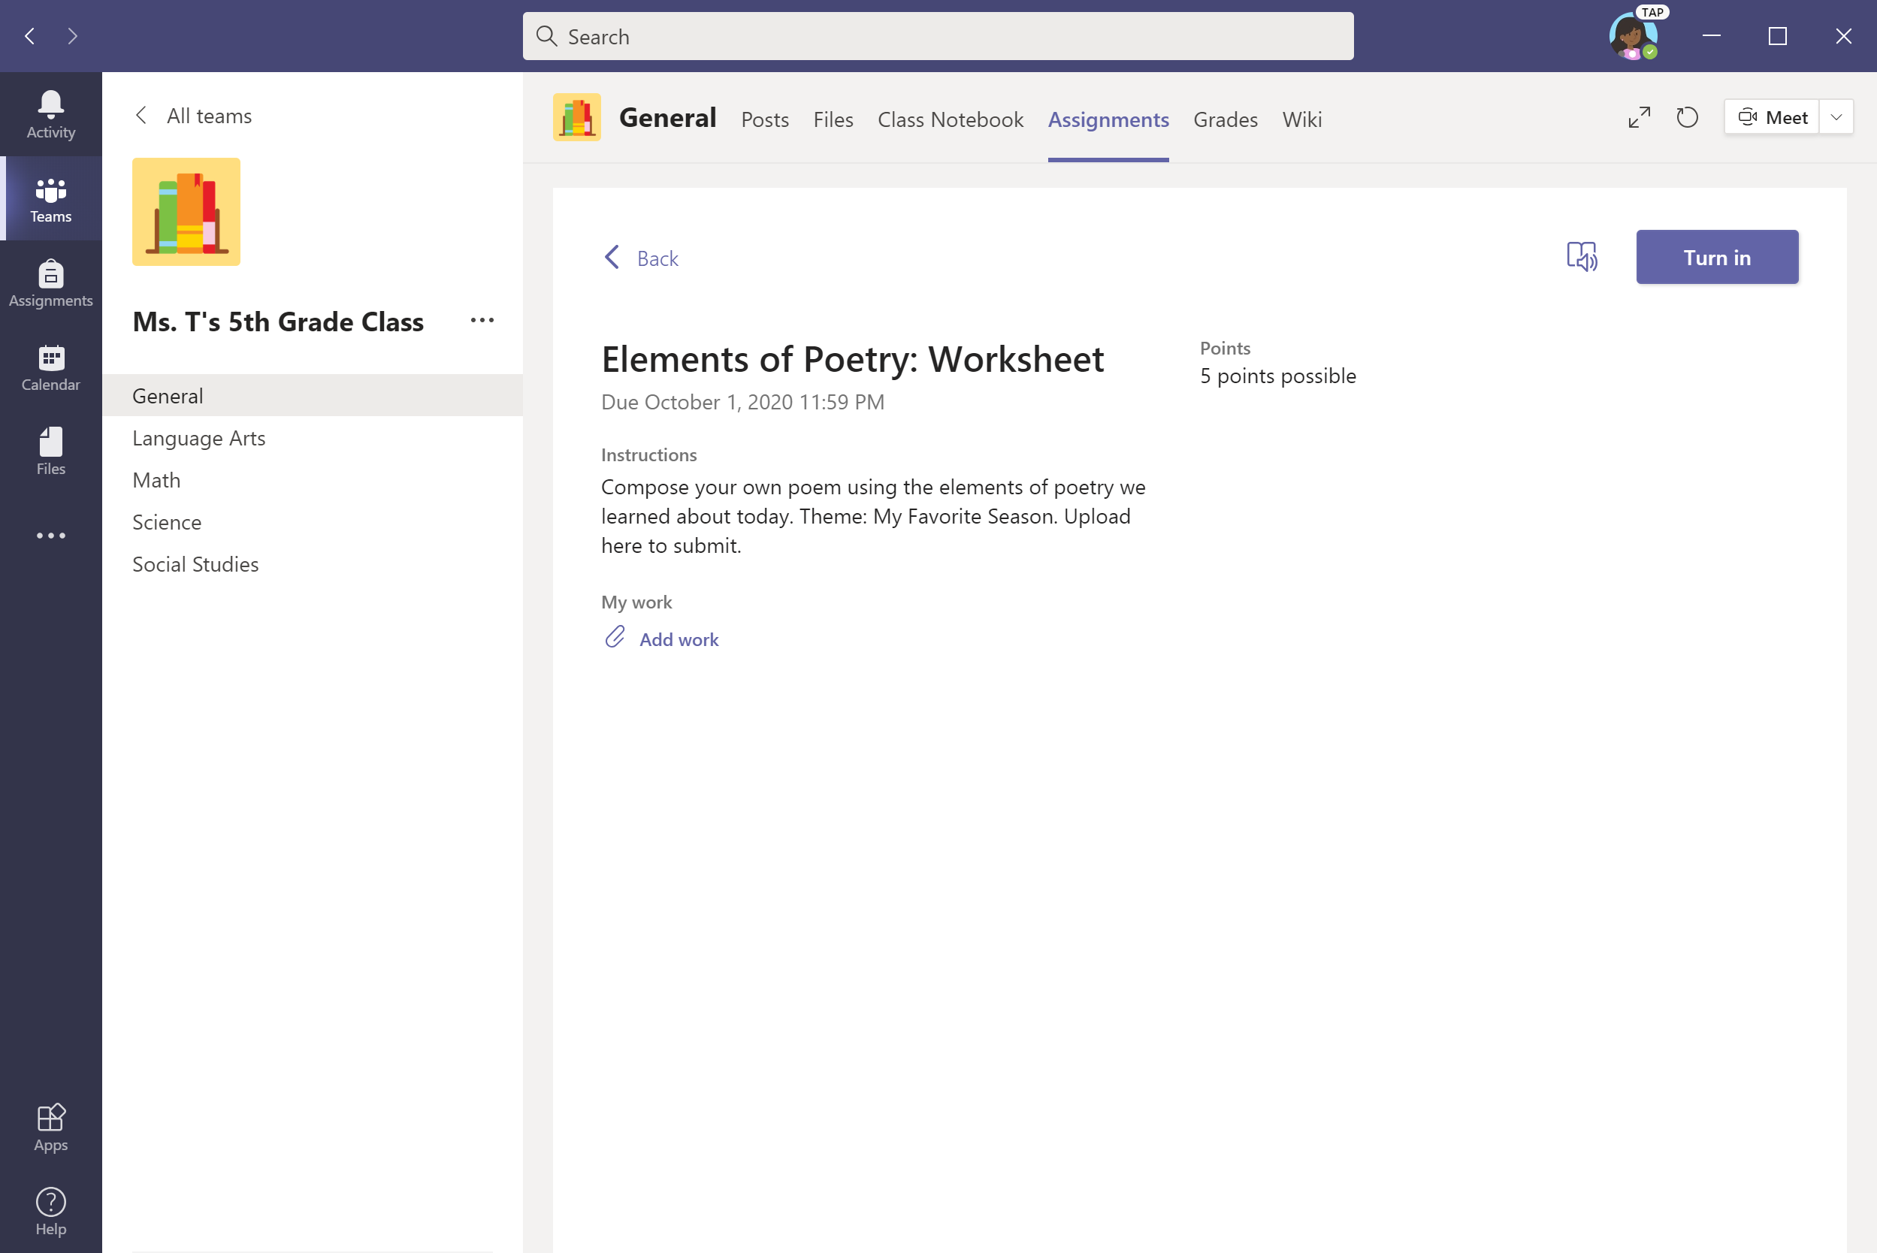
To upload work, select + Add work.

Slide 27
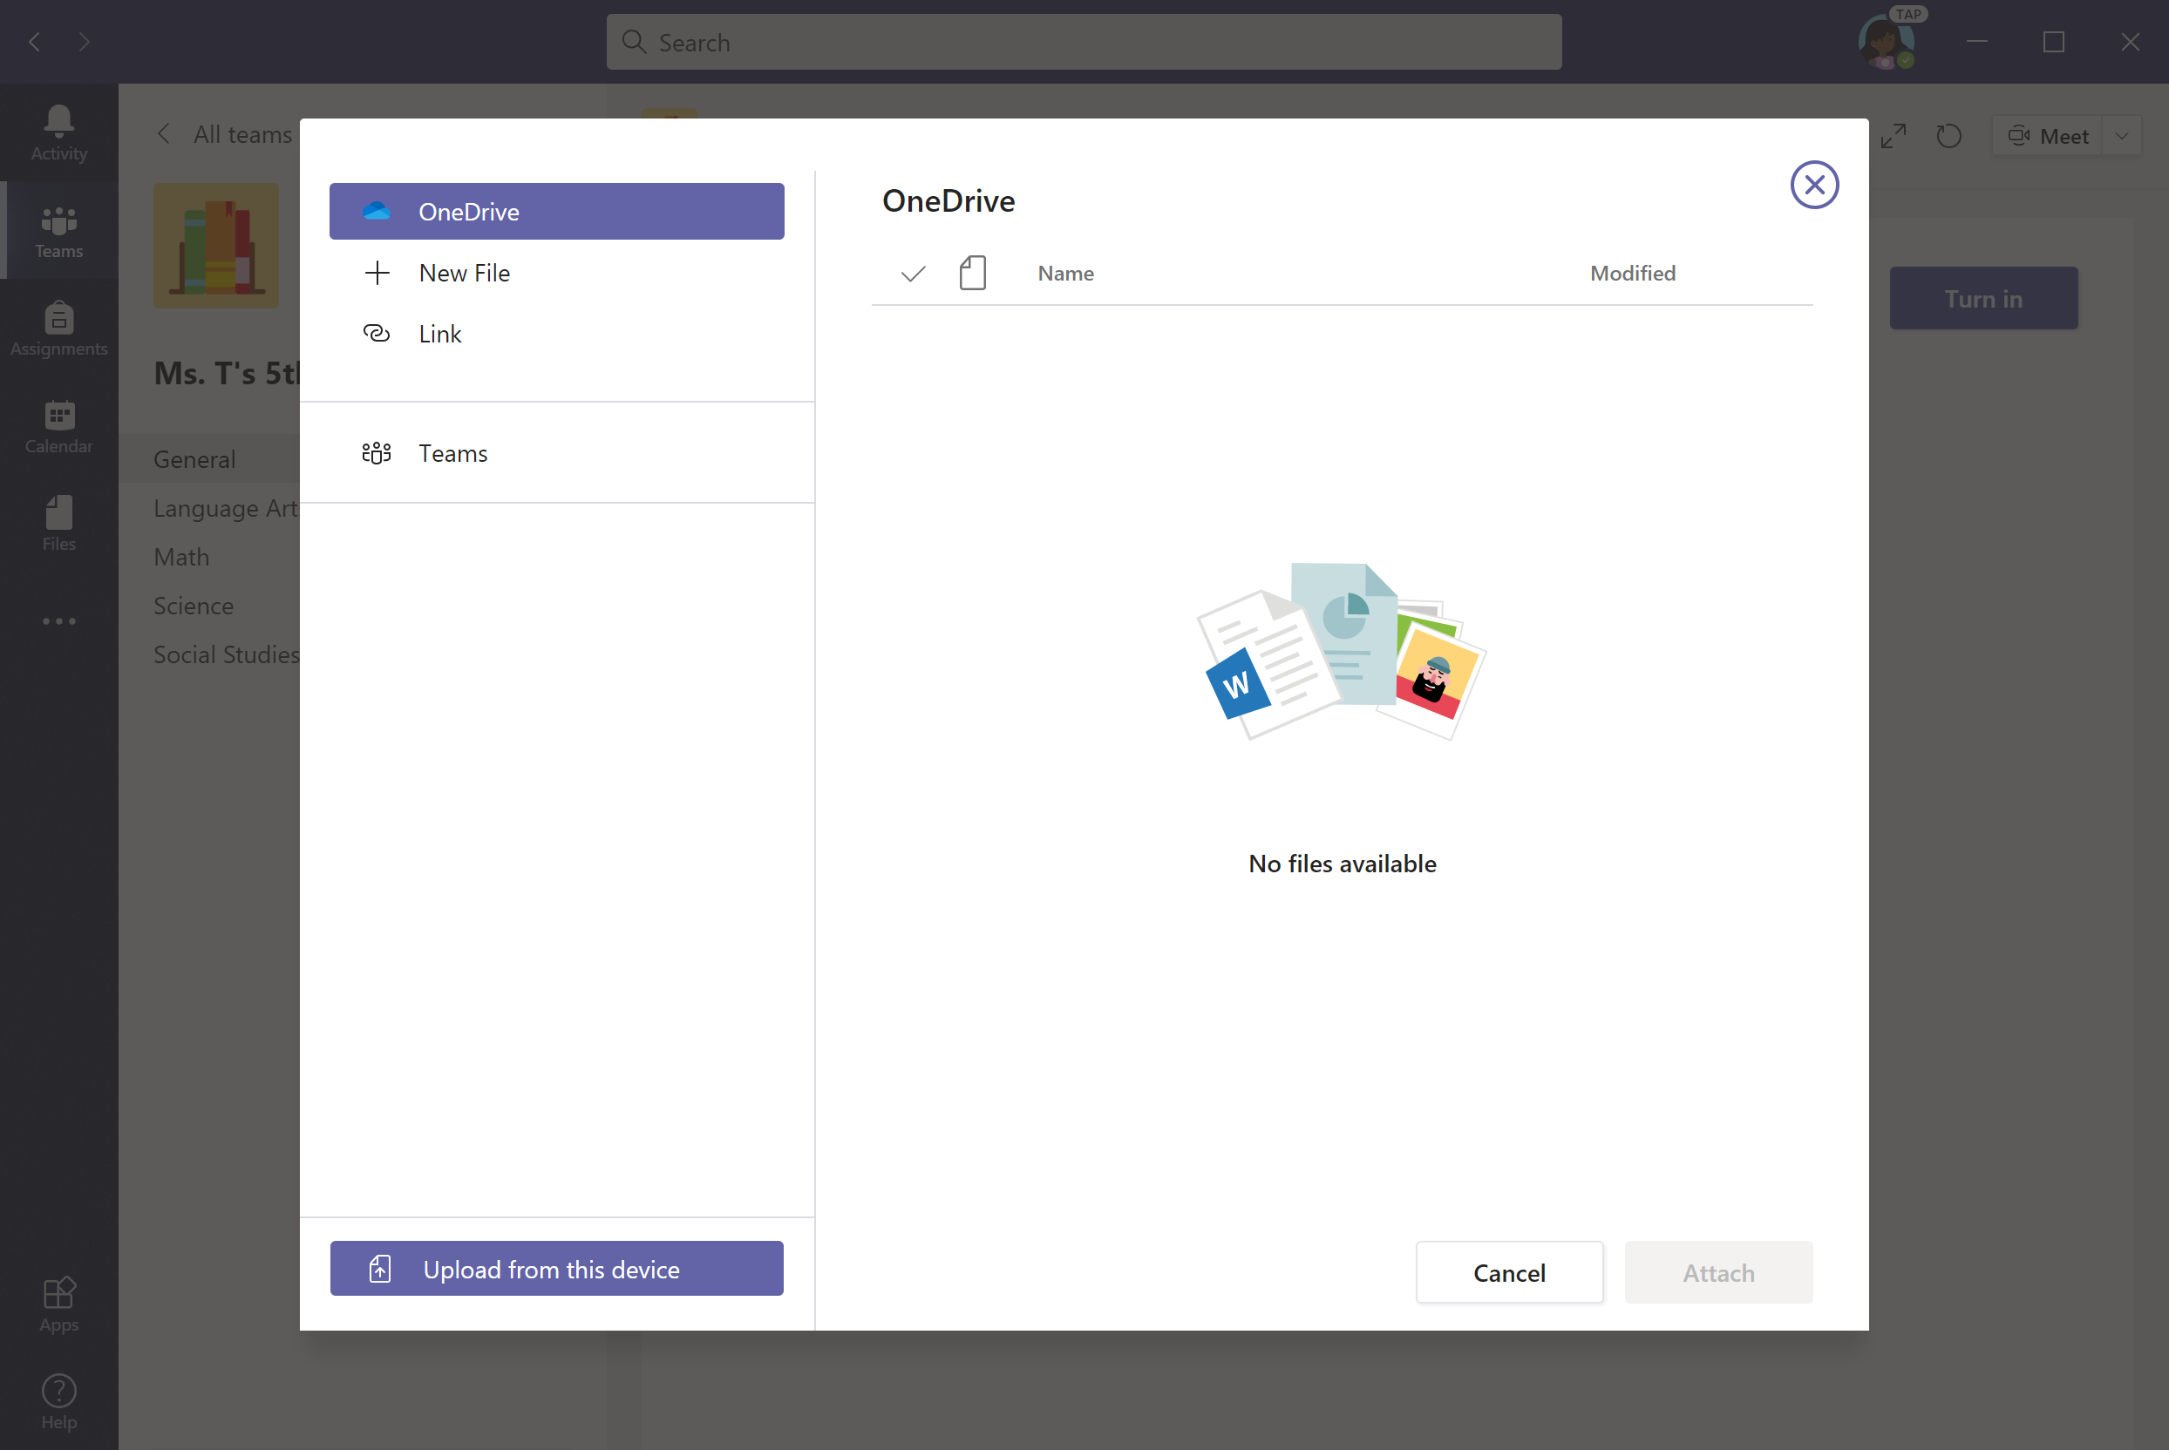
Upload file from your device, OneDrive, Teams, or a link. Let’s upload from device for this example.

Slide 28
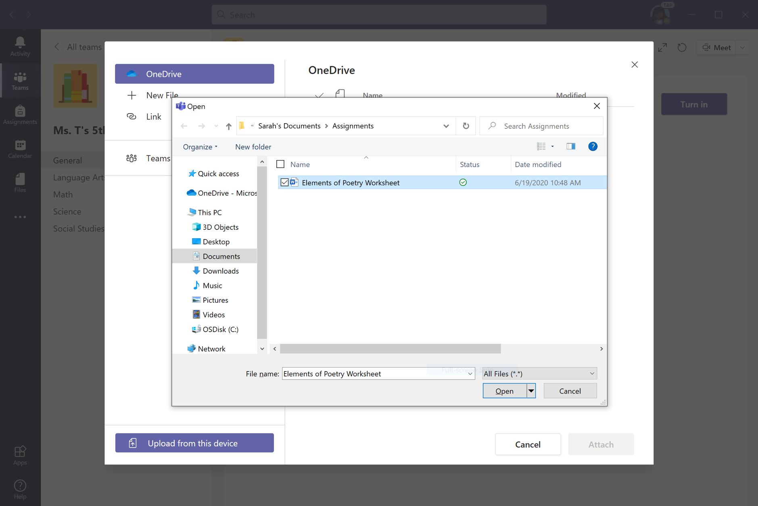
Select file and click Open.

Slide 29
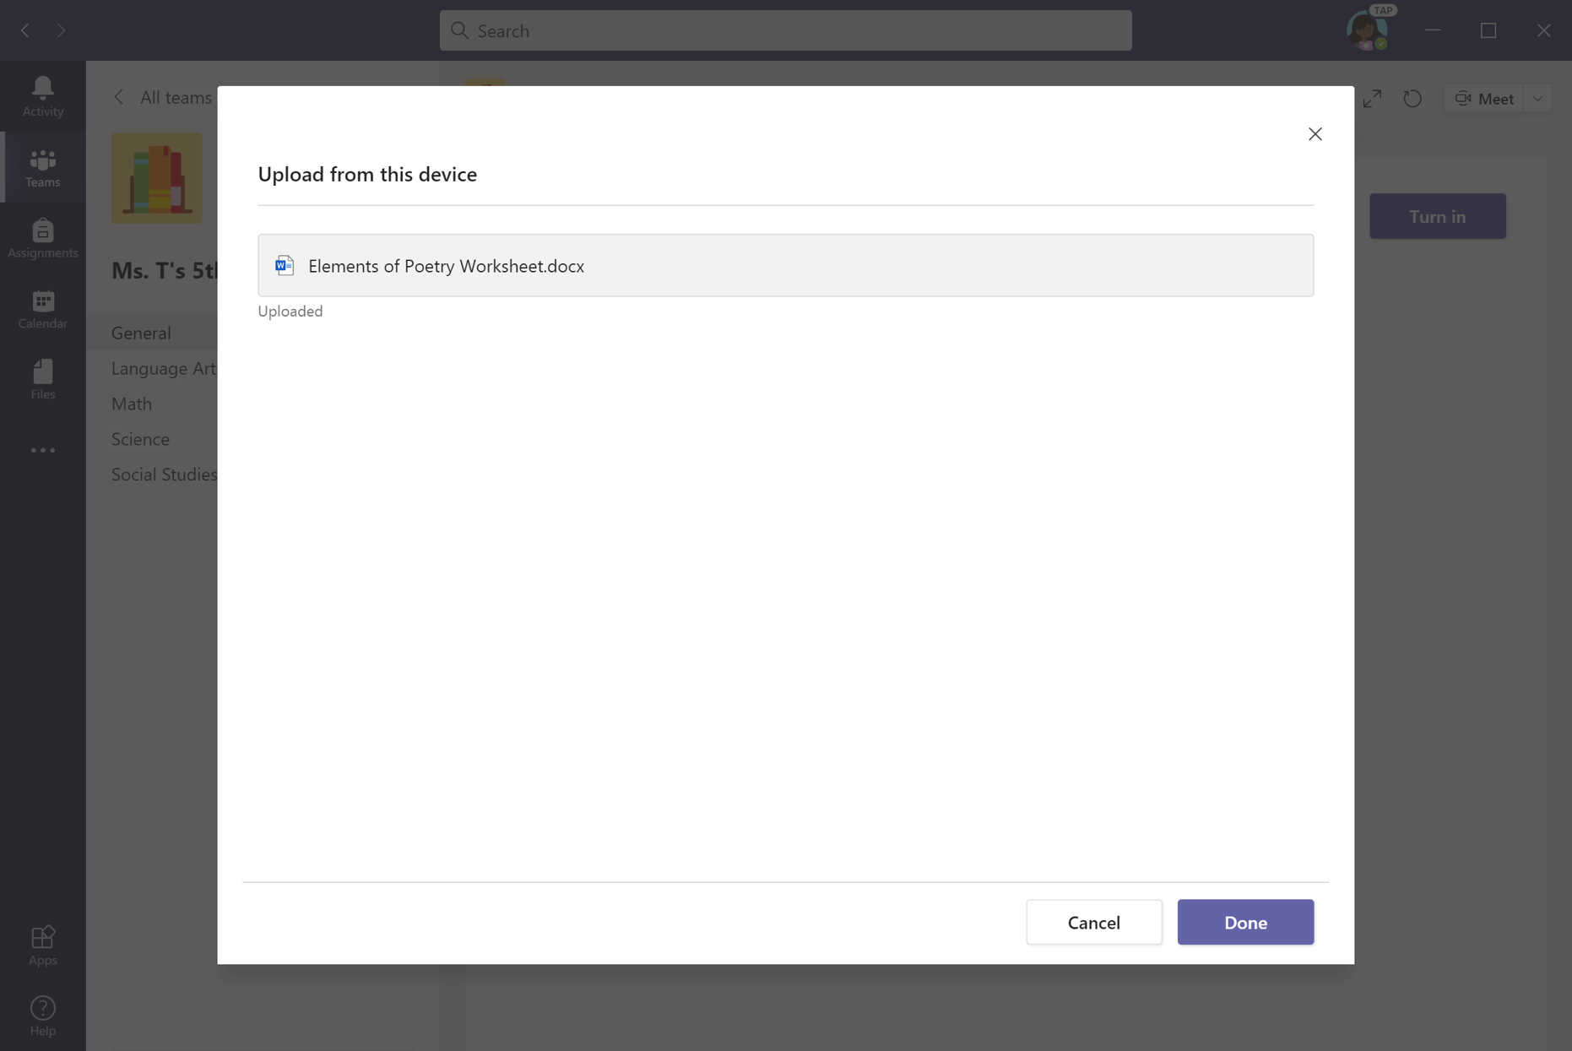
Click Done—but you’re not done yet.

Slide 30
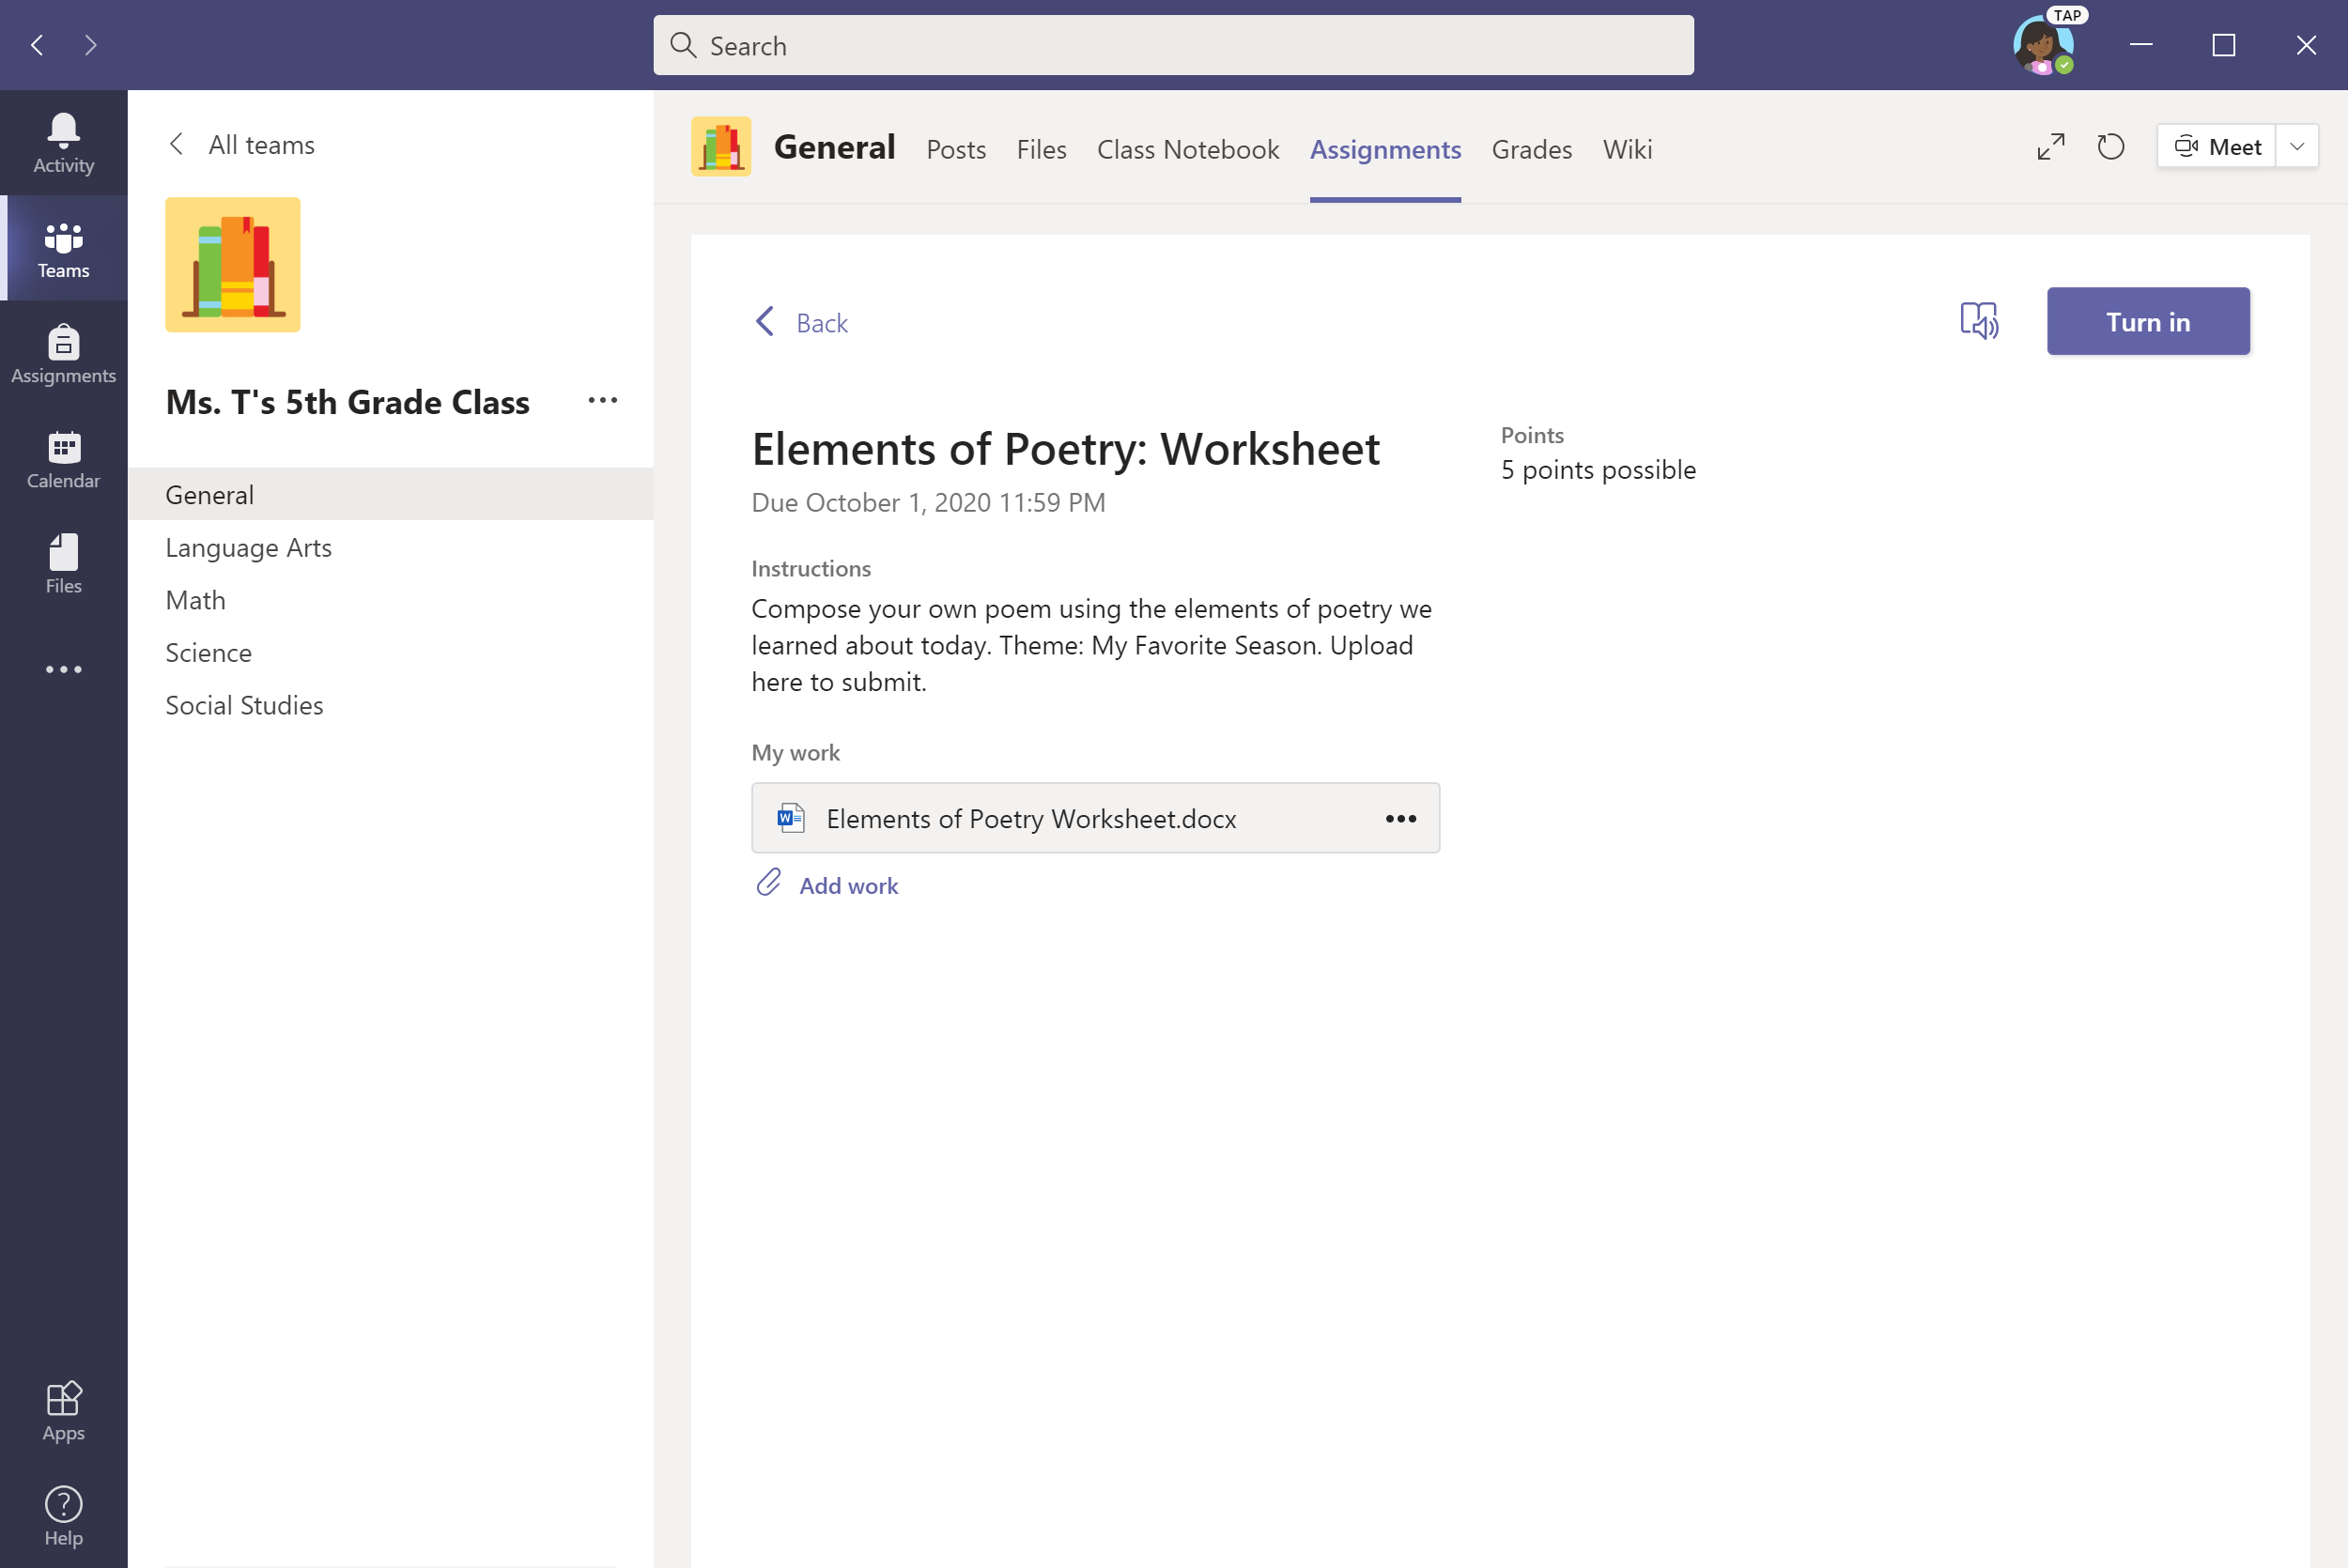
Click Turn in to submit assignment.

Slide 31

An animation will signal that the assignment has been submitted.

Slide 32
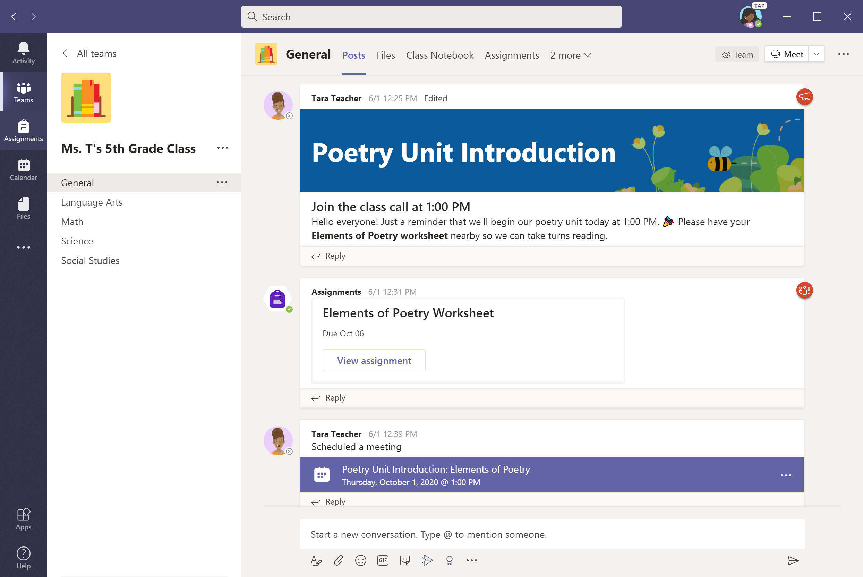
Alternate option for submitting assignments: Select Assignments in the left panel.
Notes:
Box focus in on ‘view assignment’

Slide 33
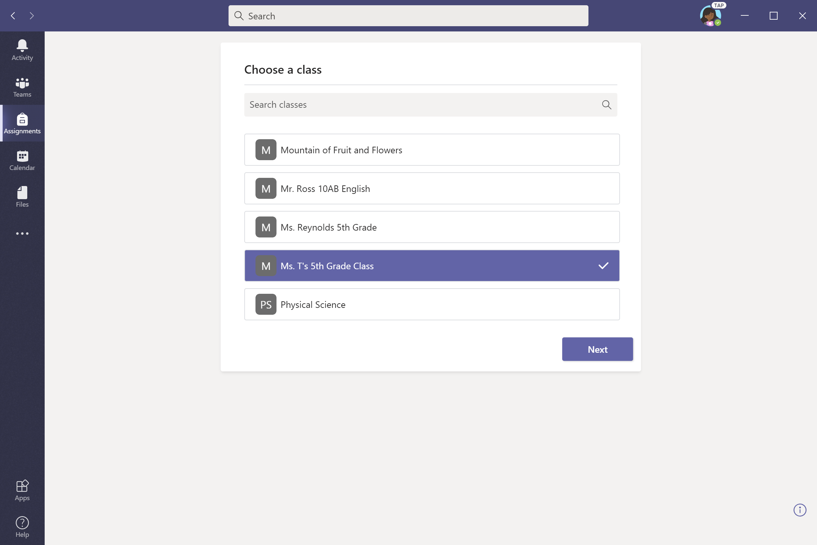
Select a class.

Slide 34
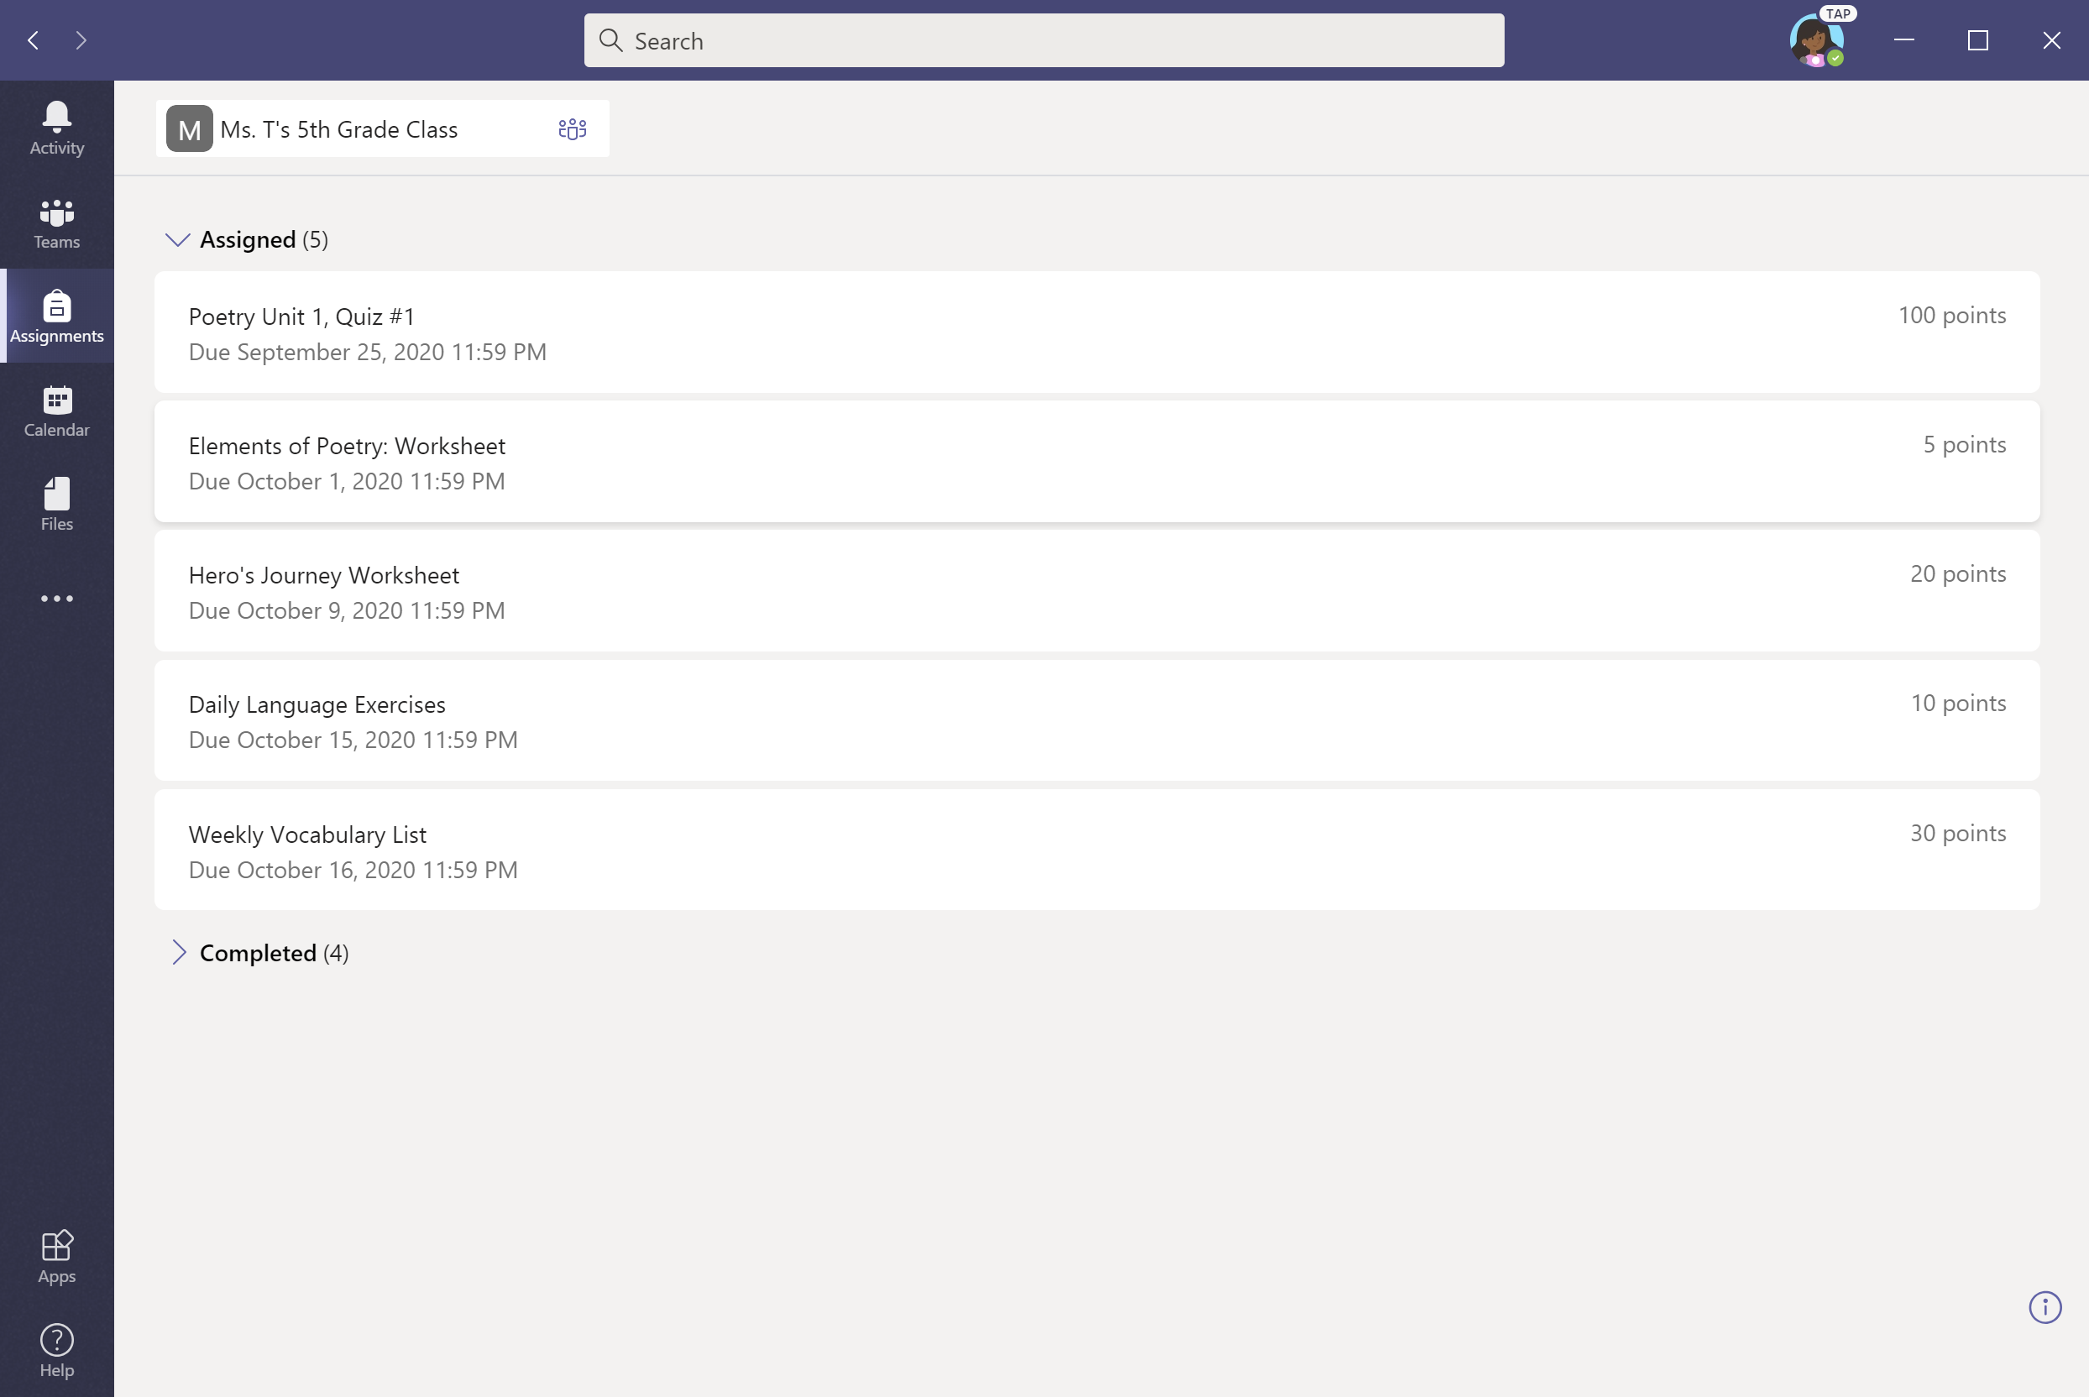
Select assignment.

Slide 35
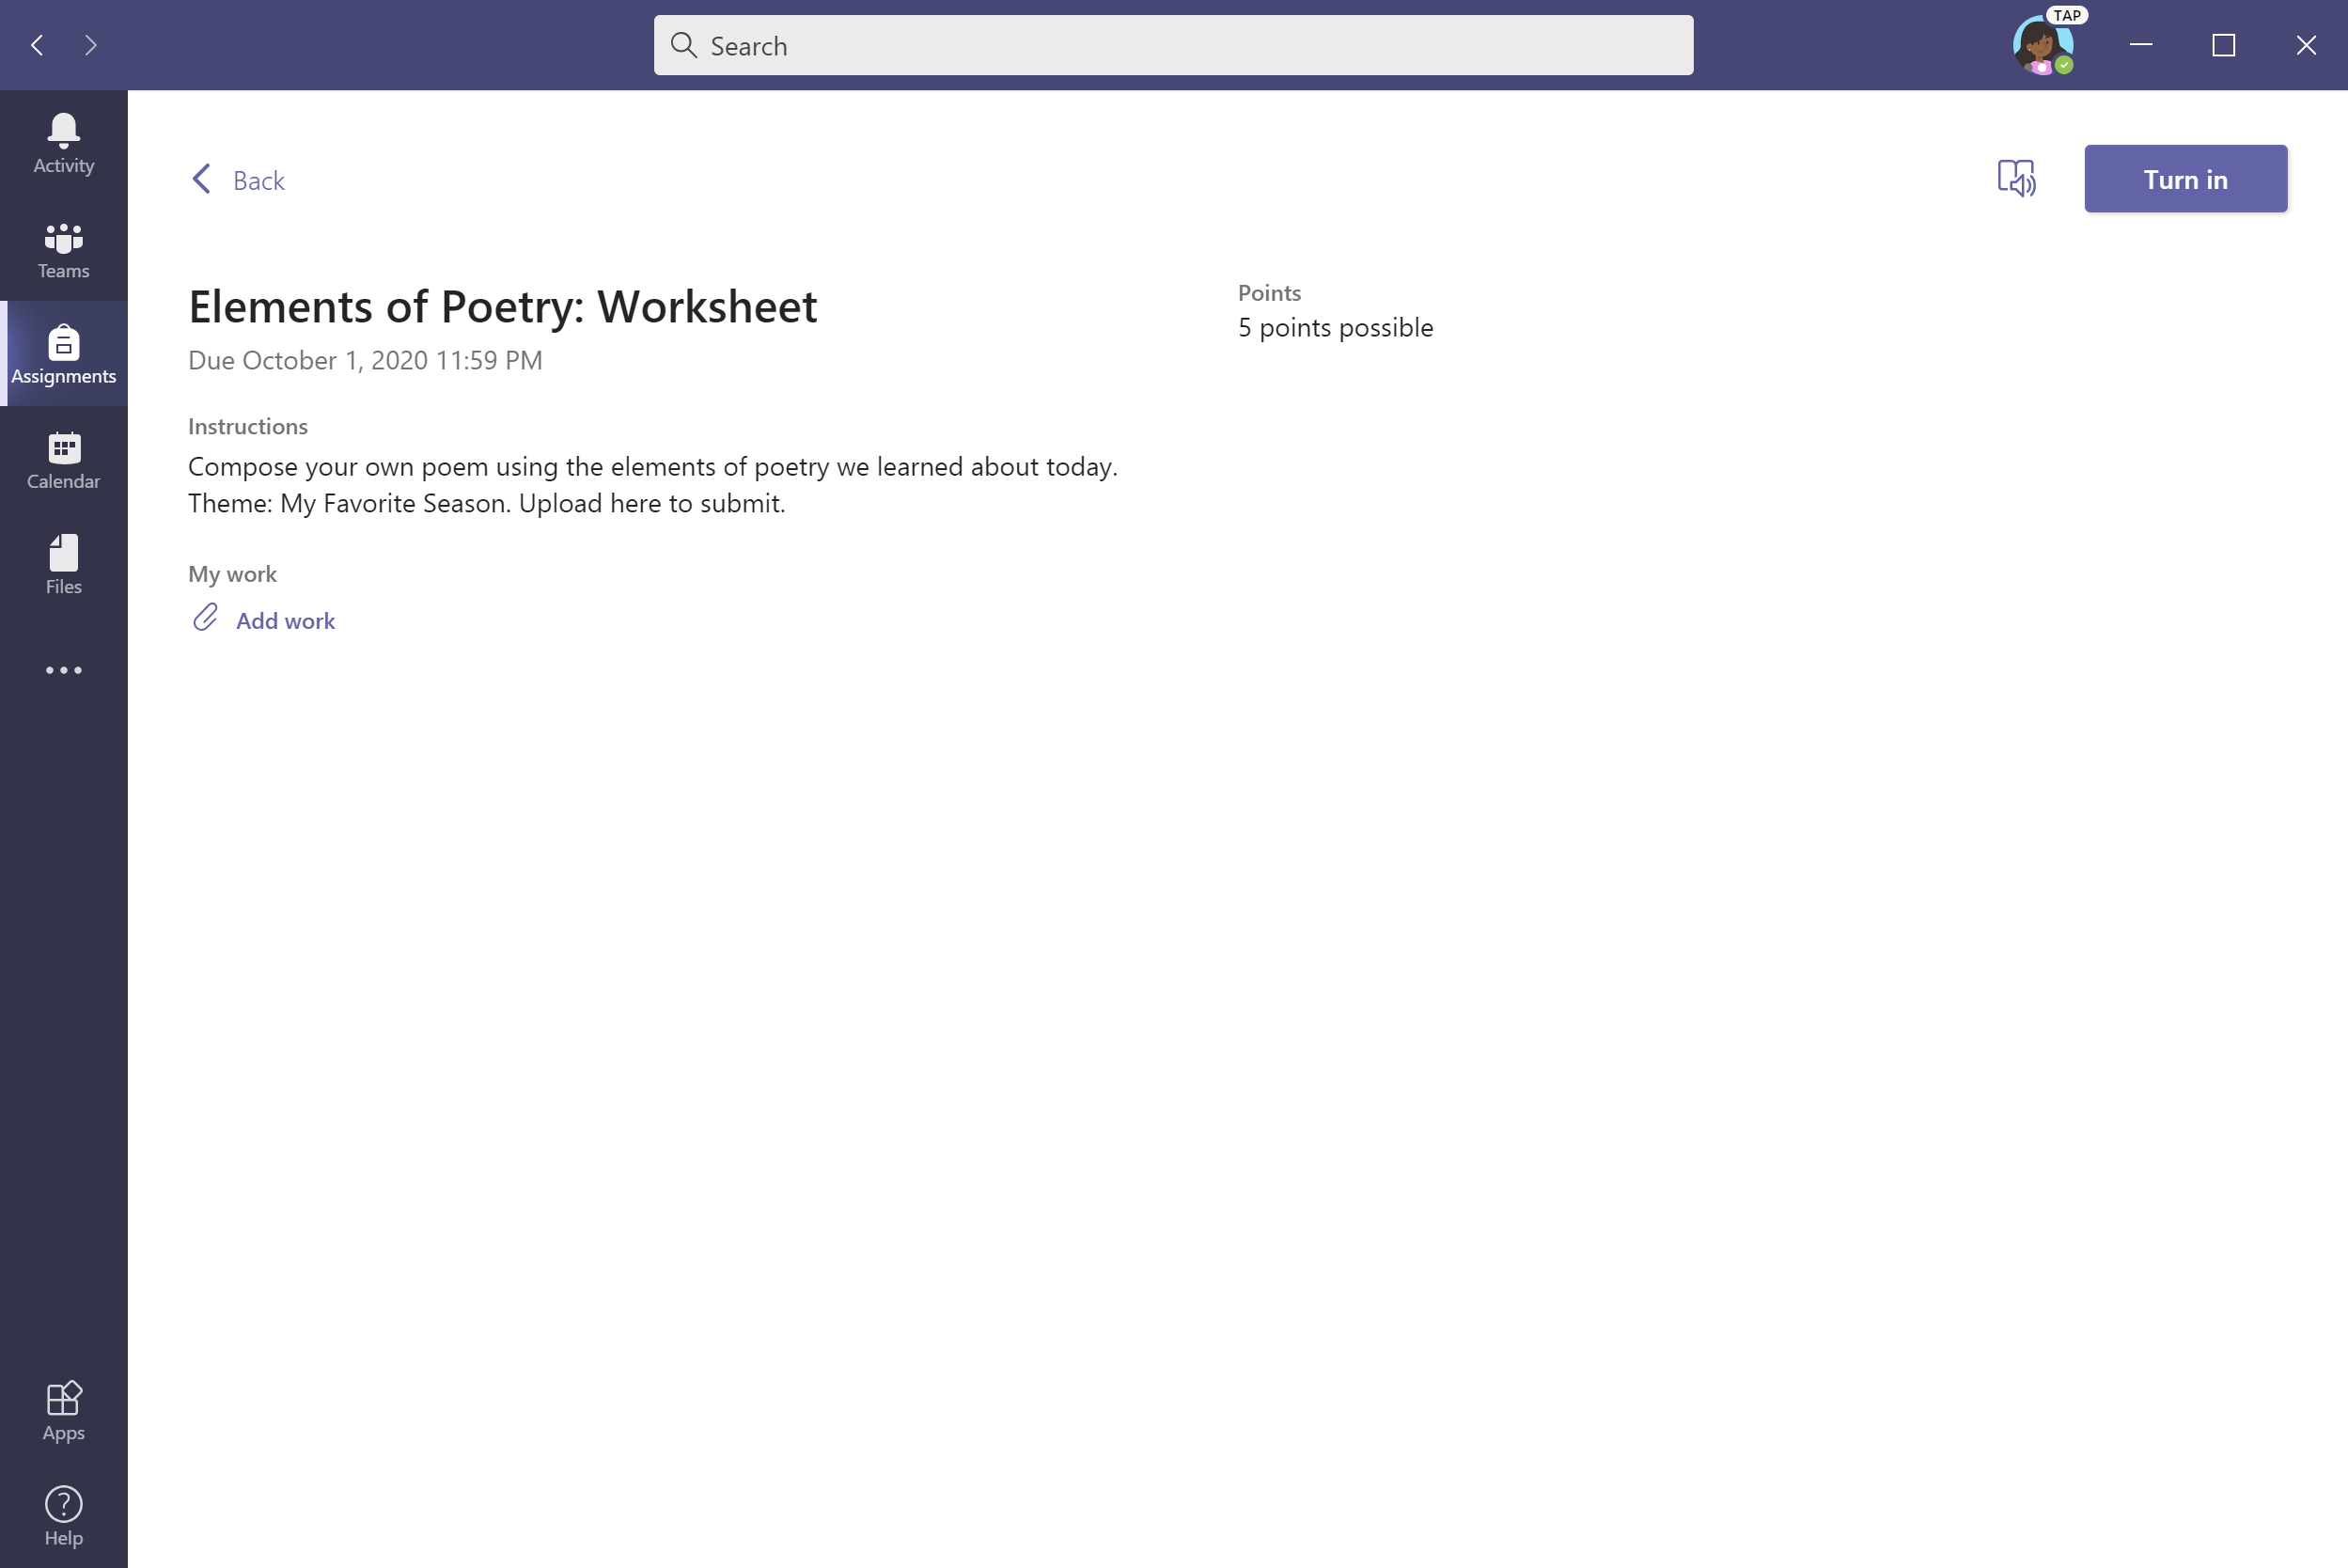
To upload work, select + Add work.

Slide 36
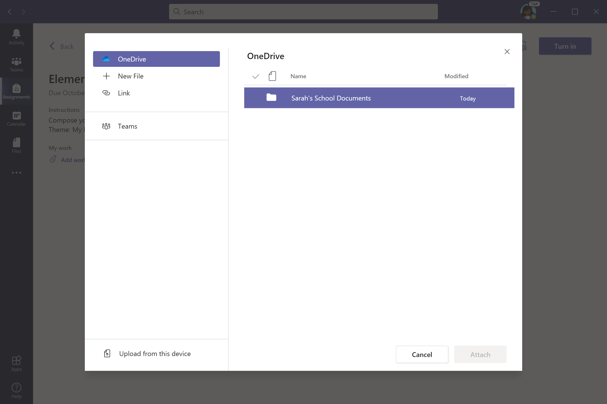
Let’s upload from OneDrive for this example. Click desired folder to find assignment.

Slide 37
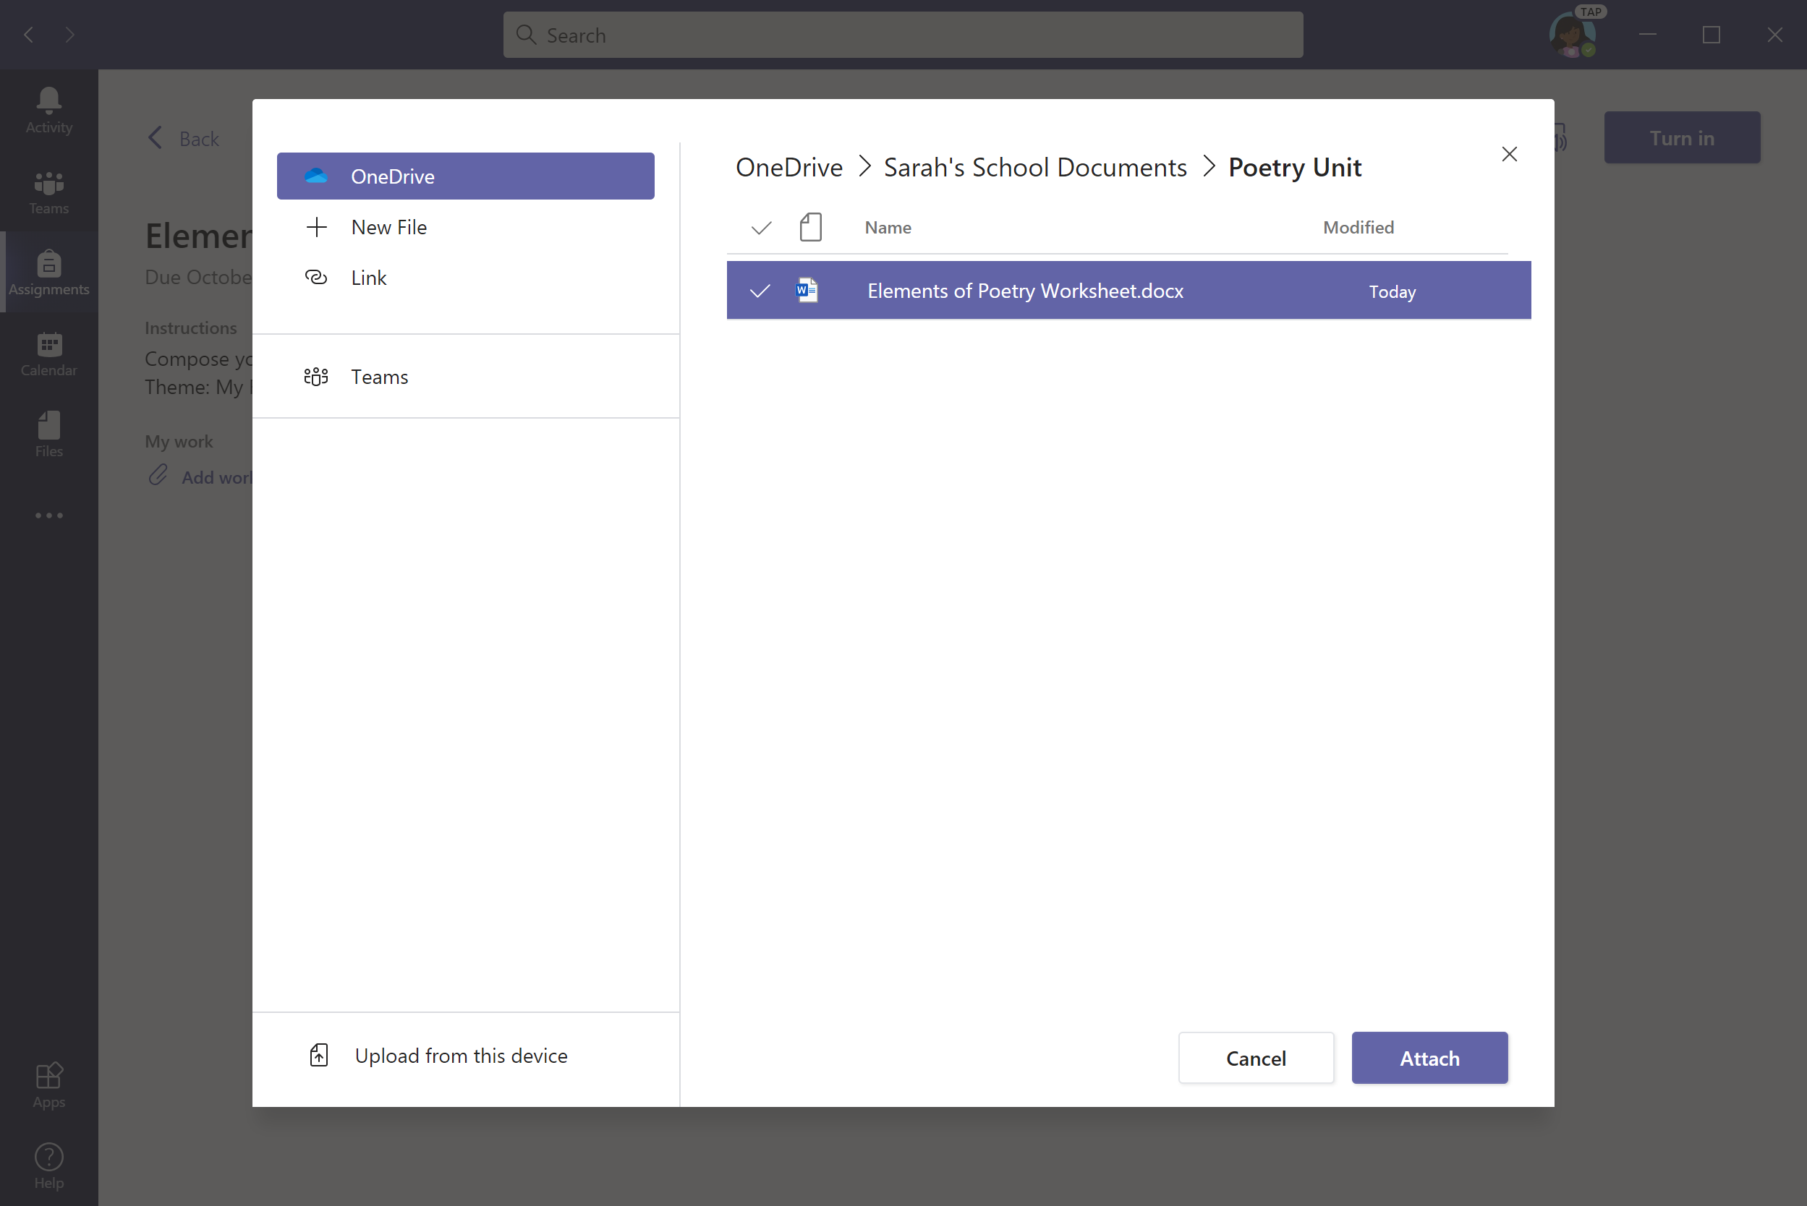
Select a file and click Attach.

Slide 38
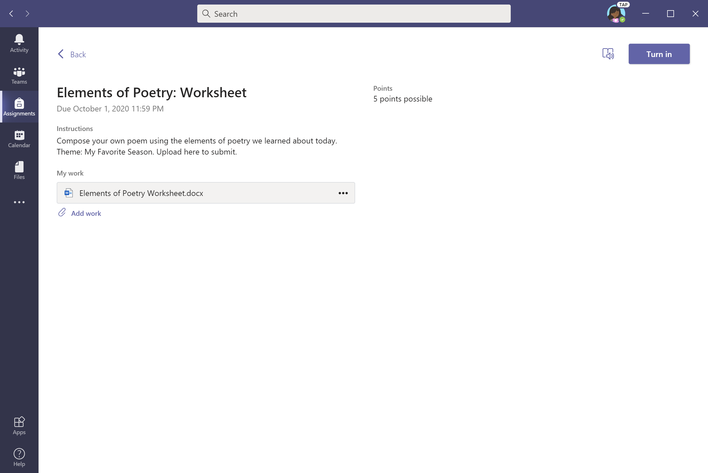
Click Turn in to submit assignment.

Slide 39

An animation will signal that the assignment as been turned in.

Slide 40
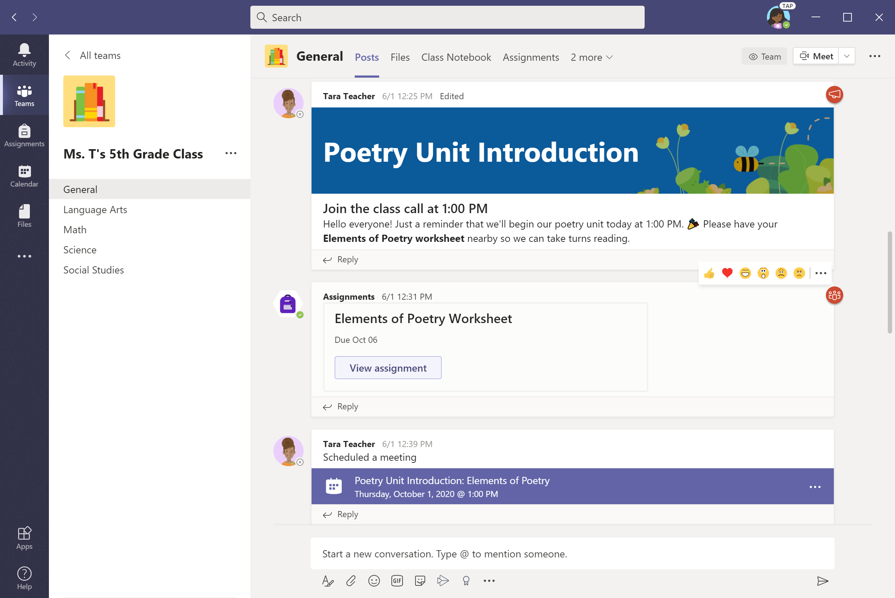
Another option for turning in assignments: View assignments from the Posts tab in the General channel.
Notes:
Box focus in on ‘view assignment’

Slide 41
To upload work, select + Add work. Proceed as shown in previous slides.

Slide 42
Attend a virtual class
Chapter 2
How to help your student use Teams
Join a class team
View and turn in assignments
Attend a virtual class
Find grades
Chat with teachers and classmates

Slide 43
Your student can attend class and customize their virtual experience with video & microphone settings.

Slide 44
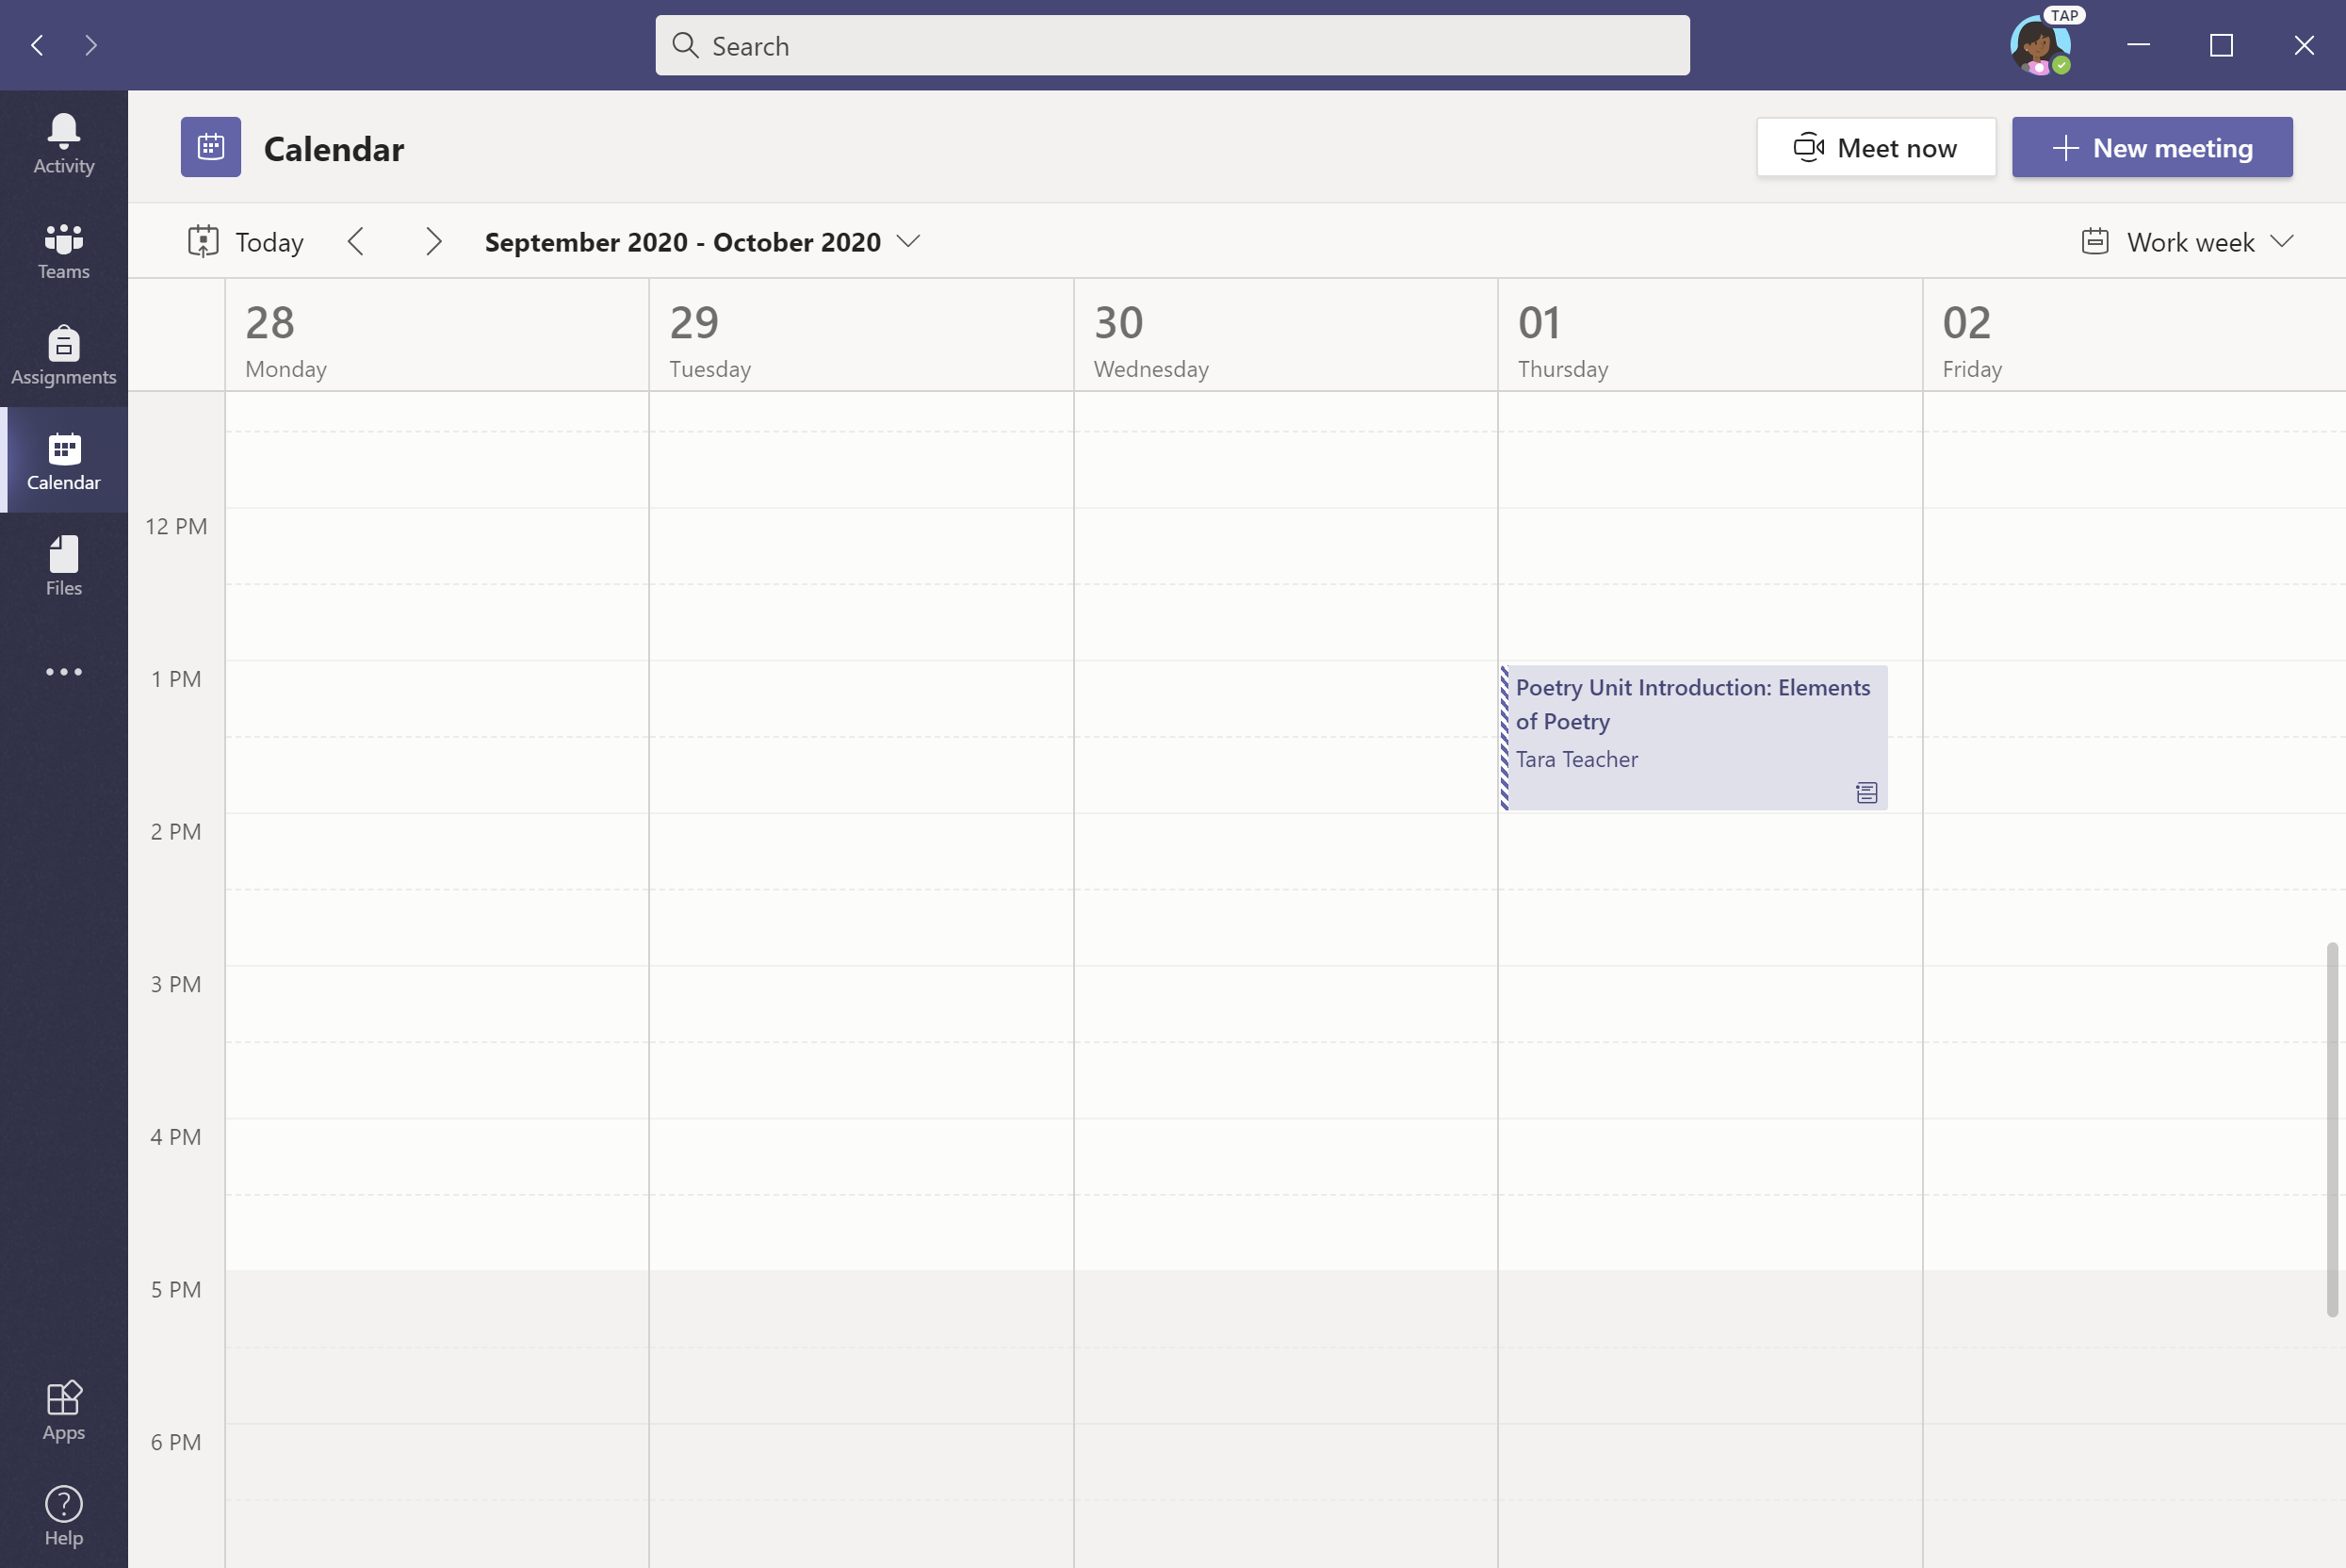
Click on Calendar in the menu bar and select the class meeting.

Slide 45
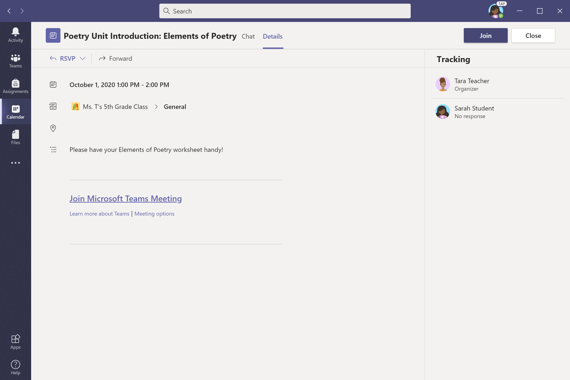
Click Join.

Slide 46
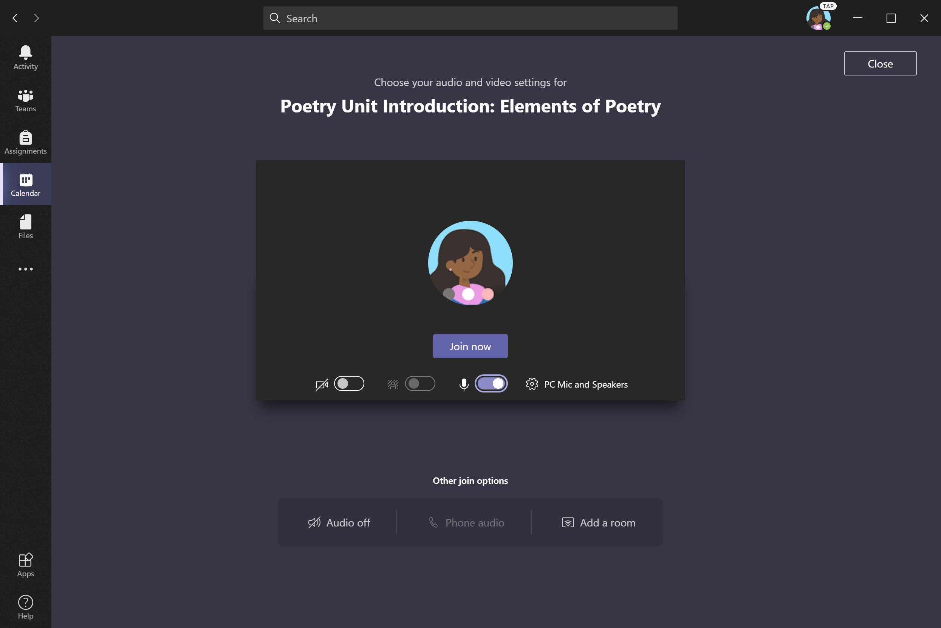
Turn video camera and microphone on/off as appropriate. Click Join now.
Note: Before joining the meeting, your student might enter a virtual lobby where they will wait until the teacher starts the meeting.
This is a new feature we’re introducing to help teachers control when the meeting starts. Check with your student’s teacher if you have any questions.

Slide 47
Find grades
Chapter 2
How to help your student use Teams
Join a class team
View and turn in assignments
Attend a virtual class
Find grades
Chat with teachers and classmates

Slide 48
You and your student can use Teams to keep tabs on assignment status and easily find grades in this quick-view list.

Slide 49
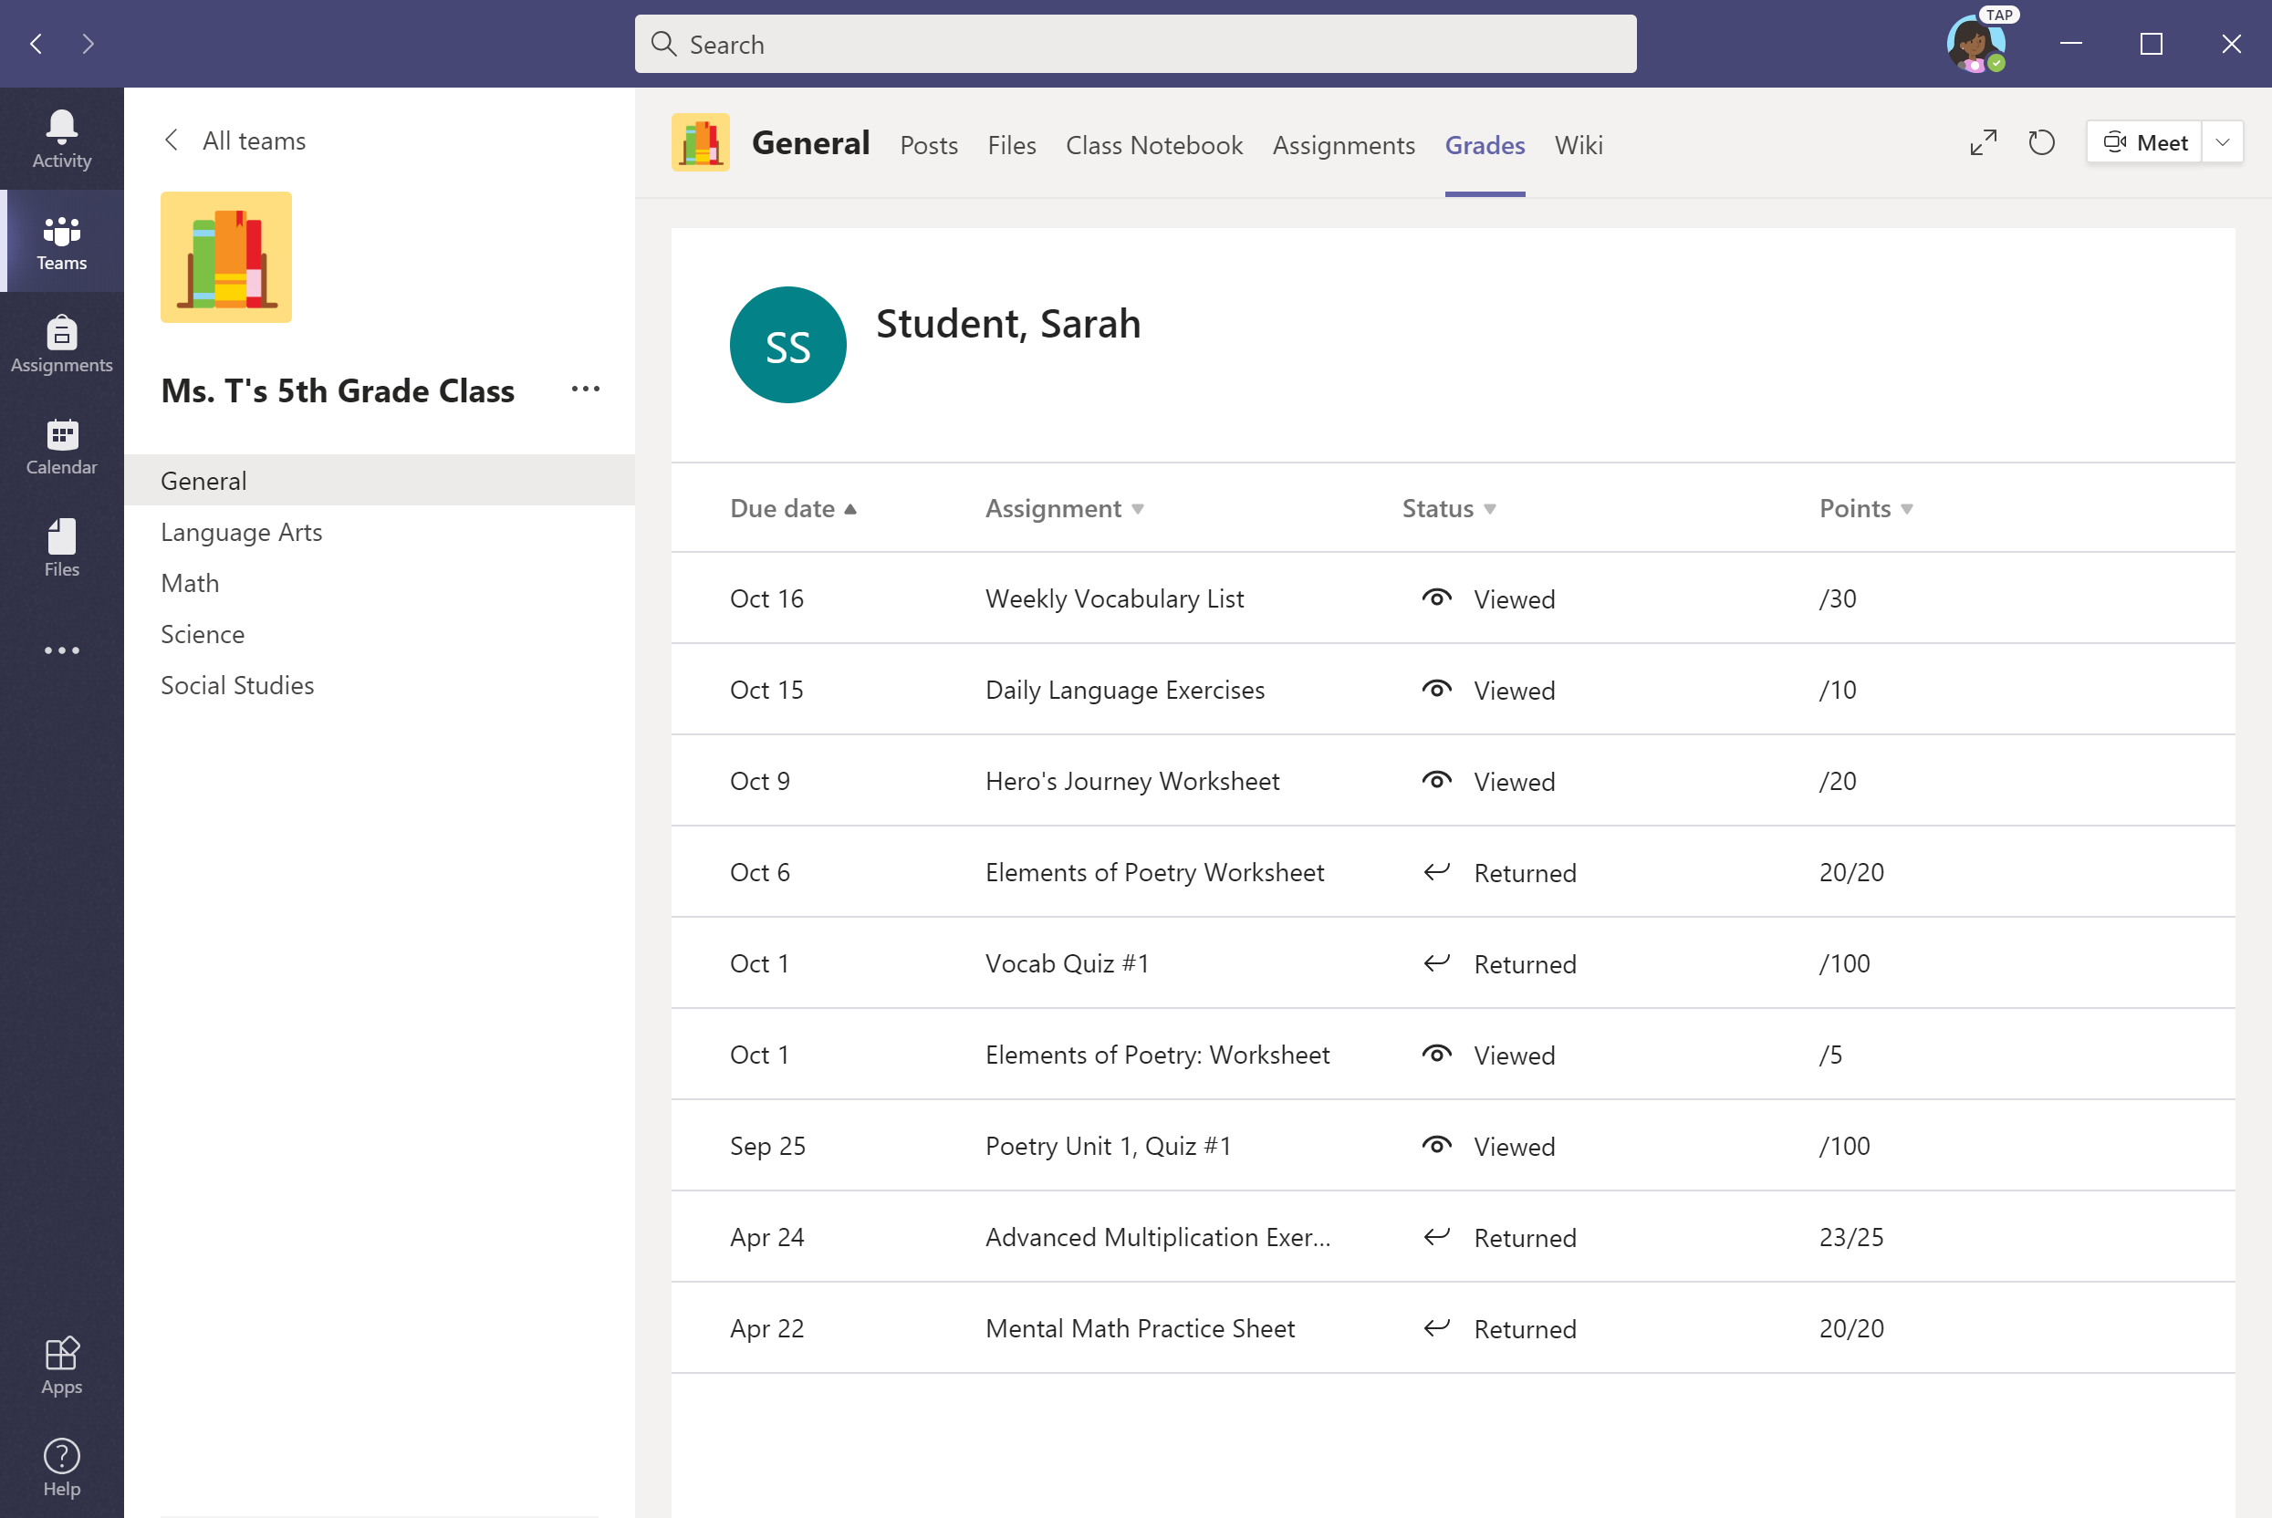
Select the Grades tab in the General channel to view status and grades for assignments.

Slide 50
Chat with teachers and classmates
Chapter 2
How to help your student use Teams
Join a class team
View and turn in assignments
Attend a virtual class
Find grades
Chat with teachers and classmates

Slide 51
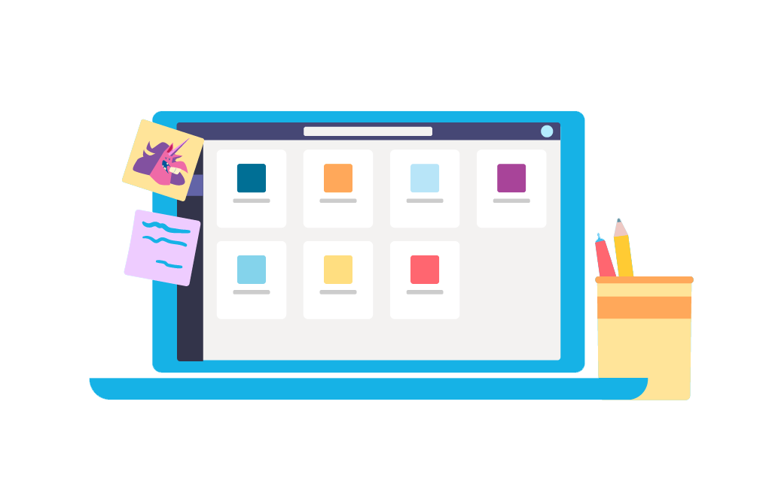
FAQ & Troubleshooting
FAQ & Troubleshooting
My student’s login isn’t working.
I can’t find my student’s class during set-up.
My student’s assignments are missing.
My student missed a class—what now?
What if I have more than one student using Teams on one device?
What do I do if we have low internet bandwidth?
Audio troubleshooting
Additional resources

Slide 52
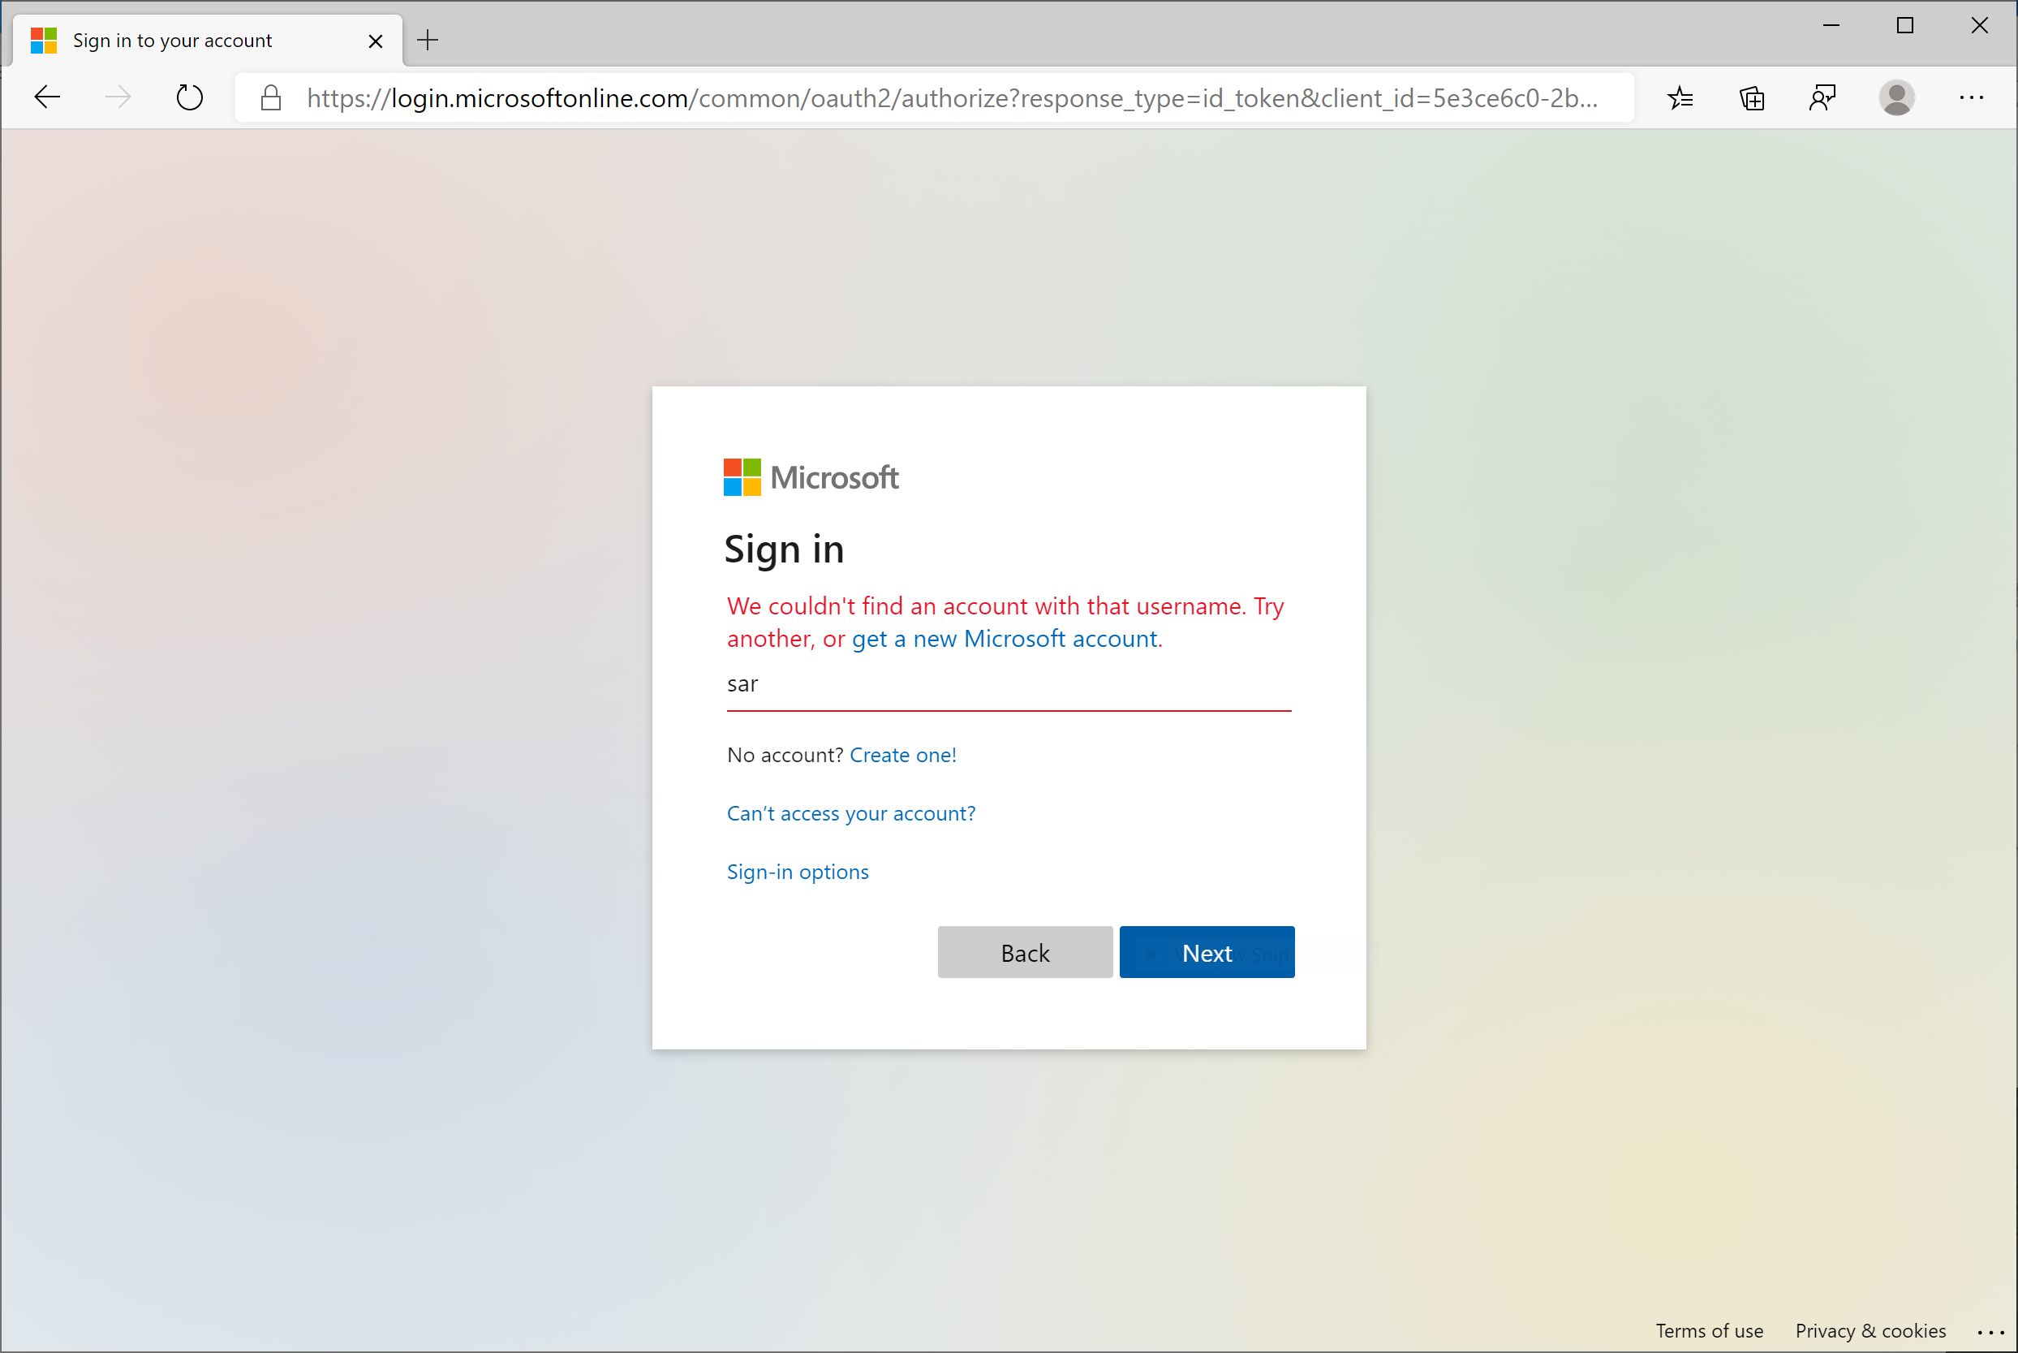
My student’s login isn’t working.
The login information may not be accurate or there might be some other issues with the accounts in your student's school. Contact your student’s teacher or school district with questions.

Slide 53
2. I can’t find my student’s class during set-up.
If you don’t see your student’s classes after you log in, the teacher may have invited you to join your class team with:
A join code. From the Teams page, select Join team
and enter the code.
A unique link. Ask your student to check their email.

Slide 54
3. My student’s assignments are missing.
Check the Assignments tab. If you don’t see any assignments, have your student email the teacher.

Slide 55
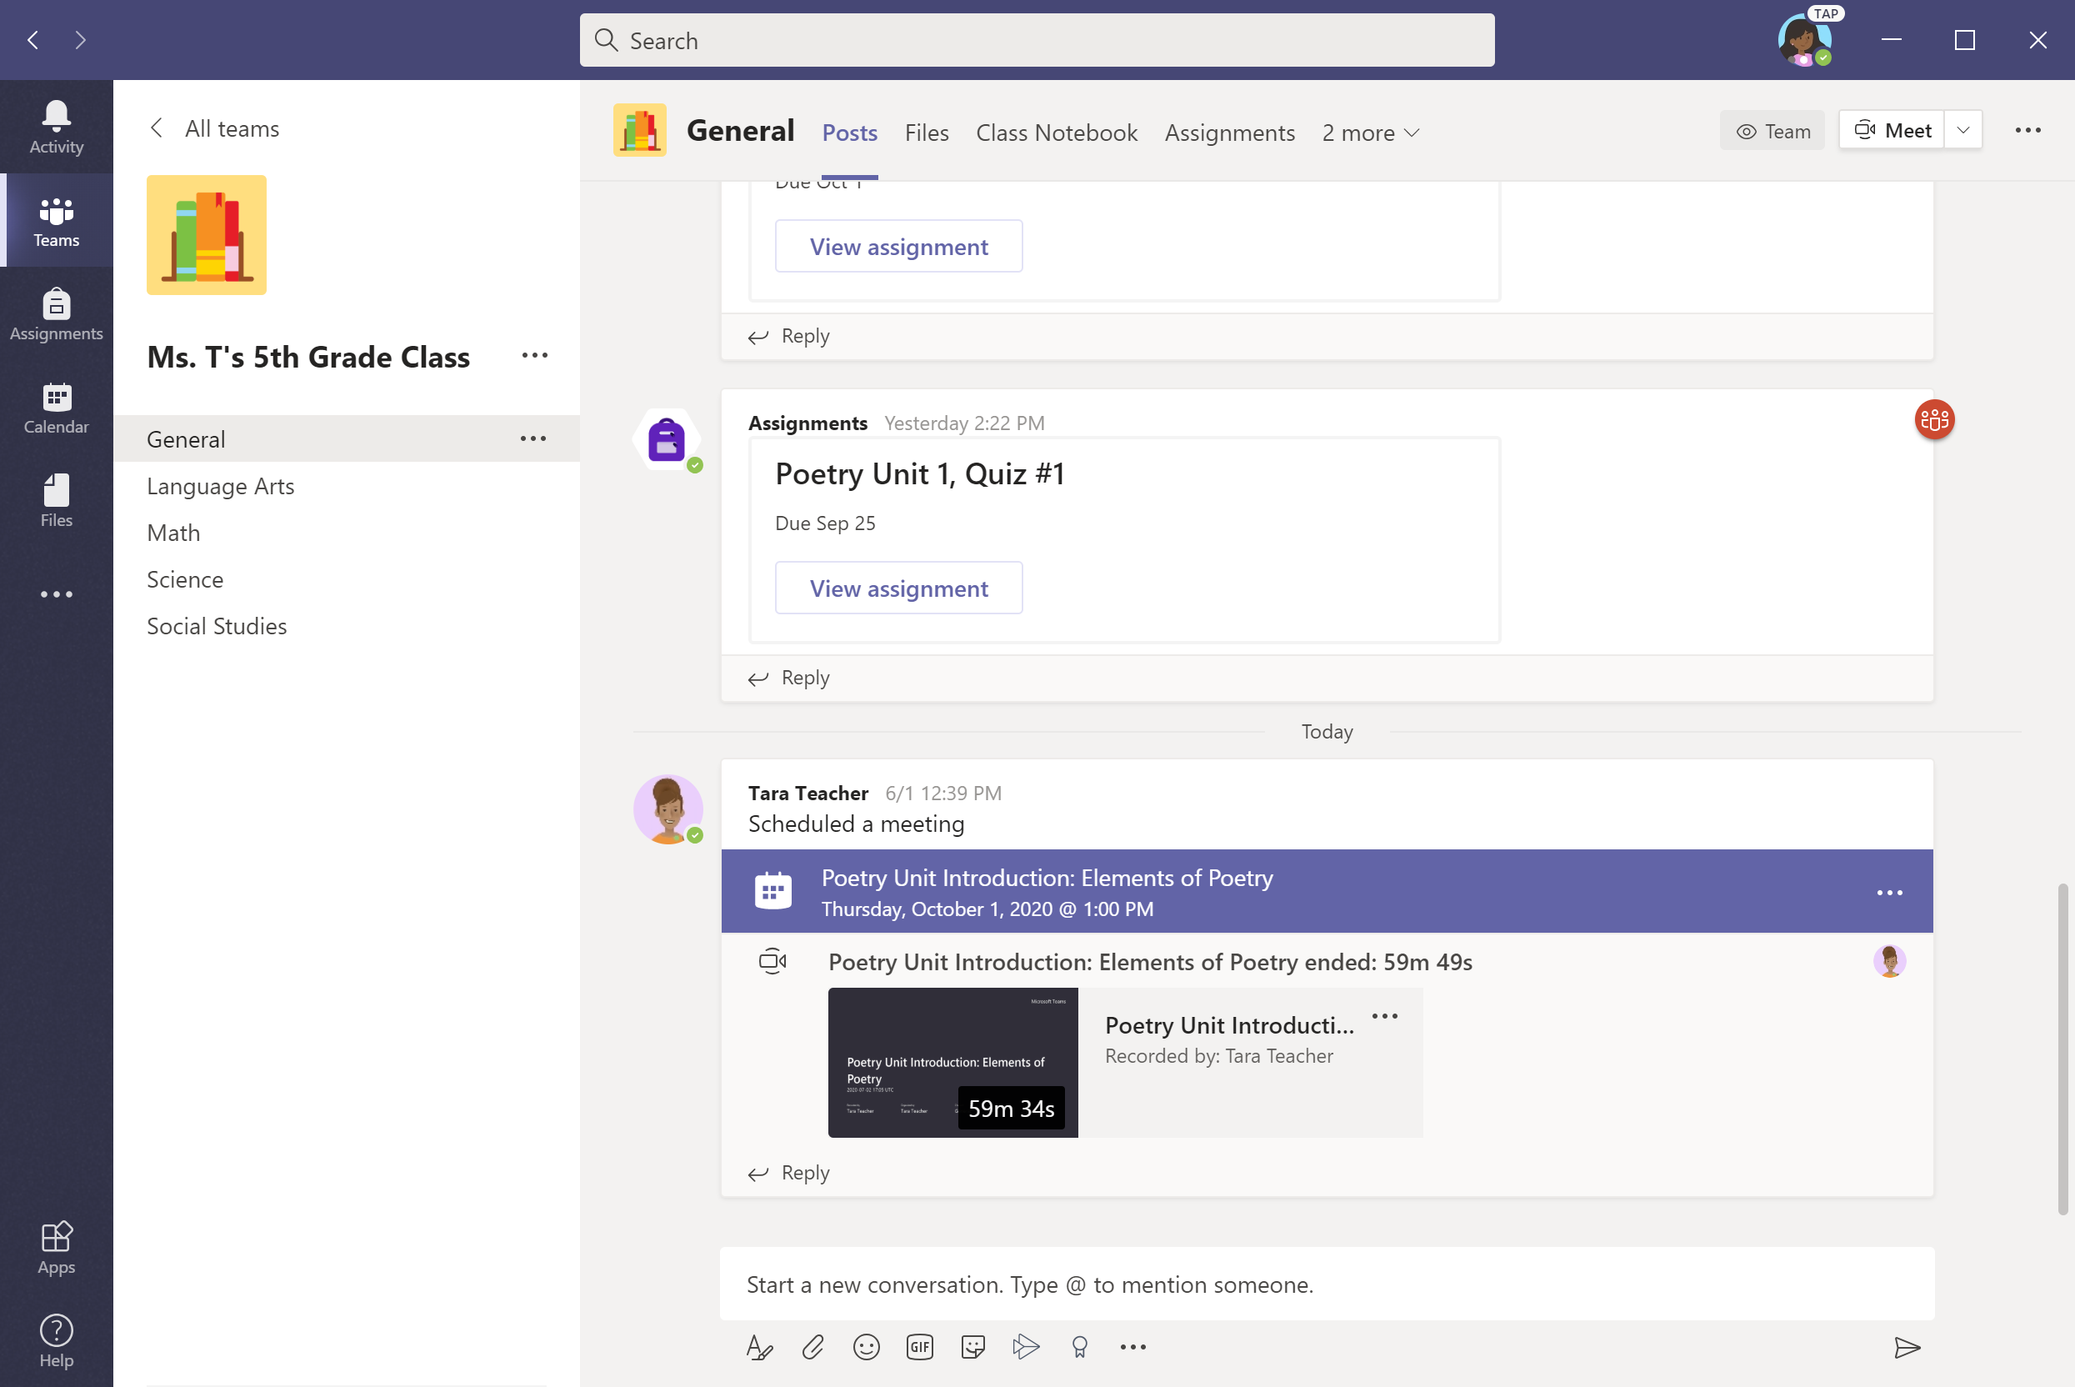
4. My student missed a class—what now?
Read any new posts in the class team channel.
Check for a recording of the class meeting in the team channel and watch the meeting.
Check in with the teacher for additional information.

Slide 56
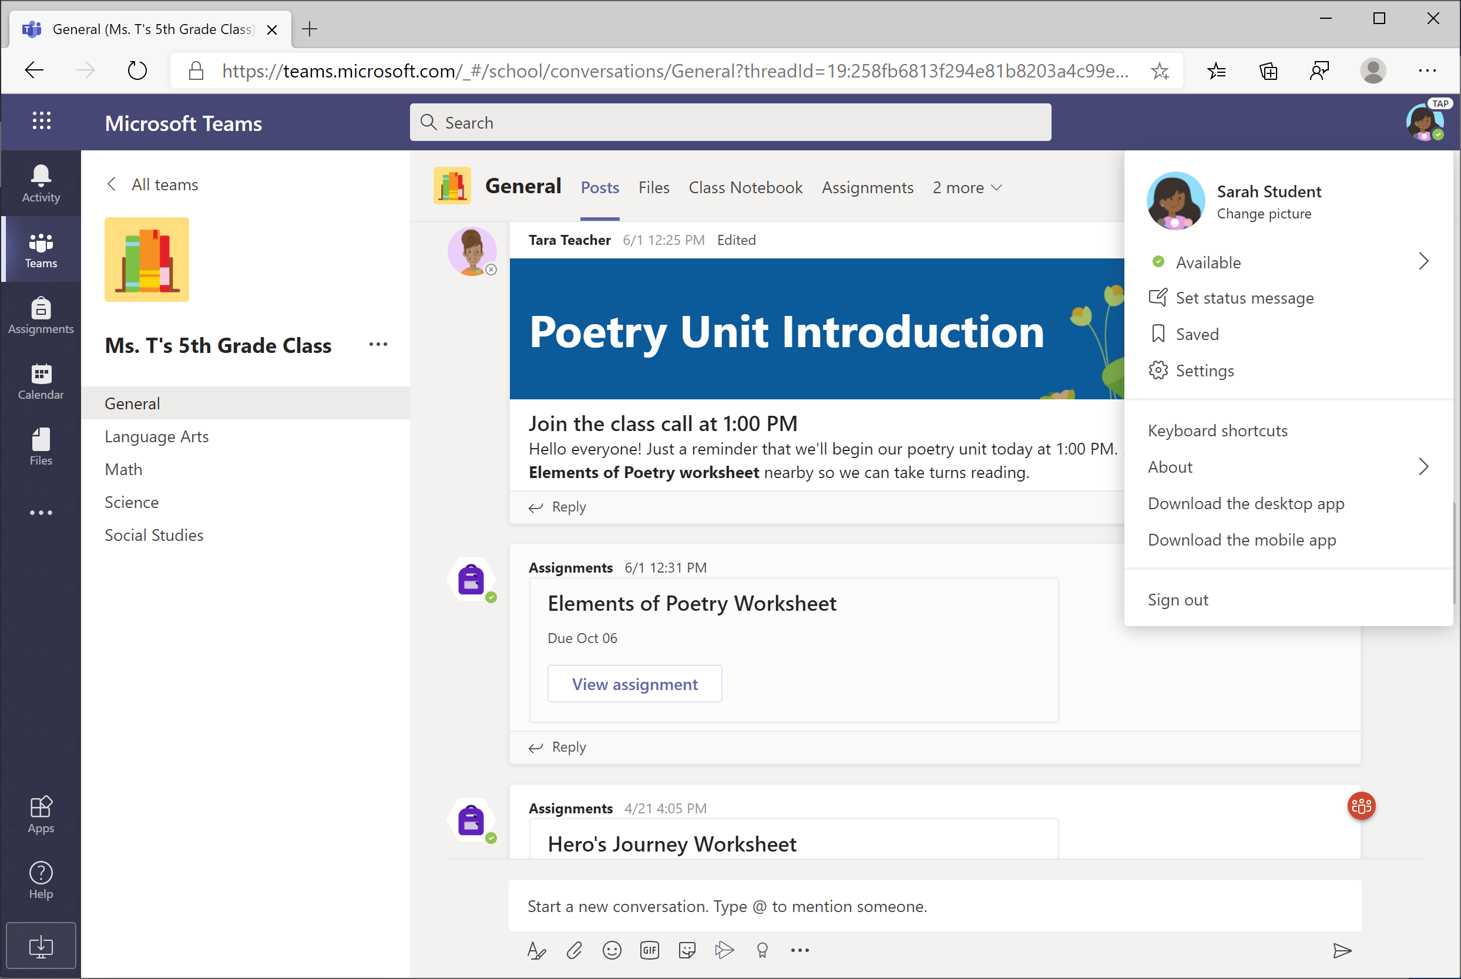
5. What if I have more than one student using Teams on one device?
Each student is able to log in to their own Teams account with their unique username and password.
When one student is done with their Teams work, click on their icon in the top-right corner and select Sign out. The next student can then log in.

Slide 57
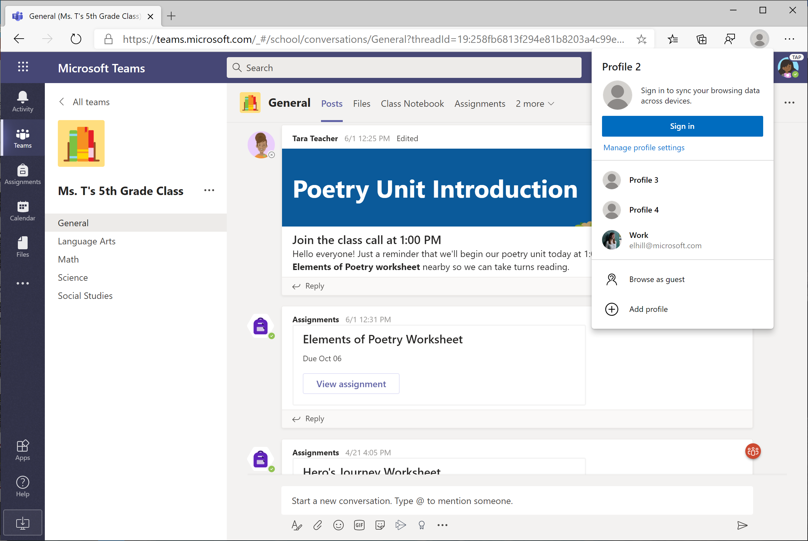
You can also create multiple accounts (also called profiles) in the new Edge browser.

Slide 58
6. We are experiencing low internet bandwidth. What can we do?
You can still use Teams when internet bandwidth is low. Teams will work to reduce the amount of video streams automatically.
You can try limiting video usage during live class sessions. Have your student turn on the camera at the beginning of the session to say hello, or have your student only use the camera when they are speaking.

Slide 59
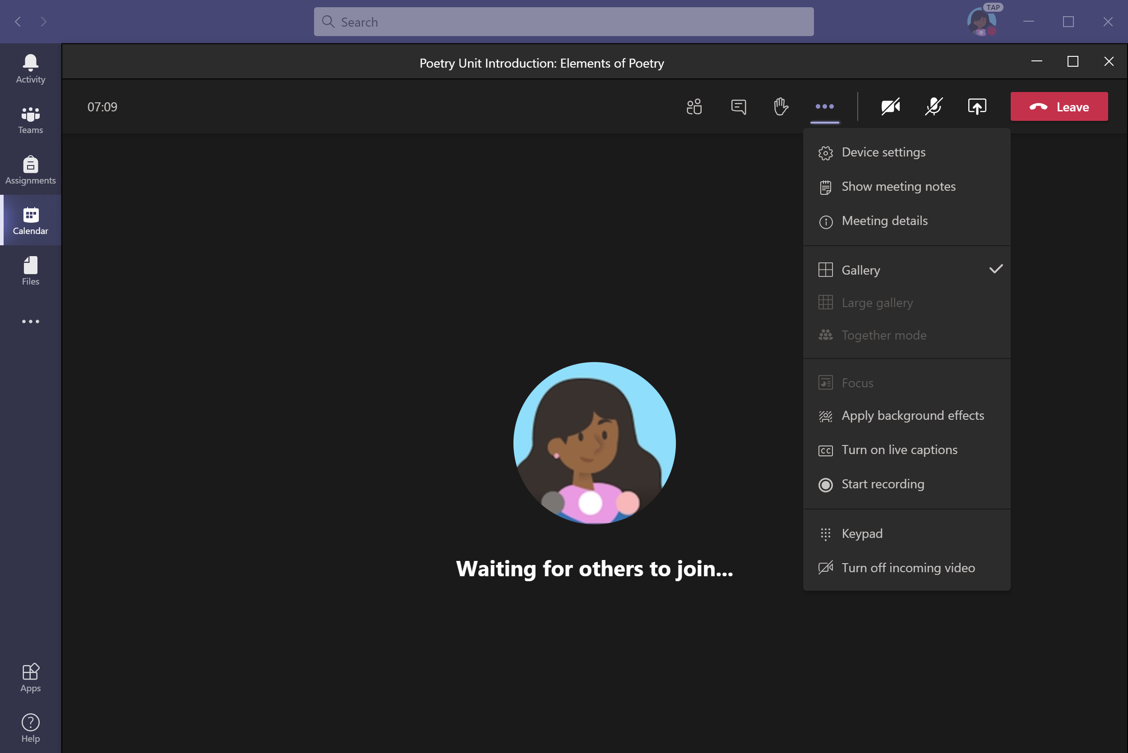
You can also turn off incoming video when bandwidth is low.
Click on the “. . .” (More Options) and select Turn off incoming video.

Slide 60
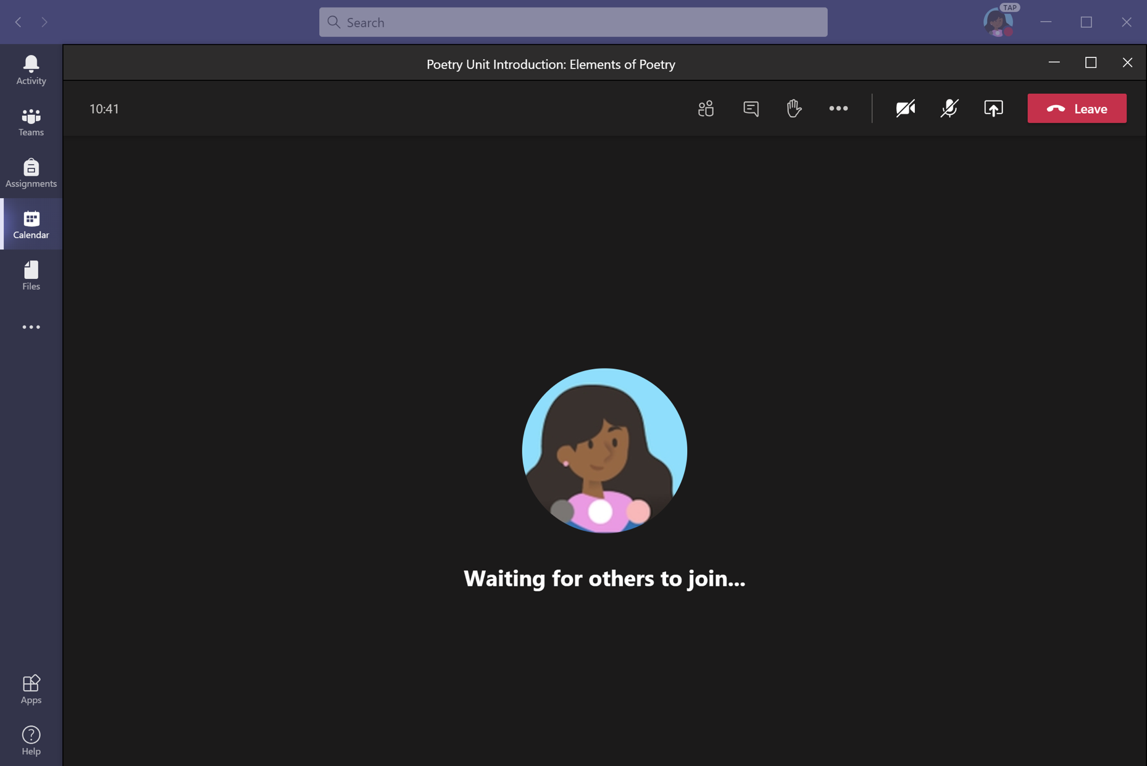
7. Audio troubleshooting: The teacher can’t hear my student, or my student can’t hear the teacher.
If people in a class meeting can't hear your student, they might be muted or the microphone setting might be incorrect.
Click the microphone icon to turn the mute button on/off.

Slide 61

To change your speaker or microphone settings in a meeting, select the “. . .” (More Options) button from the toolbar. Click Device settings.

Slide 62

Select the speakers and microphone you wish to use.

Slide 63
Additional resources
Additional resources
Help your student successfully navigate online learning through time management, communication, study habits, and motivation best practices:
Tips for successful online learning
Find support articles and troubleshooting assistance:
Microsoft Teams support center

