Slide 1
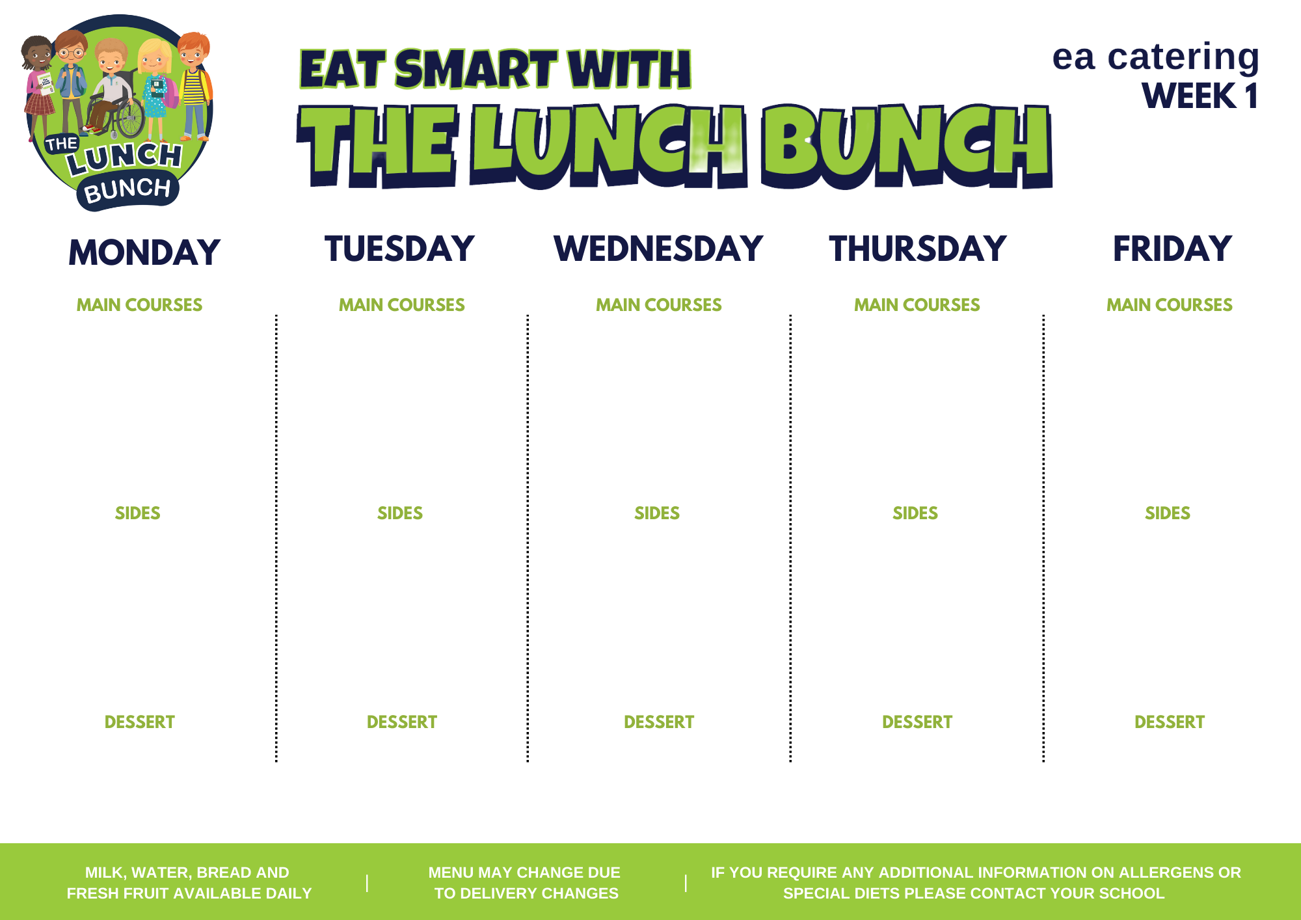
Savoury
Mince
Or
Chicken & ham pasta bake
Classic Margherita
Pizza
Or
Fish fingers
Roast Chicken Stuffing & Gravy
Lunch Bunch Chicken Curry & Naan Bread
Or
Chicken & Cheese Panini
Hot Dog
Or
Crispy Cod Fishcakes
Mash & Baton Carrots
Garlic bread & Peas
Chipped Potatoes & salad
Mash & Baked Beans
Carrots & Broccoli
Mashed Potatoes/Oven Roast Potato
Steamed Rice & peas
Oven Baked Wedges & sweetcorn
Tomato Ketchup
Chipped Potatoes/Baked Potato
Toffee or strawberry yoghurt & Fresh fruit
Artic Roll & Fresh Fruit
Chocolate brownie & Custard
Jelly & Fresh fruit
Fresh Fruit & Ice cream

Slide 2
Sausage Roll
Or
Sweet and Sour Chicken
Pasta Bolognaise with Garlic Bread
Or
Pepperoni Pizza
Roast Gammon with Stuffing & Gravy
Lunch Bunch Chicken Curry & Naan Bread
Or
Ish fingers
Beef Burger in a Bap with Tomato Ketchup
Or
Pepper Chicken & Rice
Spaghetti Hoops & Garden Peas
Chipped Potatoes/Rice
Sweetcorn
Oven Roasted Potato Wedges
Cauliflower or Broccoli
Mashed Potatoes/Oven Roasted Potato
Garden Peas
Diced potatoes
Sweetcorn/Salad
Chipped Potatoes/Rice
Artic Roll & Fruit
Ice cream & Fruit
Rice Krispie sprinkle cake
Blueberry
Muffin
Yoghurt & Fruit

Slide 3
Golden Crumbed Fish Fingers
Or
Mighty Mac ‘n’ Cheese with Garlic Bread Slice
Lunch Bunch Chicken Curry & Naan Bread
Or
Steak Burger in a Bap & Cheese
Tasty Pork Sausages with Tomato Ketchup/Gravy
Or
Salt N Chilli Chicken Wrap with Garlic Mayo
Chicken Goujons
Or
Margherita Pizza
Roast Chicken Stuffing & Gravy
Baked Beans Chipped Potatoes
Garden Peas
Diced Potatoes
Carrot /Cauliflower Cheese
Mashed Potatoes/Oven Roast Potato
Steamed Rice
Salad
Spaghetti Hoops
Mini Corn on the Cob
Chipped Potatoes
Artic Roll & fruit
Fresh Fruit Pot
Old School Cake & Custard
Jelly & Fruit
Ice cream & fruit

Slide 4
Pasta Bolognaise with Garlic Bread
Or
Cod Fishcakes
Pepperoni pizza
Or
Chicken & broccoli pasta bake & Garlic bread
Roast Gammon Stuffing & Gravy
Lunch Bunch Chicken Curry & Naan Bread
Or
BBQ Chicken Wrap
Oven Baked Chicken Goujons
Or
Sweet Chilli Chicken Panini
Garden Peas
Oven Baked Potato Wedges
Chipped Potatoes
Sweetcorn
Broccoli/ Carrots
Mashed Potatoes/Oven Roast Potato
Peas
Steamed Rice
Wedges
Baked Beans
Chipped Potatoes
Yoghurt & fruit
Jelly & Fruit
Cornflake Tart & Custard
Shortbread & Milkshake
Ice cream m & fruit

