Slide 1
Welcome to Old Warren Primary School
Mr Campbell (Principal)
Mrs Jolly (Nursery Teacher)
Mrs Evans (Nursery Teacher-Fridays)

Slide 2
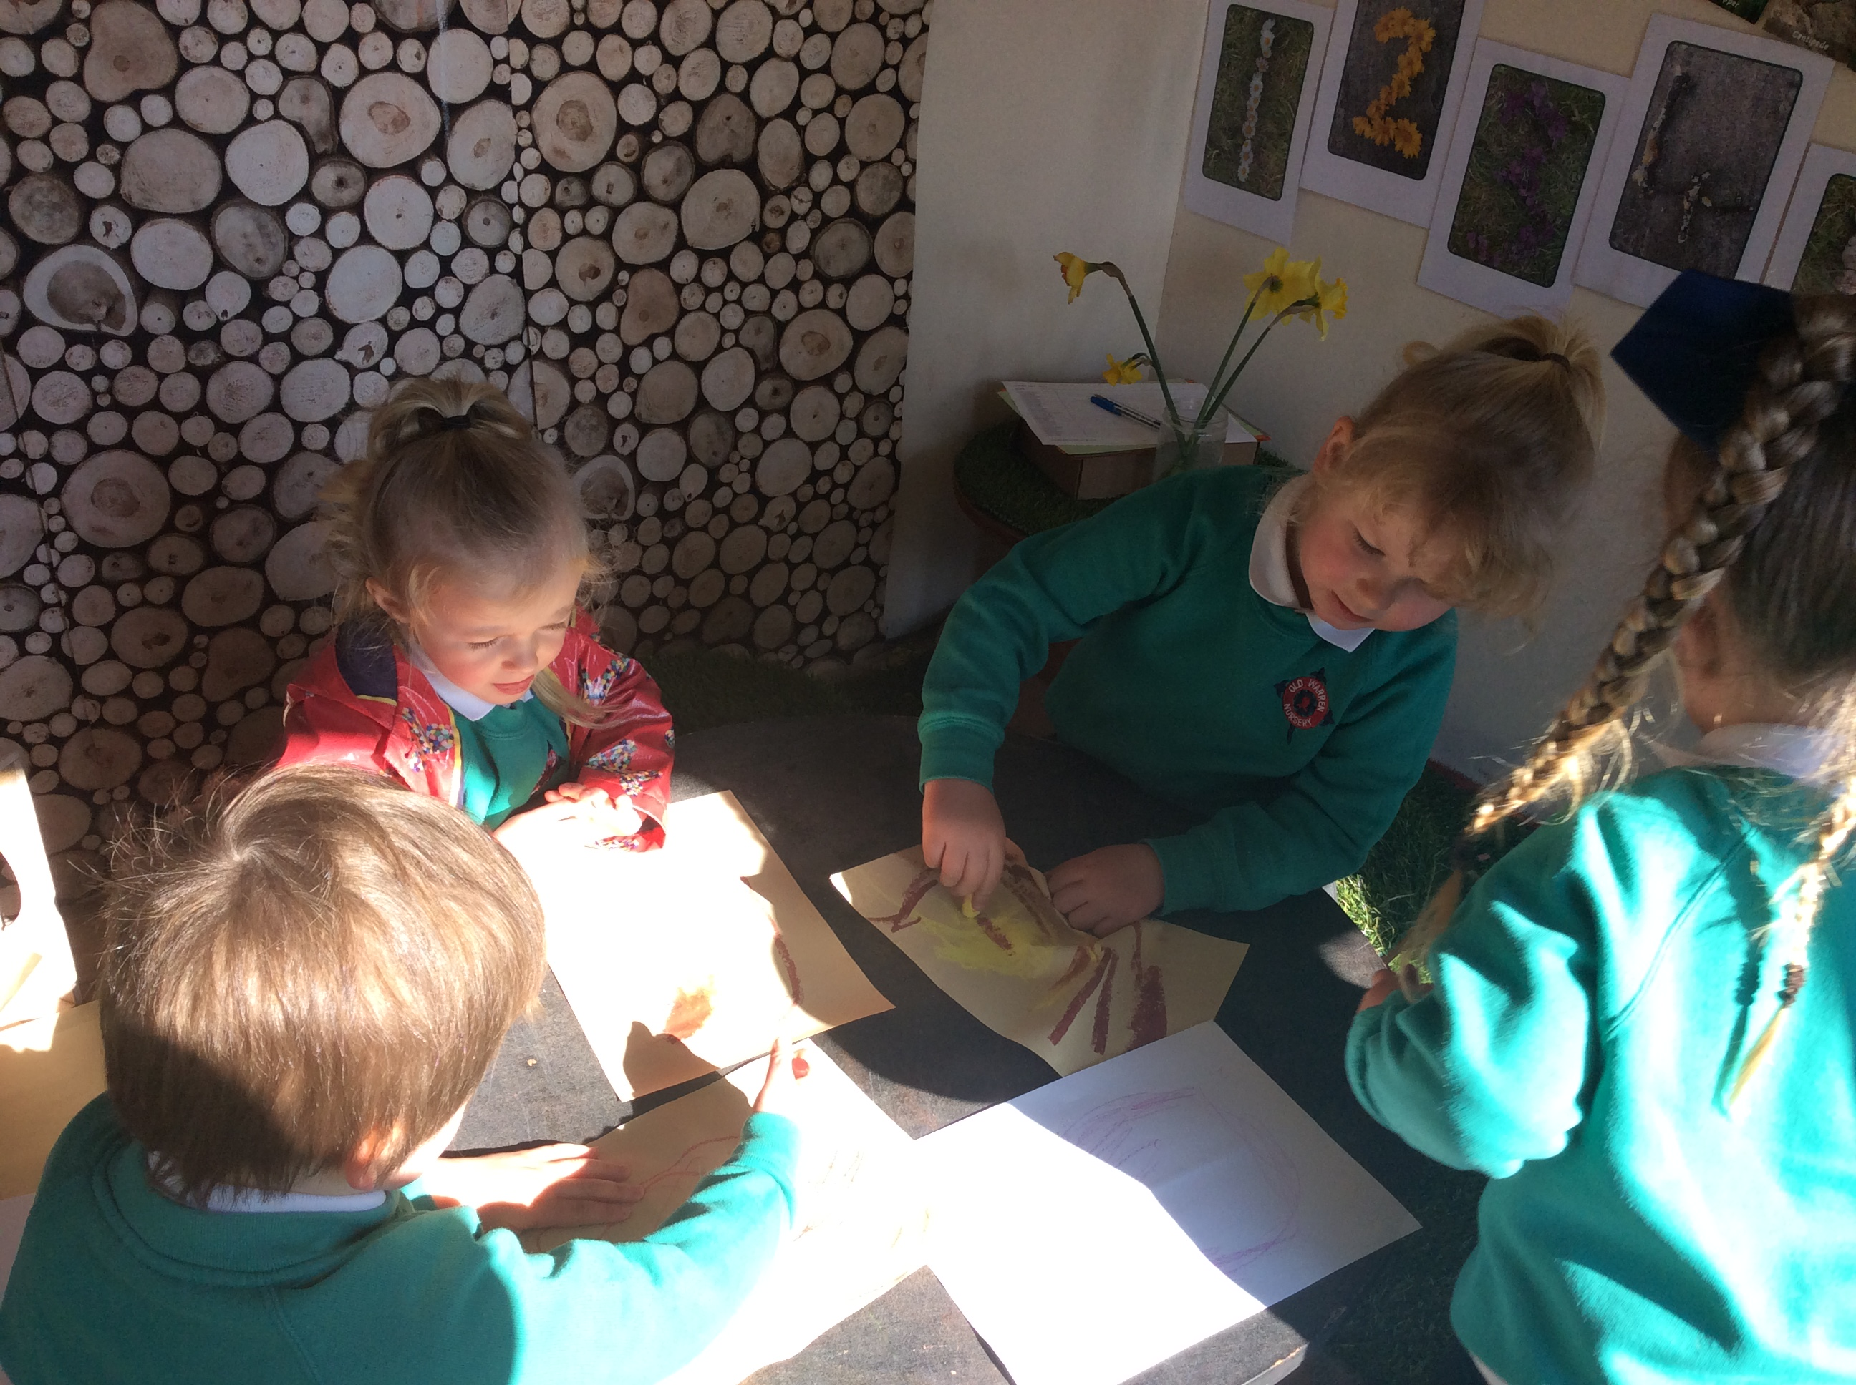
Our Ethos
We aspire for all our children to become confident, happy and caring individuals who achieve personal success and develop a love of learning and of life.

Slide 3
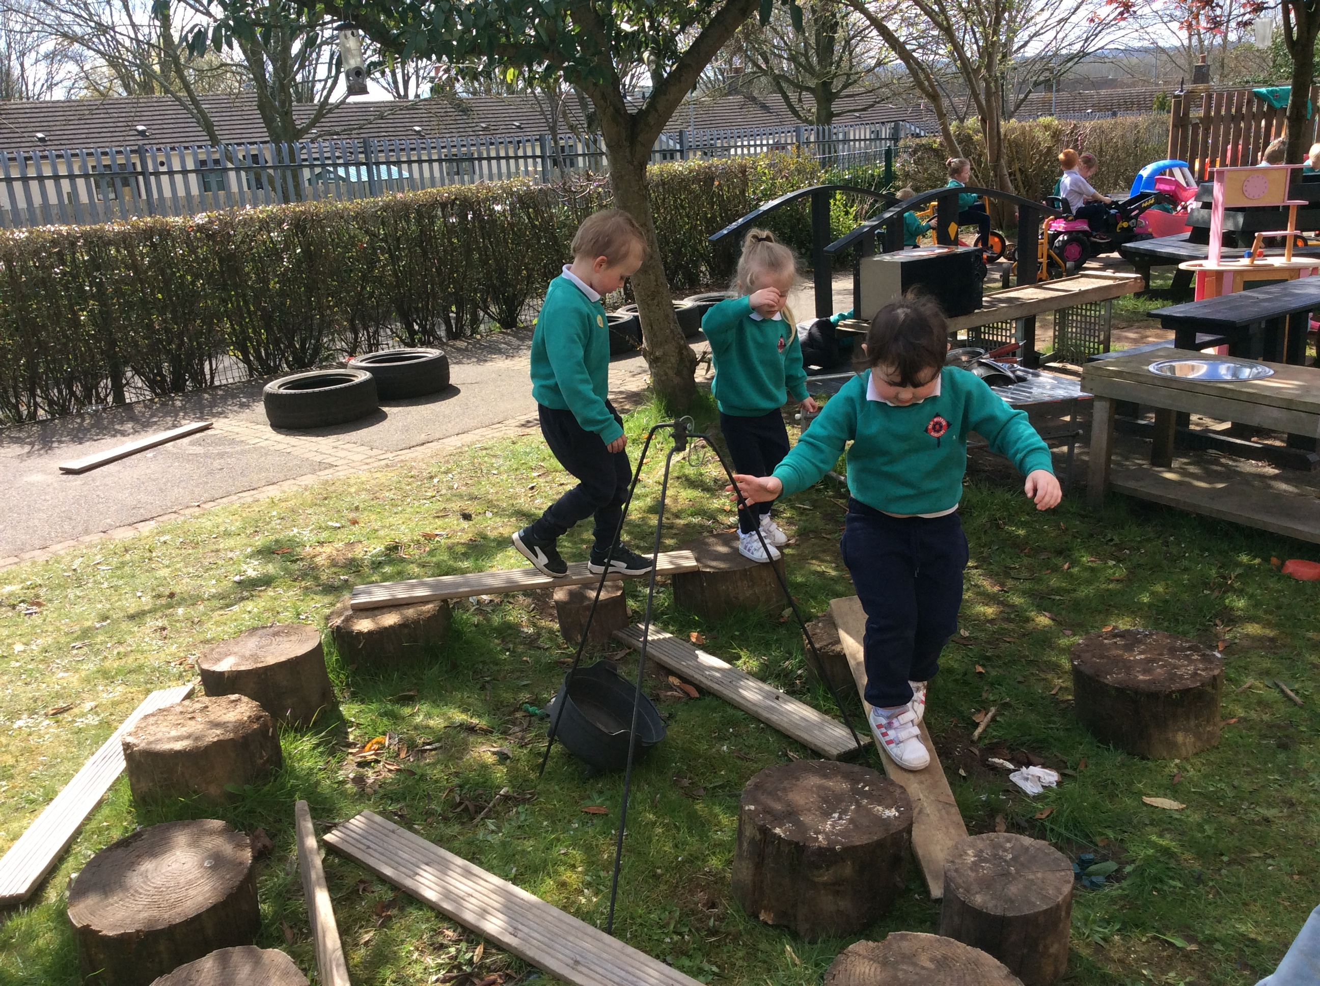
Our Nursery Offers:
Dedicated approachable staff
A full time place – 8.55am – 1.25pm, including lunch
Incredible Years parenting programme
Book and toy lending and up to date advice from the Getting Ready to Learn team
Links with external agencies eg speech therapy, educational psychology
A smooth transition programme with Sure Start and then on to our P1class

Slide 4
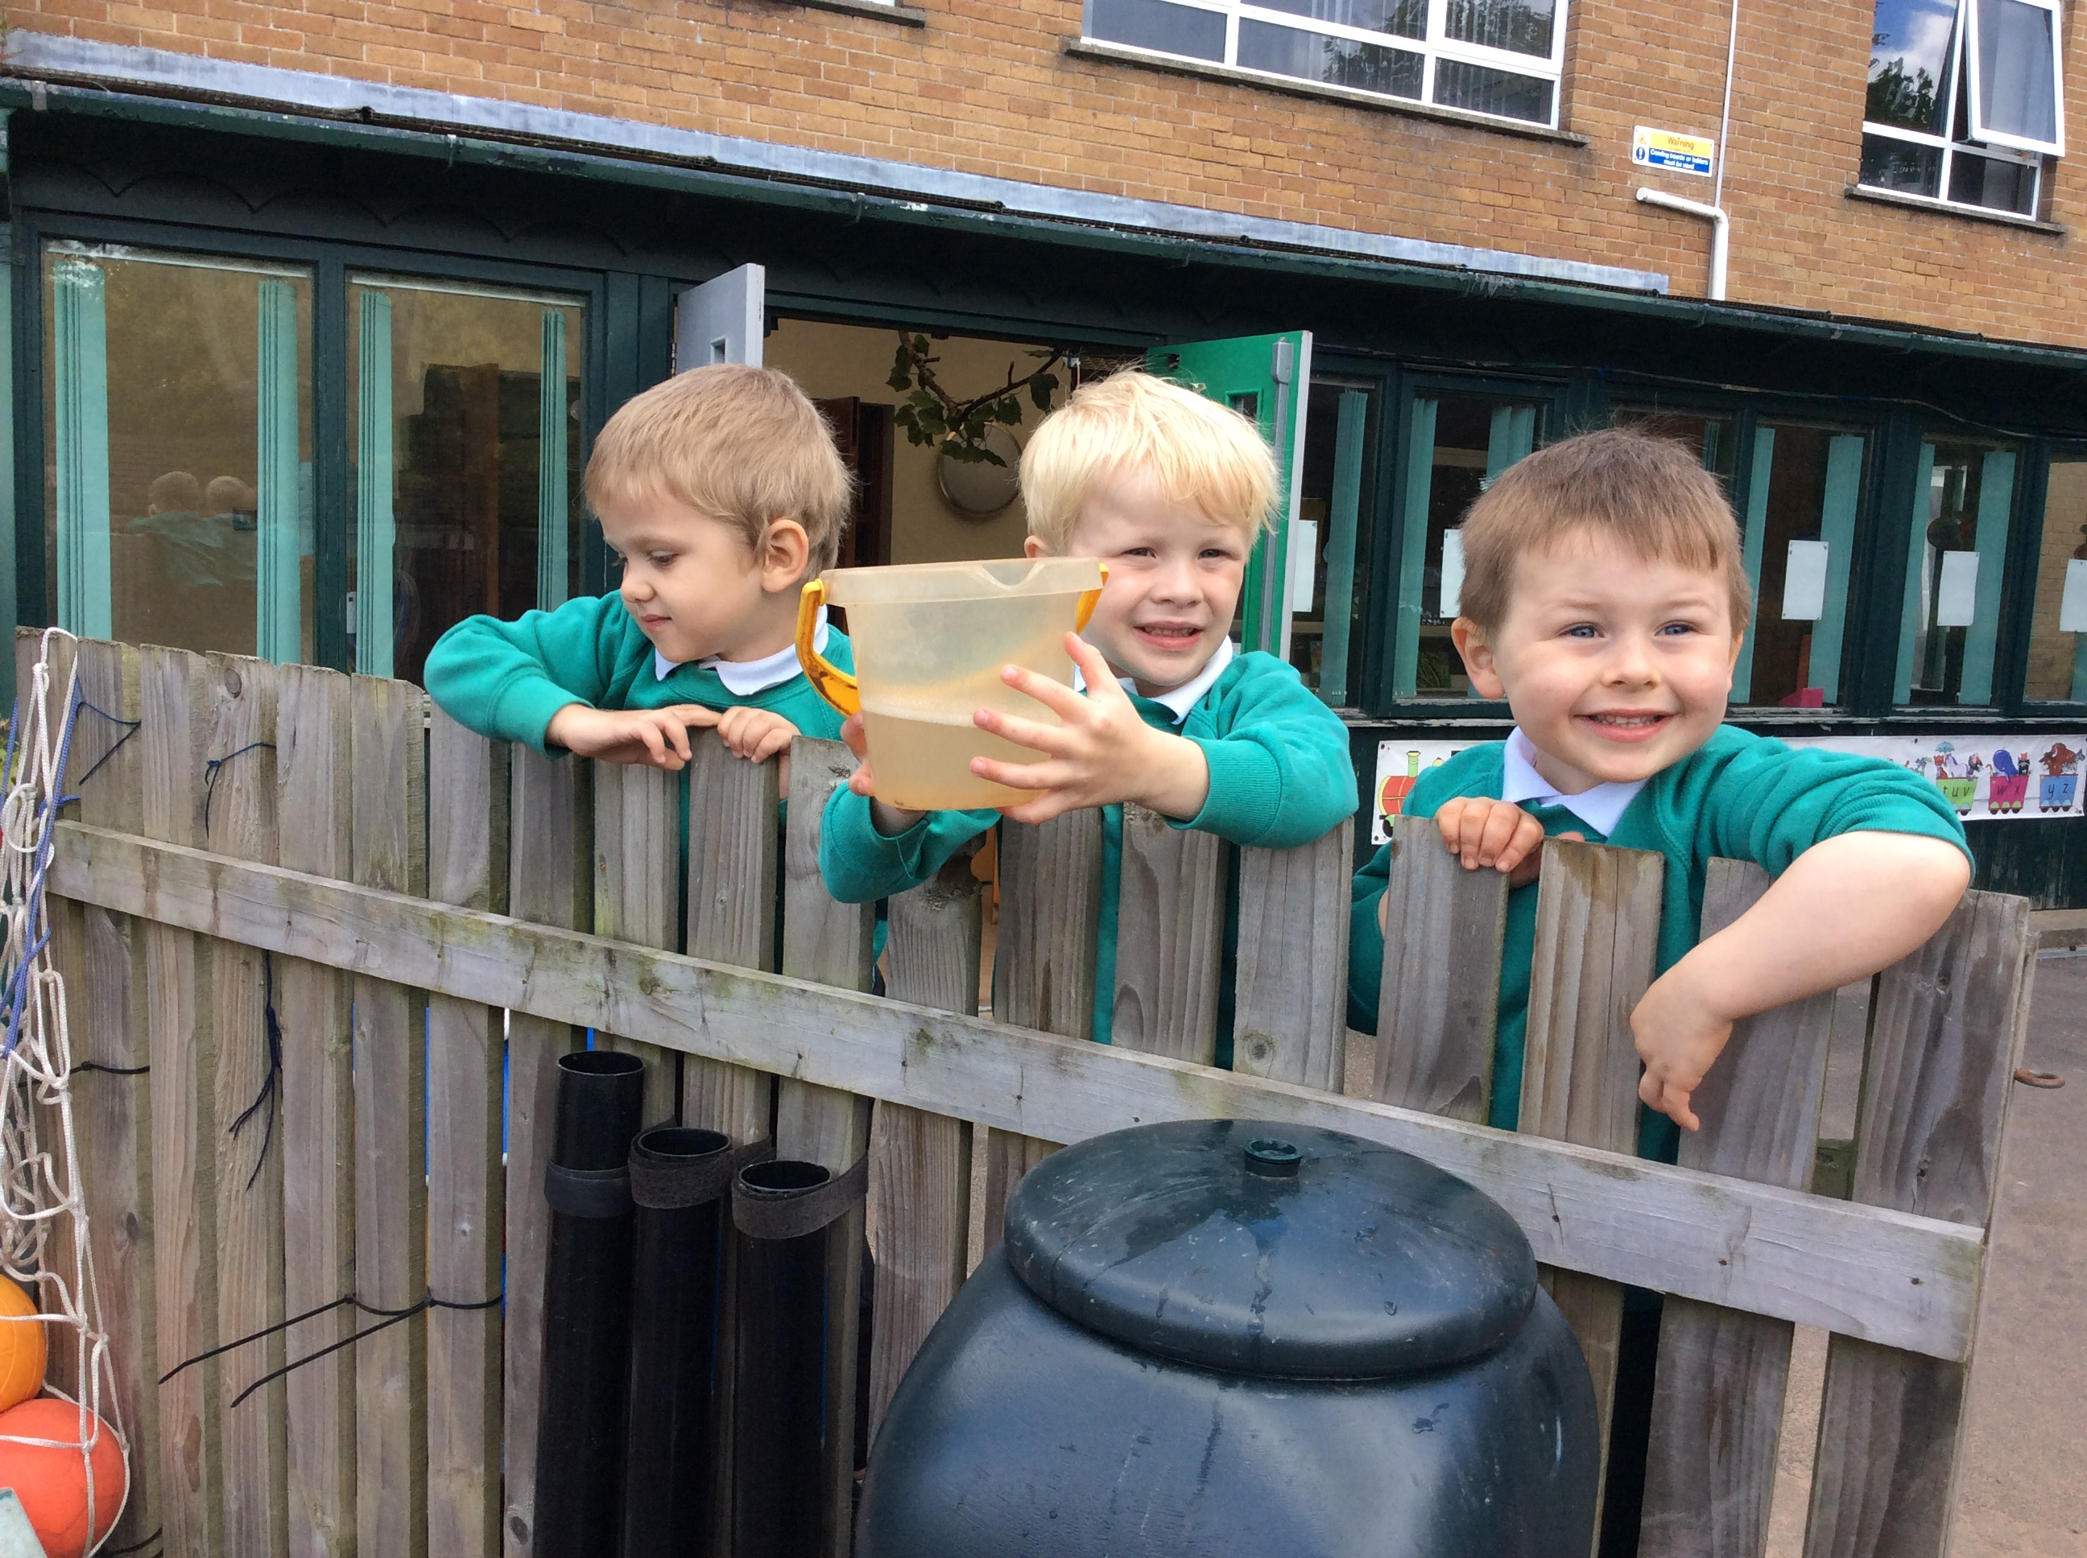
Application Procedure for September 2022
The EA Nursery online portal opens on Monday 10th January 2022 at 12 noon.
The portal closes on Monday 28th January at 12 noon
Birth certificates, proof of identity and benefits must be downloaded via the portal by Friday 4th February 2022

Slide 5
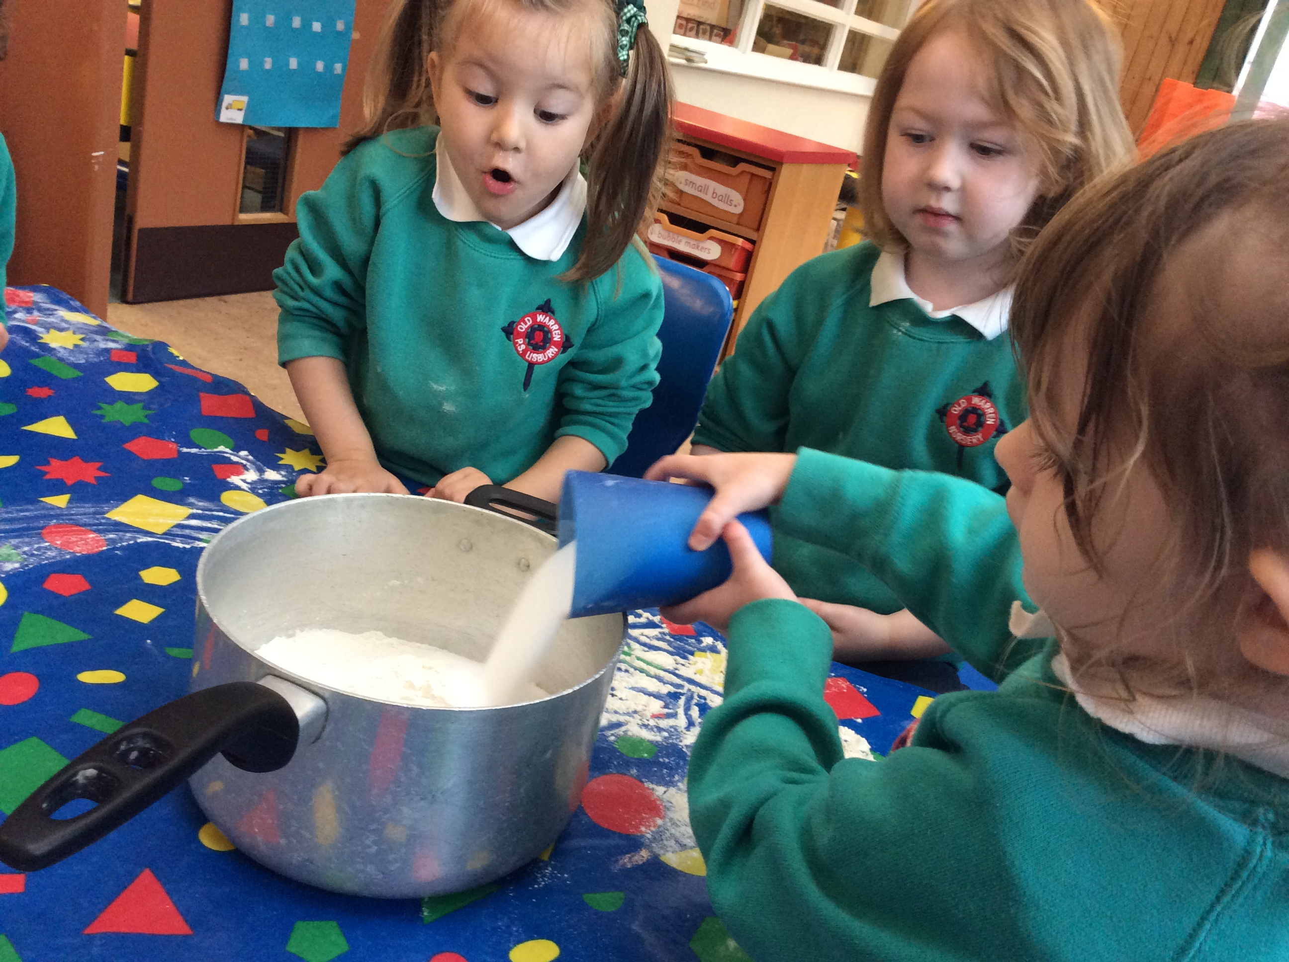
Our Nursery Unit
Mrs Jolly and Mrs Evans are the Nursery teachers
Mrs McAleenon and Nathan Spratt are the Nursery assistants
There are 26 pupils in Nursery
We have a well resourced classroom and safe enclosed outdoor area
The children develop and learn through their play both indoors and outdoors

Slide 6
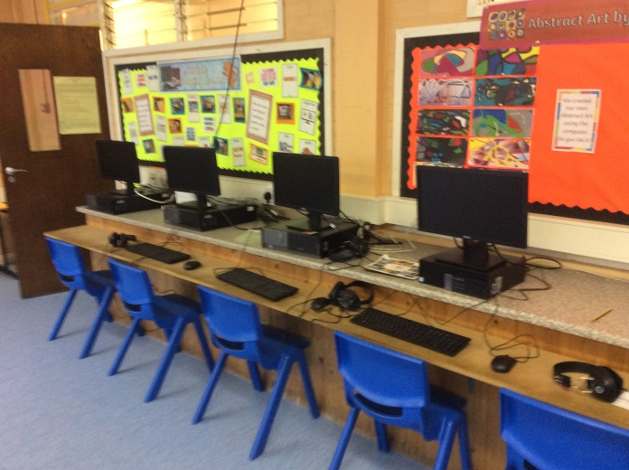
We Are Proud of Our School!
In our school every child matters
Pupils are supported by hardworking and caring staff
Creative curriculum is used to inspire and enthuse
Modern facilities and extensive grounds
Small class sizes

Slide 7
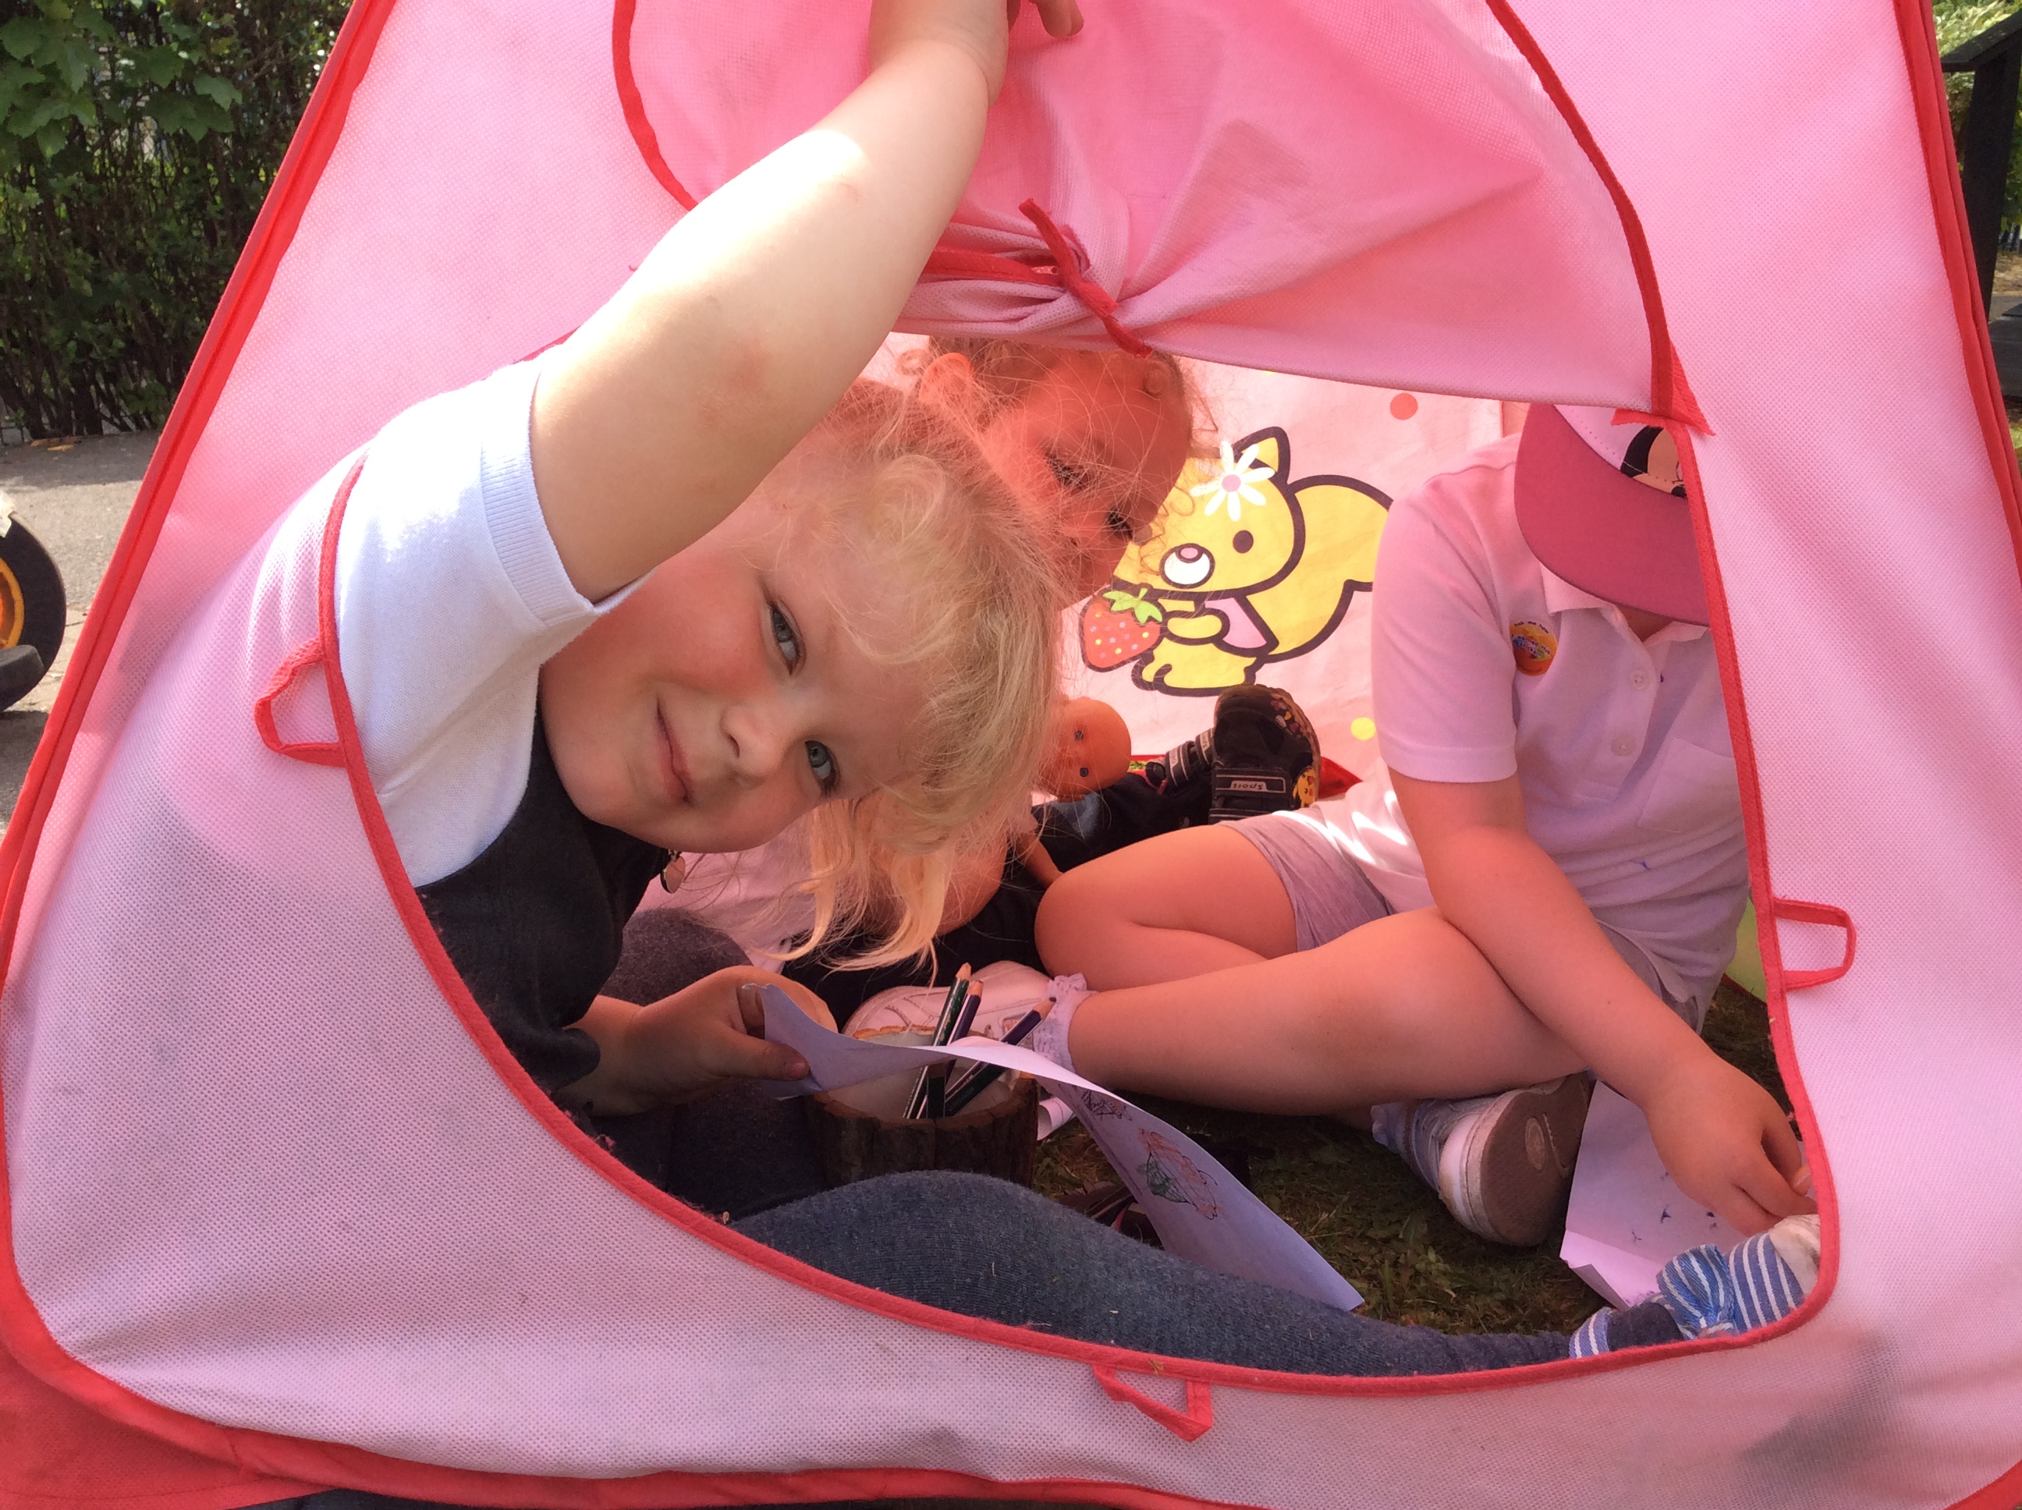
Links with Parents
The Nursery strives to build close relationships with parents
We offer home visits before your child starts nursery
There are three ‘Parent Consultation Meetings’ throughout the year
We regularly share information on how to build on your child’s skills at home
We run ‘Incredible Years Workshops’. The programme is designed to support parents in educating their young children.

Slide 8
Please contact school if you wish to visit the Nursery Unit
The staff will be happy to help with any queries
We hope to see you all in September 2022!

