Slide 1
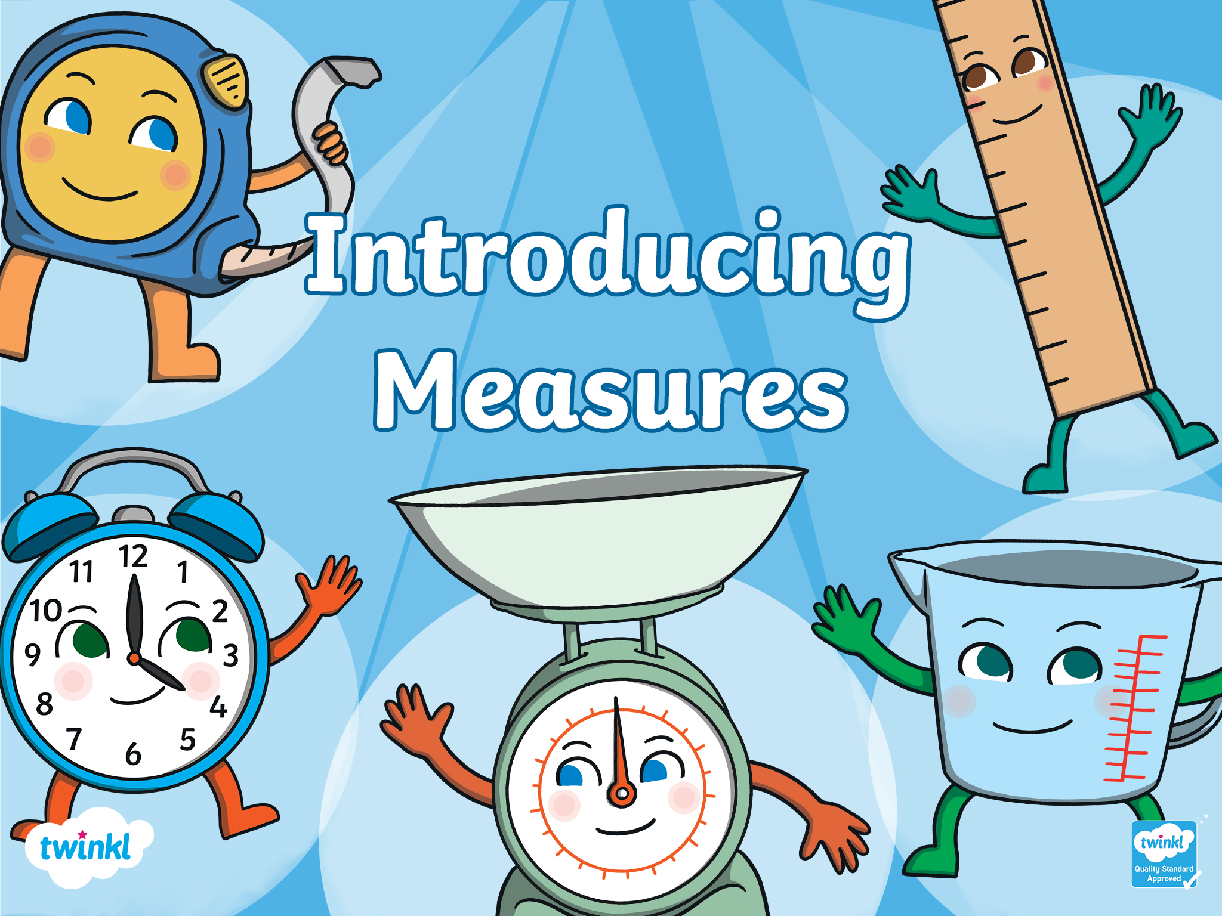

Slide 2

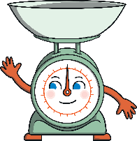
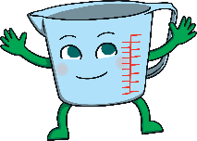
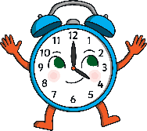
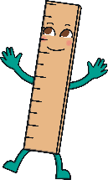
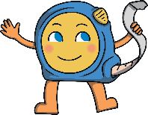

Contents
Weight
Capacity
Time
Length
Height
Quiz

Slide 3


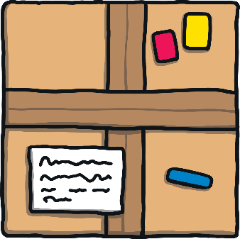
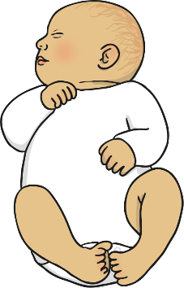

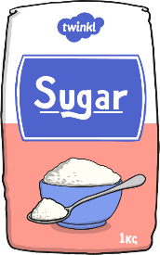
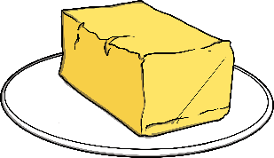
Weight
Can you think of something we might weigh?
Sometimes, we need to measure how much things weigh.
parcel
baby
ingredients
1

Slide 4
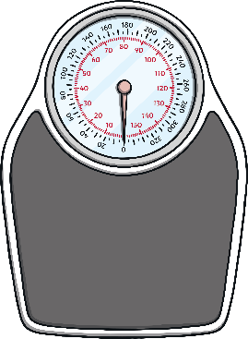
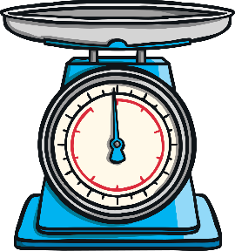
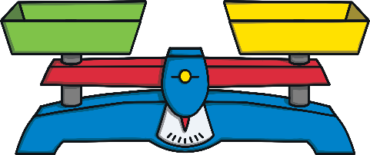
Weight
Can you name any of these weighing tools?
We can use different equipment to measure weight.
balance scale
kitchen scale
bathroom scale
Reveal answers!
2

Slide 5
Weight
We might use these words to talk about weight.
grams
kilograms
heavy
heavier than
heaviest
light
lighter than
lightest
3

Slide 6


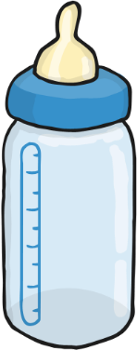

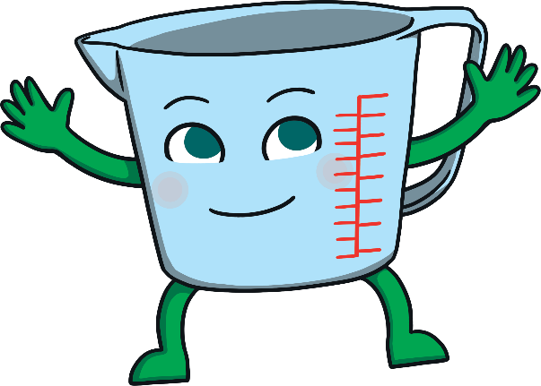
Capacity
water bottle
baby bottle
paddling pool
Can you think of something we might need to measure the capacity of?
Sometimes, we need to measure amounts of liquid, such as water.
1

Slide 7
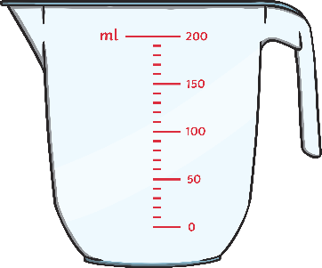
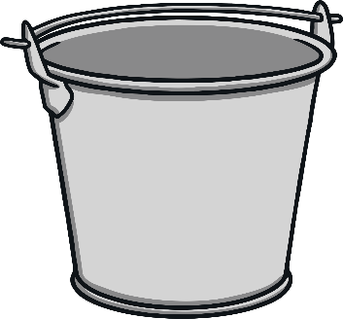

Capacity
measuring jug
bucket
cup
Reveal answers!
Can you name any of these tools for measuring capacity?
We can use different equipment to measure capacity.
2

Slide 8
Capacity
empty
half empty
full
half full
millilitres (ml)
less
nearly full
more
litres (l)
nearly empty
We might use these words to talk about capacity.
3

Slide 9

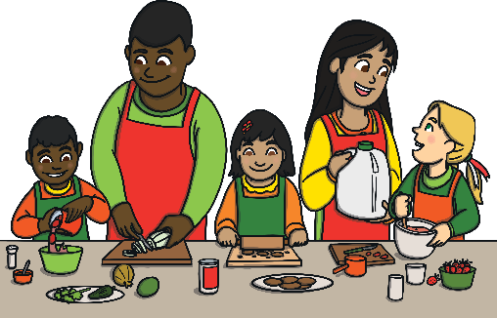
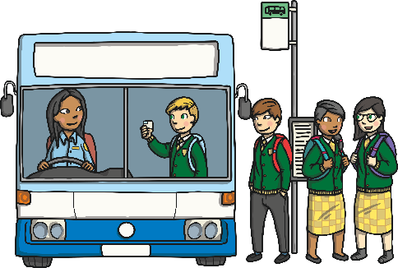
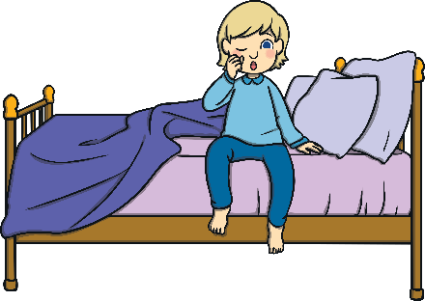

Time
how long dinner takes to cook
getting out of bed
the time you need to catch the bus
We measure time in different ways. Sometimes, we need to measure a short amount of time (such as how long it takes us to do a task) or plan for different events that might happen (such as what time to be at school).
Can you think of something we might need to measure using time?
1

Slide 10
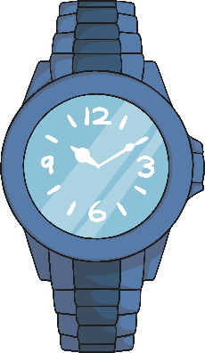
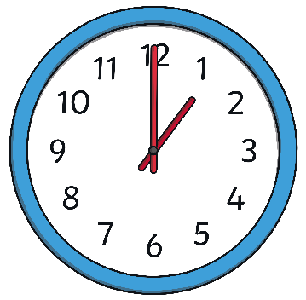
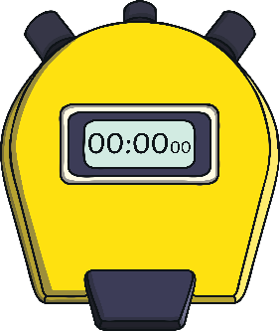
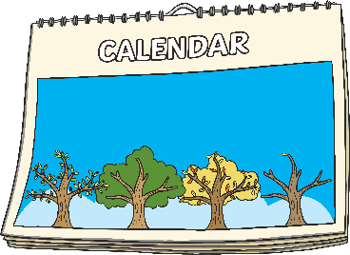
Time
stopwatch
watch
clock
calendar
Reveal answers!
Can you name any of these tools for measuring time?
There are different ways to measure time.
2

Slide 11
Time
day
month
week
second
tomorrow
year
today
minute
hour
yesterday
We might use these words to talk about time.
3

Slide 12


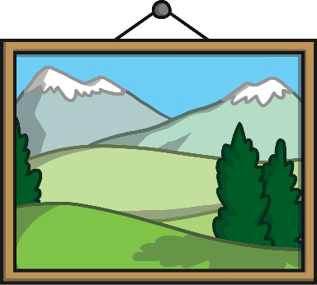


Length
road
book
photo for a frame
Can you think of something we might need to measure the length of?
Sometimes, we need to measure objects or distances to find out how long they are.
1

Slide 13

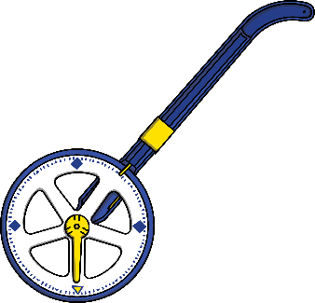
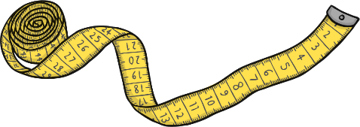

Length
cubes
ruler
measuring tape
trundle wheel
Reveal answers!
Can you name any of these tools for measuring length?
We can use different equipment to measure length.
2

Slide 14
Length
metres (m)
shortest
longer
long
centimetres (cm)
short
longest
shorter
We might use these words to talk about length.
3

Slide 15


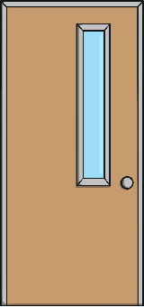
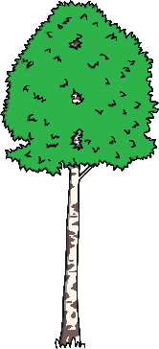

Height
child
door
tree
Can you think of something we might need to measure the height of?
Sometimes, we need to measure objects or people to find out how tall they are.
1

Slide 16

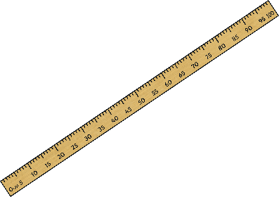
Height
cubes
ruler
measuring tape
metre stick
Reveal answers!
Can you name any of these tools for measuring height?
We can use different equipment to measure height.
2

Slide 17
Height
metres (m)
shortest
taller
tall
centimetres (cm)
short
tallest
shorter
We might use these words to talk about height.
3

Slide 18

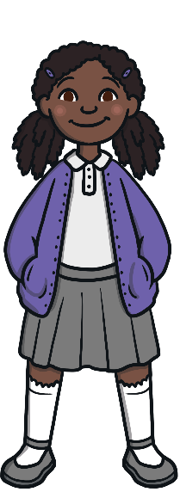
Let’s check what we can remember!
bathroom scale
What would you use to measure how tall you are?
Try again.
Well done!
measuring tape
1
2
3
4
5

Slide 19
Let’s check what we can remember!
ruler
What would you use to weigh ingredients to bake a cake?
Try again.
Well done!
kitchen scale
2

Slide 20
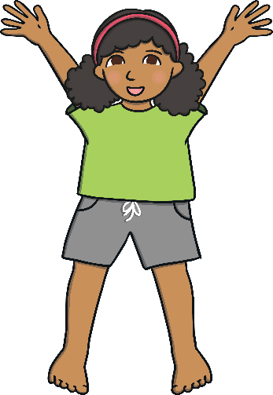
Let’s check what we can remember!
stopwatch
Try again.
What would you use to time how long it takes you to do ten jumps?
measuring jug
Well done!
3

Slide 21

Let’s check what we can remember!
bathroom scale
Try again.
What would you use to find out how much water is in your bottle?
Well done!
measuring jug
4

Slide 22

Let’s check what we can remember!
clock
Try again.
What would you use to measure the length of the book?
Well done!
ruler
5

Slide 23





Well done!

Slide 24
