Slide 1
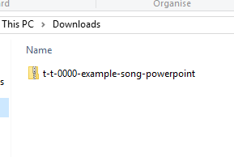
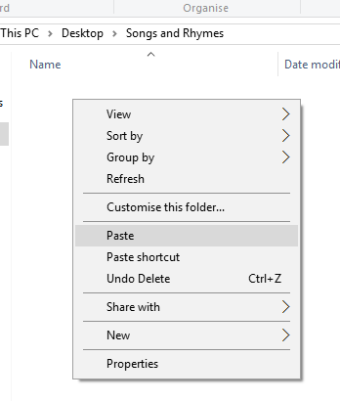


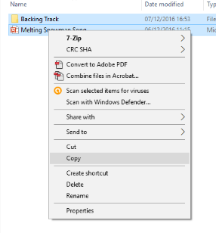
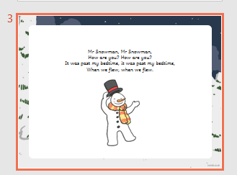
Guidance for Video/Audio in PowerPoints
1. Open the folder and copy all the files.
2. Paste the copied files into a new folder.
3. Open the PowerPoint file, enable editing and enter presentation mode (start the slide show). Go to slide 3 and the backing track will start automatically.
Please note the embedded audio may not be compatible with early versions of PowerPoint.
You may wish to delete this slide before beginning the presentation.

Slide 2
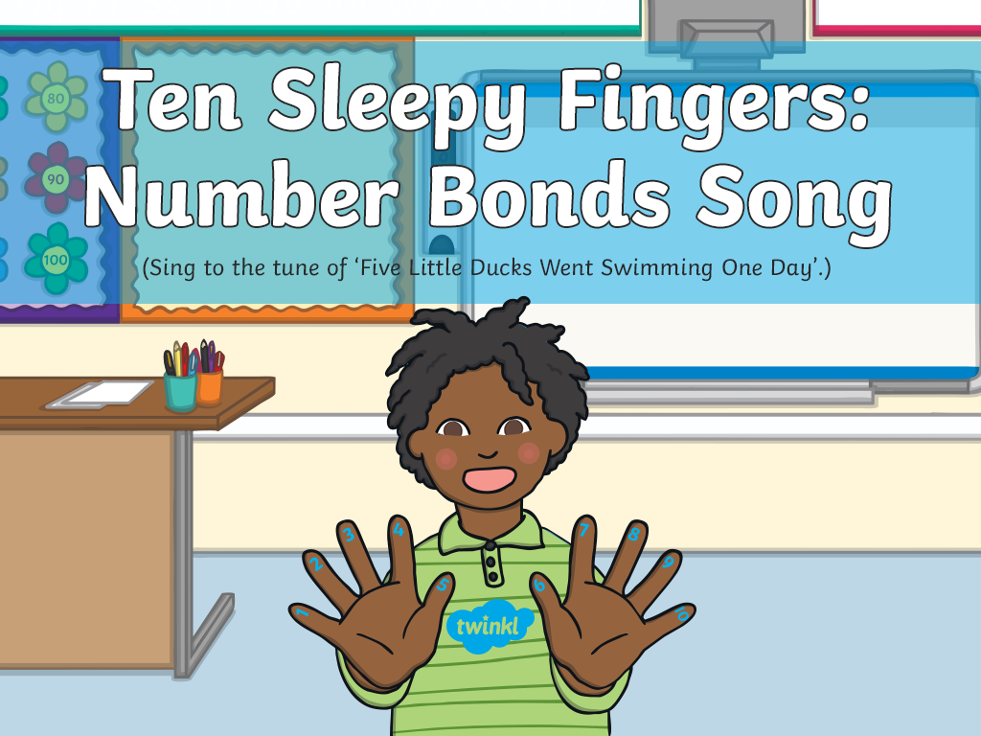

Slide 3


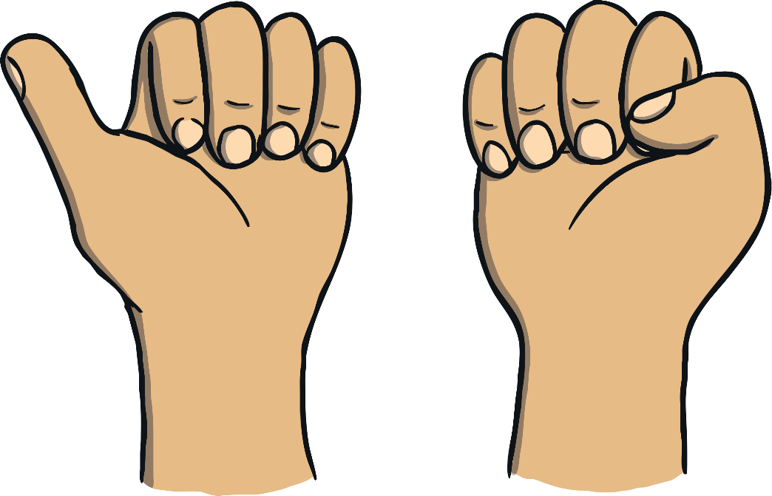

10 sleepy fingers are curled up so small,
All getting ready to stand up tall!
Number one says: “Let’s have some fun!”
9 are sleeping and awake is 1.
1

Slide 4
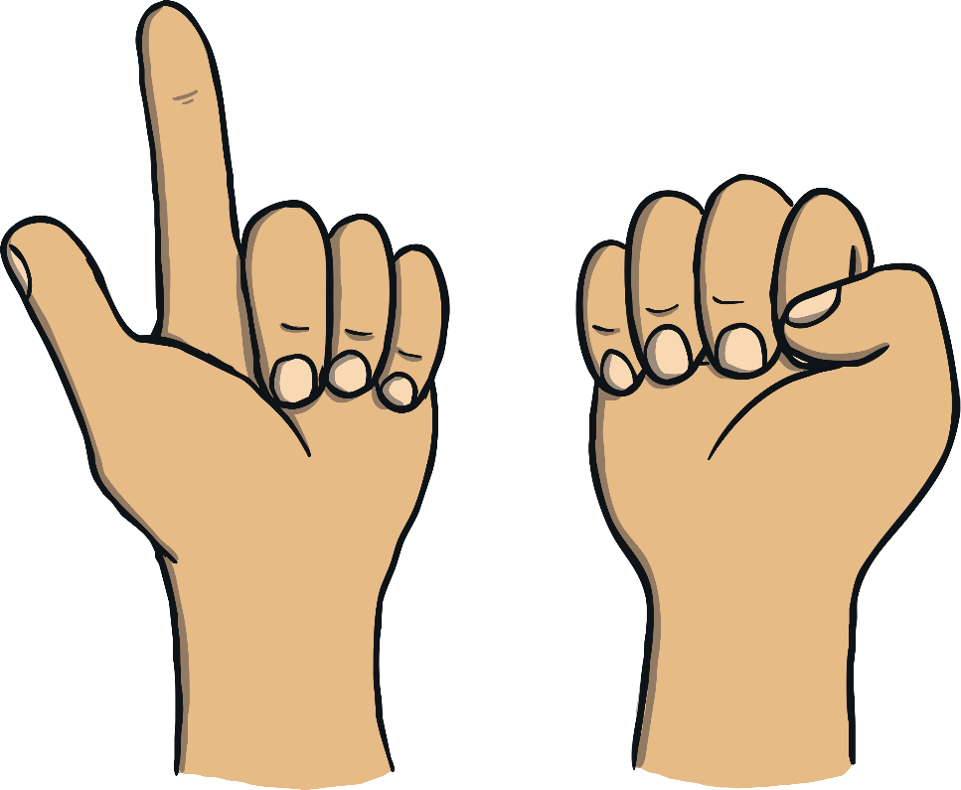
9 sleepy fingers are curled up so small,
All getting ready to stand up tall!
One of them says, “I’ll stand with you”,
8 are sleeping and awake are 2.
2

Slide 5
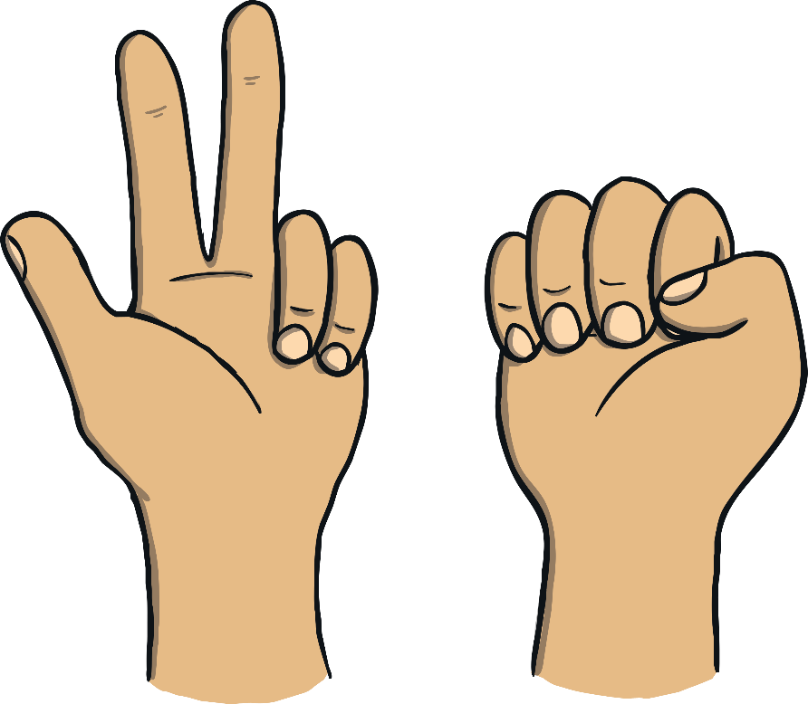
8 sleepy fingers curled up so small,
All getting ready to stand up tall!
One of them says, “Come play with me”,
7 are sleeping and awake are 3.
3

Slide 6
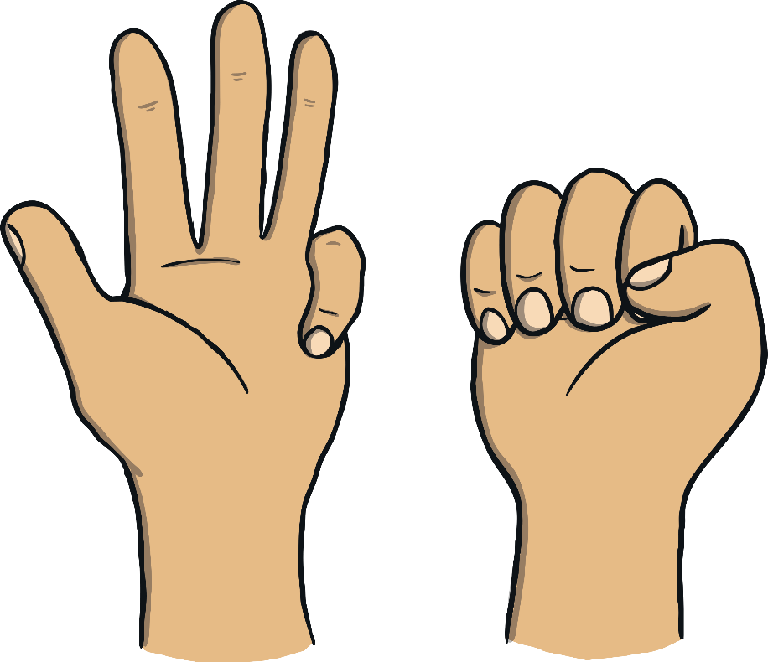
7 sleepy fingers are curled up so small,
All getting ready to stand up tall!
One of them says, “No time to snore!”,
6 are sleeping and awake are 4.
4

Slide 7
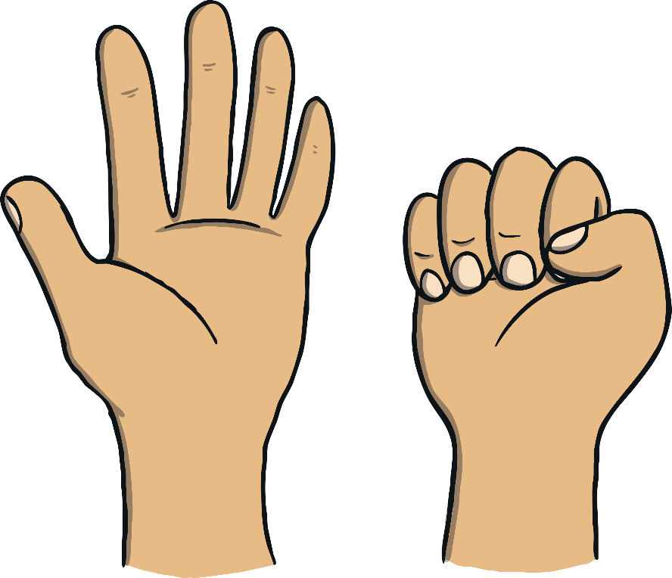
6 sleepy fingers are curled up so small,
All getting ready to stand up tall!
One of them says, “I feel alive!”,
5 are sleeping and awake are 5.
5

Slide 8

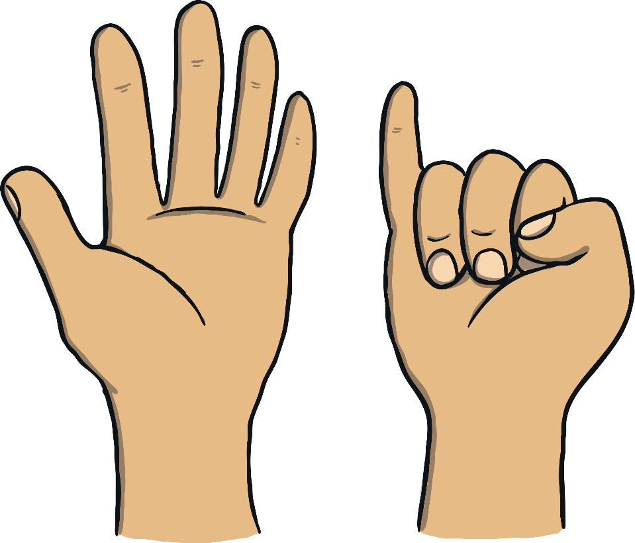
5 sleepy fingers curled up so small,
All getting ready to stand up tall!
One of them says, “It’s time for tricks!”,
4 are sleeping and awake are 6.
6

Slide 9

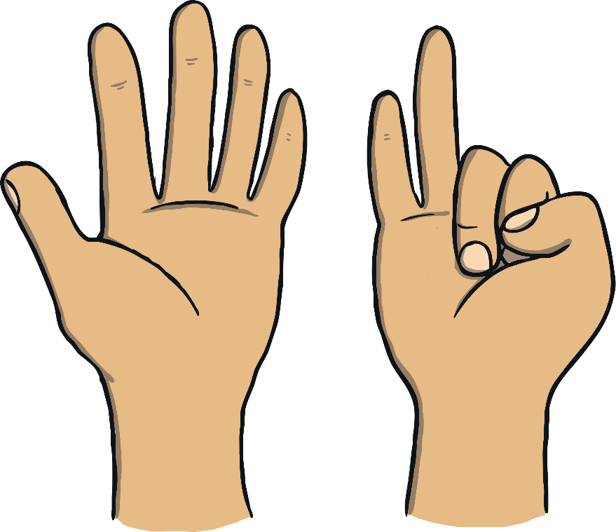
4 sleepy fingers are curled up so small,
All getting ready to stand up tall!
One of them says, “I’m number 7!”,
3 are sleeping and awake are 7.
7

Slide 10
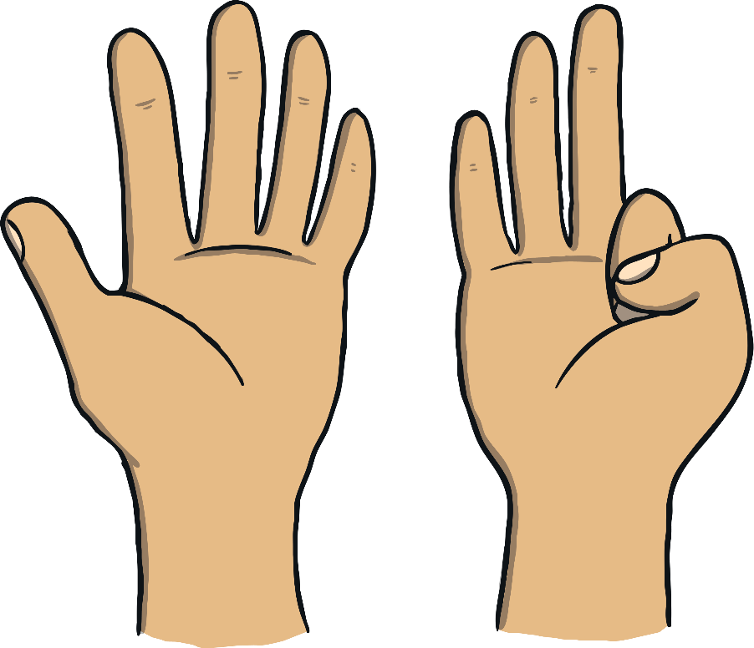

3 sleepy fingers are curled up so small,
All getting ready to stand up tall!
One of them says, “I’m feeling great!”,
2 are sleeping and awake are 8.
8

Slide 11
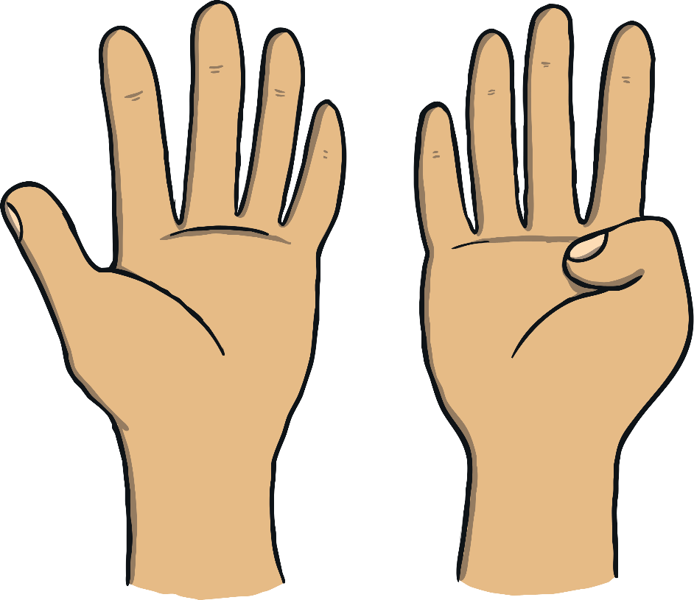

2 sleepy fingers are curled up so small,
All getting ready to stand up tall!
One of them says, “I’ll join the line”,
1 is sleeping and awake are 9.
9

Slide 12
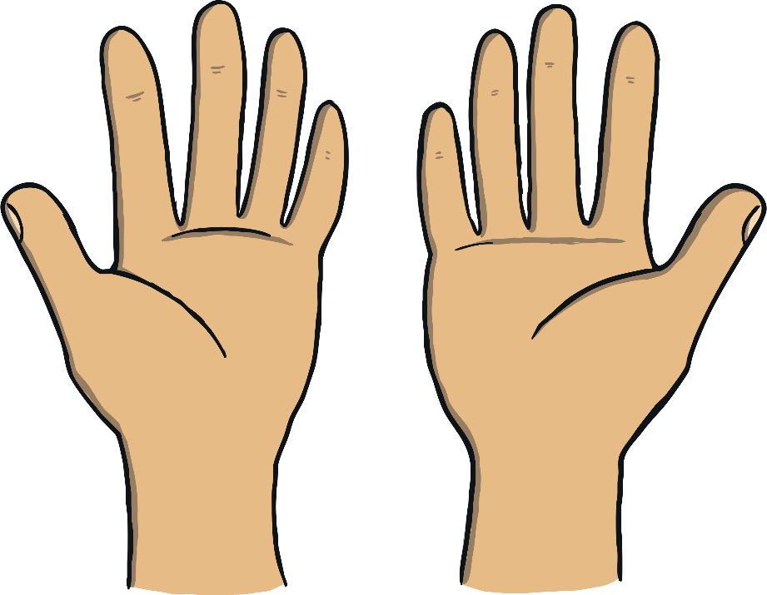

1 sleepy finger is curled up so small,
All getting ready to stand up tall!
One of them says, “I’m awake again!”,
None sleeping and awake are 10.
10

