Slide 1
Angle sizes

Slide 2
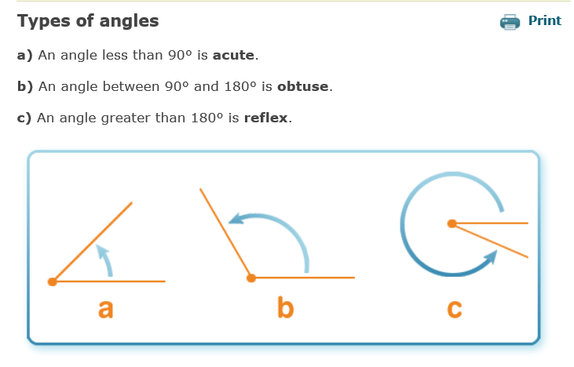

Slide 3
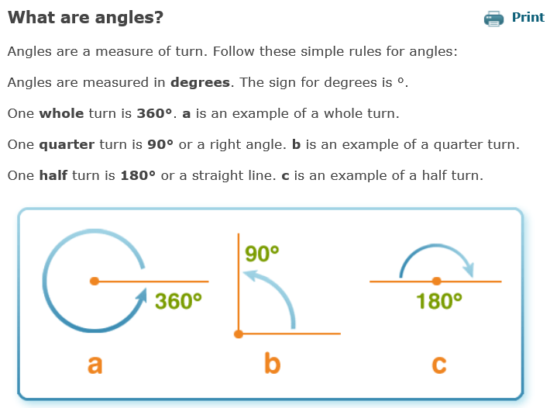

Slide 4
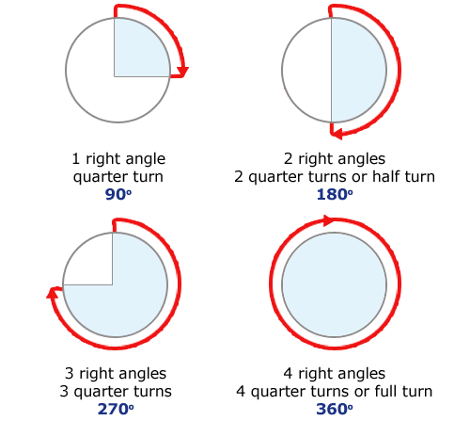

Slide 5
P6 & P7 Pupils Problem-solving

Slide 6

How many degrees between 12 and 3?

Slide 7
How many degrees between 12 and 3?
90º

Slide 8

How many degrees between 12 and 2?

Slide 9
How many degrees between 12 and 2?
60º

Slide 10

How many degrees between 11 and 12?
30º

Slide 11
How many degrees between 11 and 12?

Slide 12

How many degrees between 8 and 12?

Slide 13
How many degrees between 8 and 12?
120º

Slide 14

How many degrees between 12 and 5?

Slide 15
How many degrees between 12 and 5?
150º

Slide 16

How many degrees between 3 and 12?

Slide 17
How many degrees between 3 and 12?
270º

Slide 18

How many degrees between 12 and 7?

Slide 19
How many degrees between 12 and 7?
210º

Slide 20
P7 Pupils
Problem-solving

Slide 21

How many degrees in one sector?
Remember:
there are 360º in a full turn
There are 6 sectors

Slide 22
How many degrees in one sector?
360 ÷ 6 = 60º

Slide 23

How many degrees in one sector?

Slide 24
How many degrees in one sector?
360 ÷ 10 = 36º

Slide 25

How many degrees in one sector?

Slide 26
How many degrees in one sector?
45º

Slide 27
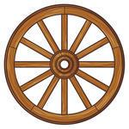
How many degrees in one sector?

Slide 28
How many degrees in one sector?
36 ÷ 12 = 3º
^{so}
360 ÷ 12 = 30º

Slide 29


How many degrees in one sector?
You can use a calculator to help you!

Slide 30
How many degrees in one sector?
360 ÷ 16 = 22.5º

