Slide 1
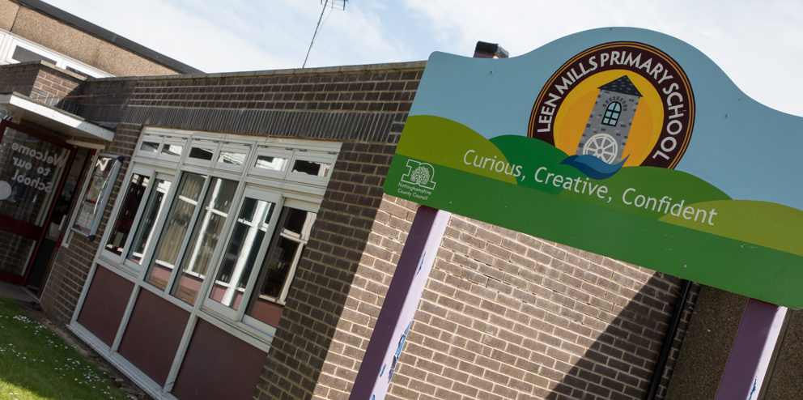
Vision

Slide 2
Leen Mills Primary School
Curious
Creative
Confident

Slide 3
Curious
How do we create Curious learners at Leen Mills?
Allowing children to talk and ask questions – move towards no hands up and the children talking in pairs. We value what all pupils have to say
Exciting lessons across the curriculum that they want to know more about – we plan for our children, not just do it like the year before. We ask would I want to be in this lesson?
Creating a safe space where children feel they can ask questions and we notice when children are puzzled or stuck – our marking is on the spot and helpful and we model asking questions.

Slide 4
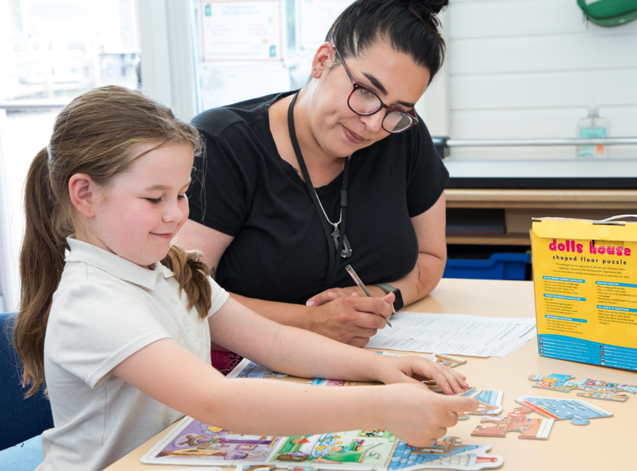
Creative
How do we create creative learners at Leen Mills?
We embrace the arts and STEM – it is celebrated in school – all children have this chance.
Our lessons across the curriculum allow children to use their imagination – our questioning allows children to think for themselves.
We provide teaching that provides children with the ability to identify and solve problems – go Ape days, Go APE activities, problem solving.

Slide 5
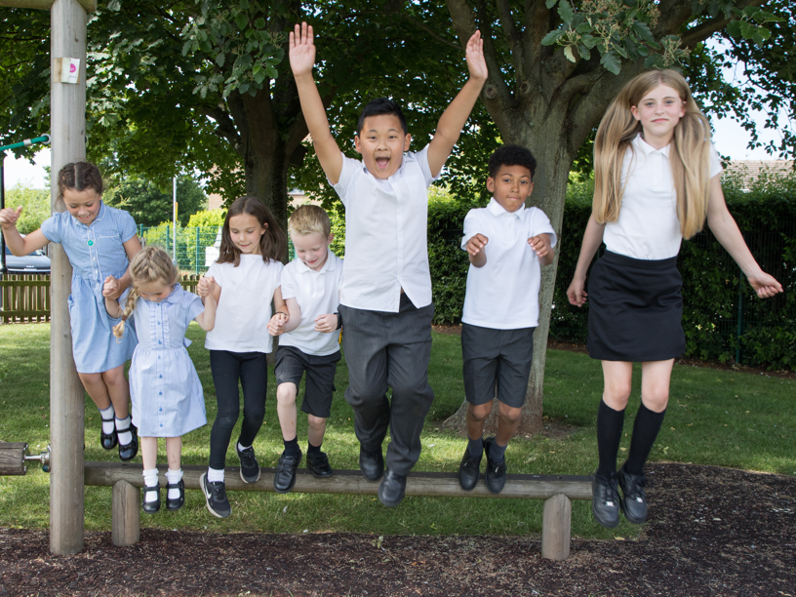
Confident
How do we develop confident learners at Leen Mills?
We value and celebrate all – British values, RE days etc…
A behaviour system that is inclusive and allows all to flourish – we value children and their achievements
Our assessment system allows us to see where gaps are and act on them quickly – children feel confident moving on.
Teachers who are experts in their field work with children who show a passion for their subject

