Slide 2

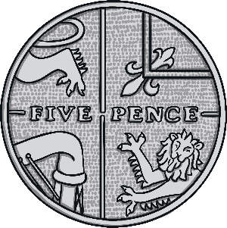
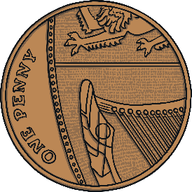
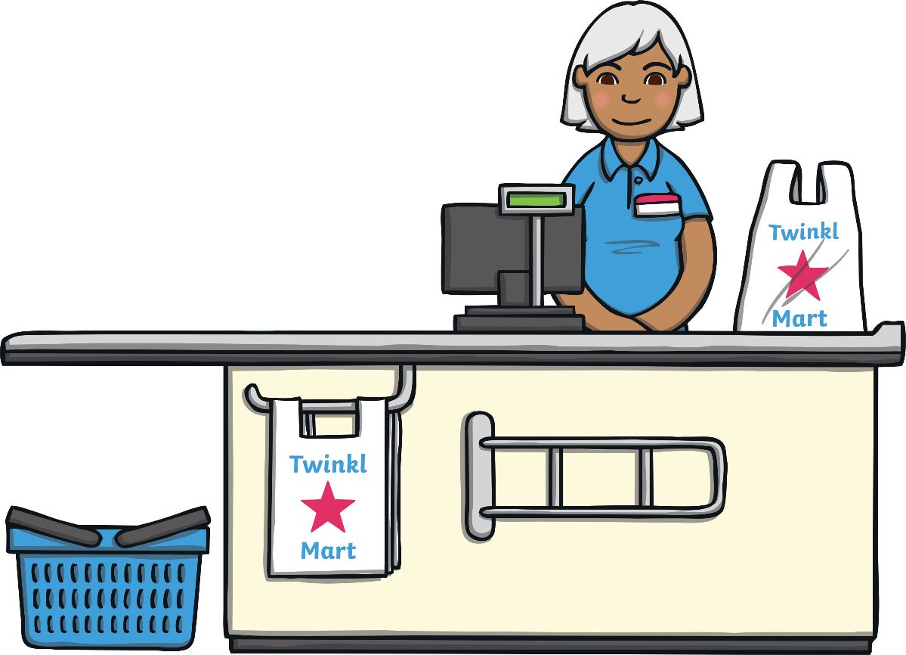



I bought an apple for 12p.
I paid using a 20p coin.
What is my change?
Use coins to make my change.
Can you think of another way of making 8p?
Answer
12p
Try counting up
from 12 to 20.
Hint

Slide 3
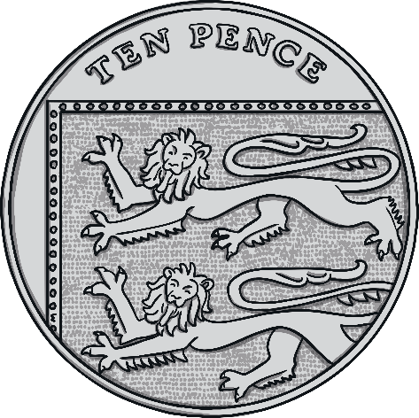

I bought a toy train for 4p.
I paid using a 20p coin.
What is my change?
Use coins to make my change.
Can you think of another way of making 16p?
Answer
4p
Try taking 4
away from 20.
Hint

Slide 4

I bought a T-shirt for 10p.
I paid using a 20p coin.
What is my change?
Use coins to make my change.
Can you think of another way of making 10p?
10p
Answer
Use your knowledge of halves to solve this one.
What is half of 20?
Hint

Slide 5

I bought a ruler for 5p.
I paid using a 20p coin.
What is my change?
Use coins to make my change.
Can you think of another way of making 15p?
Answer
5p
Try counting up from 15 to 20.
Hint

Slide 6

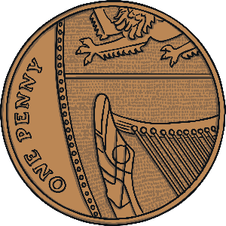

I bought a teddy for 2p.
I paid using a 20p coin.
What is my change?
Use coins to make my change.
Can you think of another way of making 18p?
2p
Answer
Try counting back 2 from 20.
Hint

Slide 7

I bought a pencil for 9p.
I paid using a 20p coin.
What is my change?
Use coins to make my change.
Can you think of another way of making 11p?
9p
Answer
Try counting up from 9 to 20. This could be easier if you count to the next ten, then add in tens until you reach the answer.
Hint

Slide 8
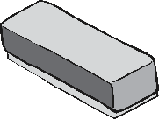
I bought a rubber for 18p.
I paid using a 20p coin.
What is my change?
Use coins to make my change.
Can you think of another way of making 2p?
Answer
18p
Try counting up from 18 to 20.
Hint

Slide 9
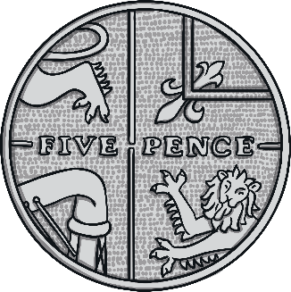

I bought a ball for 14p.
I paid using a 20p coin.
What is my change?
Use coins to make my change.
Can you think of another way of making 6p?
Answer
14p
How many more is it from 14 up to 20?
Hint

Slide 10

I bought a sweet for 7p.
I paid using a 20p coin.
What is my change?
Use coins to make my change.
Can you think of another way of making 13p?
Answer
7p
How many more is it from 7 to 10? Then, how many is it from 10 to 20? Add the two numbers together.
Hint

Slide 11
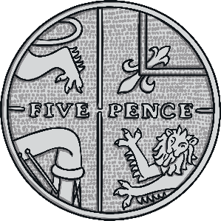

I bought a yo-yo for 5p.
I paid using a 20p coin.
What is my change?
Use coins to make my change.
Can you think of another way of making 15p?
Answer
5p
Use the sum 20-5= to work out the answer.
Hint

