Slide 2

The Sun
The sun gives off different types of energy.
Do you know what types of energy the sun gives off?
Invisible infrared radiation which makes us feel warm.
Visible light which we can see.
Ultraviolet radiation which we can’t see or feel on our skin but can damage our skin if we get too much of it.

Slide 3
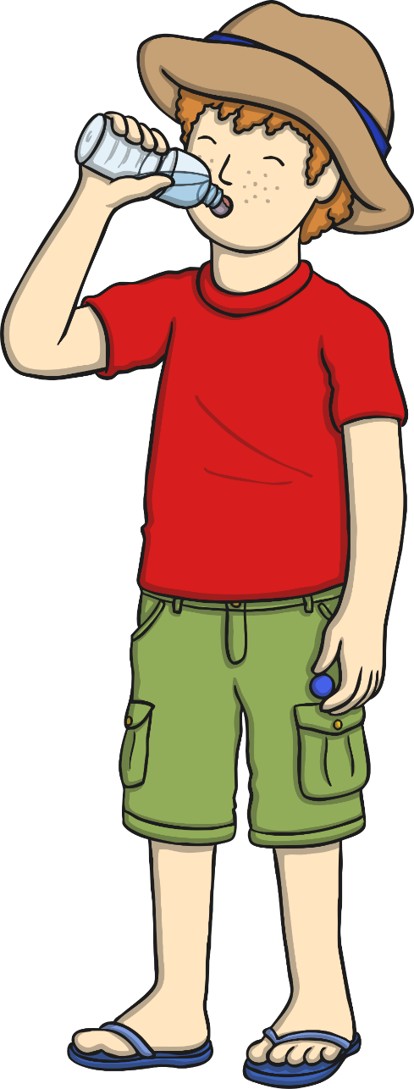
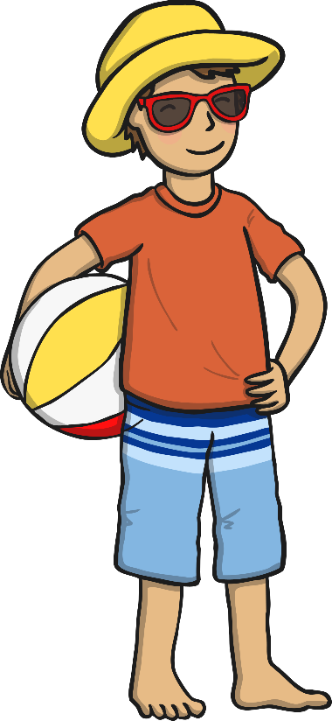
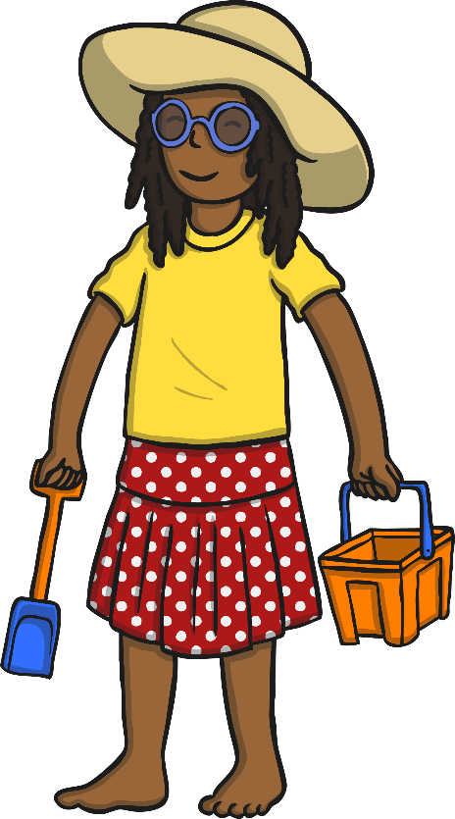
Your Skin and UV Rays
Being outside in the sunshine can be great fun, but because of the damage UV rays can do, we need to make sure that we protect our skin from
the sun.
If you’ve got fair skin, or moles and freckles, you’ll need
to take extra care to protect your skin.
What kind of skin do you have?

Slide 4

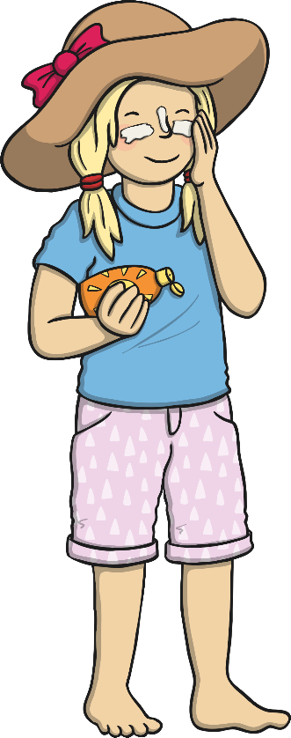
Sun Safety Code
Spending too much time in the sun can be harmful.
We should all follow a special code which reminds us how to enjoy the sun whilst staying safe.
There are five parts to remember…
Be SMART!
Spend time in the shade between 11am and 3pm.
Make sure you never burn.
Aim to cover up with a hat, t-shirt and sunglasses.
Remember children need to take extra care.
Then use sunscreen of a minimum of SPF 30.

Slide 5

Spend Time in the Shade between 11 and 3
You can help to look after your skin by spending time in the shade when the sun is at its strongest - between 11am and 3pm.
Where can you find shade?
You can find shade under trees,
canopies, umbrellas, or indoors.

Slide 6
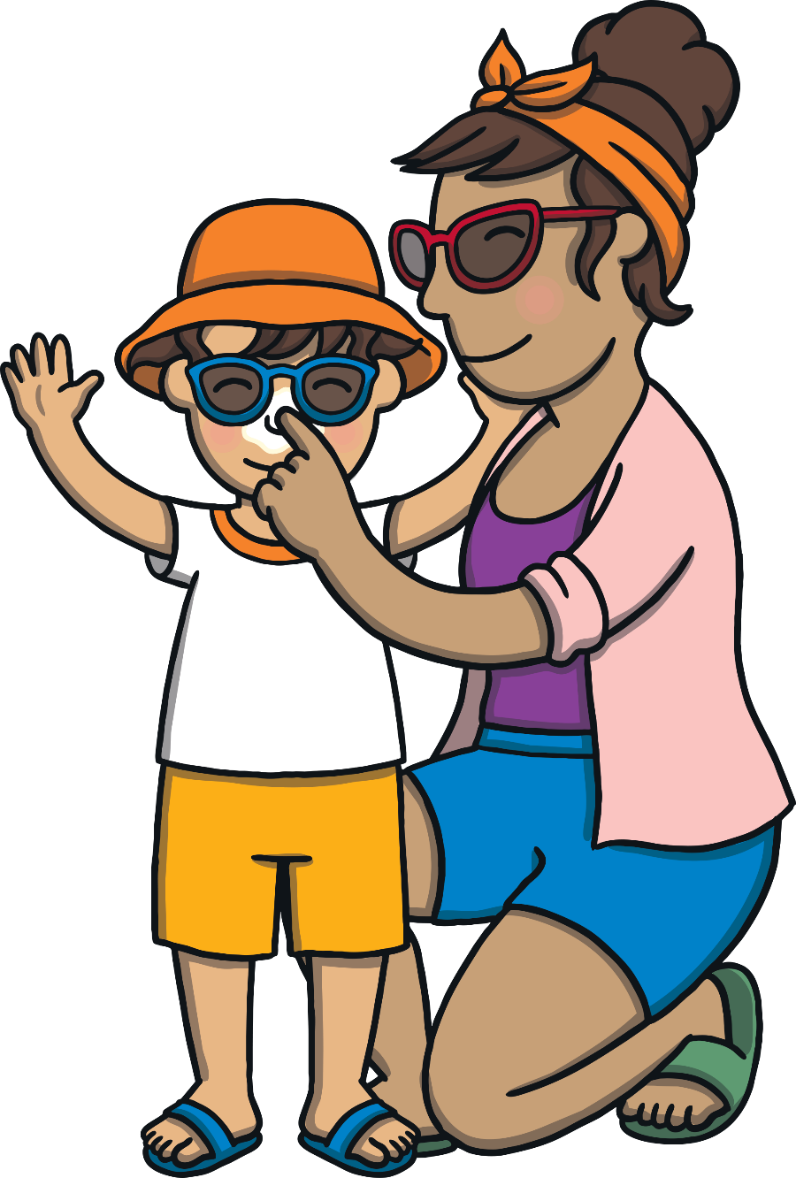
Make Sure You Never Burn
It’s easy to get sunburnt, even when you’re not expecting to.
It’s very important to avoid burning your skin.
Because you can’t feel UV rays, it’s easy
to forget that they are there.
Remember
You can still burn on a cloudy day.

Slide 7


Aim to Cover up with a T-Shirt, Hat and Sunglasses
A hat with a wide brim will shade your face and neck.
Sunglasses can help to protect your eyes from UV rays.
Covering up with a T-shirt is a good way to protect your shoulders and upper arms.

Slide 8
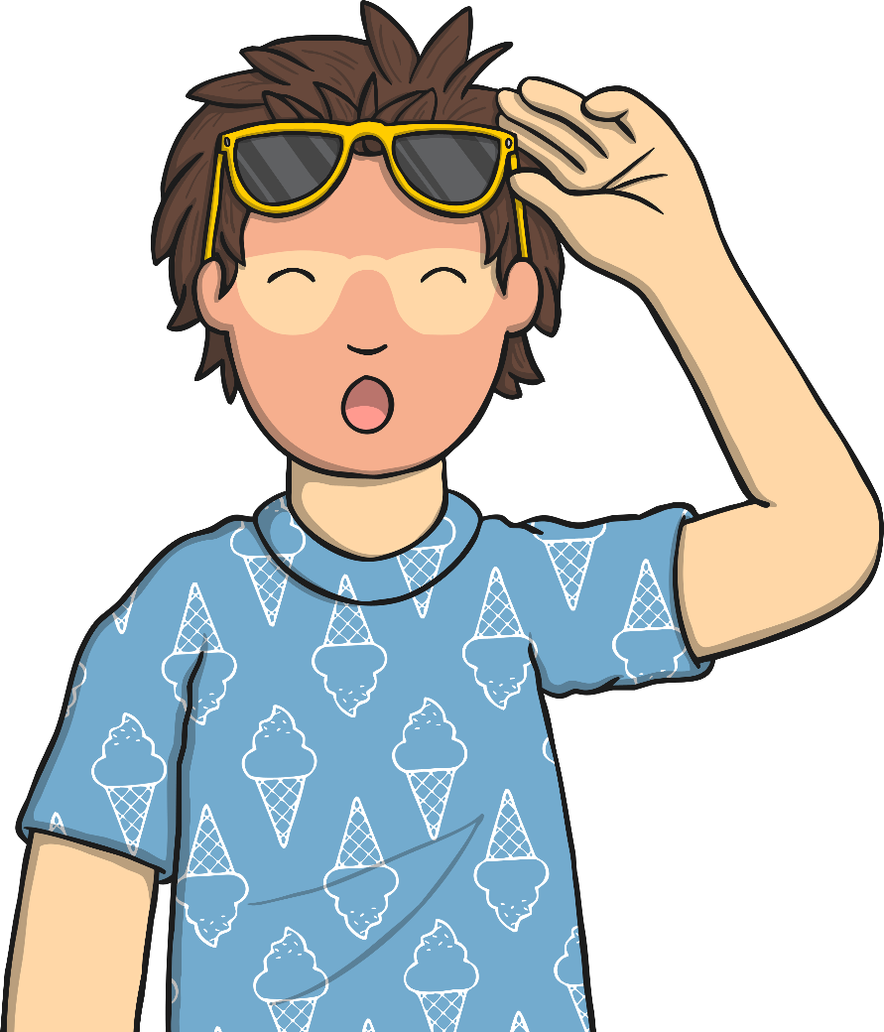
Remember, Children Need to Take Extra Care
Young skin is very delicate and easily damaged by the sun.
Make sure you take extra care to protect
yourself when playing outside or if you
are swimming outside.
If you have any young brothers or sisters,
make sure that they are protected from the sun too!

Slide 9
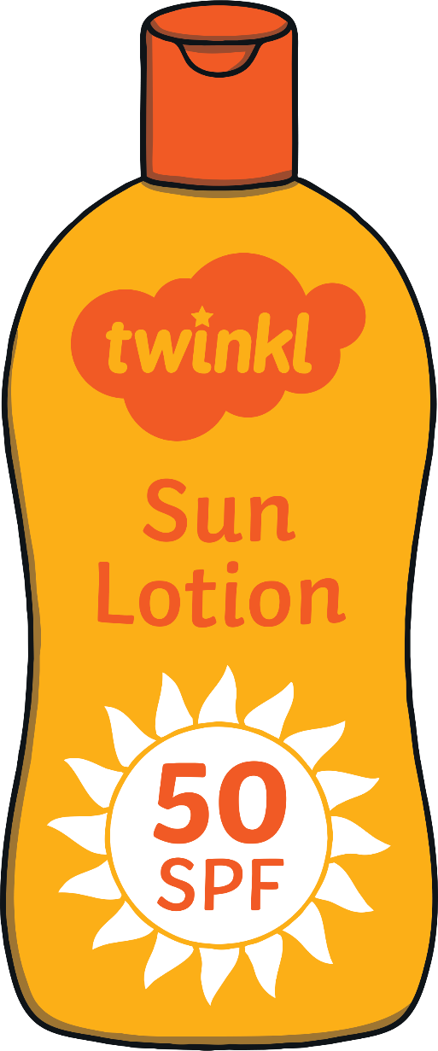
Use Sunscreen of a Minimum of SPF 30
Sometimes, you may be outside in the sunshine and
here won’t be enough shade or clothing protecting
you from the sun.
This is when factor 30 sunscreen, or stronger, should
be used to protect parts of your skin that the sun
can reach.
The factor of a sunscreen describes the amount of
Sun Protection Factor (SPF) it provides. The SPF factor
describes the strength of is the sunscreen's ability to
prevent UVB from damaging the skin. SPF 30 provides
30 times more protection from the sun than your
natural skin.
3

Slide 10
True or False?
You can’t get sunburnt on a cloudy day.
FALSE
Some UV rays still travel through thin cloud so you need to make sure you are protecting your skin, even when it doesn’t seem sunny.
Even if the sun doesn’t feel hot you can still get sunburnt.
TRUE
You can still burn on a cool day in summer.

Slide 11
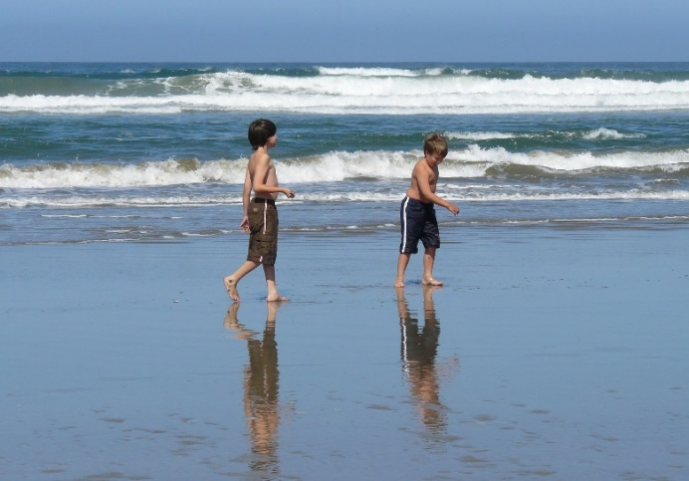
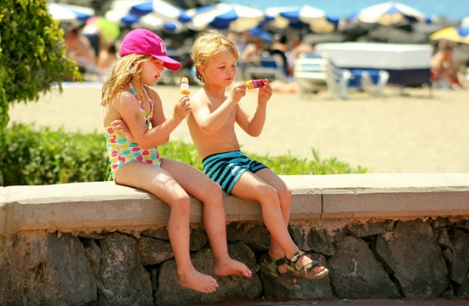
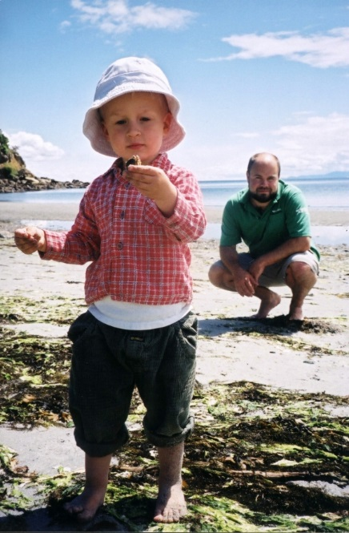
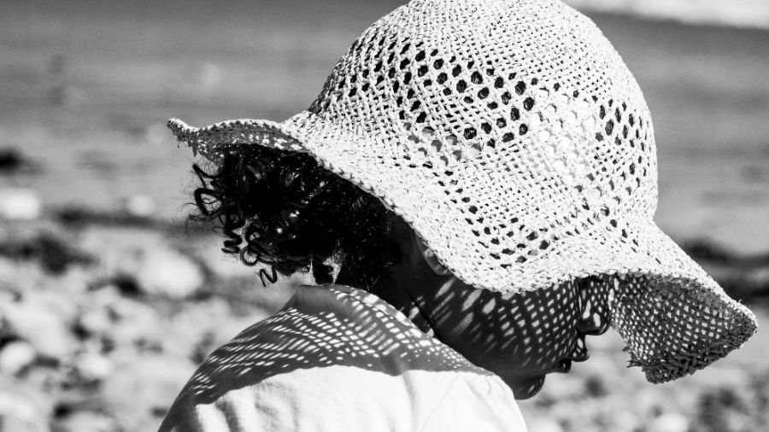
Are These Children Being Safe in the Sun?

