Slide 1
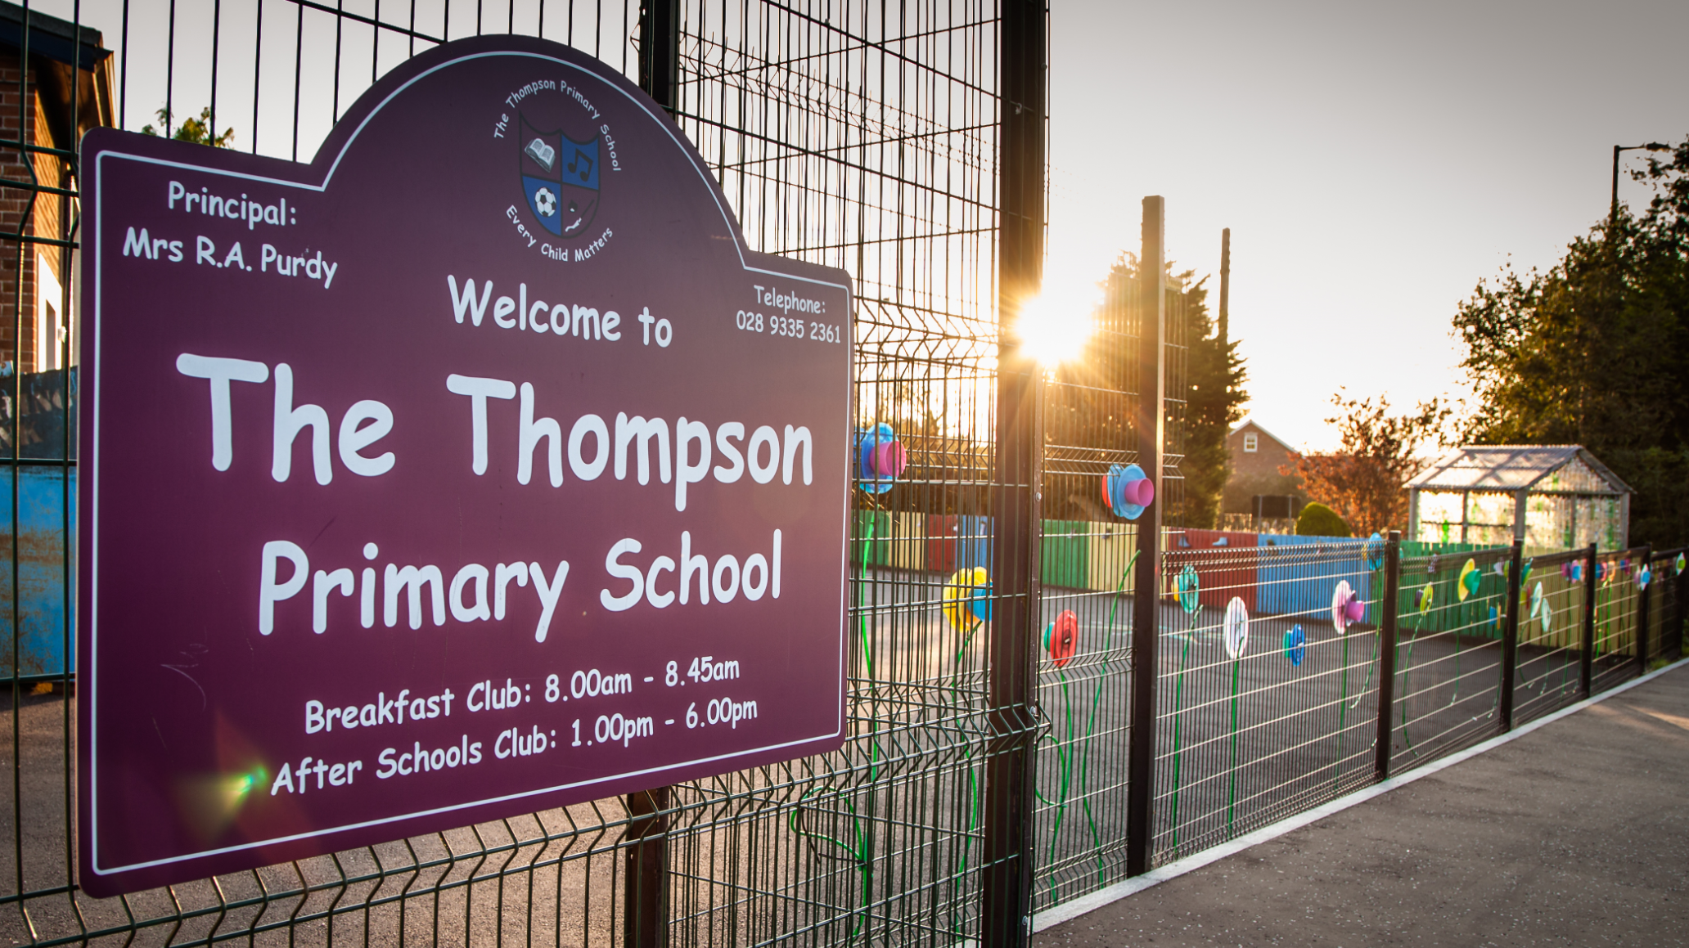
Ten Good Reasons to Become Part of The Thompson Primary
5

Slide 2
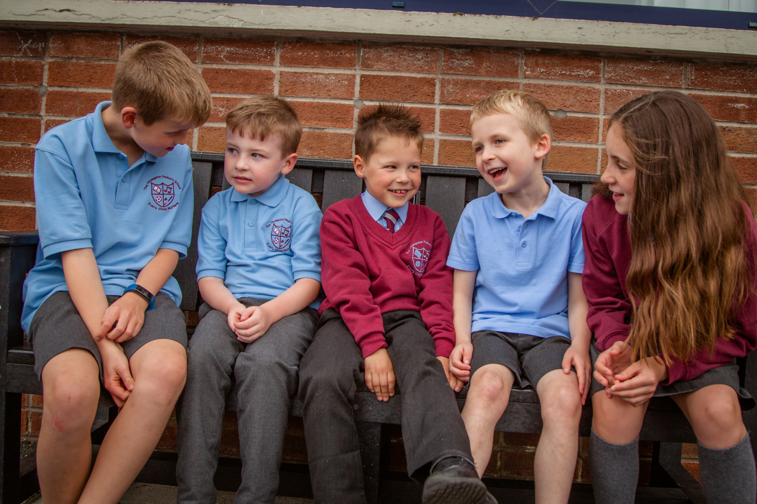
Small School - Family Atmosphere

Slide 3
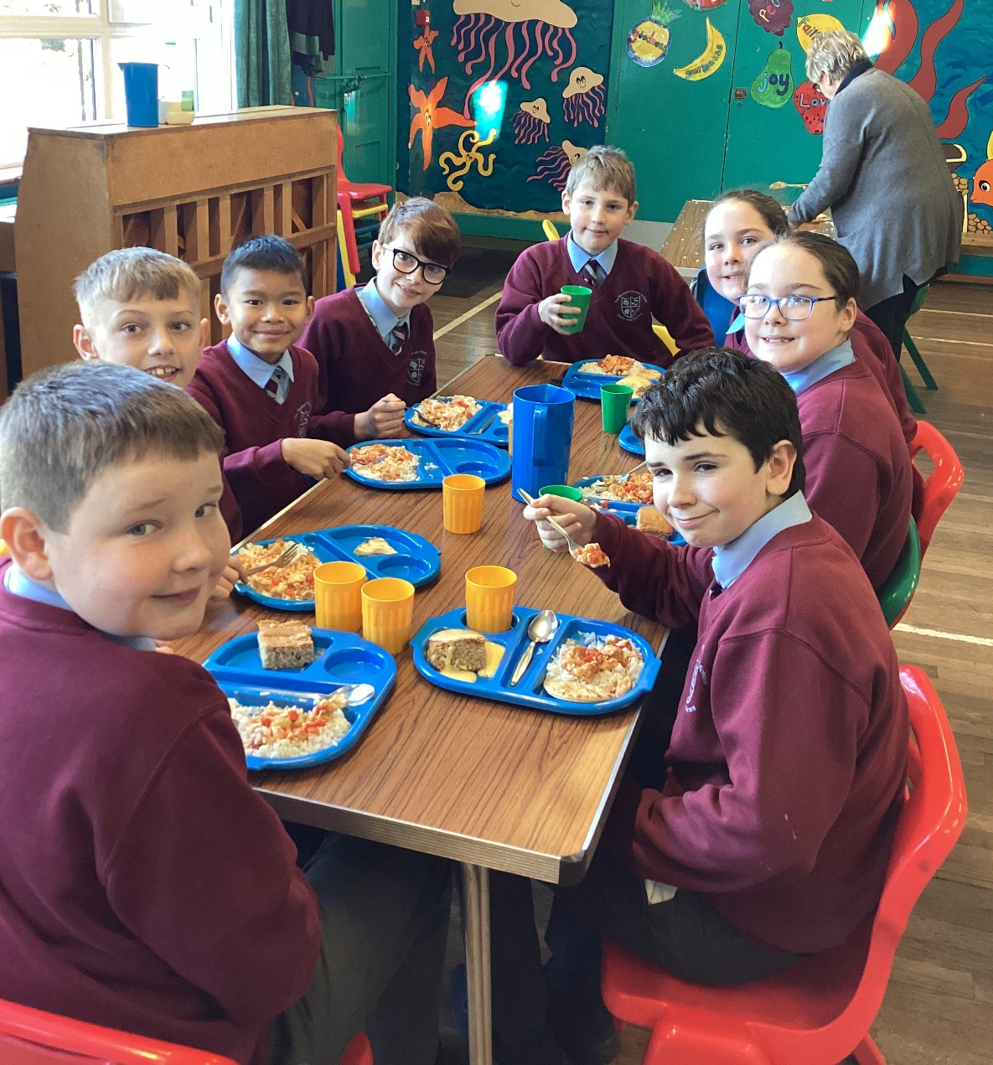
Warm, Nurturing, Christian Ethos

Slide 4
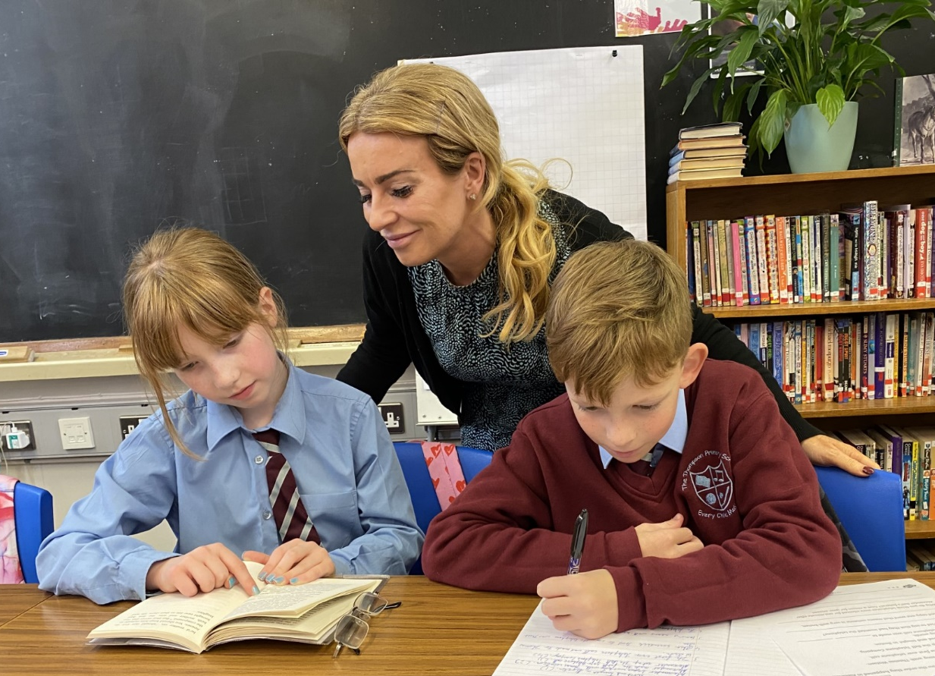
Active, Child Centred Teaching

Slide 5
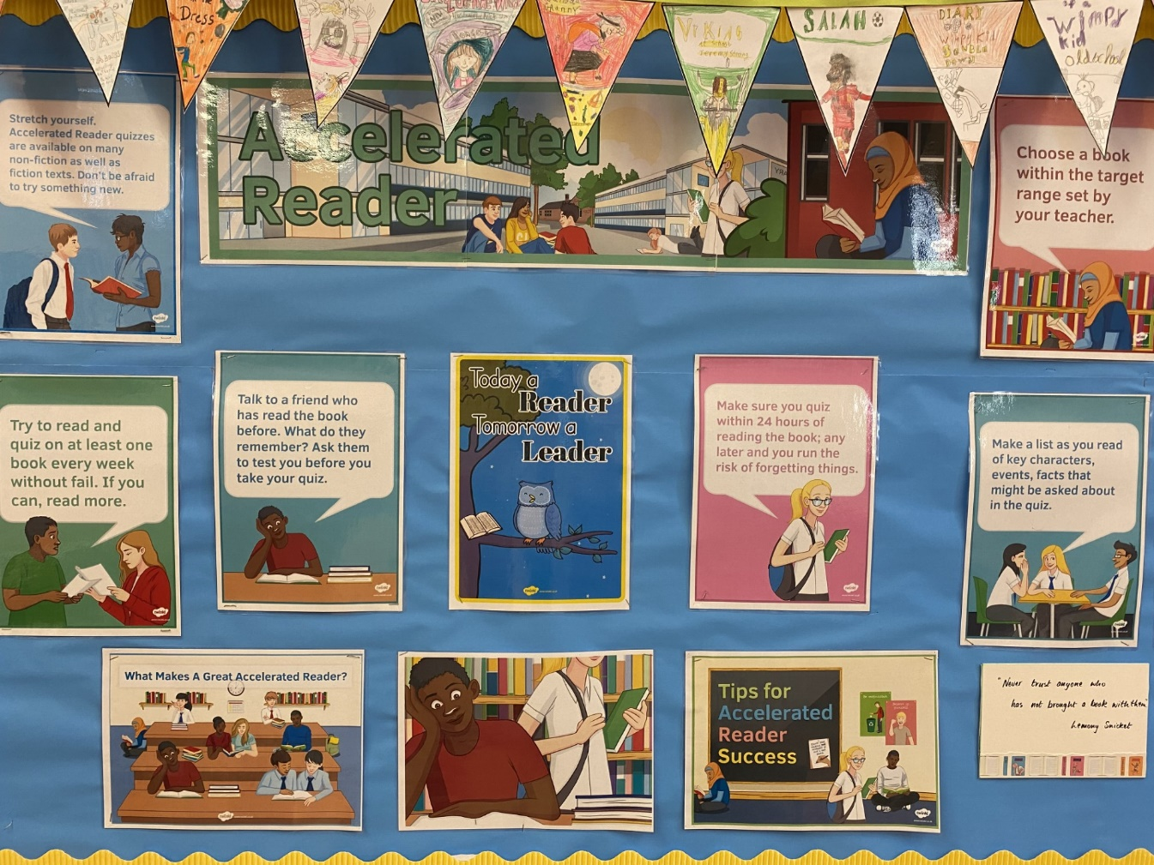
Wide Range of Strategies to Support Learning

Slide 6
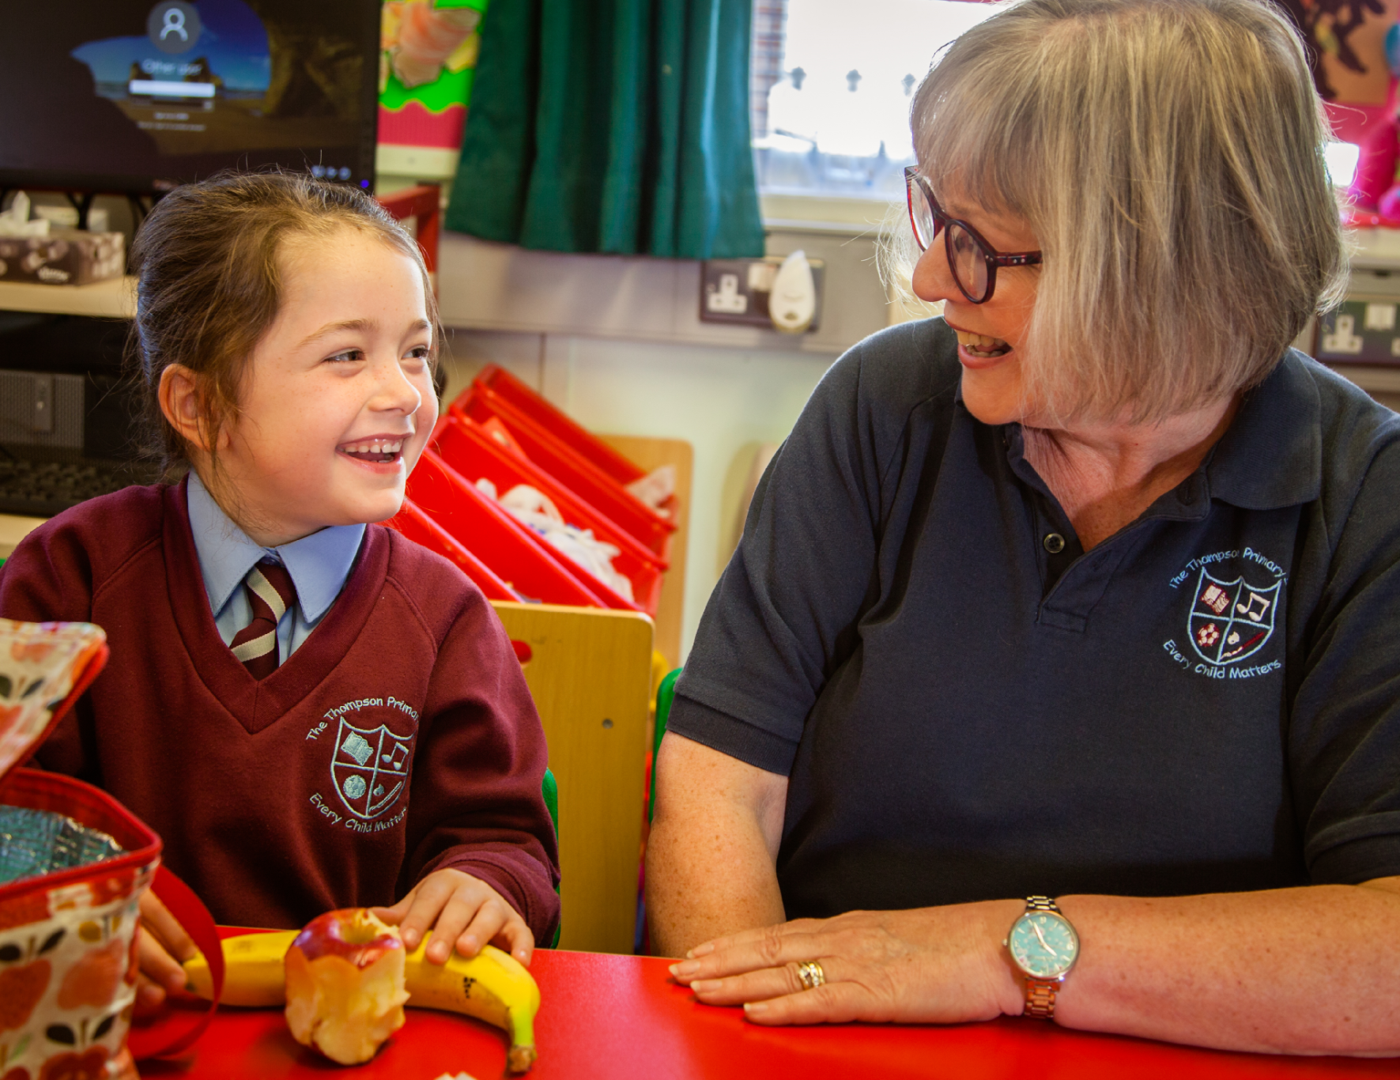
Additional Academic Support

Slide 7
Excellent Academic Results
End of Key Stage One:
*100% of pupils achieve expected levels in Literacy, Maths and ICT (Compare with N.I. average Literacy – 87%, Maths – 89%, ICT – 90%)
End of Key Stage Two:
*97 %+ of pupils achieve expected levels in Literacy, Maths and ICT (Compare with N.I. average Literacy – 79%, Maths – 79%, ICT – 85%)
Post-Primary Transfer Test:
Recent years have seen an average of 72% of P7 pupils transfer to local grammar schools.
(Ballyclare High, Belfast Royal Academy, Belfast High, Antrim Grammar, Carrick Grammar, Ballymena Academy, Cambridge House Grammar, Larne Grammar)
*Sample Data 2022

Slide 8
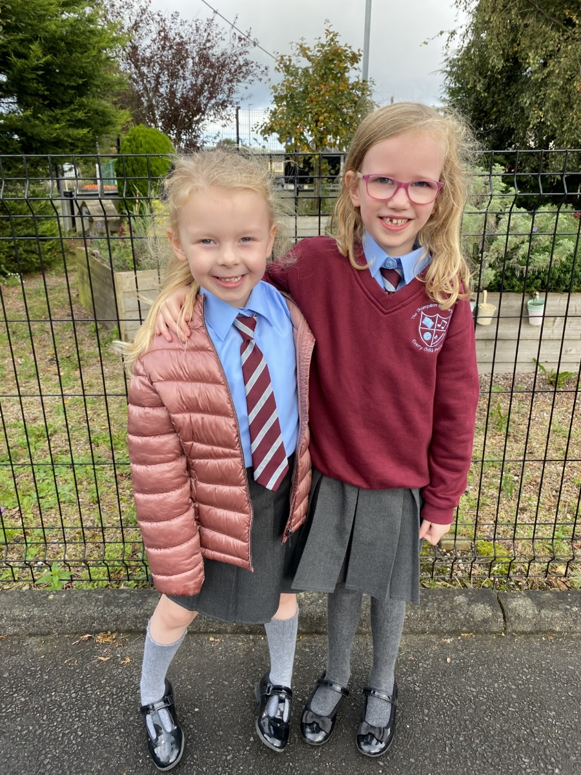
Breakfast & Afterschool Clubs

Slide 9
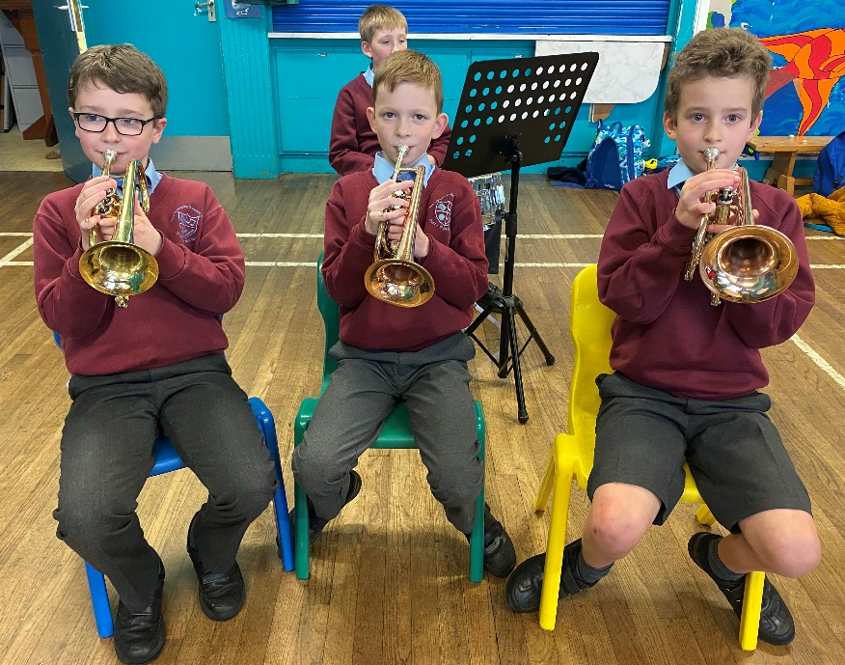
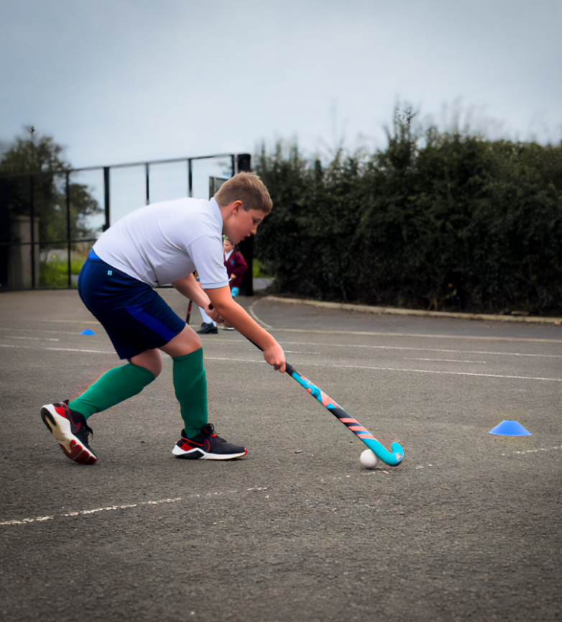
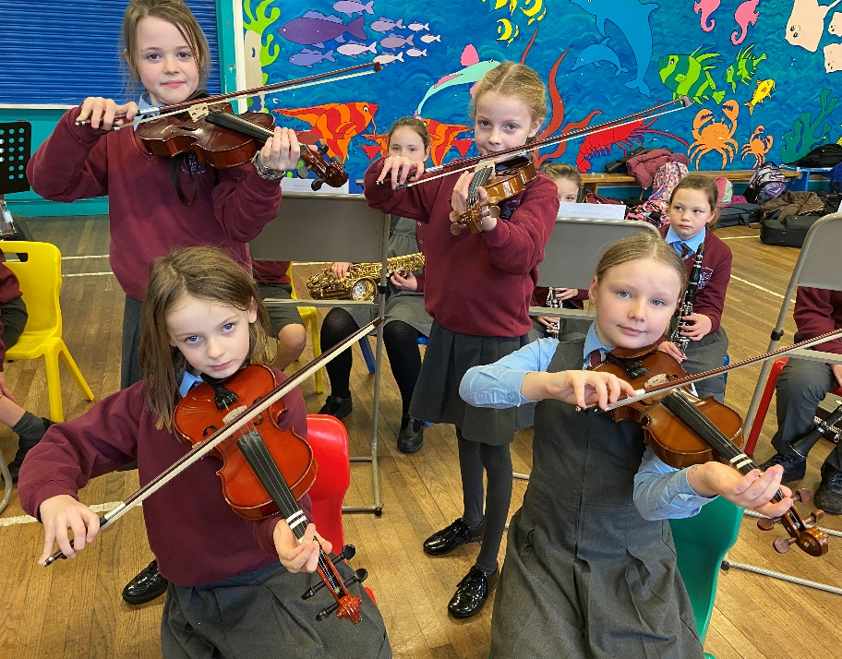
Wide Range of Extra-Curricular Activities

Slide 10
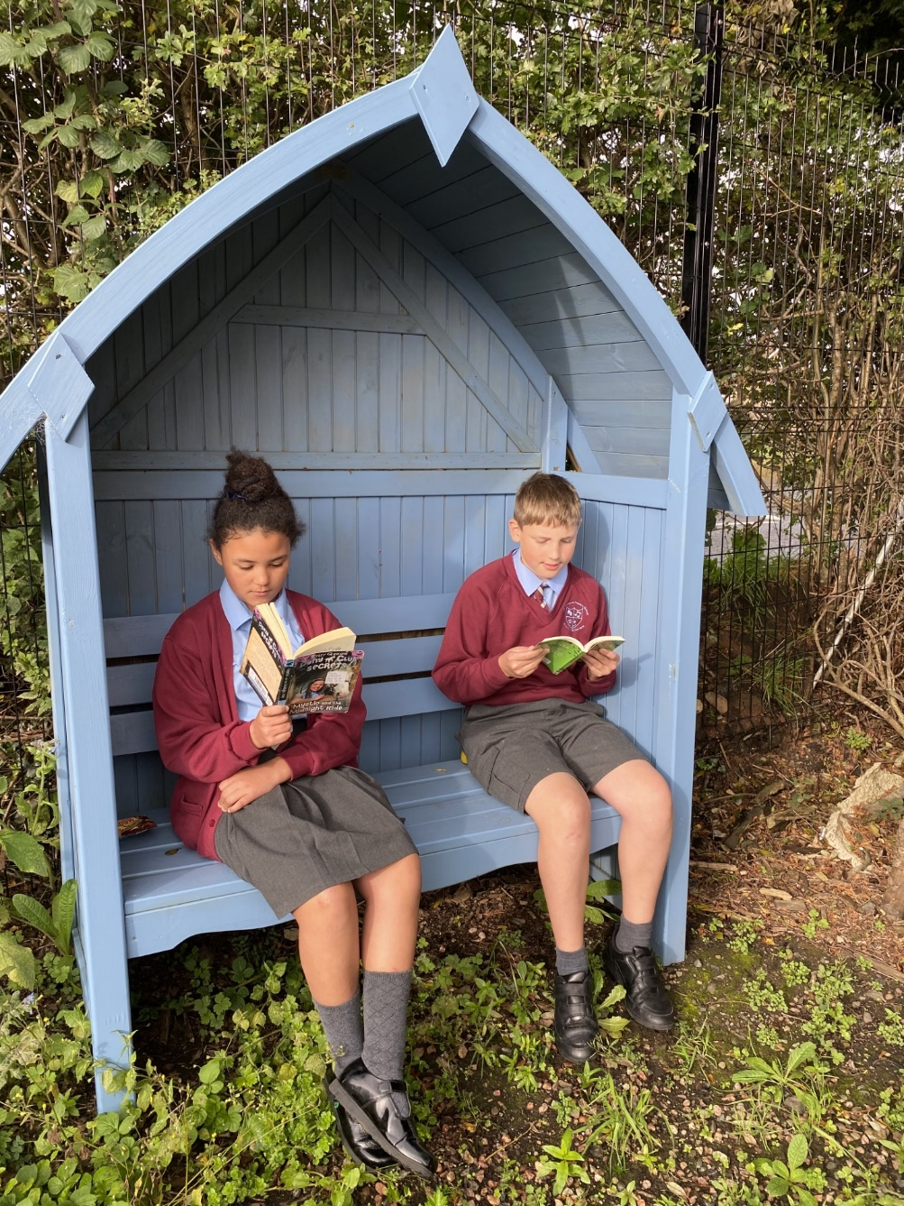
Outdoor Learning Environment

Slide 11
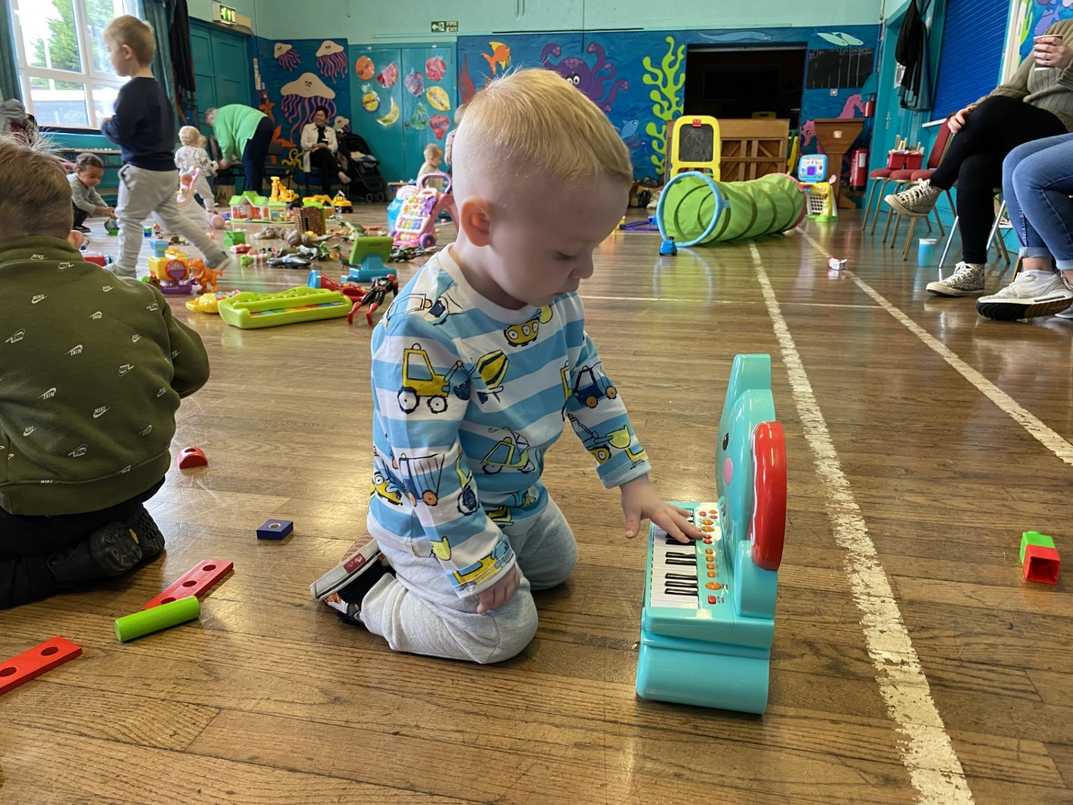
Close Links With Local Community

