Slide 2
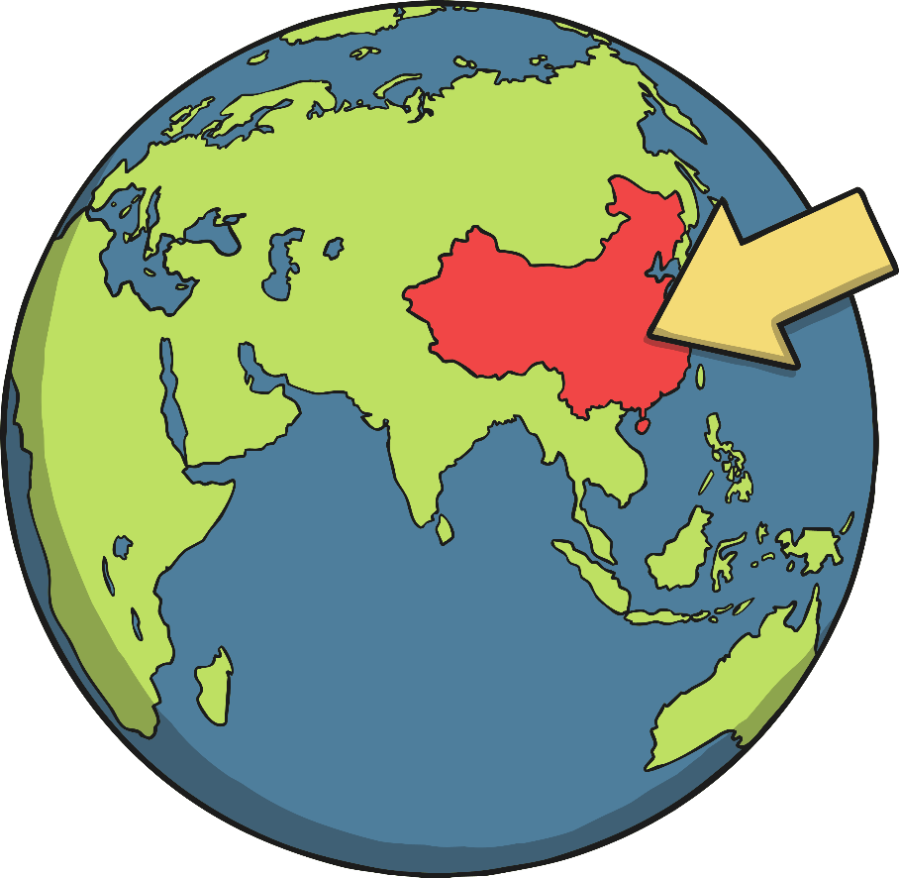
Where is China?
The country of China is in northeast Asia.
China is the fourth biggest country in the world.
China has one of the largest populations in the world with
over 1.4 billion people!
China is divided into 23 provinces.
The capital city of China is Beijing.

Slide 3
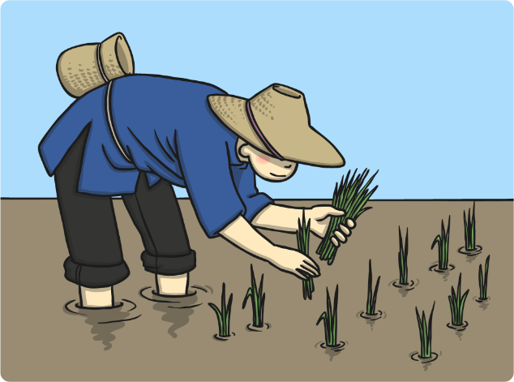
What is China like?
China has very diverse geography including deserts, mountains and dense forests.
In the north of China, there are sunken basins and high mountains where it snows much of the year.
Central China consists of less mountainous regions with a tropical climate.
The south of China is filled with jungles and it is very hot and humid. Central China consists mostly of mountainous regions.
Most of Western China is Mountains, including the Himalayas.
Rivers, lakes and coastal waters are very important in China, both for transportation and for irrigation.
Rivers are very important because much
of the wheat and rice fields in China rely
on irrigation.

Slide 4
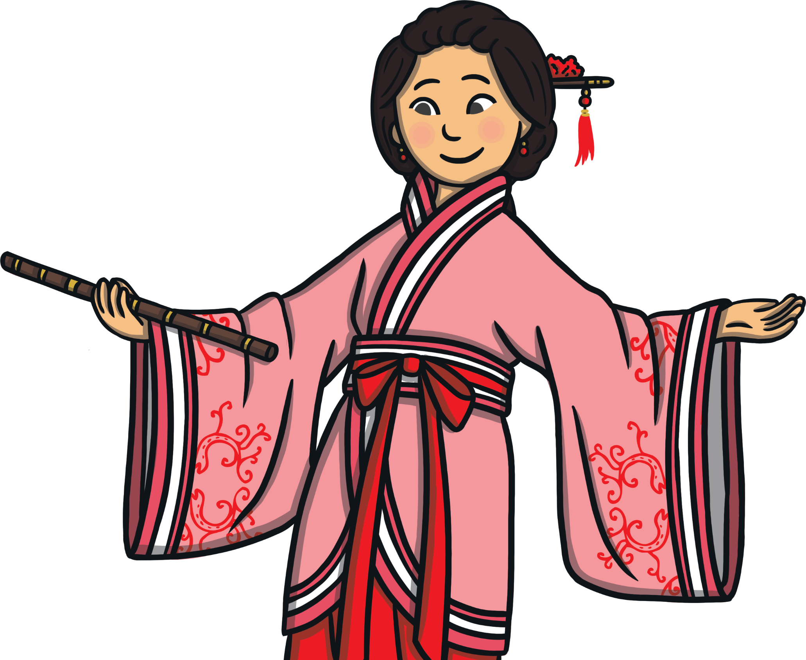
What are Chinese People Like?
China is home to people from lots of different ethnicities and cultures.
Around one-third of the population live in cities. The rest of the people live in the country.
Chinese culture is very unique.
The Chinese calendar, architecture, food, handicrafts, dance, festivals and martial arts are very popular across the world.
Chinese people mainly speak Mandarin, but some also speak Cantonese, Hakka or Yue, depending on which part of the country they are from.
Important foods in China are rice, noodles and tofu,
which are usually eaten with nearly every meal.

Slide 5
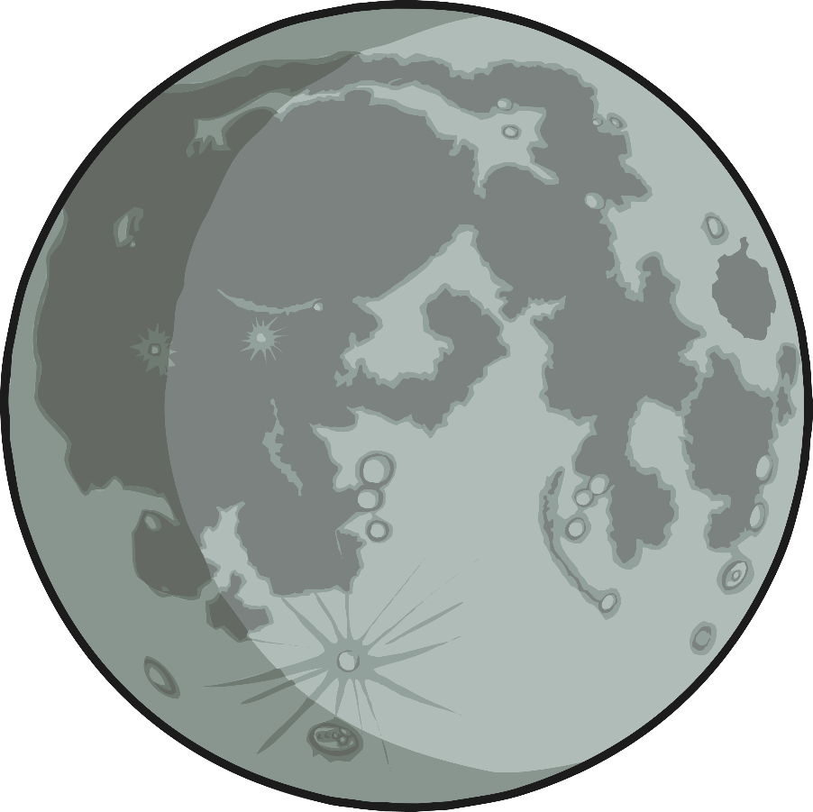
When is Chinese New Year?
The Chinese New Year starts somewhere between late January and Early February.
The date changes from year to year because it follows an ancient farmer calendar which is based on phases of the moon, known as the lunar calendar.

Slide 6
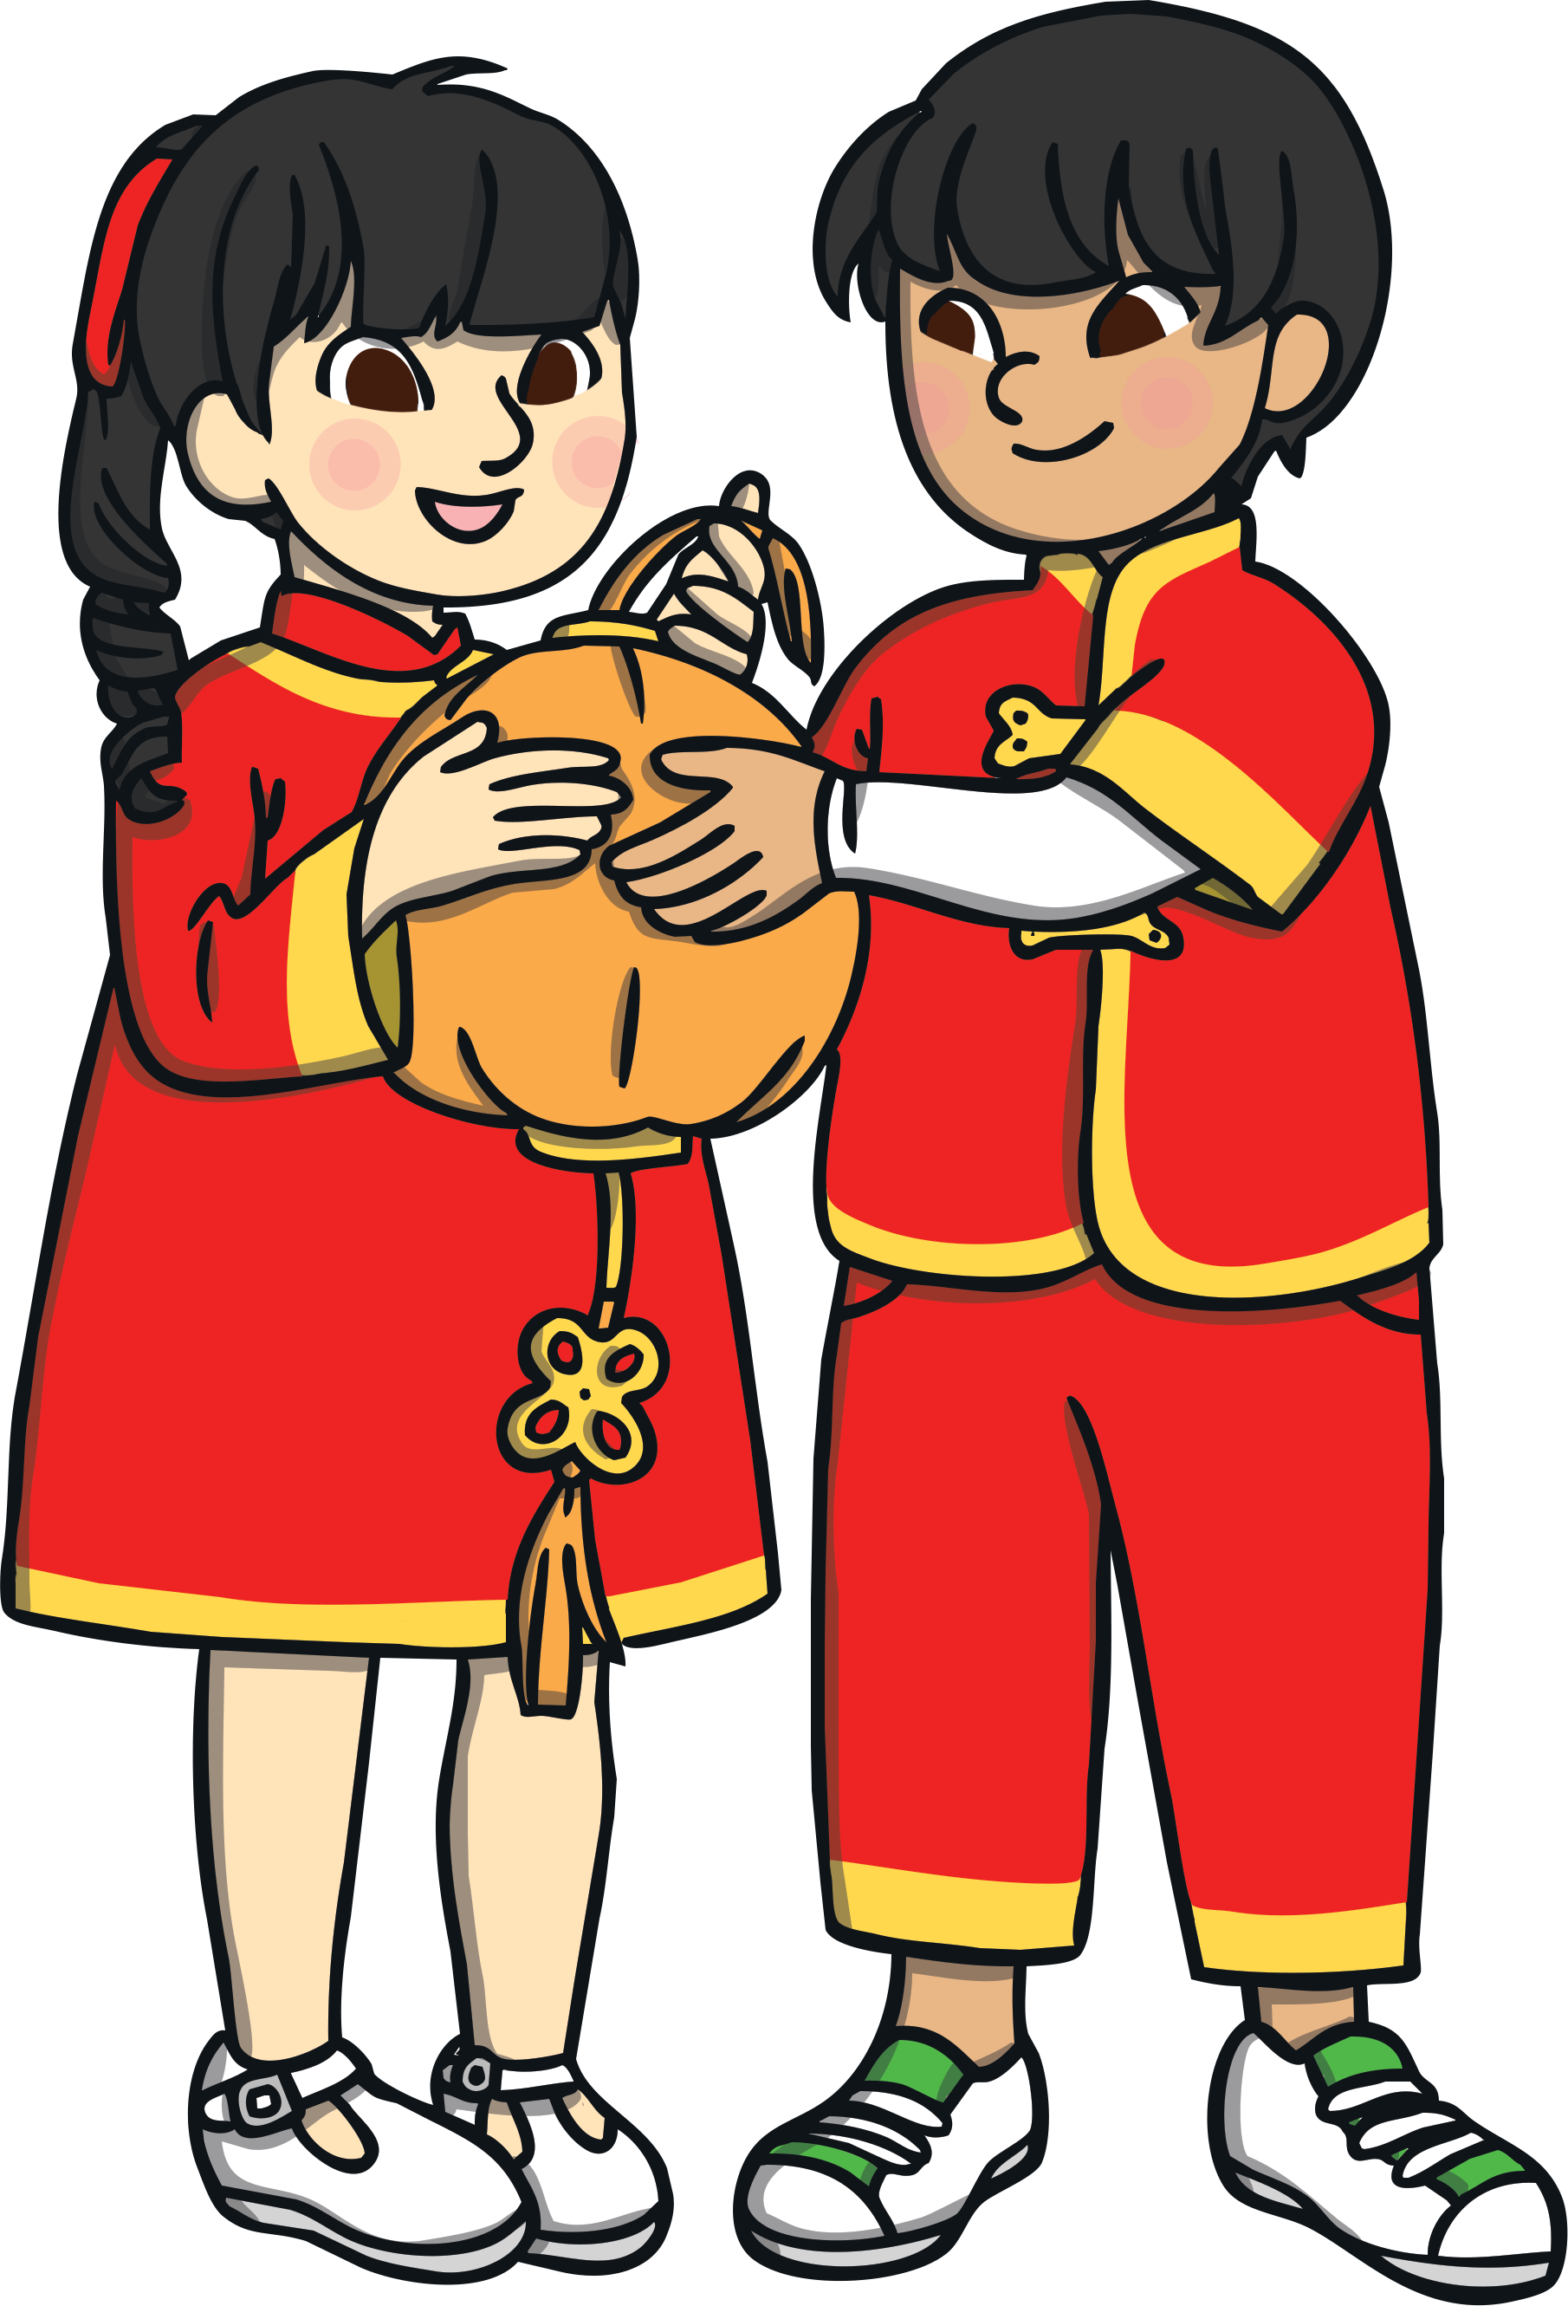
Preparing for the New Year
Chinese people clean their houses to get rid of dirt and unwanted items.
Houses are decorated with red paper scrolls and lanterns, often with good luck phrases such as 'happiness' and 'wealth' on them.
People who live or work away travel home in the days leading up to the New year so they can be with their families during this time.
Food is important during this time so lots of food is bought for the festivities.

Slide 7
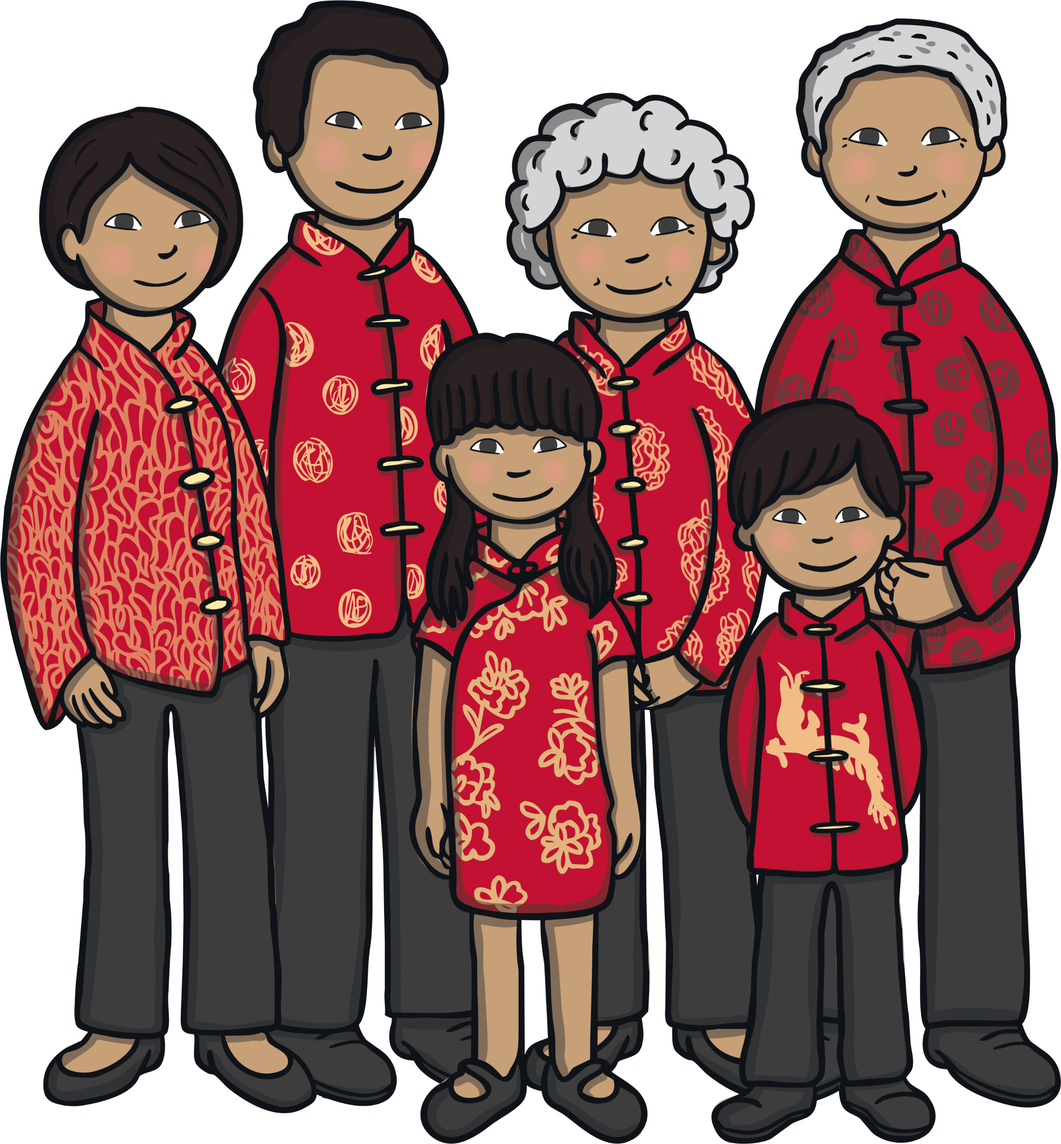
New Year’s Eve
Every family member has a thorough bath to wash away the bad luck before the end of the year.
Everyone wears brand new clothes from head to toe for the festive period. Red is a very popular
colour for clothing as it is considered lucky.
Children receive red envelopes filled with money and sweets from their parents and grandparents.

Slide 8
New Year’s Eve
Traditionally, people light candles or oil lamps to drive away evil spirits and look forward to the good luck of the New Year.
Families gather and have a large, traditional feast. This is the most important meal of the year so extra special dishes are prepared.
In the North, people eat jiaozi - a steamed dumpling.
'In the South, people eat Nian Gao (New Year’s Cake) - a sticky sweet rice pudding.

Slide 9
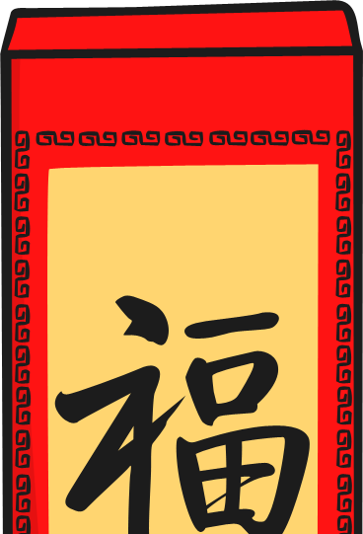
New Year’s Day
In the morning and on the days which follow, people would visit the temple to worship Gods and welcome the New Year.
Usually, on the first day of the Lunar New Year, families may visit senior members of the family.
In the days that follow people may visit their friends and offer good luck wishes to each other for the year ahead.
Lion dances are often performed in the streets on New Year’s day and throughout the period, as it is believed to be lucky to see a lion on the first day of the new year.

Slide 10
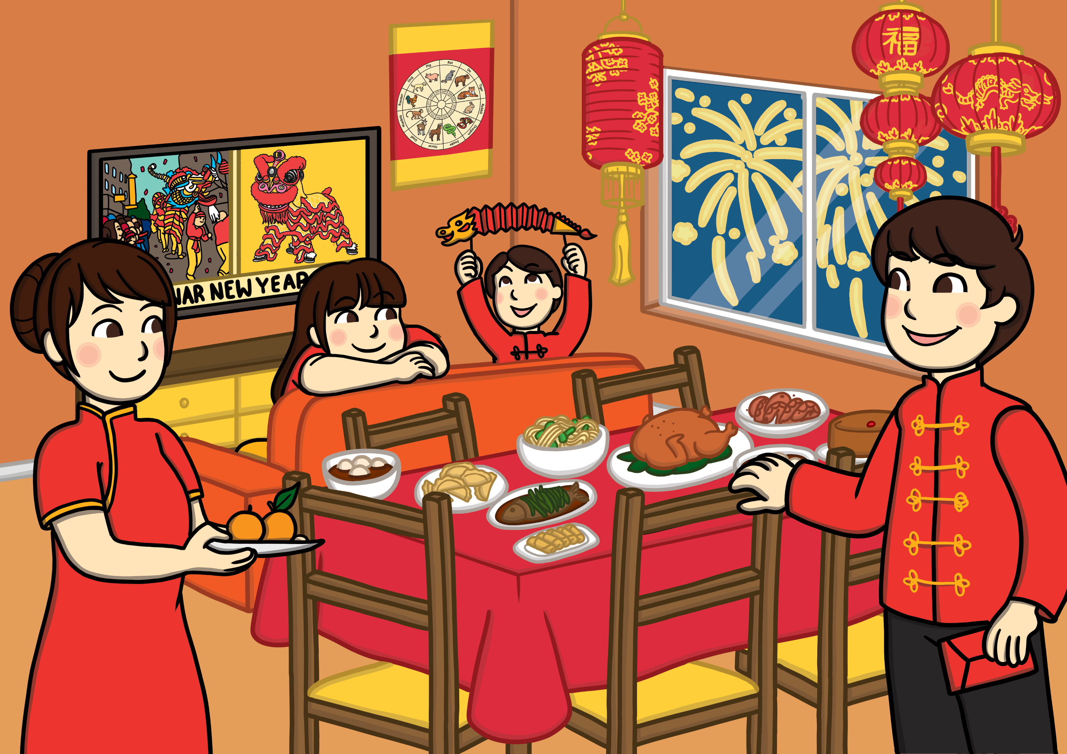
The Second Day
People say that Tsai Shen, the Chinese God of Wealth, leaves for heaven on the second day of the lunar New Year. The Chinese pray to their ancestors as well as the Gods.
The Nüwa legend believes it is the Birthday of the Dog so dogs are treated with special foods.
It is also a time for visiting families.

Slide 11
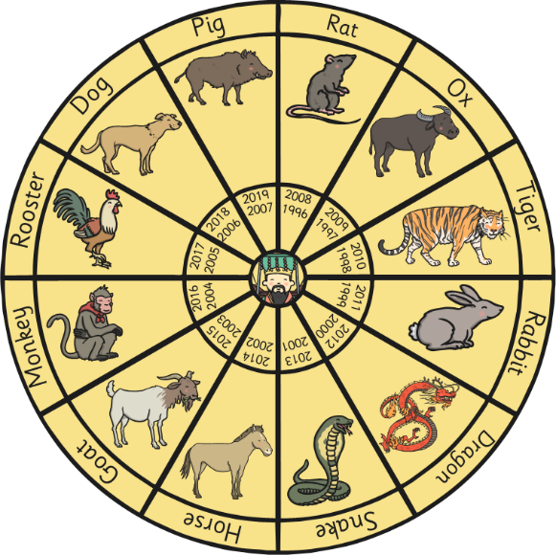
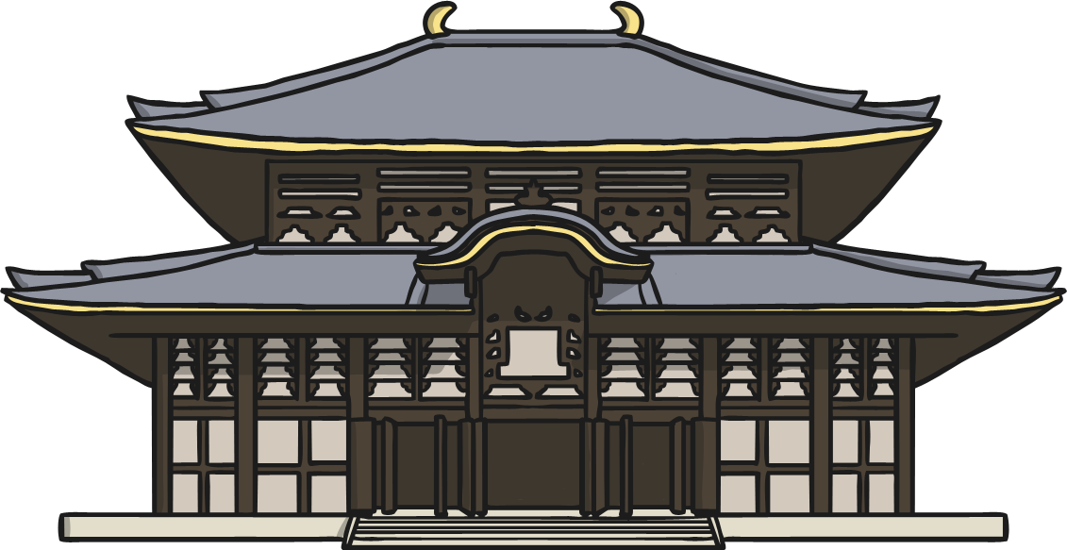
The Third and Fourth Day
The Third Day
Some people believe they should not visit friends and relatives on this day.
The Nüwa legend believes it is the Birthday of the Pig.
The Fourth Day
The fourth day continues the same as the third.
Most people spend time worshipping the God of Kitchen and welcoming him back.

Slide 12
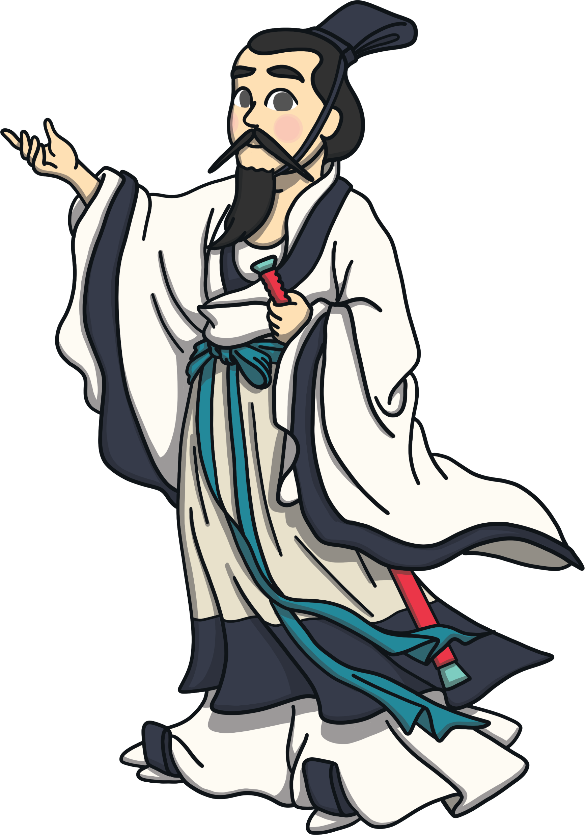
The 5^{th,} 6^{th,} 7^{th,} 8th and 9th Day
The 5th Day - Dumplings are eaten for good luck and some people shoot firecrackers to rid the five bad lucks away.
The 6th Day - Families usually send away the ghost of poverty by throwing away old ragged clothes and welcome the beautiful days in the new year.
The 7th Day - Day 7 is considered everyone's birthday.
The 8th Day - Some people release their pets, such as fish and birds into the wild to show respect for nature.
The 9th Day - Day 9 is the Jade Emperor's birthday. The Emperor is worshipped by lighting candles. People typically hold a large feast to celebrate.

Slide 13
The 10^{th,} 11^{th,} 12^{th,} 13th and 14th day
The 10th Day - Day 10 is the birthday of Earth Mother. People would typically hold a feast to celebrate.
The 11th/12th Day - Day 11 and 12 are days for celebratory family dinners.
The 13th Day - Day 13 is a day to put up lighting decorations for the Lantern Festival.
The 14th Day - This day is spent resting and preparing for the lantern festival, the last day of the Chinese New Year.

Slide 14
The 15th Day!
The 15th day is also known as the Lantern Festival.
It marks the first full moon after the Lunar New Year began and symbolises the end of the celebrations.
There are dragon and lion dancing parades in the streets, and all the streets are crowded with people.
Families light and watch other lanterns.
Candles are lit outside homes to guide wayward spirits home.
Rice balls are eaten on this day.
People solve riddles that are written on lanterns.
In Malaysia and Singapore, single women
write their phone numbers on oranges and
throw them into a river or lake. Single men
eat the oranges and the taste of the orange
(sweet or sour) represents good
or bad fate.

