Slide 2

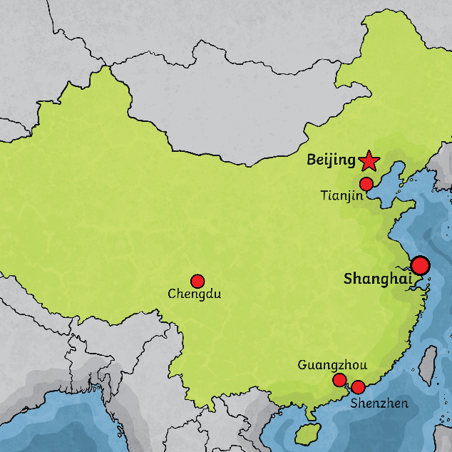
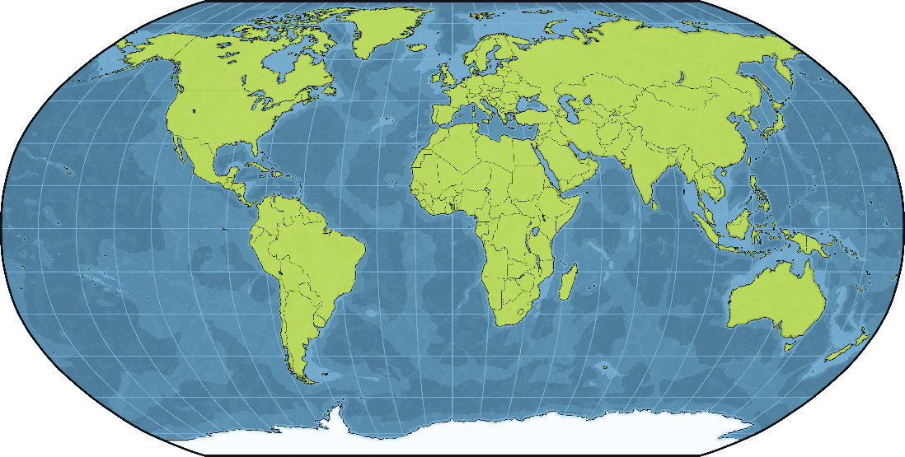
Where Is China?
The country of China is in northeast Asia.
China is the fourth biggest country in the world.
China has the largest population in the world with over 1.3 billion people!
China is divided into provinces.
The capital city of China is Beijing.

Slide 3
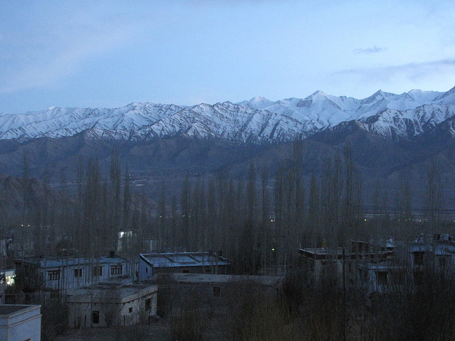
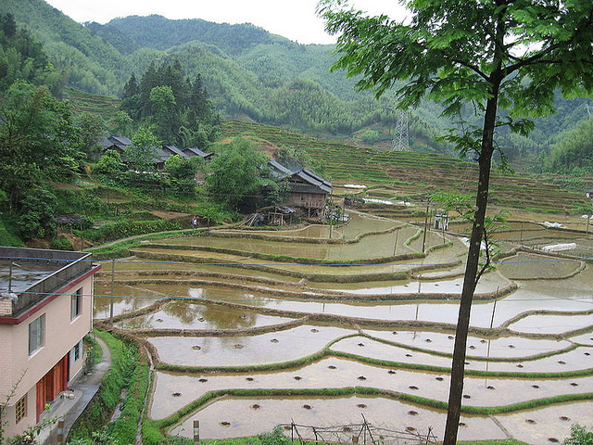
China’s Landscape and Climate
China has very diverse geography including deserts, mountains, and fertile river basins.
In the north of China, there are mountains, where it snows much of the year.
The south of China is filled with jungles, and
it is very hot and humid.
Central China consists mostly of
mountainous regions.
Most of Western China is mountainous – it is home to the Himalayas.
Rivers are very important to China, both for transportation and irrigation. The wheat and rice fields in China rely on irrigation.
Photo courtesy of Friar’s Balsam, eutrophication&hypoxia (@flickr.com) - granted under creative commons licence - attribution

Slide 4
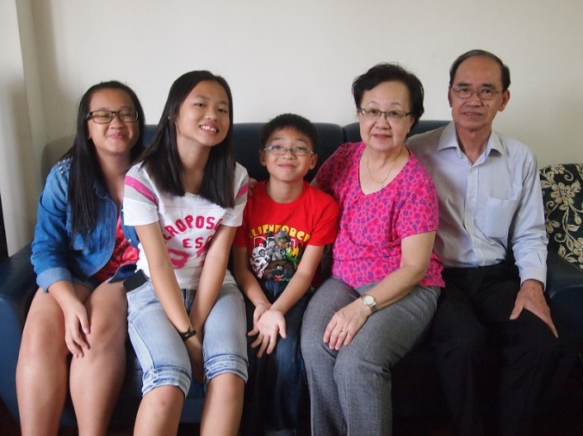
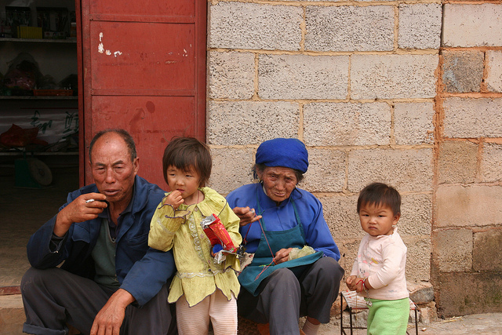
Chinese Culture
China is home to a variety of ethnicities
and cultures.
Chinese culture is very unique.
The Chinese calendar, architecture, food, handicrafts, dance, festivals, and martial arts are very popular across the world.
Mandarin is the official language in China. A few other languages spoken in China include Cantonese, Hakka, and Swatow, depending on the location.
The staple food in China is rice, and it is eaten with nearly every meal.
Photo courtesy of coolinsights, jadis1958(@flickr.com) - granted under creative commons licence - attribution

Slide 5
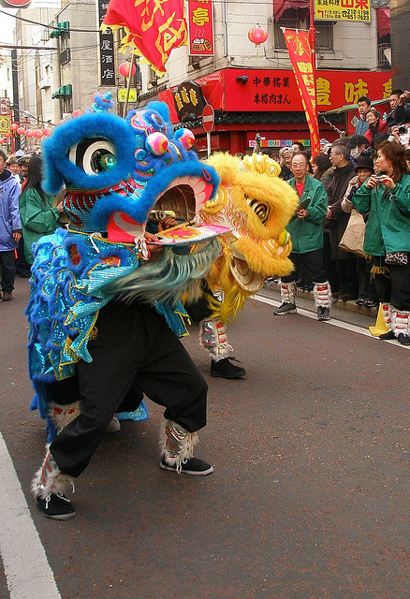
When Is Chinese New Year?
Chinese New Year starts somewhere between late January and early February.
The date changes from year-to-year. It follows an ancient farmer calendar based on the phases of the moon.
Photo courtesy of tanakawho (@flickr.com) - granted under creative commons licence - attribution

Slide 6
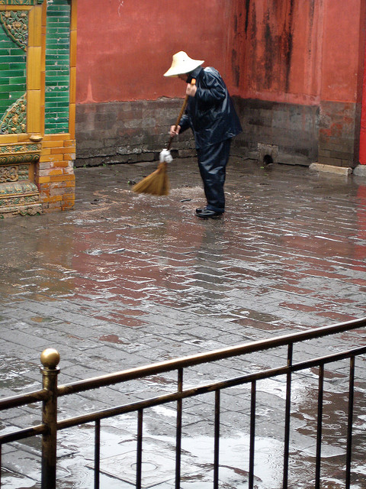
Preparing for the New Year
Some Chinese people spring clean their homes and gardens to sweep away any bad luck.
Homes are decorated with paper scrolls and lanterns with good luck phrases such as “happiness” and “wealth” on them.
All unfinished business is settled so there is a fresh start for the new year. Debts are paid, quarrels are resolved, and any work is brought up to date.
Photo courtesy of borkur.net (@flickr.com) - granted under creative commons licence - attribution

Slide 7
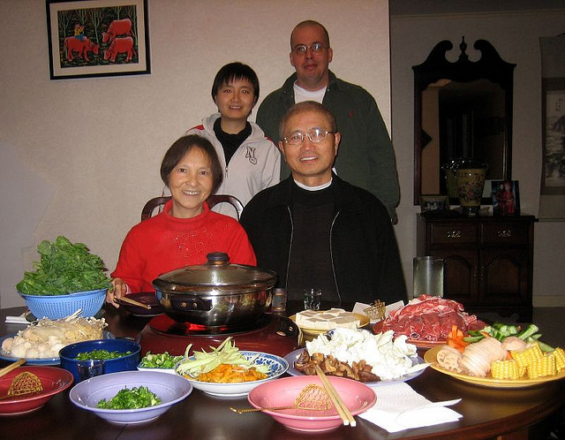
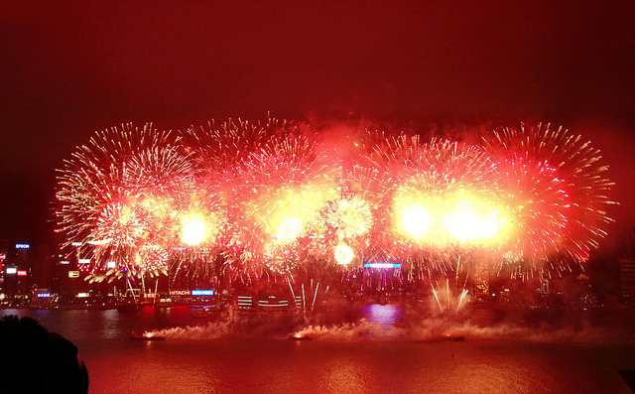
New Year’s Eve
Families gather together and have
a large, traditional feast of fish
and chicken.
In the North, people eat dijiaozi – a steamed dumpling.
In the South, people eat nian gao – a sticky sweet rice pudding.
People stay up until midnight, setting off firework to scare away evil spirits.
Photo courtesy of Prince Roy, (@flickr.com) - granted under creative commons licence - attribution

Slide 8
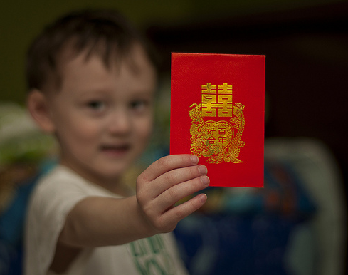
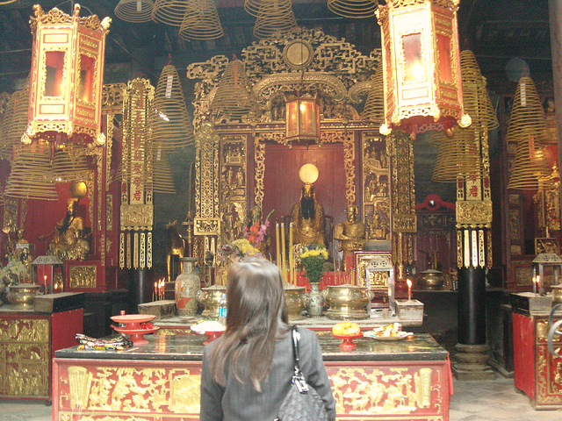
New Year’s Day
Children wake up to find red envelopes filled with money and sweets under their pillows, left by their parents or grandparents.
Each family member starts the day with brand new clothes from head to toe. Red is a very popular color for clothing as it is considered lucky.
The first stop of the day is the temple to worship the gods and to welcome the New Year.
Most Chinese families gather together for a New Year’s banquet. Each family has their own special dish they prepare for this time.
Photo courtesy of DaMongMan, oldandsolo (@flickr.com) - granted under creative commons licence - attribution

Slide 9
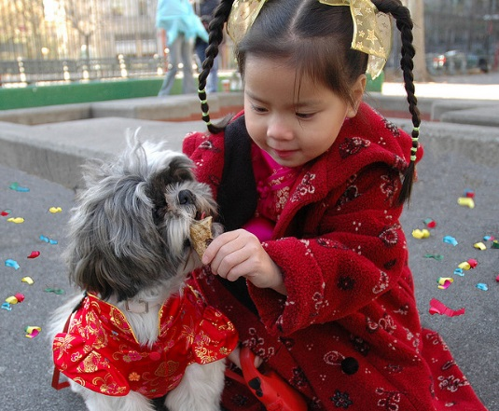
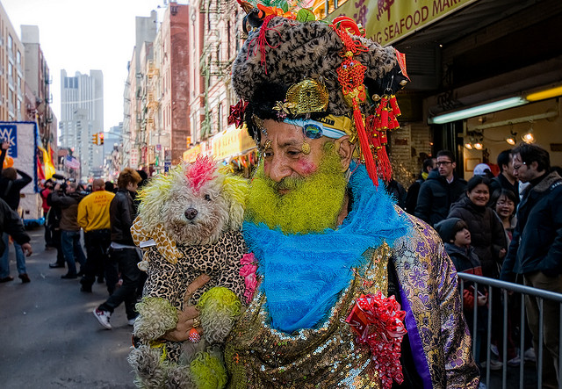
The Second Day
The birthday of the Chinese God of Wealth, Cai Shen, is celebrated.
Chinese people pray to their ancestors as well as the gods.
It is believed to be the birthday of all dogs, so dogs are treated with special foods.
It is also a time for visiting families.
Photo courtesy of Bob Jagendorf, heypatrick(@flickr.com) - granted under creative commons licence - attribution

Slide 10
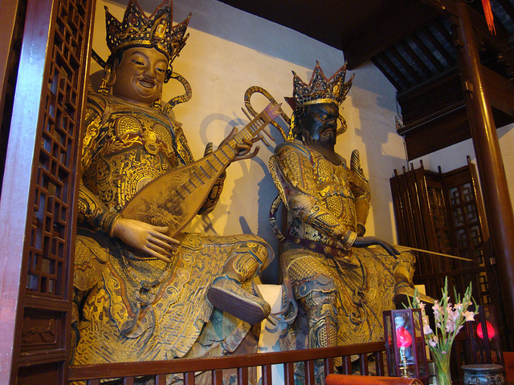
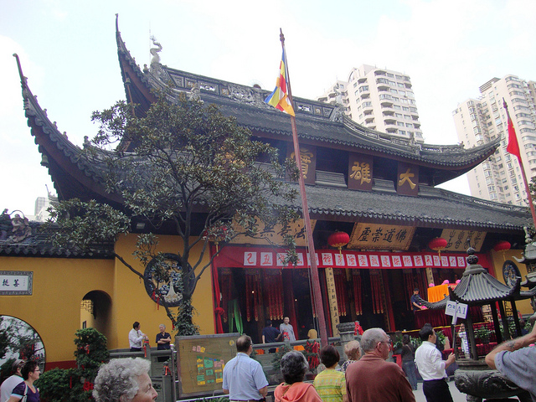
The 3rd and 4th Days
The third day:
Tradition says people should not visit friends and relatives on this day.
Instead, they visit the Temple of Wealth and have their futures told.
The fourth day:
Most people go back to work.
It is also the day of Spring Dinners. Businesses have departments dinners or social events for their employees.
Photo courtesy of lyng883(@flickr.com) - granted under creative commons licence - attribution

Slide 11
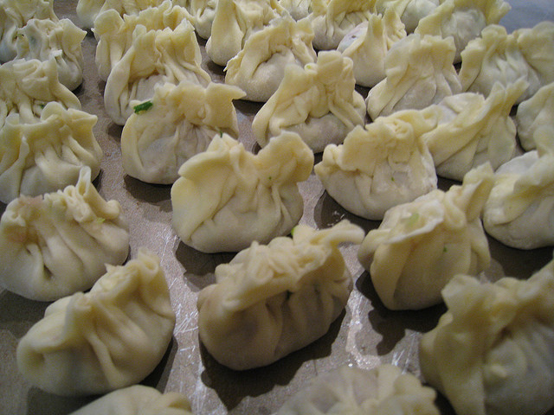
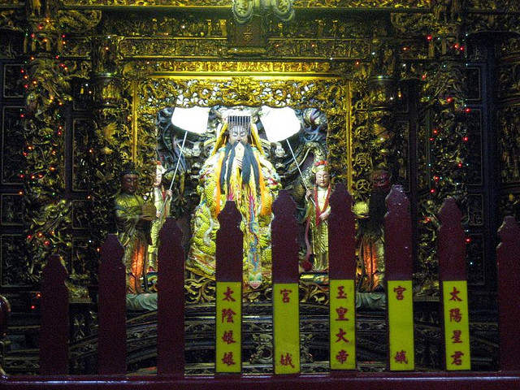
The 5th, 6th, 7th, 8th, and 9th Days
The 5th Day – Dumplings are eaten for good luck and some people shoot firecrackers to worship the God of War.
The 6th Day – Firecrackers are thrown to keep away bad spirits to worship the God of War.
The 7th Day – Day 7 is considered everyone’s birthday.
The 8th Day – This is the eve of the Jade Emperor’s birthday. Special family dinners are held.
The 9th Day – The Jade Emperor’s birthday. The Emperor is worshipped by lighting incense and offering prayers.
Photo courtesy of itjournalist, Prince Roy (@flickr.com) - granted under creative commons licence - attribution

Slide 12
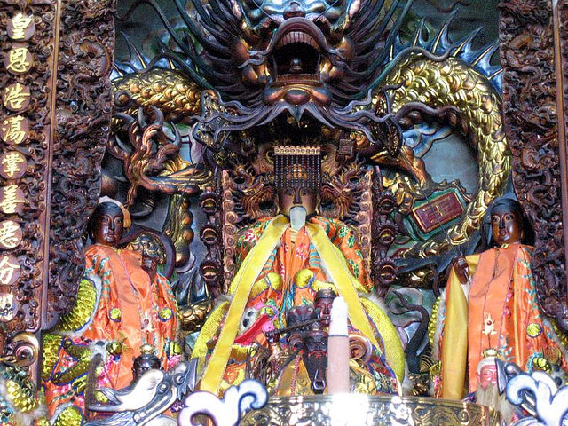
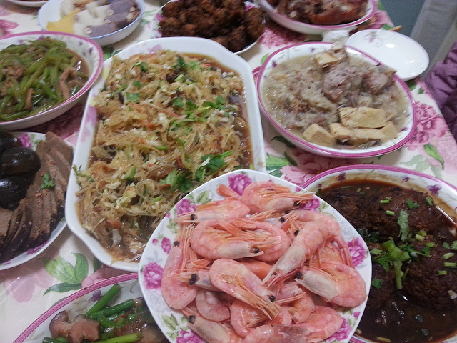
The 10th, 11th, 12th, 13th, and 14th Days
The 10th Day – Recognition and offerings continue towards the Jade Emperor.
The 11^{th/}12th Day – Family dinners.
The 13th Day – People eat vegetarian food on the thirteenth day to give their stomachs
a rest!
The 14th Day – This day is spent resting and preparing for the Lantern Festival, the last day of Chinese New Year.
Photo courtesy of Prince Roy, Azchael (@flickr.com) - granted under creative commons licence - attribution

Slide 13
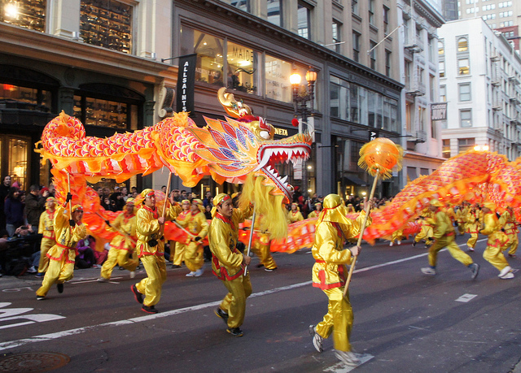
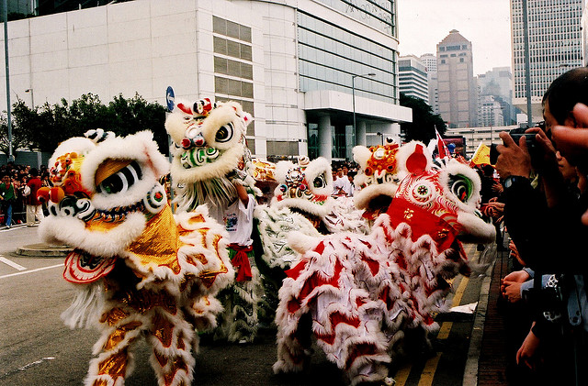
The 15th Day
The 15th Day is also known as the Lantern Festival.
Crowds of people watch dragon dancing and lion dancing parades.
Families walk the streets with their glowing lanterns.
Candles are lit outside homes to guide wayward spirits home.
In Malaysia and Singapore, single women write their numbers on oranges and throw them into a river or lake. Single men eat the oranges and the taste of the orange (sweet or sour) represents good or bad fate.
Photo courtesy of MoonSoleil, Maureen lunn (@flickr.com) - granted under creative commons licence - attribution

