Slide 2
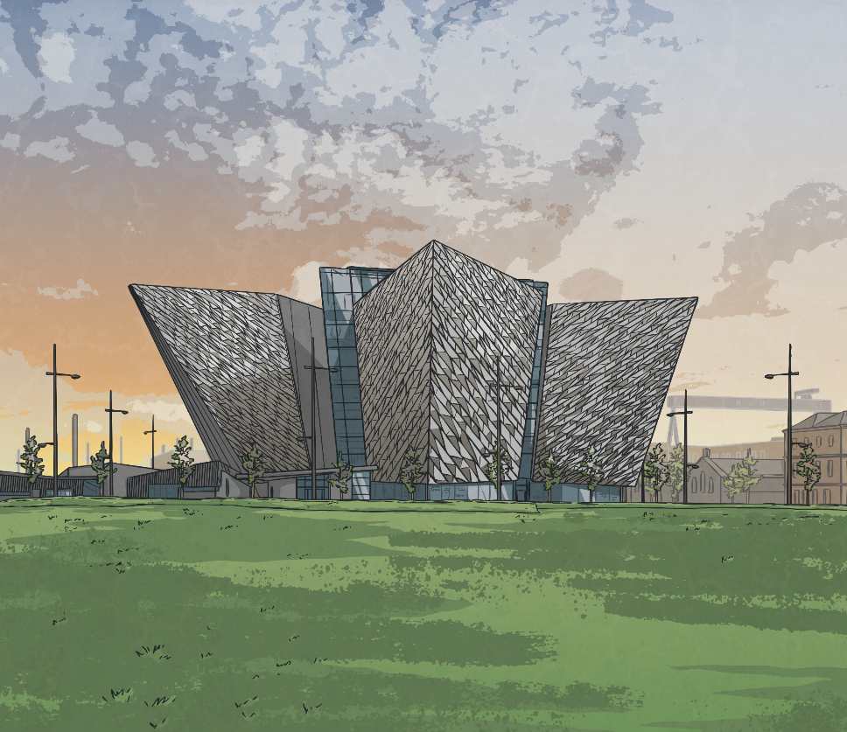
Titanic Centenary
The visitor attraction Titanic Belfast opened on 31st March 2012, just before the centenary of the Titanic disaster.
The iconic six floor building has nine galleries of interactive exhibition space.
At 14,000 square metres, it is the biggest Titanic tourist attraction in the world.

Slide 3
Award Winner 2016
2016 was a fantastic year for Titanic Belfast!
In September of that year, at a ceremony in Italy, Titanic Belfast was named Europe’s Leading Visitor Attraction.
The venue beat off stiff competition from attractions such as the Eiffel Tower, the Acropolis, Buckingham Palace, the Roman Colosseum and the Guinness Storehouse.
In December 2016, in the Maldives, Titanic Belfast went one further and scooped the title of World's Leading Visitor Attraction!
It edged out competition from eight other finalists around the globe, including Machu Picchu and the Las Vegas Strip.
Challenge
Can you find out what countries the other tourist attractions mentioned are in?

Slide 4
Answers
Eiffel Tower – France (Paris)
Acropolis – Greece (Athens)
Buckingham Palace – England (London)
Roman Colosseum – Italy (Rome)
Guiness Storehouse – ROI (Dublin)
Machu Picchu – Peru (Andes Mountains)
Las Vegas Strip – USA (Las Vegas)

Slide 5
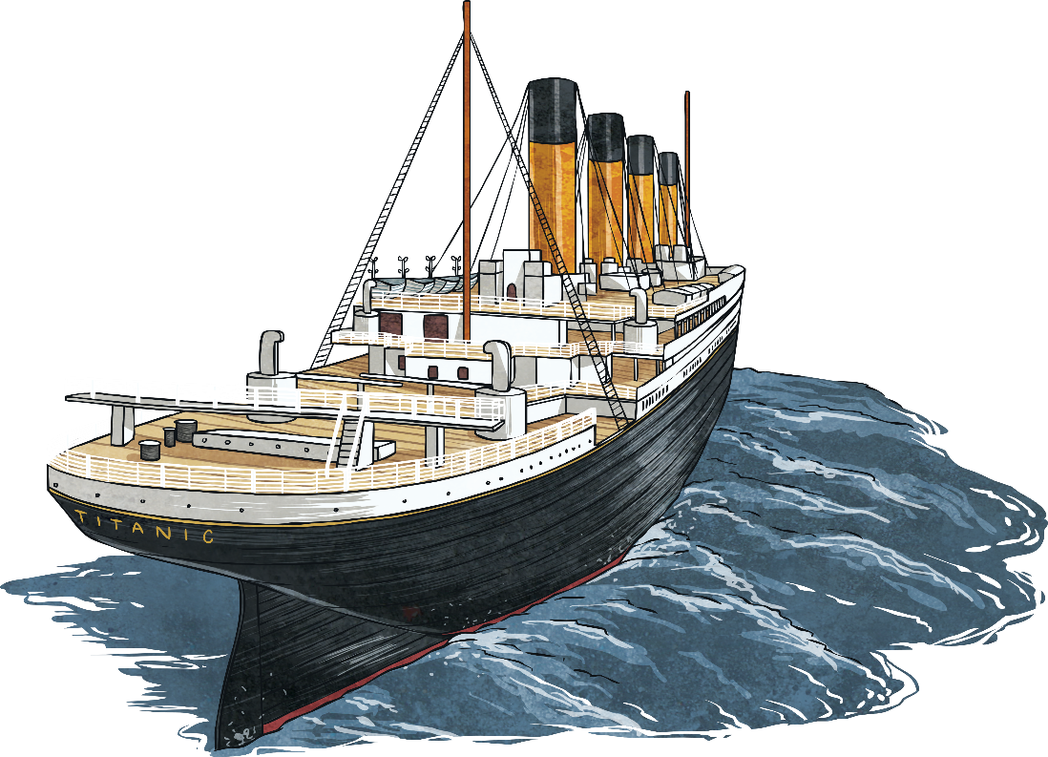
Titanic Story
The exhibitions in Titanic Belfast tell the story of the ship – its design, construction, launch and sinking.
Visitors move through nine interactive galleries, exploring the many strong links between the Titanic and Belfast.
The building is in the Titanic Quarter and stands very close to where the ship was constructed over a century ago.

Slide 6
The Galleries
Gallery One: Boomtown Belfast
Gallery Two: The Arrol Gantry and Shipyard Ride
Gallery Three: Launch
Gallery Four: The Fit-Out
Gallery Five: The Maiden Voyage
Gallery Six: The Sinking
Gallery Seven: The Aftermath
Gallery Eight: Myths and Legends
Gallery Nine: Titanic Beneath
Before Titanic Belfast opened, Dr Robert Ballard, the man who discovered the Titanic wreckage in 1985, returned to the seafloor to capture new images of the ship for Gallery 9.

Slide 7
Design and Symbols
The architecture and structure of the building was inspired and influenced by symbols of ship-building and the Titanic story.
From above, Titanic Belfast is a star shape, echoing the White Star logo.
Aspects of the building symbolise water crystal clusters and the angled planes of icebergs.

Slide 8
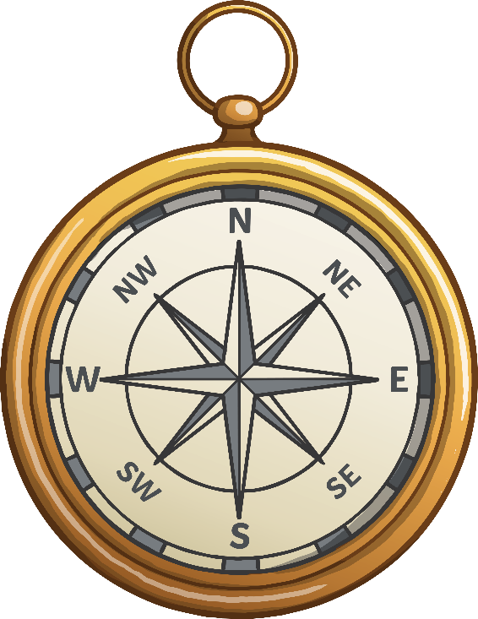
Design and Symbols
Sections of Titanic Belfast jut out like four huge ships’ bows. The ‘bows’ are plated in undulating aluminium, symbolising waves and ice.
The bows surround a Grand Atrium. An accurate compass rose is set into the floor. The building is designed around this compass, with the four ‘bows’ jutting out to form its points and four doors lining up with north, south, east and west.

Slide 9
The Shipyard Poet
Thomas Carnduff, a shipyard poet, wrote the words that encircle the compass set in the floor of Titanic Belfast. They are taken from his poem, ‘Men of Belfast’ from Songs of the Shipyards, published in 1924.
O city of sound and motion!
O city of endless stir!
From the dawn of the misty morning
To the fall of the evening air.
From the night of moving shadows
To the sound of the shipyard horn.
We hail thee Queen of the Northland
We who are Belfast born.

Slide 10
Features
As well as the interactive galleries, other features of Titanic Belfast include a dark ride allowing visitors to be transported back to the Belfast shipyards of the early twentieth century.
There is also an underwater exploration theatre and accurate examples of the ship’s cabins.
Up to one thousand guests can be catered for by the conference & banqueting suites.

Slide 11
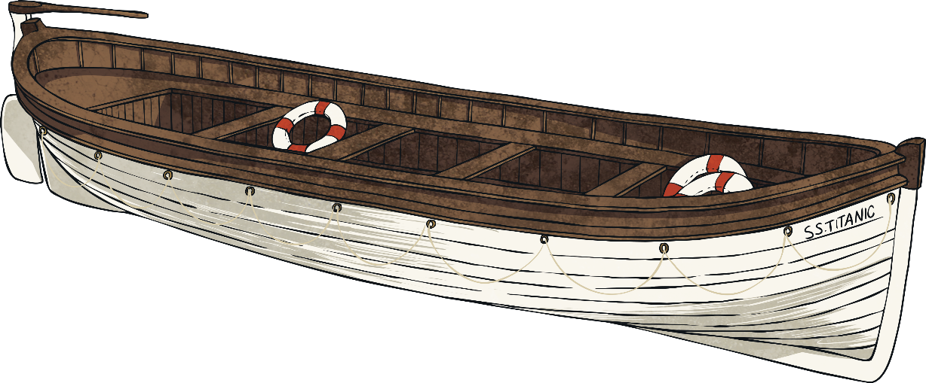
Outside the Building
On the slipway where Titanic was constructed, a life-size plan of the ship’s Promenade Deck has been inlaid in white stone.
The locations of the lifeboats and funnels are also marked.
Benches have been positioned where they would have been on the Titanic itself.

Slide 12
Morse Code
The Titanic Belfast building and grounds also feature examples of Morse code, an important element of the Titanic story.
Wooden benches around the building are spaced in Morse code sequence.
If read clockwise around the plaza the message is “DE (this is) MGY MGY MGY (Titanic’s call sign) CQD CQD SOS SOS CQD” – which was the message of distress that Titanic sent after the collision with the iceberg.
Visitors versed in Morse code who enter the building from the car park will be able to read the message, ‘Welcome to Titanic Belfast’.

Slide 13
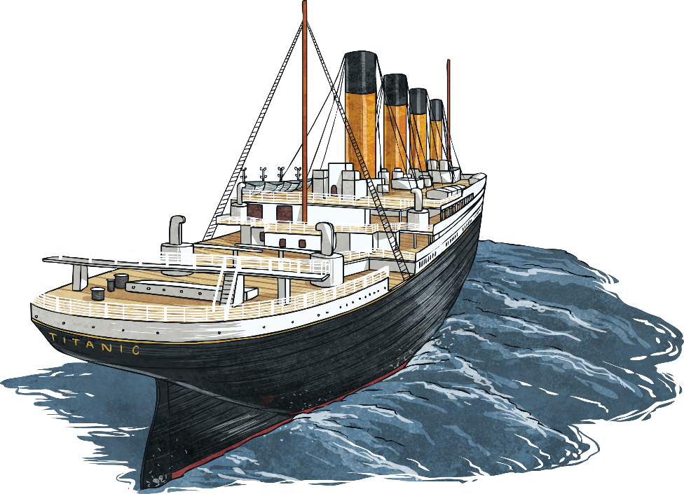
The Grand Staircase
A detailed 3D technical model was developed, based on photographs of the original staircase on the Olympic (Titanic’s sister ship).
Oldtown Joinery (a family firm from Bellaghy) then used traditional joinery techniques and 1,500 working hours to construct the staircase.
The 23-foot-high staircase is made up of 10,000 individual parts.
It had to be built in six separate sections.

Slide 14
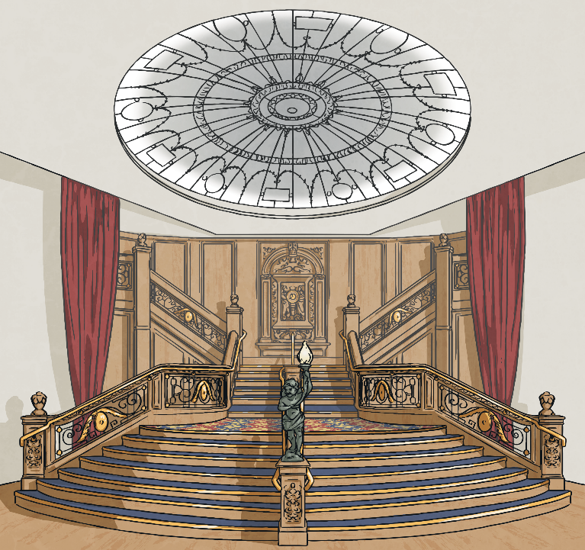
The Grand Staircase
The joiners used red oak, the same wood which was used for the original Grand Staircase on Titanic.
Some changes had to be made to satisfy modern building control, including a brass handrail installed for health and safety purposes.
The replica staircase is located in the Titanic Suite, underneath a replica of the glass dome.
The Grand Staircase Replica
The fifth and sixth floors of Titanic Belfast seek to recreate the luxurious first class banqueting room on the Titanic and can accommodate a thousand people.

Slide 15
Grand Staircase Debate
When the Titanic Belfast attraction opened, the fact that the staircase was only accessible to people attending tea parties, dinners or functions in the banqueting hall caused heated debate.
Many people felt that all visiting members of the public should be able to see the staircase.
What do you think?

Slide 16
The Titanic Sign
The laser-cut ‘Titanic’ sign outside the building was constructed by BSK Engineering.
After being transported from County Tyrone, it was installed in February 2012.
The sign is the same size as the private promenades available for Titanic’s First Class Parlour Suites - 14.5 metres long and 4.5
metres tall.
The sign is the same weight as the Titanic’s main anchor.

Slide 17
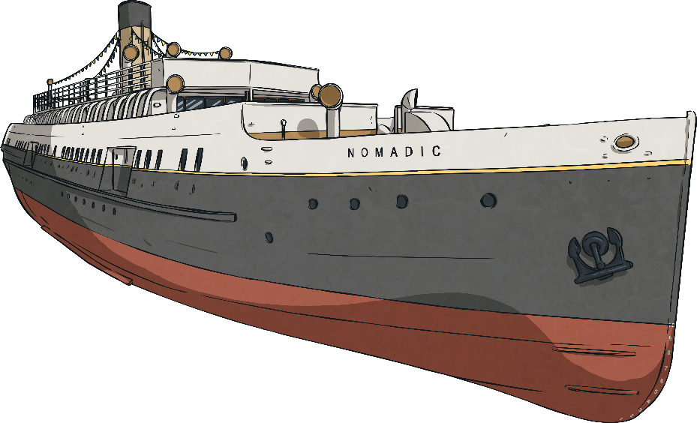
SS Nomadic
As part of their trip to the tourist attraction, visitors can also choose to visit the restored SS Nomadic.
The Nomadic is now the only White Star Line ship left in the world and is berthed in Hamilton Dry Dock, beside Titanic Belfast.
The Nomadic took first and second class passengers from the dockside in Cherbourg to the Titanic, so played its own part in the ship’s story.

Slide 18
Facts and Figures Titanic Belfast
The main Titanic Belfast building cost 77 million pounds and total costs of the project topped 100 million pounds.
About 60 million pounds of public money went to the project.
Titanic Belfast stands 100 metres in front of where Titanic's hull was constructed and launched; the drawing offices where the ship was designed are located to its right.

Slide 19
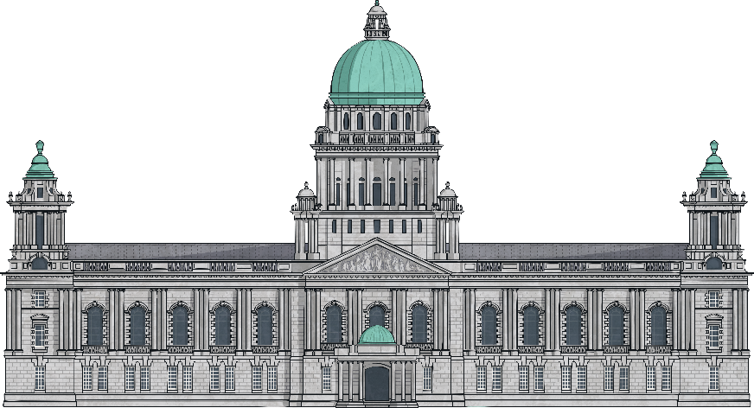
Facts and Figures Titanic Belfast
Titanic Belfast is double the size of Belfast City Hall.
At its highest point, it is 38.5 metres (126 feet) above the plaza level.
Titanic Belfast has the longest freespan escalator anywhere in Ireland. There are 124 steps and it is more than 25 metres long. The escalator provides access to the top floor Titanic Suites.

Slide 20
Facts and Figures Titanic Belfast
The building’s ticketing desks are designed to be like the wooden keel blocks that supported the 46,328 tonnes weight of Titanic, while the ship was in the dock.
During construction of Titanic Belfast, the foundations required the largest ever concrete pour anywhere in Ireland – 4,200 cubic metres. This meant that about 700 concrete lorry deliveries were needed.

Slide 21
Facts and Figures Titanic Belfast
More than five million visitors have passed through Titanic Belfast’s doors since the attraction opened.
These visitors have come from over 145 different countries, with more than 85% now coming from outside Northern Ireland.

