Slide 2
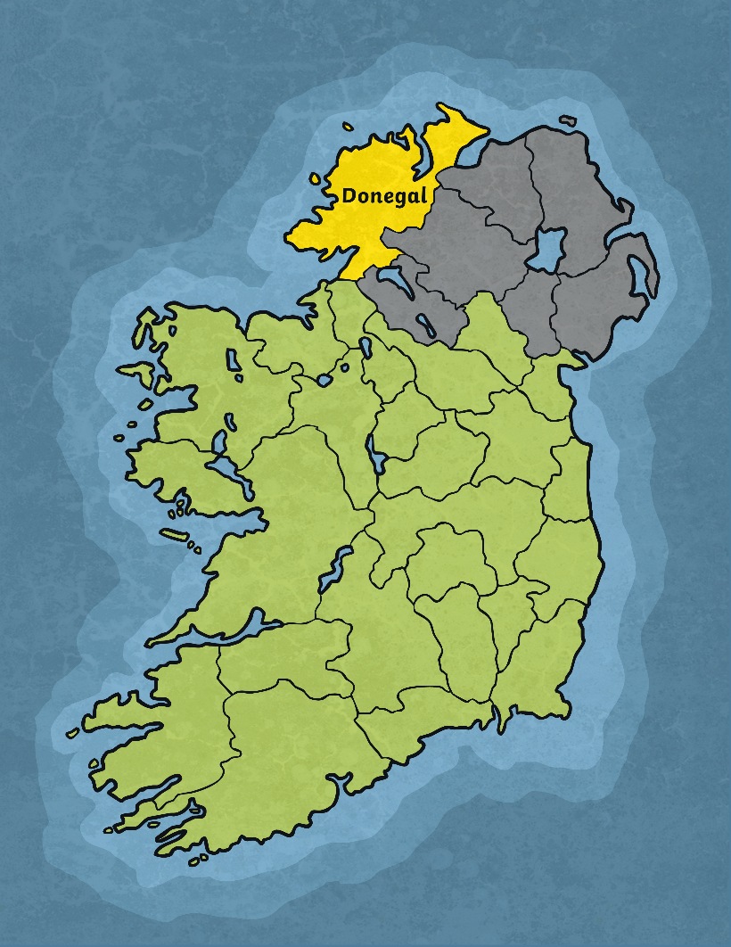
The Early Years
Saint Colmcille was born in Gartan, Co. Donegal in AD521.
He was christened Crimhthann, but was known as Colmcille later in his life.
His mother was Princess Eithne of Leinster.
His father, Fedelmidh, was the great grandson of King Niall of the Nine Hostages.

Slide 3
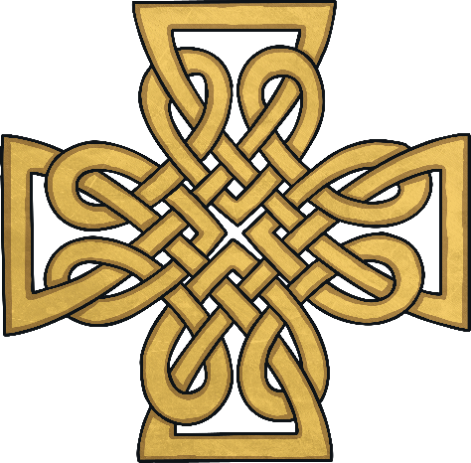
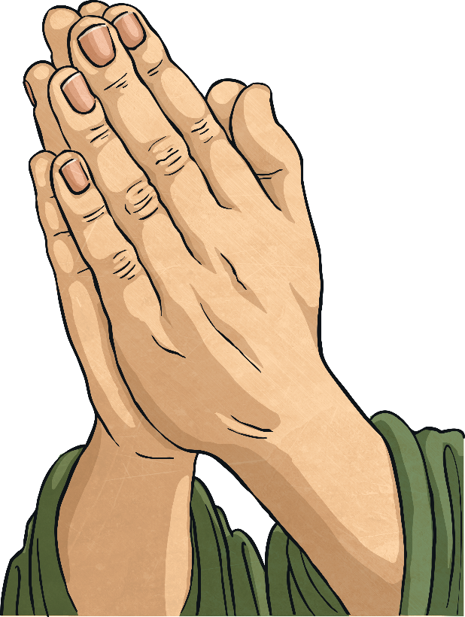
The Early Years
Colmcille was sent to be fostered by another family when he was young. This was normal for princes back in this time.
He was sent to the house of Cruithnechan, a holy man.
Colmcille spent a lot of his time in church, praying and meditating.

Slide 4
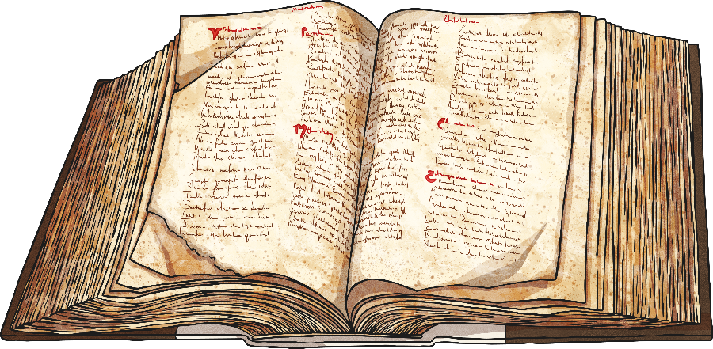
Education
Colmcille was a well-educated scholar. He attended many different schools around Ireland.
He first attended St. Finnian’s monastic school in Derry.
After this, he travelled down to Clonard Monastery, Co. Meath.
His last place of study was St. Mobhi’s, Glasnevin, Co. Dublin.
He only stayed a short time in Dublin because there was a breakout of the plague. He returned to Donegal at this point.

Slide 5
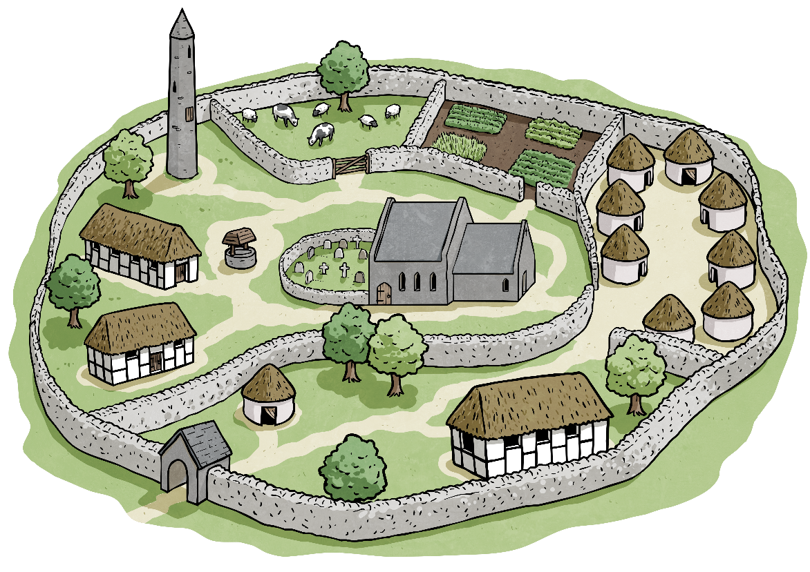
Monasteries
In AD545, he founded his first monastery in Co. Derry.
He went on to found over 60 monasteries and churches in Ireland, including ones in Swords, Co. Dublin and in the Burren, Co. Clare

Slide 6
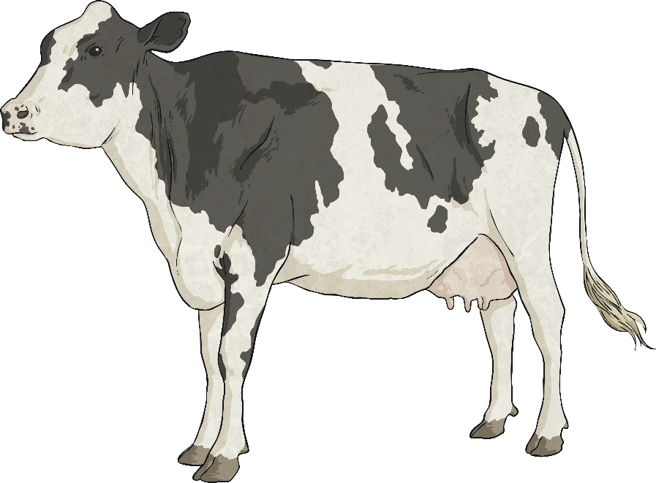
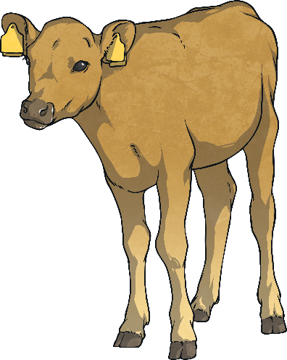
Copyright
Once Colmcille borrowed a book with psalms written in it from St. Finian. He copied it and intended to keep the copy. St. Finian disputed his right to keep it. The High King of Ireland was asked to solve the dispute. He ruled against Colmcille saying, 'To every cow belongs her calf, therefore to every book belongs its copy.' The first case of law against copyright.

Slide 7
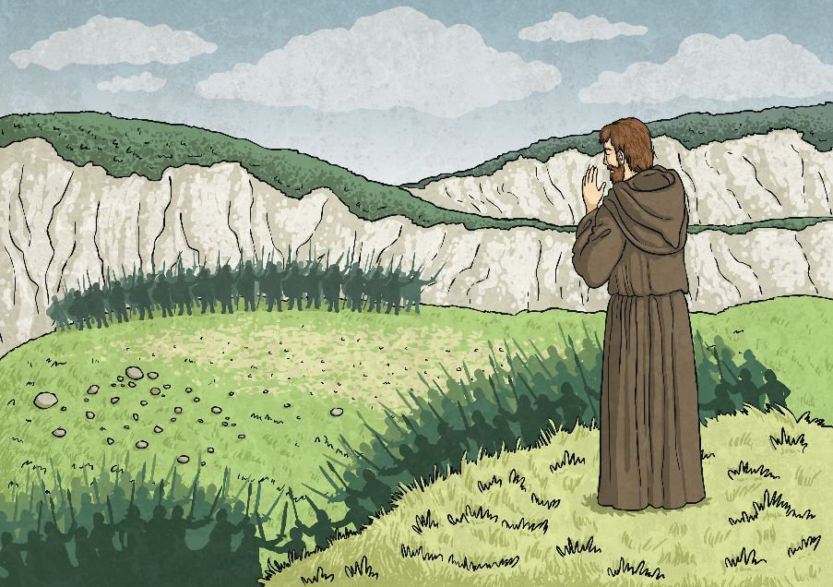
Pilgrimage to Iona
In AD563, Saint Colmcille travelled to the island of Iona off the western coast of Scotland.
He went into exile. The pilgrimage was a kind of repentance for his involvement in the Battle of Cúl Dreimhne, where 3,000 warriors died.

Slide 8
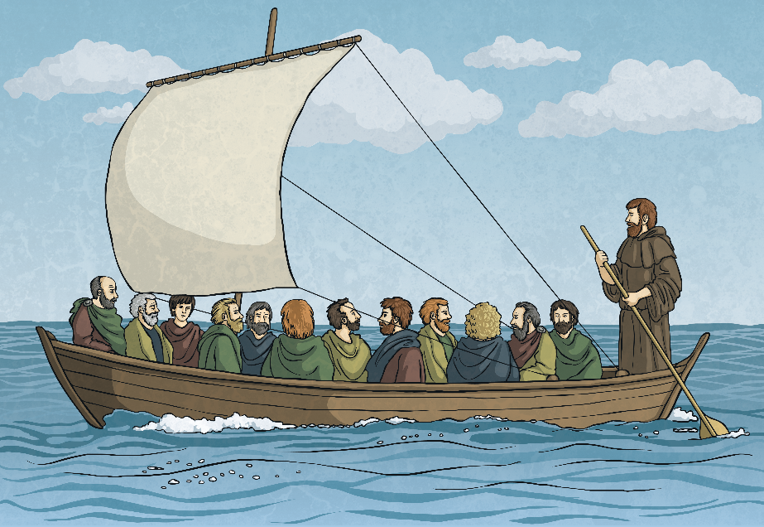
Pilgrimage to Iona
He set sail with 12 clansmen and sailed to Iona.
He founded a monastery here and spread the word of God to local people and to the people of the Picts tribe.

Slide 9
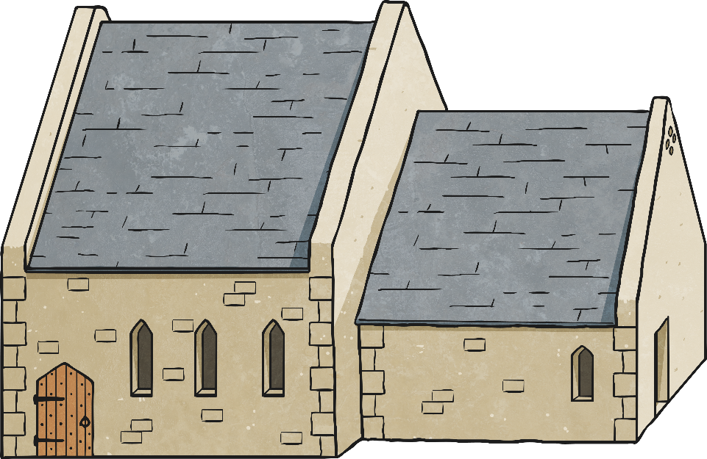
Iona
The monastery at Iona was originally very small and built in timber.
It soon began to thrive. The land was very fertile and there was plenty of timber available to build a large community.
Over time, the monastery was rebuilt in stone and in AD1200, it was taken over by the Augustinian monks.
High Kings of Scotland are buried in Iona.
Many people today go to Iona on a pilgrimage.

Slide 10
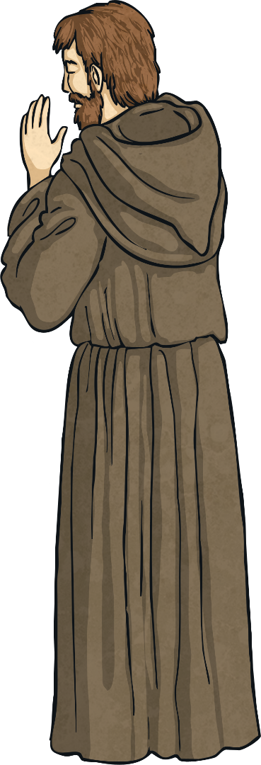
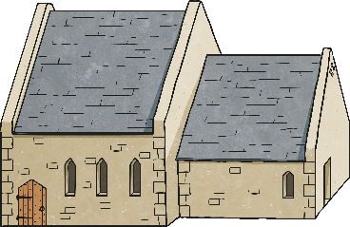
Later Years
Saint Colmcille died in AD597 at the age of 76.
Saint Colmcille died in the church, on the altar, in Iona.
His monks buried him in the grounds of his monastery on Iona and many years later, his bones were disinterred and are thought to be buried in Downpatrick, County Down, with Saint Patrick and Saint Brigid.

Slide 11
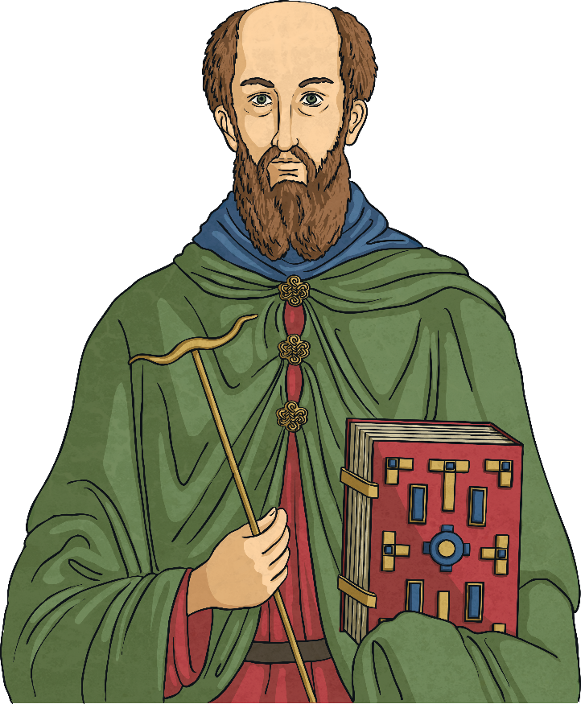
Patron Saint of Ireland
Saint Colmcille is one of Ireland’s patron saints, along with Saint Patrick and Saint Brigid.

Slide 12
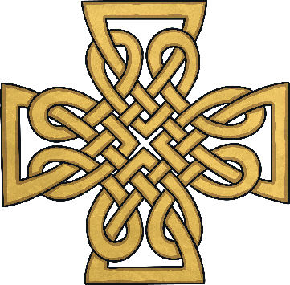
Prayer to Saint Colmcille
Dear Colmcille,
Saint of great gifts,
protect us every hour
from early morning
and during the day.
Fill our hearts
with pure love of God
to do his blessed will,
as you yourself would do.
Amen.
June 9 is the feastday of St. Colmcille.
th

