Slide 1


YOUR CHALLENGE
Create aCreate a tower
INSTRUCTIONS
Using paper as the main material, try to build the best structure you can
You will need to make sure you plan the structure of your building first before starting.
When you have finished, test how strong your structure is by putting your favourite teddy bear at the top, without it falling.
Take a video or photo and share it with us!

Slide 2
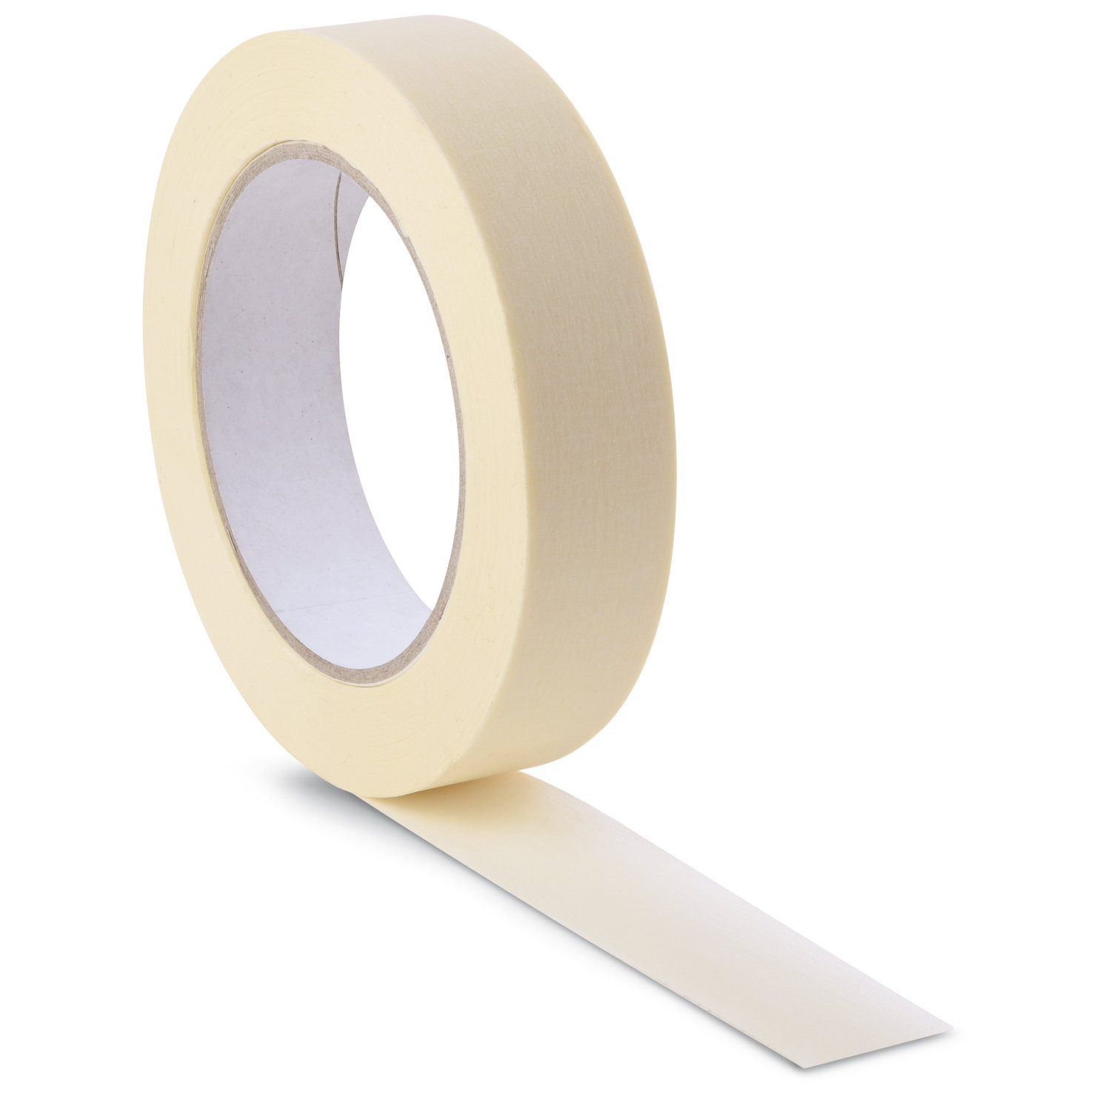


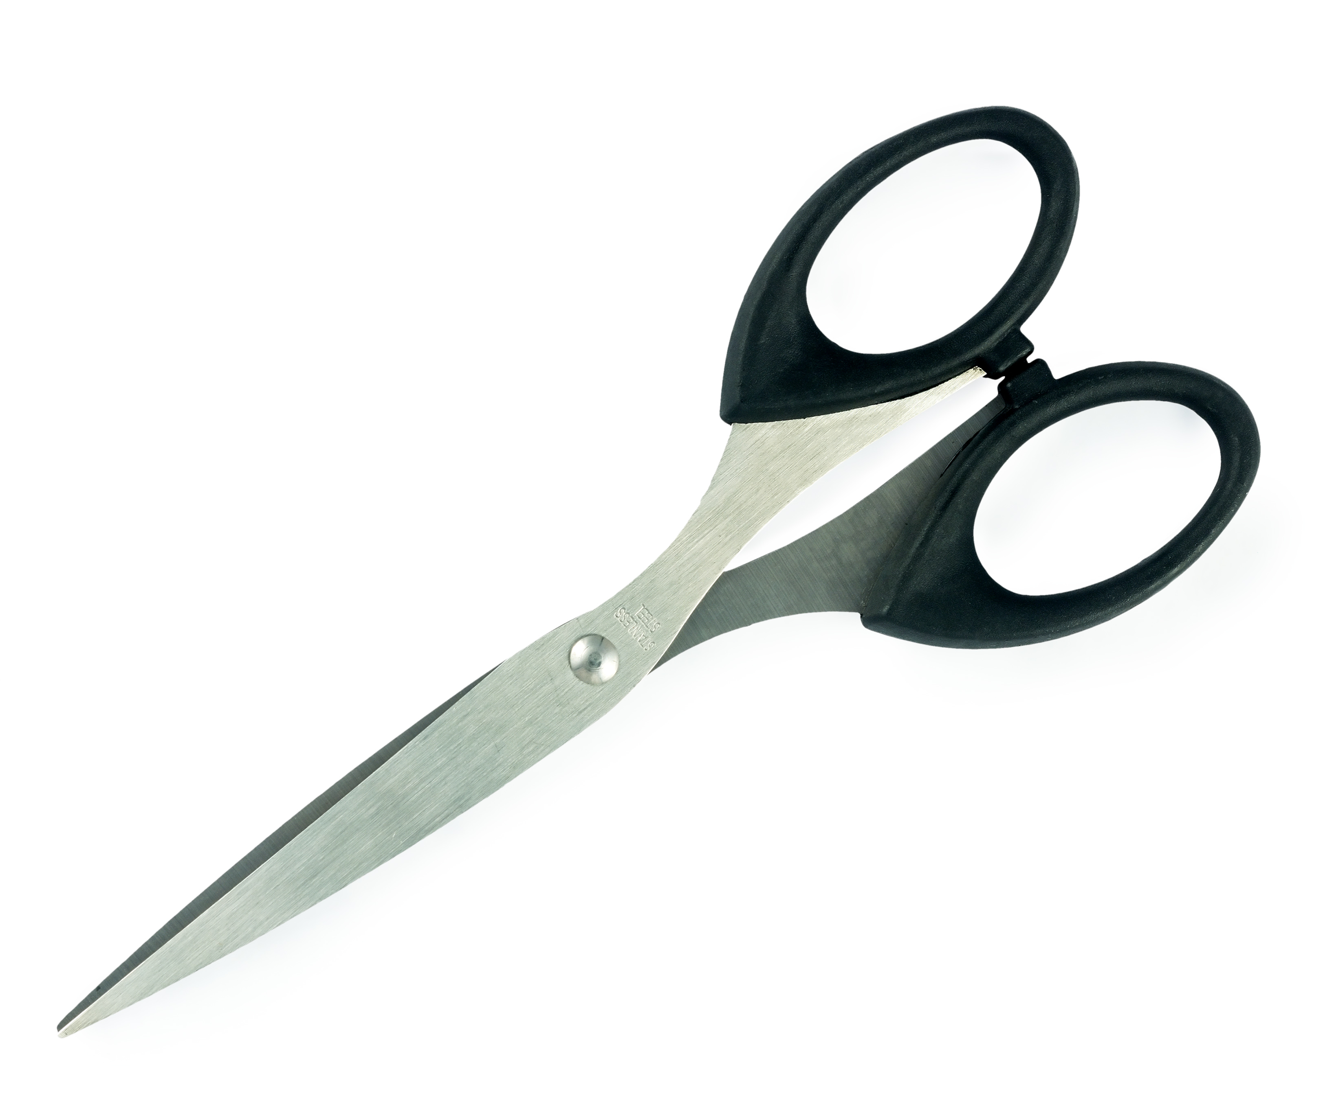
STEP 1
Gather Your Materials

Slide 3
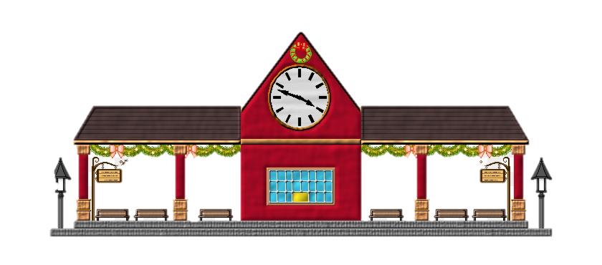
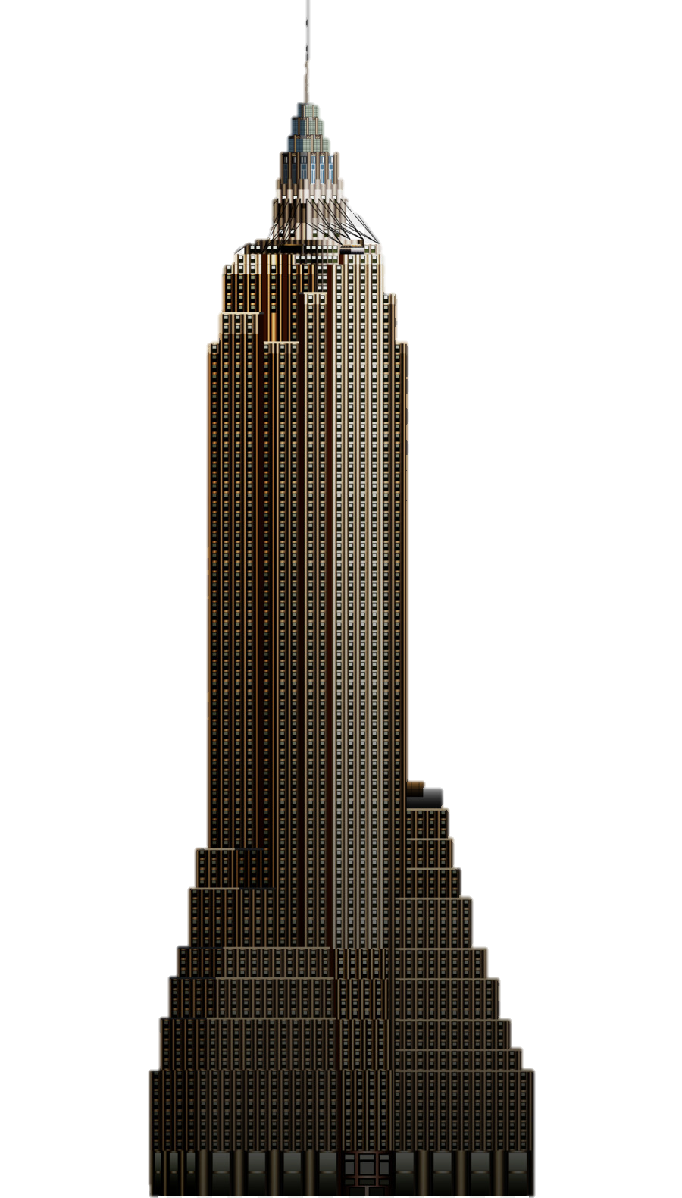
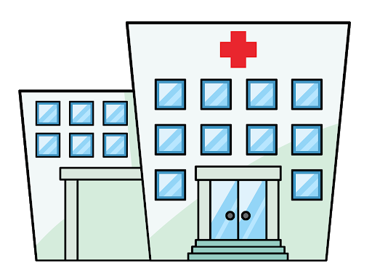

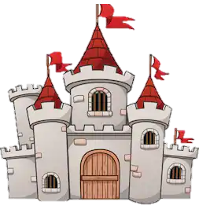

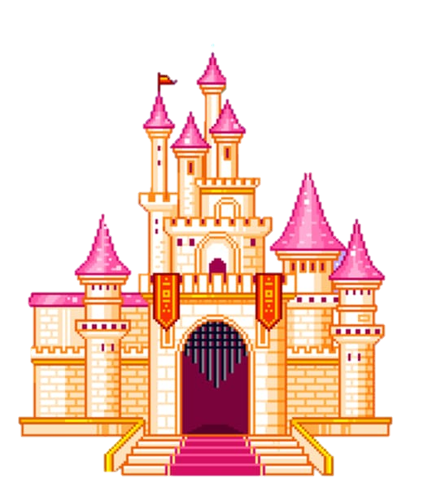

STEP 2
Choose what you are going to build

Slide 4
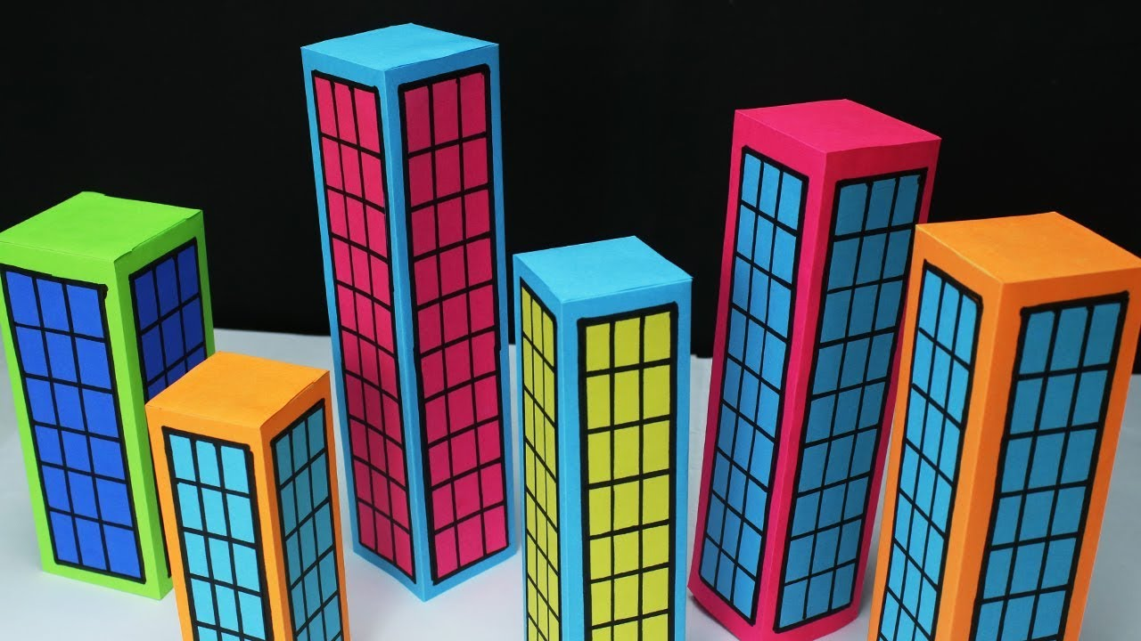
STEP 3
Plan and build your structure
Now that you have decided what type of building your going to make we need to make a plan.
You need to make sure your building will be strong and have steady foundations.
When you have finished, test how strong your structure is by putting your favourite teddy bear at the top, without it falling.

Slide 5




Send us a picture of your project
@ Sentinus
@ SentinusNi
@ Sentinus_ni

Slide 6


Slide 7

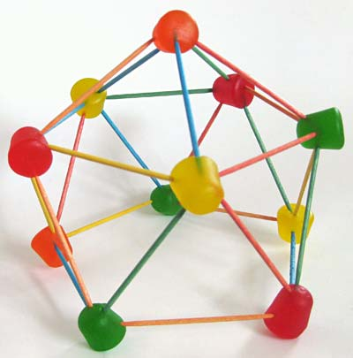
LET’S INVESTIGATE
Using Jelly babies and spaghetti build the strongest and highest tower
Measure it with a measuring tape and record how high it is
Remember it must stand by itself so you will have to make sure it has a strong FOUNDATION
Send us a picture of your finished tower so we can pick a winner

