Slide 2
Metric Measurements
litre
centi | hundredth | one hundred times smaller (than a litre)
milli | thousandth | one thousand times smaller (than a litre)
If you know that a centilitre is one hundred times smaller than a litre…
How much smaller than a litre do you think a millilitre is?

Slide 3
Converting between millilitres and centilitres
For every centilitre, there are 10 millilitres.
Remember!
1000 millilitres
100 centilitres
1 litre
× 10
1000 milli | 100 centi | 1 litre
÷ 10
If 1000 millilitres = 100 centilitres
What would 20 centilitres be in millilitres?
20cl = 200ml
How did you do it?
for every
1000 millilitres
100 centilitres
1 litre

Slide 4
Converting between millilitres and centilitres
For every centilitre, there are 10 millilitres.
Remember!
1000 millilitres
100 centilitres
1 litre
× 10
1000 milli | 100 centi | 1 litre
÷ 10
If 1000 millilitres = 100 centilitres
What would 4000 millilitres be in centilitres?
4000ml = 400cl
How did you do it?
for every
1000 millilitres
100 centilitres
1 litre

Slide 5
Converting between millilitres and centilitres
For every centilitre, there are 10 millilitres.
Remember!
1000 millilitres
100 centilitres
1 litre
× 10
1000 milli | 100 centi | 1 litre
÷ 10
What is 300ml in cl? 30cl
What is 420cl in ml? 4200ml
What is 570ml in cl? 57cl
for every
1000 millilitres
100 centilitres
1 litre

Slide 6
Converting between litres and centilitres
In every litre, there are 100 centilitres.
Remember!
1000 millilitres
100 centilitres
1 litre
× 100
1000 milli | 100 centi | 1 litre
÷ 100
What would 6000 centilitres be in litres?
6000 cl = 60l
How did you do it?
If 100 centilitres = 1 litre
What would 6 litres be in centilitres?
6l = 600cl
How did you do it?
How did you do it?

Slide 7
Converting between litres and centilitres
In every litre, there are 100 centilitres.
Remember!
1000 millilitres
100 centilitres
1 litre
× 100
1000 milli | 100 centi | 1 litre
÷ 100
What would 6000 centilitres be in litres?
6000 cl = 60l
How did you do it?
If 100 centilitres = 1 litre
What would 6000 centilitres be in litres?
6000cl = 60l
How did you do it?
How did you do it?

Slide 8
Converting between litres and centilitres
In every litre, there are 100 centilitres.
Remember!
1000 millilitres
100 centilitres
1 litre
× 100
1000 milli | 100 centi | 1 litre
÷ 100
What would 6000 centilitres be in litres?
6000 cl = 60l
How did you do it?
What is 500cl in l? 5l
What is 8l in cl? 800ml
What is 2600cl in l? 26l
How did you do it?

Slide 9
Converting between litres and millilitres
In every litre, there are 1000 millilitres.
Remember!
1000 millilitres
100 centilitres
1 litre
× 1000
1000 milli | 100 centi | 1 litre
÷ 1000
If 1000 millilitres = 1 litre
What would 5 litres be in millilitres?
5l = 5000ml
How did you do it?

Slide 10
Converting between litres and millilitres
In every litre, there are 1000 millilitres.
Remember!
1000 millilitres
100 centilitres
1 litre
× 1000
1000 milli | 100 centi | 1 litre
÷ 1000
If 1000 millilitres = 1 litre
What would 5 litres be in millilitres?
5l = 5000ml
How did you do it?

Slide 11
Converting between litres and millilitres
In every litre, there are 1000 millilitres.
Remember!
1000 millilitres
100 centilitres
1 litre
× 1000
1000 milli | 100 centi | 1 litre
÷ 1000
If 1000 millilitres = 1 litre
What would 2000 millilitres be in litres?
2000ml = 2l
How did you do it?

Slide 12
Converting between litres and millilitres
In every litre, there are 1000 millilitres.
Remember!
1000 millilitres
100 centilitres
1 litre
× 1000
1000 milli | 100 centi | 1 litre
÷ 1000
What is 12000ml in l? 12l
What is 7l in ml? 7000ml
What is 1500ml in l? 1.5l

Slide 13
Converting between litres, centilitres and millilitres
Complete the table below:
litres | centilitres | millilitres
2.6 | 260 | 2600
0.75 | 75 | 750
0.6 | 60 | 600
0.2 | 20 | 200
3.5 | 350 | 3500
11.2 | 1120 | 11 200
Remember!
1000 millilitres
100 centilitres
1 litre

Slide 14
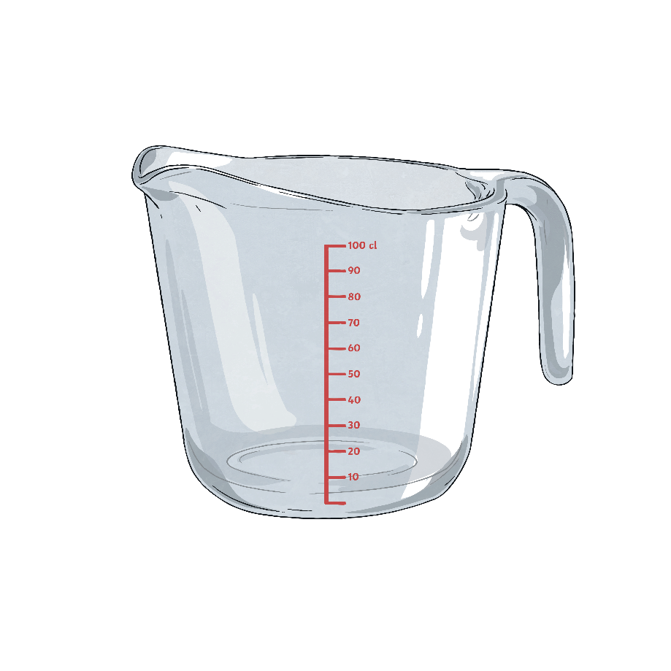
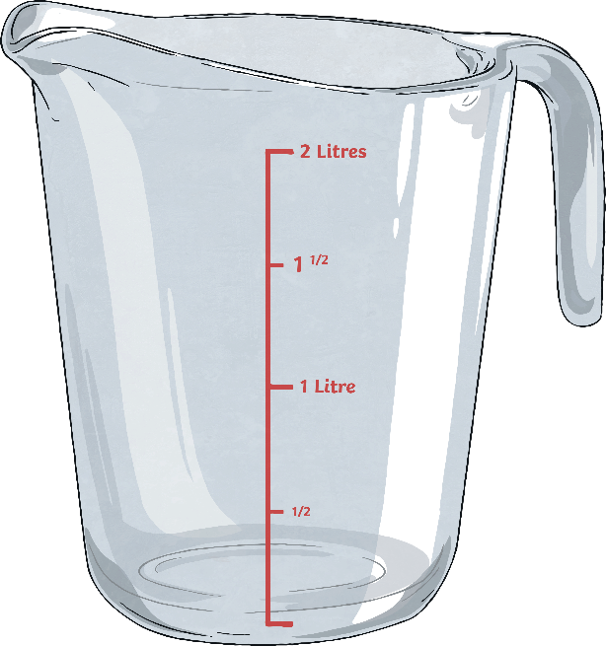
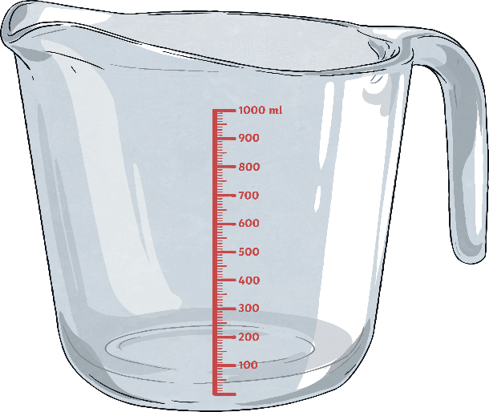
Ordering Capacity
How much water does each jug hold?
Order the jugs from most liquid to least liquid.
350ml
75cl
2 litre
2 litre
350ml
75cl

Slide 15
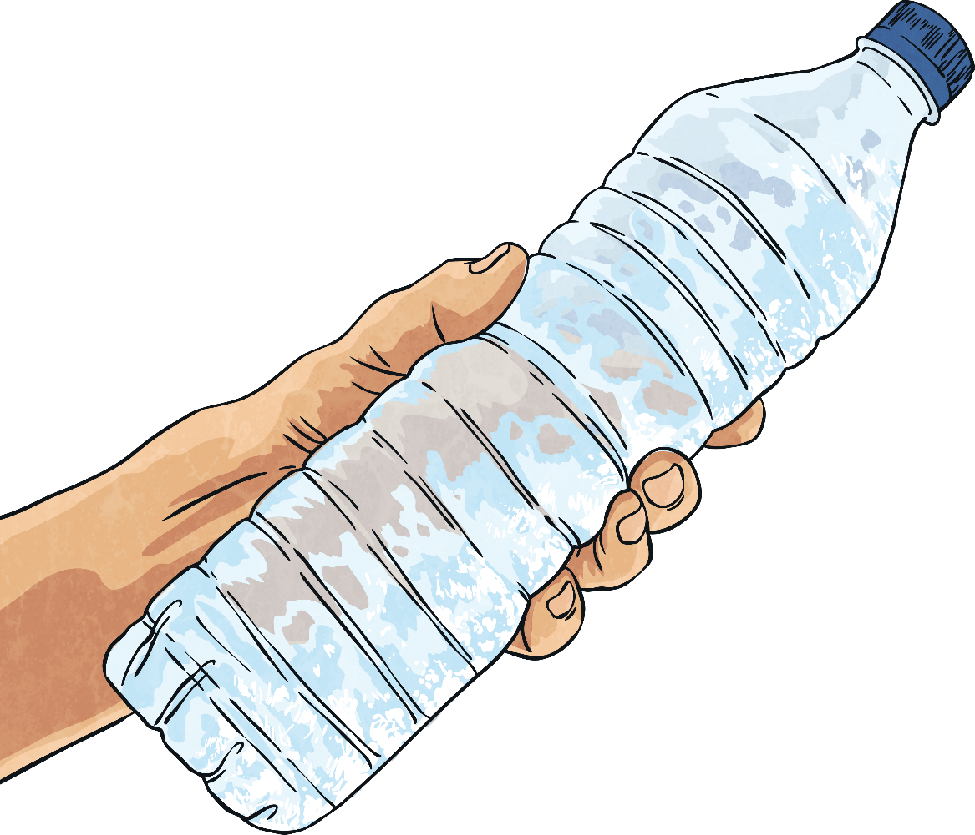
Challenge Question 1
Remember!
1000 millilitres
100 centilitres
1 litre
Sarah has a new water bottle.
It holds 750ml of liquid in it,
how many centilitres can it hold?
750 ÷ 10 = 75
It can hold 75cl of liquid.

Slide 16
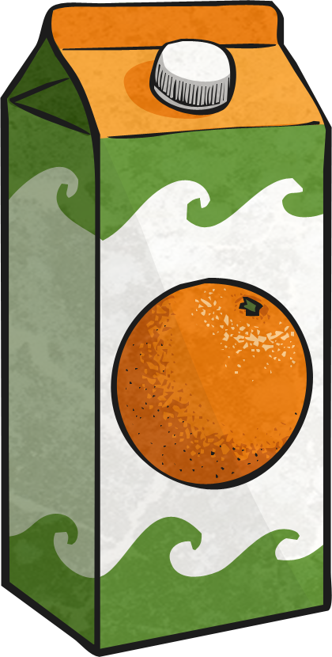
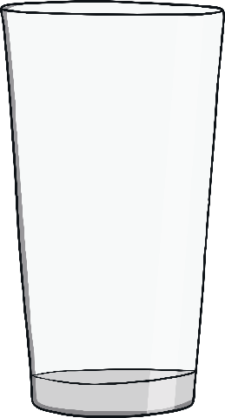
Challenge Question 2
Remember!
1000 millilitres
100 centilitres
1 litre
Mohammed buys a 3.5 litre bottle of orange juice. How many millilitres has he got?
3.5 × 1000 = 3500
He has 3500ml of orange juice.

Slide 17
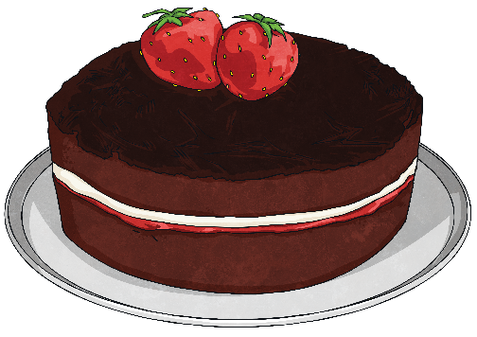
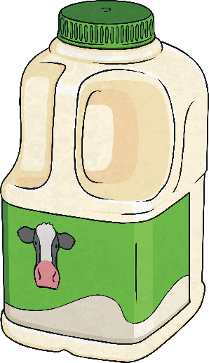
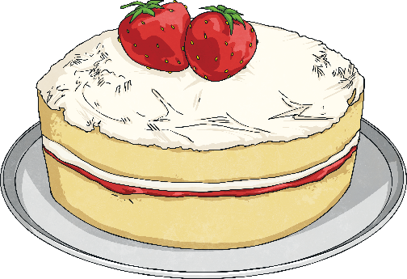
Challenge Question 3
Remember!
1000 millilitres
100 centilitres
1 litre
Amina needs 45cl of milk for a cake recipe. She has 1 litre of milk. If she bakes 2 cakes, will she have enough milk? How much more will she need or how much will she have left over?
45 × 2 = 90 cl
1 litre = 100 cl
Amina has enough milk to make two cakes, and will have 10cl left over.

Slide 18

Challenge Question 4
Remember!
1000 millilitres
100 centilitres
1 litre
Jayne buys a 2 litre bottle of water from the shop. She pours two equal glasses of water and has 1150ml left. How much water was in each glass?
2000 – 1150 = 850 ml
850 ÷ 2 = 425
There was 425ml in each glass.

