Slide 2
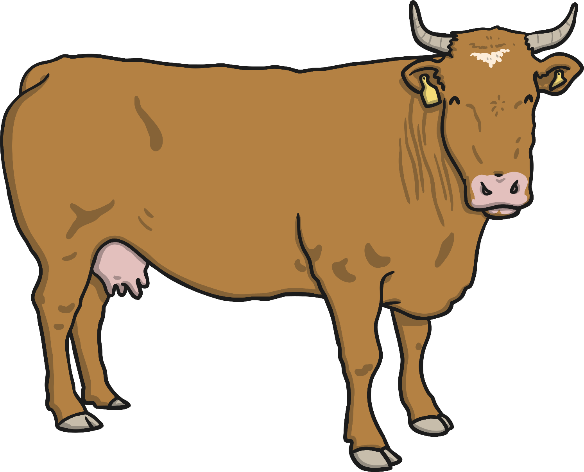
Feicim bó ar an bhfeirm.

Slide 3
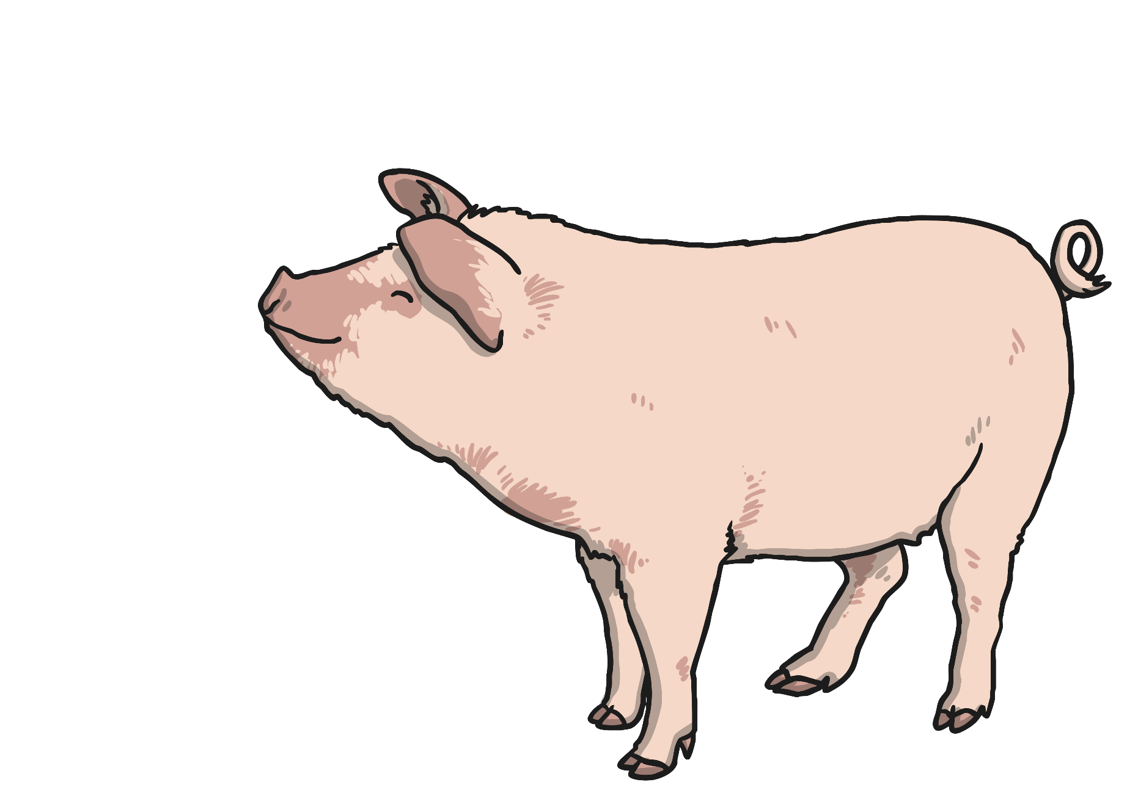
Feicim muc ar an bhfeirm.

Slide 4
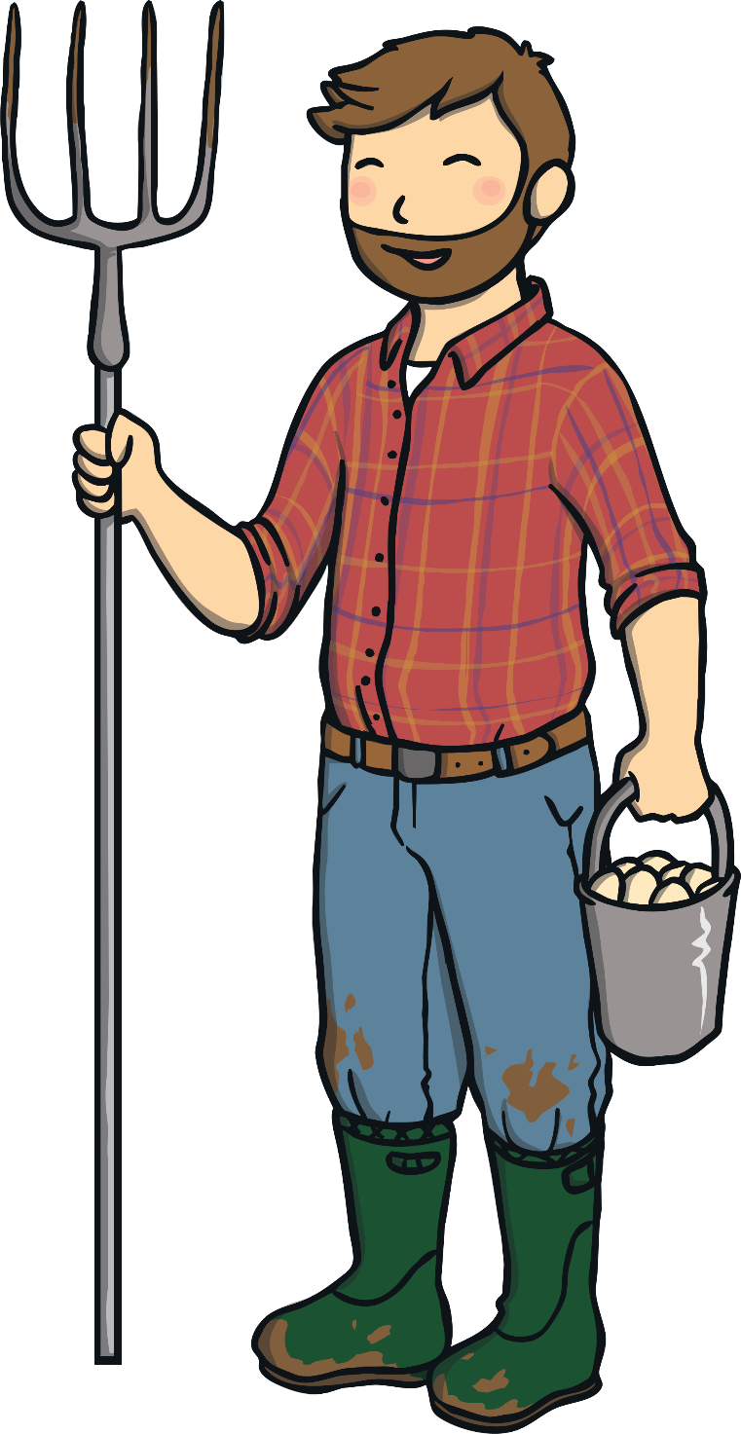
Feicim feirmeoir ar an bhfeirm.

Slide 5
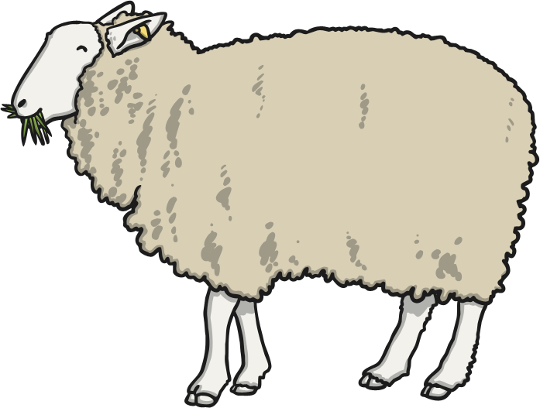
Feicim caora ar an bhfeirm.

Slide 6
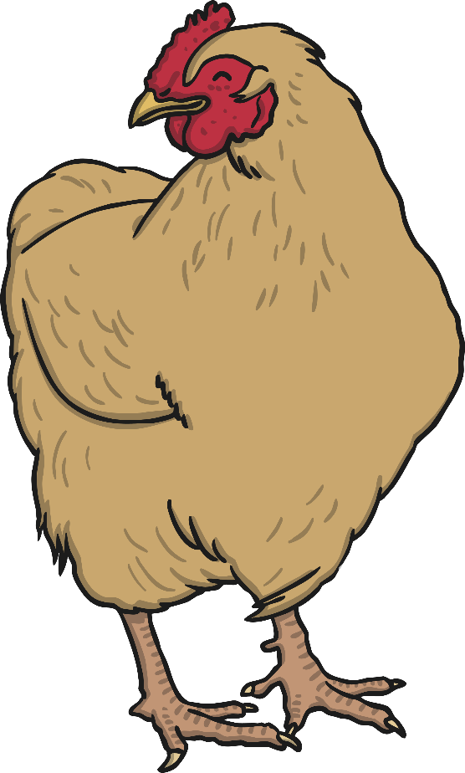
Feicim sicíní ar an bhfeirm.

Slide 7
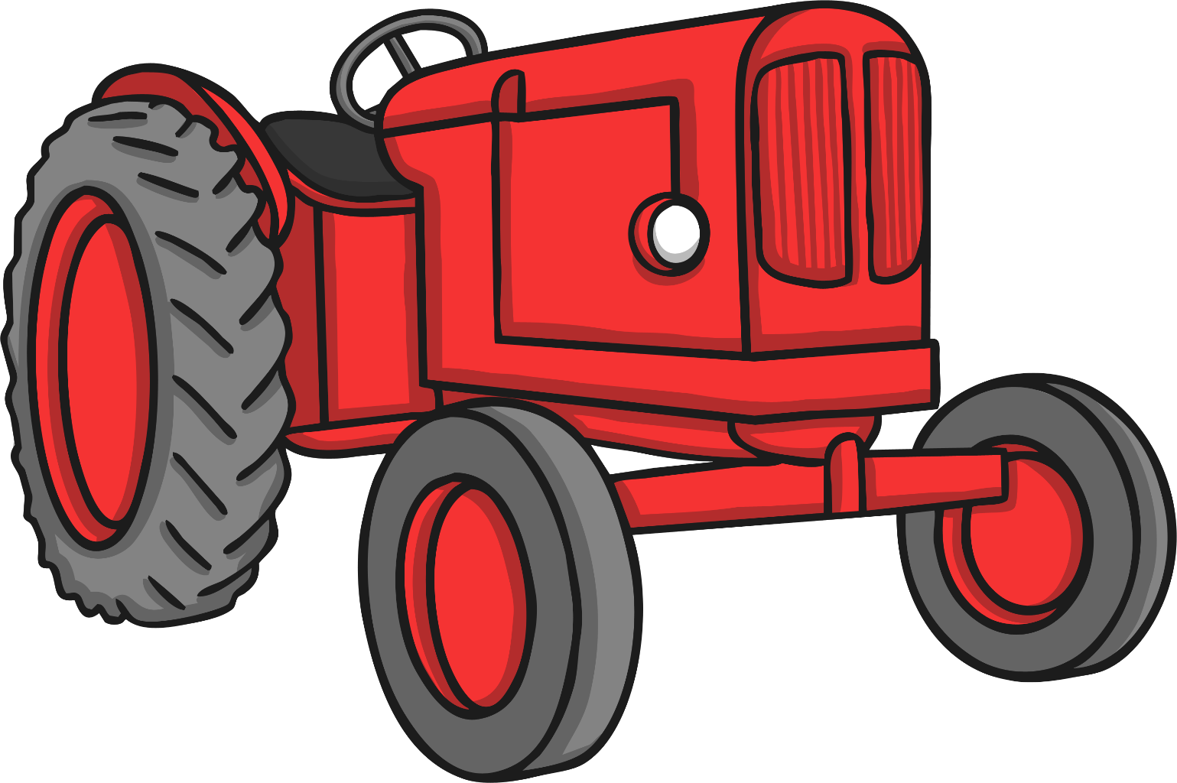
Feicim tarracóir ar an bhfeirm

Slide 8
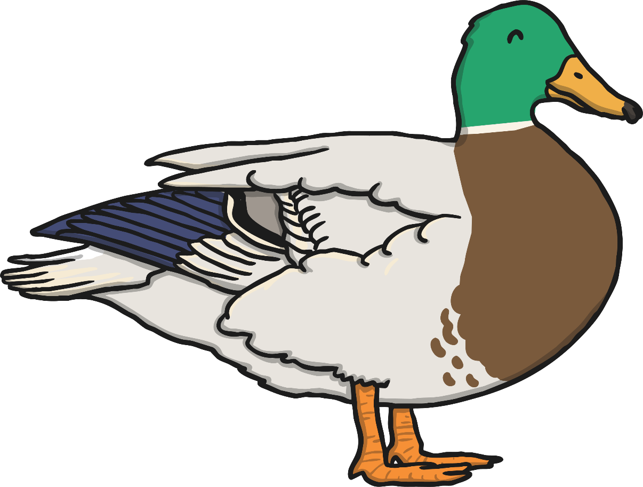
Feicim lacha ar an bhfeirm.

Slide 9
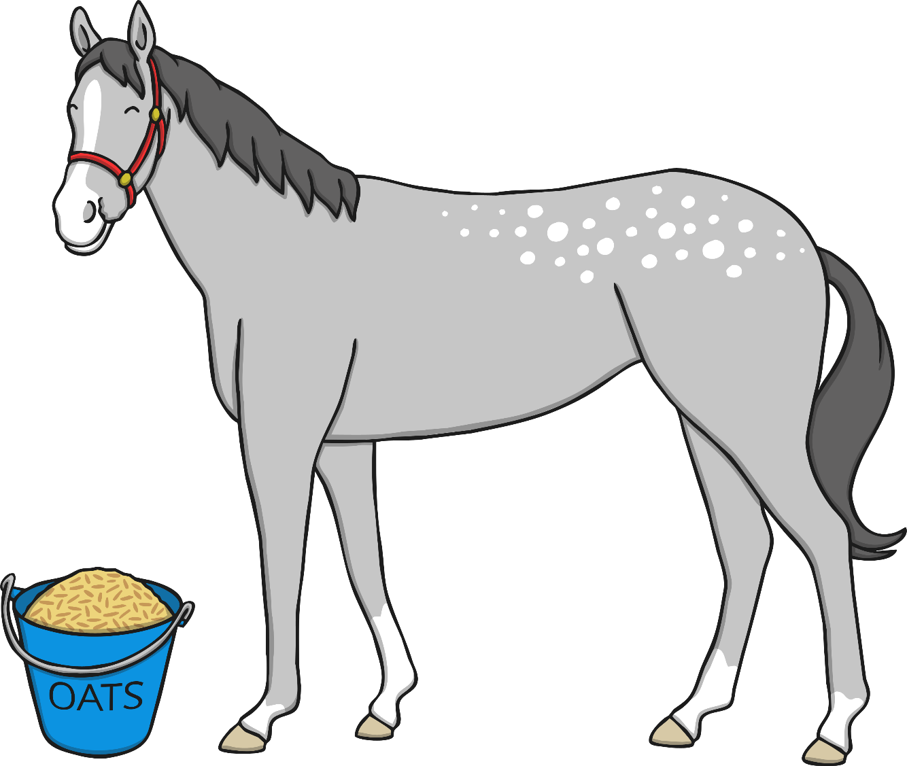
Feicim capall ar an bhfeirm.

Slide 10
Feicim teach feirme ar an bhfeirm.

Slide 11
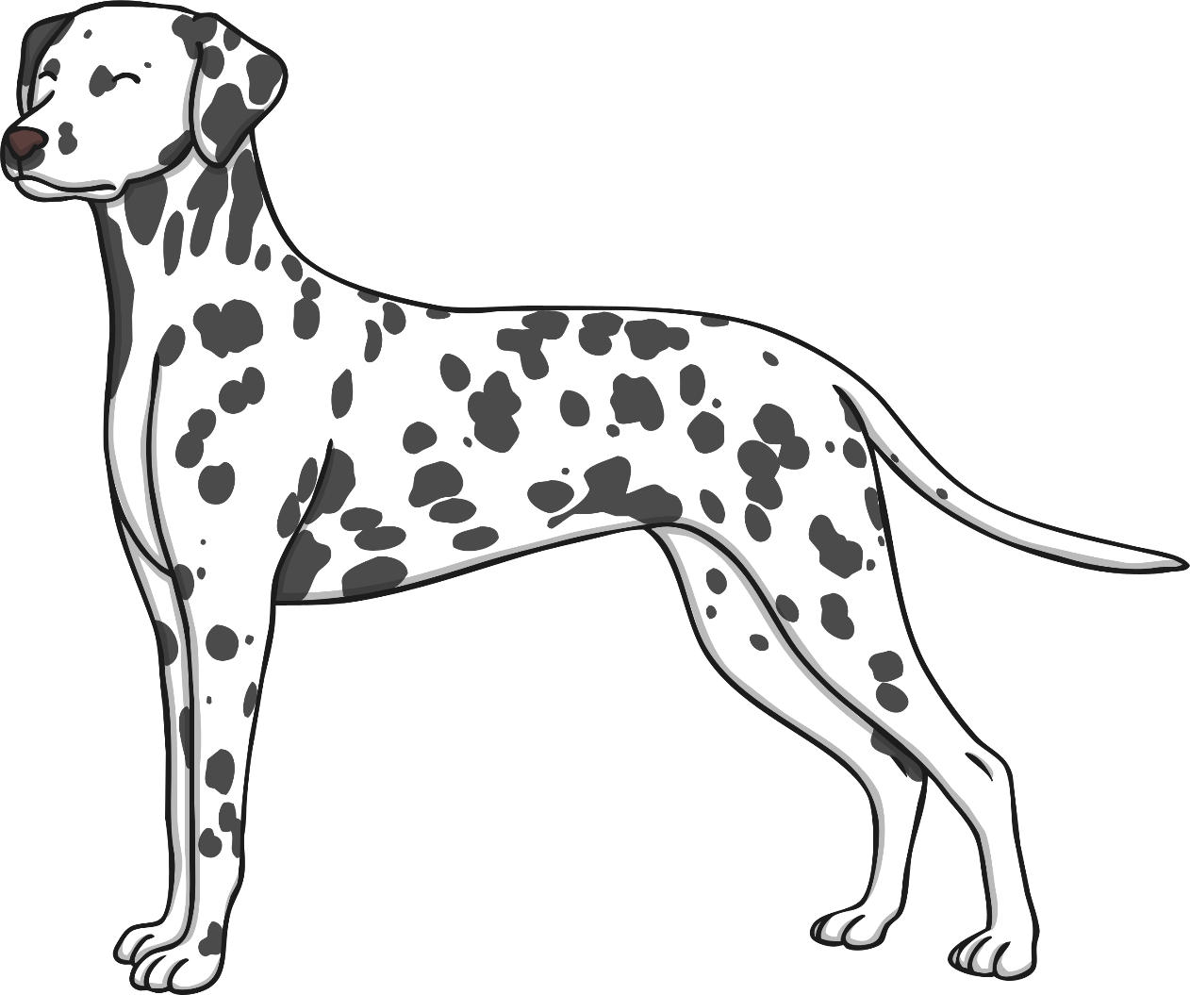
Feicim madra ar an bhfeirm.

