Slide 2
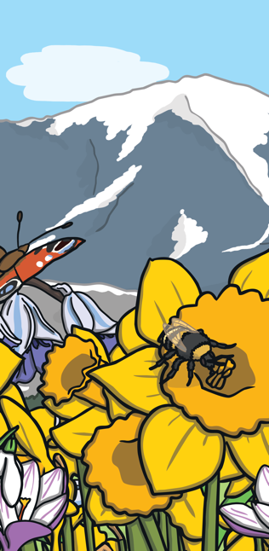
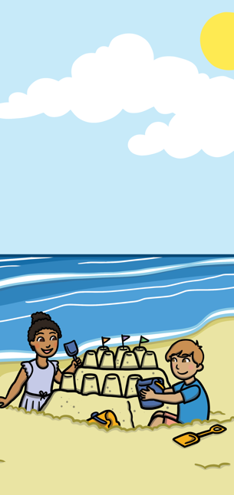
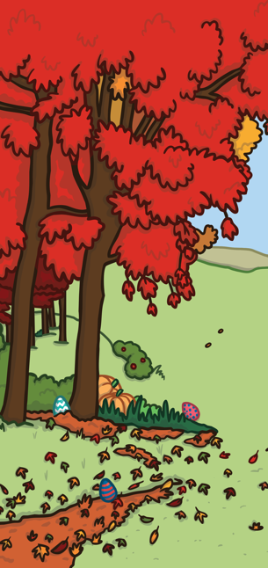
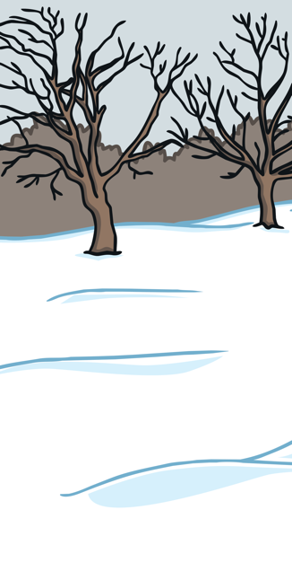
What Happens in Winter?
During the winter there is less sunlight, which means the days are shorter and colder than during any other season.
Winter is one of the four seasons.
It is the season that comes after autumn.
Winter begins at the beginning of December and is finished at the end of February.
Most trees and plants stop growing in the winter.
There are several outside
activities that people enjoy
in the winter season such
as making snowmen, sledding,
and ice skating. Cold weather
and snow can be a lot of fun!
Many festivals are celebrated during the winter including Christmas, New Year and Hanukkah.
Many animals hibernate.
Winter

Slide 3
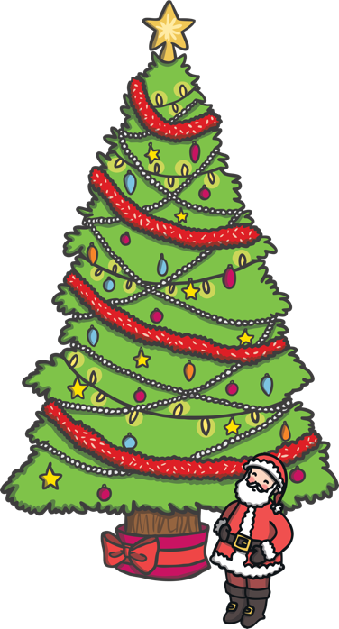
What Happens in Winter?
In winter the deciduous trees lose nearly all of their leaves. Tiny buds can be seen tightly wrapped together on tree branches. When the weather begins to warm in spring, the buds lengthen and begin to grow.
Evergreens keep their leaves.
People bring evergreen trees inside and decorate them as Christmas trees.

Slide 4
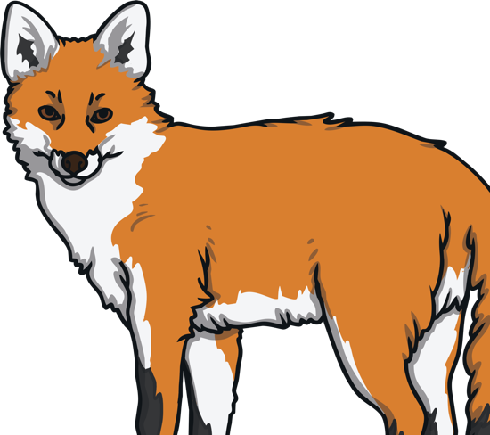
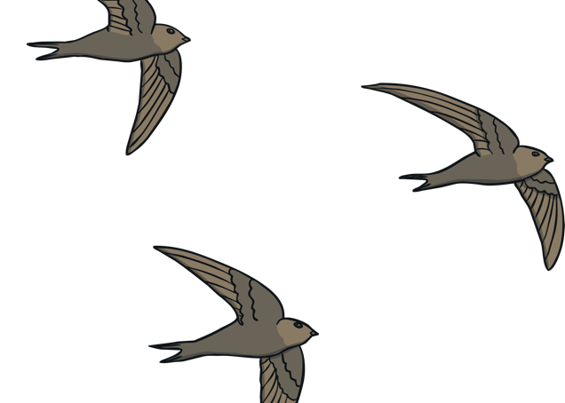
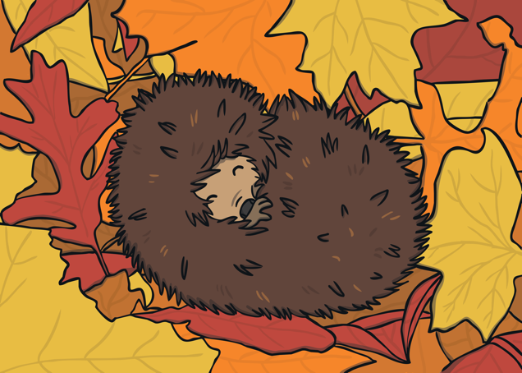
What Happens to Animals in Winter?
The weather becomes much colder in the winter.
People can wear warm clothes and buy their food from stores.
This is not possible for animals, so how do they survive?
Adaption
Migration
Hibernation
Not all birds migrate - some stay in their homes all winter. People can help these birds by feeding them. Other animals stay active in winter such as squirrels, rabbits, and foxes. It is more difficult for them to find food. Some animals grow more fur in winter to help them stay warm.
Hibernation is the way that some animals survive through the winter.
They find a safe place and fall into a very deep sleep. When the temperature is warmer, in the spring, they wake up again.
Some birds fly south for the winter, where it is warmer.
This is called migration. They go to a warmer place to find food.

Slide 5
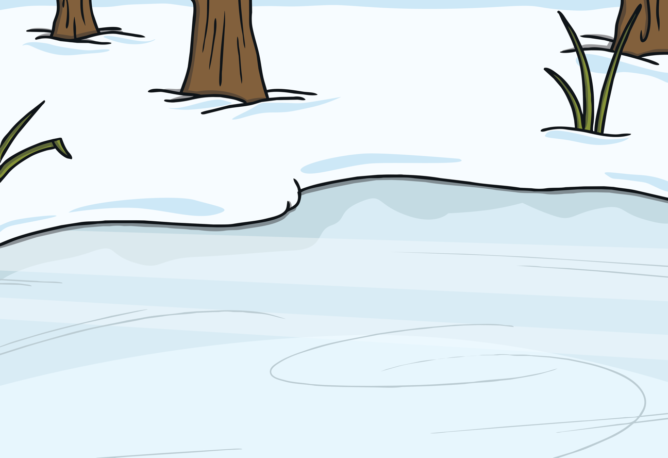
Winter Weather
The temperature outside drops during the winter.
When the temperature outside becomes very cold, water freezes and turns to ice.

Slide 6
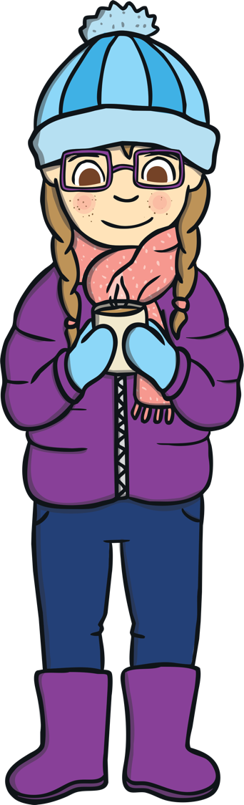
Staying Warm
To stay warm, people wear
extra clothing such as warm coats, hats, scarves, and gloves.
To keep our houses warm we light the fire or turn on the heating system.

Slide 7
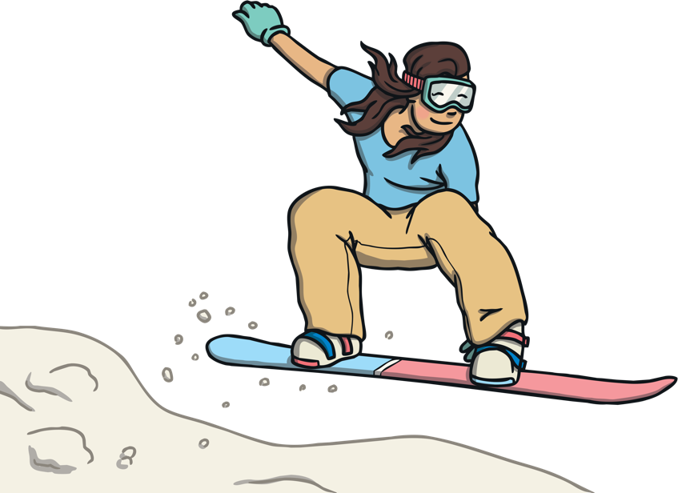
Winter Activities
Snow can be great fun. People take part in many activities such as building a snowman, having snowball fights, and sledding.
These sports all need snow:
snowshoeing
skiing
snowboarding

Slide 8
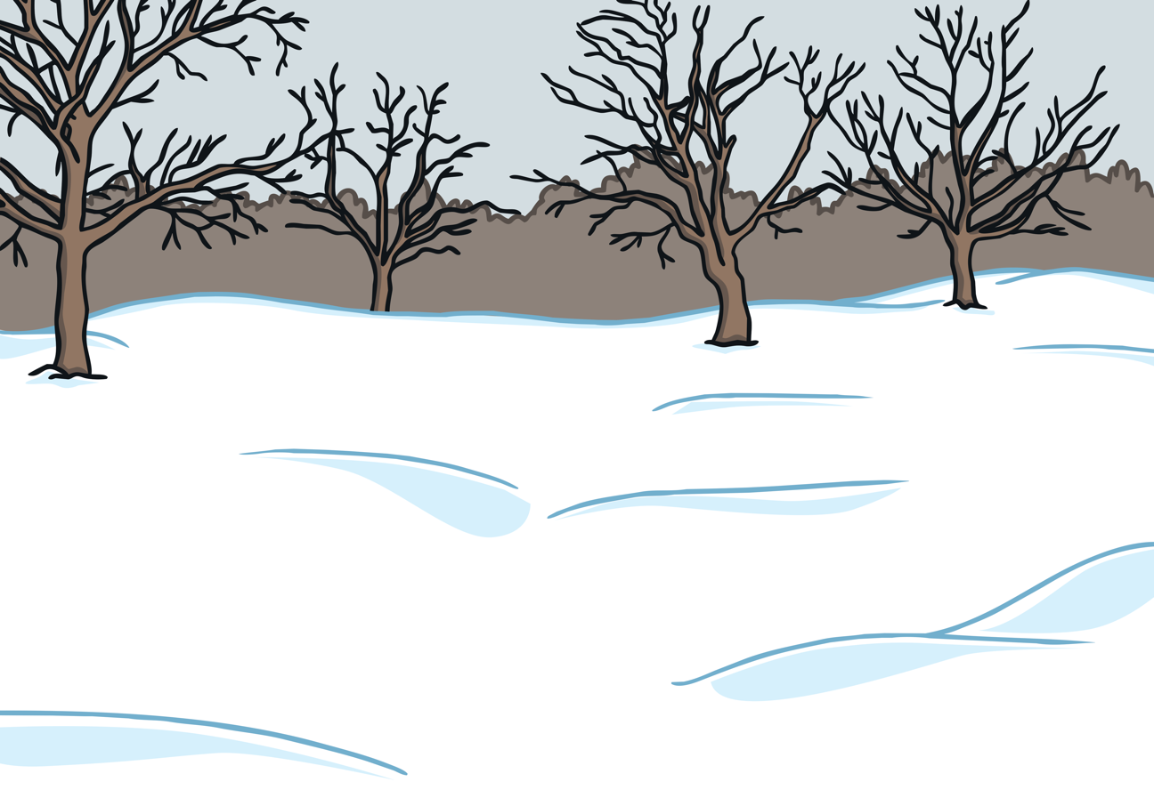
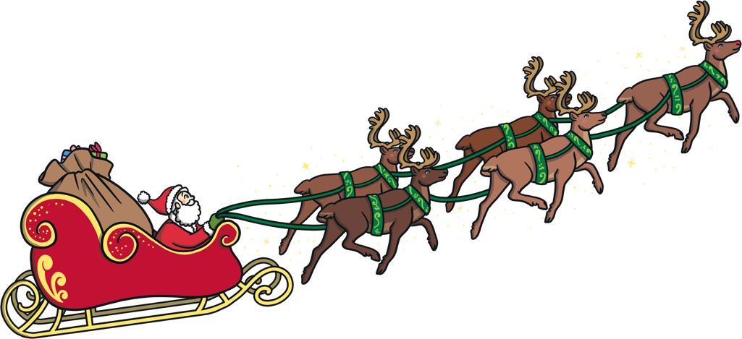
Celebrations in Winter
Christmas
Many people around the world celebrate Christmas Day on December 25th. This is a time that Christians remember the birth of Jesus.
Many people decorate their houses with lights, Christmas trees, and decorations. Christmas cards are exchanged sending good wishes. Children look forward to a visit from Santa Claus on Christmas Eve.
On Christmas Day presents are opened and family and friends often join together to share a special meal.

Slide 9

Celebrations in Winter
New Year
New Year's Day is the first day of the new year. It is celebrated as a holiday in almost every country in the world. It is a time of fun, remembering the past, and hoping for good things in the future.
Many people celebrate New Year’s Eve by spending time with family and friends, eating, watching fireworks, and dancing.

Slide 10
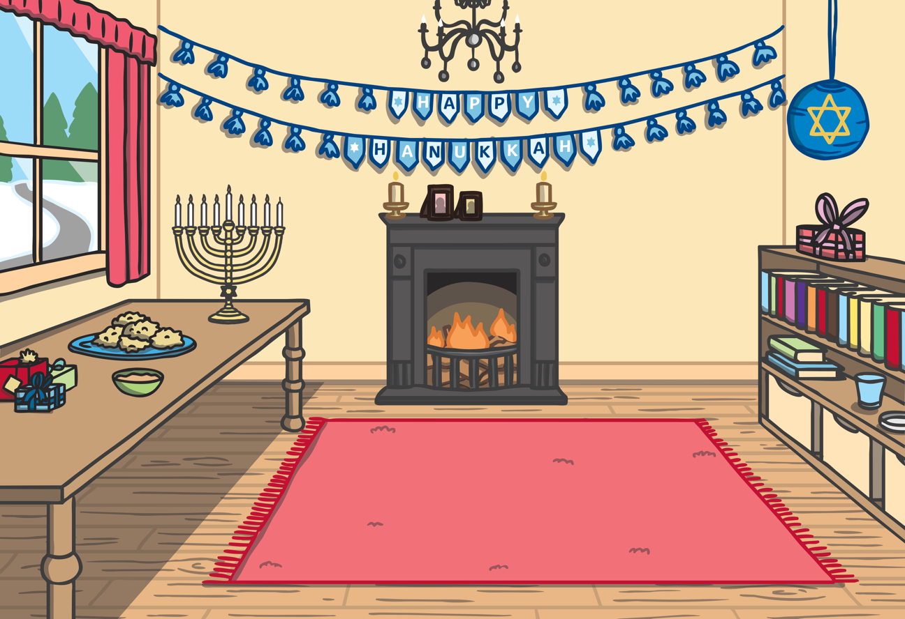
Celebrations in Winter
Hanukkah is a Jewish winter holiday.
Hanukkah is the annual Festival of Lights which can occur from late November through late December. The date changes yearly as it follows the Jewish calendar.
The festival is a reminder of the recapture of a temple which had been taken from the Jewish people. When the temple was cleaned, the Ner Tamid, or everlasting light, was lit. But there was only enough oil to burn for one night. Eight days later the lamp was still lit. This was seen as a miracle, showing that God was on their side in the fight against evil.
Hanukkah is a time for family and friends to get together. There are special meals, songs, stories, and games. Food is cooked in oil to celebrate the miracle of the oil which burned in the temple.

