Slide 1
Guidance for Video/Audio in PowerPoints
1. Open the folder and copy all the files.
2. Paste the copied files into a new folder.
3. Open the PowerPoint file, enable editing and enter presentation mode (start the slide show).
Please note the embedded audio may not be compatible with early versions of PowerPoint.

Slide 3
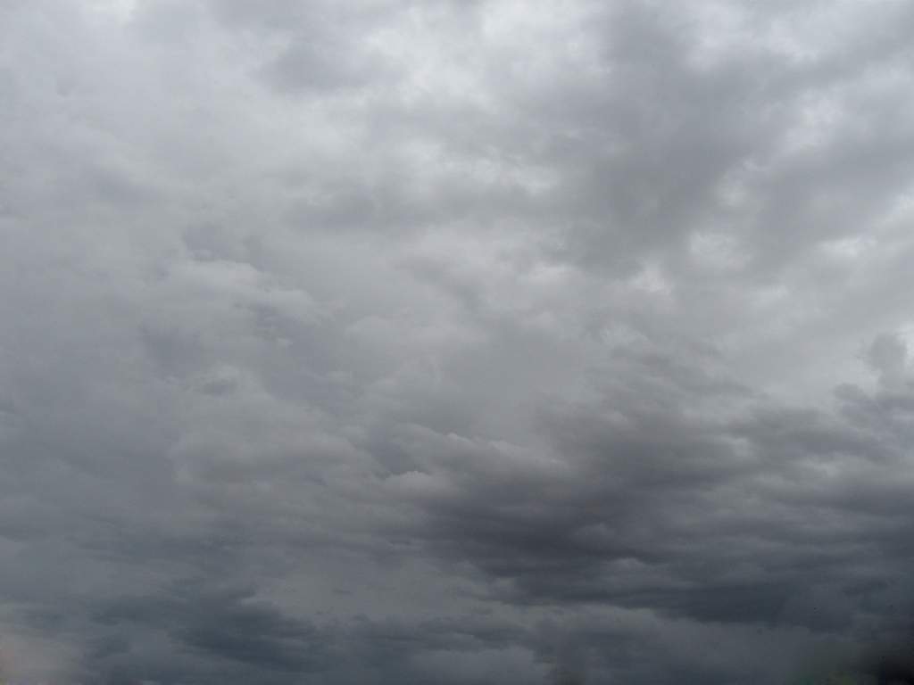
Scamall Tá sé scamallach.
Photo courtesy of second_mouse (@flickr.com) - granted under creative commons licence – attribution

Slide 4
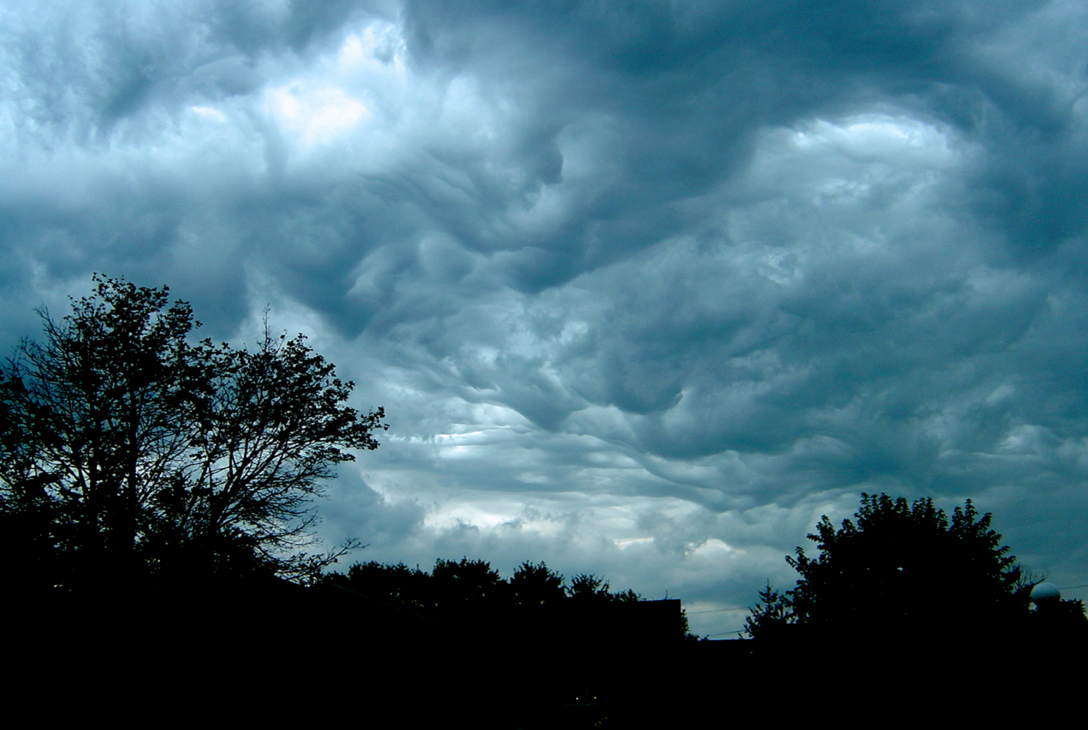
Stoirm Tá sé stoirmiúil.
Photo courtesy of laffy4k (@flickr.com) - granted under creative commons licence – attribution

Slide 5
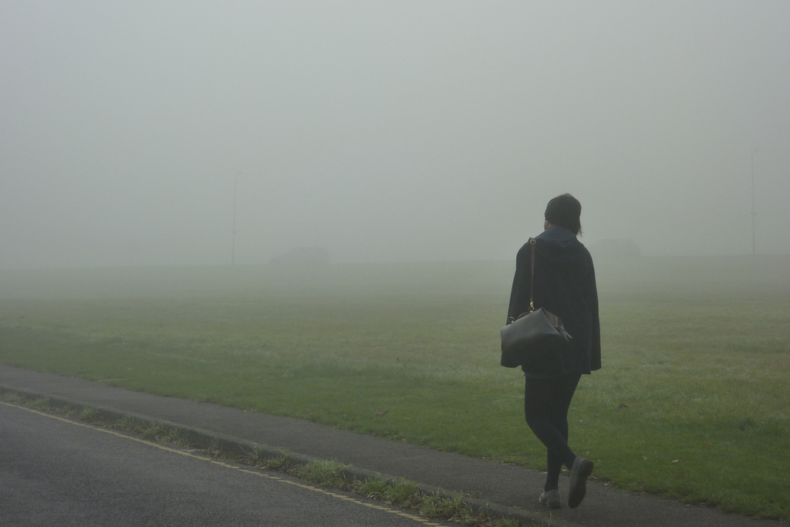
Ceo Tá sé ceomhar.
Photo courtesy of Juile70 (@flickr.com) - granted under creative commons licence – attribution

Slide 6
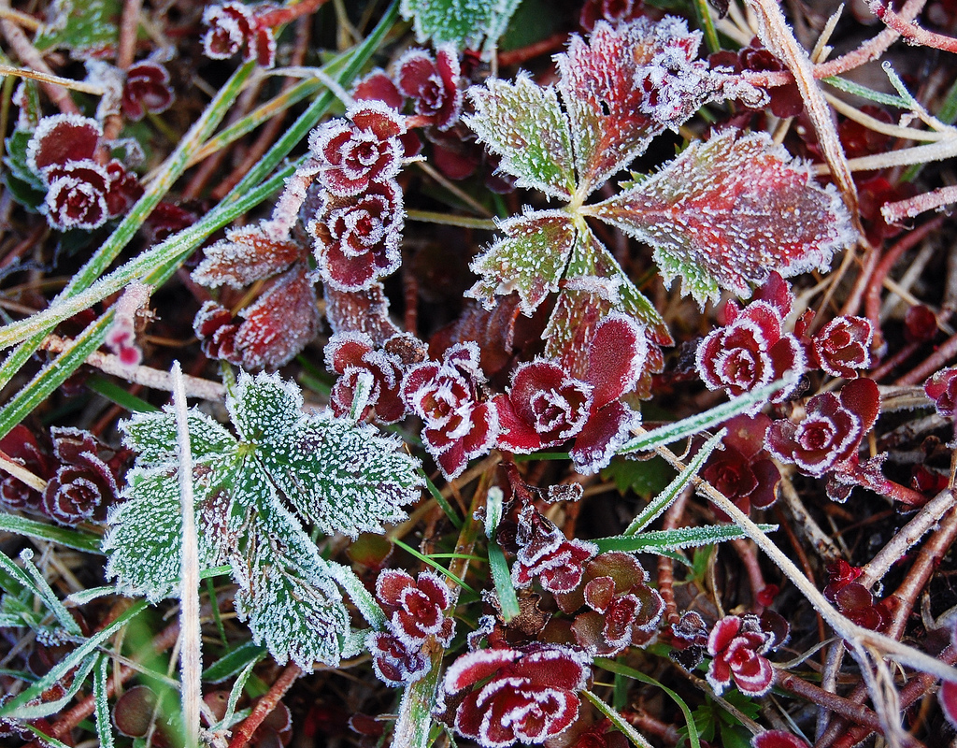
Sioc Tá sioc ar an talamh.
Photo courtesy of looseends (@flickr.com) - granted under creative commons licence – attribution

Slide 7
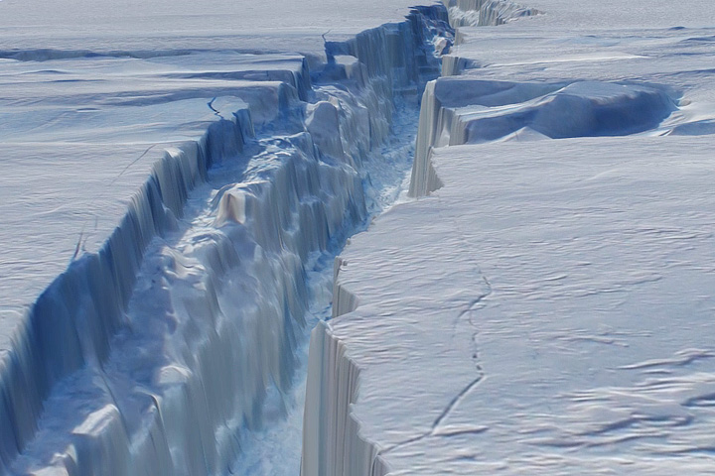
Leac Oighir
Photo courtesy of NASA Goddard Photo and Video (@flickr.com) - granted under creative commons licence – attribution

Slide 8
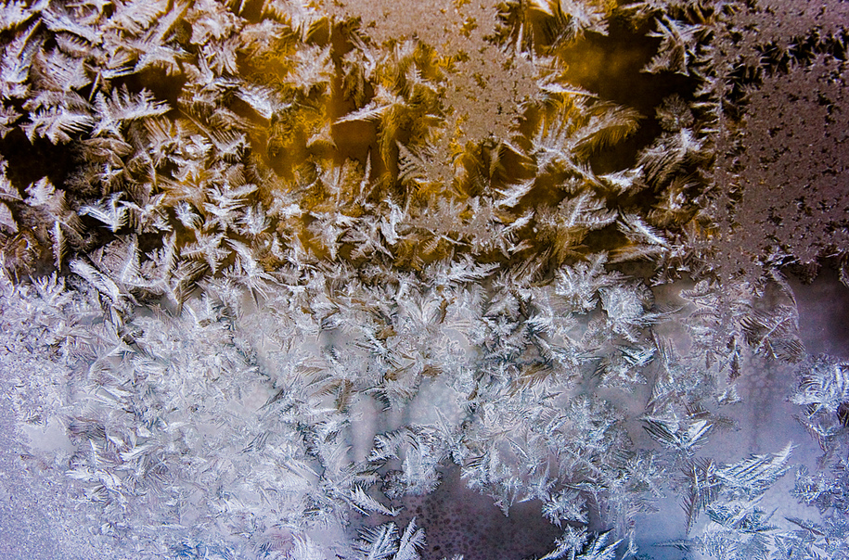
Tá sé reoite.
Photo courtesy of 1vo (@flickr.com) - granted under creative commons licence – attribution

Slide 9
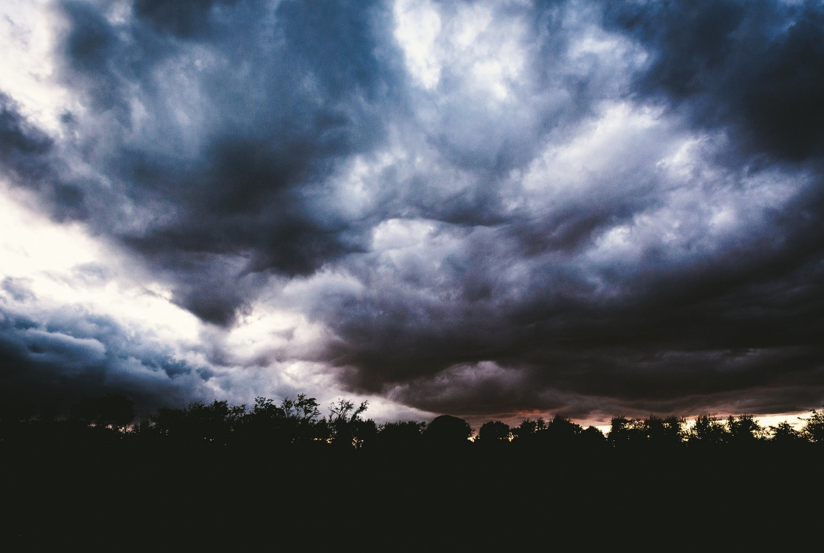
Toirneach Chuala mé toirneach.

Slide 10
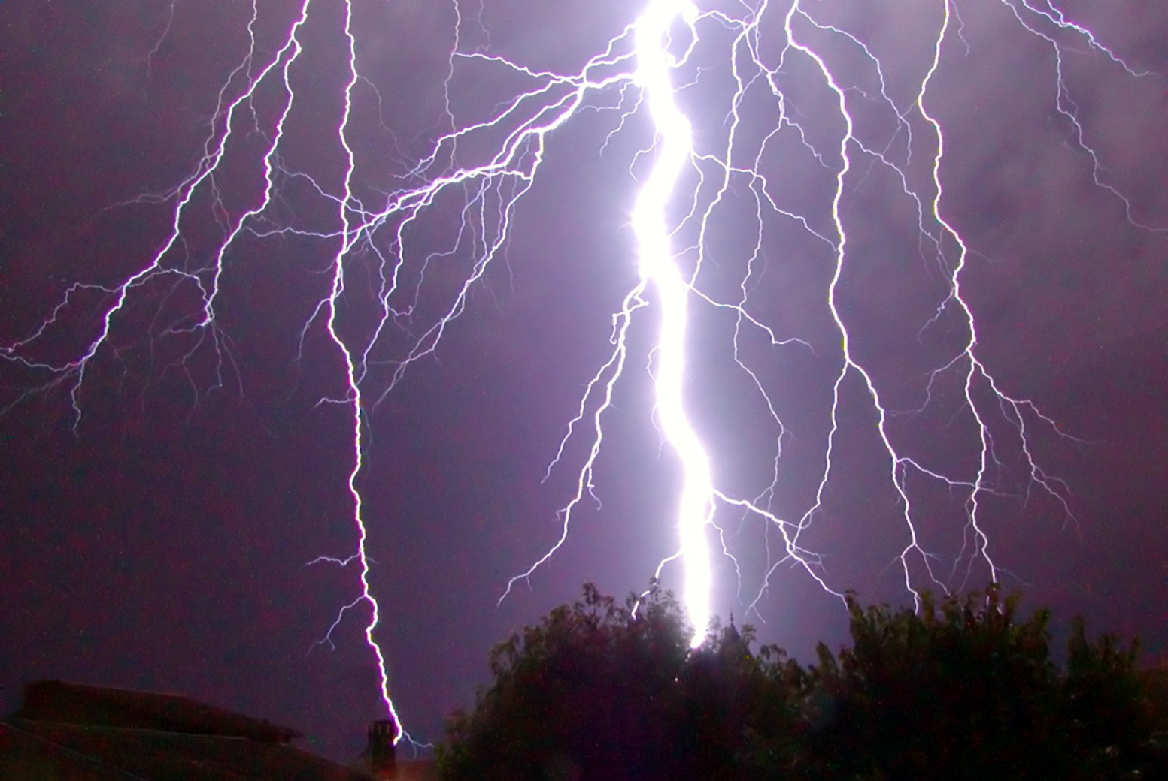
Tintreach Chonaic mé tintreach.
Photo courtesy of Alex Rouvin (@flickr.com) - granted under creative commons licence – attribution

Slide 11
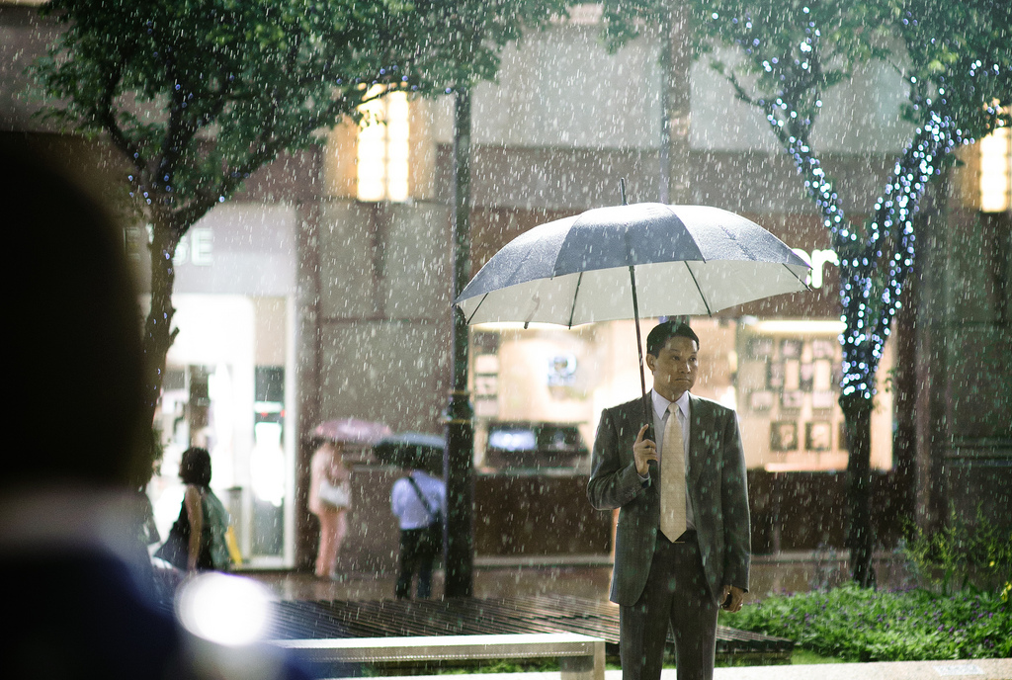
Fliuch Tá sé ag cur báistí.
Photo courtesy ofルーク.チャン.チャン (@flickr.com) - granted under creative commons licence – attribution

Slide 12
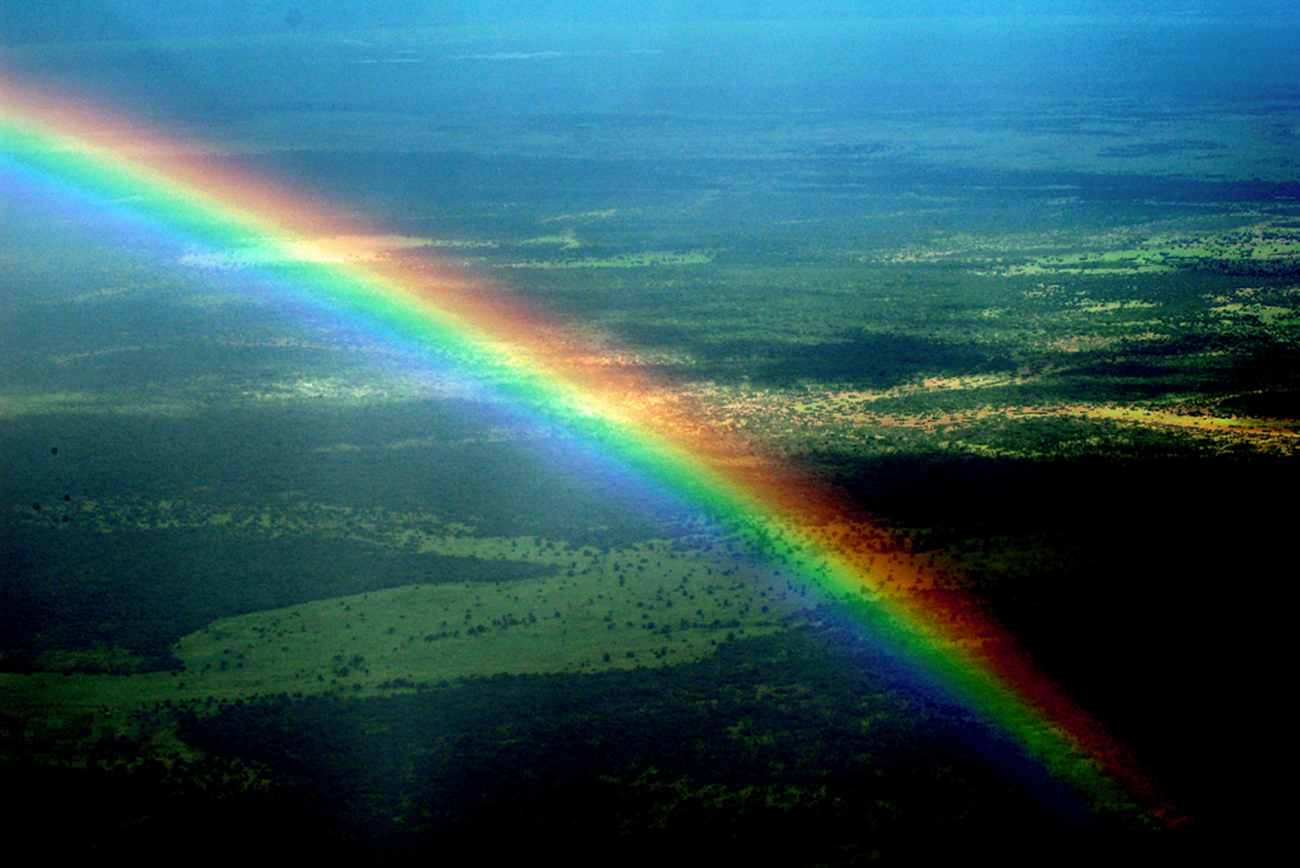
Bogha báistí Tá bogha báistí sa spéir.
Photo courtesy of Cessna 206 (@flickr.com) - granted under creative commons licence – attribution

Slide 13
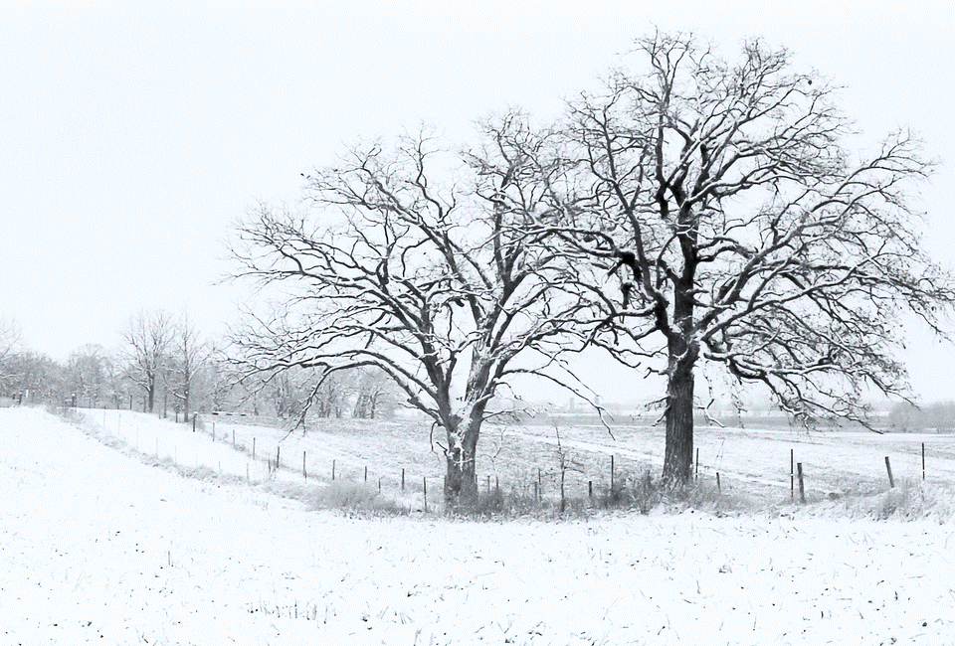
Sneachta Tá sé ag cur sneachta.
Photo courtesy of oliworx (@flickr.com) - granted under creative commons licence – attribution

Slide 14
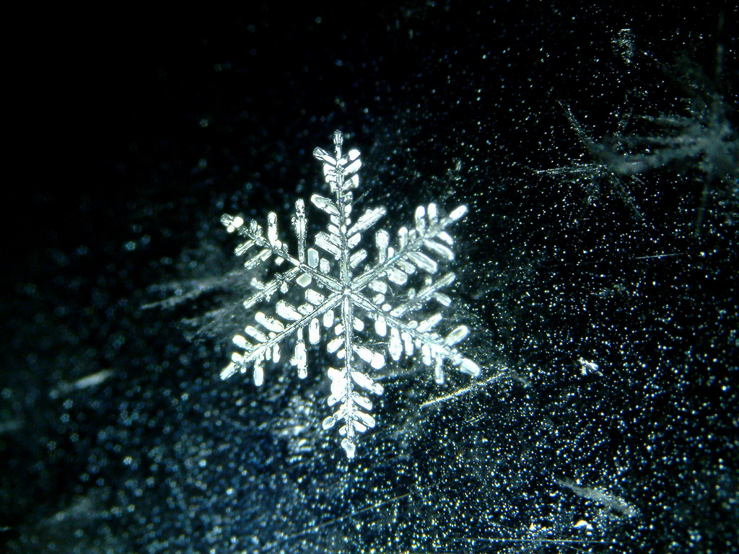
Calóg shneachta Tá calóga sneachta ag titim.
Photo courtesy of yellowcloud (@flickr.com) - granted under creative commons licence – attribution

Slide 15
An ghrian Tá an ghrian ag taitneamh.
Photo courtesy of **Mary** (@flickr.com) - granted under creative commons licence – attribution

Slide 16
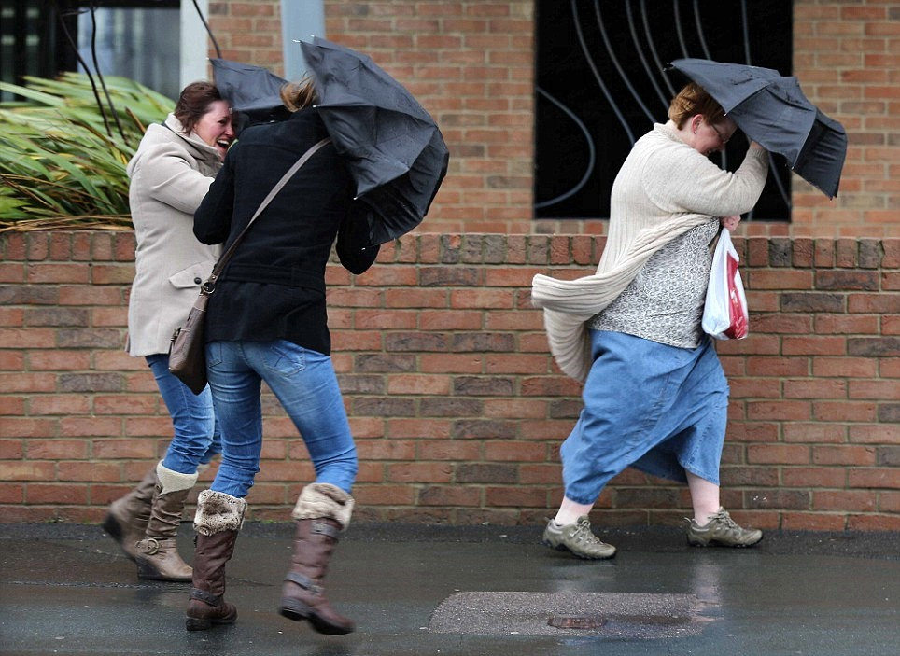
Gaoth Tá sé gaofar!
Photo courtesy of brizlzle born and bred (@flickr.com) - granted under creative commons licence – attribution

