Slide 1
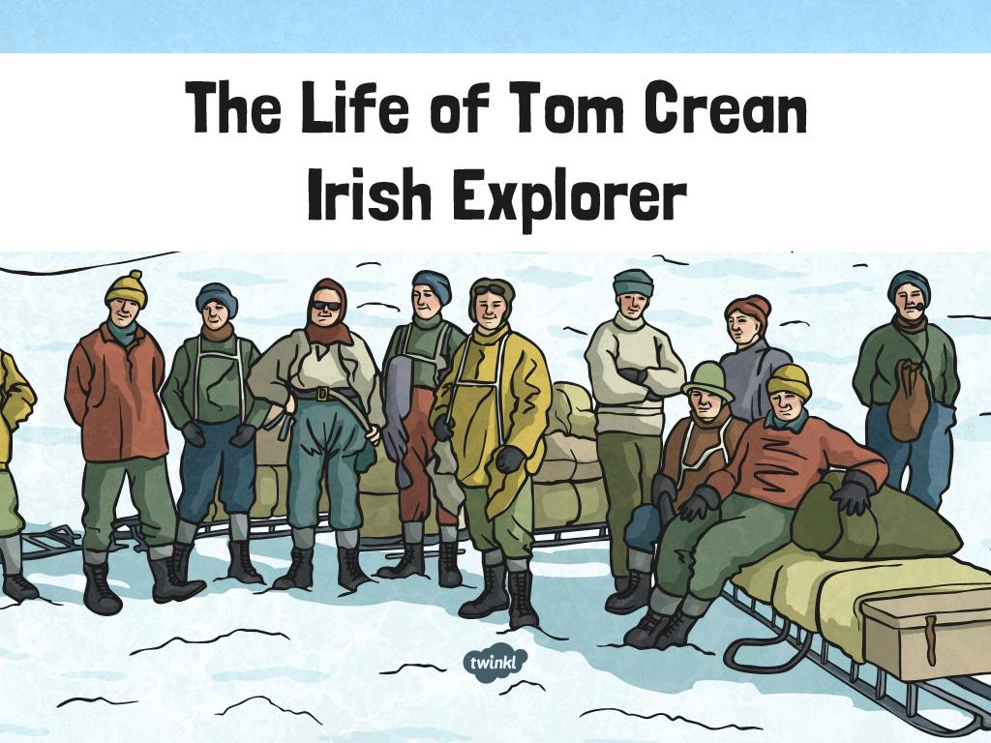

Slide 2
What Will I Learn?
• Who was Tom Crean?
• What was his childhood like?
• Why was he interested in exploring?
• Where did he explore?
• What happened towards the end of his life?

Slide 3
Tom’s Childhood
Tom was born in 1877 in Annascaul, Co. Kerry on the Dingle Peninsula.
His parents were farmers.
He had five brothers and five sisters.
He went to Brackluin School in Annascaul Village but left school aged 12 to work on a farm.
Tom dreamed of becoming a sailor, like many boys his age.

Slide 4
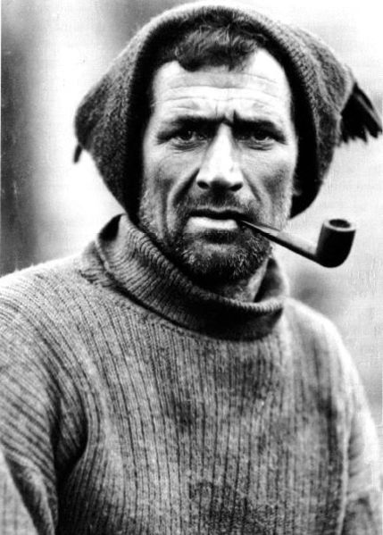
Tom Joins the Navy
In 1893, when Tom was 15, he stole a suit and some money. He ran away from home with a friend and joined the Royal Navy. Tom was too young to join but tricked the Navy into believing he was old enough.

Slide 5
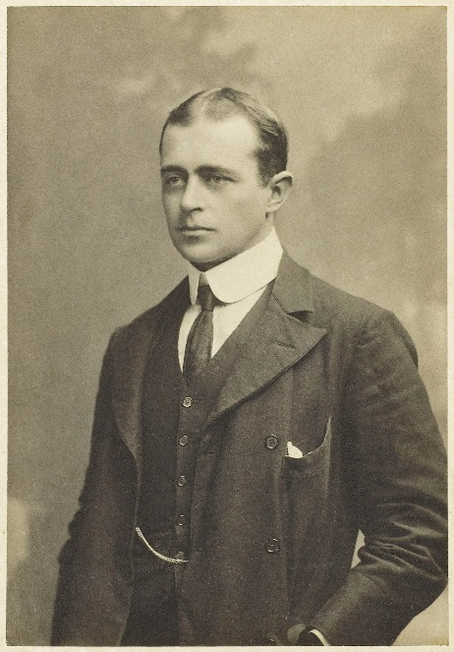
Discovery 1901-1904
• Robert Scott was an explorer who was known as ‘Scott of the Antarctic’.
• Tom’s first journey was with Scott, who was the leader of the expedition.
• They travelled aboard the ship ‘Discovery’, which was powered by coal and sail.
• They packed the ship with enough coal and fuel for their journey.

Slide 6
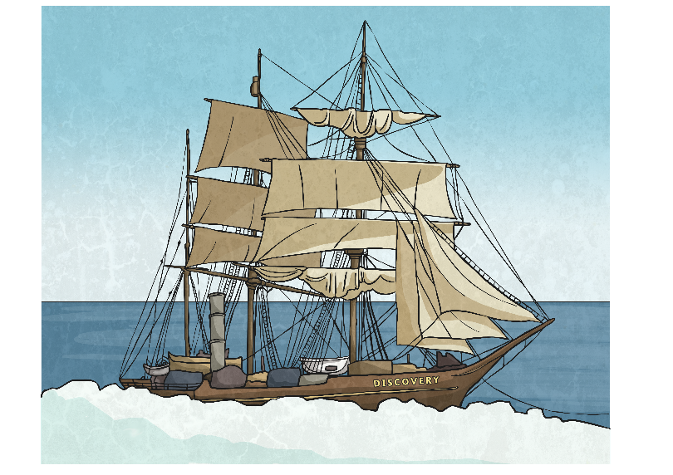
Discovery Gets Stuck
On the route to Antarctica, ‘Discovery’ the ship became trapped in the ice and was stuck there for almost two years. The crew of the ship erected a wooden hut on a headland which became known as ‘Hut Point’. Heavy sledges filled with up to 360kg of food were dragged by men to the hut, which was very difficult.
The trip began in 1901 and they returned in 1904.

Slide 7
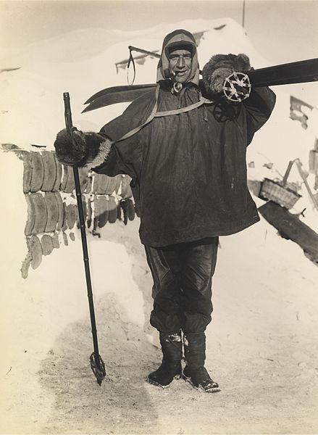
The First Record
On this expedition, Tom was part of a team of men who set a new record. The group had managed to get just 575 miles away from the South Pole- closer than anyone had managed before.
Tom received a medal for his work on the expedition.
Robert Scott recommended Tom for the medal for his ‘good conduct and meritorious service’ throughout the trip.

Slide 8
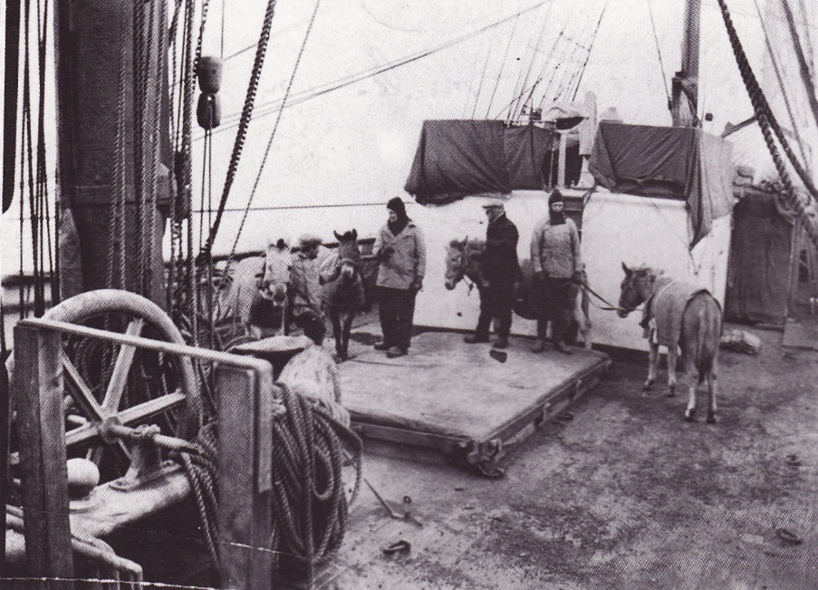
The Race to the South Pole
Tom wanted to be the first person to reach the South Pole.
Tom joined Robert Scott on another expedition, which began on 24th October 1911.
This was on the ship ‘Terra Nova’.
They expected the trip to last five months and 16 men joined them.

Slide 9
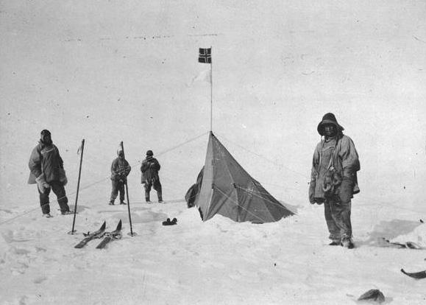
…Continued
They bought heavy sledges with them to drag across the thick snow and ice.
The terrain was extremely dangerous as the glacier was full of deep cracks called crevasses.
As the team were just 140 miles from the South Pole, Scott thought it best for only 4 of them to continue. Tom was devastated when he wasn’t chosen.

Slide 10
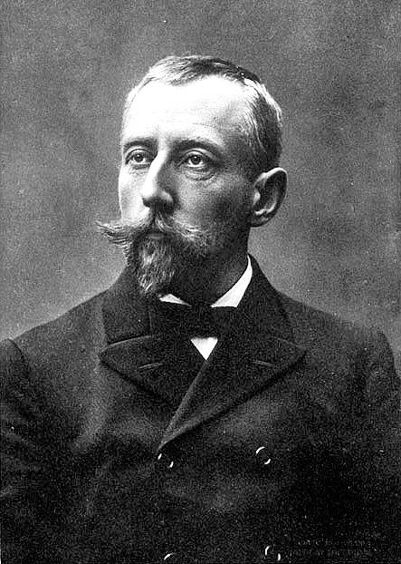
Roald Amundsen
Scott and his four-man team struggled on for a further two weeks.
As they approached the South Pole they were dismayed to see a Norwegian flag in the ground.
A Norwegian explorer, named Roald Amundsen, had beaten them to it.
Amundsen had used dogs to pull the sledges across the ground, which was much faster.

Slide 11
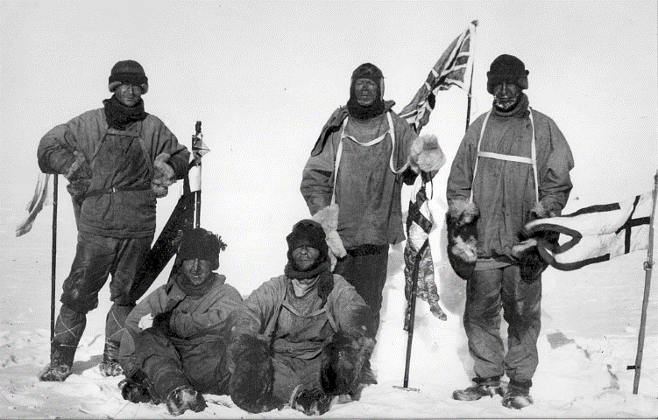
Scott’s team at the South Pole

Slide 12
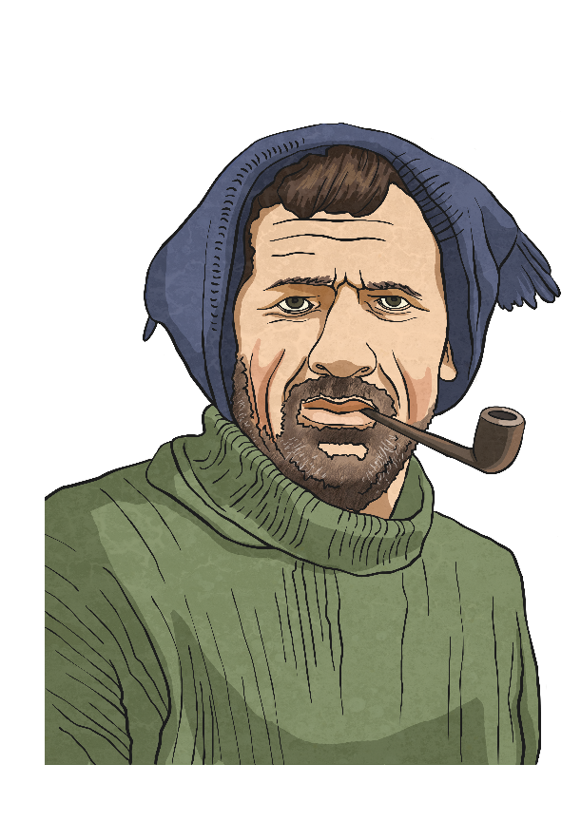
Tom’s Journey Back
As Scott and his team ventured for the South Pole, Tom and two of his fellow explorers, Bill Lashly and Taff Evans, were sent back to the base camp some 1200km away.
Severely bad weather hit the trio on their way back, sending them miles off course.
The harsh conditions caused them to become very weak.
They were running out of food and Evans collapsed.
When they were 56km from Hut Point, the crew ran out of food and became so weak that they couldn’t drag Evans any longer.
Tom volunteered to finish the journey alone so that Lashly could keep tending to Evans.

Slide 13


…Continued
He left the pair at 10.00am on Sunday 18th February.
He was cold, starving, thirsty and exhausted. He only had three biscuits and a bar of chocolate to eat.
He had no means of navigation.
After 18 hours, he made it back to Hut Point and collapsed after telling his crewmates to send help to Evans and Lashly.
Both Tom and Lashly were awarded the Albert Medal – the highest recognition for gallantry.

Slide 14
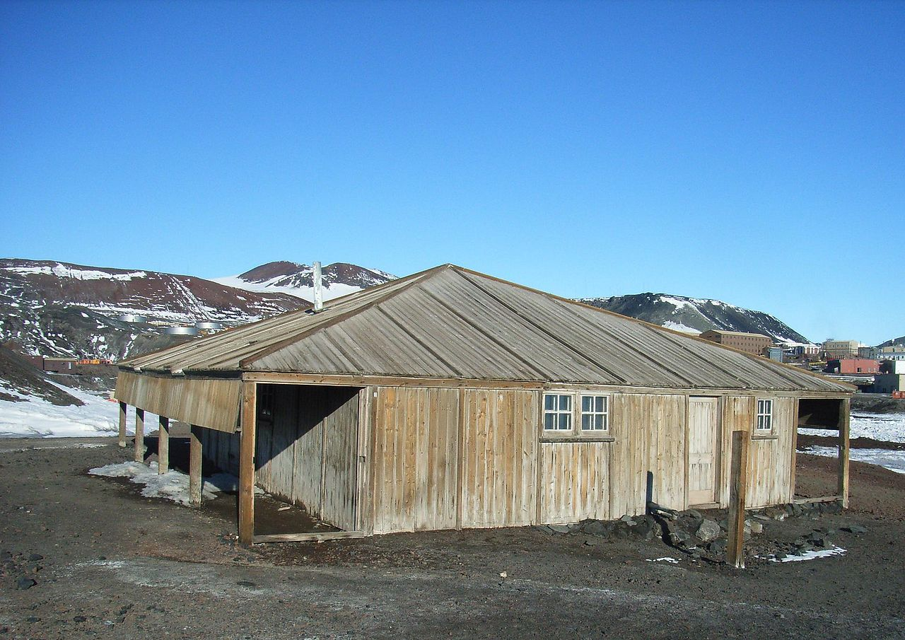
Hut Point
Hut Point as it stands today.

Slide 15
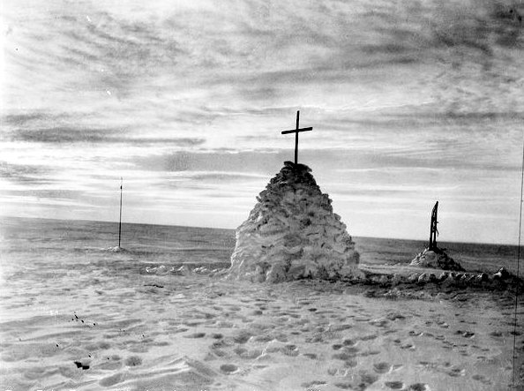
Scott’s fate
Scott and his team who had ventured on to the South Pole planted their flag beside Amundsen’s and headed back for home.
However, the bitter weather conditions had withered his men.
Frostbite had affected some of the men and it was slowing them down.
While on their way back to the base camp, a drastic drop in temperature caused the team to halt.
The last entry in Scott’s diary was made on March 29th 1912, presumably the day he died.

Slide 16
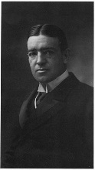
The Endurance
(1914-1916)
Ernest Shackleton was born in Kildare in 1847, the eldest of ten children.
Shackleton sailed on Discovery in 1901 and led other expeditions before leading his most famous on ‘The Endurance’ in 1914.
Tom Crean joined him on The Endurance, where their objective was to walk across Antarctica from coast to coast.
The expedition was 3000km.
Tom played a central role in the plan and it would be his defining moment in polar exploration.

Slide 17
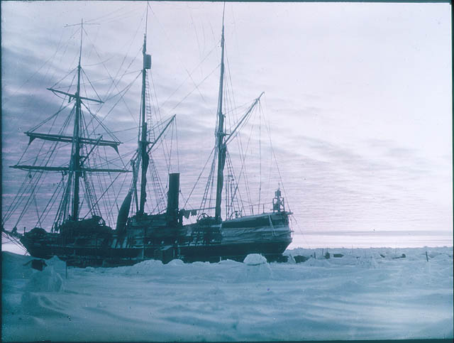
Endurance 1915

Slide 18
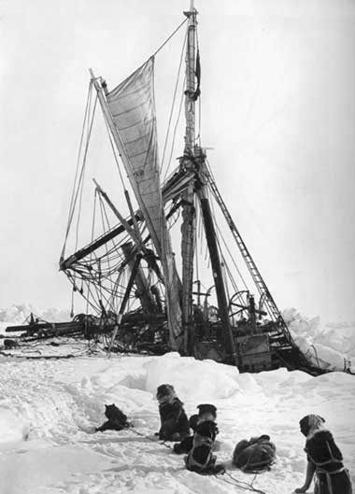
The Endurance is Trapped
On their way to Antarctica, Endurance got trapped in ice for almost ten months.
The ship drifted 1950km while stuck in the ice.
Eventually, the pressure of the ice was so strong that the ship was crushed and abandoned on October 27.
It was a disaster – the 28 men aboard were left stranded on the ice, floating on the ocean and more than 1600km from any known human settlement.
Nobody could track their movements, meaning nobody knew where they were and they had no means of communication.

Slide 19
Reaching Elephant Island
For the following 170 days, the crew drifted more than 3600km north.
The ice melted from an initial mile length piece of ice to less than 150 metres.
Food supplies ran short and the dogs were killed to use as food rations.
On April 9th 1916, open water was reached and the crew were able to launch lifeboats that they had saved from Endurance.
Crean manned one of these with nine others aboard.
A week later, they reached Elephant Island.

Slide 20
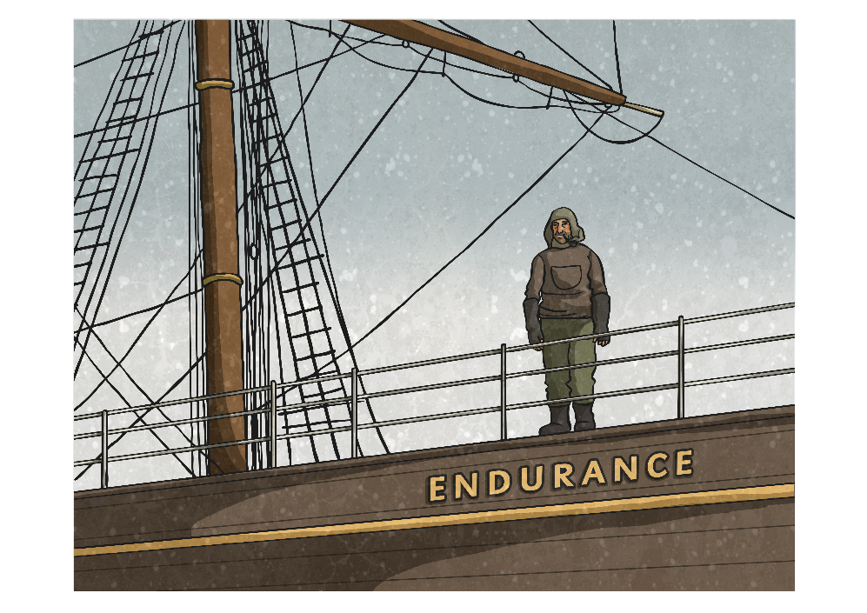
Despair Hits In
The men had been out at sea for almost 500 days.
300 days had been spent on Endurance, 170 days on the ice cap and seven days on the boat.
The men thought that there was no hope – they had no food, no communication ability and were 1600km away from where they were supposed to be.
A makeshift camp was made by turning the boats upside down and covering them with tents.

Slide 21
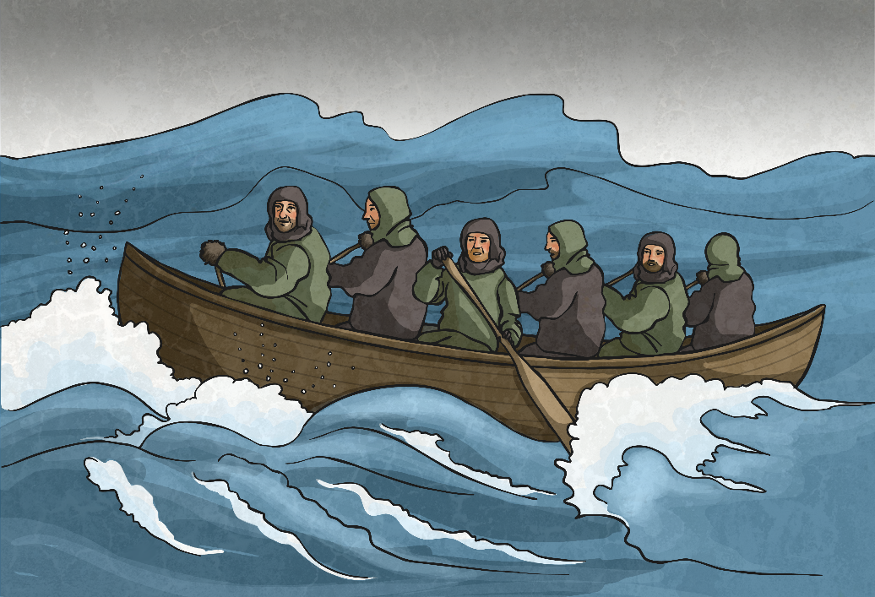
Despair Hits In
Six members of the crew, Crean included, set off on a 1,500km boat journey to South Georgia to find help.
After arriving at South Georgia, Crean and two others had to trek 48km across the mountainous island before arriving at a whaling station.
It took three months to rescue the 22 men stranded on Elephant Island.

Slide 22
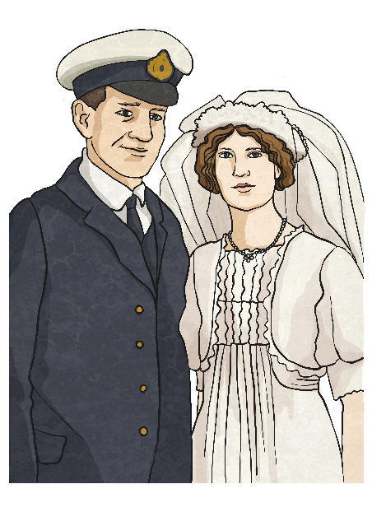
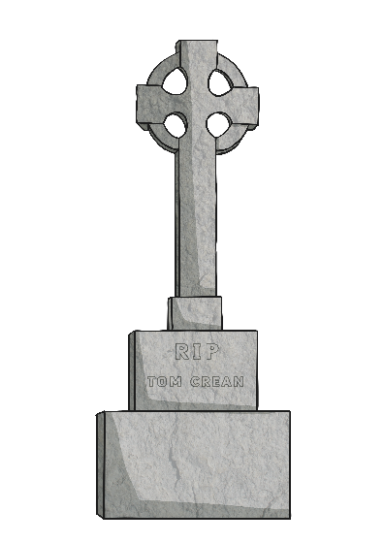
Back to Ireland
Tom came back to Ireland and rejoined the Navy.
He married in 1917 and left the Navy a few years later.
He opened the South Pole Inn in Annascaul, Co. Kerry.
He died in 1938 and was buried in a tomb he had built himself which overlooks the Kerry hills.
The South Pole Inn still exists today and features many tributes to one of Ireland’s most famous and celebrated explorers.

Slide 23
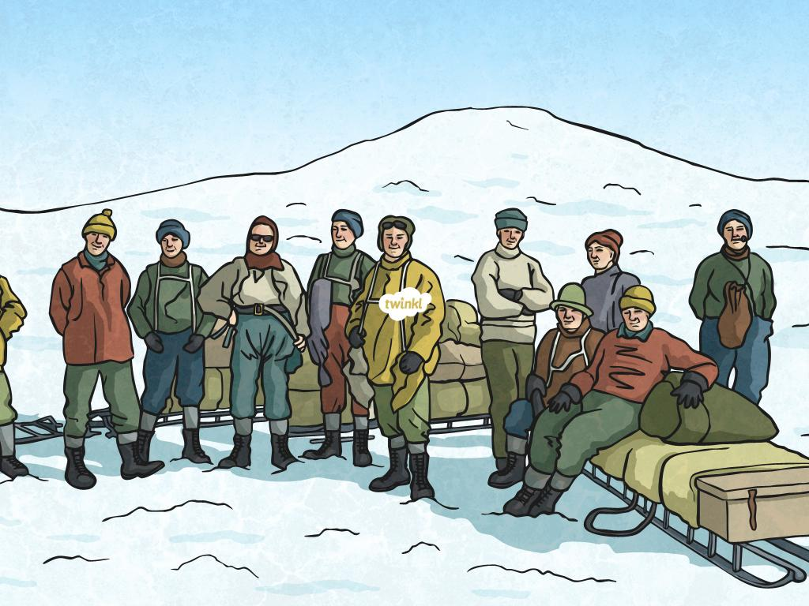

Slide 25
What Will I Learn?
• Who was Tom Crean?
• What was his childhood like?
• Why was he interested in exploring?
• Where did he explore?
• What happened towards the end of his life?

Slide 26
Tom’s Childhood
Tom was born in 1877 in Annascaul, Co. Kerry on the Dingle Peninsula.
His parents were farmers.
He had five brothers and five sisters.
He went to Brackluin School in Annascaul Village but left school aged 12 to work on a farm.
Tom dreamed of becoming a sailor, like many boys his age.

Slide 27
Tom Joins the Navy
In 1893, when Tom was 15, he stole a suit and some money. He ran away from home with a friend and joined the Royal Navy. Tom was too young to join but tricked the Navy into believing he was old enough.

Slide 28
Discovery 1901-1904
• Robert Scott was an explorer who was known as ‘Scott of the Antarctic’.
• Tom’s first journey was with Scott, who was the leader of the expedition.
• They travelled aboard the ship ‘Discovery’, which was powered by coal and sail.
• They packed the ship with enough coal and fuel for their journey.

Slide 29
Discovery Gets Stuck
On the route to Antarctica, ‘Discovery’ the ship became trapped in the ice and was stuck there for almost two years. The crew of the ship erected a wooden hut on a headland which became known as ‘Hut Point’. Heavy sledges filled with up to 360kg of food were dragged by men to the hut, which was very difficult.
The trip began in 1901 and they returned in 1904.

Slide 30
The First Record
On this expedition, Tom was part of a team of men who set a new record. The group had managed to get just 575 miles away from the South Pole- closer than anyone had managed before.
Tom received a medal for his work on the expedition.
Robert Scott recommended Tom for the medal for his ‘good conduct and meritorious service’ throughout the trip.

Slide 31
The Race to the South Pole
Tom wanted to be the first person to reach the South Pole.
Tom joined Robert Scott on another expedition, which began on 24th October 1911.
This was on the ship ‘Terra Nova’.
They expected the trip to last five months and 16 men joined them.

Slide 32
…Continued
They bought heavy sledges with them to drag across the thick snow and ice.
The terrain was extremely dangerous as the glacier was full of deep cracks called crevasses.
As the team were just 140 miles from the South Pole, Scott thought it best for only 4 of them to continue. Tom was devastated when he wasn’t chosen.

Slide 33
Roald Amundsen
Scott and his four-man team struggled on for a further two weeks.
As they approached the South Pole they were dismayed to see a Norwegian flag in the ground.
A Norwegian explorer, named Roald Amundsen, had beaten them to it.
Amundsen had used dogs to pull the sledges across the ground, which was much faster.

Slide 34
Scott’s team at the South Pole

Slide 35
Tom’s Journey Back
As Scott and his team ventured for the South Pole, Tom and two of his fellow explorers, Bill Lashly and Taff Evans, were sent back to the base camp some 1200km away.
Severely bad weather hit the trio on their way back, sending them miles off course.
The harsh conditions caused them to become very weak.
They were running out of food and Evans collapsed.
When they were 56km from Hut Point, the crew ran out of food and became so weak that they couldn’t drag Evans any longer.
Tom volunteered to finish the journey alone so that Lashly could keep tending to Evans.

Slide 36
…Continued
He left the pair at 10.00am on Sunday 18th February.
He was cold, starving, thirsty and exhausted. He only had three biscuits and a bar of chocolate to eat.
He had no means of navigation.
After 18 hours, he made it back to Hut Point and collapsed after telling his crewmates to send help to Evans and Lashly.
Both Tom and Lashly were awarded the Albert Medal – the highest recognition for gallantry.

Slide 37
Hut Point
Hut Point as it stands today.

Slide 38
Scott’s fate
Scott and his team who had ventured on to the South Pole planted their flag beside Amundsen’s and headed back for home.
However, the bitter weather conditions had withered his men.
Frostbite had affected some of the men and it was slowing them down.
While on their way back to the base camp, a drastic drop in temperature caused the team to halt.
The last entry in Scott’s diary was made on March 29th 1912, presumably the day he died.

Slide 39
The Endurance
(1914-1916)
Ernest Shackleton was born in Kildare in 1847, the eldest of ten children.
Shackleton sailed on Discovery in 1901 and led other expeditions before leading his most famous on ‘The Endurance’ in 1914.
Tom Crean joined him on The Endurance, where their objective was to walk across Antarctica from coast to coast.
The expedition was 3000km.
Tom played a central role in the plan and it would be his defining moment in polar exploration.

Slide 40
Endurance 1915

Slide 41
The Endurance is Trapped
On their way to Antarctica, Endurance got trapped in ice for almost ten months.
The ship drifted 1950km while stuck in the ice.
Eventually, the pressure of the ice was so strong that the ship was crushed and abandoned on October 27.
It was a disaster – the 28 men aboard were left stranded on the ice, floating on the ocean and more than 1600km from any known human settlement.
Nobody could track their movements, meaning nobody knew where they were and they had no means of communication.

Slide 42
Reaching Elephant Island
For the following 170 days, the crew drifted more than 3600km north.
The ice melted from an initial mile length piece of ice to less than 150 metres.
Food supplies ran short and the dogs were killed to use as food rations.
On April 9th 1916, open water was reached and the crew were able to launch lifeboats that they had saved from Endurance.
Crean manned one of these with nine others aboard.
A week later, they reached Elephant Island.

Slide 43
Despair Hits In
The men had been out at sea for almost 500 days.
300 days had been spent on Endurance, 170 days on the ice cap and seven days on the boat.
The men thought that there was no hope – they had no food, no communication ability and were 1600km away from where they were supposed to be.
A makeshift camp was made by turning the boats upside down and covering them with tents.

Slide 44
Despair Hits In
Six members of the crew, Crean included, set off on a 1,500km boat journey to South Georgia to find help.
After arriving at South Georgia, Crean and two others had to trek 48km across the mountainous island before arriving at a whaling station.
It took three months to rescue the 22 men stranded on Elephant Island.

Slide 45
Back to Ireland
Tom came back to Ireland and rejoined the Navy.
He married in 1917 and left the Navy a few years later.
He opened the South Pole Inn in Annascaul, Co. Kerry.
He died in 1938 and was buried in a tomb he had built himself which overlooks the Kerry hills.
The South Pole Inn still exists today and features many tributes to one of Ireland’s most famous and celebrated explorers.

