Slide 1
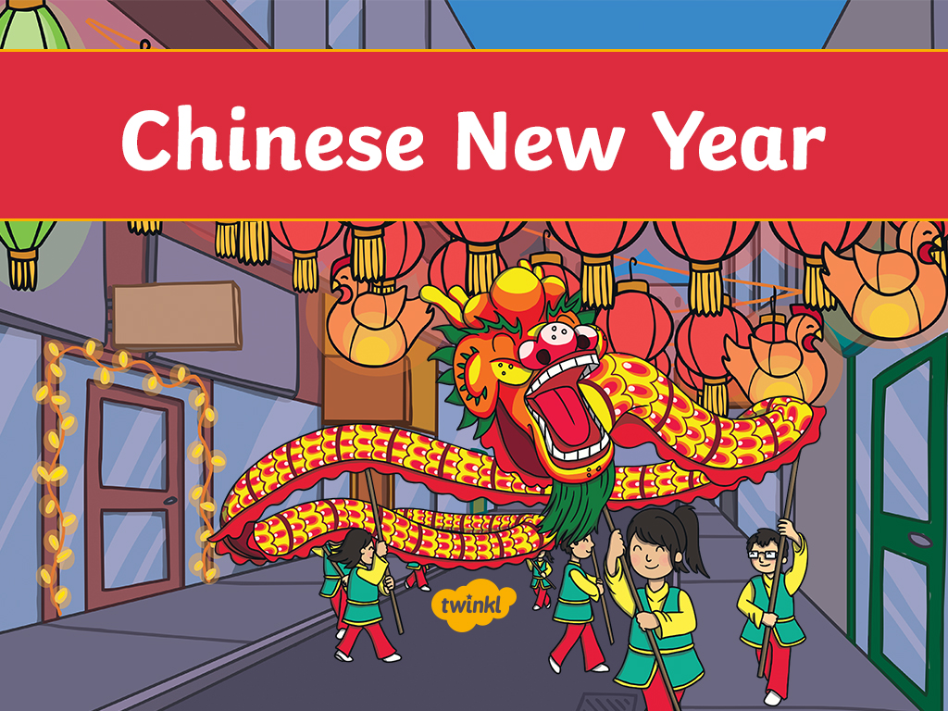

Slide 2
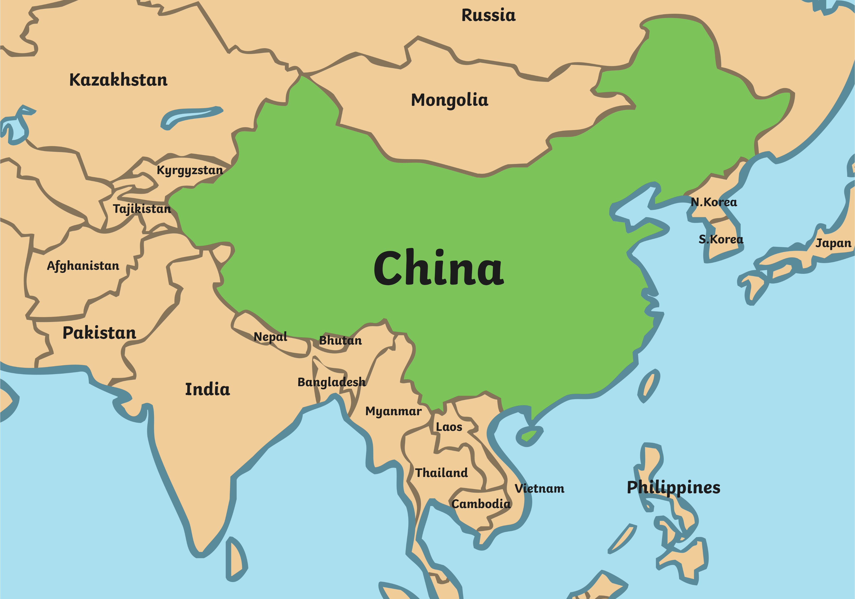
Where Is China?
The country of China is in northeast Asia.
China is the fourth biggest country in the world.
China has the biggest population of all countries in the world.
China is divided into provinces.
The capital city of China is Beijing.

Slide 3
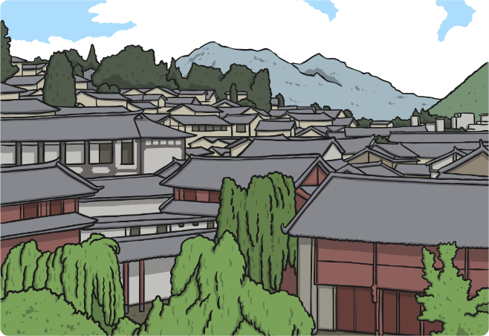
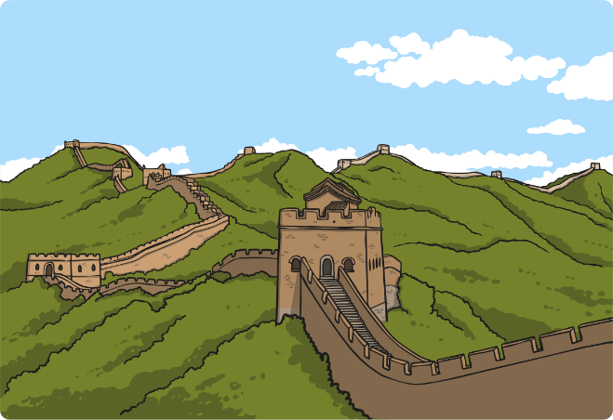
What Is China Like?
China has mountains, deserts and large rivers.
In the north of China, there are mountains, where it snows for much of the year.
The south of China is filled with jungles and it is very hot.
Central China consists mostly of mountainous regions.
Most of Western China is mountains, including the Himalayas.
Rivers are very important in China, because Chinese farmers use them to grow rice under the water.

Slide 4
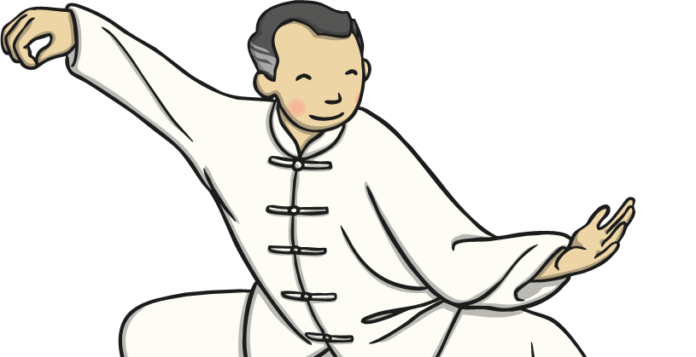
What Are Chinese People Like?
China is home to people from lots of different ethnicities and cultures.
Chinese culture is very unique.
The Chinese calendar, architecture, food, handicrafts, dance, festivals and martial arts are very popular across the world.
Chinese people mainly speak Mandarin but some also speak Cantonese, Hakka or Swatow, depending on which part of the country they are from.
The staple food in China is rice and it is eaten with nearly every meal.
In the last 20 years China has changed more than any country in the world.

Slide 5
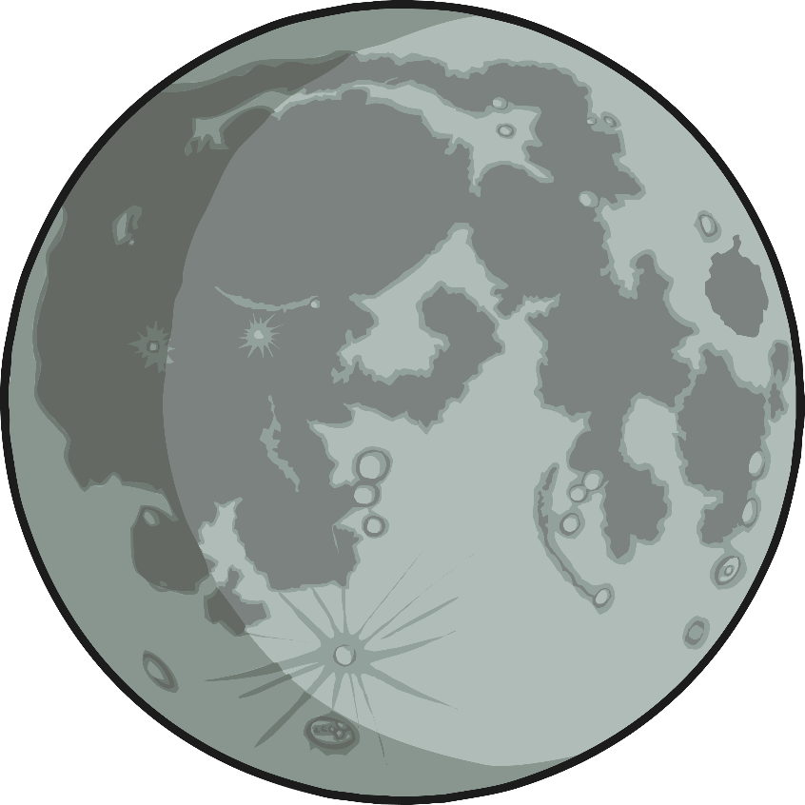
When Is Chinese New Year?
Chinese New Year starts somewhere between late January and early February.
The date of Chinese New Year changes each year because it follows an ancient farmer calendar which is based on phases of the Moon.

Slide 6
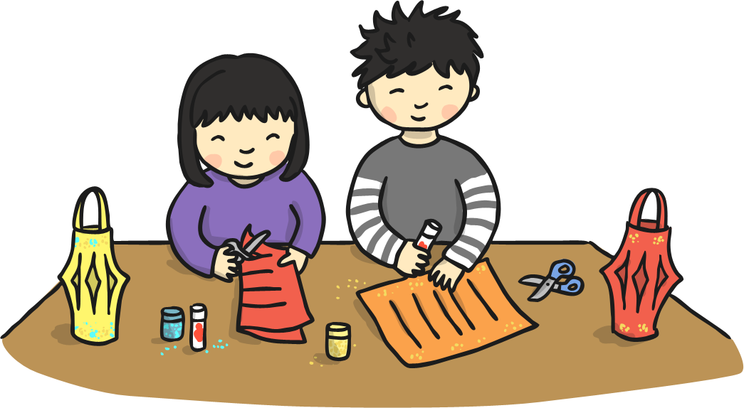
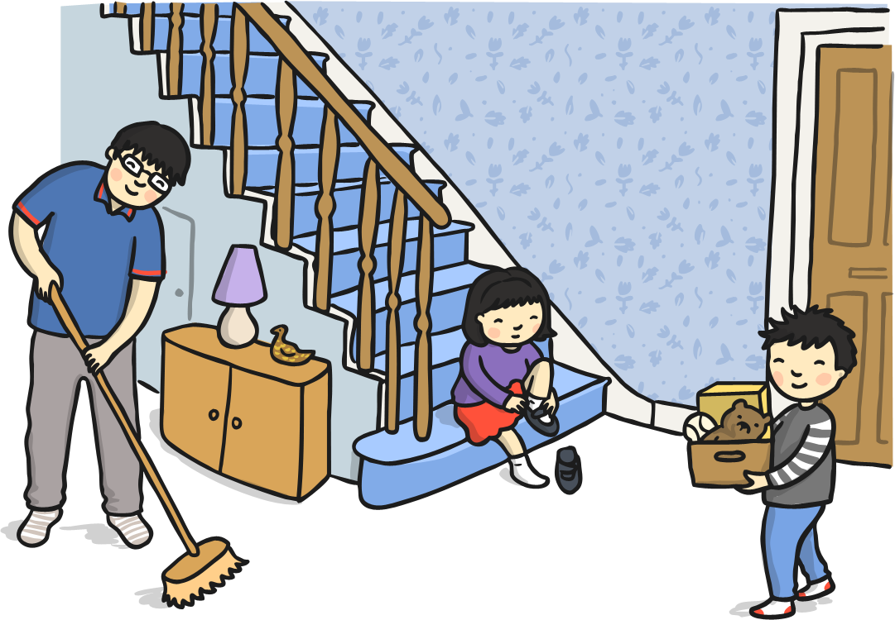
Preparing for the New Year
Chinese people spring clean their houses and gardens to sweep away any bad luck.
Houses are decorated with paper scrolls and lanterns, with good luck phrases such as 'happiness' and 'wealth' on them.
All unfinished business is settled so there is a fresh start for the new year. Debts are paid, quarrels are resolved and any work is brought up to date.

Slide 7
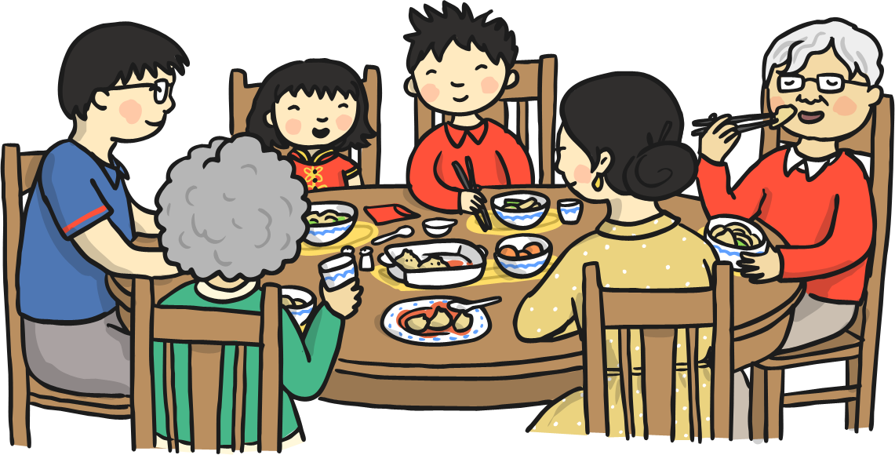
New Year's Eve
Families gather together and have a large, traditional feast of fish and chicken.
In the north people eat dijiaozi – a steamed dumpling.
In the south people eat nian gao – a sticky, sweet rice pudding.
People stay up until midnight setting off fireworks to scare away evil spirits.

Slide 8
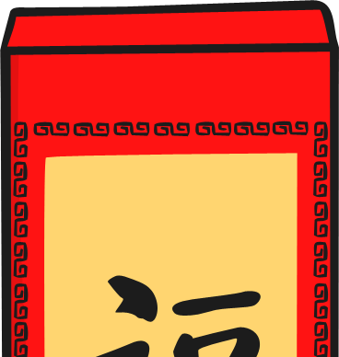
New Year's Day
Children wake up to find red envelopes filled with money and sweets under their pillow, left by their parents or grandparents.
Every family member starts the day with brand new clothes from head to toe.
Red is a very popular colour for clothes, as it is considered lucky.
The first stop of the day is the temple, to worship Gods and to welcome the New Year.
Most Chinese families gather together for a New Year banquet. Each family has their own special dish which they prepare for this time.

Slide 9
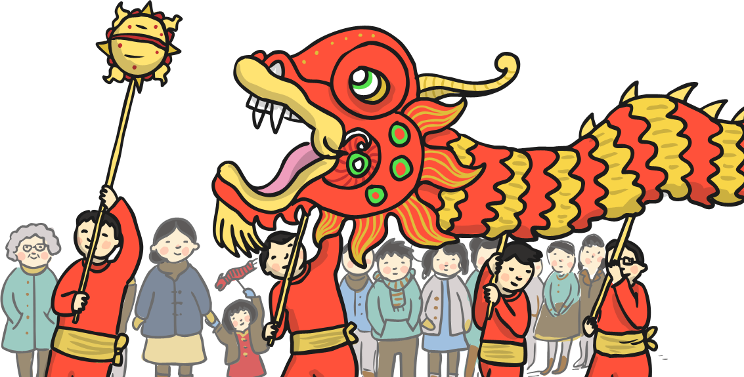
The Lantern Festival
The 15th day of celebrations is known as the Lantern Festival.
There is dragon dancing and lion dancing parades in the streets, and all the streets will be crowded with people.
Families walk the streets carrying lit lanterns.

Slide 10
