Slide 2
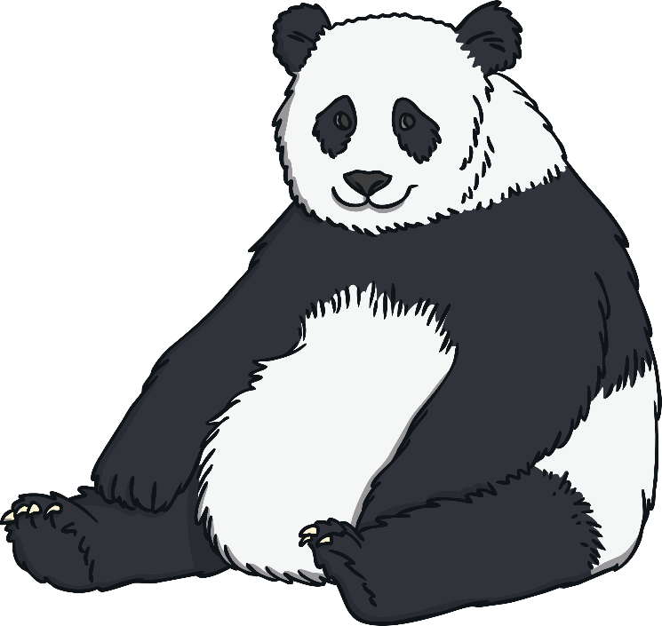
What Do Pandas Look Like?
Pandas belong to the bear family.
This type of panda is called the giant panda. Giant pandas have black and white fur and black eye patches.
Pandas have paws. Their paws each have 5 fingers and a ‘thumb’ so they can grip in the same way that people can.
Fun Fact
Not all pandas are black and white. One rare panda is brown and white. There is also a type of panda, called a red panda. Red pandas look quite different to giant pandas. You can find out more about them here.

Slide 3
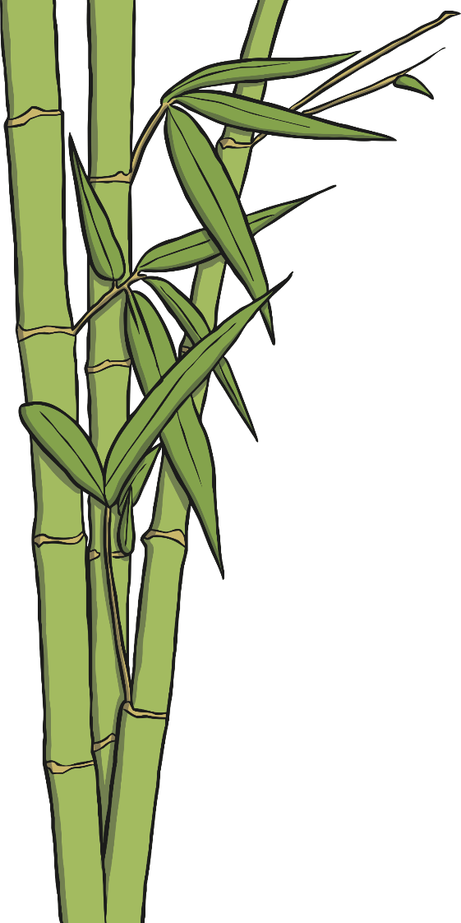
What Do Pandas Eat?
Giant pandas eat a plant called bamboo. Bamboo doesn’t have many nutrients in it. This means it doesn’t give pandas much energy or vitamins so pandas have to eat lots of bamboo shoots to stay healthy.
Every day, one giant panda eats about 60lbs of bamboo.
Even though giant pandas are big, they are great climbers. They spend up to 12 hours of their day looking for food and climbing plants and trees.
Sometimes pandas can’t find enough bamboo to eat. If this happens, they will eat rodents, fish, insects and birds.
Fun Fact

Slide 4
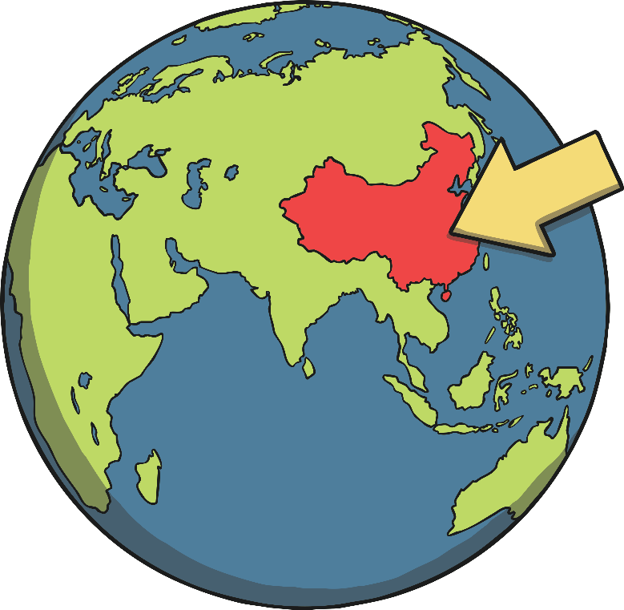
Where Do Pandas Live?
Giant pandas are only found in China. They live in the mountains, which are cool and wet.
The pandas make their dens out of tree stumps or hollowed out logs.
Pandas like to be on their own and like to have their own space.
Even though giant pandas only live in China in the wild, there are about 300 in different parts of the world that are living in zoos.
Fun Fact

Slide 5
Why Are Pandas so Important in China?
Pandas are very important creatures in China.
Lots of people who visit China on holiday, go to see the pandas as they cannot see them in the wild anywhere else in the world.
Every giant panda in the world is owned by China. If a panda lives anywhere else in the world, it is borrowed from China.
Pandas are calm animals and because of this they are seen a sign of friendship. Pandas are also believed to bring good luck.

Slide 6
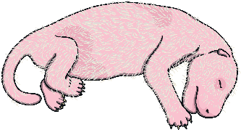
Baby Pandas
Female pandas give birth to one or two baby pandas every two to three years.
Baby pandas are not black and white when they are born, they are pink.
Baby pandas weigh about the same as a pack of butter.

Slide 7
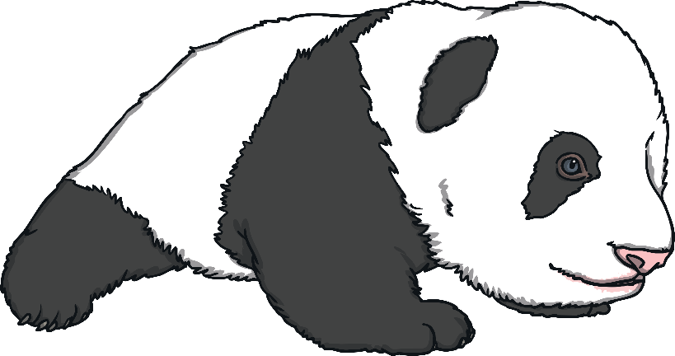
Baby Pandas
Baby pandas are born blind, which means they can’t see. They start to see when they are about 50 days old.
Baby pandas start crawling when they are just 10 weeks old.
Baby pandas become adults at around 6 years old. Adult pandas are about 4 feet tall.

Slide 8
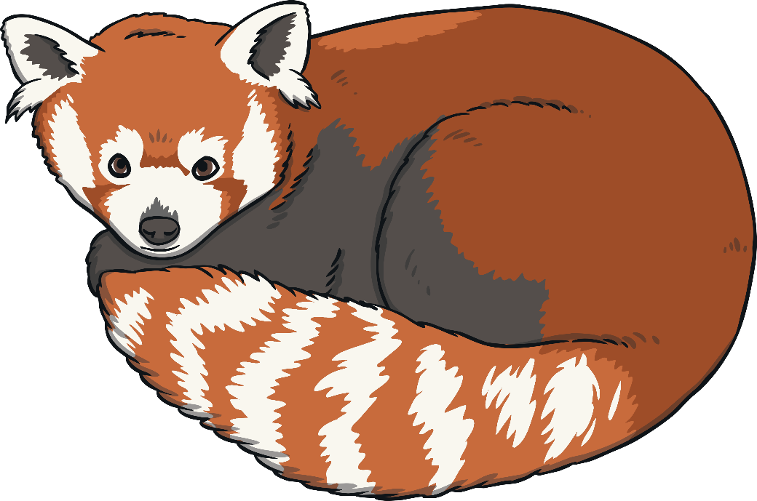
Red Panda Facts
The red panda is another type of panda.
Red pandas don’t look like giant pandas. They look more like raccoons or squirrels.
Red pandas have reddish brown fur with white patches.
Red pandas are good climbers. They have long tails to help them balance when they are climbing.
Red pandas are much smaller than giant pandas. One giant panda is the same weight as over 20 red pandas.

Slide 9
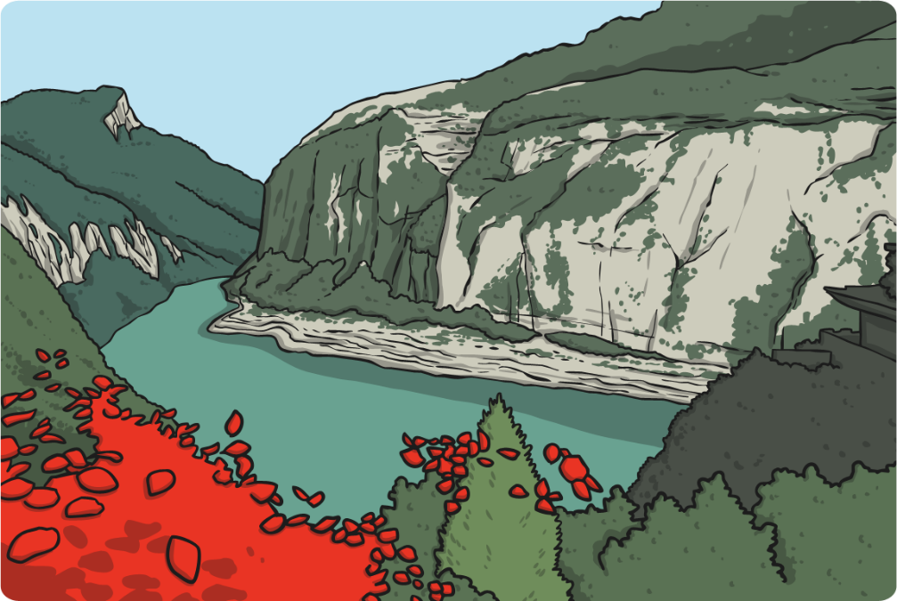
Red Panda Facts
Red pandas live in the mountains and eat bamboo. Sometimes they eat insects, fruit, flowers and eggs too.
Red pandas aren’t just found in China. Some of them live in India, Nepal, Myanmar and Bhutan.

Slide 10
Red Pandas in Danger
The International Union for Conservation of Nature (IUCN) have made the Red List, which puts all species of plants and animals into groups. They list which plants or animals are in danger of dying out and becoming extinct. Extinct means there will never be any more of that species again because there would be no male and female to have babies.
The red panda is on the endangered list. This means the amount of red pandas in the wild is getting smaller and there is a very high risk that they will become extinct if they are not protected now.
Think about it
How do you think we could protect the endangered red pandas and stop them becoming extinct?

