Slide 2
Important Words
number
a quarter
figures we use to count
split into 4 equal groups
1
2
3
4
5
6
7
8
9
10
equal
the same amount

Slide 3
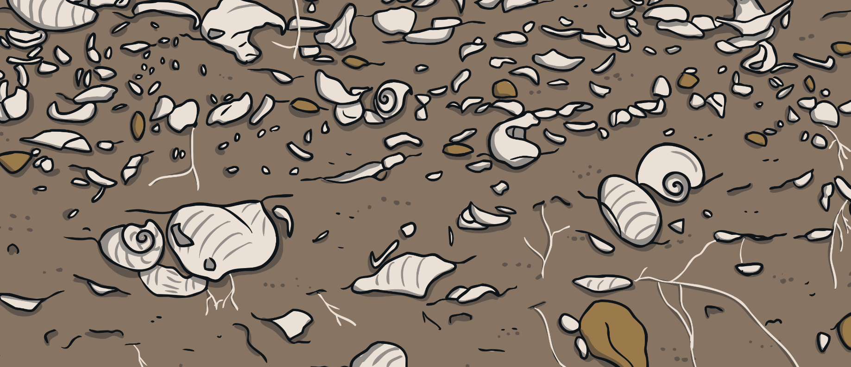
Finding a Quarter (¼)
You need to divide by 4 to find one quarter.
Count the number of bones.

Slide 4
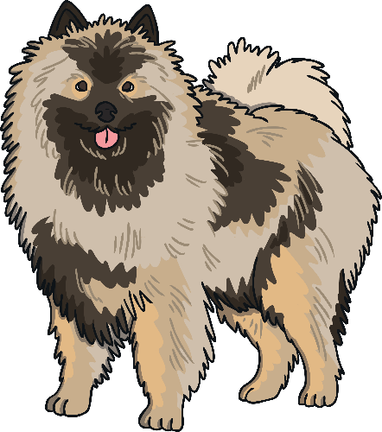
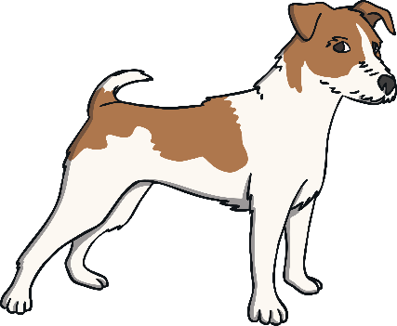
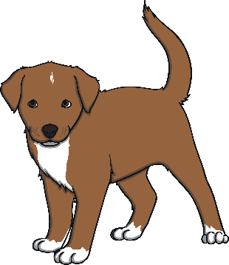
Finding a Quarter (¼)
There are 8 bones.
Divide the bones between the four dogs so that they have the same number each.
How many bones does each dog have?

Slide 5
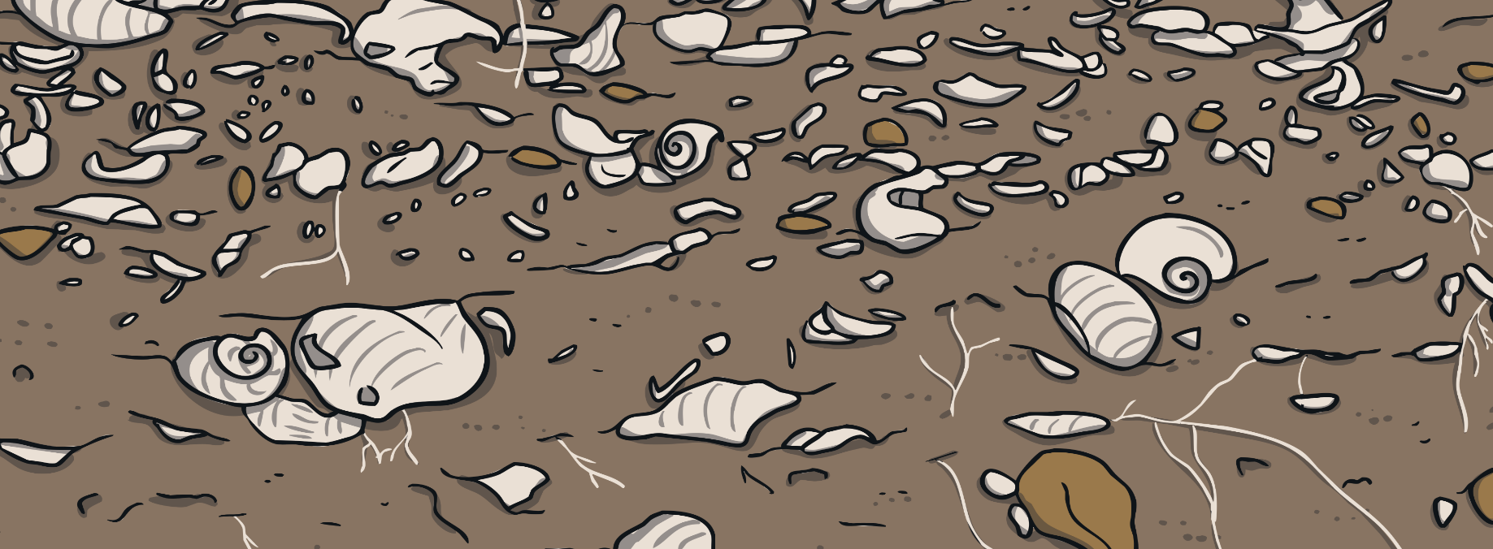
Finding a Quarter (¼)
How many bones does each dog have?
So, one quarter of 8 is 2. ¼ of 8 = 2
Each dog has 2 bones.

Slide 6
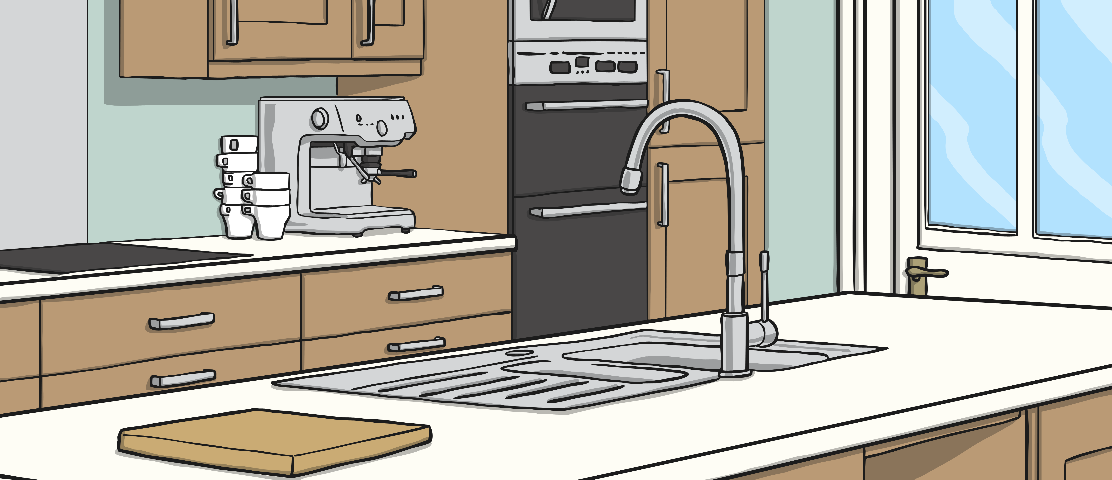
Which Strategies Can I Use to Find One Quarter (¼)?
There are twelve cakes. I share them equally between
four friends. How many cakes does each friend get?
What is ¼ of 12?

Slide 7
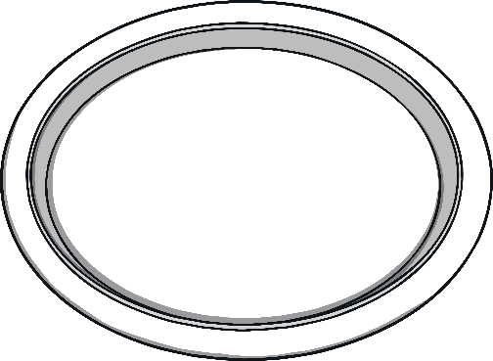
Draw Groups
Share the cakes equally into four groups.
¼ of 12 = 3

Slide 8
Halve and Halve Again
Find half
Find half again
What is ½ of 12?
12 ÷ 2 = 6
Answer: ¼ of 12 = 3
What is ½ of 6?
6 ÷ 2 = 3

Slide 9
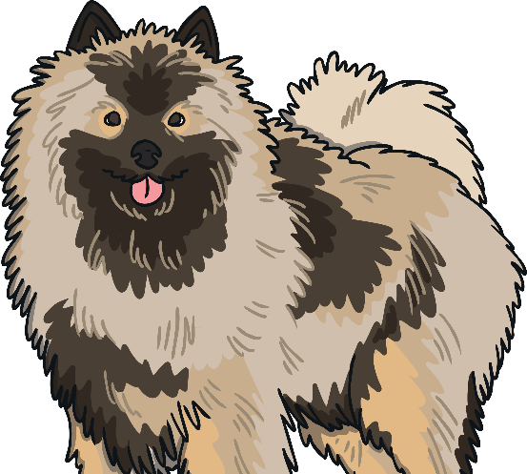
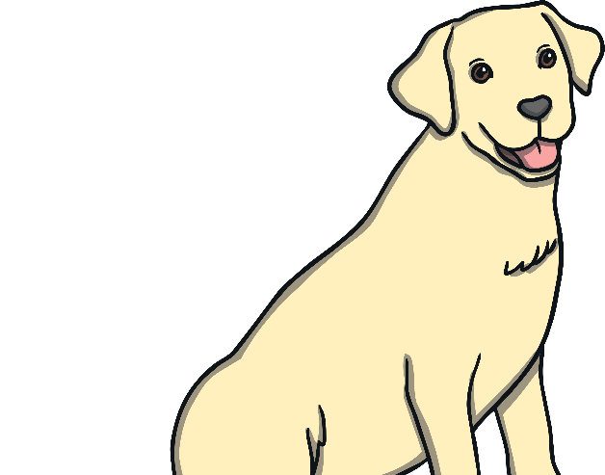
Use the Inverse
Multiplication is the inverse of division.
12 ÷ 4 =
× 4 = 12
3 + 3 + 3 + 3 = 12
3 × 4 = 12

Slide 10
Problem Solving
Now, choose a strategy to solve these problems.
What is ¼ of 4?
What is ¼ of 16?
¼ of 4 = 1
¼ of 16 = 4
What is ¼ of 20?
¼ of 20 = 5
Which strategy did you use? Discuss.

Slide 11
Problem Solving
Lexi had 20 grapes.
She gave a quarter of them to Sam.
How many did Sam get?
Answer
¼ of 20 = 5
Which strategy did you use? Discuss.

Slide 12
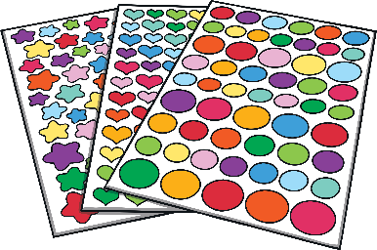
Problem Solving
Miss Jones had 24 stickers.
She shared them equally with four children.
How many stickers did each child get?
Answer
¼ of 24 = 6
Which strategy did you use? Discuss.

Slide 13
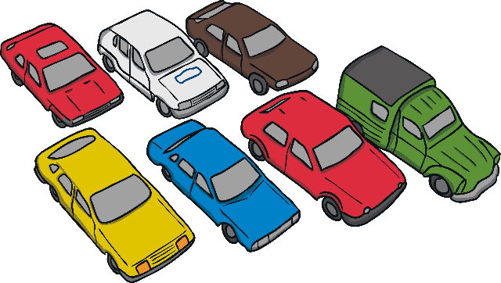
Problem Solving
Rishi had 40 cars.
¼ of the cars were red.
How many cars were red?
Answer
¼ of 40 = 10
Which strategy did you use? Discuss.

Slide 14
Challenge Section
If you have found it easy to find one quarter, try these next few challenges!

Slide 15
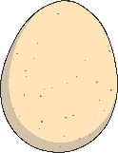
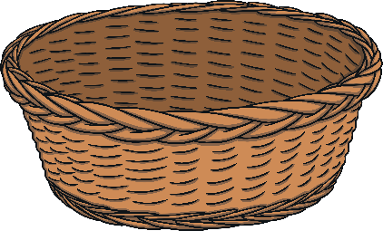
Finding Three Quarters (¾)
You know how to find one quarter so now let’s look at finding three quarters.
First, find ¼ .
There are 8 eggs. If we divide these eggs between 4 baskets, how many eggs will be in each basket?

Slide 16
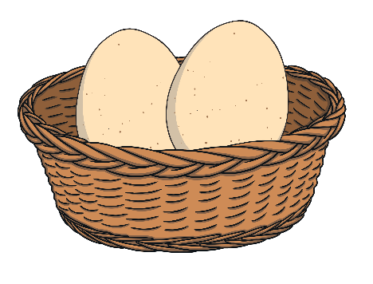
Finding Three Quarters (¾)
There will be 2 eggs in each basket because ¼ of 8 = 2
To find three quarters, simply count the total number of eggs in 3 of the baskets.
There are 6 eggs in the 3 baskets, so ¾ of 8 = 6.

Slide 17
Problem Solving
What is ¾ of 4?
What is ¾ of 12?
What is ¾ of 16?
¼ of 4 = 1
1 × 3 = 3
so ¾ of 4 = 3
¼ of 12 = 3
3 × 3 = 9
so ¾ of 12 = 9
¼ of 16 = 4
4 × 3 = 12
so ¾ of 16 = 12

Slide 18
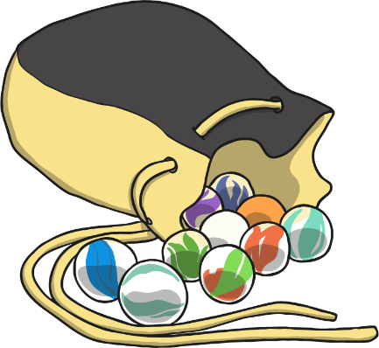
Problem Solving
Sami had 20 marbles.
He gave three quarters of them to Sam.
How many did Sam get?
¼ of 20 = 5
5 × 3 = 15
¾ of 20 = 15

