Slide 2
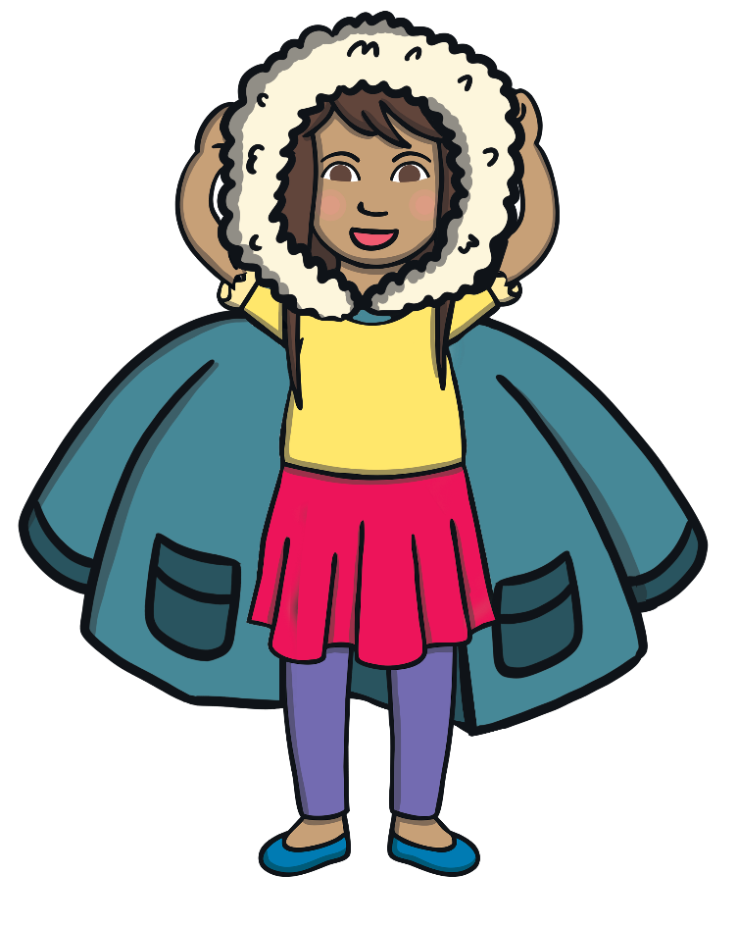
Place the hood of your coat on your head.
Be a superhero!

Slide 3
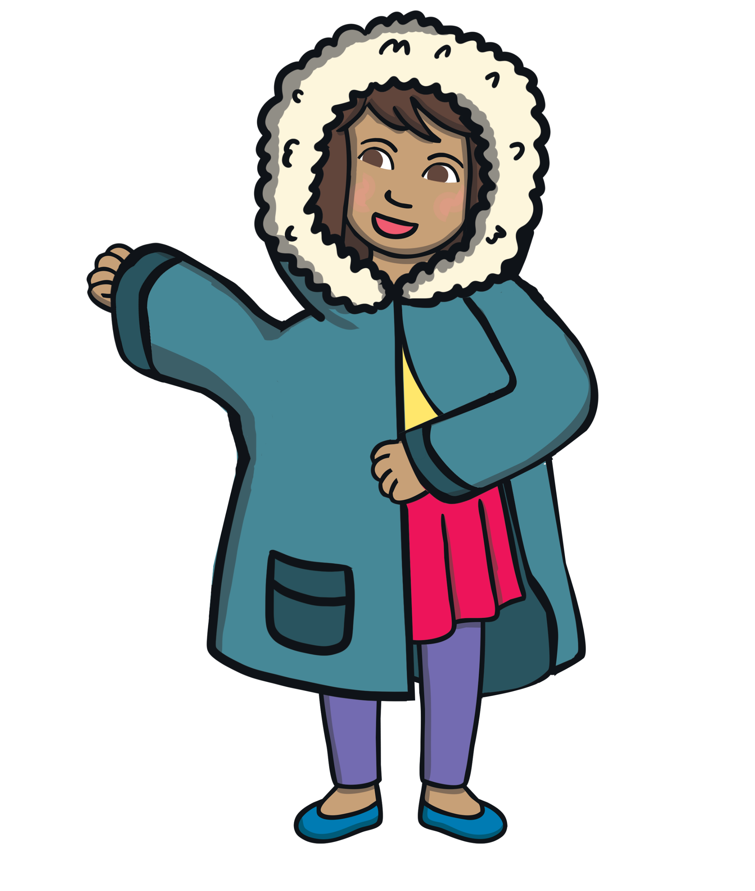
Next, put your hands in the arms of your coat.
Remember hands in the holes!

Slide 4
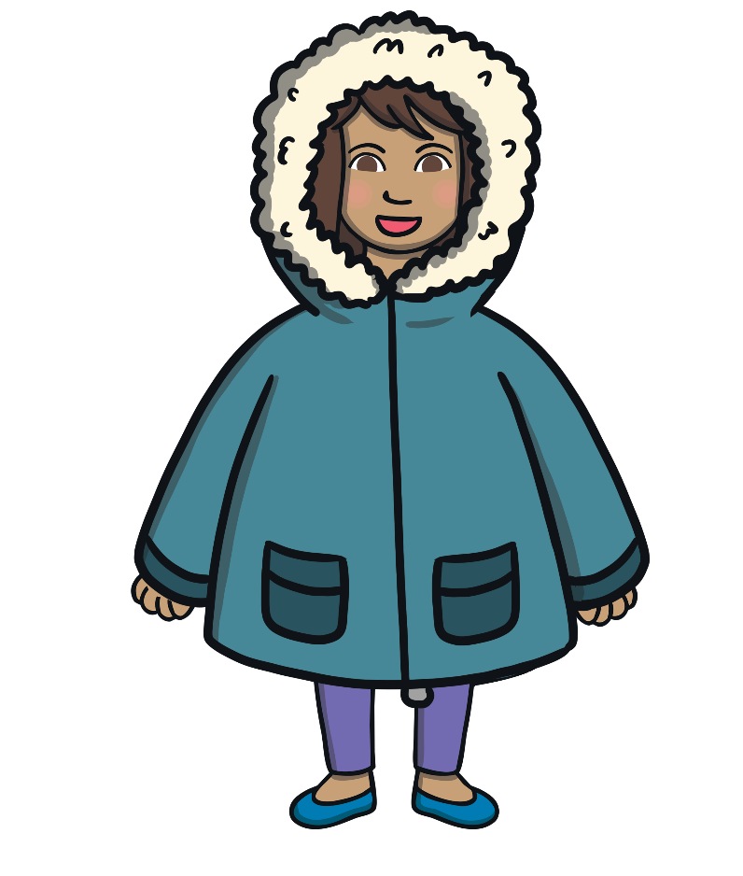
Well done! Your coat is now on!

