Slide 1
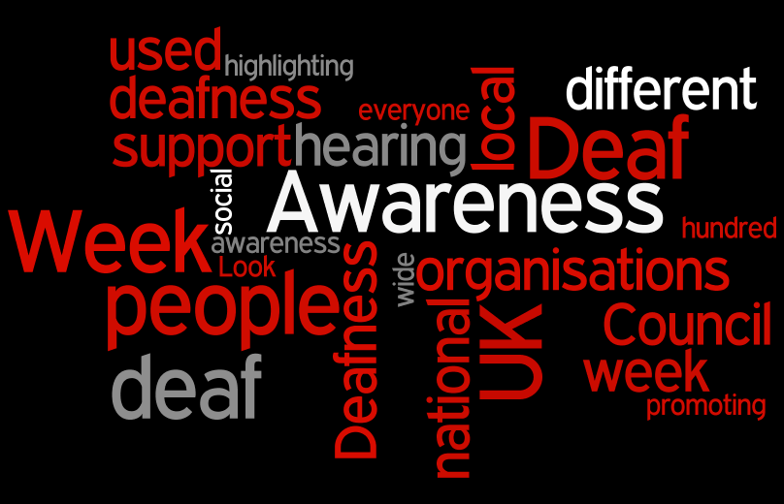
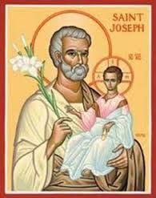
St Josephs Centre For The Deaf
Deaf Awareness Training

Slide 2
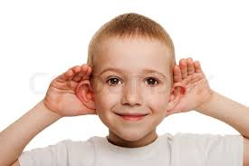
What is Deafness ?

Slide 3
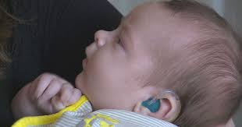
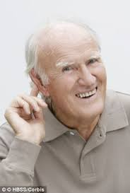
WHY IS SOMEBODY DEAF ?
Some are born deaf
Some become deaf after an illness
Some become deaf through old age

Slide 4
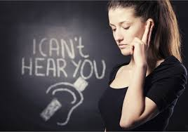
WHAT DOES IT MEAN TO BE DEAF
Not having the power to hear
Having a hearing impairment
It affects every part of your life
Why – because it affects your ability to communicate

Slide 5
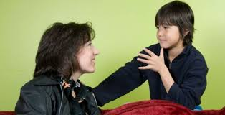
ARE DEAF PEOPLE ALL THE SAME
DO DEAF ADULTS HAVE DEAF CHILDREN
90% OF DEAF CHILDREN ARE BORN TO HEARING PARENTS

Slide 6
My Story

Slide 7
What can you hear

Slide 8
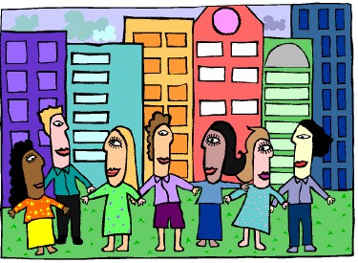
Game

Slide 9
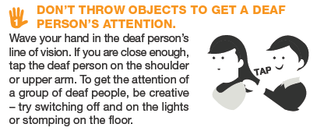
Do’s and Don’t of communicating with someone who is deaf

Slide 10
HOW DO DEAF PEOPLE COMMUNICATE?
Sign Language
Fingerspelling
Lip Reading
Speech
Pictures

Slide 11
Sign Language

Slide 12
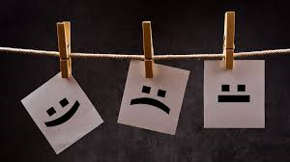
HOW DOES A DEAF PERSON FEEL
Lonely Left out
Angry
Sad Shy Hurt

Slide 13
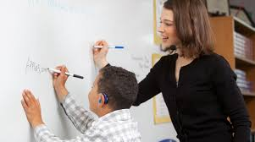
ARE THERE SCHOOLS FOR DEAF CHILDREN
Jordanstown School
Cabra
Mary Hare
Is a deaf person able to work ?

Slide 14
A DEAF PERSON CAN DO ANYTHING EXCEPT HEAR

