Slide 1
How Children’s Learning is
Supported in the Primary School
Children and Young People’s Services
SEND Implementation Team
Notes:
*Welcome parents and introduce yourself and your role as the SENCo of the school.*
--Today I want to discuss with you the ways in which we provide support for all the learners in our school through a learning continuum.
-It is important for the school and parents to work closely in partnership to ensure that your child’s education and development is managed effectively by all concerned with them.
-We will discuss the importance of sharing information about your child with the school to allow us to plan to meet their needs.
-Finally, we will look at the ways in which the school meets the needs of all its individual learners though a wide range of resources, strategies and teaching styles and what you should do if you are concerned that your child may have a difficulty with an aspect of their learning

Slide 2
The role of parents
As a parent you know your child better than anyone else.
You hold key information about your child.
You contribute to the shared view of your child’s needs and the best way to help them with their learning both at home and in school.
Share with us what you think we need to
know.
Notes:
-Your role as a parent is vitally important to us within the school. You possess unique information about your child that may be usefully shared with the school in order that we can prepare and plan effectively to meet their needs.
-It is important that we work together in partnership to support your child and that we communicate openly.
-If information about your child’s needs is communicated to us it will be treated with the utmost respect and confidentiality.

Slide 3
Open and honest communication
We will always listen to your concerns.
If we can, we will offer you advice and
support or advise you where to go to get the help you
need.
We will always involve you in decisions to be made about your child’s needs in school.
We will ask your permission if we think advice is needed from outside the school to help your child.
Notes:
-The school will make time to listen to any concerns that you may have about your child and will offer advice and support if needed. We will involve you and your child in decisions that affect them and will ask your permission if we need to involve any other professionals to support or assess your child.

Slide 4
The voice of the child
Young children depend on the adults around them to share important information about them that will allow their needs to be fully met.
Children also have a unique view of their needs and abilities and should be helped to express their opinions about things that affect them in school.
The school will ensure that your child will be listened to and that their views will be valued and responded to.
Notes:
(largely self-explanatory)
-In school we encourage the children from a young age to have a say in things that affect them. Pupil voice is the right for children to:
express opinions;
participate in making decisions regarding all aspects of their life such as education; and
receive support to express themselves from those who can influence decisions
We will always listen to your child’s views about their education but will respond to them appropriate to their age and capacity.

Slide 5
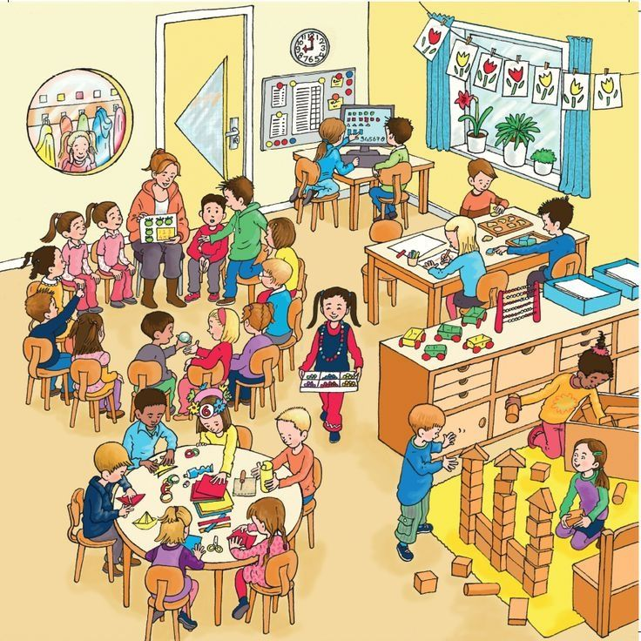
Meeting the needs of learners
Children have different skills, abilities and interests.
Children make progress at different rates.
Children learn best in different ways.
Please don’t compare your child with
others. Instead, praise them for trying
their best. This will build their
confidence.
Notes:
HIGHLIGHT:
-Children are all individual and bring a diverse range of strengths, needs and experiences to the classroom. Every child makes their own unique and different contribution to their class group and this is something which should be celebrated and encouraged.
-Teachers are highly skilled at amending their teaching approaches and resources to meet the needs of the full range of learners in their classrooms. They do this instinctively as part of their everyday teaching.
-As a parent, you can help your child to develop by talking to them positively about their school experiences, by praising them for the effort they make and by reassuring them about any worries they may have about school.

Slide 6
Supporting individual differences
Don’t worry if your child is provided with different work or activities from their classmates as this normal throughout schools.
Children learn differently and teachers are highly skilled professionals who will use a wide range of approaches to help the children learn best.
Teachers adapt lessons, the classroom,
materials and activities for the children.
In education this is called
differentiating the curriculum.
Notes:
- Every child is individual and will need to be allowed time to adapt to each new learning environment throughout the school at their own pace.
-Please feel assured that the school is very aware of the issues and difficulties that children may experience and has lots of strategies and activities which will help your child reach their potential.
-A wide range of differentiation, modified resources, questioning approaches, etc, that appeal to different learning styles are used by teachers on a daily basis to ensure that all children are being fully engaged in the learning process.
-Do not assume that your child has Special Educational Needs simply because they may be being offered slightly different activities than their peers. This is just an indication that your child’s class teacher is aware of the individual needs of everyone in the classroom and is catering for these in a range of different ways.

Slide 7
What to do if you are concerned about your child’s progress
As your child moves through school, their progress is monitored and their teachers will build up a picture of their interests,
skills and abilities.
Many children experience difficulties with aspects of
their learning from time to time but only a small number
may have Special Educational Needs.
Many factors can impact upon a child’s progress in school. For example, changed home circumstances, illness or friendship fall-outs.
Always let the school know if you are aware of anything that is
upsetting your child or if you are concerned about their progress.
Notes:
Self-explanatory

Slide 8
What the school will do
The school will have clear procedures about who you should speak to if you have concerns about your child and will explain how to make contact with the correct staff member to help you.
The school will address any concerns you may have and will also advise you on how you can help your child at home.
Please be aware that home and school are very different environments and have different routines, structures and expectations. As a result, your child may present very differently at home and in school.
The school can only act upon their observations of how your child behaves, interacts or performs within the school environment.
Notes:
--Highlight what the procedure in your school is for making contact with individual teachers/SENCo.
-Many children will experience issues with aspects of their learning as they move through the school but the majority of these issues are dealt with through good quality teaching approaches and are not Special Educational Needs.
-Reinforce the point that children behave, interact and perform differently at home and at school. Teachers can only comment/act upon their observations of how the child presents in the school and classroom environments.

Slide 9
What to expect if the school is concerned about your child’s progress
The school will take actions to address any difficulties children experience in school. This is normally outlined in the school’s Literacy, Numeracy and Pastoral policies.
If school interventions are not working, and your child is not making expected progress, the class teacher will contact you to plan the best way forward.
The school will always tell you if they think
your child has Special Educational Needs
and should be on the school’s SEN Register.
Notes:
-If the school has concerns about your child’s progress, they will initially take time to monitor and observe the nature of the child’s difficulties and will begin to record information which will build up a picture of what their needs may be.
-Class teachers will follow procedures and implement intervention strategies as outlined in the school’s Literacy, Numeracy and Pastoral Care Policies to address the child’s needs. It is only when it is felt that the child is not making progress despite these interventions being put in place that the school may consider placing your child on the SEN register.
-This process takes time. It is important that the school builds up a full and detailed picture of what your child’s issues may be and that relevant school staff collaborate together on the best way forward before they identify your child as having Special Educational Needs. The school will discuss their concerns with you and will keep you informed of any decisions regarding your child.

Slide 10
The SEN register
Only the school can determine who should be
placed on the school’s SEN register.
Teachers have a professional responsibility to meet children’s needs in school.
They must act upon their observations of the child in school and on the results of any school assessments.
The school is unlikely to respond to recommendations in external reports if they do not match their professional judgement.
Notes:
-If the school decides that your child has SEN, their name will be placed on the SEN register and they will have an IEP written for them with targets which are specific to their individual needs. You will always be consulted about this and will know what your child’s targets are.
-The school will only act upon the recommendations of private reports if they match their view of the child and if they feel that these are in the best interests of the child.

Slide 11
What is meant by Special Educational Needs (SEN)?
In the 1996 Education Order a child is described as having special educational needs (SEN) if they have significantly greater difficulty in learning or a disability that prevents access to school facilities.
Their SEN calls for special educational provision to be made that is additional to or otherwise different from what the other children of a similar age receive in an ordinary school.
If the school thinks that your child needs special educational provision they will be placed on the school’s SEN Register and the Special Educational Needs Coordinator (SENCo) will arrange provision and monitor their progress on an individual education plan (IEP).
The school will meet with you to discuss your child’s needs and agree the targets for their Individual Education Plan (IEP) and what you can do to help address their learning needs at home.
Notes:
-The school has very clearly defined processes for deciding whether a child has special educational needs which require additional provision to be made for them.
-Lots of interventions, differentiation and reasonable adjustments will be put into place by class teachers before the school considers placing a child on the SEN register. It is only when the school feels that these interventions and adjustments are not working, the child is not progressing or is not happy, and when they now feel that further action needs to be taken to meet their needs, that additional provision will be made and the child’s name placed on the SEN register.
-Deciding to put a child on the SEN register is a serious consideration for a school and a significant amount of thought, investigation and discussion is part of this process.
-The school will keep you aware of any concerns they have about your child’s learning needs and will discuss any proposed provision with you in advance.

Slide 12
What’s important for learning
School is fun!
I can do some things for myself.
Everyone is different, it’s important I try my best.
Mistakes are learning opportunities.
Mummy/Daddy are pleased to hear I tried.
Happy children learn best!
Notes:
-Talk to your child in a positive way about school.
-Make sure that your child is well rested and has all the resources and equipment they need ready for school each morning so that they arrive refreshed, calm and ready for a full day of new learning experiences.
-Encourage them to be independent at home as well as in school.
-Reinforce the message that it’s alright to make mistakes and allow your child the freedom to develop their creativity and experimental nature through their mistakes.
-Praise your child as often as you can. Children need lots of affirmation at the early stages of their education.

