Slide 1
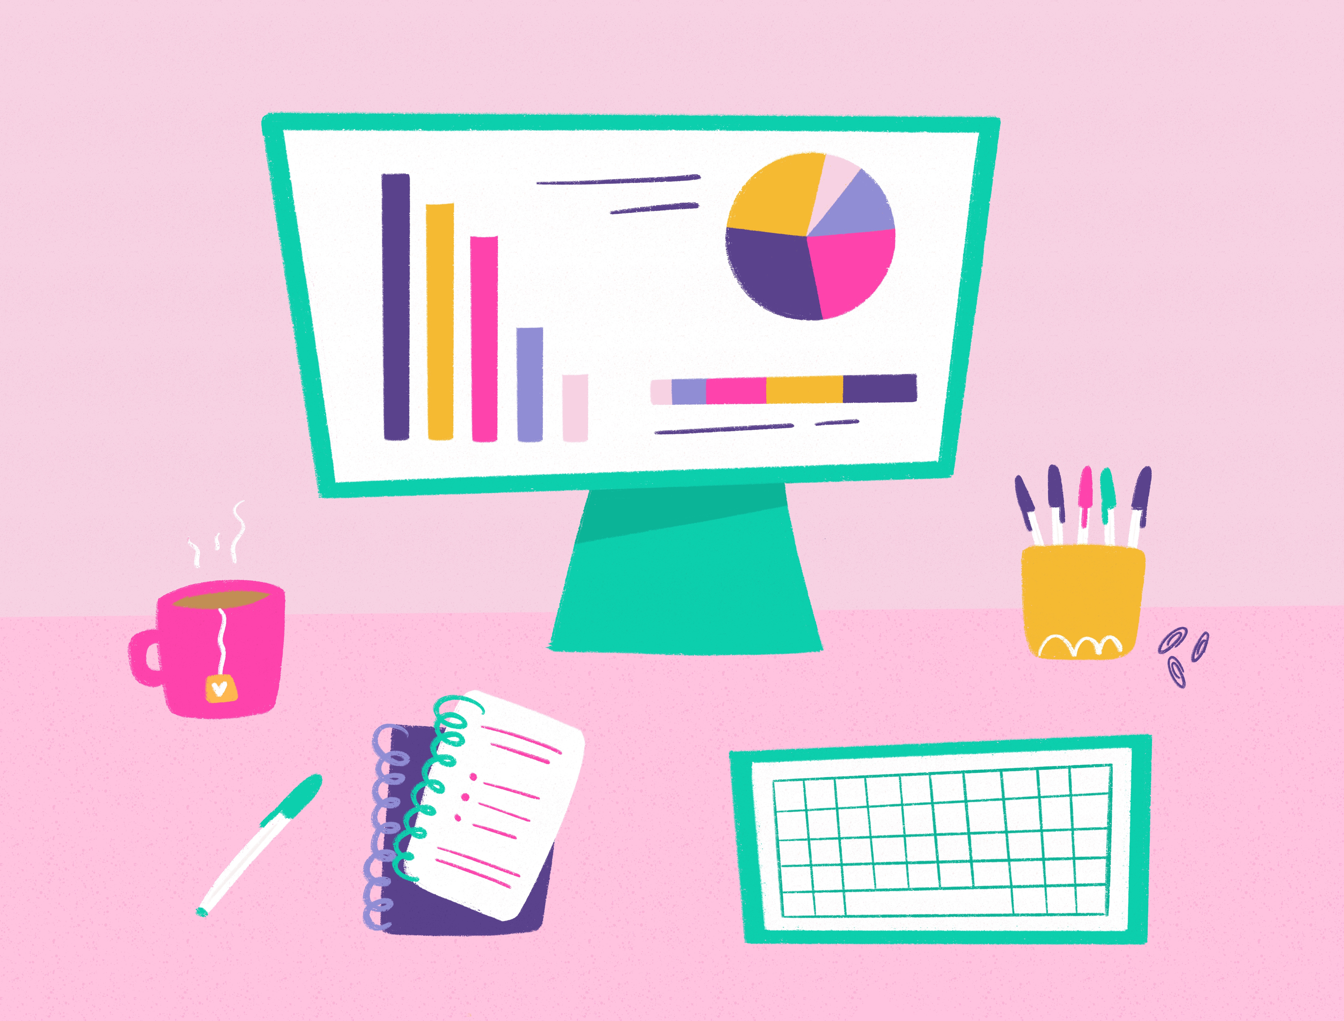
Internet safety day
6/2/24
Together for a better internet
From this theme we want to inspire change, make a difference and navigate change online.

Slide 2
The good things we can do online
There are lots of great things we can do online as listed below.
Play games
Email each other
Learn things
Read
And plenty more

Slide 3
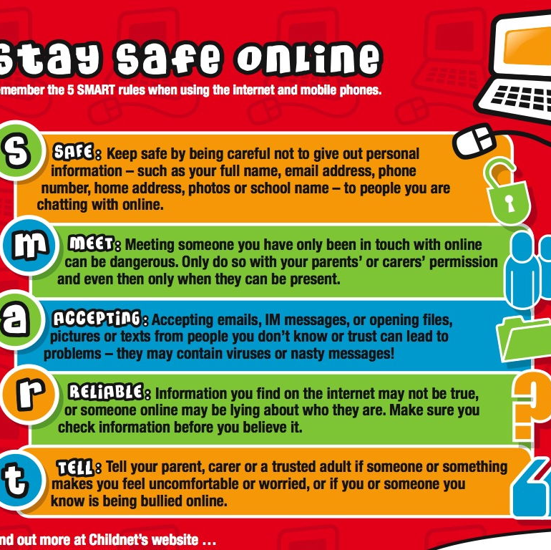
Being careful online
We must be careful online. We must ensure that we use our three R's online :
Respect Yourself
Respect Each other
Respect The Environment
Treat people online like you do in person – with kind words and kind actions!
This Photo by Unknown author is licensed under CC BY-SA-NC.

Slide 4
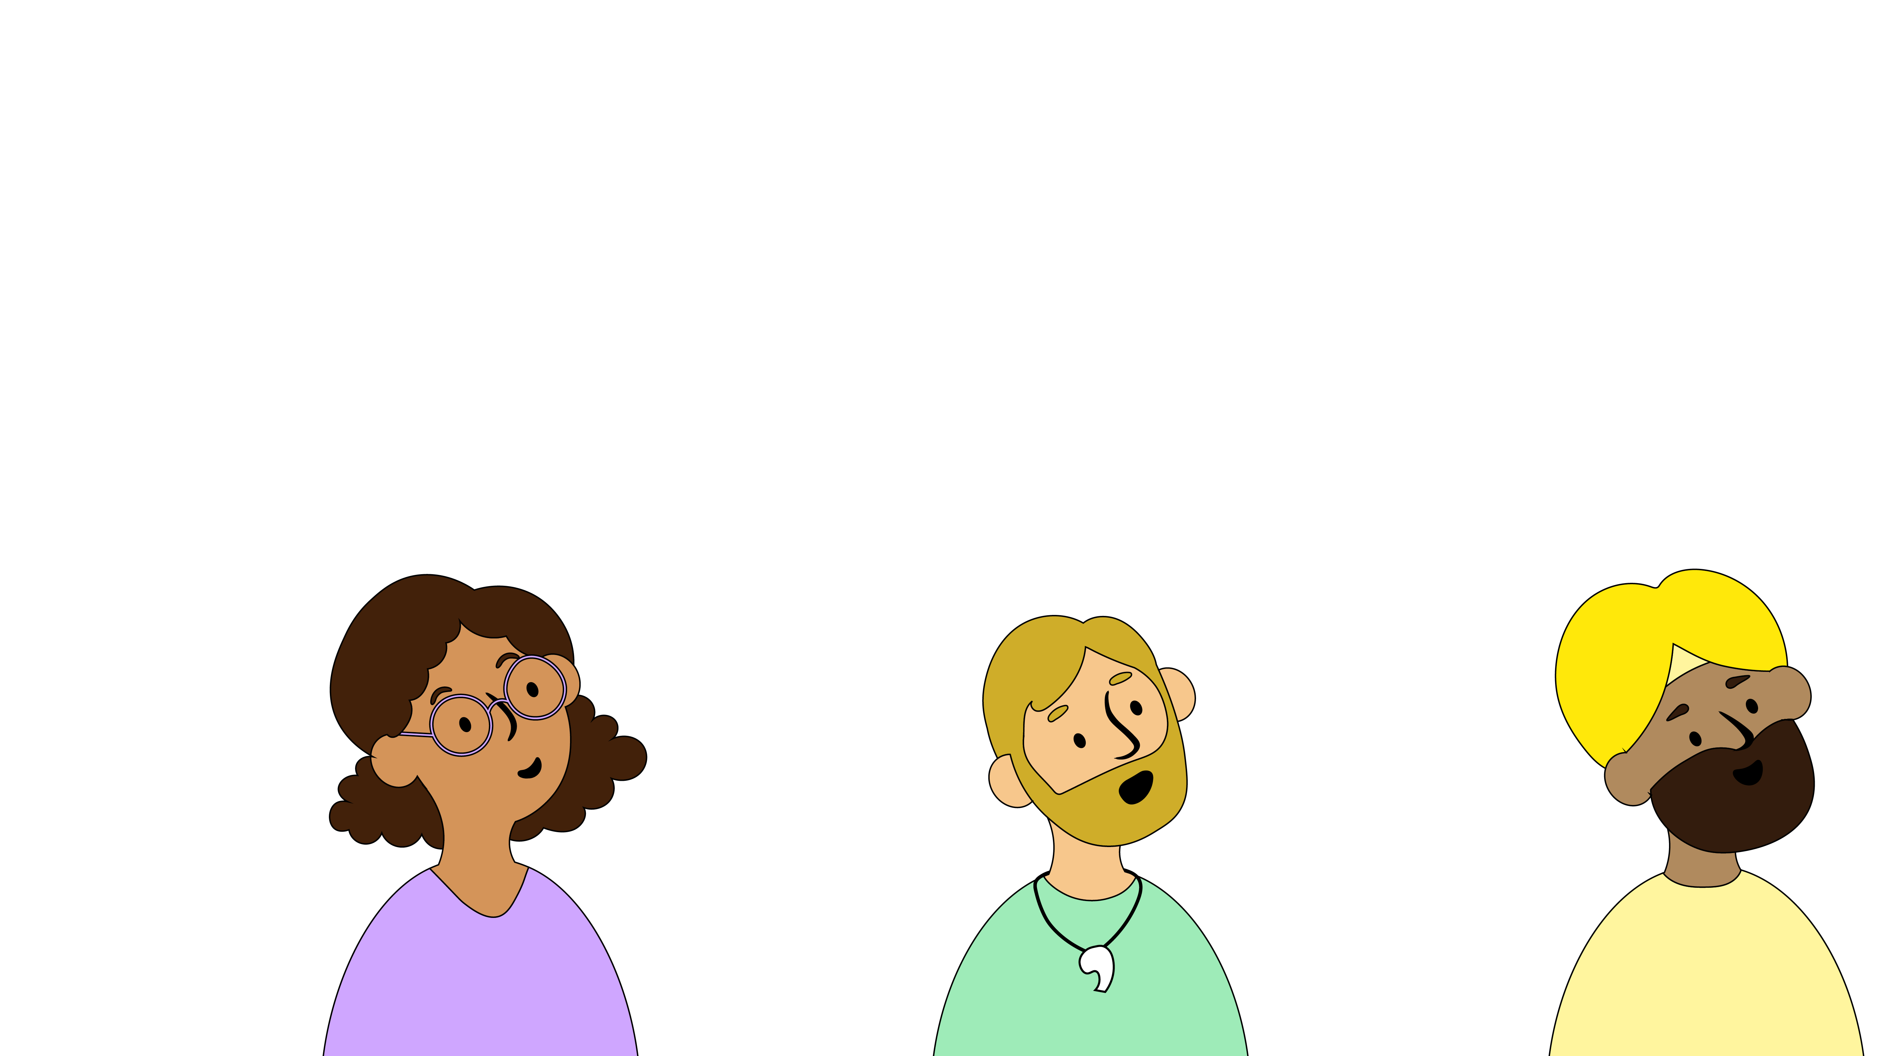
We Must Know What We Are Allowed Online
We must ask an adult before downloading or playing any game or watching anything.

Slide 5
We must know what to do
We need to talk to trusted adults if we see anything we do not like or makes us worried.
You could also pause/ turn off the device screen or delete the app/game

Slide 6
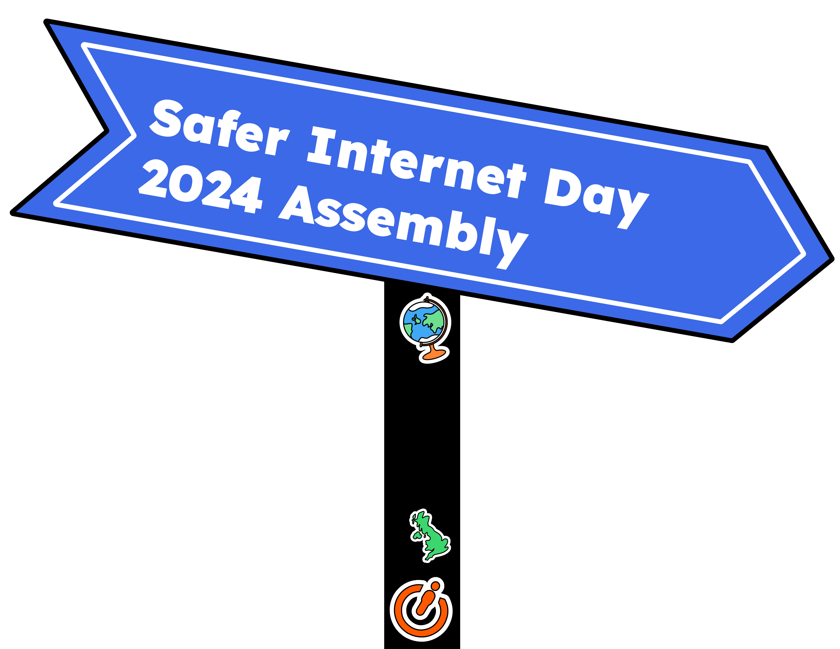
Safer internet day poem
Going online can be so much fun,
You can play, and chat, and find out.
But when things change and you feel unsure,
Then that's when it's time to shout...
"Something has changed, and I need some help,
What's happening doesn't feel good."
Things will get better when a trusted adult knows,
And your feelings have been understood.

Slide 7
Supporter of safer internet day
St Mary's is now a registered and certified supporter of safer internet day
This Photo by Unknown author is licensed under CC BY-NC.

