Slide 1
Macroeconomics:
Time for a Second Opinion
Money and System Dynamics with Ravel

Slide 2
Almost all Macroeconomic Models today…
Are based on Neoclassical economic theory
Are mainly DSGE models (some CGE models still, and RBC precursors to DSGE)
Do not include money or a financial sector
As of 2007: did not include “financial frictions”, and did not anticipate the GFC
Bernanke “Monetary Policy Report to the Congress”, July 18, 2007
  “The U.S. economy seems likely to continue to expand at a moderate pace in the second half of 2007 and in 2008…
  forecasts for the increase in real GDP …
    2¼ percent to 2½ percent over the four quarters of 2007
    and 2½ percent to 2¾ percent in 2008.”
My prediction, based on Minsky’s “Financial Instability Hypothesis”, May 2007
  “At some point, the [private] debt to GDP ratio must stabilise—and on past trends, it won't stop simply at stabilising.
  When that inevitable reversal of the unsustainable occurs, we will have a recession.”

Slide 3
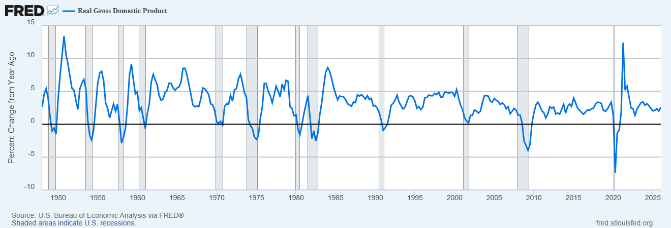
Actual outcomes
The 2008 growth rate was minus 2.5%, and it fell to minus 4% in 2009
“Global Financial Crisis” was the longest & deepest downturn since the Great Depression
How did DSGE models miss it?
  One major omission: no consideration of monetary dynamics…

Slide 4
The missing links in DSGE models
The GFC data strongly supports this:
The inventors of RBC/DSGE models— “Nobel” Prize winners Kydland & Prescott—said credit had to be considered in economic models:
  “The fact that the transaction component of real cash balances (M1) moves contemporaneously with the cycle
  while the much larger nontransaction component (M2) leads the cycle
suggests that credit arrangements could play a significant role in future business cycle theory.
Introducing money and credit into growth theory
in a way that accounts for the cyclical behavior of monetary as well as real aggregates
is an important open problem in economics.” (Kydland and Prescott, 1990)
Credit up, unemployment down
Credit down, unemployment up

Slide 5
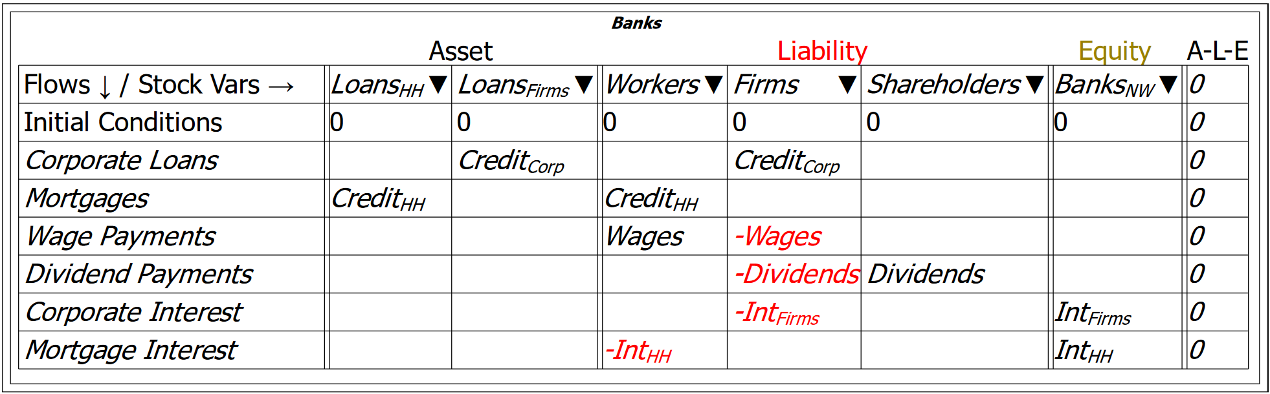
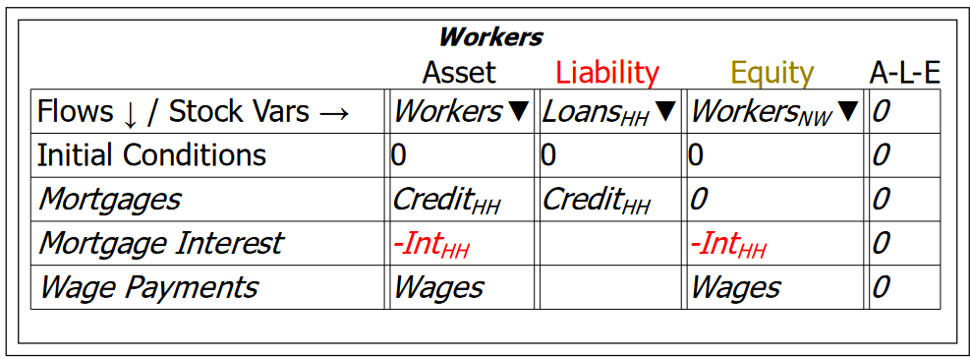
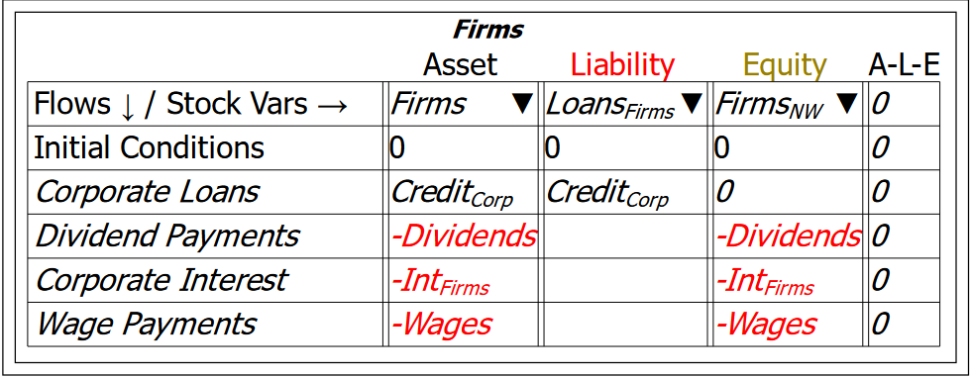
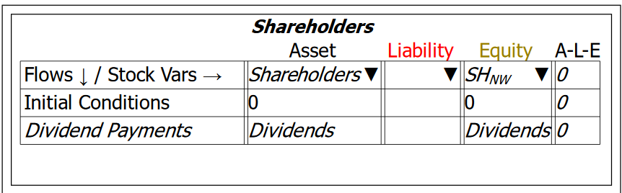
Ravel for system dynamics modelling of money and production
We need monetary macroeconomic models that incorporate this effect
I invented Ravel to enable monetary dynamic modelling of the economy
  Double-entry bookkeeping for monetary modelling in “Godley Tables”…
Enables integrated view of entire monetary system

Slide 6
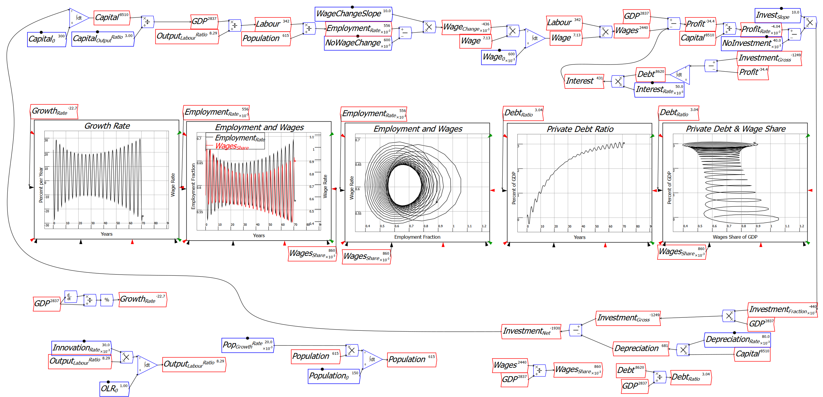
Ravel for system dynamics modelling of money and production
Flowchart dynamic complex systems equations for modelling production

Slide 7
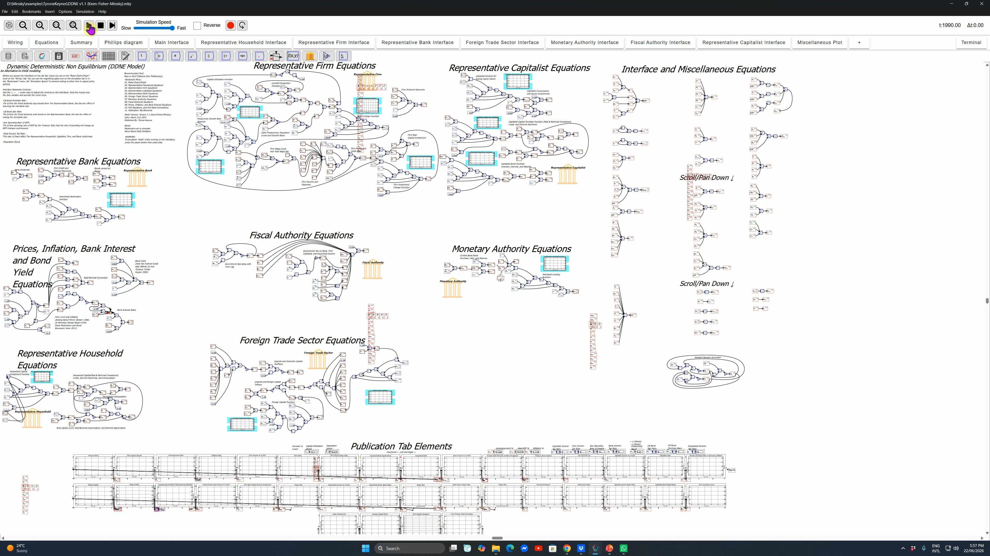
Ravel for system dynamics modelling of money and production
Scales from “Toy” models for teaching and exposition…
To fully integrated large-scale models of national economies…

Slide 8
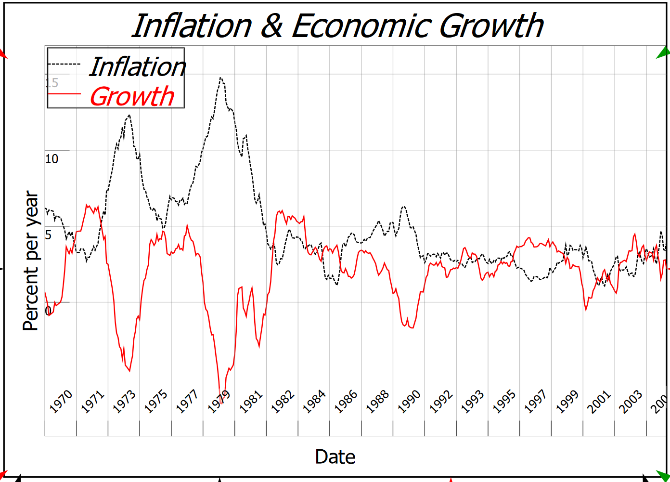
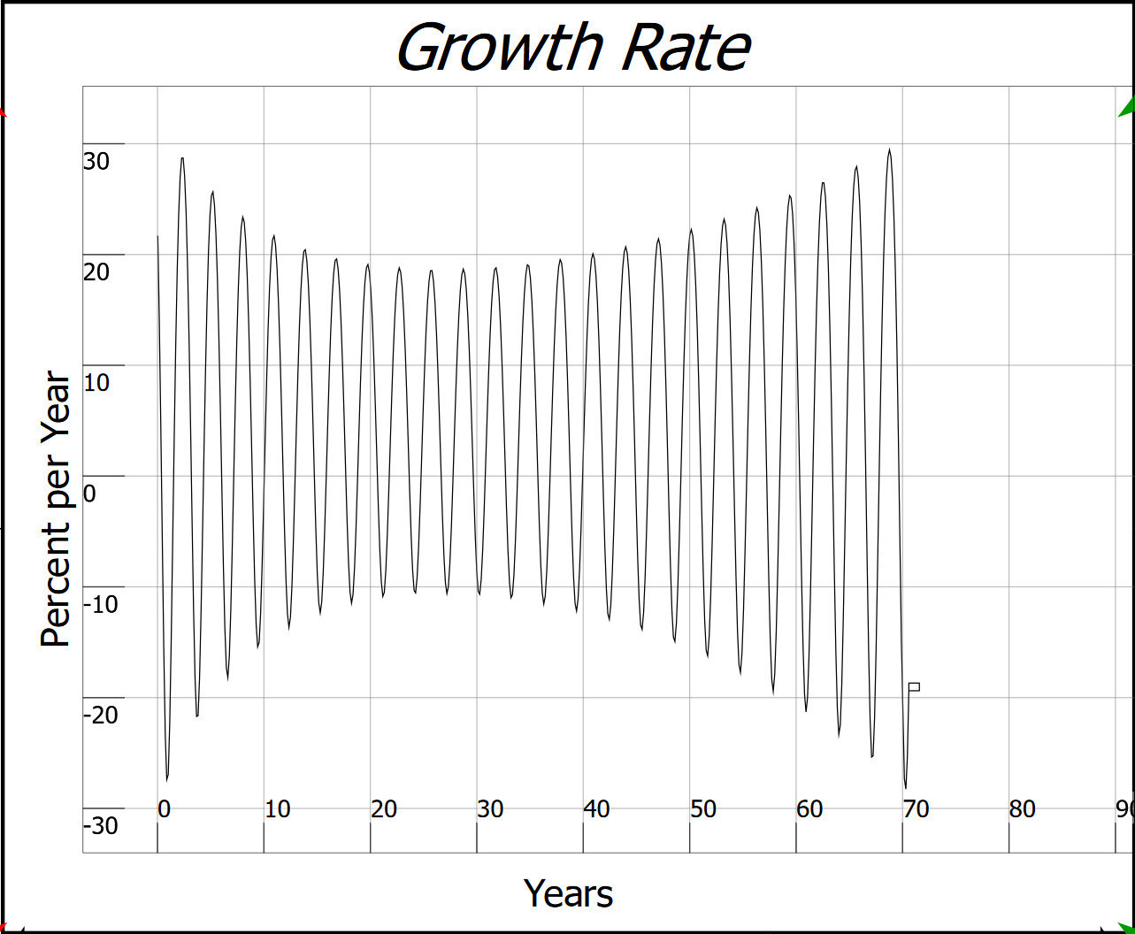
The need for a second opinion
Inflation trending down
Min Growth trending up
Guided by DSGE models, Bernanke welcomed “The Great Moderation” (Bernanke 2004)
“… a marked reduction in economic volatility … a phenomenon that has been dubbed “the Great Moderation”…
improved control of inflation has contributed in important measure to this welcome change in the economy”
Guided by my model of Minsky’s “Financial Instability Hypothesis” (Keen 1995), I concluded
“The chaotic dynamics explored in this paper should warn us against accepting a period of relative tranquility in a capitalist economy as anything other than a lull before the storm”
“The Great Moderation” was actually a prelude to crisis

Slide 9
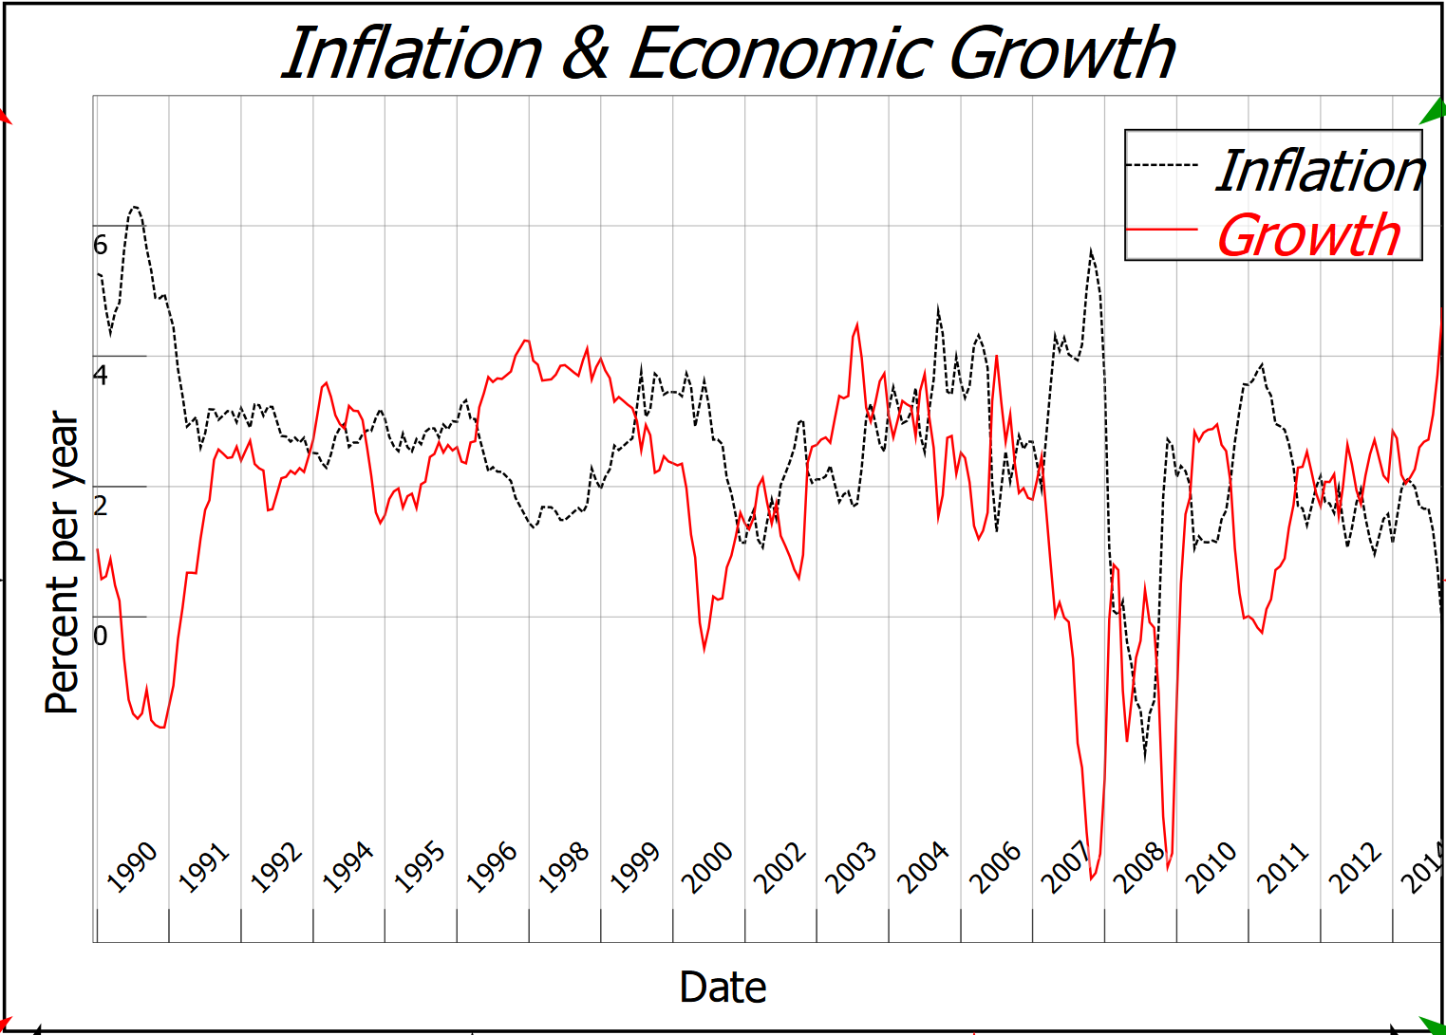
The need for a second opinion
The outcome
Growth collapsed from +4% to -4% p.a.
Inflation of 6% gave way to deflation of 2%

Slide 10
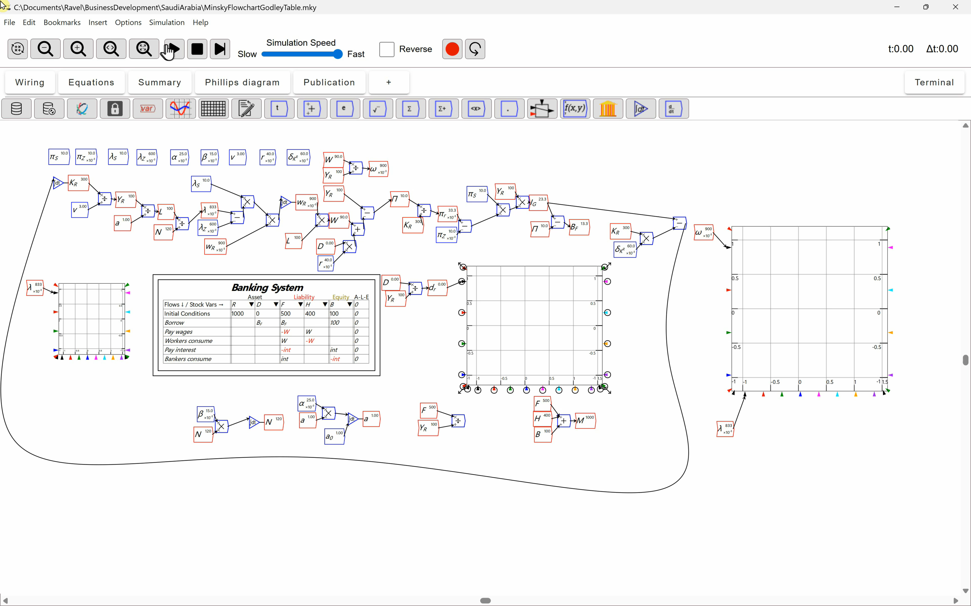
Can credit be incorporated into DSGE models?
There are attempts, e.g. Kumhof and Jakab (2015). “Banks are not intermediaries of loanable funds — and why this matters”, Bank of England.
But this is an inherently non-equilibrium process
Enter system dynamics for non-equilibrium modelling…
But aren’t such models “ad hoc”?

Slide 11
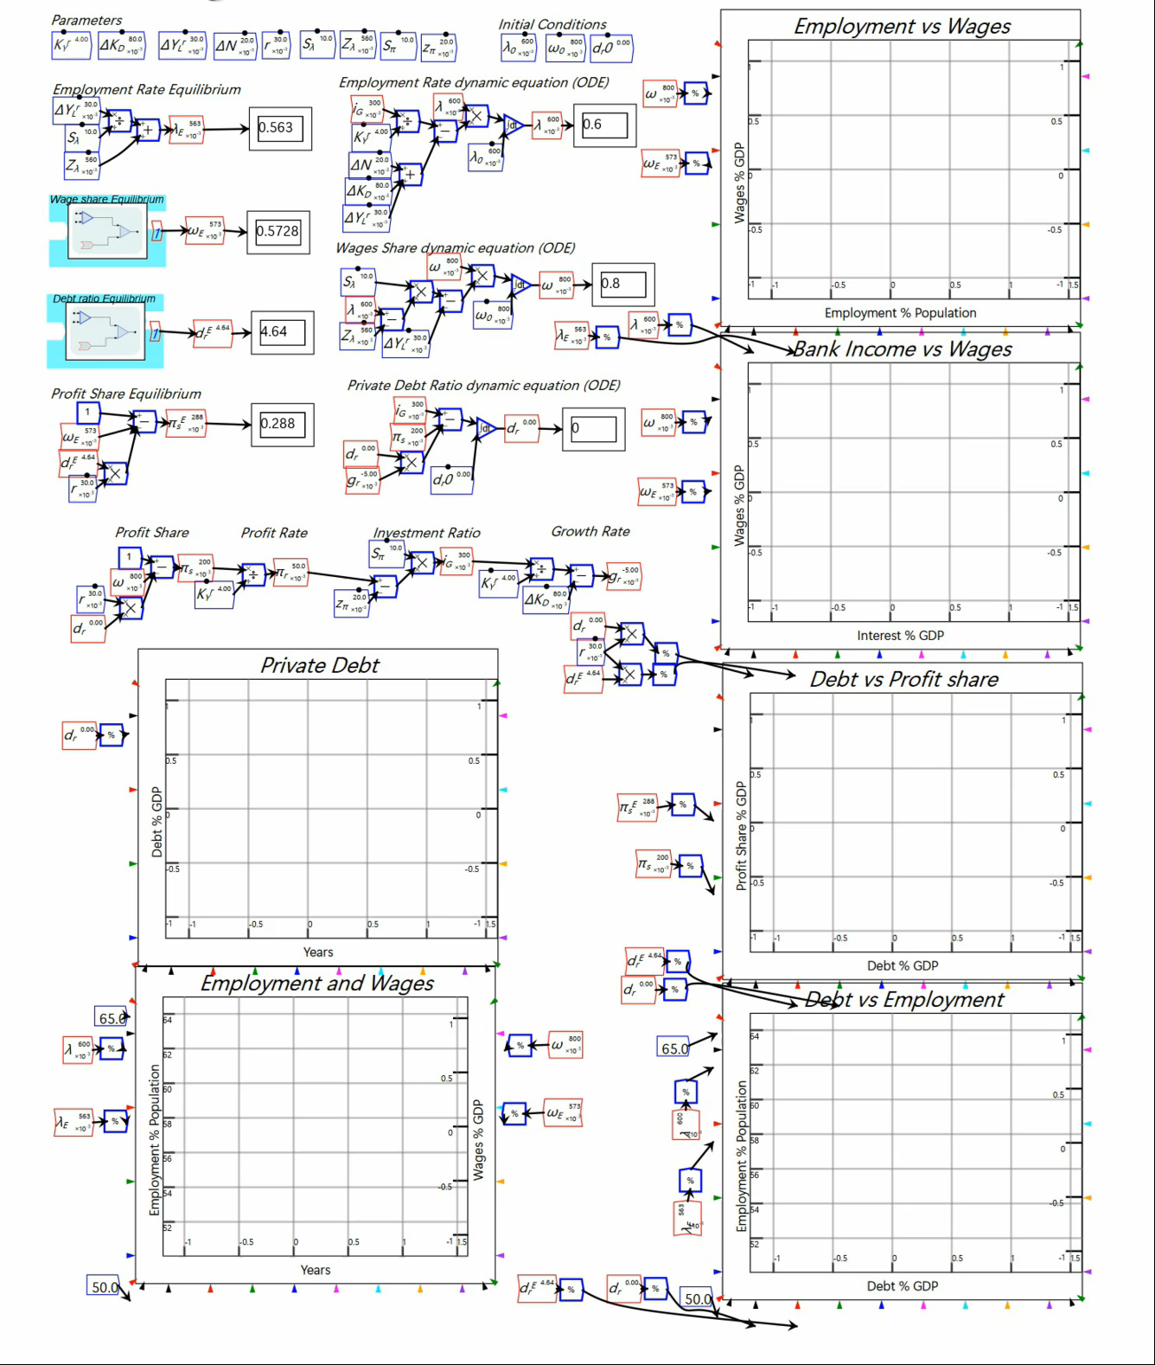
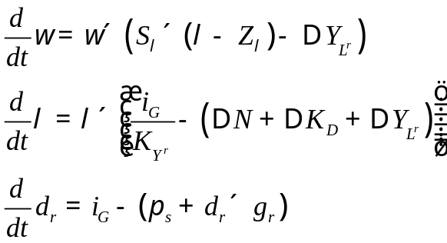
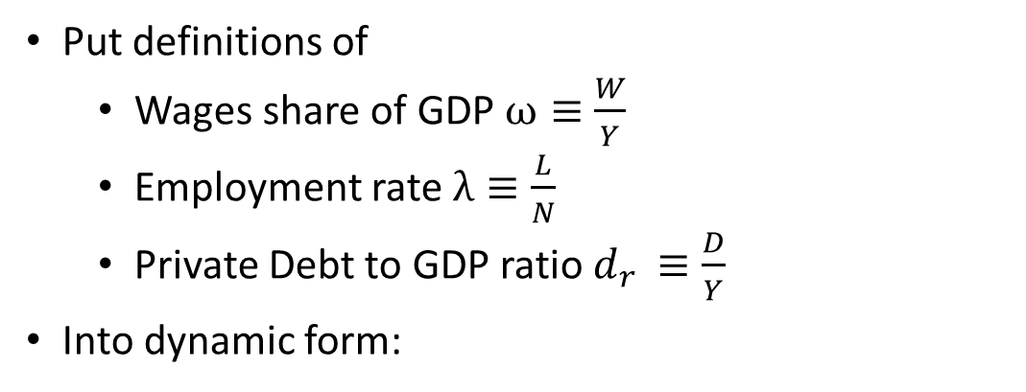
System dynamics and strictly true macroeconomic definitions
No: system dynamics models can be shown to be identical to models derived from strictly true macroeconomic definitions…
Put definitions of
  Wages share of GDP $ω≡\frac{W}{Y}$
  Employment rate $λ≡\frac{L}{N}$
  Private Debt to GDP ratio $d_{r }≡\frac{D}{Y}$
Into dynamic form:
The same dynamics as flowchart model

Slide 12
The need for a second opinion
DSGE models are “microfounded”—based on Neoclassical microeconomics
  Ravel models are “macrofounded”—based on the structure of the macroeconomy
DSGE models do not include banks, debt and money
  Ravel models include banks, debt and money
DSGE models impose an ultimate equilibrium
  Ravel models are complex systems operating far-from-equilibrium
DSGE models are hard for policymakers to understand
  Ravel’s Godley Tables & flowcharts can be read by non-mathematical readers
Just one perspective on the economy
Missed the biggest economic event of this century
A second opinion is better than relying on just one perspective on the economy

Slide 13
Different answers to open economic questions
The role of bank credit in the economy?
  Neoclassical theory: “pure redistributions should have no significant macro­economic effects.” (Bernanke 2000)
  Banks as “competitive, risk-neutral financial institutions who intermediate between savers and borrowers ” (Bernanke 2022)
  Bank of England 2014: “banks do not act simply as intermediaries, lending out deposits that savers place with them…” (McLeay, Radia et al. 2014)
Ravel can resolve this
  IF banks are intermediaries, then credit does not matter…

Slide 14
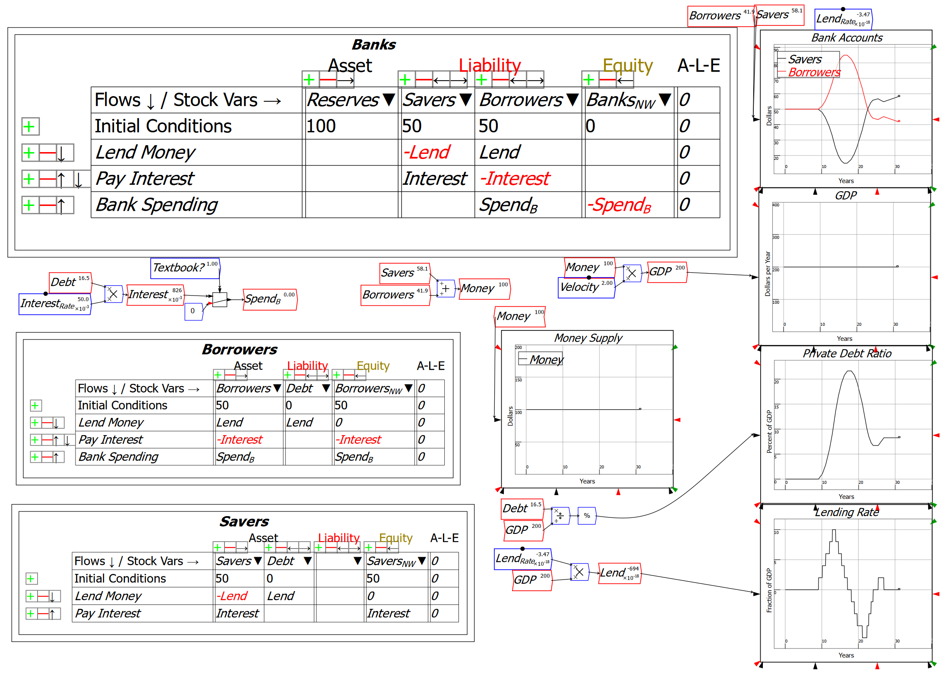
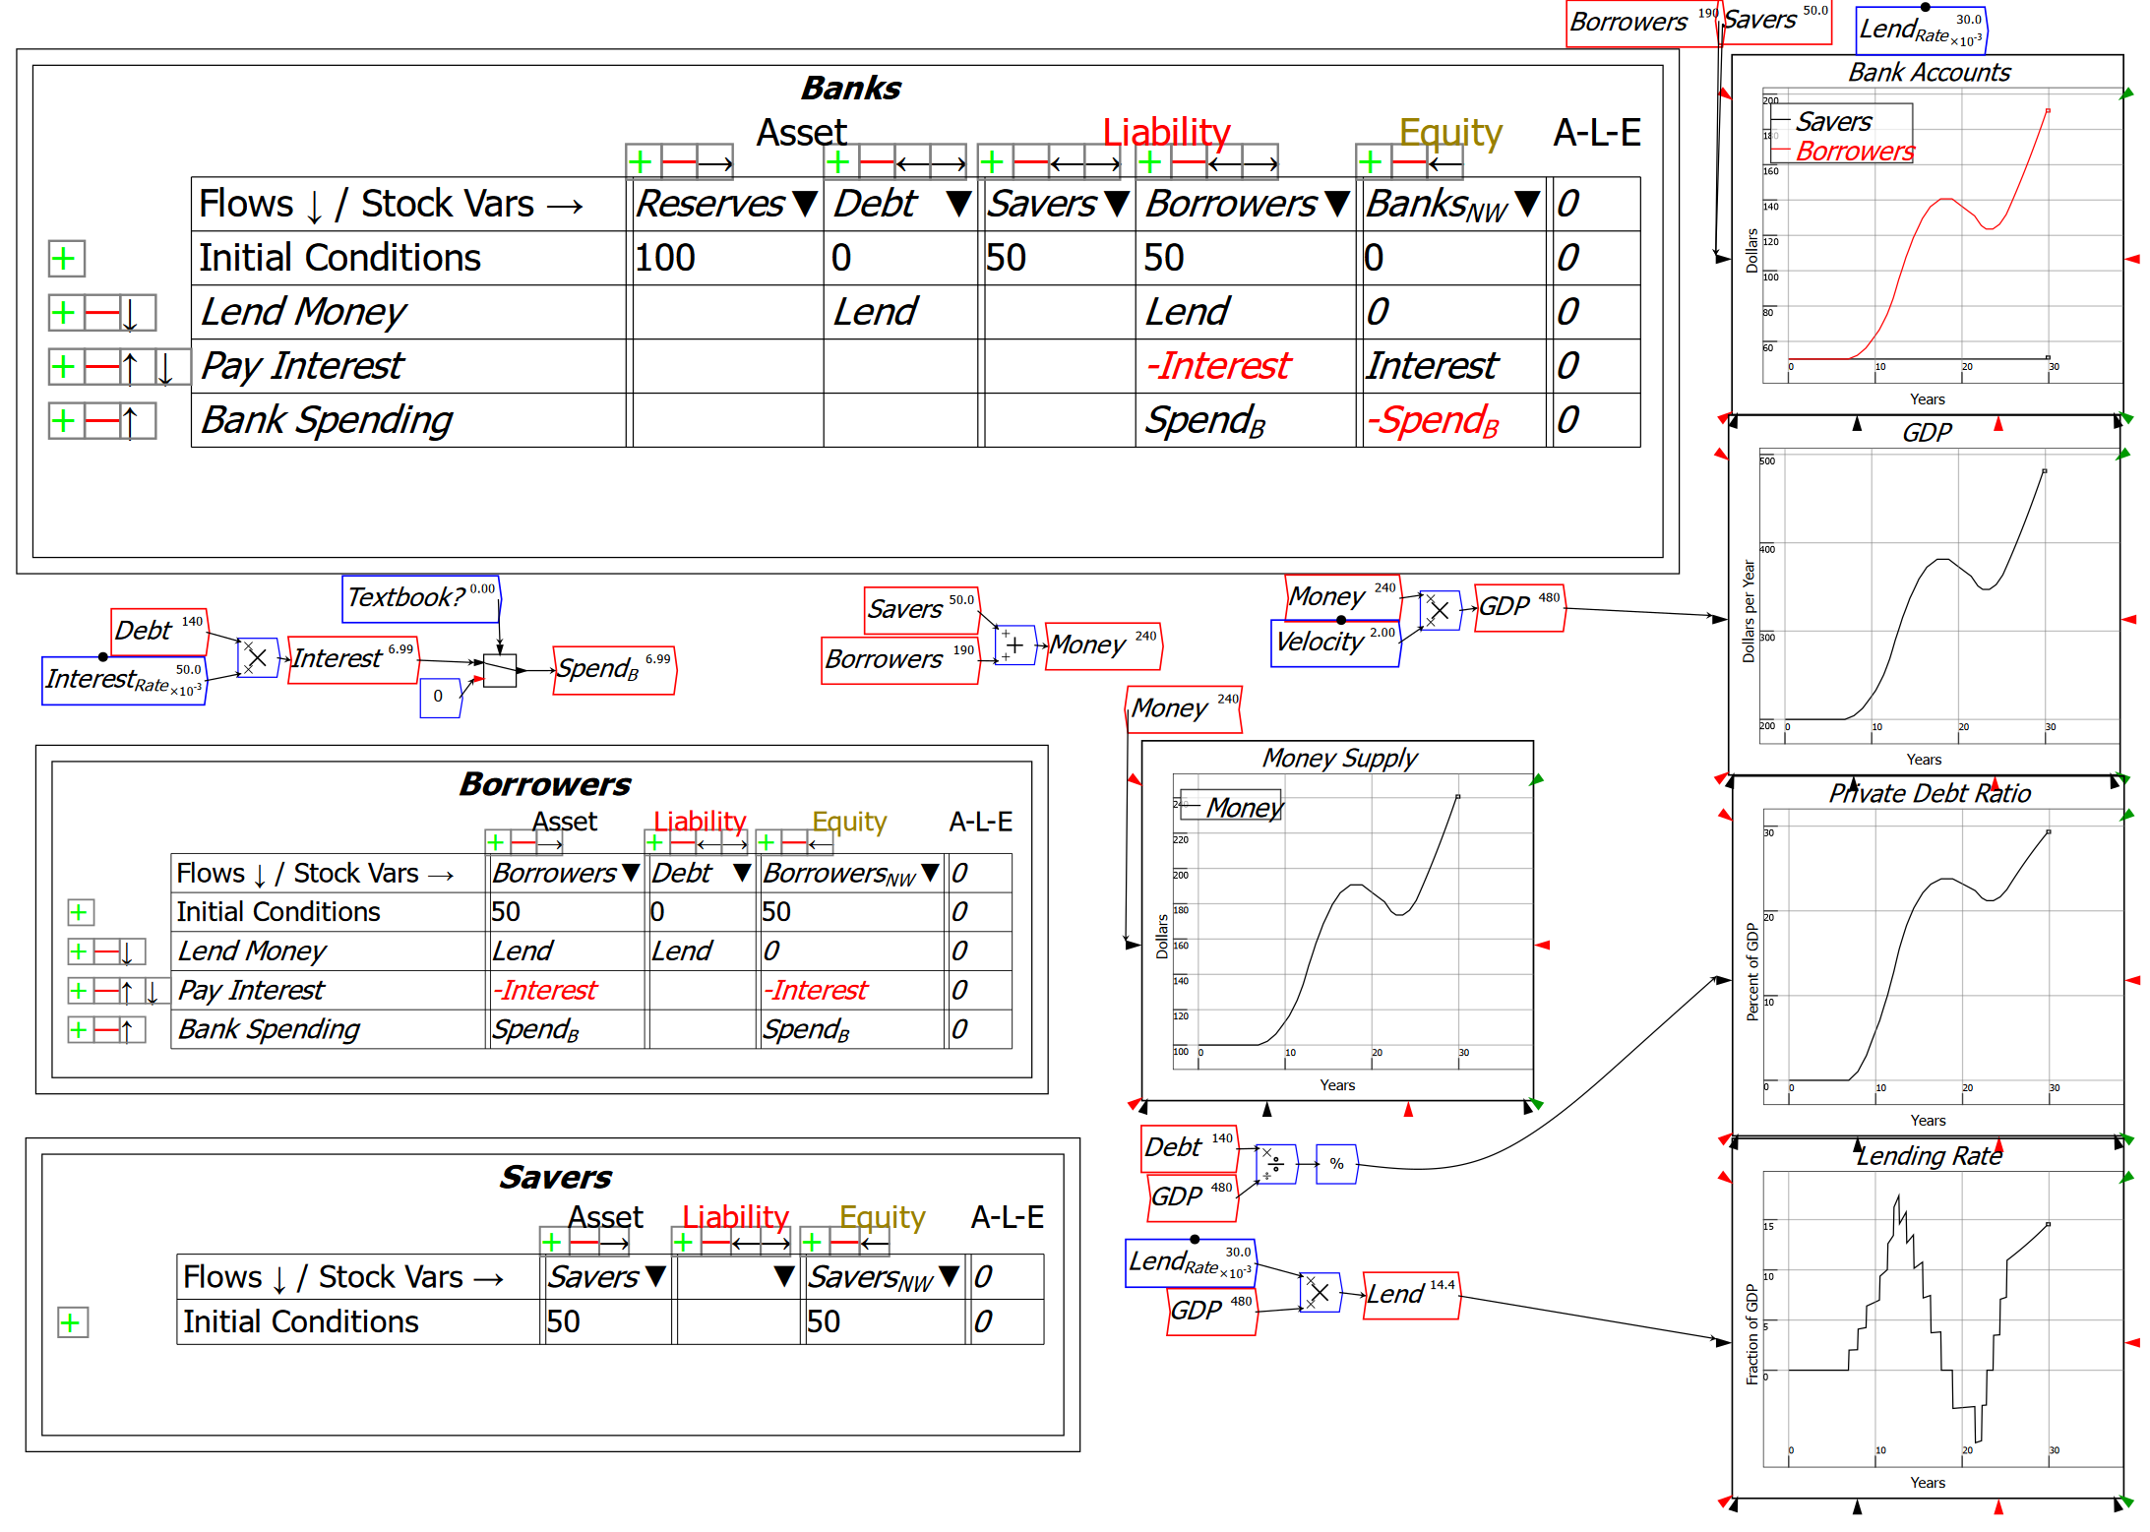
Different answers to open economic questions
Credit doesn’t change GDP if banks are intermediaries
Credit can be ignored in macroeconomics…
But if banks are loan originators?
Credit affects GDP
Credit cannot be ignored in macroeconomics

Slide 15
Different answers to open economic questions
Mankiw’s textbook states the mainstream case: deficits reduce “Loanable Funds”
  “When a government spends more than it collects in taxes, it has a budget deficit, which it finances by borrowing from the private sector or from foreign governments… (p. 555)
  The accumulation of past borrowing is the government debt
  Many economists have criticized this increase in government debt as imposing an unjustifiable burden on future generations.” (p. 557)
Modelling government finances using Godley Tables & Double-entry Bookkeeping…

Slide 16
Different answers to open economic questions
Deficits create “Loanable Funds”

Slide 17
Conclusion: Time for a second opinion
The fact that all governments use Neoclassical DSGE models
  Is why no formal models anticipated the GFC
Neoclassical models omit credit dynamics
  Confirmed by the Bank of England and the Bundesbank
  Their arguments on government deficits and debt burdens are provably wrong in accounting
An alternative approach is needed
Ravel models the monetary system using accounting, and enables dynamic non-equilibrium modelling of production
It is the realistic second opinion that policymakers need

