Slide 1


Cultural Landscape
How Culture Affects The Earth's Physical Landscape

Slide 2
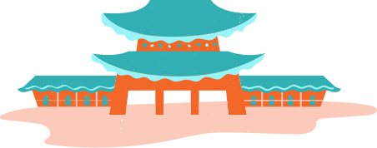
How to Use This Presentation
  Google Slides
  PowerPoint
  Canva
Click on the "Google Slides" button below this presentation preview. Make sure to sign in to your Google account. Click on "Make a copy." Start editing your presentation.
Alternative: Click on the "Share" button on the top right corner in Canva and click on "More" at the bottom of the menu. Enter "Google Drive" in the search bar and click on the GDrive icon to add this design as a Google slide in your GDrive.
Click on the "PowerPoint" button below this presentation preview. Start editing your presentation.
Alternative: From Canva template file, Click on the "Share" button on the top right corner in Canva and click on "More" at the bottom of the menu. Enter "PowerPoint" in the search bar and click on the PowerPoint icon to download.
Click on the "Canva" button under this presentation preview. Start editing your presentation. You need to sign in to your Canva account.

Slide 3



Table Of Contents
  01
Write an agenda here.
  02
Write an agenda here.
  03
Write an agenda here.

Slide 4





Lesson Outline
  What Is Culture?
  How Does Culture Affect The Landscape?
  Different Cultural Influences On Landscape

Slide 5



Learning Outcomes
  Learn how culture can affect landscape
  Understand the different kinds of cultural landscapes
  How is culture spread?
  Identify the cultural markers of your area

Slide 6

Cultural Landscape
  When we talk about landscape, we often think of the natural physical characteristic of the Earth's surface. However, geographical landscape can also be defined by the culture of the people who live in a particular area.
  People coming together in communities form common behaviors and habits that become shared beliefs, traditions, and actions. This is culture.
  This then affects or influences the landscape the communities reside in.

Slide 7




Some Cultural Indicators Affecting Landscape
  Ethnicity
  Language
  Religion
  Groupings of people that have a shared culture, a shared biological ancestry, or a shared origin place.
  A communication system that has meaning to a group of people through speech.
  Beliefs and ideologies. Can be ethnic (specific to national groups) or universalizing (anyone can join).

Slide 8

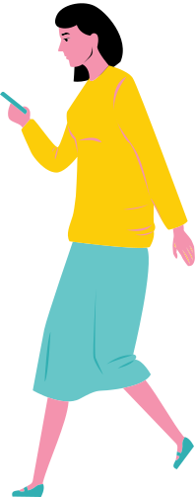
Cultural Diffiusion
  Cultural Region
  The location of cultural traits or communities.
  Cultural Hearth
  The origin of the cultural traits of a group of people.
  Definition
  The spread of culture and the methods of how it happens (migration, trade, etc.)

Slide 9


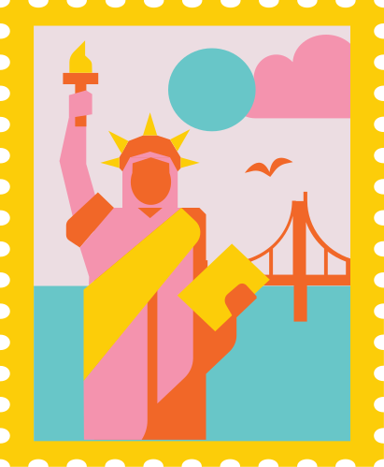
Folk vs. Popular
  Folk Culture
  Popular Culture
  Also known as local culture. Characteristed by cultural elements of a small, homogeneous group.
  What can be found in larger, heterogeneous groups sharing certain cultural elements. They may or may not be found in one area.

Slide 10


Mid-Discussion Break
  You will be assigned a partner. Ask them about the area they live in and if they can share any practices or habits they've observed from their surroundings that may not be present elsewhere.

Slide 11

Summary
  Culture can be...
  01
Inherited, or grown through diffusion or coming together of different cultures.
  02
Defined by different aspects such as ethnicity, religion, and language.
  03
Shared by a group of people in the same area, or by bigger groups across different areas.

Slide 12


Assignment
  Over the weekend, talk to 2-3 of your neighbors. Like with our activity, ask them about things that they believe are unique to your area.
  What languages do they speak?
  What events or celebrations do you have?
  Is there any particular food that they haven't found else where?
  Create a poster on Canva with your findings.

Slide 13
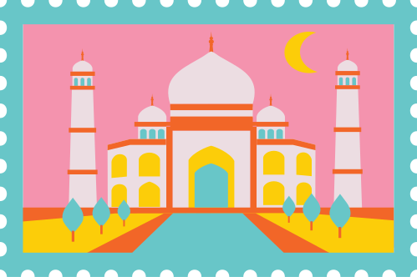
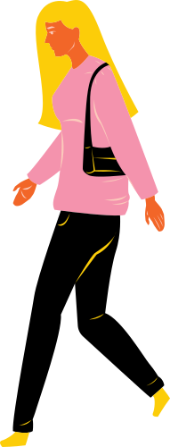
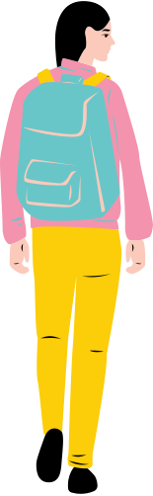
References
  Puyallup School District. Human Geography. Puyallup School District, 2015, www.oercommons.org/courseware/lesson/16294.

Slide 14
Resource
Page
  Use these design resources in your Canva Presentation.
  This presentation template uses the following free fonts:
  Titles: Paytone One
  Headers: Oregano
  Body Copy: Nunito
  You can find these fonts online too. Happy designing!
  Don't forget to delete this page
  before presenting.

Slide 15


This presentation template is free for everyone to use thanks to the following:
  SlidesCarnival for the presentation template
  Pexels for the photos
Happy designing!

