Slide 1
Accounting Resume
Presentation

Slide 2
Table Of Contents
01
02
03
Introduction
Experience
Skills
Elaborate on what you want to discuss.
Elaborate on what you want to discuss.
Elaborate on what you want to discuss.

Slide 3
01
Introduction
Welcome to a world of endless possibilities and boundless imagination. In this passage, we will embark on a journey through words and ideas, exploring the depths of creativity and knowledge. Let your mind wander and your thoughts flow freely as we delve into the realms of inspiration and discovery.
Together, we will uncover new perspectives, ignite passions, and create a tapestry of thoughts that will inspire and uplift.

Slide 4
Welcome To Presentation
I'm Rain, and I'll be sharing with you my beautiful ideas. Follow me at @reallygreatsite to learn more.

Slide 5
Professional Experience
Sales Account Manager, XYZ Company
[Month, Year] - Present
Spearhead strategic planning and execution of sales initiatives, driving revenue growth and market expansion.
Cultivate and maintain strong relationships with key clients, ensuring satisfaction and retention.
Develop and implement tailored solutions to meet client needs, resulting in a 20% increase in upsell opportunities.
Lead a high-performing sales team, providing coaching and guidance to drive performance and exceed targets.

Slide 6
Education
Master of Business Administration (MBA)
University Name, City, Country
Graduation Date
Specialization in Sales and Marketing
Relevant coursework: Strategic Sales Management, Market Analysis, Negotiation Strategies

Slide 7
My Projects
Project 1
Project 2
Project 3
Project 1 is a new venture that promises innovation and excitement. As we embark on this journey together, we are filled with anticipation and enthusiasm for what lies ahead.
Project 1 is a new venture that promises innovation and excitement. As we embark on this journey together, we are filled with anticipation and enthusiasm for what lies ahead.
Project 1 is a new venture that promises innovation and excitement. As we embark on this journey together, we are filled with anticipation and enthusiasm for what lies ahead.

Slide 8
Professional Experience
In addition to academic qualifications, professional experience plays a vital role in shaping one's career path. It provides a platform for individuals to apply their knowledge in real-world situations, honing their skills and capabilities.
Professional experience can encompass a wide range of activities, from internships and part-time jobs to full-time positions in various industries.

Slide 9
Gallery Image
What can you say about your projects? Share it here!

Slide 10
Job position
In addition to academic qualifications, professional experience plays a vital role in shaping one's career path. It provides a platform for individuals to apply their knowledge in real-world situations, honing their skills and capabilities.
Professional experience can encompass a wide range of activities, from internships and part-time jobs to full-time positions in various industries.

Slide 11
Computer skills
Skills 1
Skills 2
Skills 3
Elaborate on what you want to discuss.
Elaborate on what you want to discuss.
Elaborate on what you want to discuss.

Slide 12
Testimonials
Client name
Client name
Client name
Elaborate on what you want to discuss.
Elaborate on what you want to discuss.
Elaborate on what you want to discuss.

Slide 13
About Me
I am a passionate individual who thrives on creativity and innovation. I believe in the power of continuous learning and self-improvement. Exploring new ideas and perspectives is something that always excites me.
I enjoy connecting with people from diverse backgrounds and learning from their experiences. In my free time, you can find me indulging in my hobbies such as reading, painting, and exploring nature. I believe that each day is an opportunity to grow and make a positive impact in the world. Thank you for taking the time to learn a little bit about me.

Slide 14
My History
Our history is a tapestry woven with the threads of the past, each strand representing a moment in time that has shaped who we are today. It is a story of triumphs and tribulations, of great achievements and challenging setbacks. From ancient civilizations to modern societies, our history spans continents and cultures, connecting us to our ancestors and to each other.
As we look back on the chapters of our collective past, we see the resilience of the human spirit, the power of innovation, and the importance of learning from our mistakes.

Slide 15
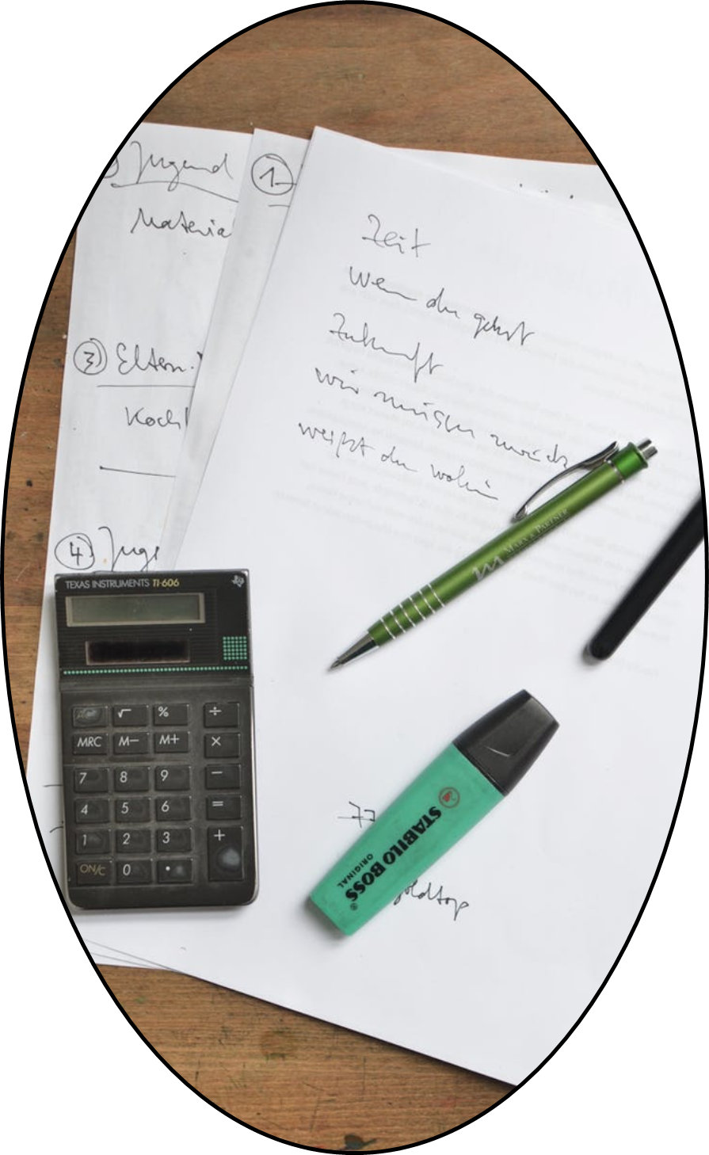
My case 1
In "My case 1", I found myself facing a challenging situation that tested my resolve and problem-solving skills. The journey was not easy, but I approached it with determination and a positive attitude.
With each obstacle that came my way, I learned valuable lessons and grew stronger. I sought guidance from mentors and leaned on the support of my loved ones. Through perseverance and hard work, I overcame the challenges and emerged victorious. This experience taught me the importance of resilience and believing in myself, even when faced with adversity.

Slide 16
A picture is worth a thousand words

Slide 17
Write an original statement or inspiring quote

Slide 18
Contact Me
Address: [Your Physical Address]
Phone: [Your Phone Number]
Email: [Your Email Address]
LinkedIn: [Your LinkedIn Profile URL]
Website/Blog: [Your Website or Blog URL]
If you have any questions, suggestions, or just want to say hello, feel free to reach out to me. I would love to hear from you! You can contact me through email, social media, or by filling out the contact form on my website.

Slide 19
Resource Page
Use these design resources in your Canva Presentation.
You can find these fonts online too. Happy designing!
Don't forget to delete this page before presenting.
This presentation template uses the following free fonts:
Titles: Archivo black
Headers: Archivo black
Body Copy: Open Sans

Slide 20
Credits
This presentation template is free for everyone to use thanks to the following:
SlidesCarnival for the presentation template
Pexels for the photos
Happy designing!

