Slide 1
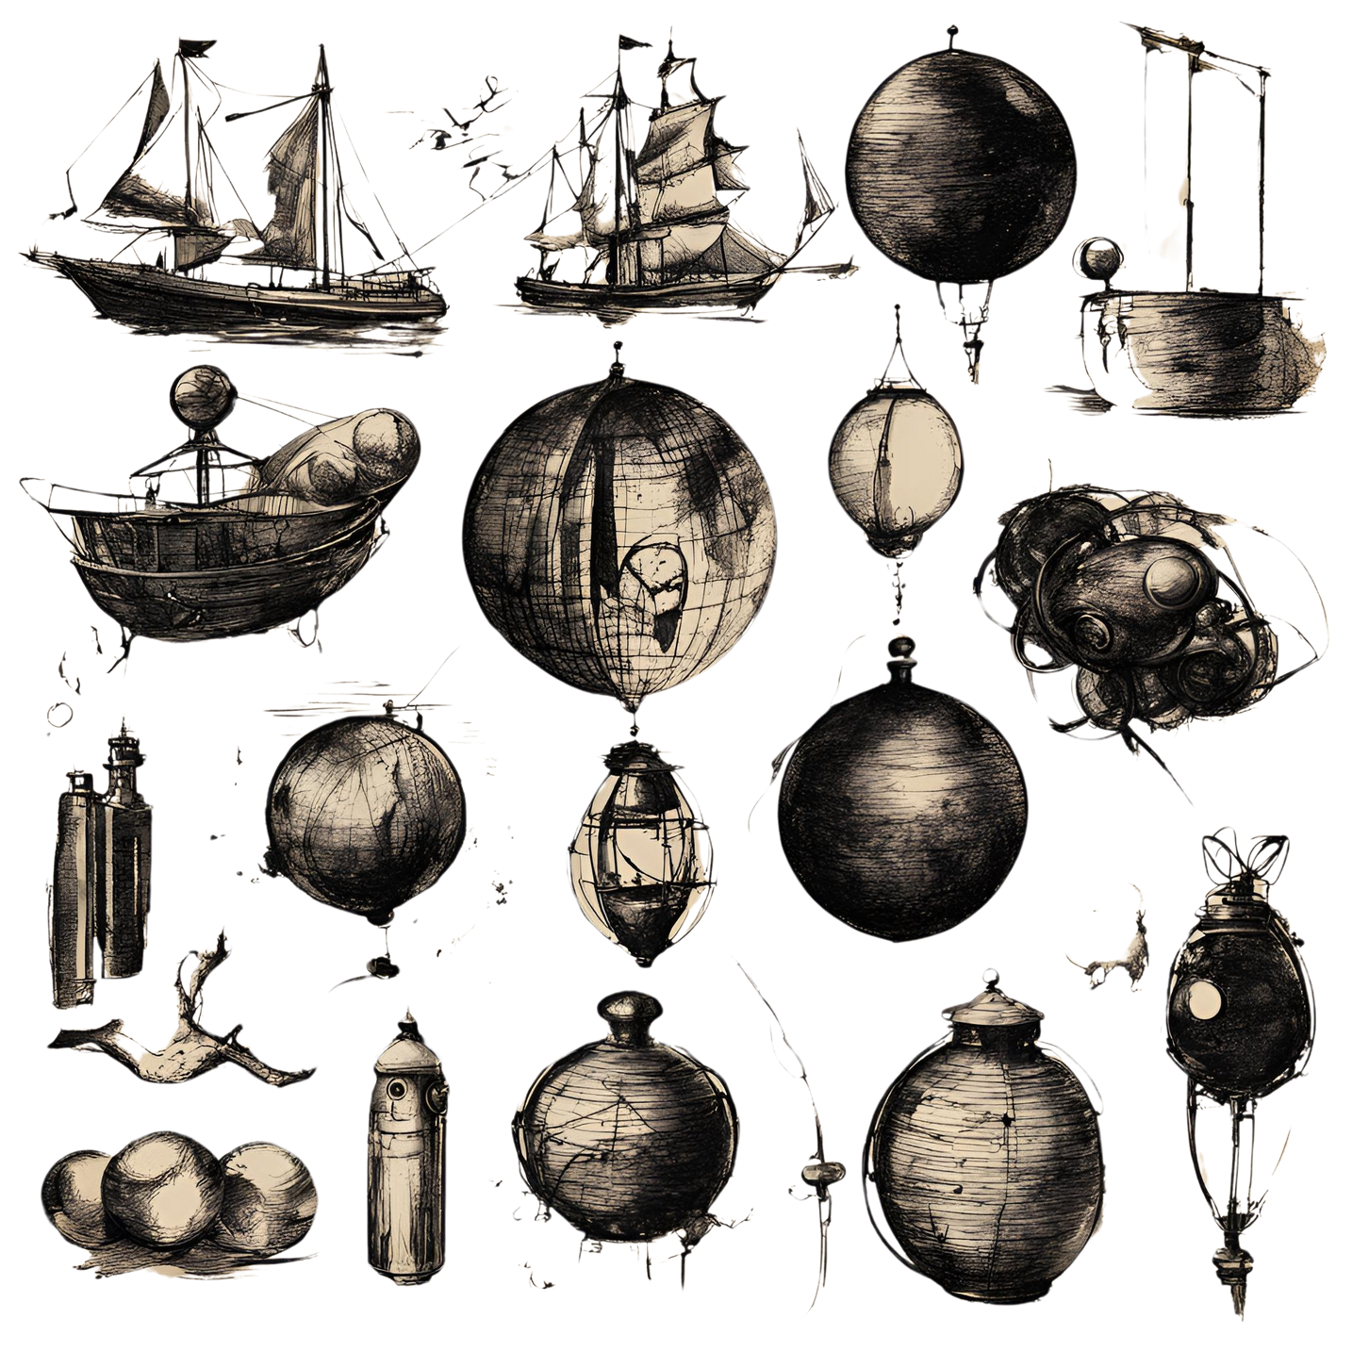
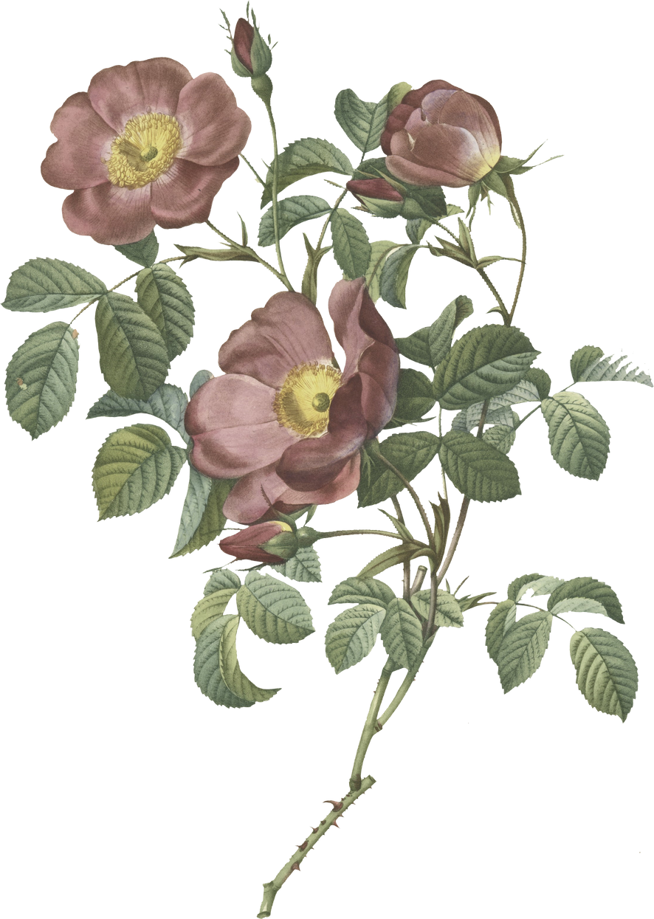

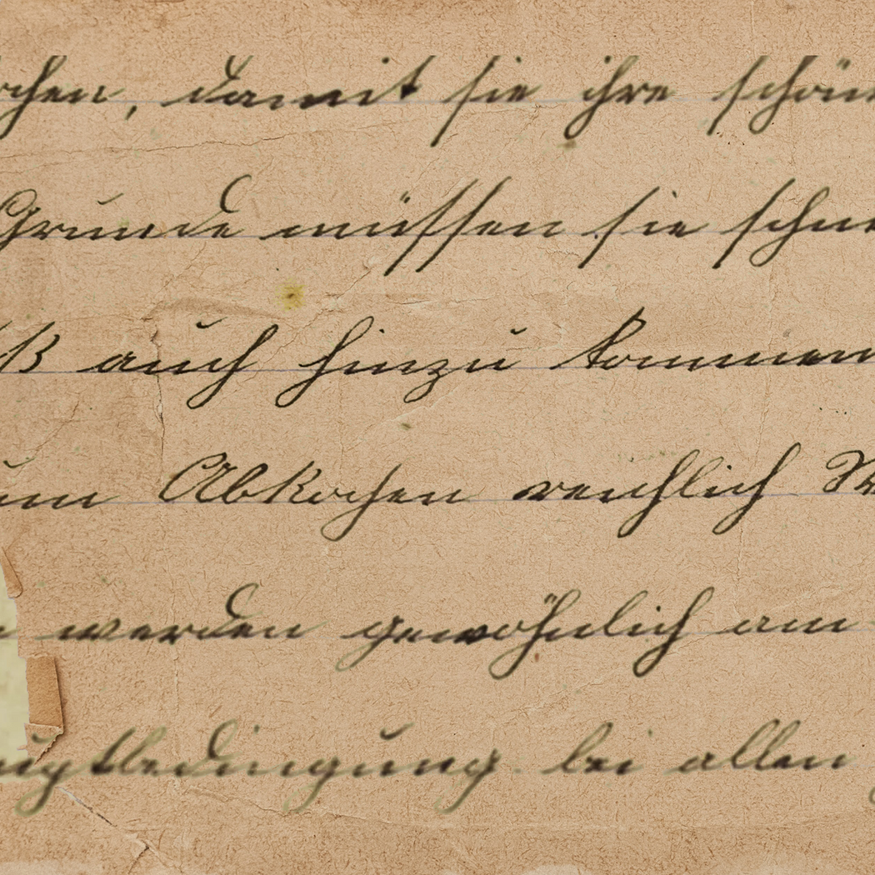
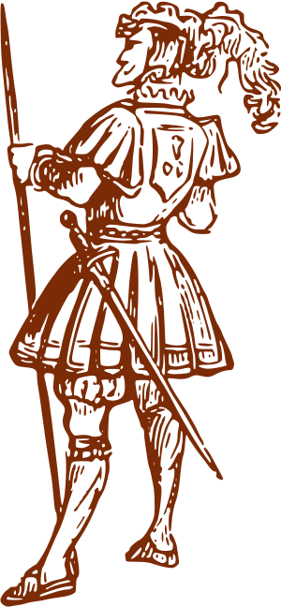


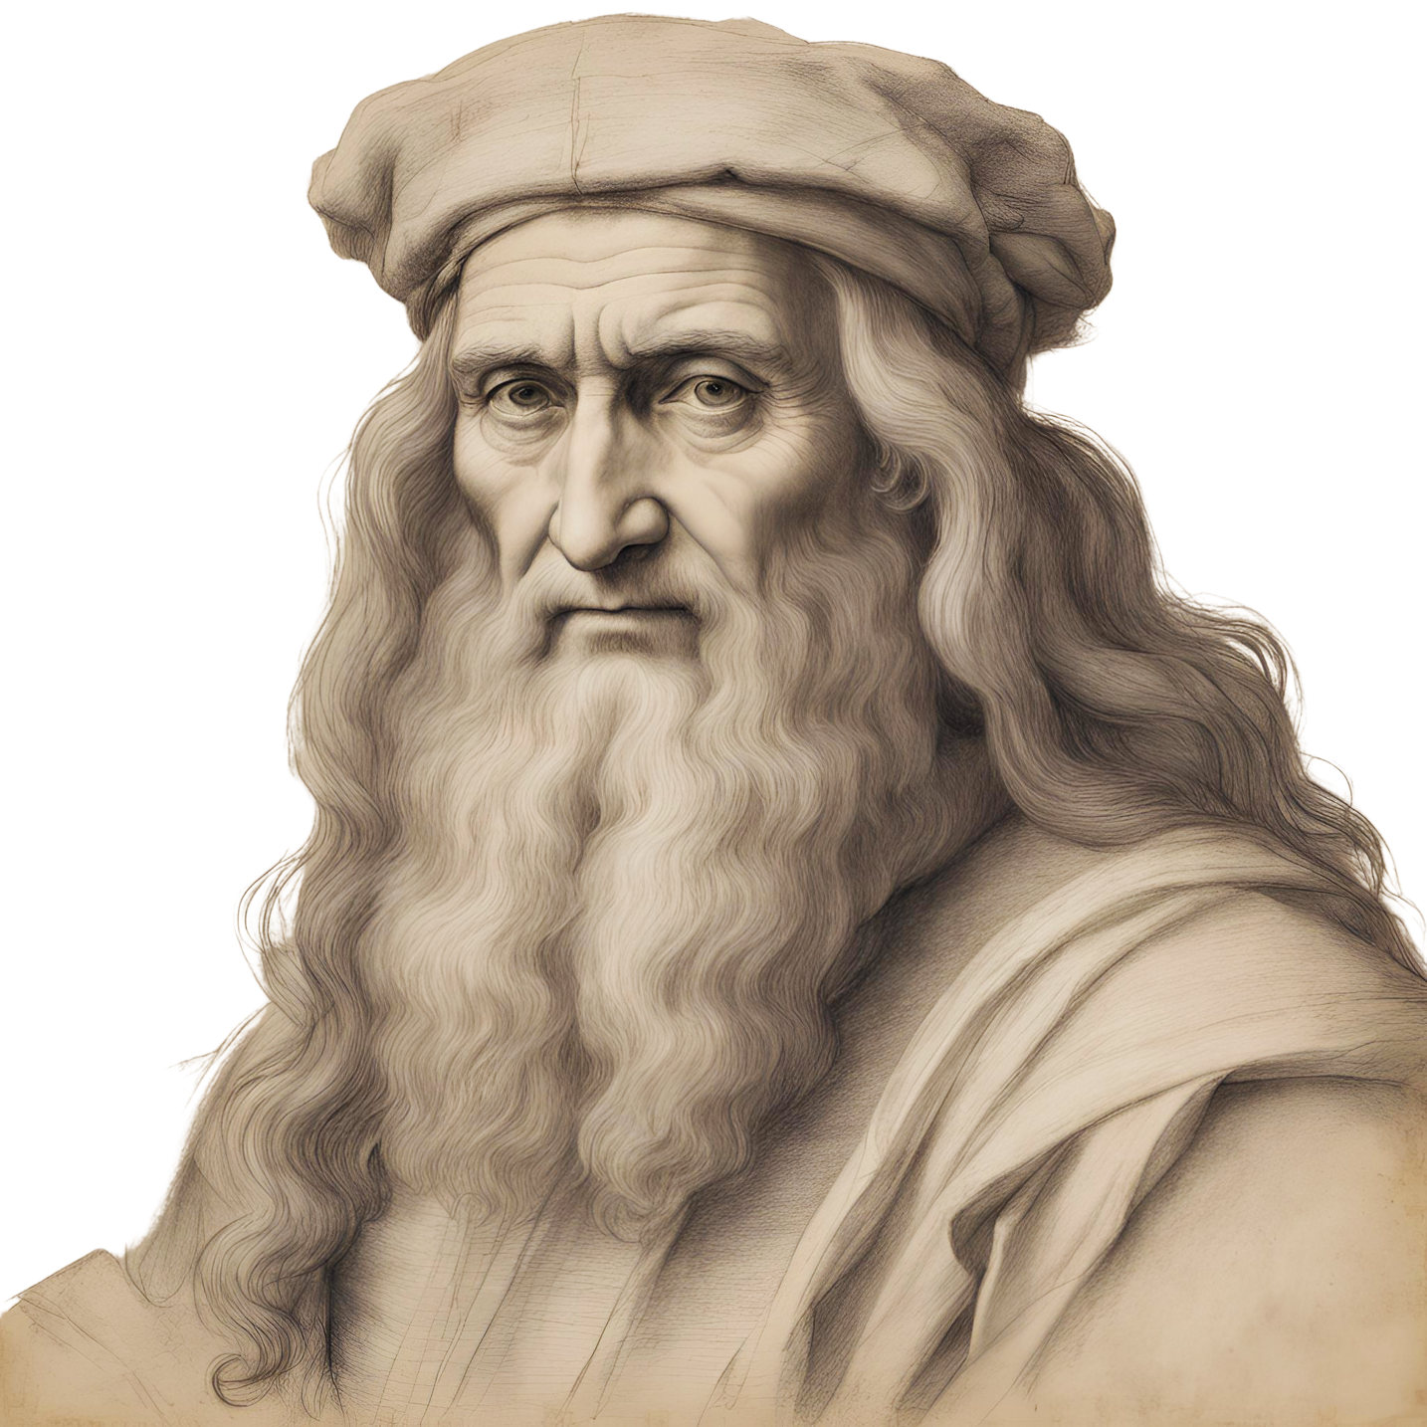




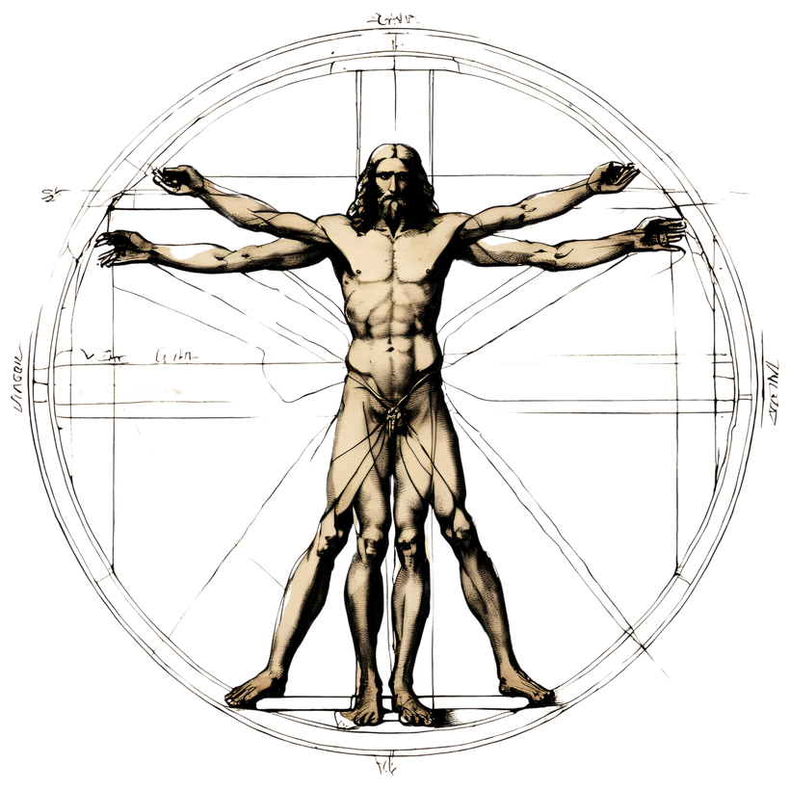
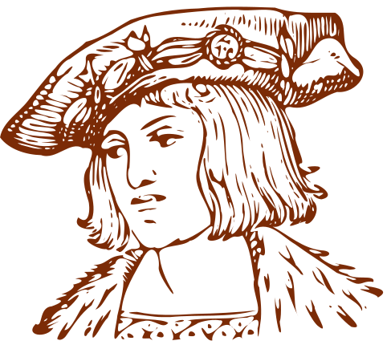
Renaissance Genius
Leonardo Da Vinci

Slide 2
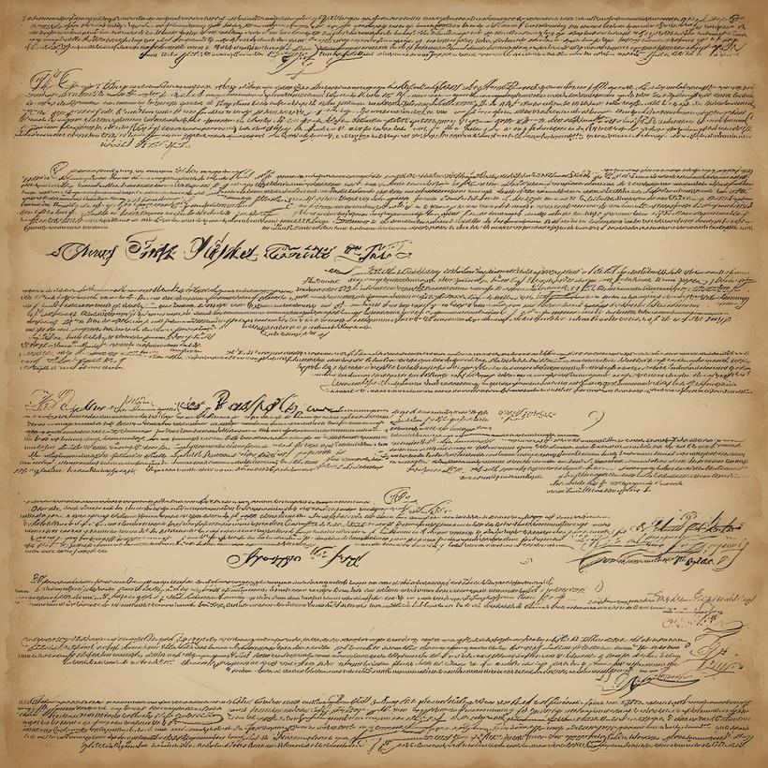


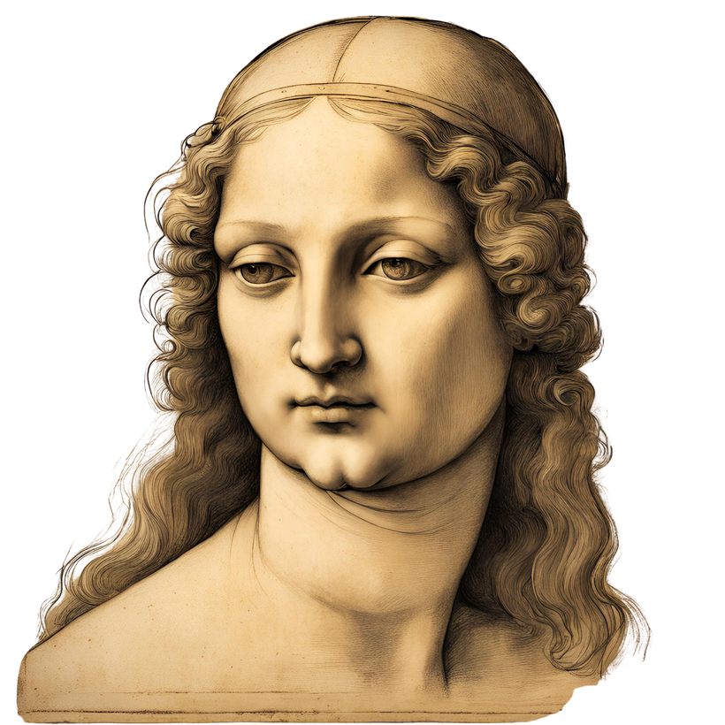
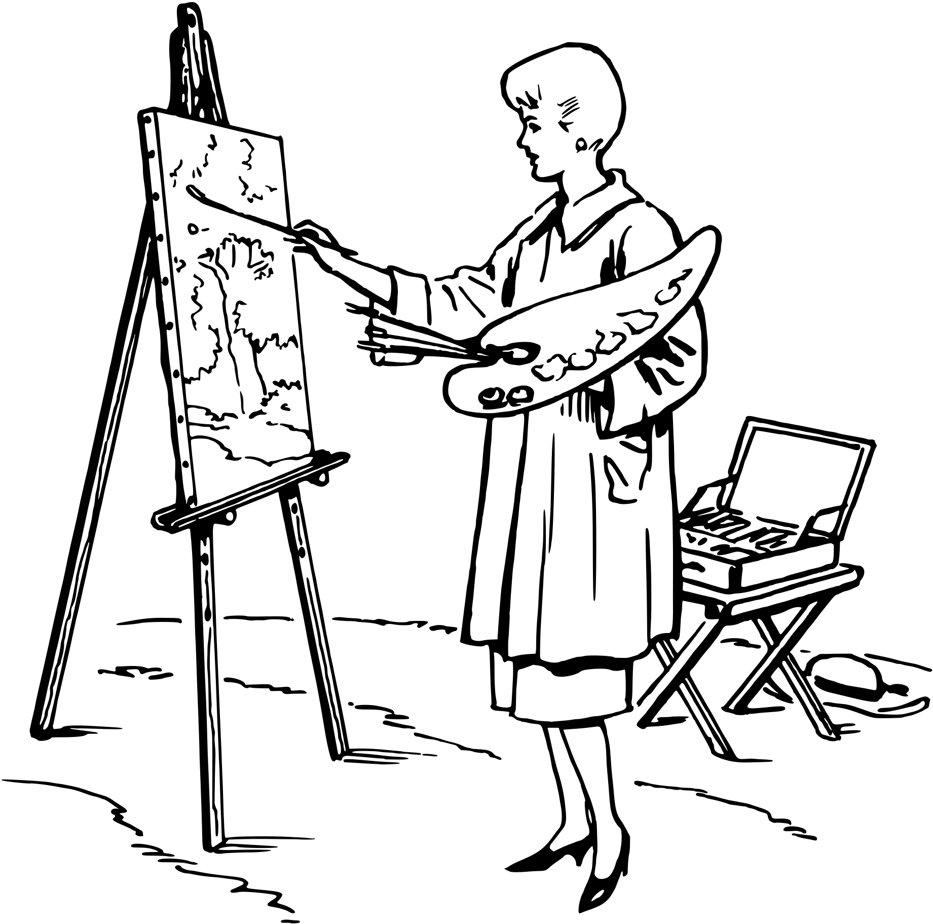


Exploring the Mind of a Genius
Leonardo Da Vinci (1452-1519) was a true Renaissance man, renowned for his extraordinary talents as a painter, sculptor, architect, scientist, inventor, and more. His insatiable curiosity, boundless creativity, and innovative thinking continue to inspire generations of artists, scientists, and thinkers around the world. Join us on a journey to discover the life and legacy of this multifaceted genius.

Slide 3
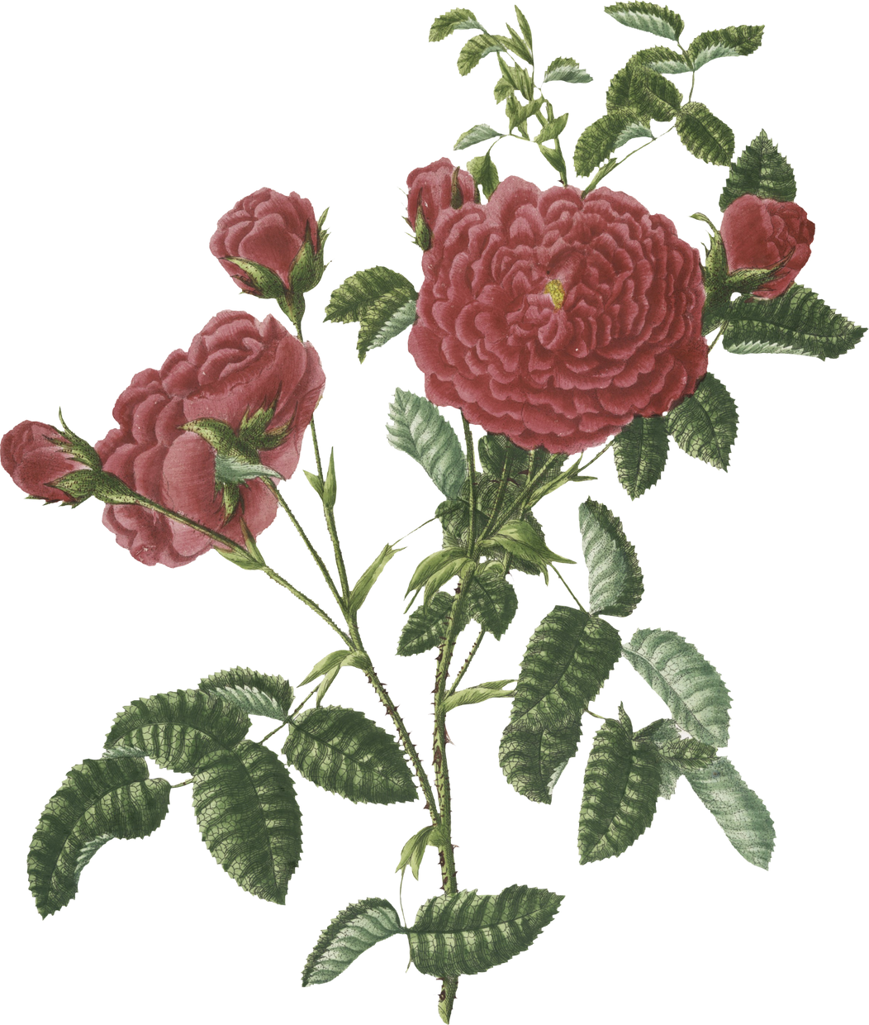
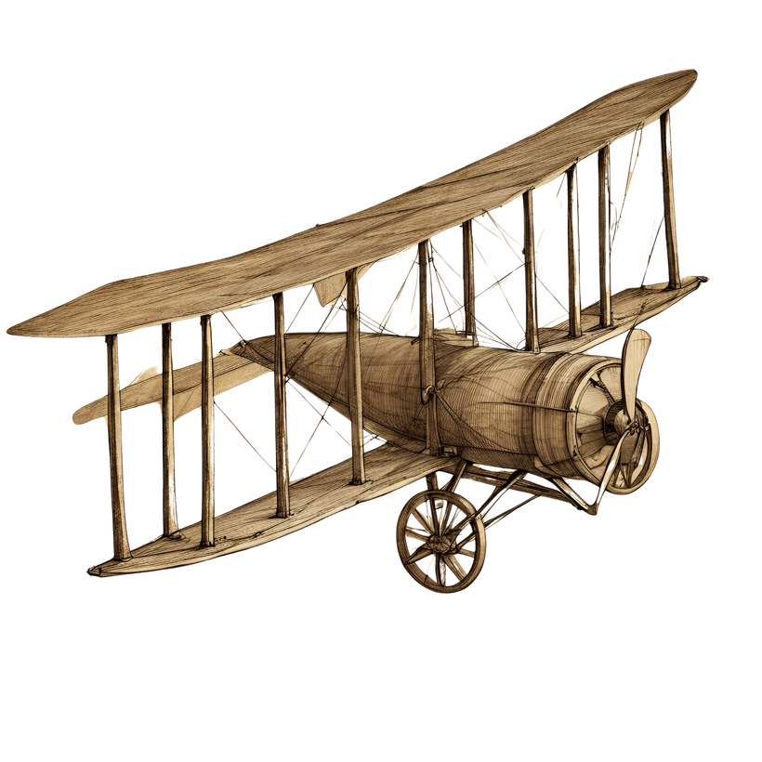
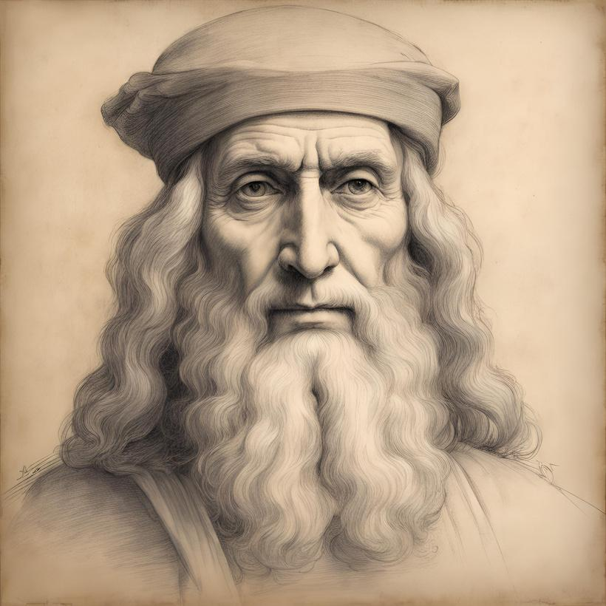
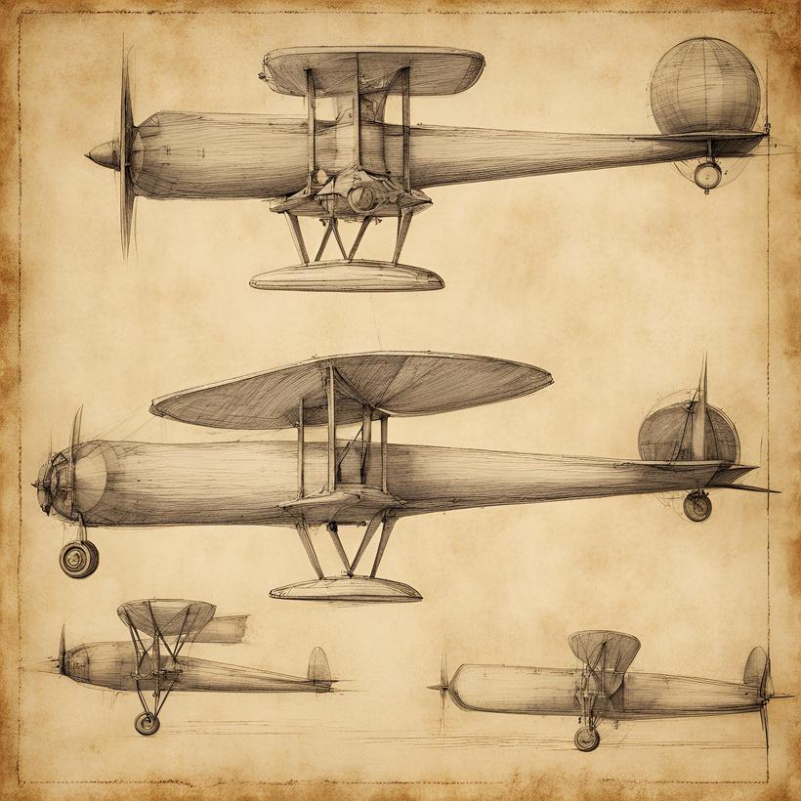
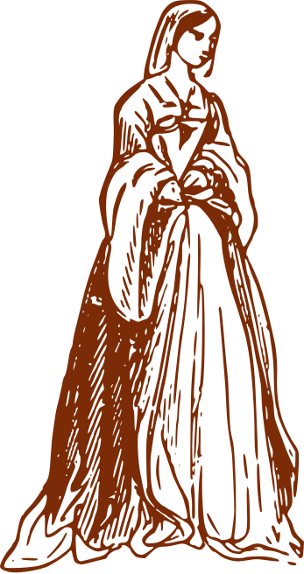
Early Life
Seeds of Genius
Leonardo Da Vinci was born on April 15, 1452, in Vinci, Italy, to Piero da Vinci, a notary, and Caterina, a peasant woman. From a young age, Leonardo displayed an exceptional aptitude for art and innovation, often spending hours observing and sketching the natural world around him. His early years in Vinci laid the foundation for his future achievements as a polymath and visionary thinker.

Slide 4
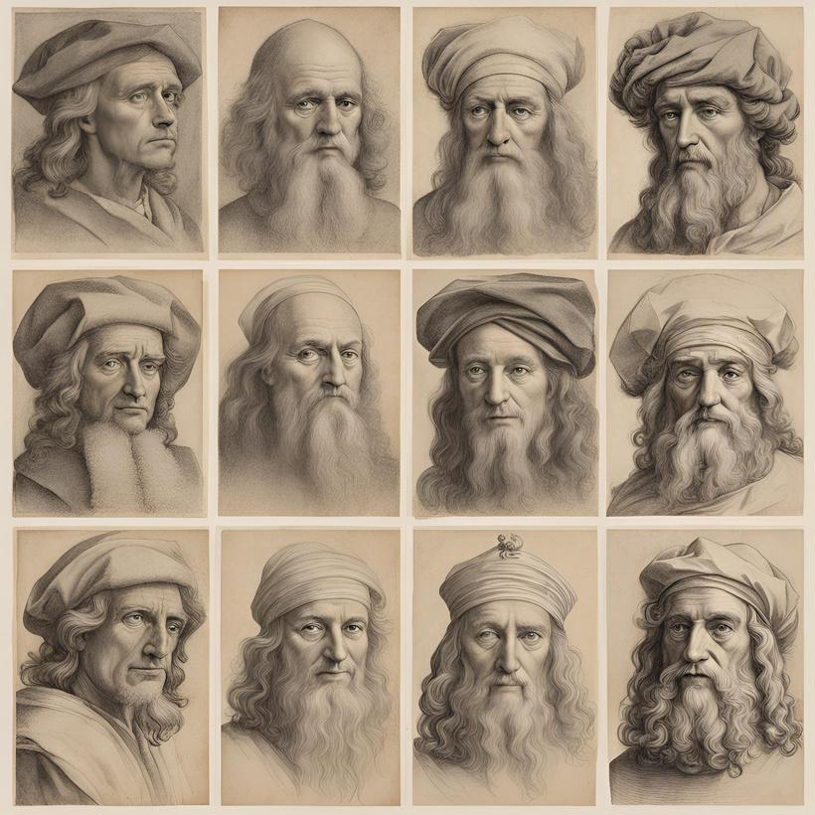
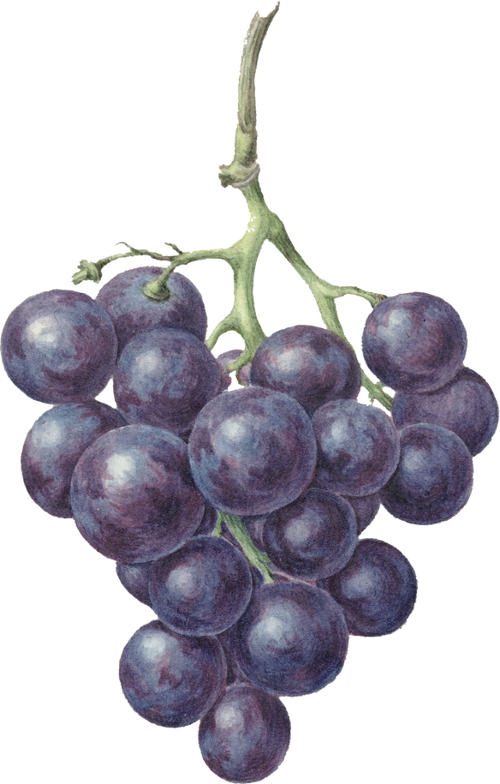
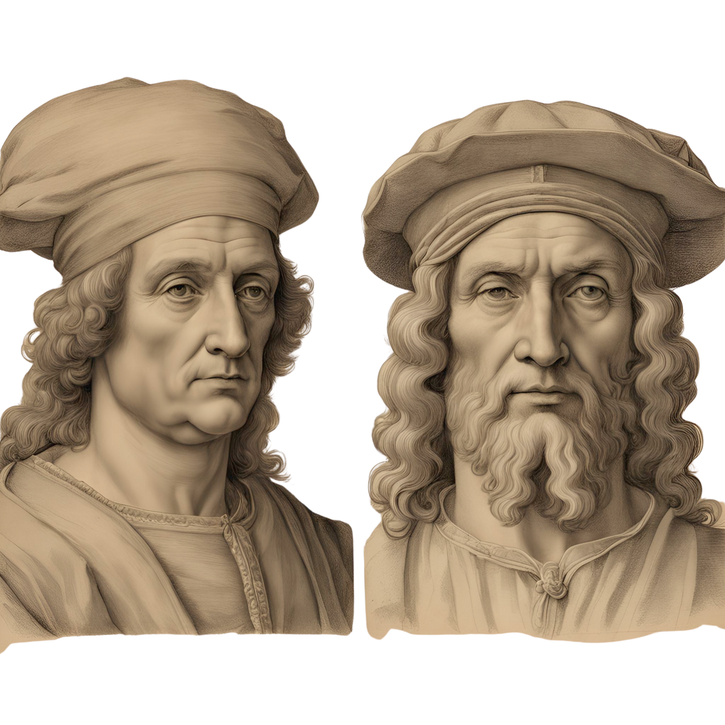
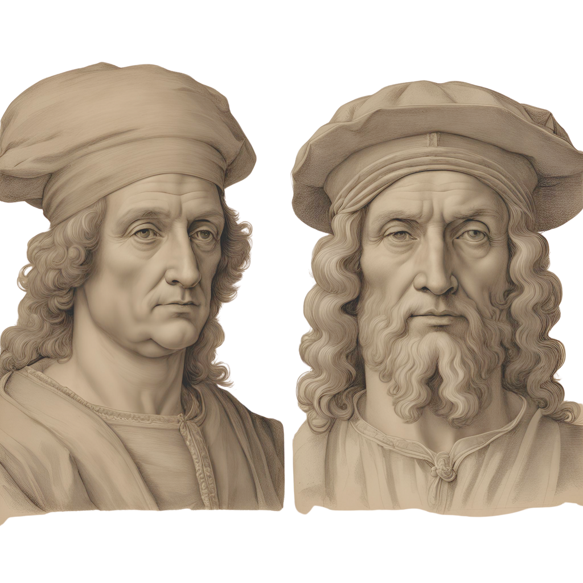

A Mentorship with Mastery
At the age of 14, Leonardo became an apprentice to Andrea del Verrocchio, a prominent Florentine artist and sculptor. Under Verrocchio's guidance, Leonardo honed his skills as a painter and learned the principles of perspective, anatomy, and composition. His time in Verrocchio's workshop provided invaluable training and laid the groundwork for his future success as an artist.

Slide 5
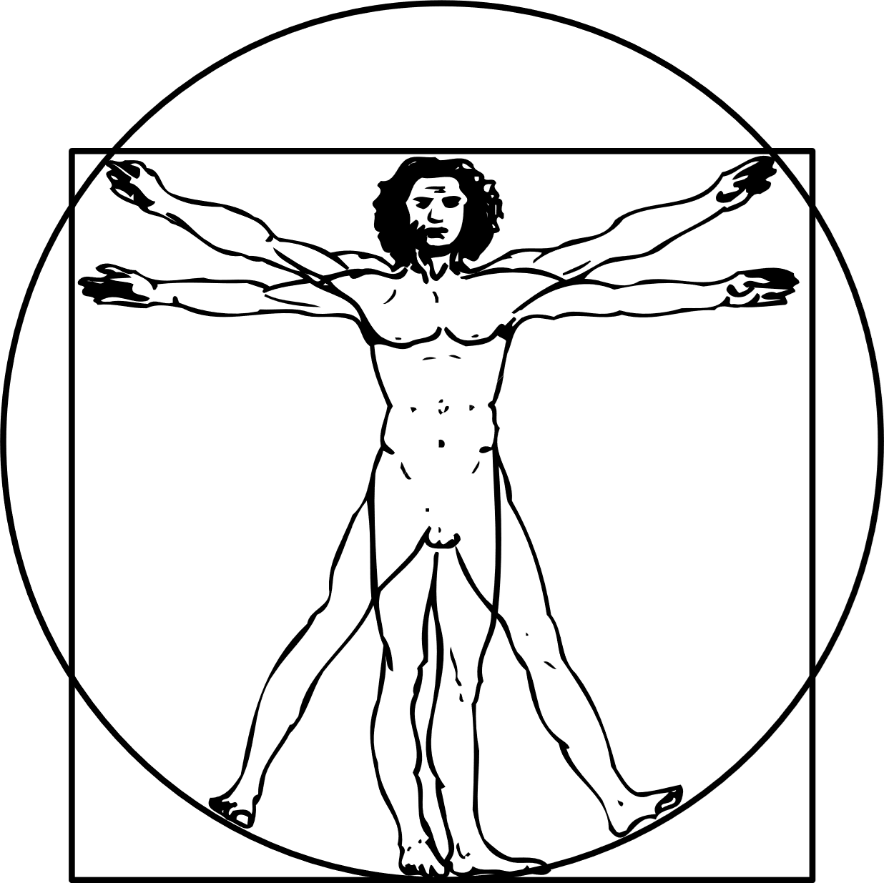
Vitruvian
Man
One of Leonardo's most famous works is the Vitruvian Man, a drawing that illustrates the ideal proportions of the human body according to the ancient Roman architect Vitruvius. Created around 1490, the Vitruvian Man exemplifies Leonardo's fascination with the intersection of art and science, as well as his meticulous attention to detail and anatomical accuracy.
Art Meets Science

Slide 6
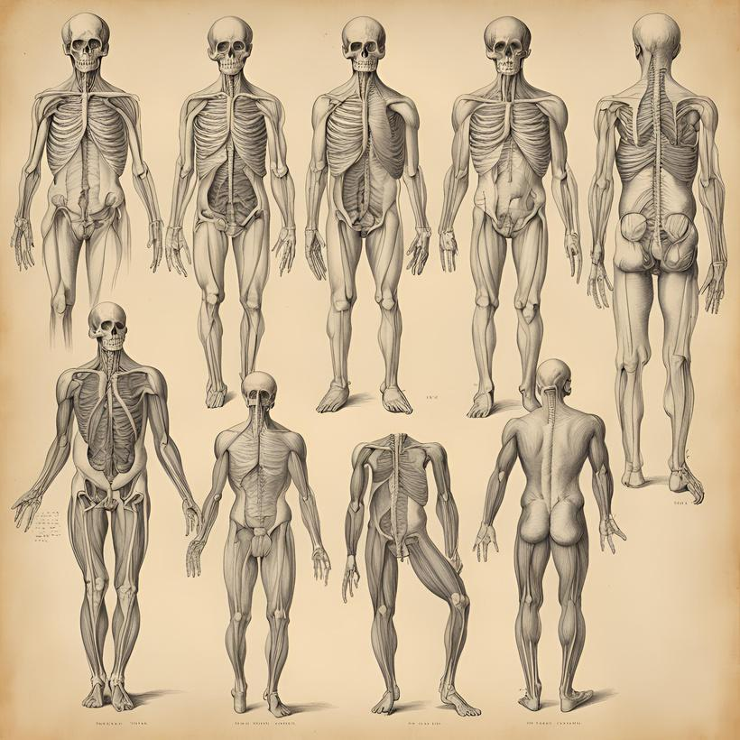
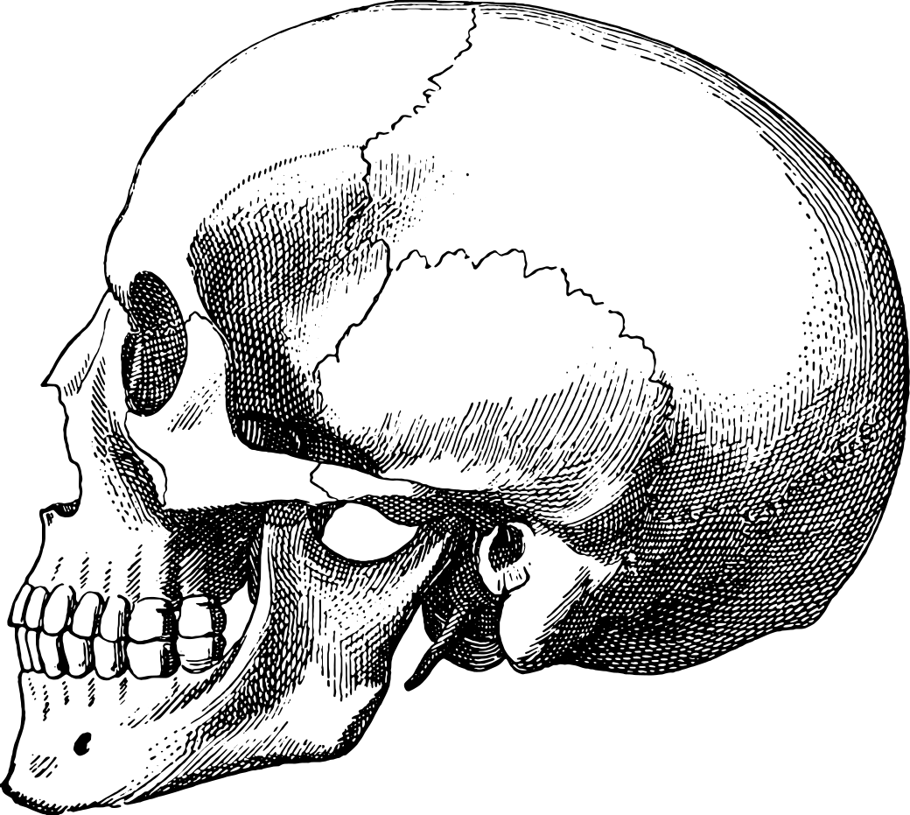
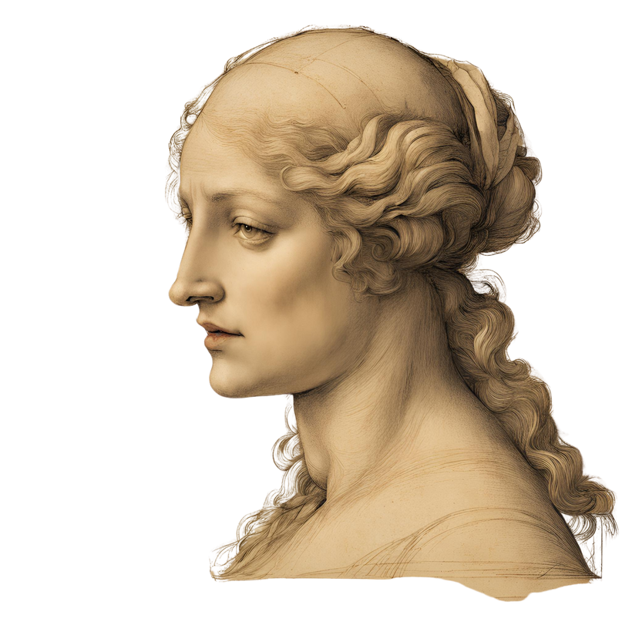
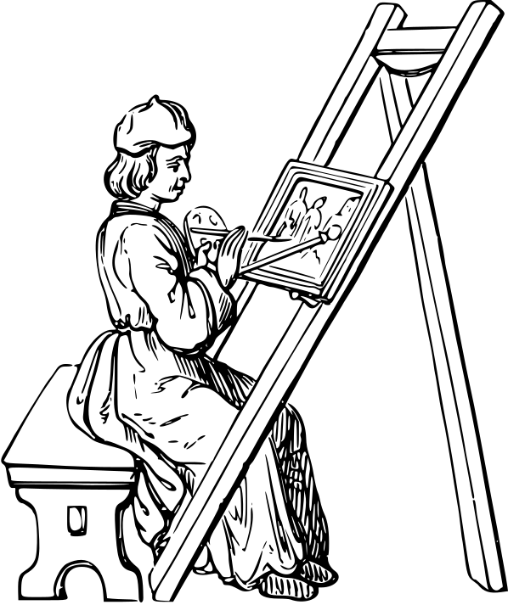
Scientific
Studies
In addition to his artistic pursuits, Leonardo Da Vinci was a pioneering scientist and inventor whose curiosity knew no bounds. He conducted extensive studies in anatomy, botany, geology, and engineering, often recording his observations and ideas in his notebooks. Leonardo's scientific investigations, including his anatomical sketches and designs for flying machines and war machines, foreshadowed many developments in modern science and technology.

Slide 7
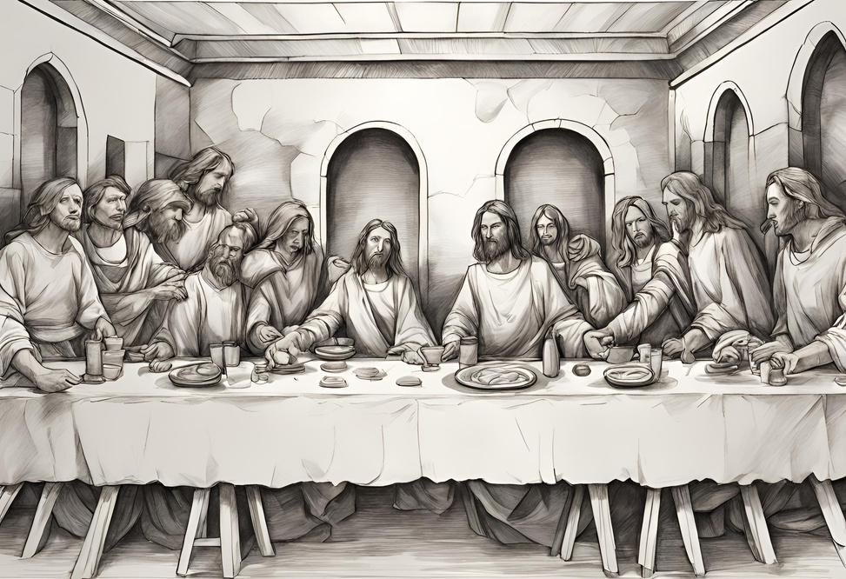
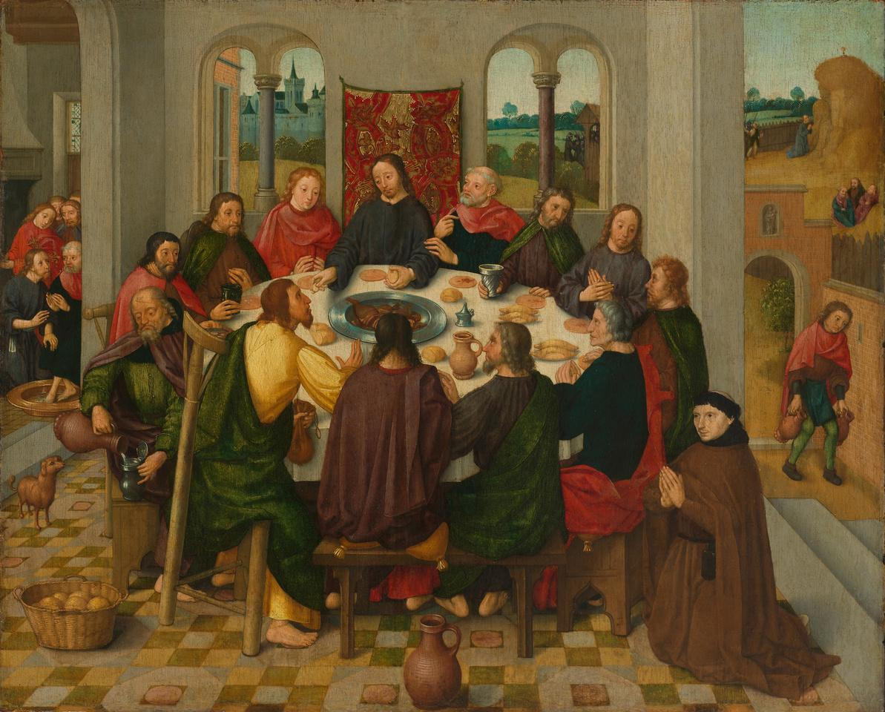
The Last Supper
Leonardo Da Vinci's "The Last Supper" is one of the most iconic and influential works of art in history. Painted between 1495 and 1498 in the refectory of the Convent of Santa Maria delle Grazie in Milan, Italy, the mural depicts the scene of the Last Supper of Jesus with his disciples. Leonardo's innovative use of perspective, composition, and expression captures the emotional intensity of the moment and elevates the painting to the status of a timeless masterpiece.
Iconic Masterpiece

Slide 8
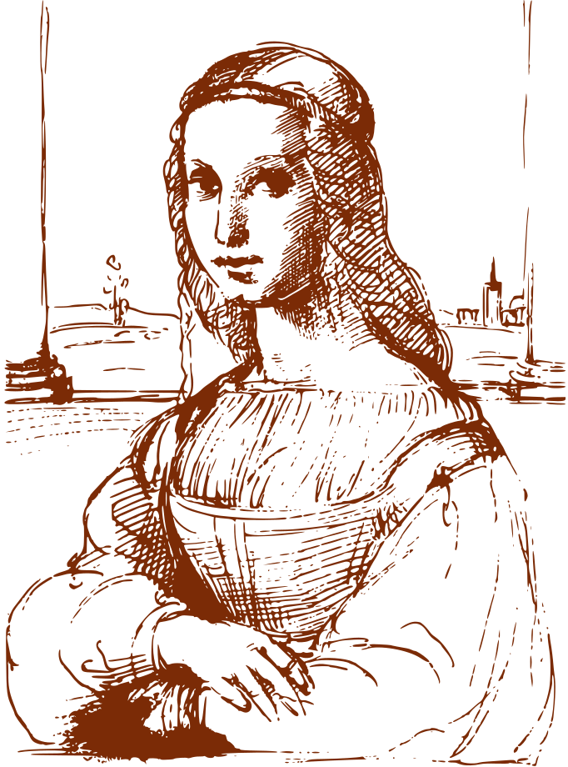
Mona Lisa
Perhaps the most famous painting in the world, Leonardo Da Vinci's "Mona Lisa" has captivated audiences for centuries with her enigmatic smile and mysterious gaze. Completed around 1506, the portrait of Lisa Gherardini, the wife of Florentine merchant Francesco del Giocondo, is renowned for its subtle use of sfumato (blurring) and chiaroscuro (light and shadow), as well as its psychological depth and realism. The Mona Lisa remains an enduring symbol of beauty, intrigue, and artistic mastery.

Slide 9
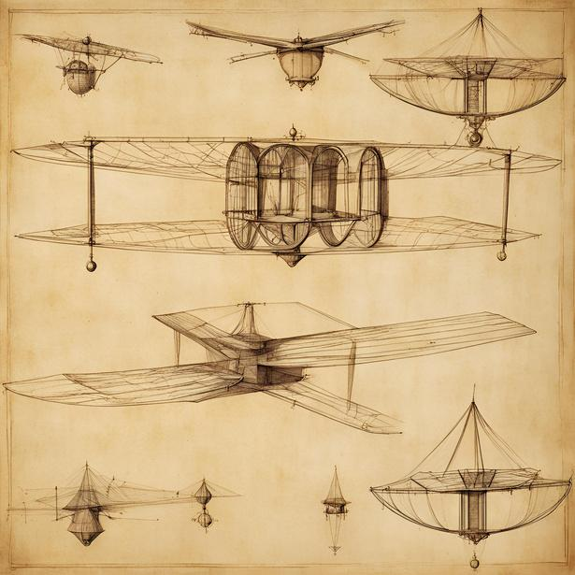
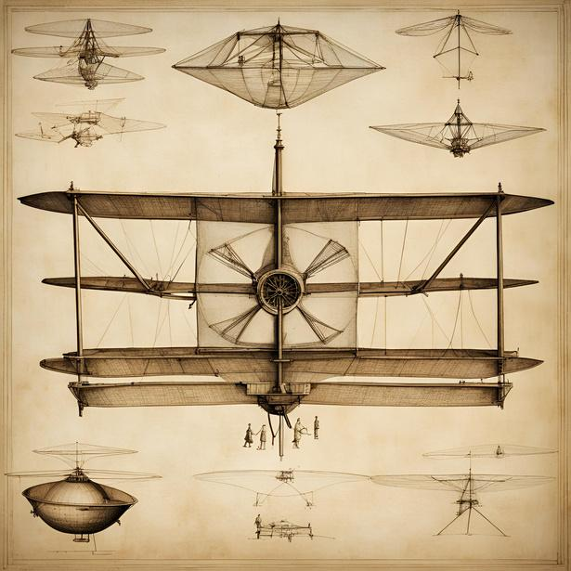
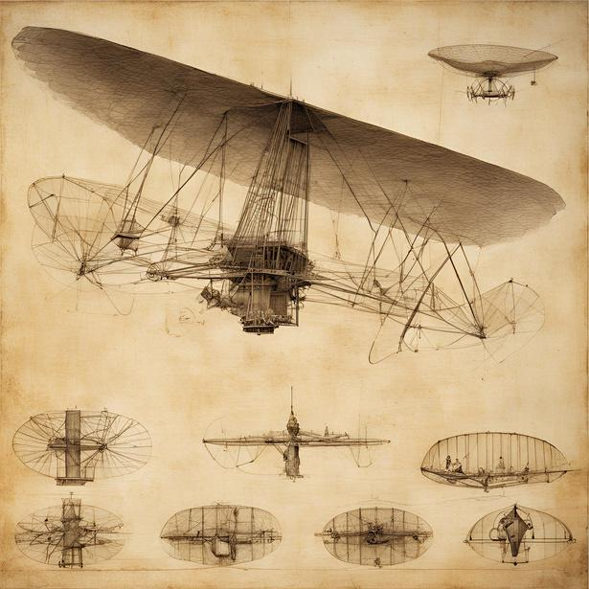

Flying Machines
Leonardo Da Vinci's fascination with flight inspired him to design a variety of flying machines, including ornithopters, gliders, and parachutes. Through his studies of bird anatomy and observation of natural flight.
Leonardo developed innovative designs that anticipated many principles of modern aviation. While most of Leonardo's flying machine designs were never realized, they demonstrated his visionary thinking and pioneering spirit.

Slide 10
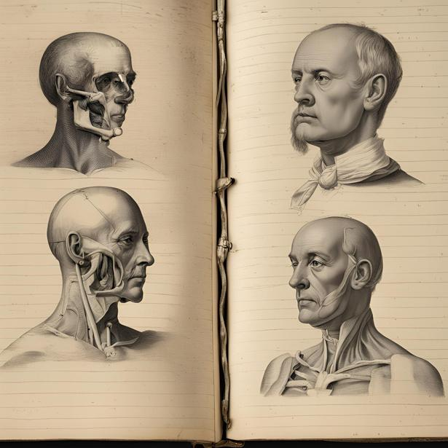
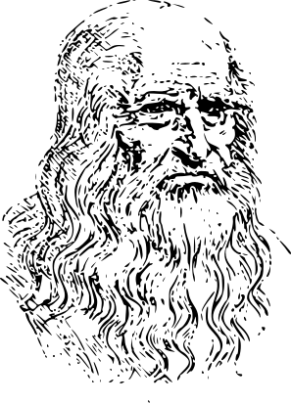
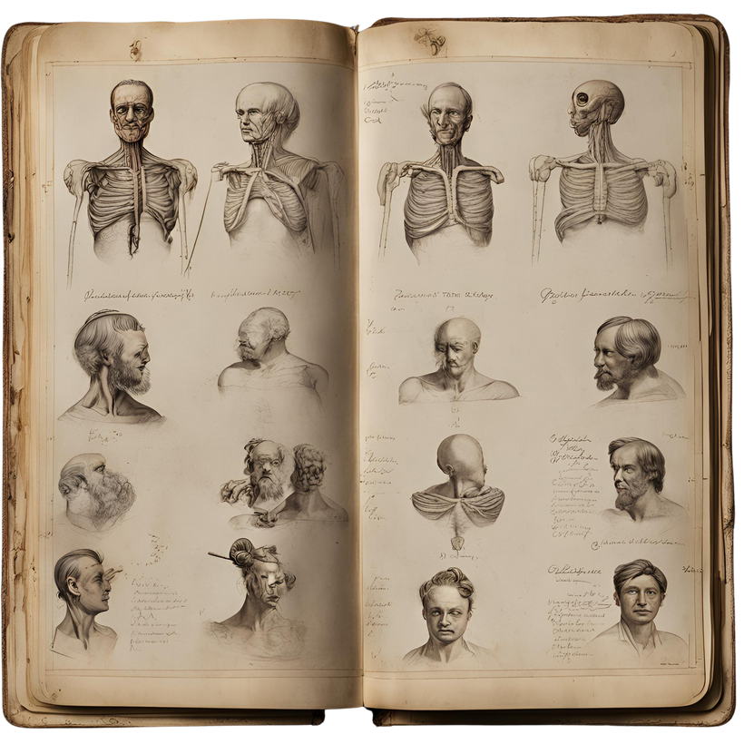
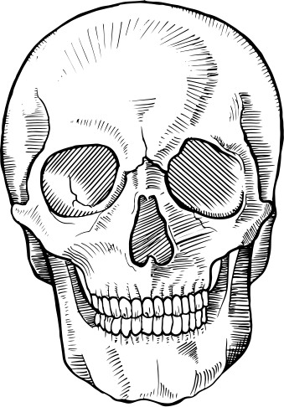
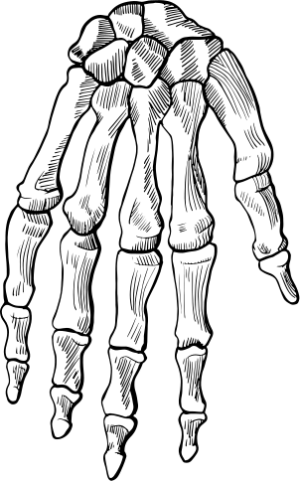
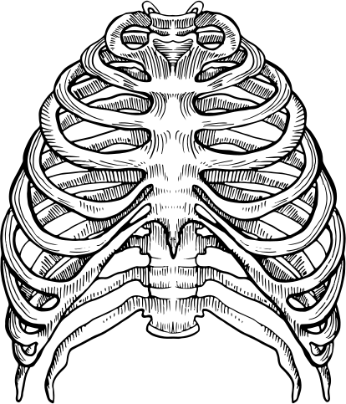
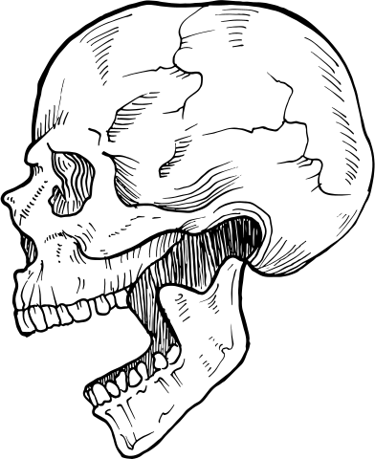
Codex Leicester
A Window into Genius
The Codex Leicester, also known as the Codex Hammer, is one of Leonardo Da Vinci's most famous notebooks, containing his scientific writings and sketches. Compiled between 1508 and 1510, the Codex Leicester explores topics such as astronomy, hydrodynamics, and the nature of water. Named after Thomas Coke, the Earl of Leicester, who acquired the manuscript in 1717, the Codex Leicester provides a fascinating glimpse into the mind of a true Renaissance polymath.

Slide 11
Engineering Marvels
Diverse
Inventions
Cross-disciplinary Influence
Modern Inspiration
Leonardo Da Vinci's inventive mind led him to design a wide array of devices and machines, ranging from hydraulic pumps and water wheels to siege engines and armored vehicles.
Leonardo's inventions were not limited to a single field; his interdisciplinary approach to innovation drew upon principles from art, science, engineering, and beyond.
Leonardo's inventive genius and engineering prowess continue to inspire innovation and technological advancement in the modern world, serving as a testament to his enduring impact on human ingenuity.

Slide 12

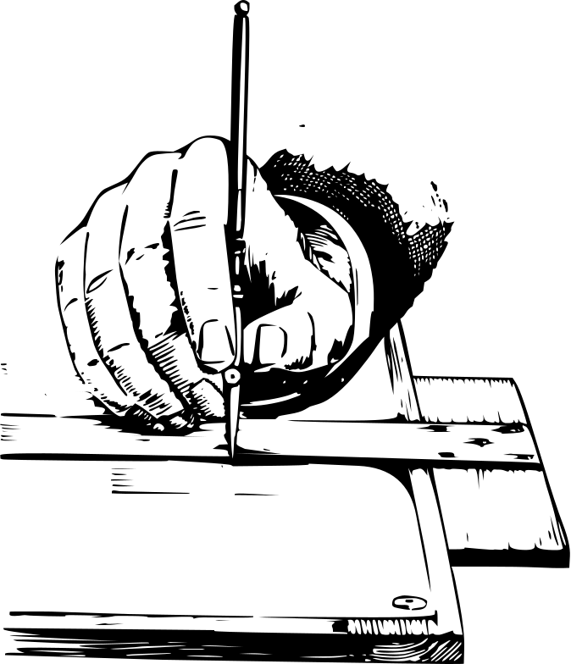
Legacy and Influence
Leonardo Da Vinci's legacy extends far beyond his own time, influencing artists, scientists, and thinkers for centuries to come. His innovative techniques, groundbreaking discoveries, and visionary ideas continue to inspire creativity, curiosity, and exploration in fields ranging from art and science to engineering and philosophy. As we celebrate Leonardo's contributions to human knowledge and culture, we honor his enduring legacy as a true Renaissance genius.

Slide 13
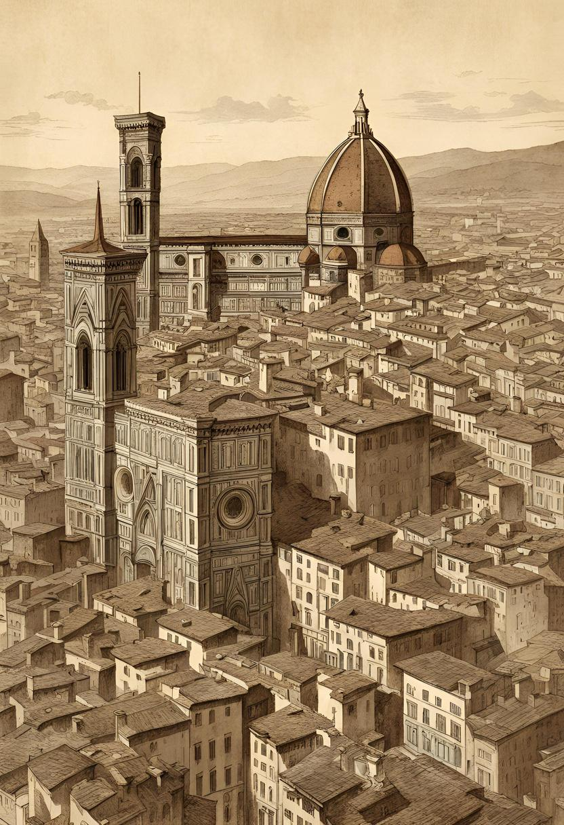
The Renaissance
The Renaissance, meaning "rebirth" in French, was a transformative period in European history characterized by a revival of interest in art, literature, science, and humanism. Emerging in Italy in the 14th century, the Renaissance marked a departure from the medieval worldview and a renewed emphasis on individualism, human potential, and the pursuit of knowledge. Artists like Leonardo Da Vinci played a central role in the Renaissance, creating masterpieces that reflected the era's values of creativity, innovation, and humanism.

Slide 14
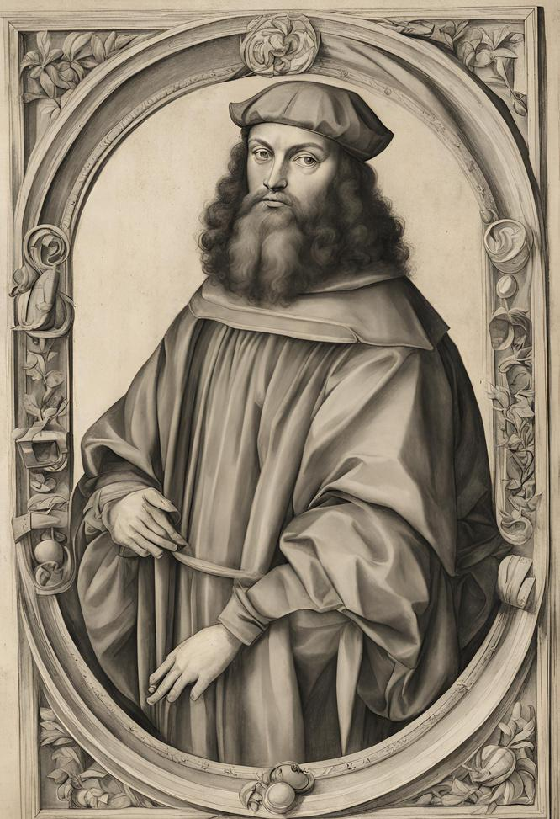
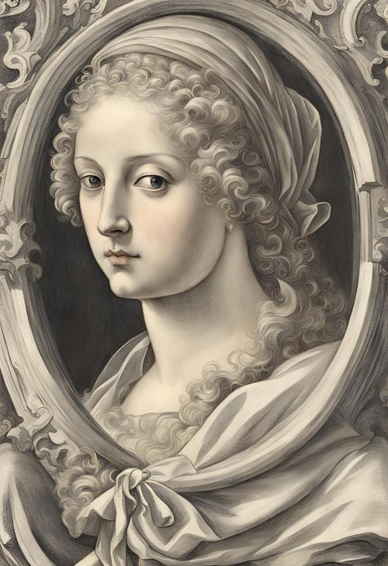
Passing on the Torch
Throughout his life, Leonardo Da Vinci served as a mentor to a number of talented artists and apprentices, known as his "pupils." These individuals learned from Leonardo's teachings and guidance, absorbing his techniques, philosophies, and artistic principles. While Leonardo himself achieved unparalleled fame and recognition, his influence extended beyond his own work, shaping the artistic practices and styles of future generations of artists. Among his notable pupils were Bernardino Luini, Giampietrino, and Francesco Melzi, who carried on his legacy and contributed to the spread of Renaissance artistry throughout Europe.

Slide 15
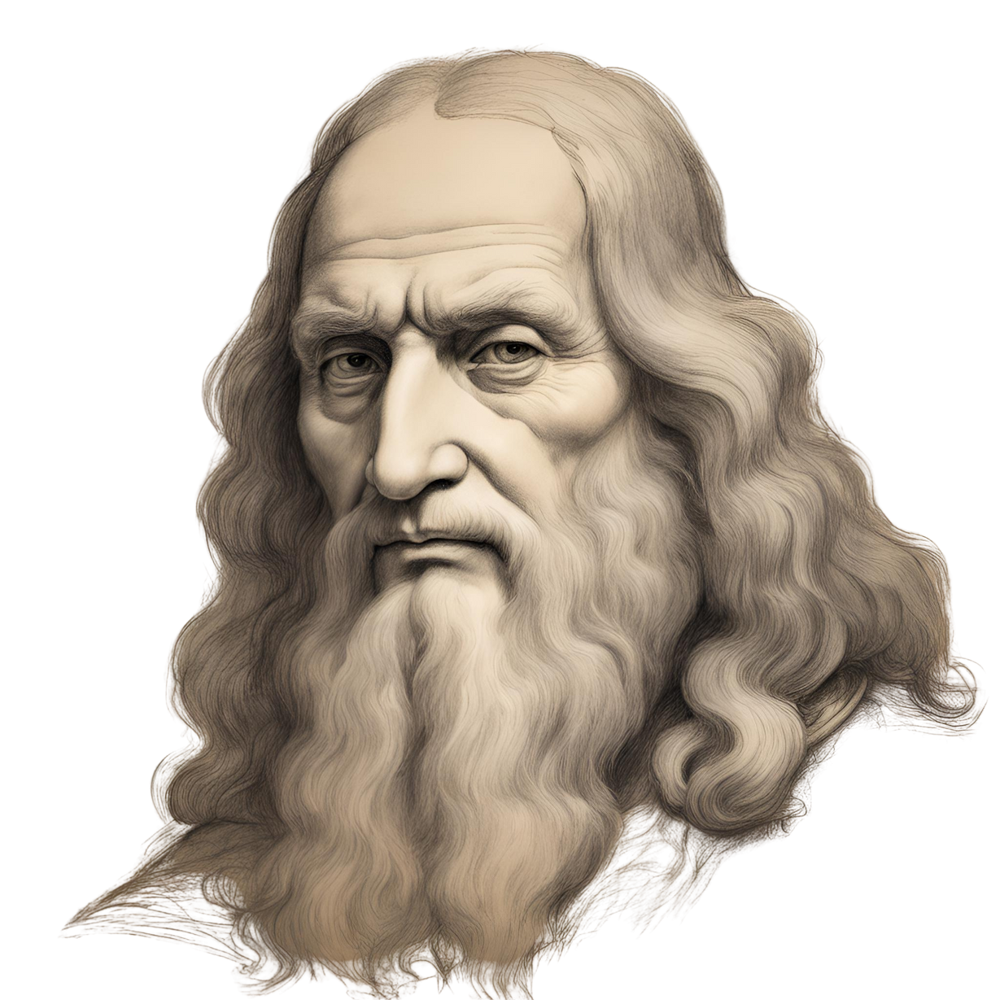
Honoring
a Genius
As we conclude our journey through Leonardo Da Vinci's life and contributions, let's reflect on his lasting impact. Leonardo's art, science, and inventions continue to inspire worldwide. His curiosity, creativity, and interdisciplinary approach remind us of the boundless potential of the human mind. Let's embrace his spirit of inquiry and innovation, striving to create a world where creativity, knowledge, and beauty enrich and inspire humanity.

Slide 16
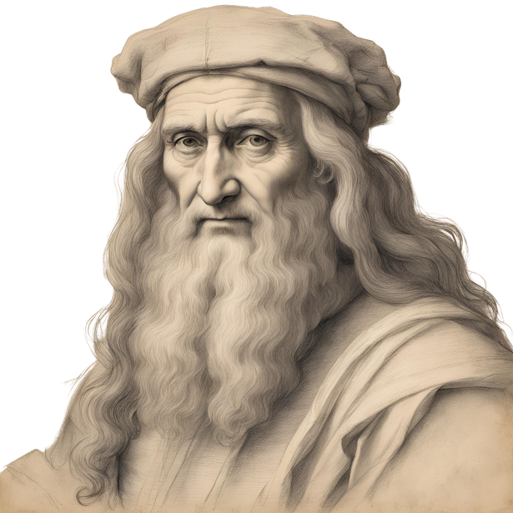
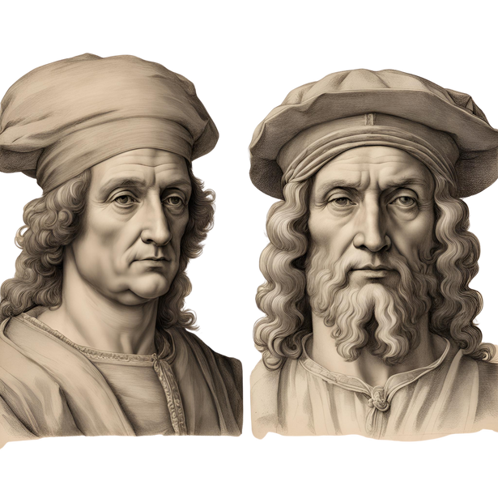
Resource Page
Use these design resources in your Canva Presentation.
Fonts
Design Elements
This presentation template
uses the following free fonts:
TITLES:
CHARM
HEADERS:
ARCHITECTS DAUGHTERS
BODY COPY:
ARCHITECTS DAUGHTERS
You can find these fonts online too.
Colors
#7B2B06
#B89868
#E8D7C8
DON'T FORGET TO DELETE THIS PAGE BEFORE PRESENTING.

Slide 17
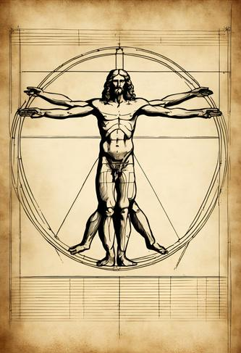
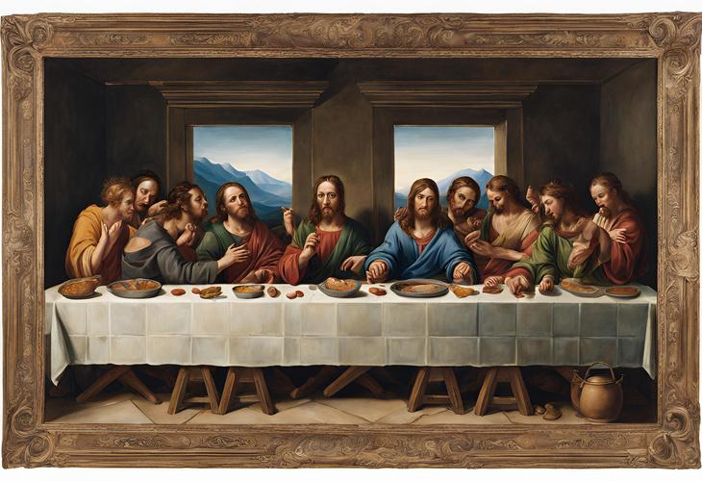
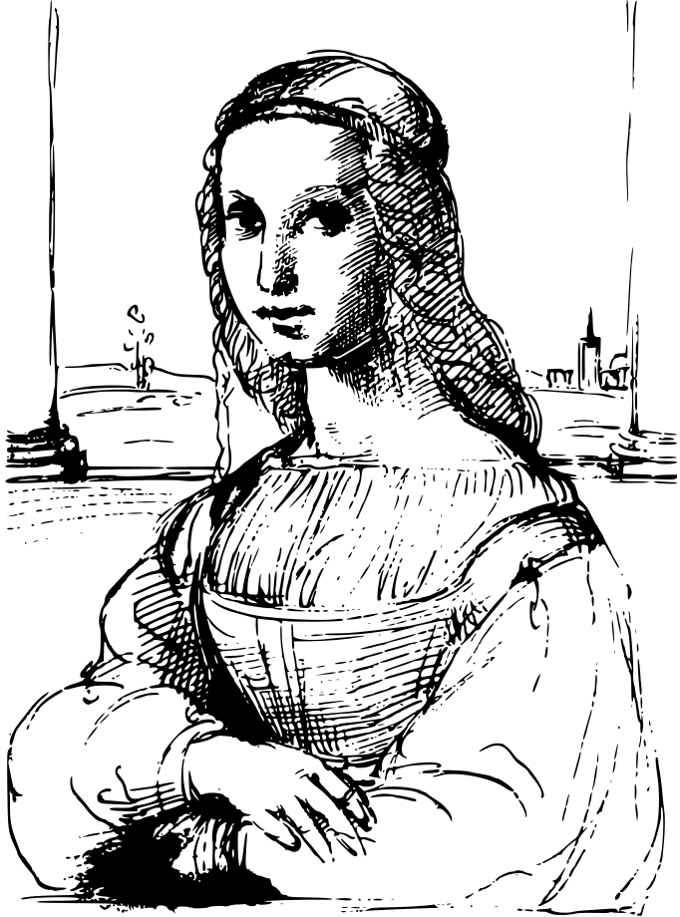
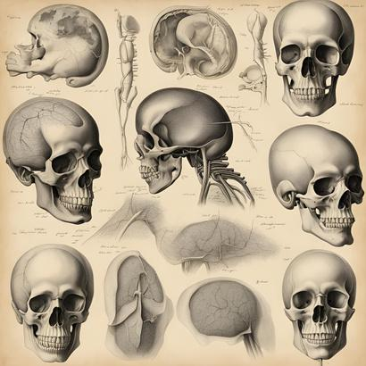
Resource Page
Use these design resources in your Canva Presentation.
Fonts
Design Elements
This presentation template
uses the following free fonts:
TITLES:
CHARM
HEADERS:
ARCHITECTS DAUGHTERS
BODY COPY:
ARCHITECTS DAUGHTERS
You can find these fonts online too.
Colors
#7B2B06
#B89868
#E8D7C8
DON'T FORGET TO DELETE THIS PAGE BEFORE PRESENTING.

Slide 18

Credits
This presentation template is free for everyone to use thanks to the following:
for the presentation template
Pexels, Pixabay
for the photos
Happy designing!

