Slide 1
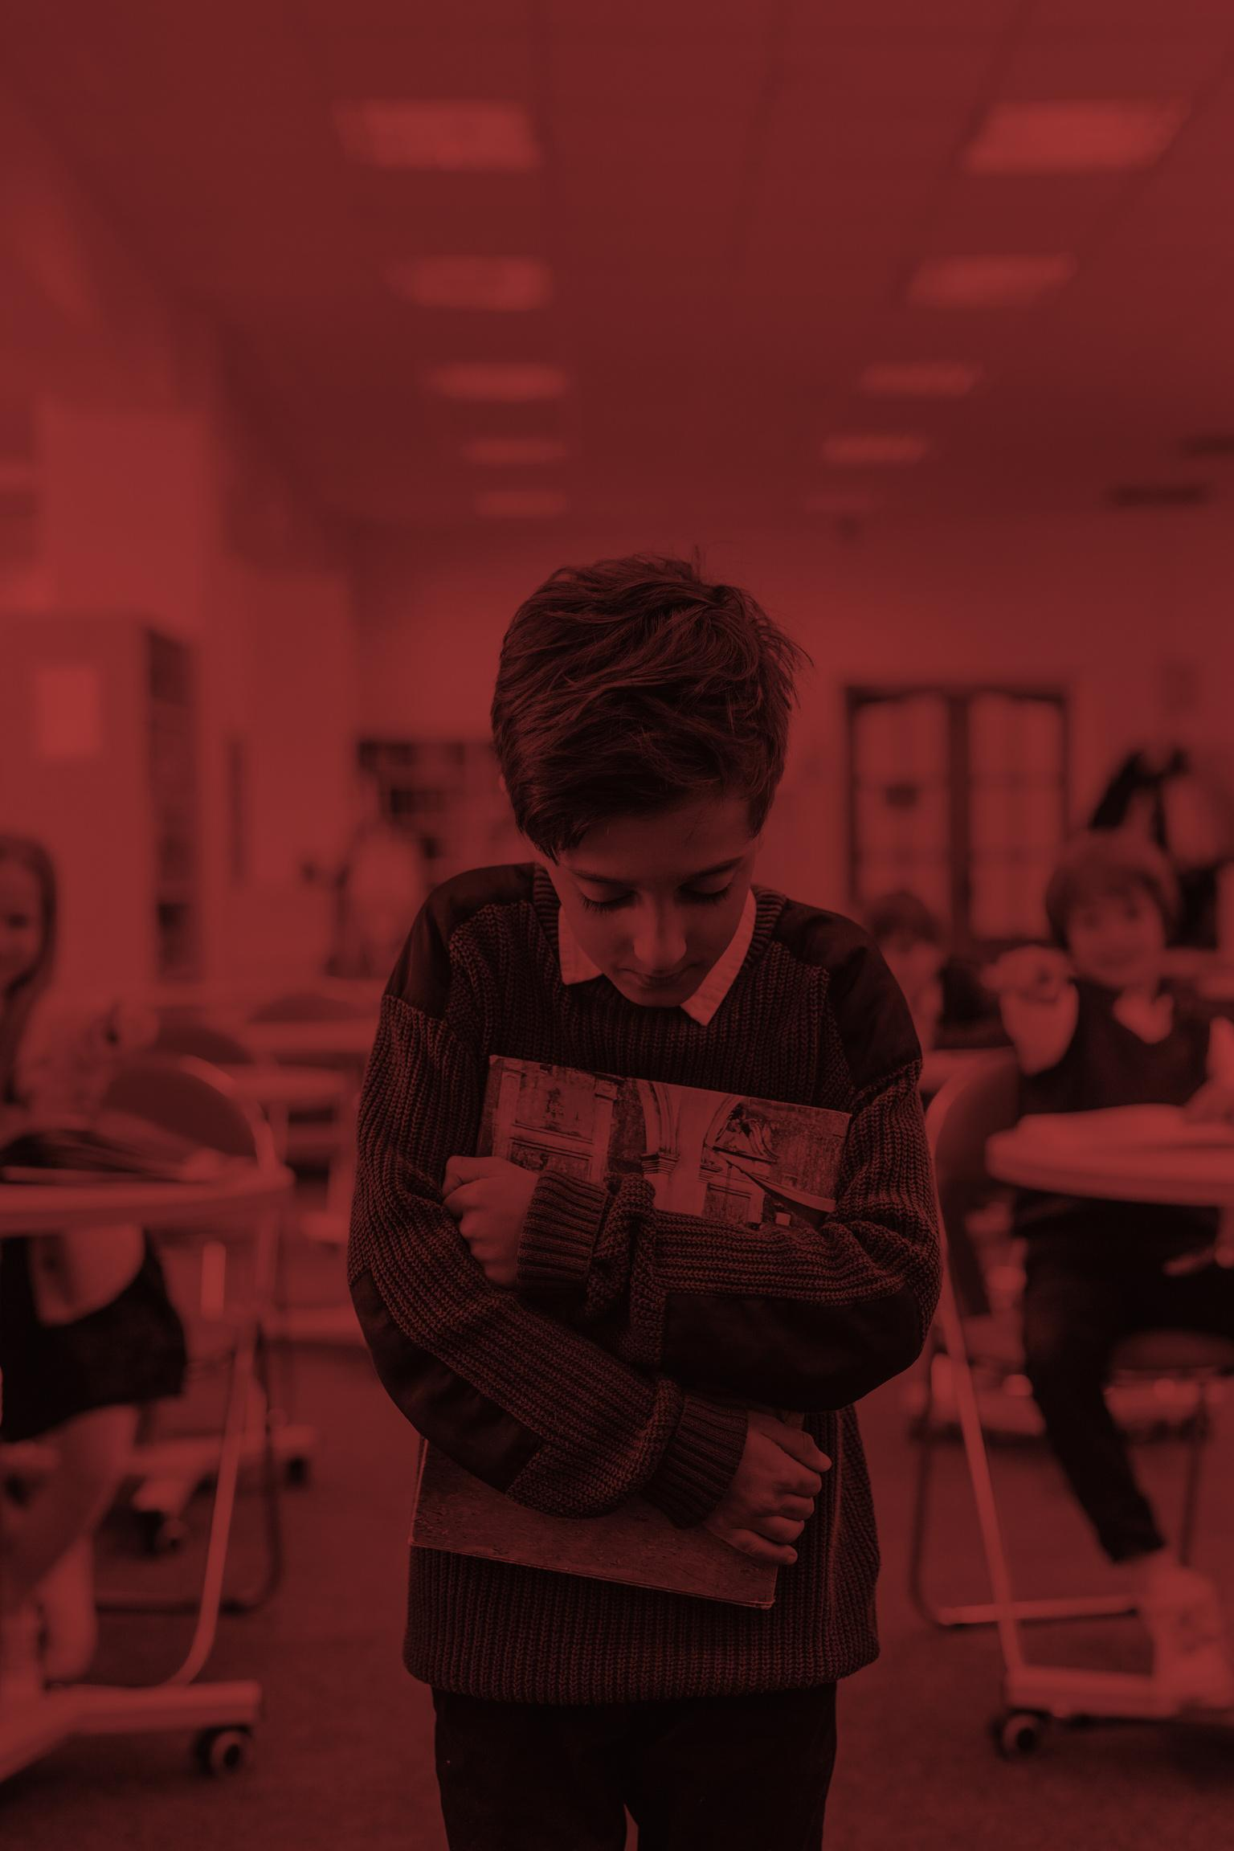
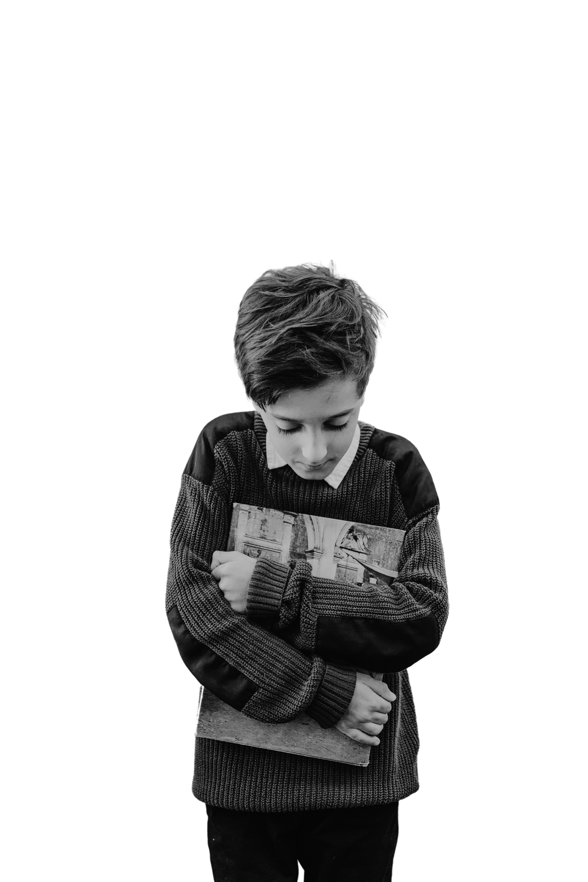
IT’S RUDE TO
EXCLUDE
BE A FRIEND, NOT A BULLY.

Slide 2

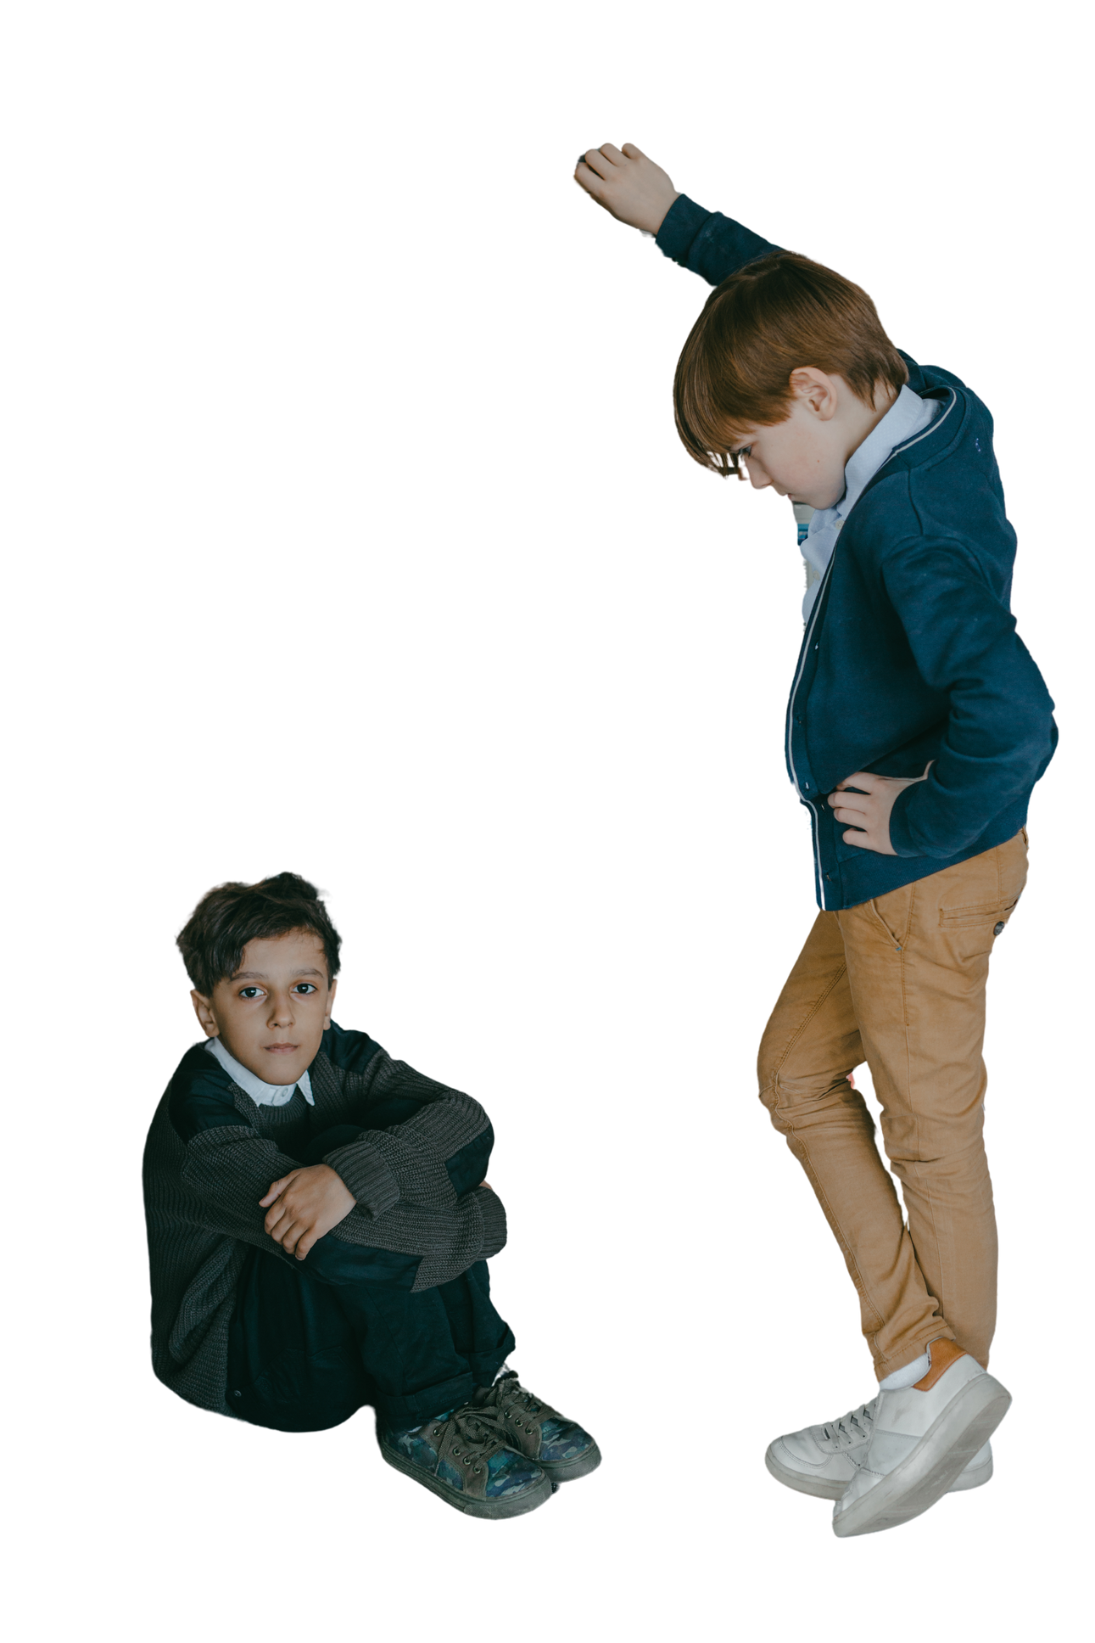
STAND UP.
SPEAK OUT.
SAY NO TO
BULLYING!

Slide 3







































RESOURCE PAGE
  Use these design resources in your Canva Presentation.
Fonts
This presentation template
uses the following free fonts:
TITLES:
ARCHIVO BLACK | ANTON
BODY COPY:
ARIMO
You can find these fonts online too.
Design Elements

Slide 4

CREDITS
This presentation template is free for everyone to use
  thanks to the following:
  for the presentation template
Pexels, Pixabay
  for the photos
  HAPPY DESIGNING!

