Slide 1


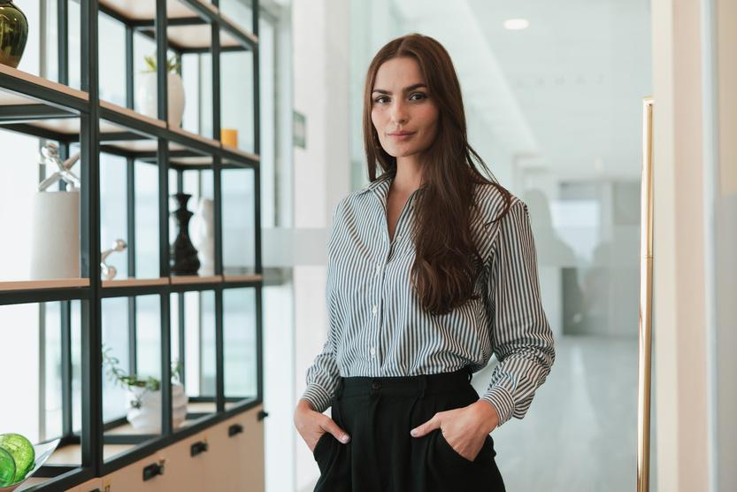

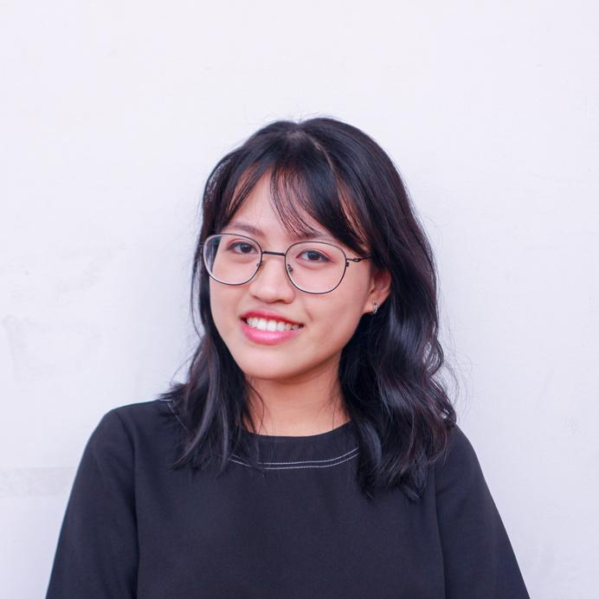
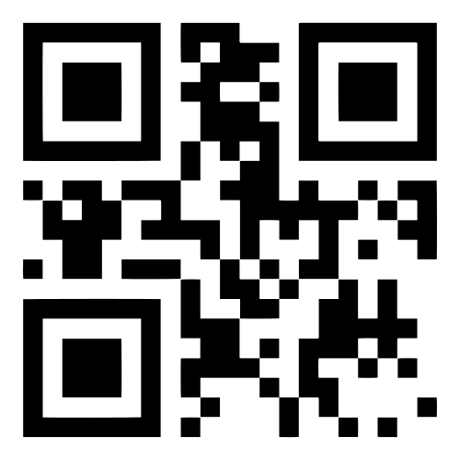
2030
Business Conference
INNOVATE. LEAD. SUCCEED.
Unlock the future of business with groundbreaking and expert-led sessions
Margo Sleet
Nyle Alcott
Laria Yun
CEO
Brimton Co.
Founder,
Kenvilleton Co.
VP of Innovations,
The Caseton
The Future of Leadership
Sustainable Strategies
Revolutionizing Business with AI
April 20-22, 2030
123 Anywhere St., Any City
2030 BUSINESS CONFERENCE
Register now!
reallygreatsite.com

Slide 2







































Resource Page
  Use these in your template, then delete or hide this page afterward.
Fonts
Colors
This template uses the following
free fonts:
TITLES:
Libre Franklin
#79C6FD
#5ECB97
#F8A11D
BODY TEXT:
Libre Franklin
You can find these fonts online too.
#000000
#FFFFFF
Design Elements / Icons

Slide 3

Credits
This template is free for everyone to use,
  thanks to the following:
  for this template
Pexels, Pixabay, Sketchify
  for the photos, graphics, and elements
  Happy designing!

