Slide 1
National
Tango Day

Slide 2
Tango, a dance of passion and rhythm, celebrated annually on National Tango Day, pays tribute to Argentina's iconic cultural heritage.

Slide 3
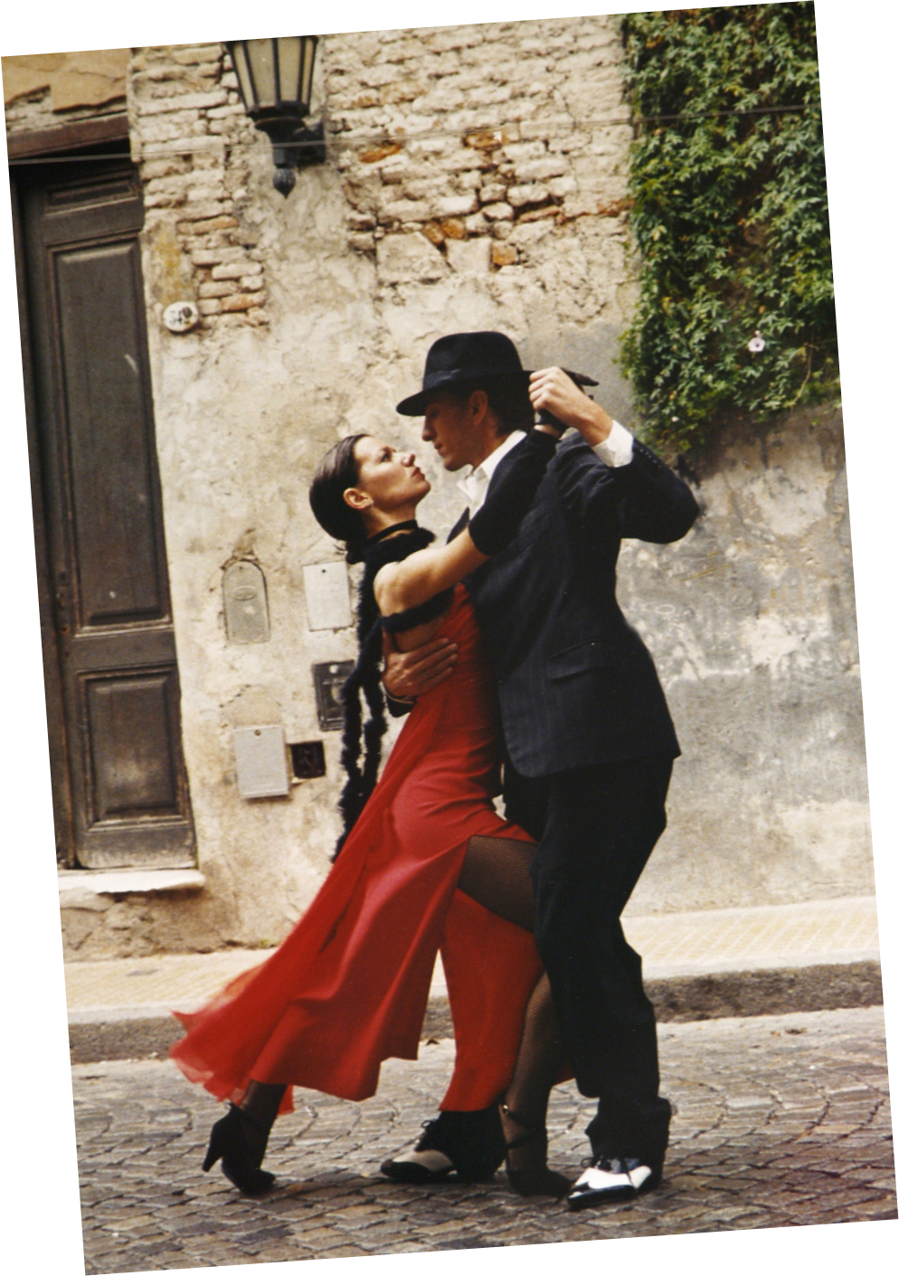
Hello
welcome to presentation
Presentations are communication tools that can be used as demonstrations, lectures, speeches, reports, and more. It is mostly presented before an audience. It serves a variety of purposes, making presentation powerful tools for convincing and teaching.

Slide 4
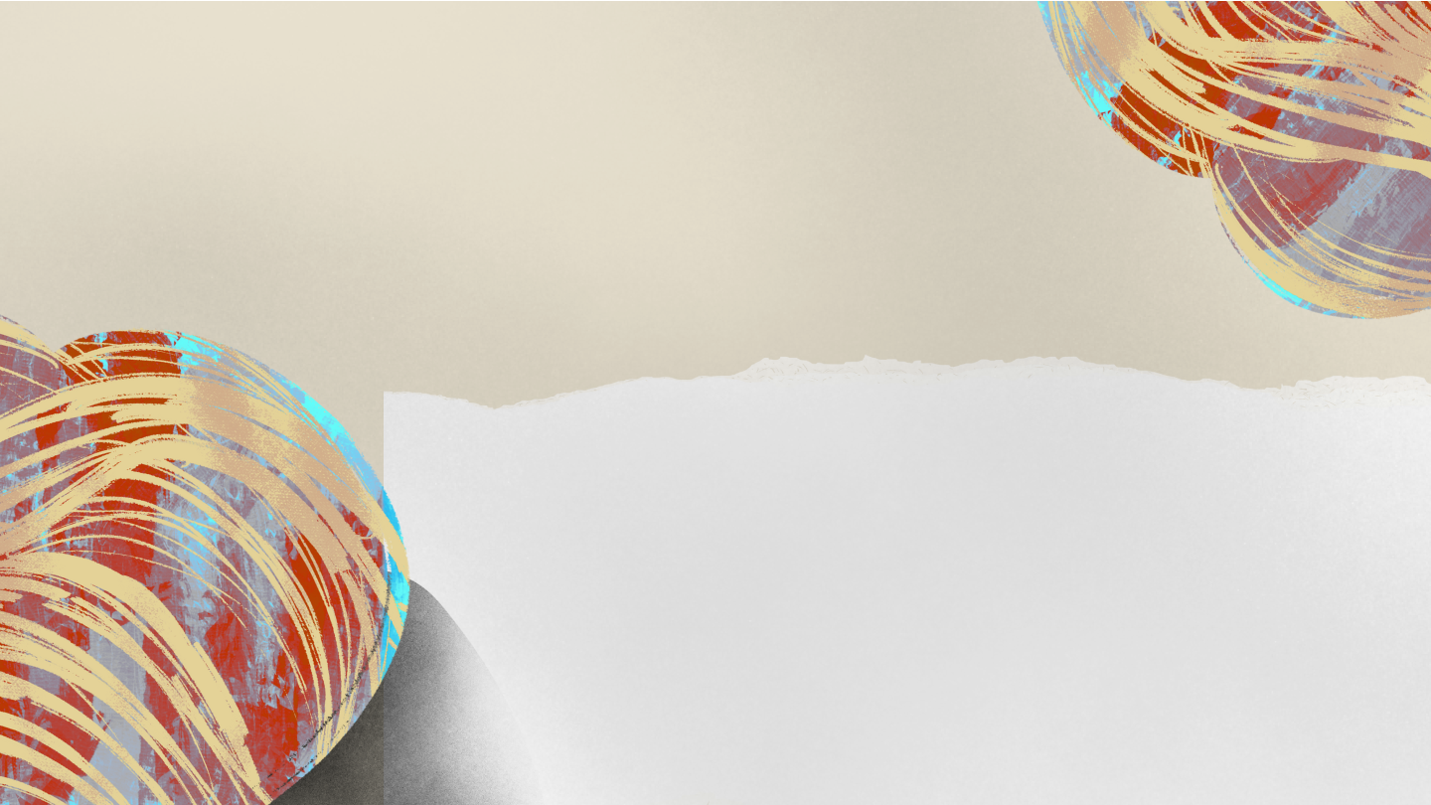
Agenda
Write your agenda point
Write your agenda point
Write your agenda point
Write your agenda point
Write your agenda point
Write your agenda point
Write your agenda point
Write your agenda point
Write your agenda point
Write your agenda point

Slide 5
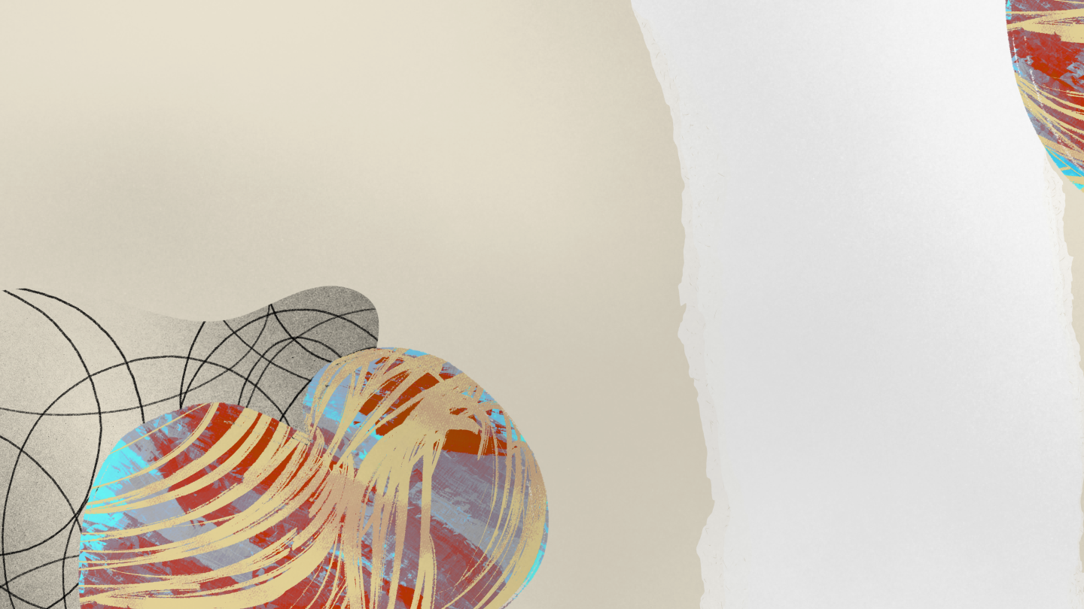
The Origins of Tango
Add a main point
Elaborate on what you
want to discuss.
Add a main point
Elaborate on what you
want to discuss.
Add a main point
Elaborate on what you
want to discuss.

Slide 6
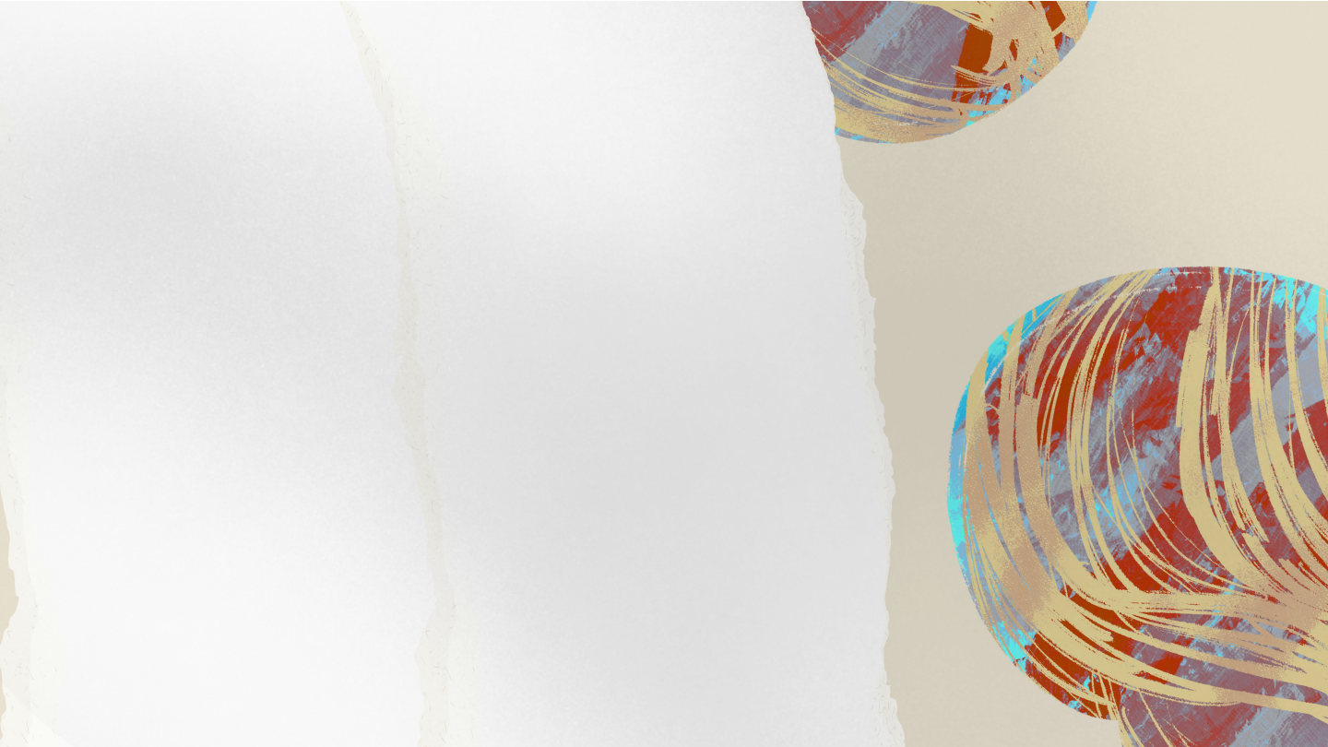
The Essence
of Tango
Tango embodies the essence of passion and emotion, weaving together intricate footwork with intimate connection. Originating from the streets of Buenos Aires, this dance captures the heart of Argentine culture, expressing love, longing, and nostalgia in every step. The music, often melancholic yet pulsating with energy, sets the stage for a dance that transcends borders and speaks to the soul.
Tango is not merely a sequence of movements; it's a profound expression of human connection, where partners communicate through movement, rhythm, and shared emotion, creating moments of profound intimacy on the dance floor. Tango is a celebration of life's raw emotions, reflecting the vibrant spirit of Argentina and captivating audiences around the globe.

Slide 7
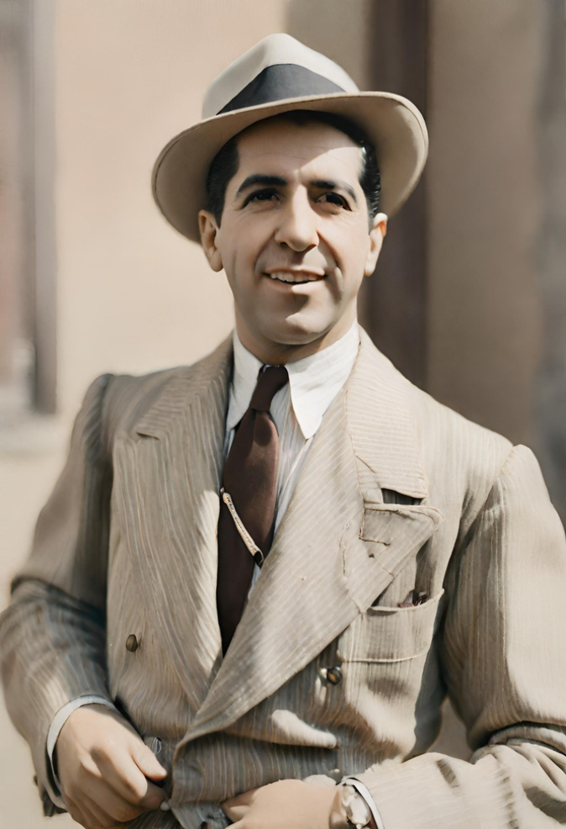
King of Tango
Carlos Gardel
Carlos Gardel, revered as the "King of Tango," left an indelible mark on the world of music and dance. Born in 1890 in Toulouse, France, Gardel's journey to stardom began in Buenos Aires, where he embraced tango as his artistic passion. His velvety voice and charismatic stage presence popularized tango on the global stage, earning him widespread acclaim.
Gardel's musical legacy extends beyond performance. He starred in numerous tango-themed films, such as "El día que me quieras" and "Tango Bar," elevating tango's allure through the silver screen. His emotive renditions of classics like "Mi Buenos Aires querido" and "El día que me quieras" continue to resonate with audiences worldwide.

Slide 8
Timeline of Tango History
1890 - 1900
1930 - 1940
1990 - 2000
Tango emerges in the late 19th century in the neighborhoods of Buenos Aires, blending African rhythms, European melodies, and local influences
The Golden Age of Tango flourishes in the 1930s, characterized by sophisticated orchestral arrangements led by musicians such as
Julio de Caro.
Tango gains global recognition as tango festivals and events spread worldwide, attracting enthusiasts from diverse cultures.

Slide 9
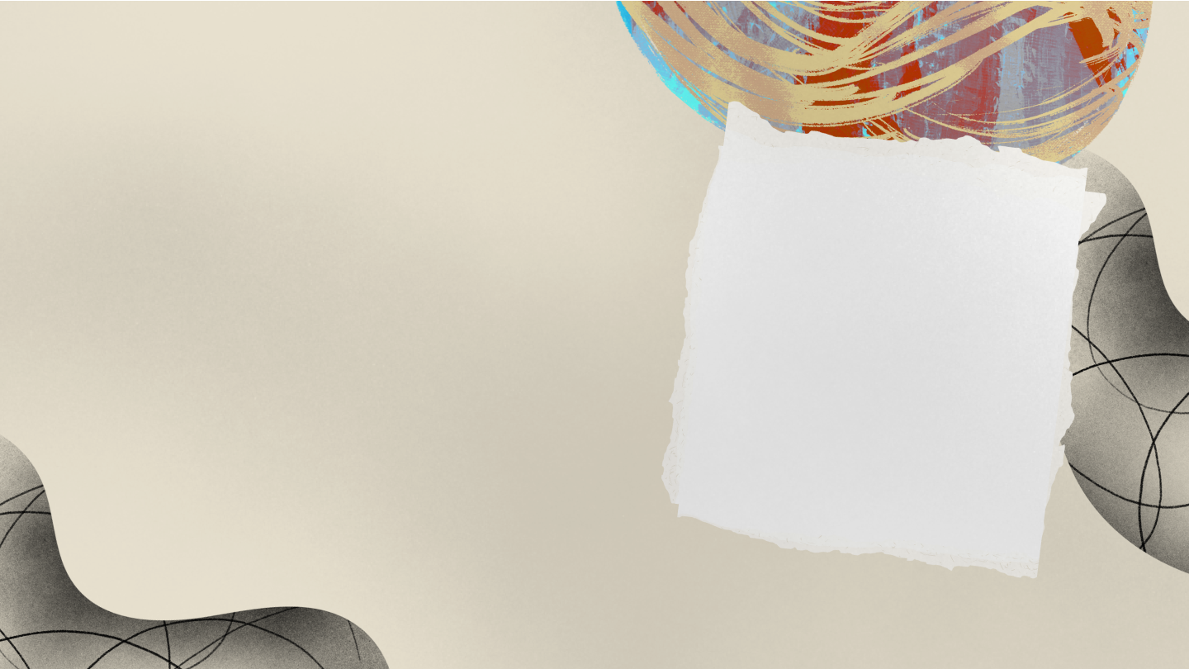
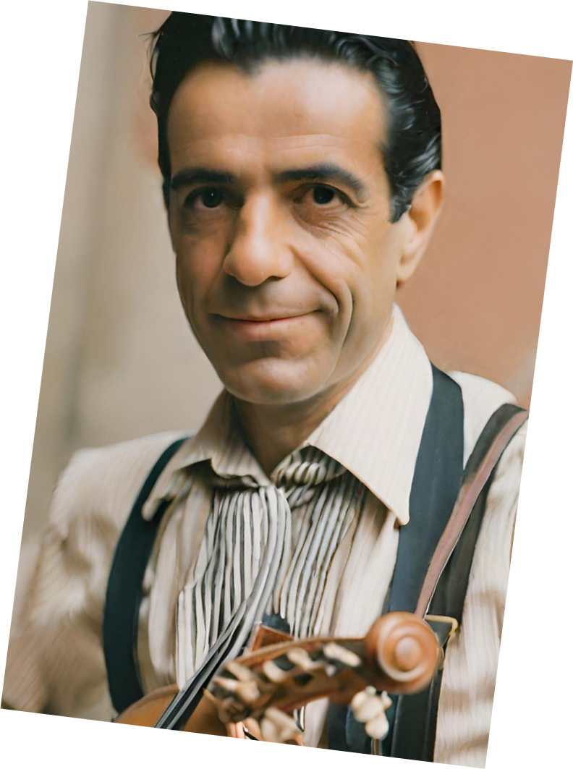
Julio de Caro's
Influence
Gardel's musical legacy extends beyond performance. He starred in numerous tango-themed films, such as "El día que me quieras" and "Tango Bar," elevating tango's allure through the silver Julio de Caro, a pivotal figure in the evolution of tango, revolutionized the genre through his innovative orchestration and musical vision. Born in 1899 in Buenos Aires, de Caro's approach to tango composition and arrangement elevated the art form to new heights.

Slide 10
Write a
Heading Here
Elaborate on what you
want to discuss.

Slide 11
Facts About Tango
Fact one
Fact three
Write down a short
fact about Tango
Write down a short
fact about Tango
Fact two
Fact three
Write down a short
fact about Tango
Write down a short
fact about Tango

Slide 12
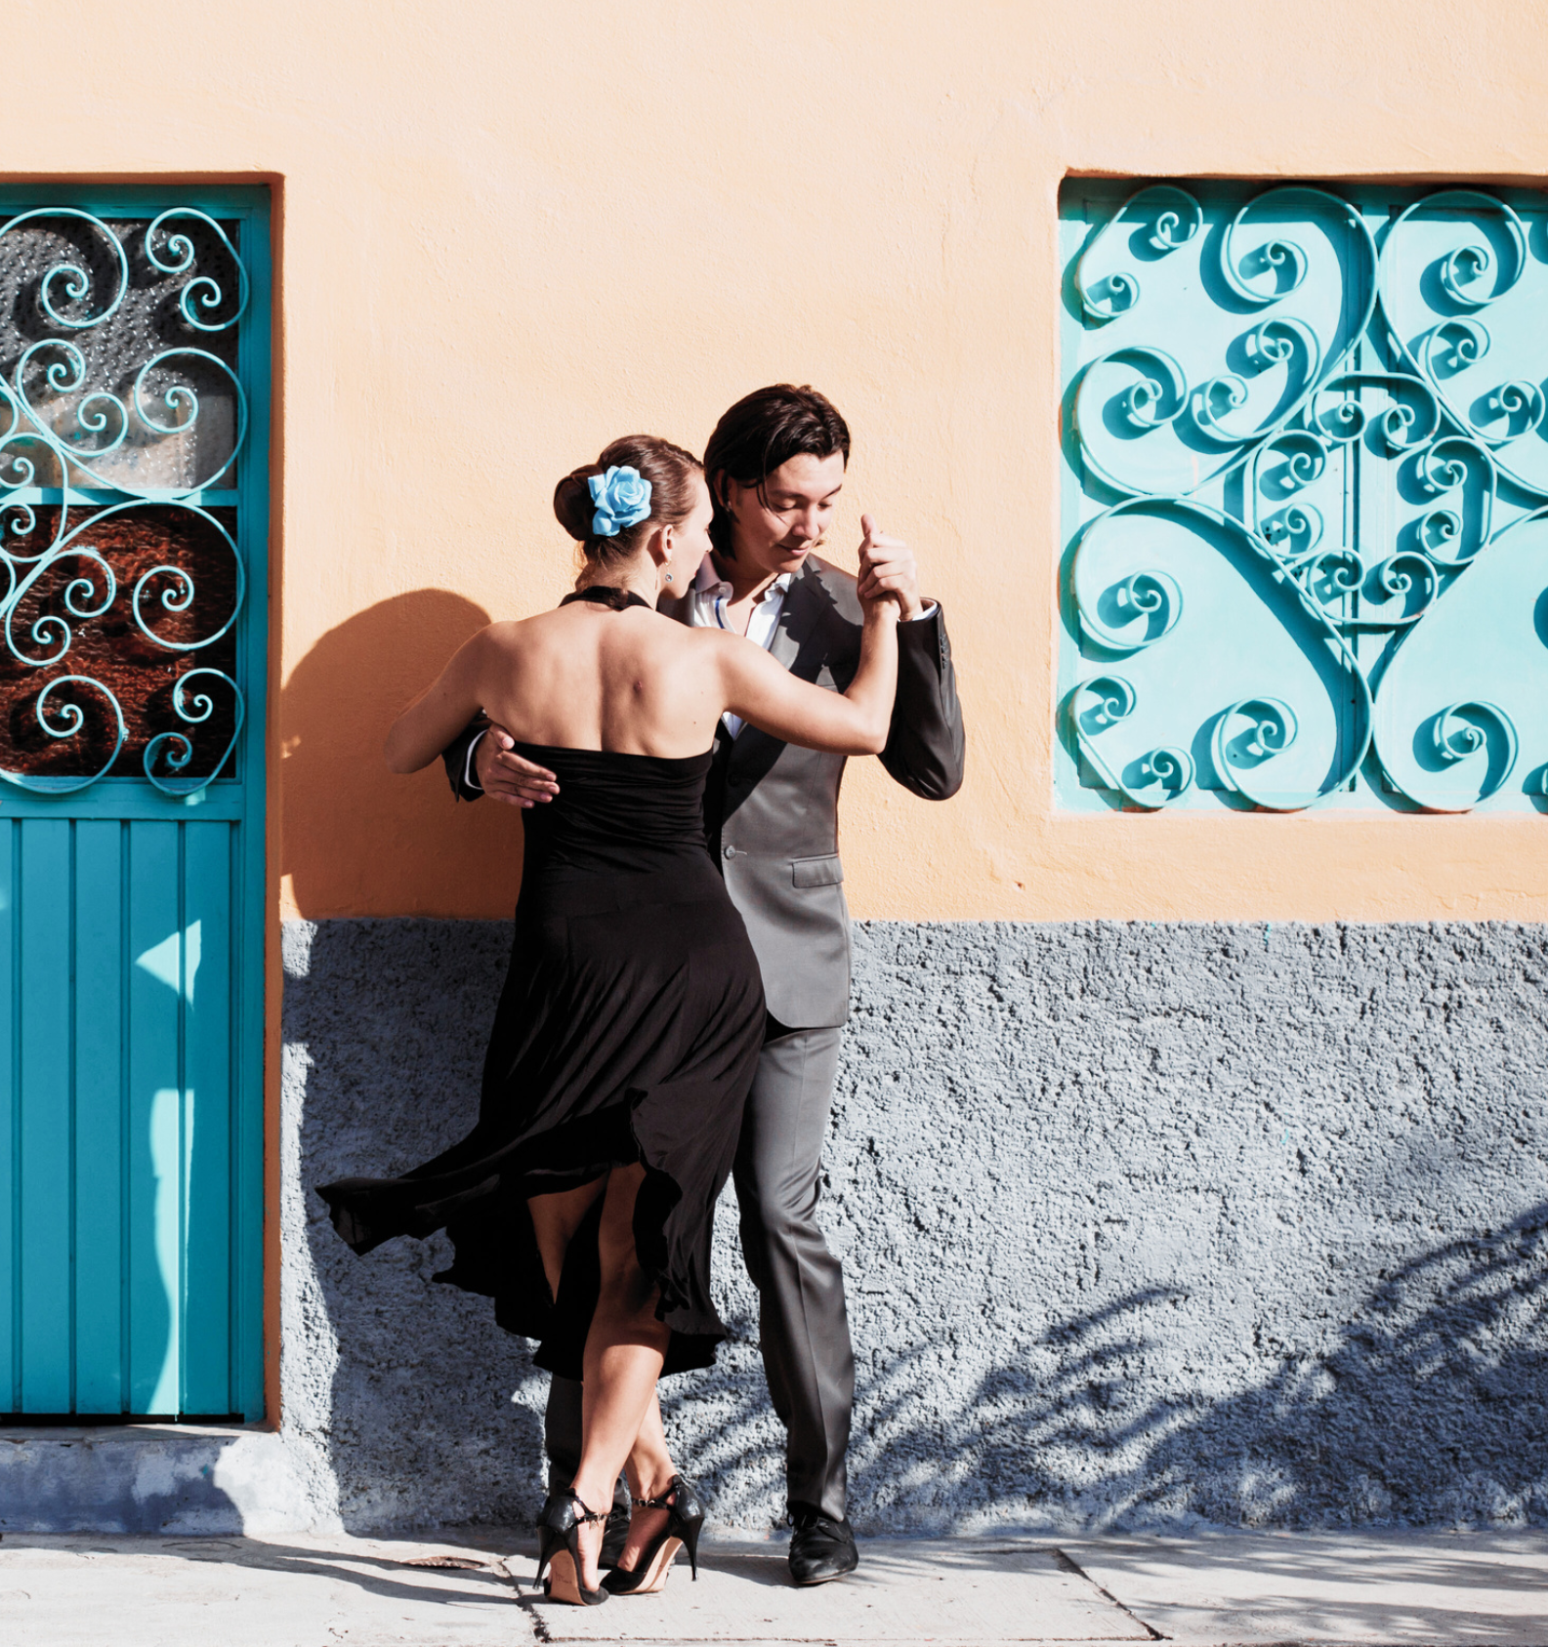
Global Impact
Tango's global impact is profound, transcending borders and captivating audiences worldwide
Recognition
Festivals
UNESCO recognized tango as Intangible Cultural Heritage of Humanity in 2009, acknowledging its significance in preserving cultural diversity and promoting mutual understanding.
Tango has spread to over 70 countries, where enthusiasts gather for festivals, workshops, and performances, celebrating its rich history and passionate expression.

Slide 13
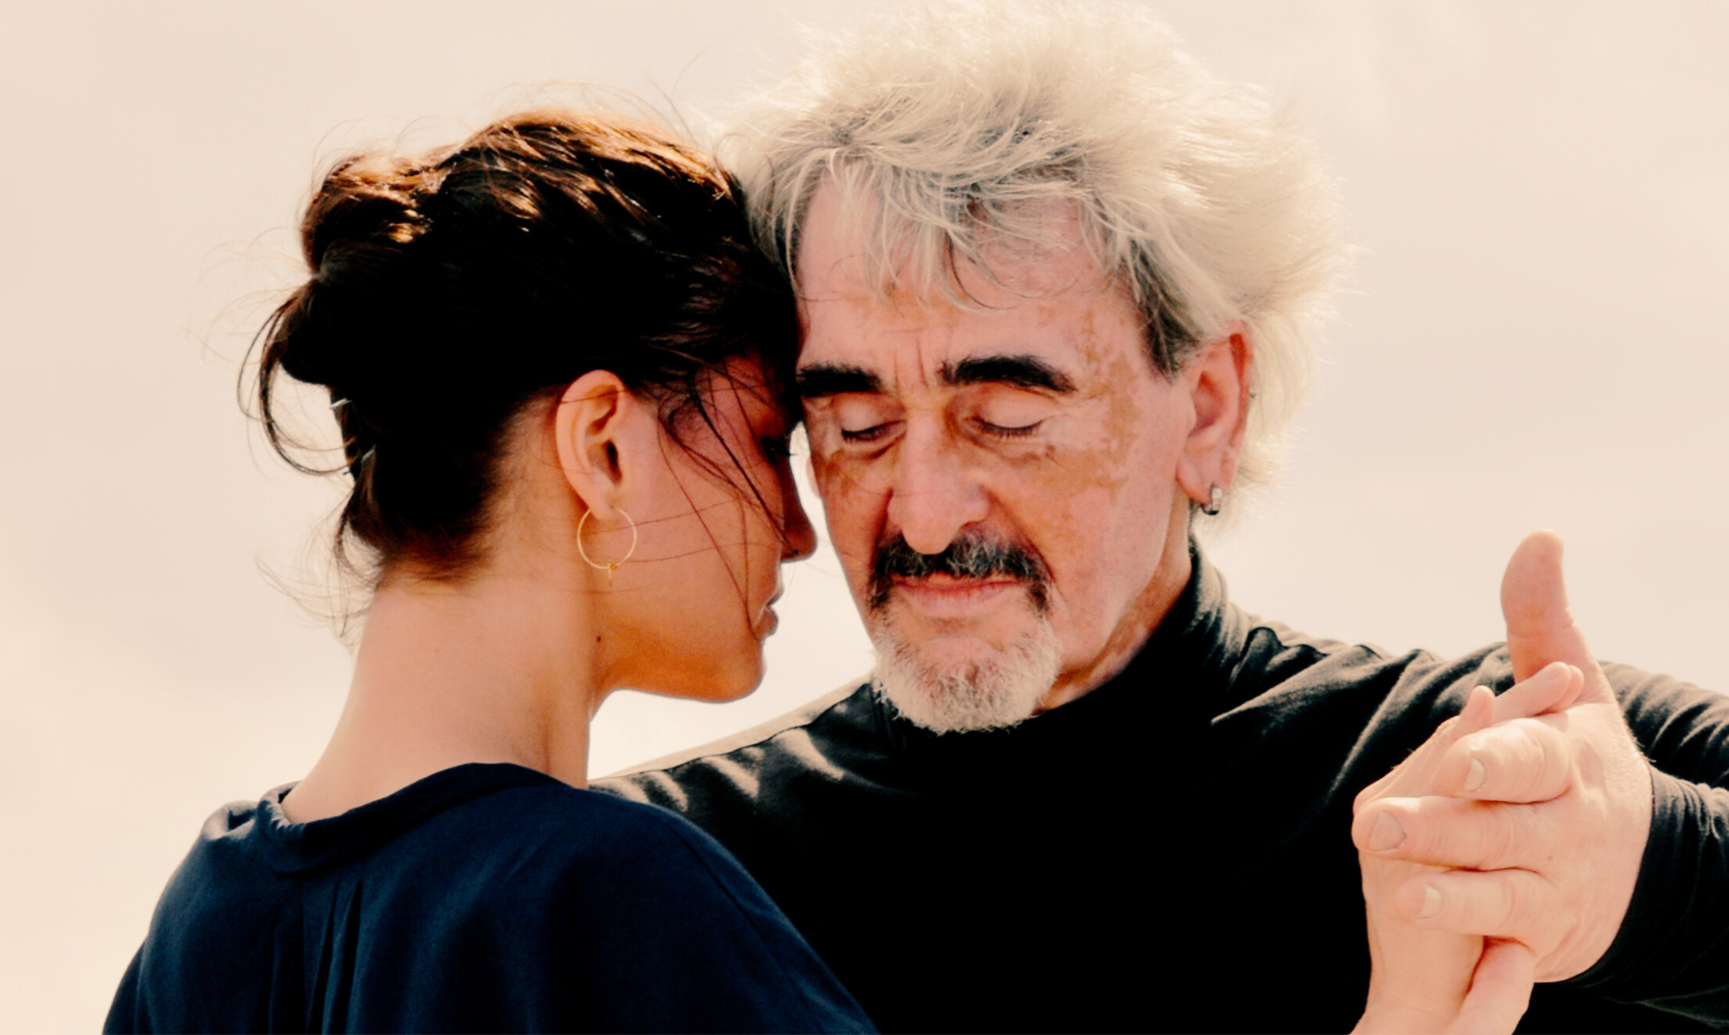
A picture is worth a thousand words

Slide 14
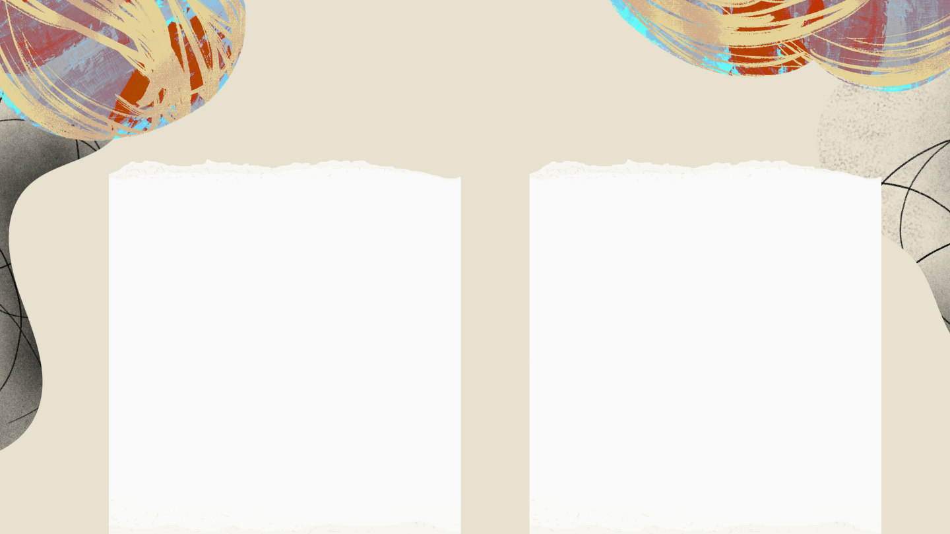
Did you know?
Around the Worlrd
Female Presence
Over 70 countries host tango festivals, demonstrating the universal passion and appreciation for this dance form in celebration of tango's rich heritage.
Approximately 60% of tango dancers worldwide are women, highlighting the significant female presence and contribution to the tango dance scene.

Slide 15
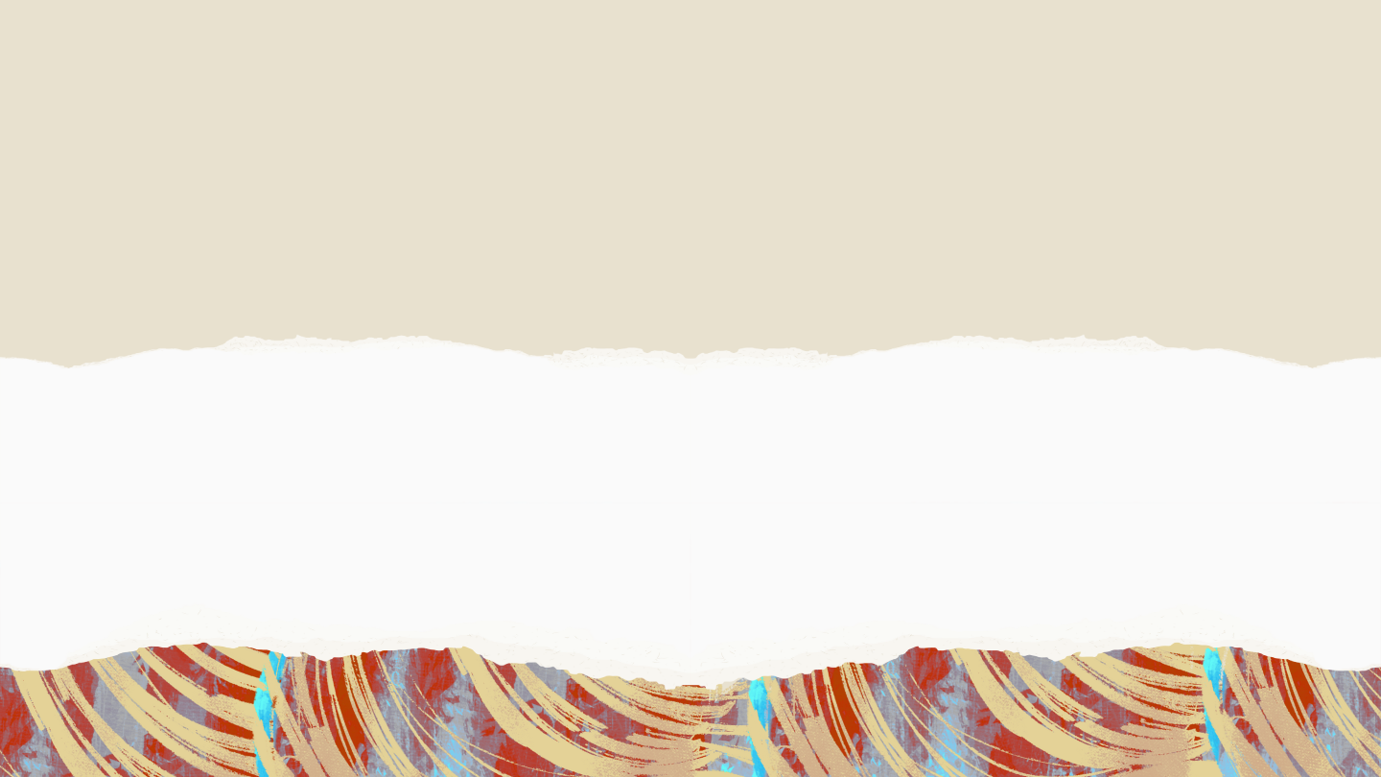
Famous Tango Songs
Explore the timeless melodies that define the essence of tango.
La Cumparsita
El Choclo
Adiós Muchachos
An iconic tango composition by Gerardo Matos Rodríguez, often considered the anthem of tango
A classic tango piece by Ángel Villoldo, known for its lively and rhythmic charm.
Composed by Julio César Sanders, this melancholic tango captures themes of farewell and nostalgia.

Slide 16
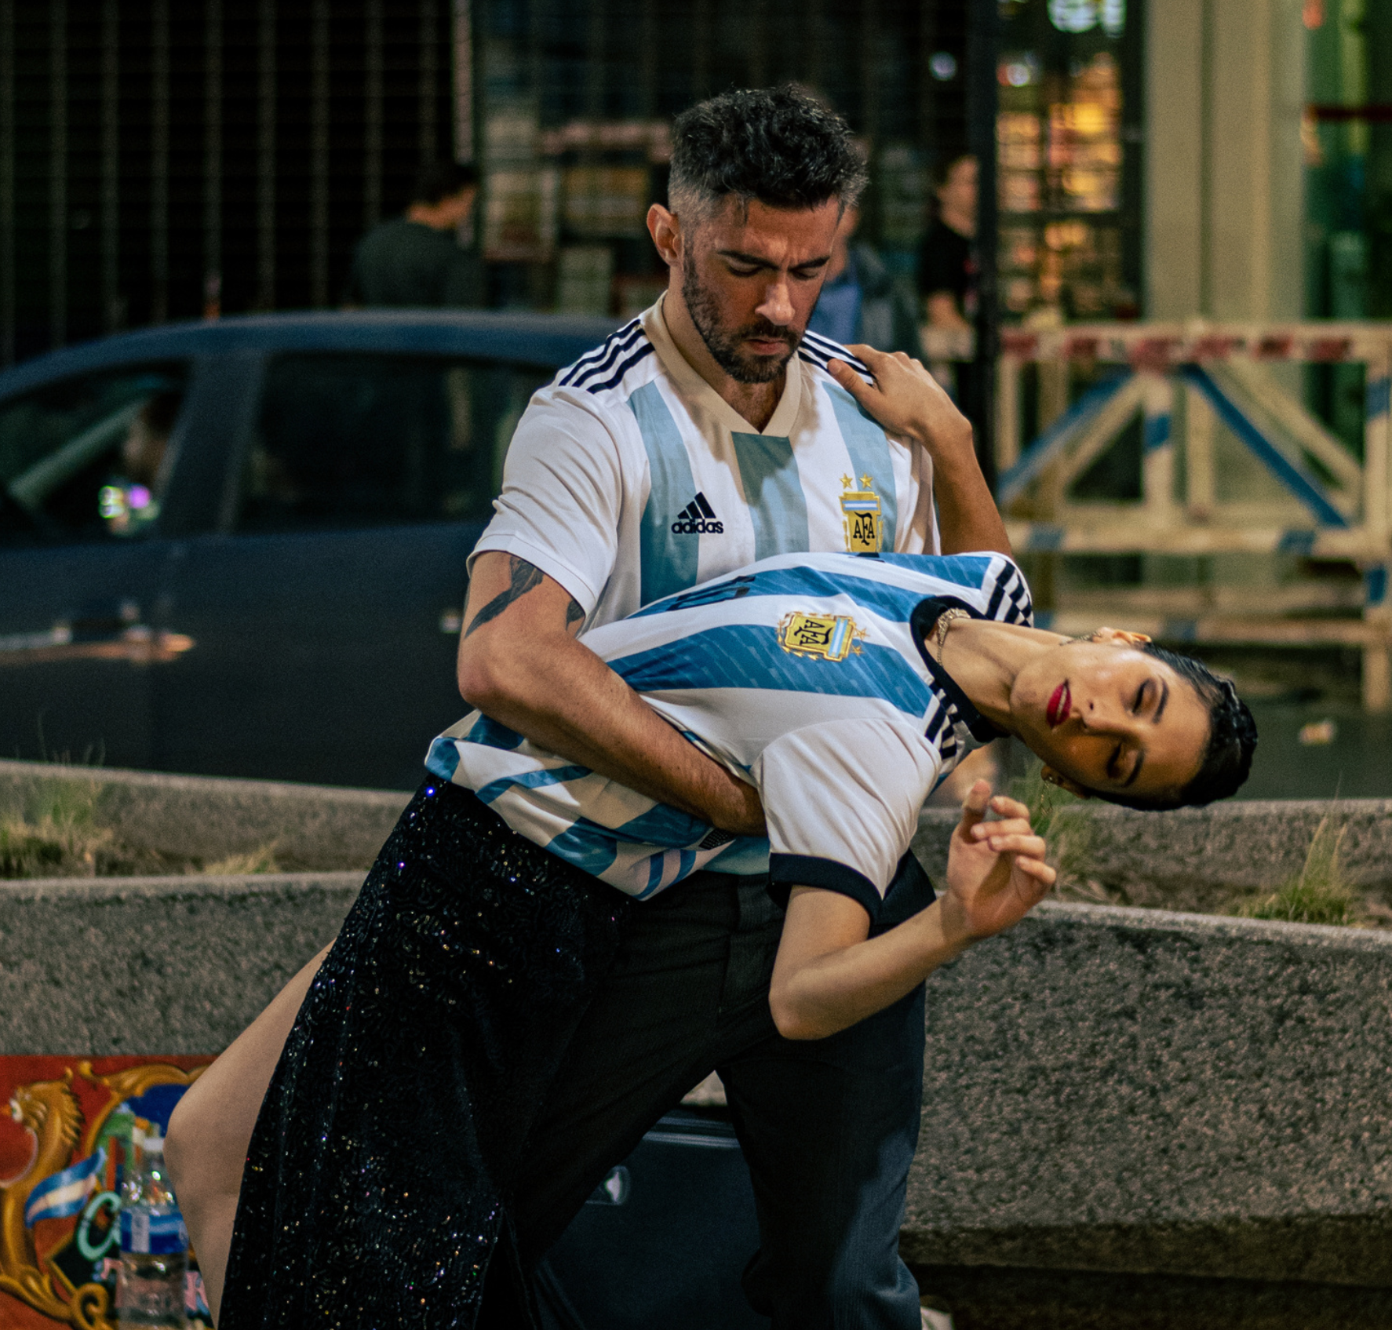
The Future
of Tango
Tango continues to evolve with modern influences, incorporating new music styles and dance techniques to attract younger audiences and preserve its cultural relevance.
Innovations in technology and global connectivity offer opportunities for tango enthusiasts to connect, collaborate, and share their passion for tango across borders, ensuring its enduring legacy in the digital age.

Slide 17
Join The
Celebration
Elaborate on what you
want to discuss.

Slide 18
Resource Page
Use these design resources in your Canva Presentation.
Fonts
Design Elements
This presentation template
uses the following free fonts:
TITLES:
ABRIL FATFACE
HEADERS:
HOMEMADE APPLE
BODY COPY:
MONTSERRAT
You can find these fonts online too.
Colors
#E8E1CF
#B14B43
DON'T FORGET TO DELETE THIS PAGE BEFORE PRESENTING.

Slide 19
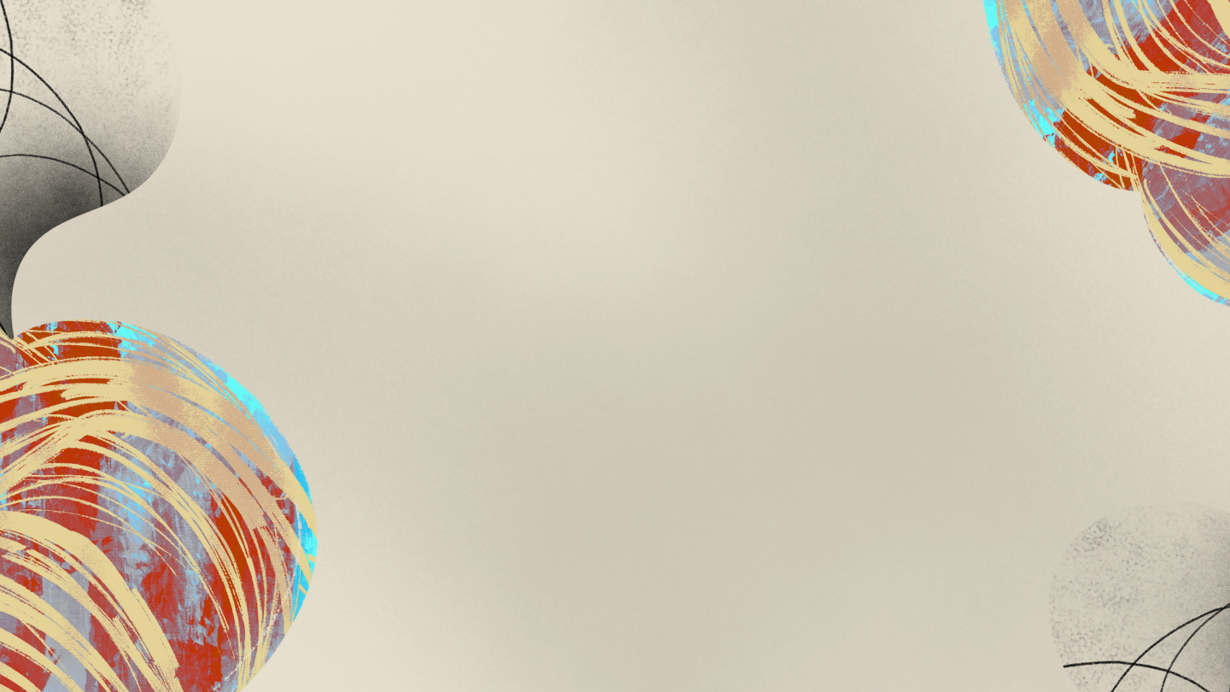
Credits
This presentation template is free for everyone to use thanks to the following:
for the presentation template
Pexels, Pixabay
for the photos
Happy designing!

