Slide 1
THE MOON
Exploring Facts vs. Opinions

Slide 2
HOW TO USE THIS PRESENTATION
GoogleSlides
PowerPoint
Canva
Click on the "Google Slides" button below this presentation preview. Make sure to sign in to your Google account. Click on "Make a copy." Start editing your presentation.
Alternative: Click on the "Share" button on the top right corner in Canva and click on "More" at the bottom of the menu. Enter "Google Drive" in the search bar and click on the GDrive icon to add this design as a Google slide in your GDrive.
Click on the "PowerPoint" button below this presentation preview. Start editing your presentation.
Alternative: From Canva template file, Click on the "Share" button on the top right corner in Canva and click on "More" at the bottom of the menu. Enter "PowerPoint" in the search bar and click on the PowerPoint icon to download.
Click on the "Canva" button under this presentation preview. Start editing your presentation. You need to sign in to your Canva account.

Slide 3
TODAY, WE'LL LEARN TO
Discover the importance of drawing on information from multiple sources
Locate answers to questions efficiently and effectively
Distinguish between facts and opinions

Slide 4
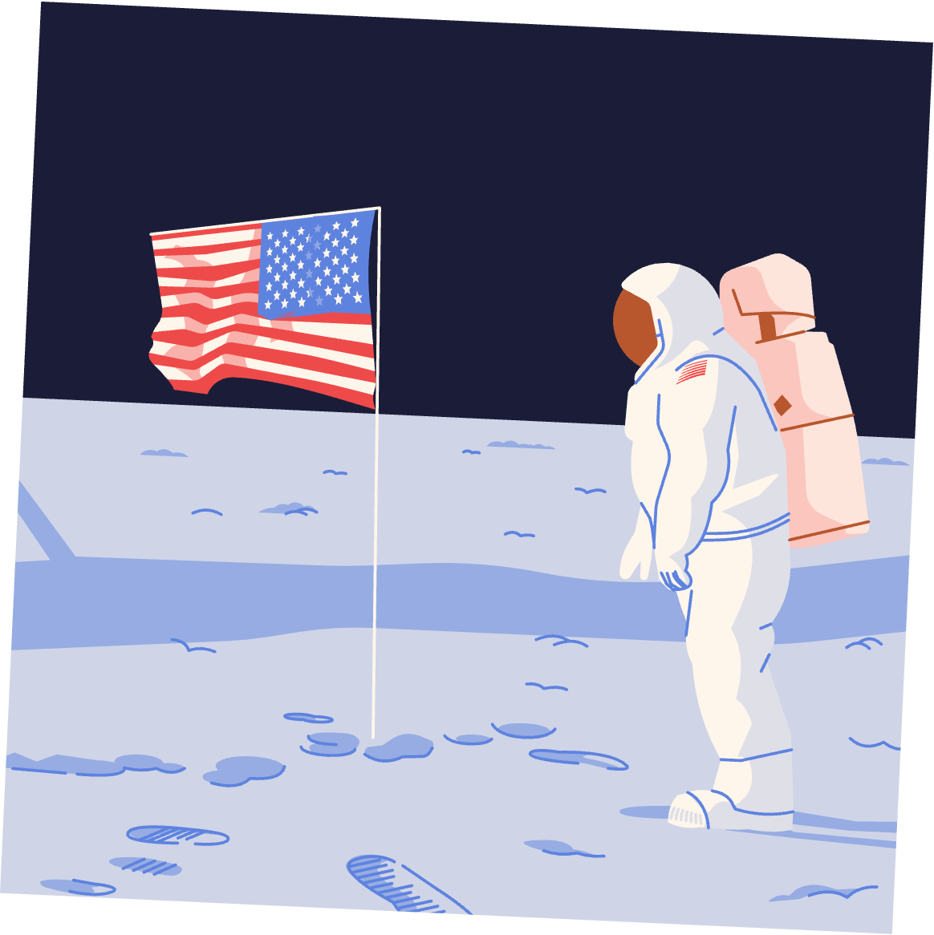
WHAT DO YOU KNOW ABOUT THE FIRST MOON LANDING?
"But beware! Not all sources are created equal."
By exploring multiple sources, we can uncover the most accurate and reliable information.
Today, we will embark on an exciting adventure to learn more-- through research!

Slide 5
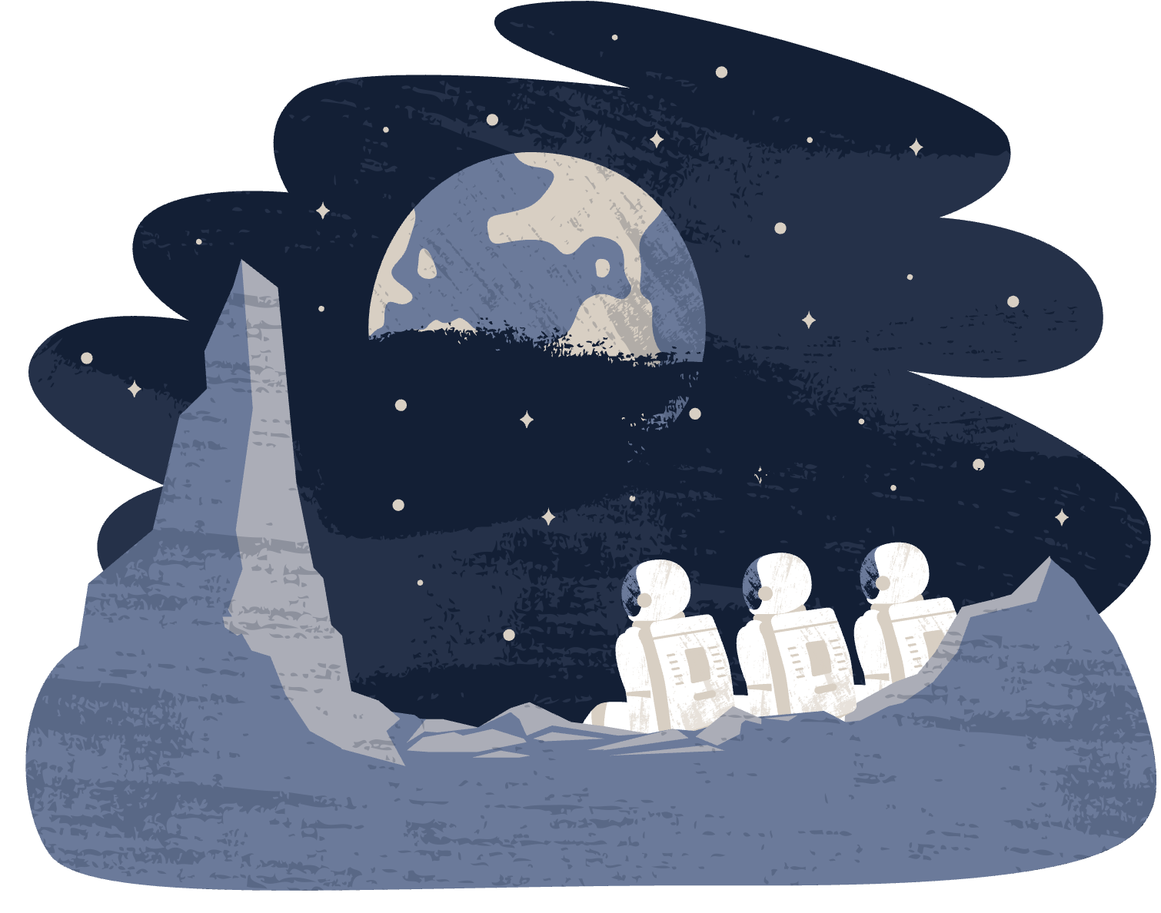
DIFFERENT SOURCES PRESENT DIFFERENT
INFORMATION, EVEN ABOUT THE SAME TOPICS.
Remember:
Choose reliable sources.
Reliability helps us determine the credibility and accuracy of the information we find

Slide 6
WHAT DOES IT MEAN TO BE RELIABLE?
Imagine a bridge built with a strong foundation, expert craftsmanship, and thorough inspections.
In the same way, a reliable source is built upon accurate information, expertise, and rigorous scrutiny!

Slide 7
TO KNOW A SOURCE IS RELIABLE,
YOU NEED TO ASK QUESTIONS.
Who wrote this source? Was it written by an expert in a field?
What could be the intention/purpose of the author in writing this?
Are there any other sources that this source refers to?
Does this source say the same things as other sources or does it say something completely different?

Slide 8
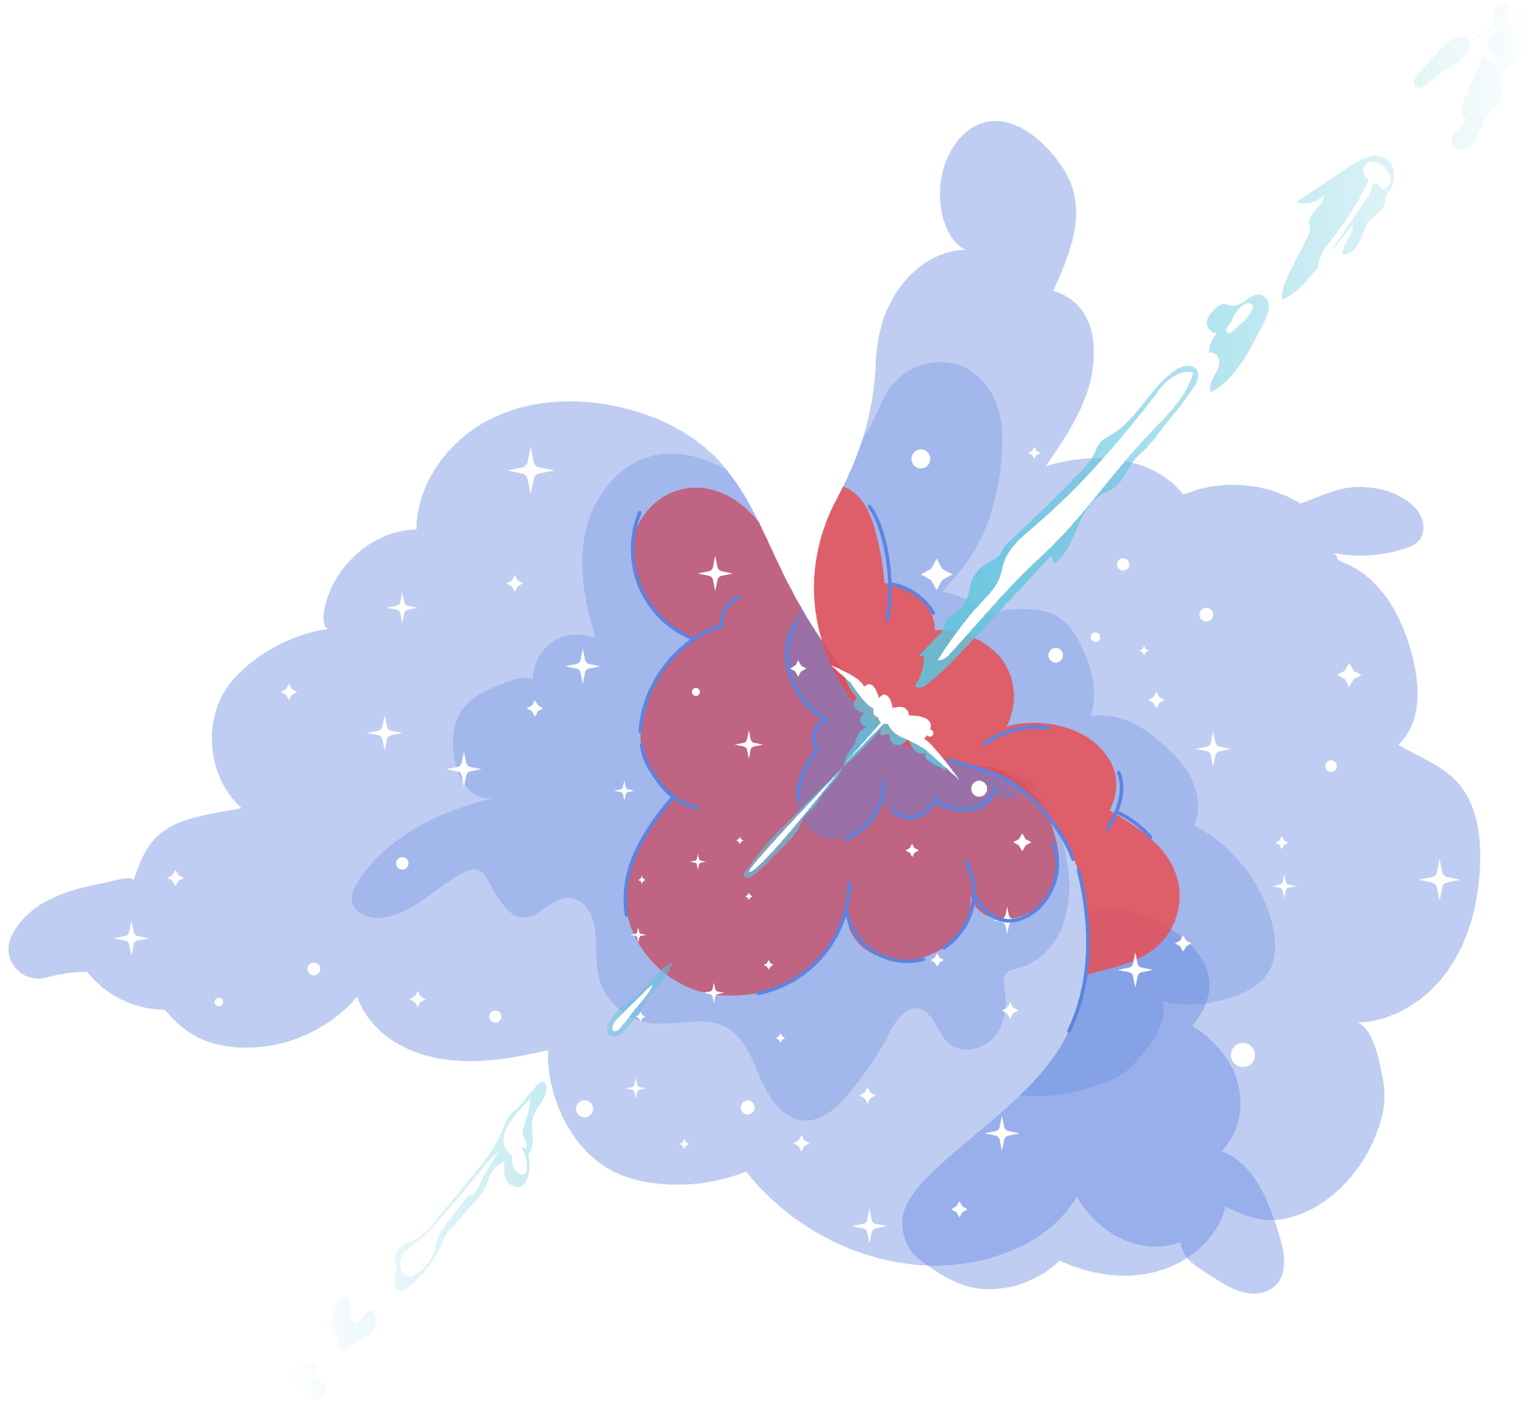
THERE ARE DIFFERENT ONLINE SOURCES
— CHOOSE WISELY!
SEARCH ENGINES
SEARCH ENGINES
DIGITAL ARCHIVES
Access historical documents, images, and videos from reputable online archives.
Use search engines to find a wide range of information.
Use search engines to find a wide range of information.

Slide 9
WHICH SOURCE WOULD YOU CHOOSE IF YOU WERE RESEARCHING ABOUT THE MOON LANDING? DISCUSS PROS AND CONS WITH A PARTNER!
Astro Science Journal
Lunar Chronicles Blog
It is a personal blog, with posts written by an individual named MoonEnthusiast without any supporting evidence or references. The tone is informal, conversational, and enthusiastic.
It is a well-respected scientific journal with peer-reviewed articles written by researchers and scientists. The tone is formal, technical, and scientific.
VS

Slide 10
LET'S DISCUSS:
Astro Science Journal
Lunar Chronicles Blog
PROS:
PROS:
Well-respected
Written by researchers and scientists
Contains citations and references
VS
Easy to understand and access
CONS:
Lack of credibility
Lack of sources
May contain inaccurate information since its a personal opinion
CONS:
May be hard to understand and access.

Slide 11
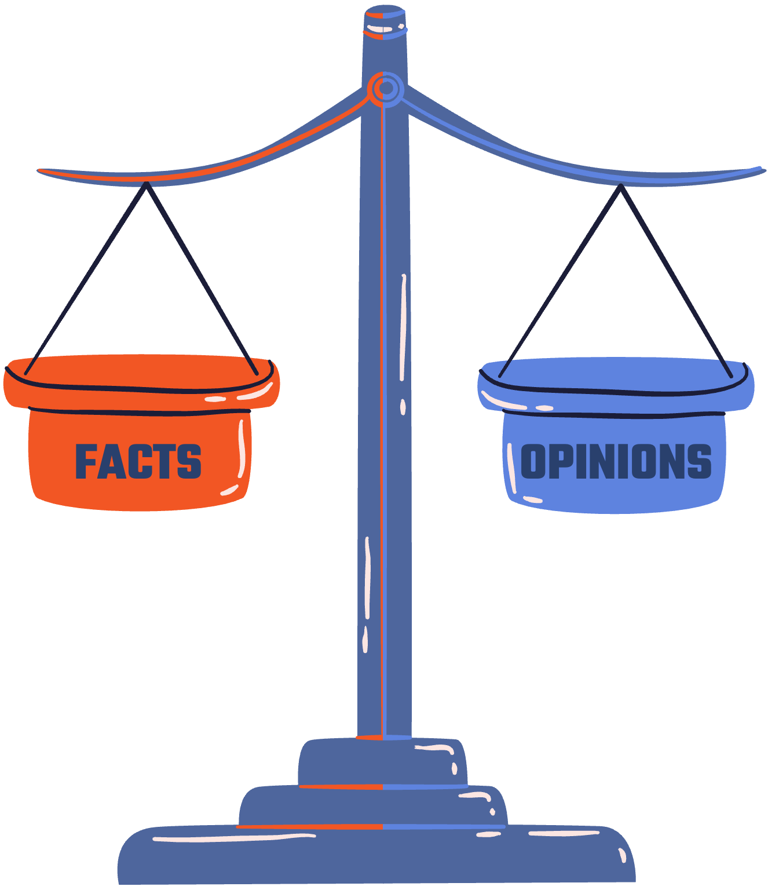
RELIABLE SOURCES ALSO HAVE VERIFIABLE FACTS AND OPINIONS
FACTS
OPINIONS
Statements based
on evidence
Personal beliefs
or preferences.

Slide 12
TO MAKE THINGS CLEARER...
Facts are like exact puzzle pieces that fit together to form a clear picture of what you are searching for-- like the moon landing, for example!
Opinions, on the other hand, are personal viewpoints based on facts or individual beliefs.
Distinguishing facts from opinions and making sure they can be verified is very important to research.

Slide 13
FOR EXAMPLE:
A fact
would be...
An opinion would be...
Astronauts go through extensive training and rigorous physical examinations before going to space.
Astronauts are the bravest individuals in the world.
CAN YOU EXPLAIN WHY?

Slide 14
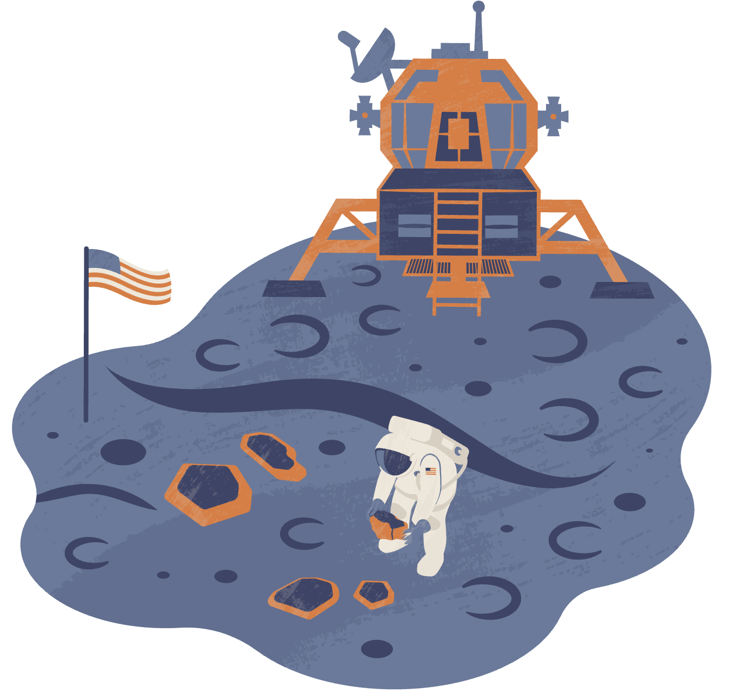
INVESTIGATING
THE MOON LANDING
Did you know that there are hoaxes and unfounded claims about the moon landing?
Investigate the moon landing and the associated hoax claims using multiple sources. You must use at least one source from an online database and one source from digital archives.
Investigate the moon landing: List 5 facts and 5 hoax claims.
Work with a partner or in small groups to gather information from online articles, videos, and credible sources.
Analyze the gathered information and identify verifiable facts and opinions.
Share your findings and insights with the class, discussing how you distinguished between facts and opinions.

Slide 15
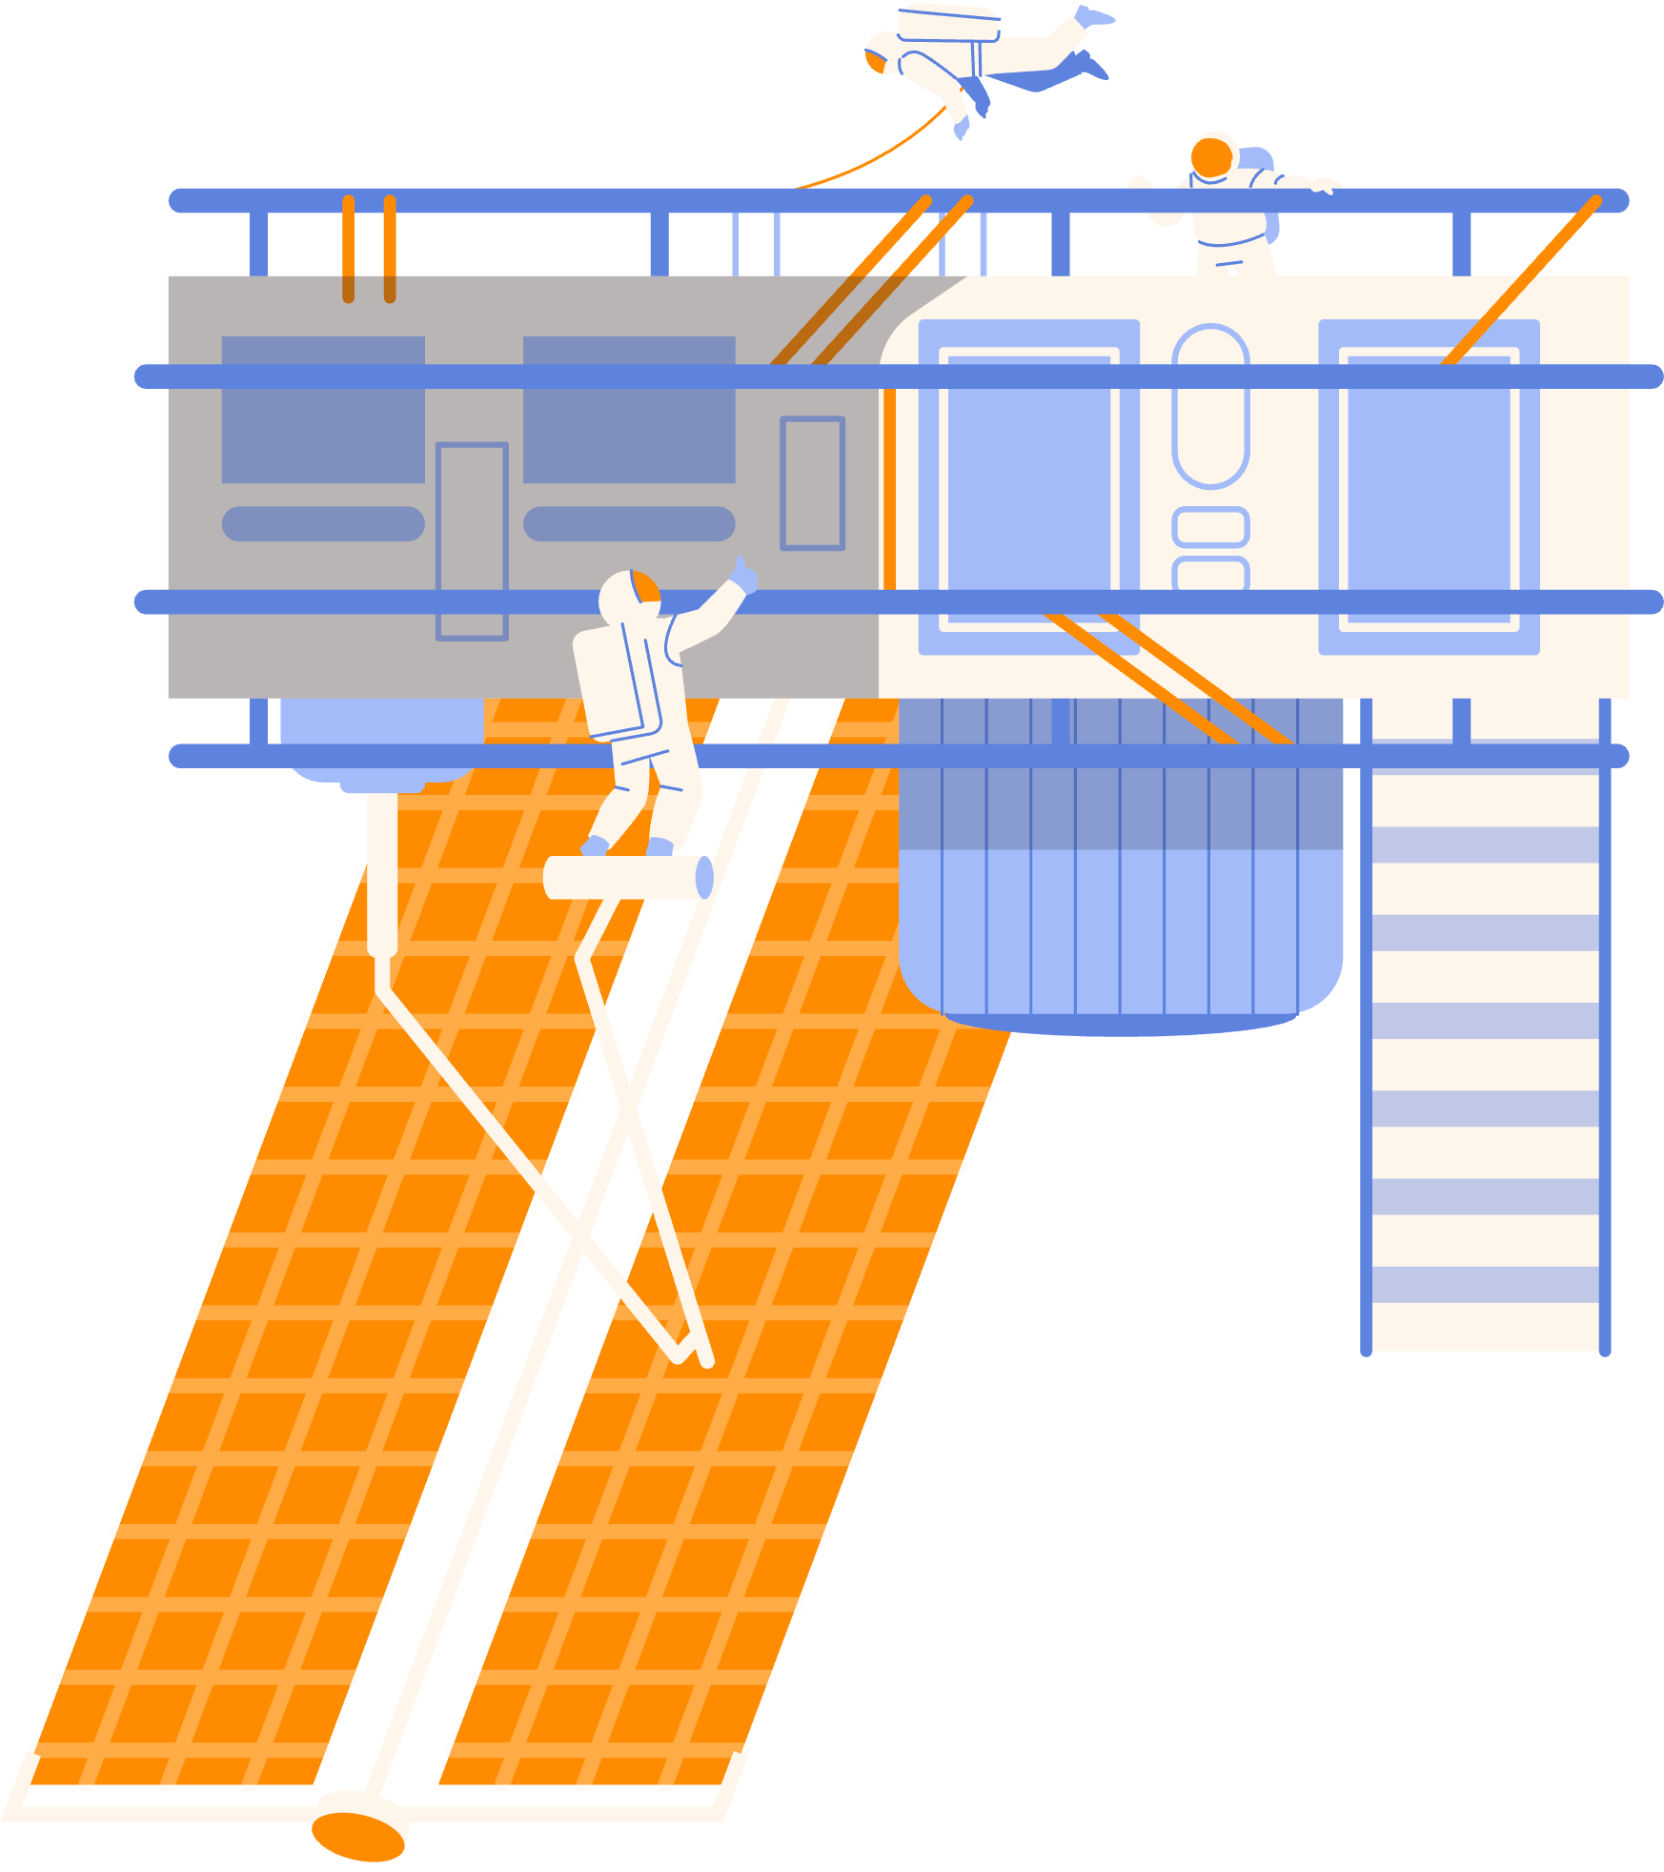
REMEMBER, a good researcher:
Can distinguish between fact
and opinion!
Uses multiple sources.
Knows how to evaluating sources
for reliability!

Slide 16
RESOURCE
PAGE
Use these design resources
in your Canva Presentation.
This presentation template
uses the following free fonts:
Titles: Teko
Headers: Poppins
Body Copy: Poppins
You can find these fonts
online too. Happy designing!
Don't forget to delete this
page before presenting.

Slide 17
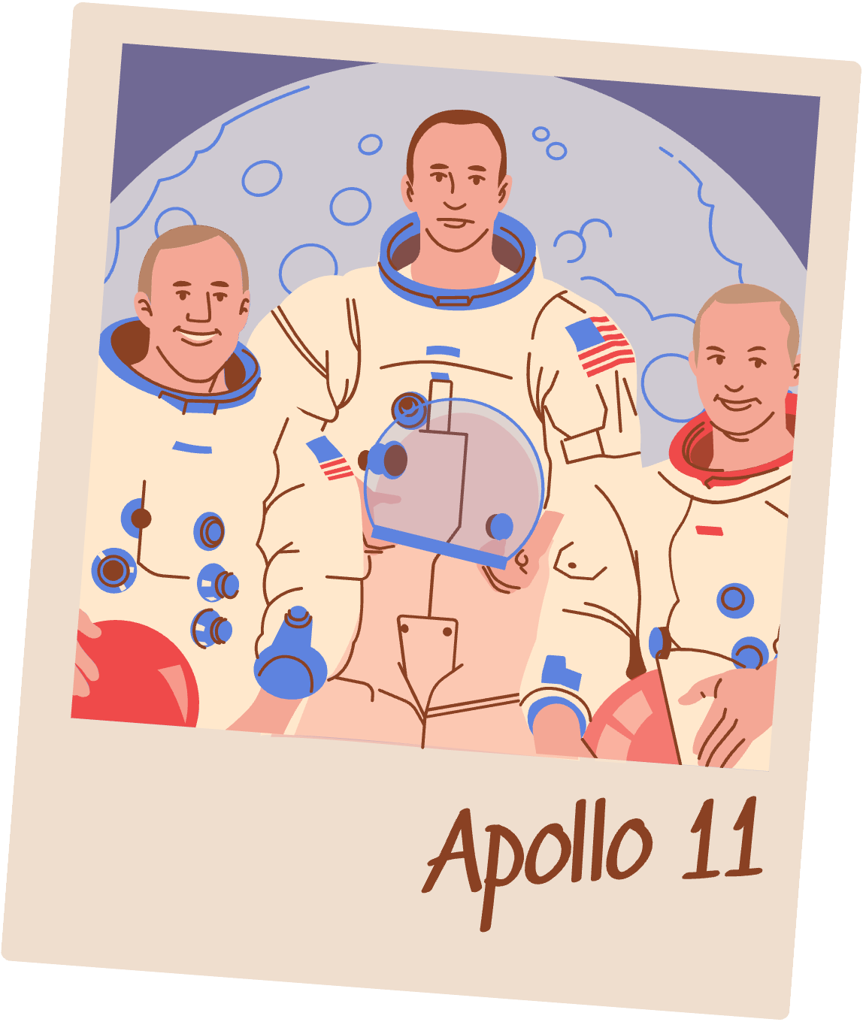
CREDITS
THIS PRESENTATION TEMPLATE IS FREE FOR EVERYONE TO USE THANKS TO THE FOLLOWING:
SlidesCarnival
FOR THE PRESENTATION TEMPLATE
HAPPY DESIGNING
Pexels
FOR THE PHOTOS

