Slide 1





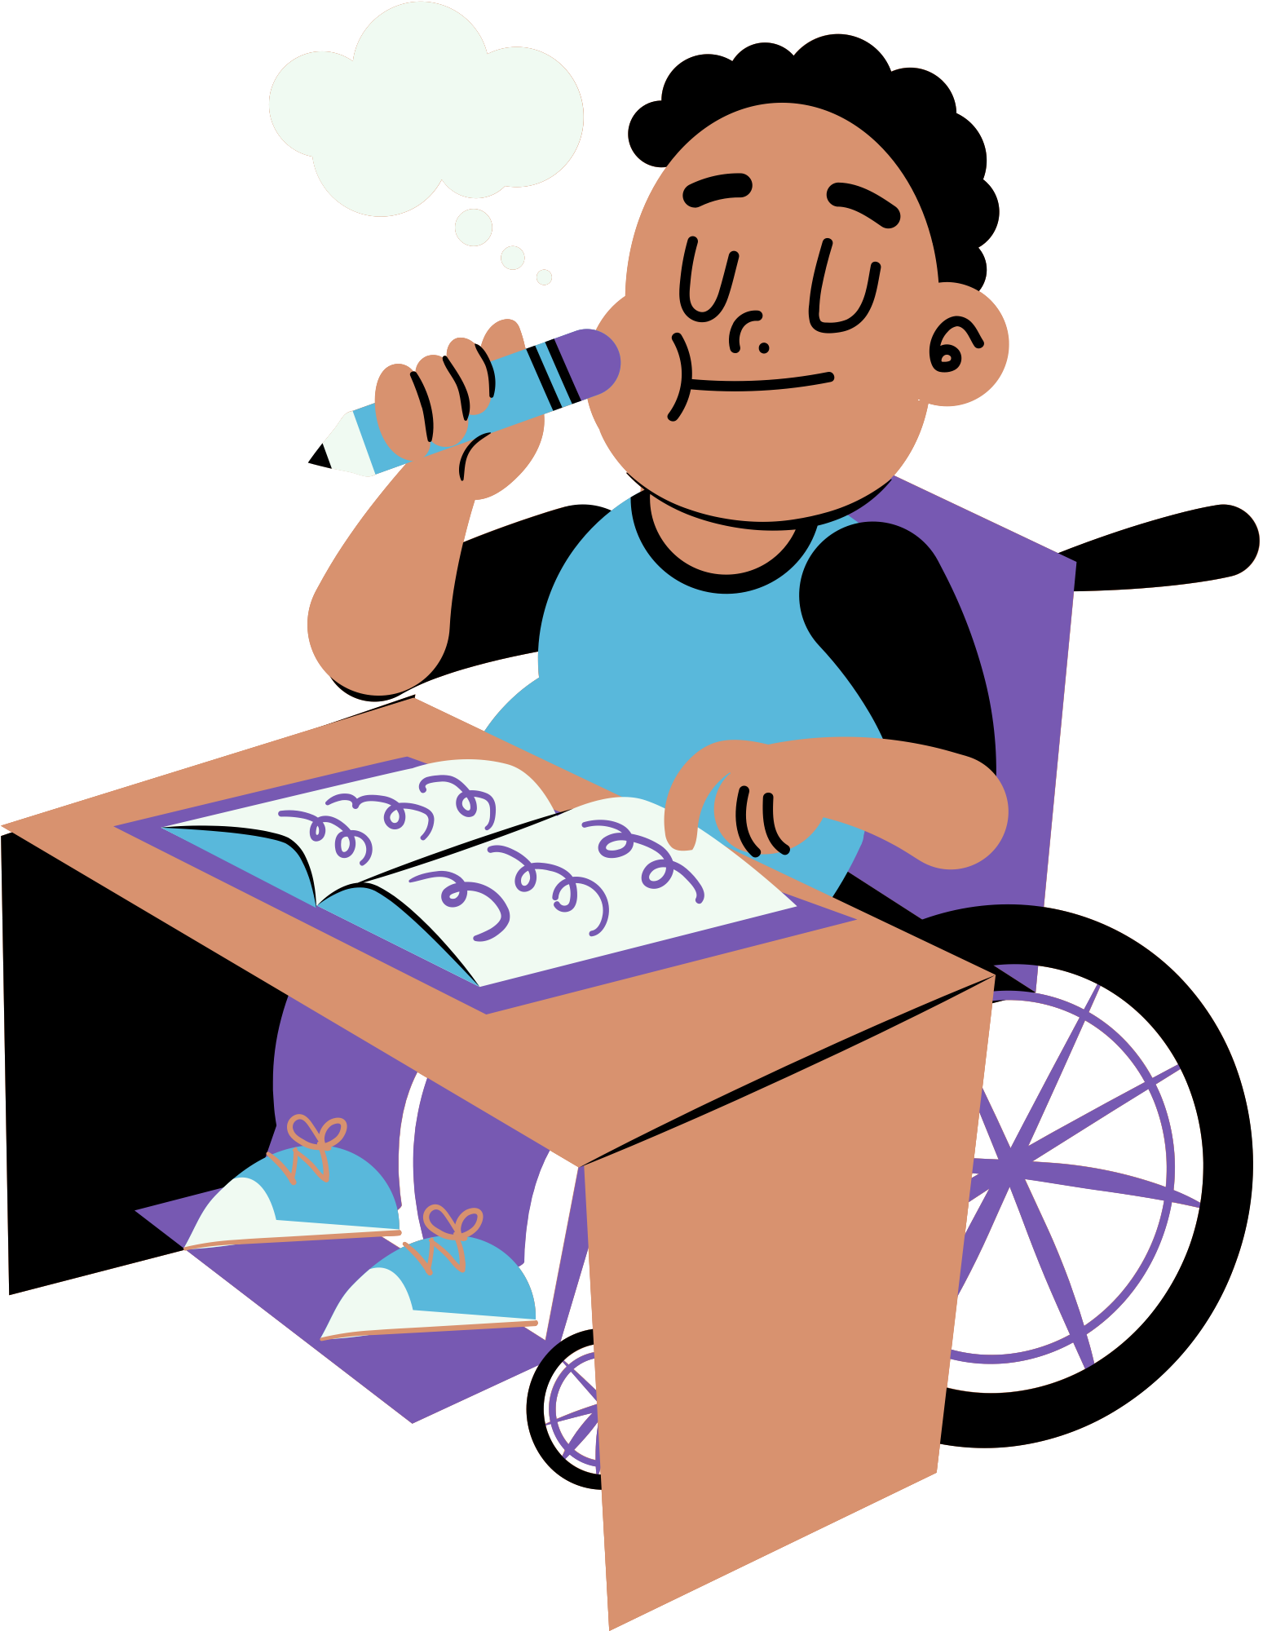


Sentence Craft
And Combining Sentences
Lesson for Middle School

Slide 2







Why is combining sentences important?
To communicate effectively to the readers
  To make writing interesting
  To demonstrate creativity and unique writing style
  Imagine writing same repeated long statements. How would this affect your readers?

Slide 3






Lesson outline
  Compounding Elements: Same Subject
  Compounding Elements: Same Object/Verb
  Coordinating Conjunctions
  Subordinating Conjunctions
  Appositive

Slide 4








Analyze! See the difference
Many people read only the headlines of a news item. Many people skim nearly all the headlines in a newspaper. Headlines are the most-read part of a paper. Headlines can summarize as well as present carefully hidden bias.
Many people read only the headlines and skim nearly all the headlines in a newspaper. Headlines are the most-read part of a paper, for it can summarize as well as present carefully hidden bias.
Too much of the same thing
  can be dragging.
  Sentence combining makes the paragraph shorter, more precise, and more interesting.

Slide 5




Compounding elements
  You can combine sentences by making compound subjects, verbs, direct objects, or indirect objects.
IF subjects are the same
THEN keep the subject
and join the verbs
Every news story is influenced by attitudes.
Every news story is influenced by assumptions.
Every news story is influenced by attitudes, assumptions, and background of the writers.
Every news story is also influenced by the background of the writers.

Slide 6



Compounding elements
  You can combine sentences by making compound subjects, verbs, direct objects, or indirect objects.
IF objects or verbs are
the same
THEN keep the objects and the verbs and join the subjects
Newspaper is a type of media that caters to a specific target audience.
Newspaper, radio, and television are types of media that cater to specific target audiences.
Radio is another form of media that caters to a specific target audience.
Television is also a type of media that caters to a specific target audience.

Slide 7

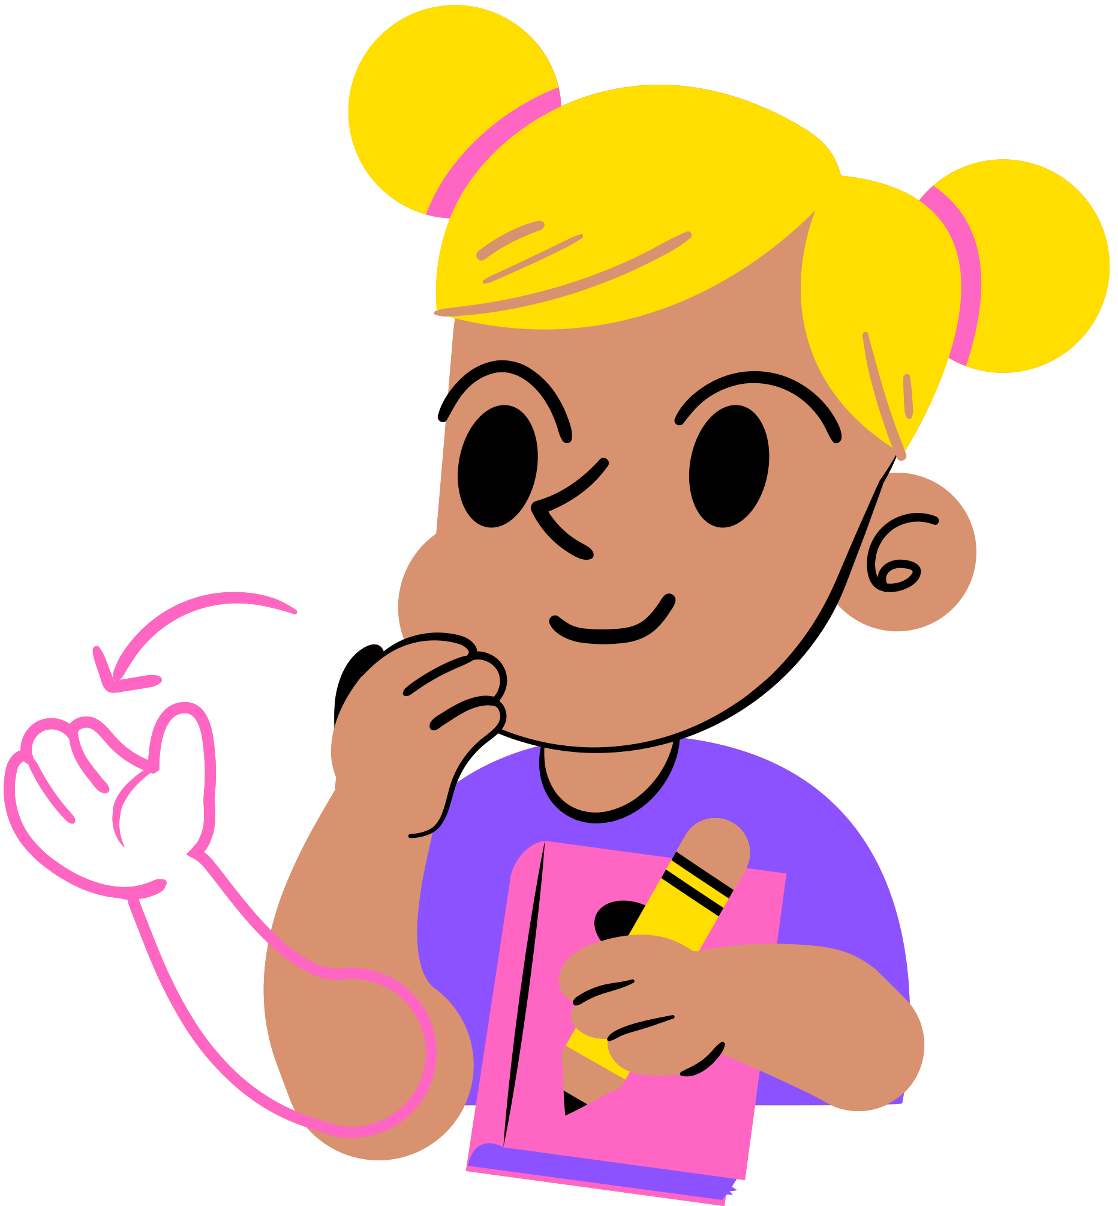

Practice
  Study the statements below. Combine the sentences to come up with clearer expression.
Misleading content is a type of content that frames or presents issues in certain ways.
Misleading content is a type of content that uses cropping photos.
Misleading content is a type of content that chooses quotes or statistics selectively.
  What sentence did you come up with?

Slide 8




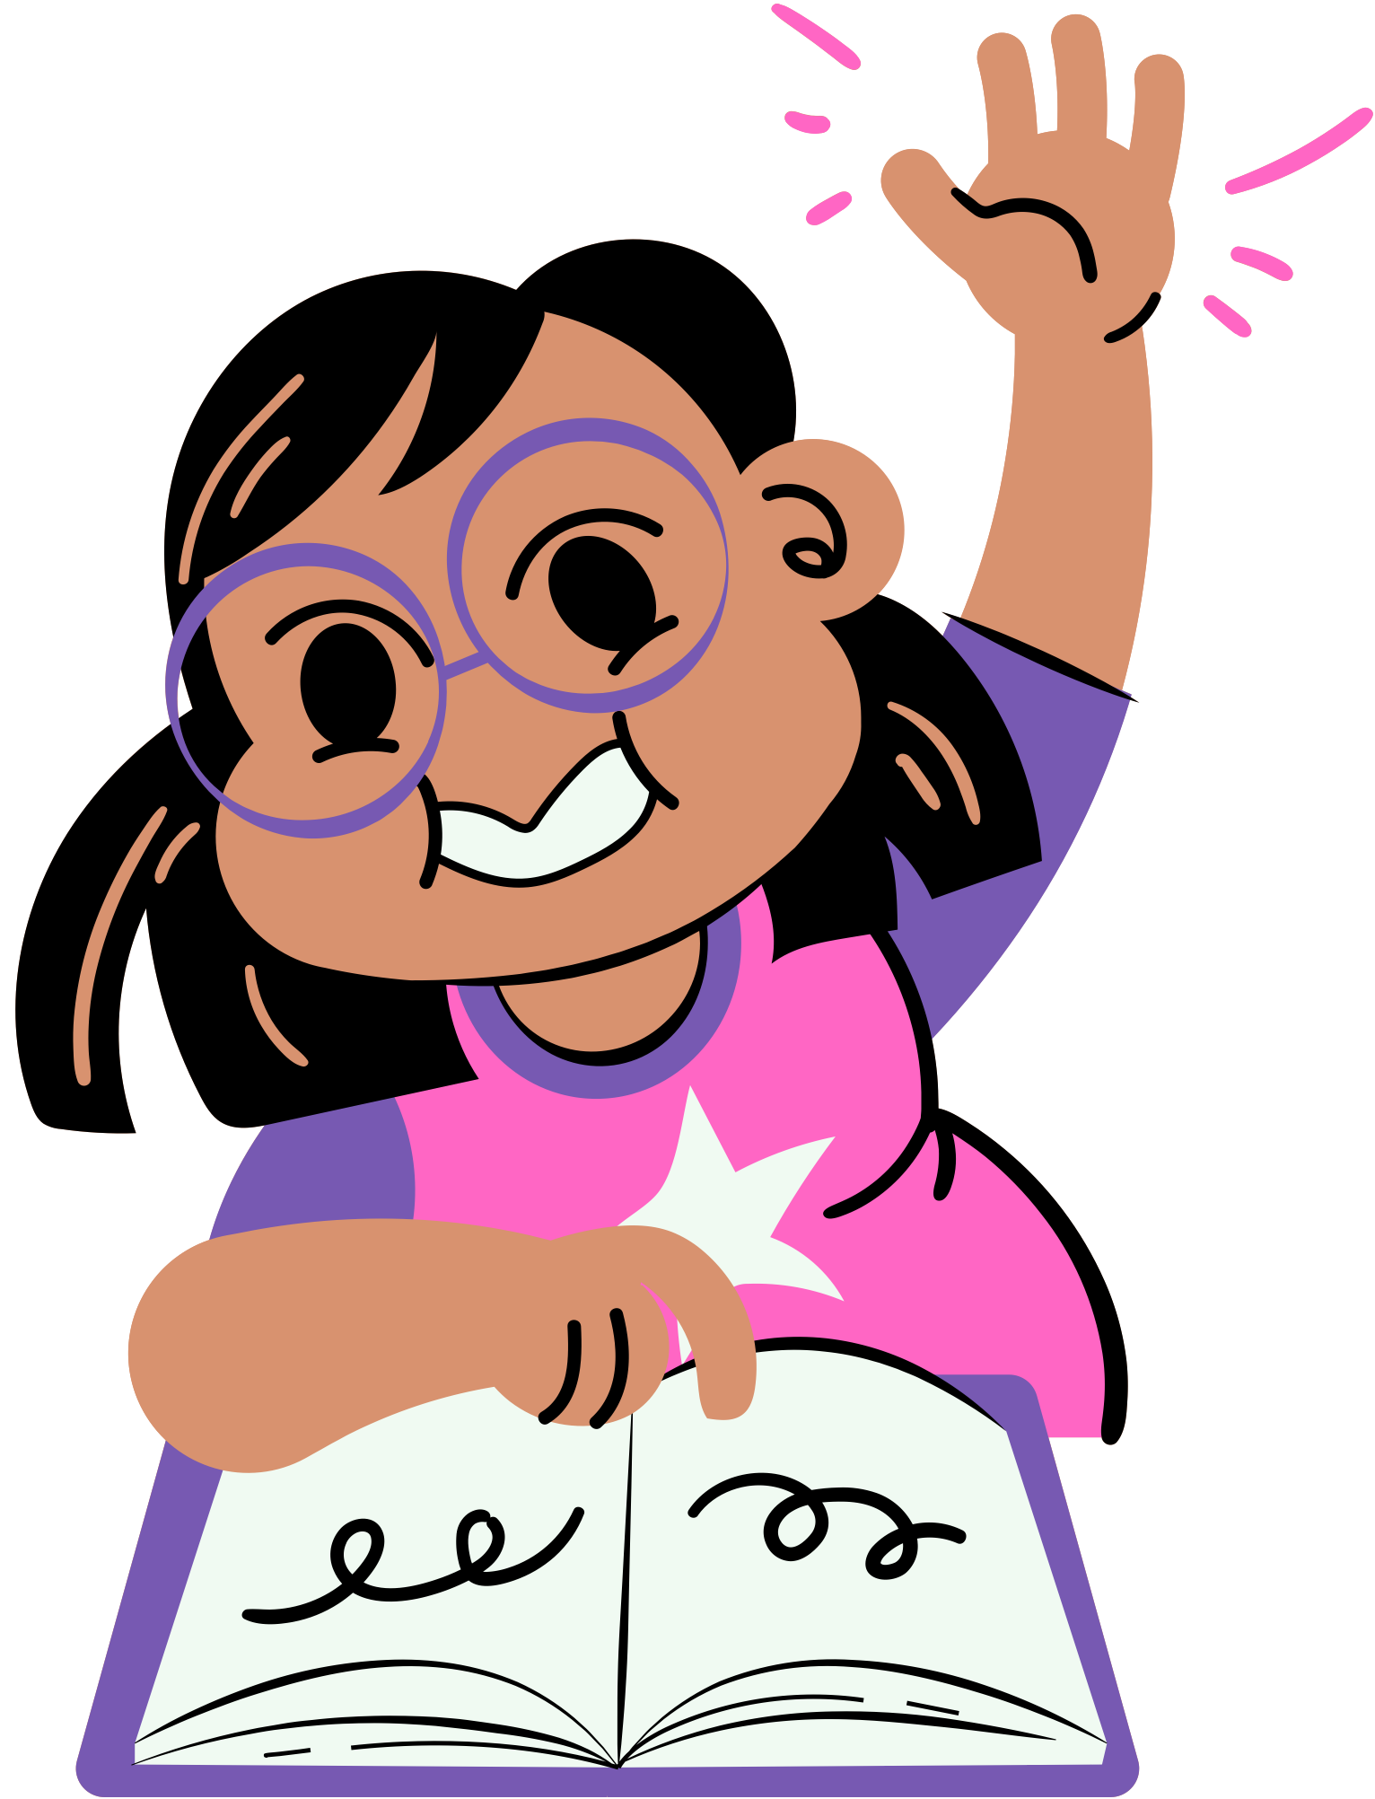

Sample answer
Misleading content is a type of content that frames or presents issues in certain ways, uses cropping photos, and chooses quotes or statistics selectively.

Slide 9











Coordinating conjunctions
Use this mnemonic device to remember the most common conjunctions you
  can use when combining sentences.
for
and
nor
but
or
yet
so

Slide 10




How can these sentences
be connected?
  Coordinating conjunctions are words we can use to combine words, phrases, or clauses that are equally important.
  The Internet is an incredible resource for news and information, but unfortunately not everything online is trustworthy.
  The Internet is an incredible resource for news and information.
  Unfortunately, not everything online is trustworthy.
What possible relationship can be used here?
Connects? Reasons? Opposing Ideas? Choices? Similar Ideas?

Slide 11


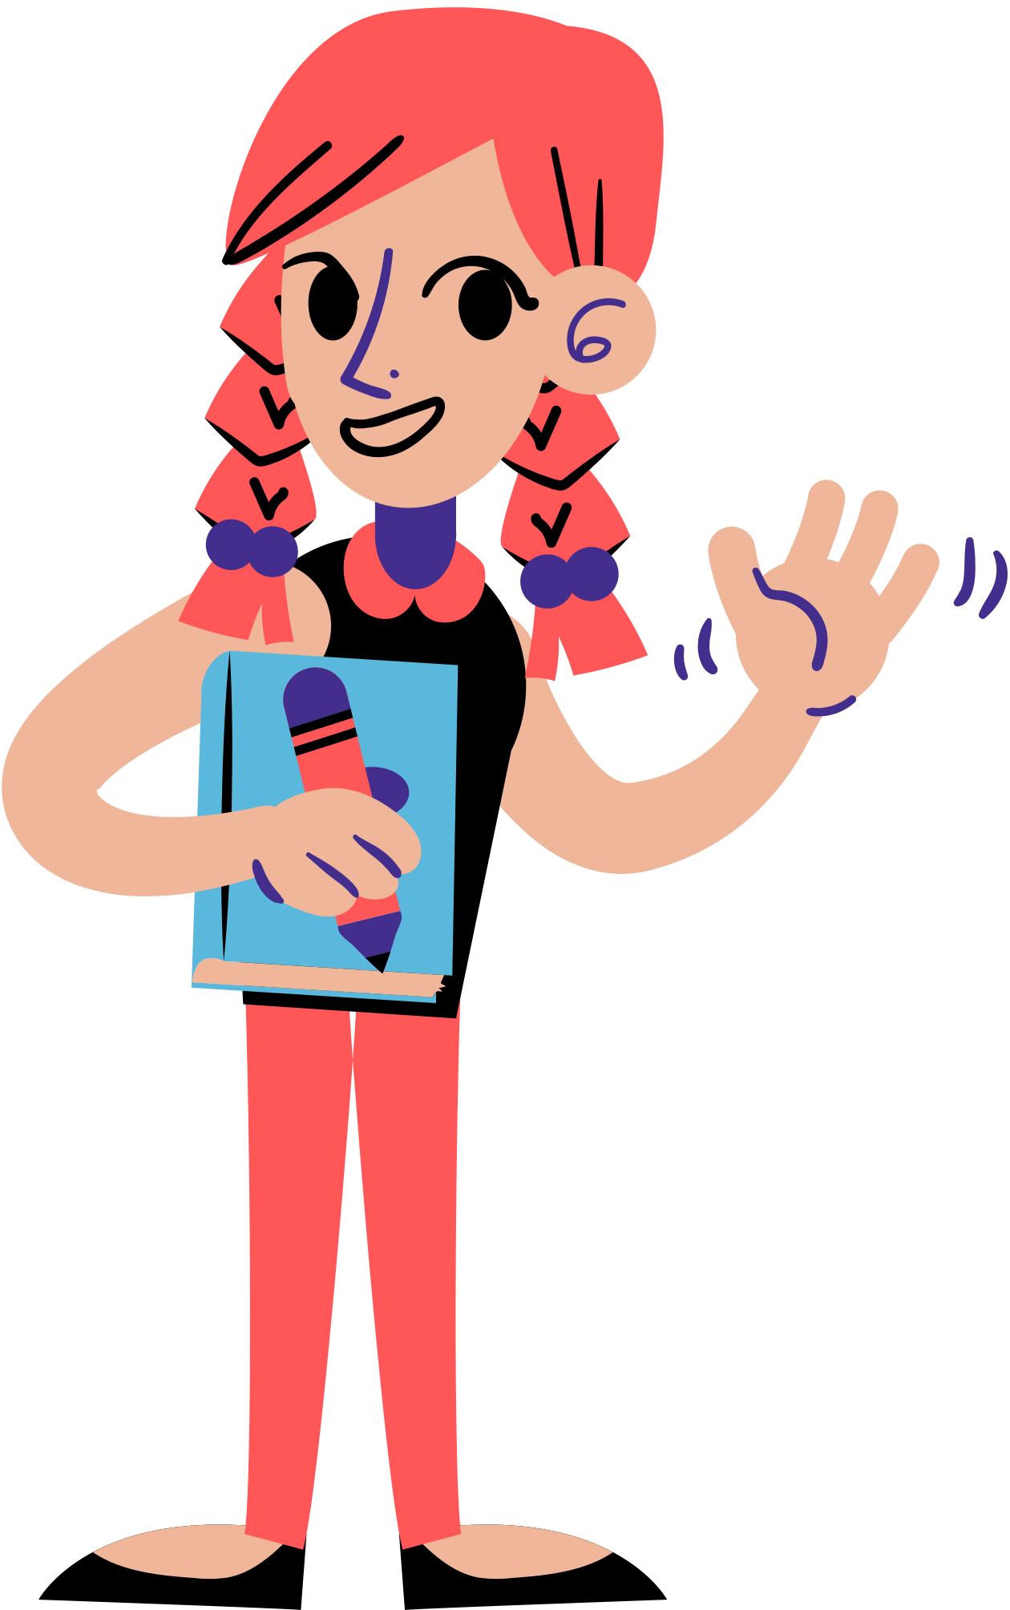


Subordinating conjunctions
  Use this mnemonic device to remember the most common subordinating conjunctions you can use when combining sentences.
A | WH | I | T | E | B | U | S
although as after | whenever wherever when which whereas | if in case in order | that though til | even even though even if | because before | until unless | since

Slide 12



How can these sentences
be connected?
Subordinating conjunctions are words we can use to combine
  dependent and independent clauses.
  Always being connected can cause problems if you do not moderate your screen time and watch out for false information.
  Always being connected can cause problems.
  Moderate your screen time and watch out for false information.
What possible relationship can be used here?
Conditional? Reasons? Opposing Ideas? Choices? Similar Ideas?

Slide 13
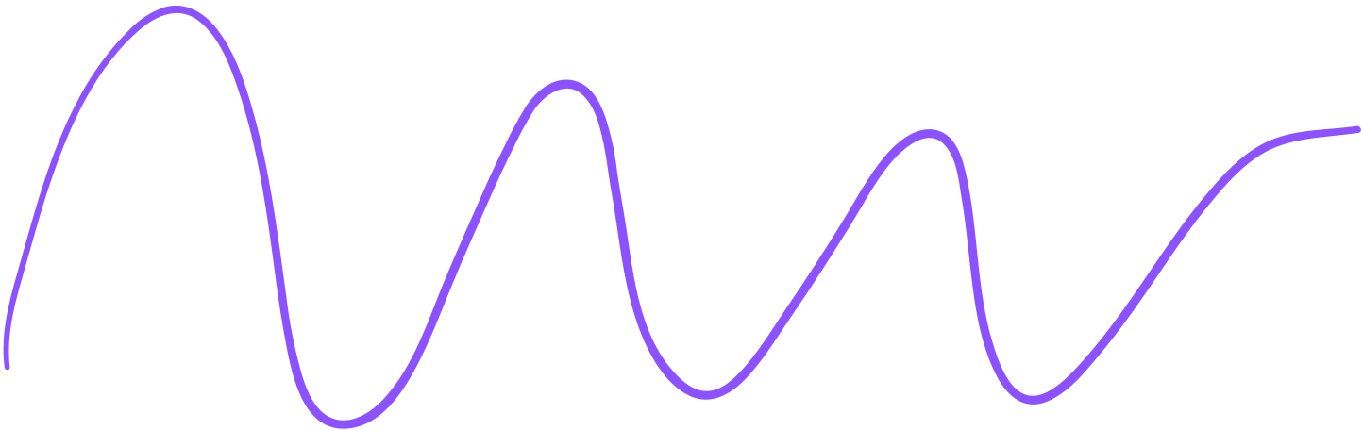

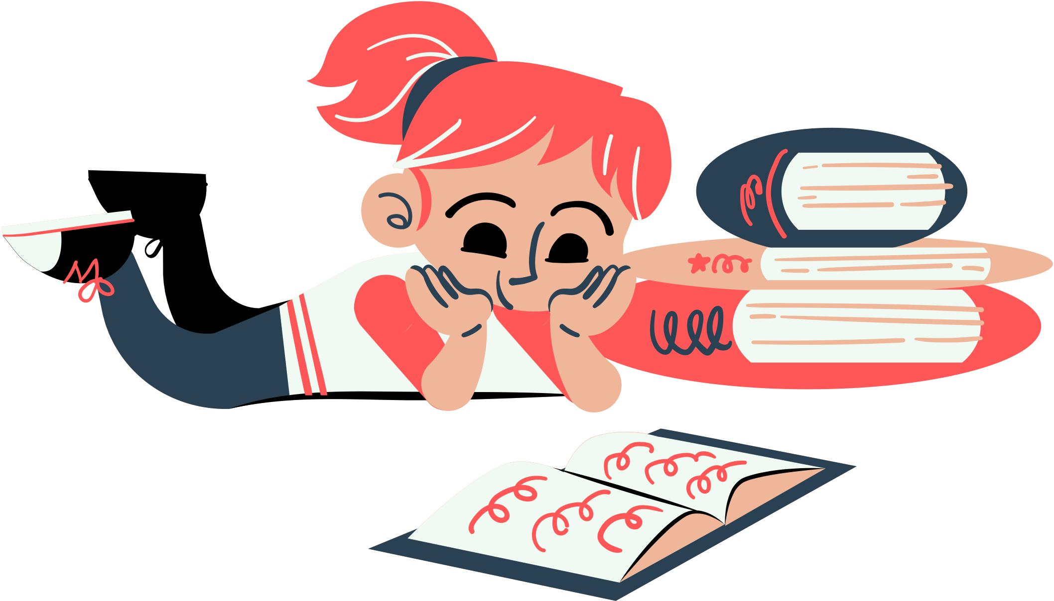


Read and combine
  Everybody who has access to social media can disseminate information anytime, anywhere.
  Not all information shared via social media is accurate, genuine, and reliable.
What single sentence did you come up with?

Slide 14


Possible answers
Everybody who has access to social media can disseminate information anytime, anywhere, but not all information shared via social media is accurate, genuine, and reliable.
Since everybody who has access to social media can disseminate information anytime, anywhere, not all information shared via social media is accurate, genuine, and reliable.

Slide 15




Using appositives to connect ideas
  An appositive is a word, phrase, or clause used to rename or redescribe a nearby noun.
Notice Sentence B explains again the topic in Sentence A.
Sentence A
Sentence B
Satire or parody is a type of misleading information.
It has no intention to harm but
potential to fool.
How do we combine these sentences using an appositive?

Slide 16

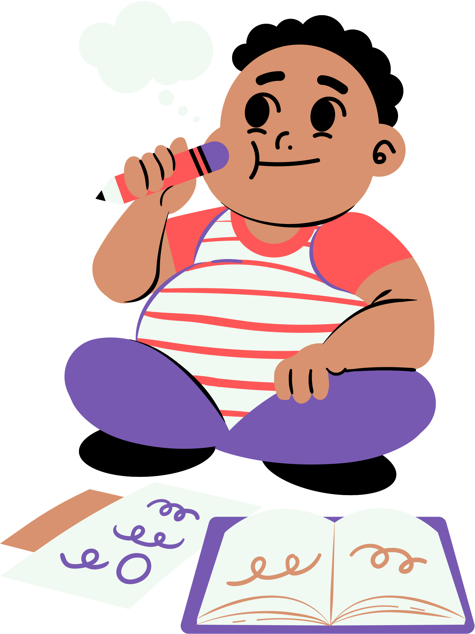



Use appositives by placing commas to add more information on the main topic.
Satire or parody, a type of misleading information, has no intention to harm
but potential to fool.
In this example, the appositive "a type of misleading information" is a phrase that follows the nouns "satire or parody" and provides additional explanation.

Slide 17

Assignment
  Using all your sentence-combining skills, revise and rewrite the following paragraph in a Canva Doc or on a piece of paper without changing its original meaning.
  One must be vigilant in reading news online. You might jump to conclusions believing everything is true. Fake news websites use numerous irrelevant links. These websites may use cropped or incorrect photos. They also use exaggerated claims or suspicious headlines. Some fake news uses old articles and events. Remember fake news is also a form of disinformation that presents false content. It presents fabricated lies and manipulated stories.

Slide 18
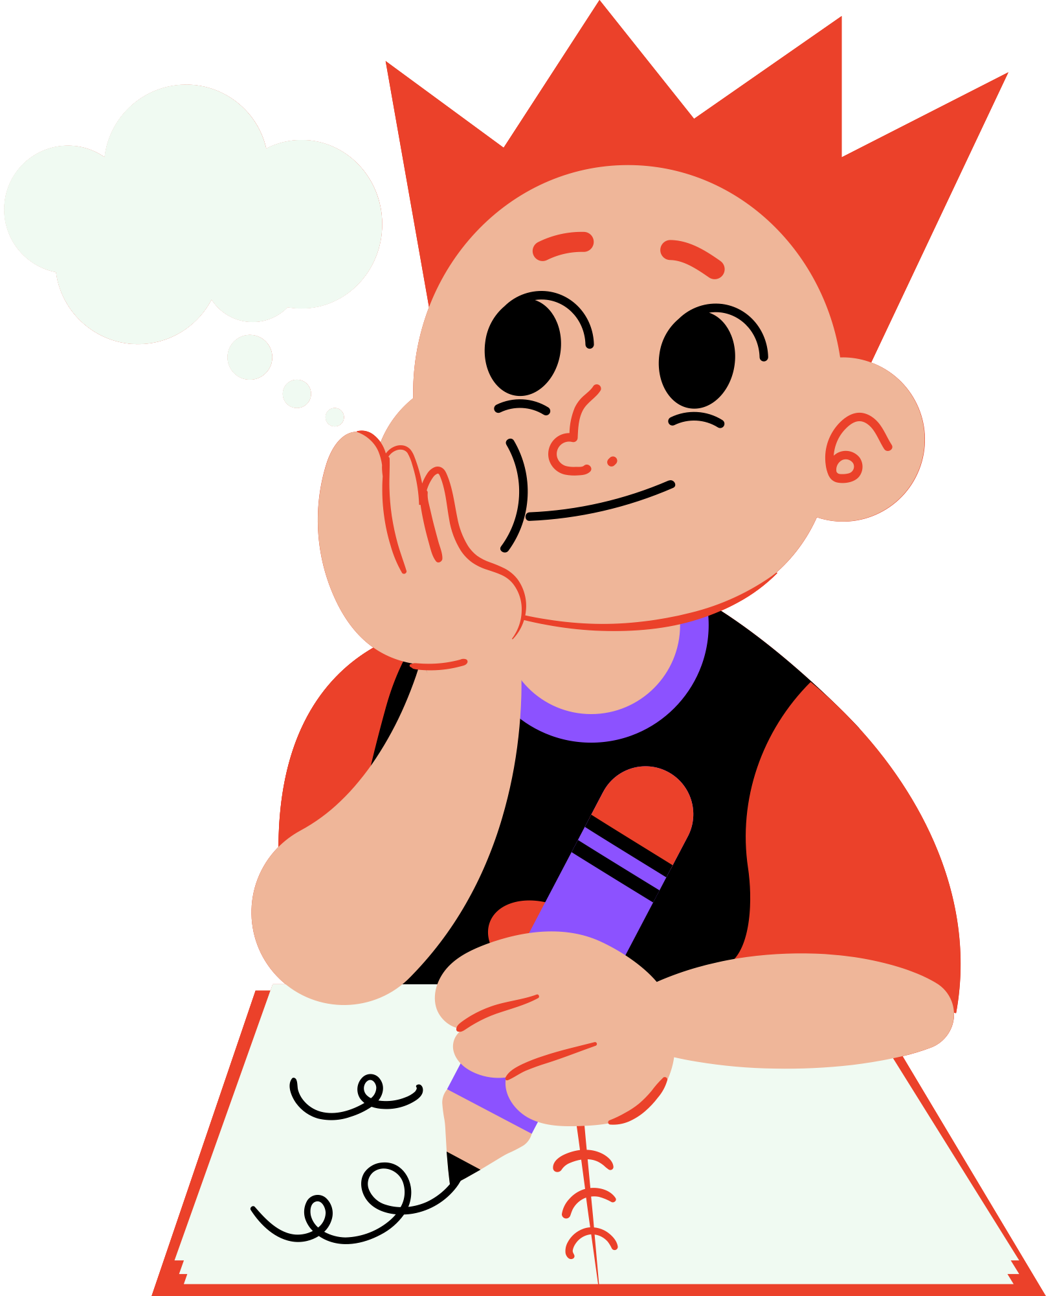
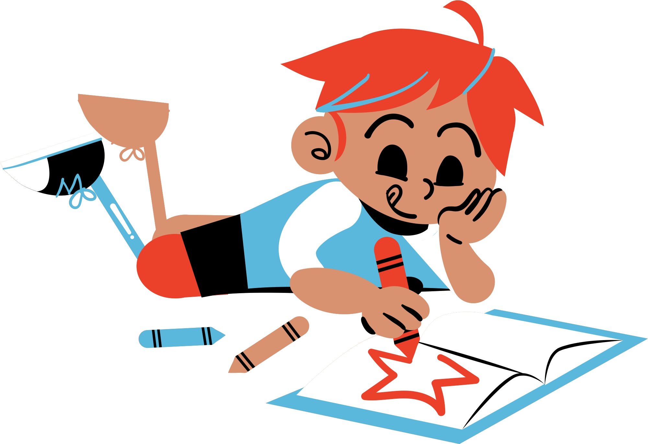

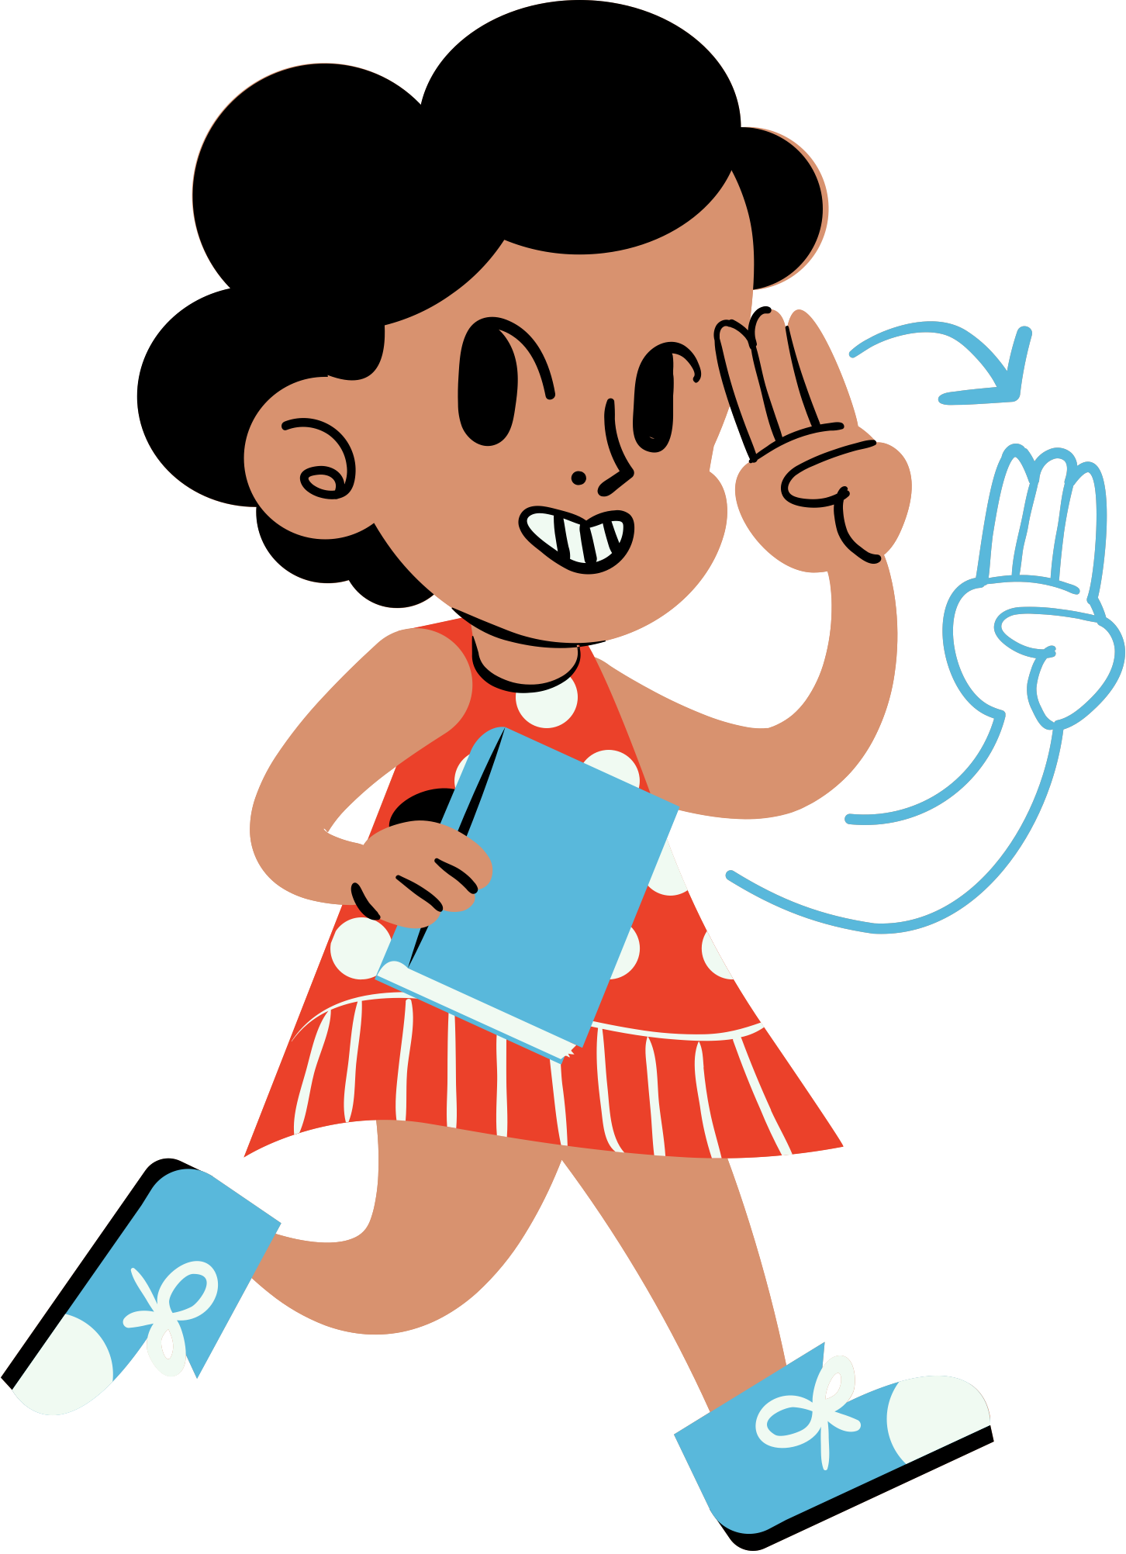

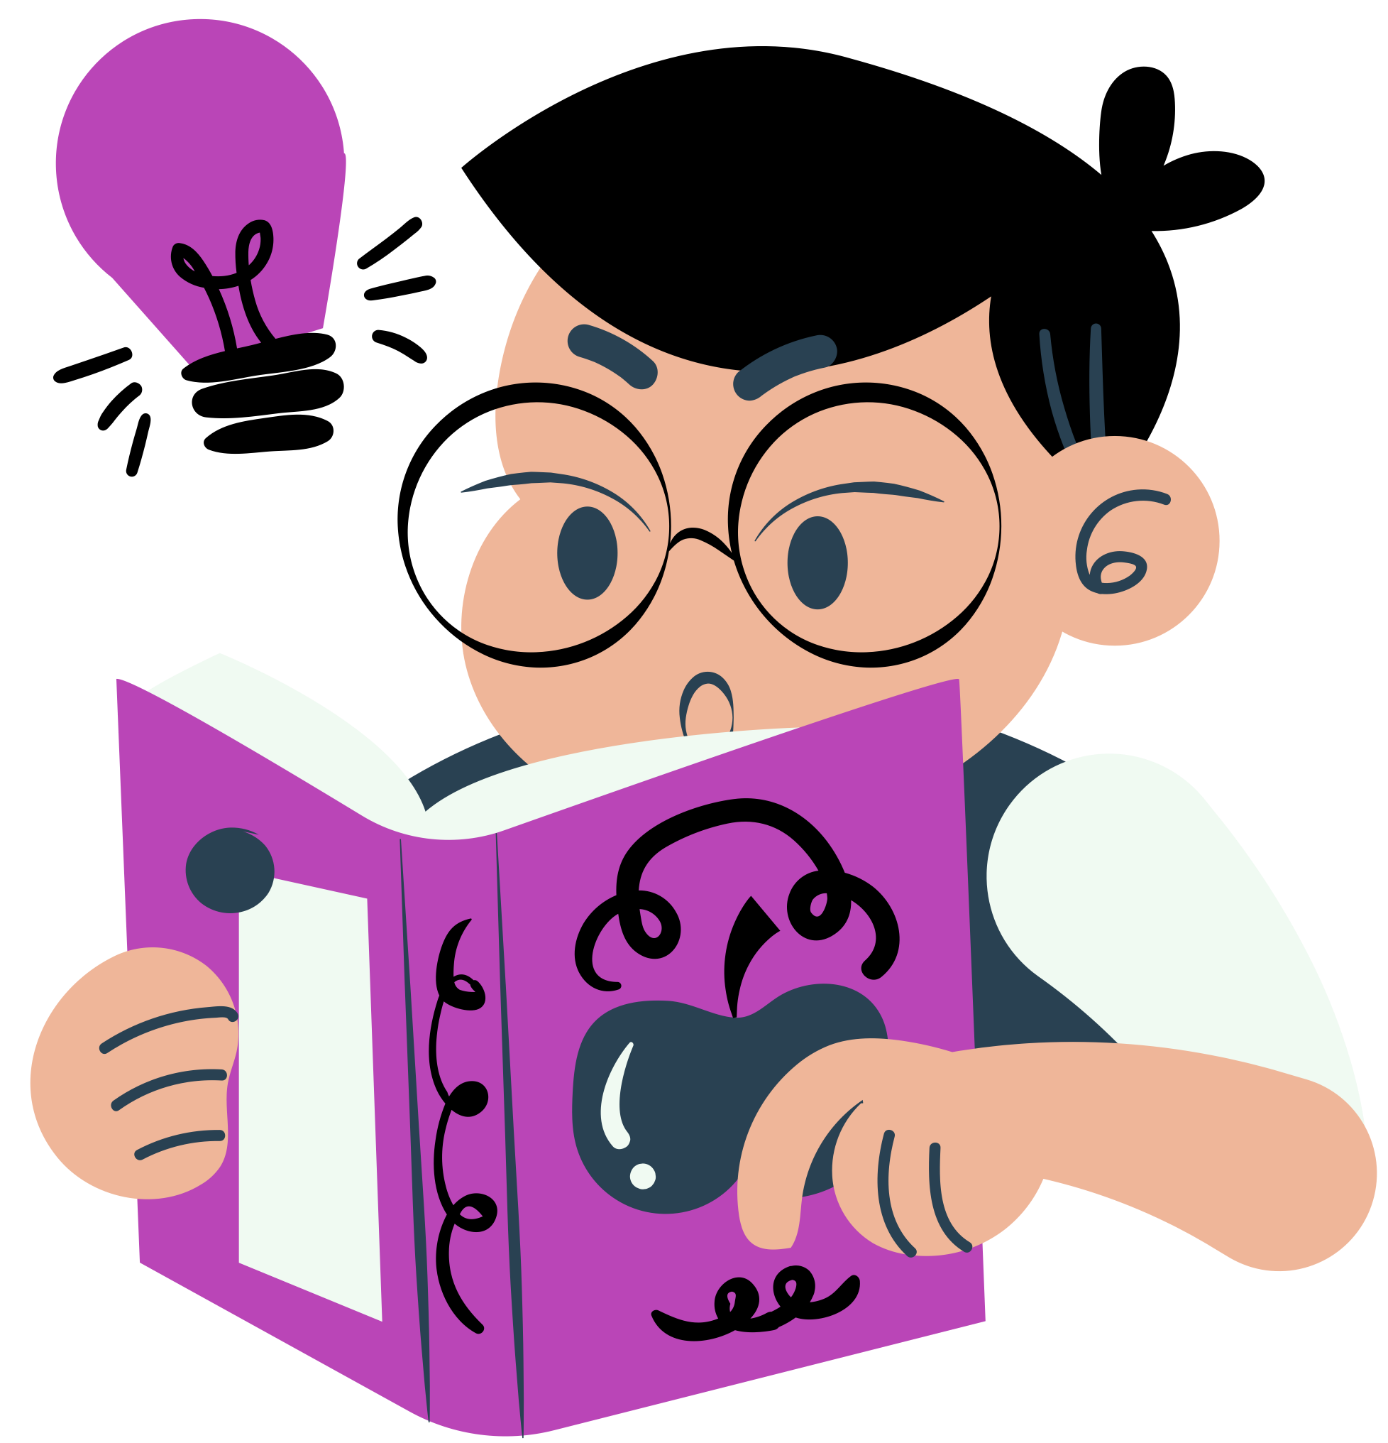


Resource
page
Use these design resources in your Canva Presentation.
You can find these fonts online too. Happy designing!
Don't forget to delete this page before presenting.
This presentation template uses the following free fonts:
  Titles: Shantell Sans
  Headers: Shantell Sans
  Body Copy: Josefin Sans

Slide 19



Credits
This presentation template is free for everyone to use thanks to the following:
SlidesCarnival for the presentation template
Pexels for the photos
Happy designing!

