Slide 1
LOGO COMPANY
ETHICS & VALUES
BOOKLET

Slide 2
LOGO COMPANY
TABLE OF CONTENTS
01
INTRODUCTION
Elaborate on what you want to discuss.
02
CORE ETHICAL PRINCIPLES AND VALUES
Elaborate on what you want to discuss.
03
ETHICAL DECISION-MAKING
Elaborate on what you want to discuss.
04
ETHICS IN DIFFERENT CONTEXTS
Elaborate on what you want to discuss.

Slide 3
LOGO COMPANY
01
INTRODUCTION
To the world of "Nature's Marvels," where we will embark on a captivating journey through the wonders of our planet. From the towering peaks of the Himalayas to the mysterious depths of the ocean, each chapter will unveil the intricate beauty and astounding diversity that make Earth a unique and vibrant home.
In this book, we will explore the delicate balance of ecosystems, the incredible adaptations of flora and fauna, and the awe-inspiring landscapes that have been sculpted over millennia. Whether you're a seasoned naturalist or a curious explorer, "Nature's Marvels" promises to ignite your sense of wonder and deepen your appreciation
for the natural world.

Slide 4
LOGO COMPANY
WHY IS IMPORTANT?
to the world of "Nature's Marvels," where we will embark on a captivating journey through the wonders of our planet. From the towering peaks of the Himalayas to the mysterious depths of the ocean, each chapter will unveil the intricate beauty and astounding diversity that make Earth a unique and vibrant home.
In this book, we will explore the delicate balance of ecosystems, the incredible adaptations of flora and fauna, and the awe-inspiring landscapes that have been sculpted over millennia. Whether you're a seasoned naturalist or a curious explorer, "Nature's Marvels" promises to ignite your sense of wonder and deepen your appreciation for the natural world.
So, prepare to be enchanted by the stories of survival, resilience, and interconnectedness that define life on Earth.
To the world of "Nature's Marvels," where we will embark on a captivating journey through the wonders of our planet. From the towering peaks of the Himalayas to the mysterious depths of the ocean, each chapter will unveil the intricate beauty and astounding diversity that make Earth a unique and vibrant home.

Slide 5
LOGO COMPANY
CORE ETHICAL PRINCIPLES AND VALUES
02

Slide 6
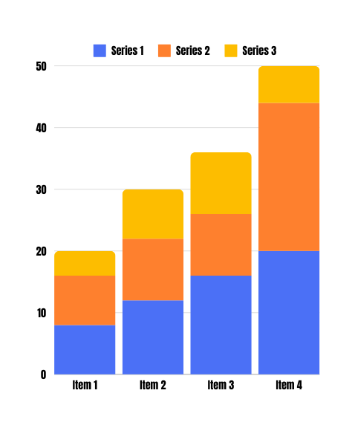
LOGO COMPANY
FACTS AND FIGURES
333,000.000
Stars twinkled in the vast expanse of the night sky, each one a beacon of light in the darkness. The celestial display was a reminder of the infinite wonders of the universe, sparking curiosity and dreams of distant galaxies. Beneath this stellar canopy, a sense of peace and awe enveloped all who gazed upward, connecting them to the timeless beauty of the cosmos.
To the world of "Nature's Marvels," where we will embark on a captivating journey through the wonders of our planet. From the towering peaks of the Himalayas to the mysterious depths of the ocean, each chapter will unveil the intricate beauty and astounding diversity that make Earth a unique and vibrant home today
and always.

Slide 7
LOGO COMPANY
HONESTY AND INTEGRITY
HONESTY
is a virtue that forms the bedrock of trust and integrity in any relationship, whether personal or professional. It is the quality of being truthful, sincere, and transparent in our actions and words. When we embrace honesty, we foster an environment where open communication and mutual respect can thrive.
INTEGRITY
is a virtue that forms the bedrock of trust and integrity in any relationship, whether personal or professional. It is the quality of being truthful, sincere, and transparent in our actions and words. When we embrace honesty, we foster an environment where open communication and mutual respect can thrive.

Slide 8
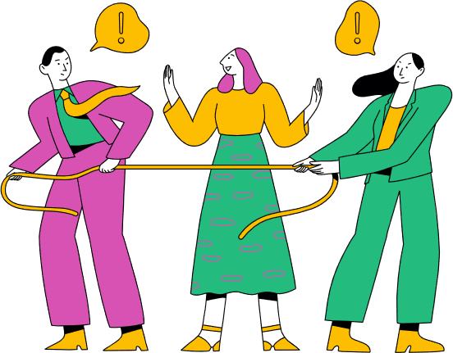
RESPECT AND FAIRNESS
Stars twinkled in the vast expanse of the night sky, each one a beacon of light in the darkness. The celestial display was a reminder of the infinite wonders of the universe, sparking curiosity and dreams of distant galaxies. Beneath this stellar canopy, a sense of peace and awe enveloped all who gazed upward, connecting them to the timeless beauty of the cosmos.
Stars twinkled in the vast expanse of the night sky, each one a beacon of light in the darkness. The celestial display was a reminder of the infinite wonders of the universe, sparking curiosity and dreams of distant galaxies. Beneath this stellar canopy, a sense of peace and awe enveloped all who gazed upward, connecting them to the timeless beauty of the cosmos.
Stars twinkled in the vast expanse of the night sky, each one a beacon of light in the darkness. The celestial display was a reminder of the infinite wonders of the universe, sparking curiosity and dreams of distant galaxies. Beneath this stellar canopy, a sense of peace

Slide 9
LOGO COMPANY
MISCONCEPTIONS
CONCEPT 1
CONCEPT 2
Stars twinkled in the vast expanse of the night sky, each one a beacon of light in the darkness.
Stars twinkled in the vast expanse of the night sky, each one a beacon of light in the darkness.
CONCEPT 3
CONCEPT 4
Stars twinkled in the vast expanse of the night sky, each one a beacon of light in the darkness.
Stars twinkled in the vast expanse of the night sky, each one a beacon of light in the darkness.
CONCEPT 5
CONCEPT 6
Stars twinkled in the vast expanse of the night sky, each one a beacon of light in the darkness.
Stars twinkled in the vast expanse of the night sky, each one a beacon of light in the darkness.

Slide 10
LOGO COMPANY
ETHICAL DECISION-MAKING
In practice, ethical decision-making often includes several steps: identifying the ethical issue, gathering relevant information, evaluating the alternatives, making a decision, and reflecting on the process and its outcomes. It's essential to remain open to diverse perspectives and to seek advice or counsel when faced with challenging dilemmas.

Slide 11
LOGO COMPANY
THE ETHICAL DECISION-MAKING PROCESS
PROCESS
PROCESS
Elaborate on what you want to discuss.
Elaborate on what you want to discuss.
PROCESS
PROCESS
Elaborate on what you want to discuss.
Elaborate on what you want to discuss.

Slide 12
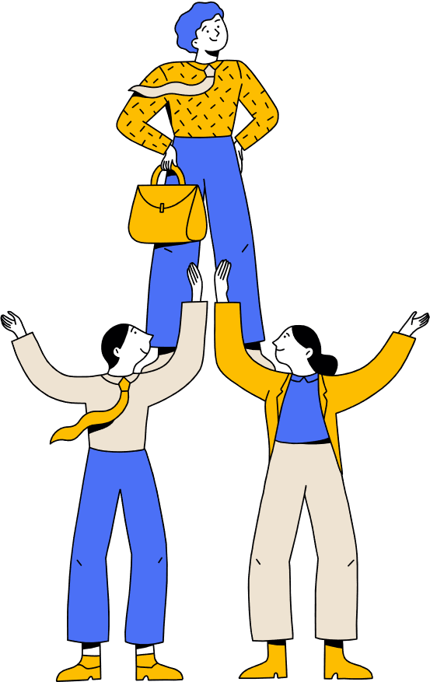
LOGO COMPANY
THE ETHICAL DECISION-MAKING PROCESS
MAKING PROCESS
Stars twinkled in the vast expanse of the night sky, each one a beacon of light in the darkness.
MAKING PROCESS
Stars twinkled in the vast expanse of the night sky, each one a beacon of light in the darkness.
MAKING PROCESS
Stars twinkled in the vast expanse of the night sky, each one a beacon of light in the darkness.

Slide 13
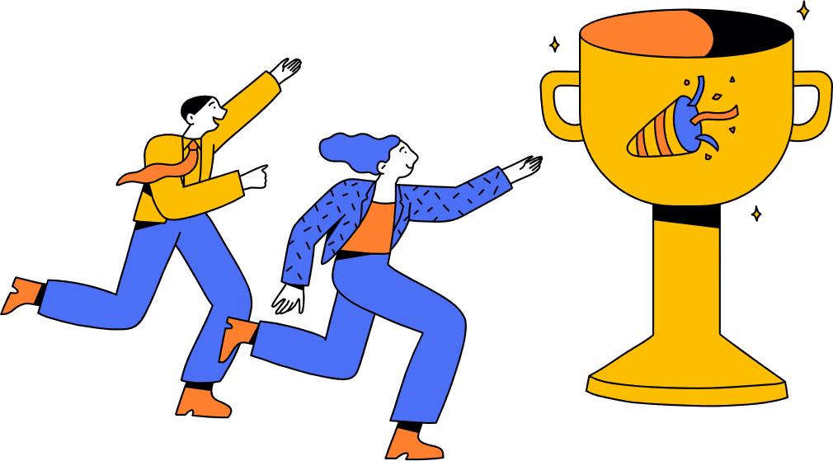
LOGO COMPANY
CONTACT US
123 Anywhere St., Any City,ST 12345
123-456-7890
hello@reallygreatsite.com
@reallygreatsite
reallygreatsite.com

Slide 14
RESOURCE
PAGE
This presentation template uses the following free fonts:
Use these design resources in your Canva Presentation.
You can find these fonts online too. Happy designing!
Don't forget to delete this page before presenting.
Titles: Anton
Headers: Anton
Body Copy: Arimo

Slide 15
CREDITS
This presentation template is free for everyone to use thanks to the following:
SlidesCarnival for the presentation template
Pexels for the photos
HAPPY DESIGNING!

