Slide 1
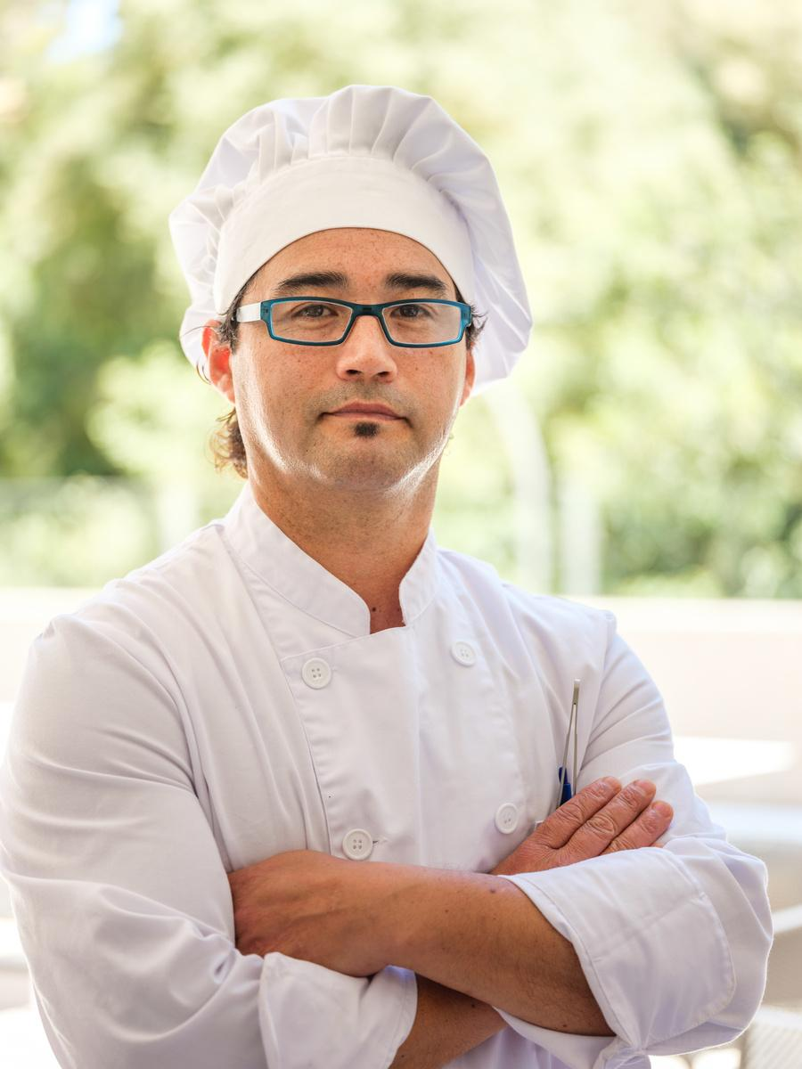











Hello! I am
KEVIN DY CHENG
EXECUTIVE CHEF
A culinary enthusiast with a deep love for creating unforgettable meals. With over 10 years of experience, I blend traditional methods with a modern twist. My passion for quality drives me to source the freshest ingredients and meticulously craft each dish to perfection.
123-456-7890
chefname@email.com
123 Anywhere St., Any City
EDUCATIONAL BACKGROUND
Culinary University
Upper East High
Hawkins Academy
Degree in Culinary Arts
High School
Grade School
2012 - 2016
2008 - 2012
2002 - 2008
WORK EXPERIENCE
SKILLS
Executive Chef
Soleil Hotel & Casino
(2020 - Present)
Menu Development & Innovation
Culinary Techniques & Presentation
Oversee daily kitchen operations, ensuring high standards of food quality, presentation, and safety.
Food Safety &
Sanitation
Kitchen Management & Leadership
Sous Chef
Wesley Hotel & Casino
(2016-2018)
Customer Service & Satisfaction
Assisted the Executive Chef in food menu development and kitchen management.
LANGUAGE
9/10
9.5/10
9.5/10
Chef de Partie
Morgana Hotel & Casino
(2018-2020)
English
French
Spanish
Collaborated with the culinary team to execute high-volume service during peak hours.
9/10
10/10
10/10
Japanese
Korean
Mandarin

Slide 2





EDUCATION HISTORY
International Culinary University
Degree in Culinary Arts
2012-2016
WORK EXPERIENCE
Executive Chef | Soleil Hotel & Casino (2020-Present)
Oversee daily kitchen operations, ensuring high standards of food quality, presentation, and safety.
Lead a team of [X] chefs and kitchen staff, providing training and guidance to maintain consistency and excellence.
KEVIN DY
CHENG
Sous Chef | Wesley Hotel & Casino (2018-2020)
Assisted the Executive Chef in menu development and kitchen management.
Supervised kitchen staff, ensuring efficient workflow and adherence to recipes.
EXECUTIVE CHEF
ABOUT ME
Chef de Partie | Morgana Hotel & Casino (2016-2018)
A culinary enthusiast with a deep love for creating unforgettable meals. With over 10 years of experience, I blend traditional methods with a modern twist. My passion for quality drives me to source the freshest ingredients and meticulously craft each dish to perfection. Cooking is more than just a profession for me; it’s an art form that I’m dedicated to mastering every day.
Specialized in [specific station, e.g., grill, pastry, etc.], preparing and presenting dishes with precision.
Collaborated with the culinary team to execute high-volume service during peak hours.
SKILLS
Menu Development & Innovation
Kitchen Management & Leadership
CONTACT
Culinary Techniques & Presentation
Inventory Management & Cost Control
123-456-7890
chefname@email.com
123 Anywhere St., Any City
Food Safety &
Sanitation
Customer Service & Satisfaction

Slide 3

KEVIN DY
CHENG
EXECUTIVE CHEF
A culinary enthusiast with a deep love for creating unforgettable meals. With over 10 years of experience, I blend traditional methods with a modern twist. My passion for quality drives me to source the freshest ingredients and meticulously craft each dish to perfection.
123-456-7890
chefname@email.com
123 Anywhere St., Any City
EXPERIENCE
Executive Chef
Soleil Hotel & Casino
(2020 - Present)
EDUCATION
International Culinary
University
Oversee daily kitchen operations, ensuring high standards of food quality, presentation, and safety.
Degree in Culinary Arts
2012 - 2016
Sous Chef
Wesley Hotel & Casino
(2016-2018)
SKILLS
Assisted the Executive Chef in food menu development and kitchen management.
Menu Development & Innovation
Culinary Techniques & Presentation
Food Safety &
Sanitation
Chef de Partie
Morgana Hotel & Casino
(2018-2020)
Kitchen Management & Leadership
Collaborated with the culinary team to execute high-volume service during peak hours.
Customer Service & Satisfaction

Slide 4







































RESOURCE PAGE
Use these design resources in your Canva Presentation.
Fonts
This presentation template
uses the following free fonts:
TITLES:
XP VOSTA
BODY COPY:
POPPINS
You can find these fonts online too.
Design Elements

Slide 5

CREDITS
This presentation template is free for everyone to use
thanks to the following:
for the presentation template
Pexels, Pixabay
for the photos
HAPPY DESIGNING!

