Slide 1
PARIS
P
Themed Slides

Slide 2
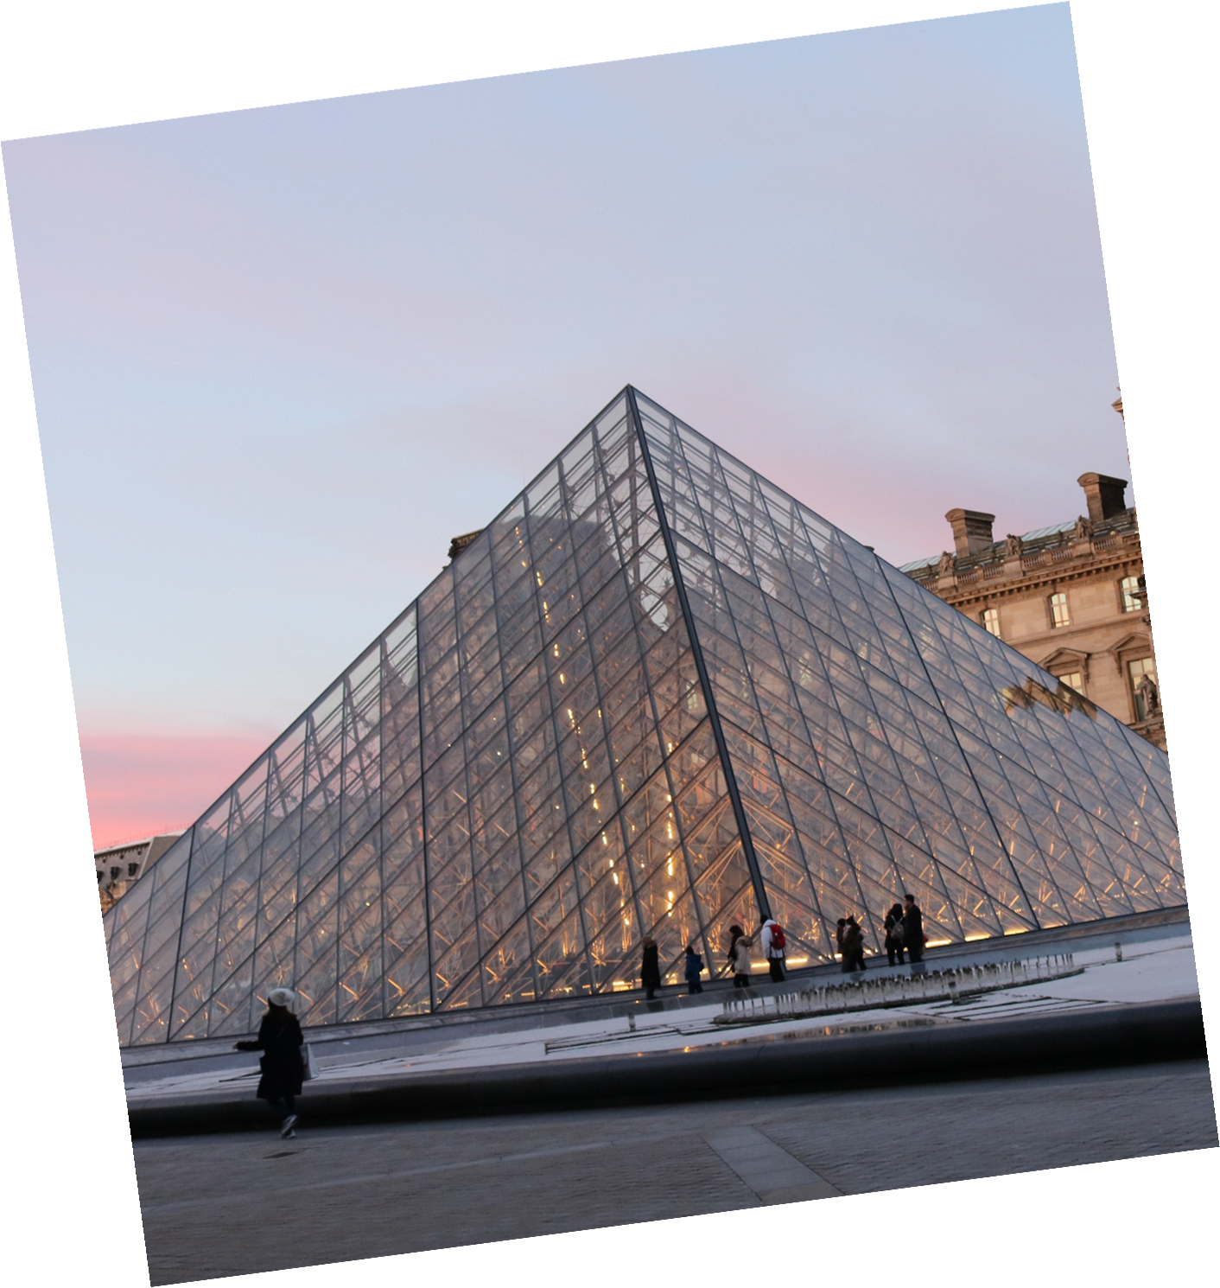
AGENDA
PAGE
Bonjour
01. Introduction
02. Exploring Paris
03. Cultural Highlights
04. Romantic Paris

Slide 3
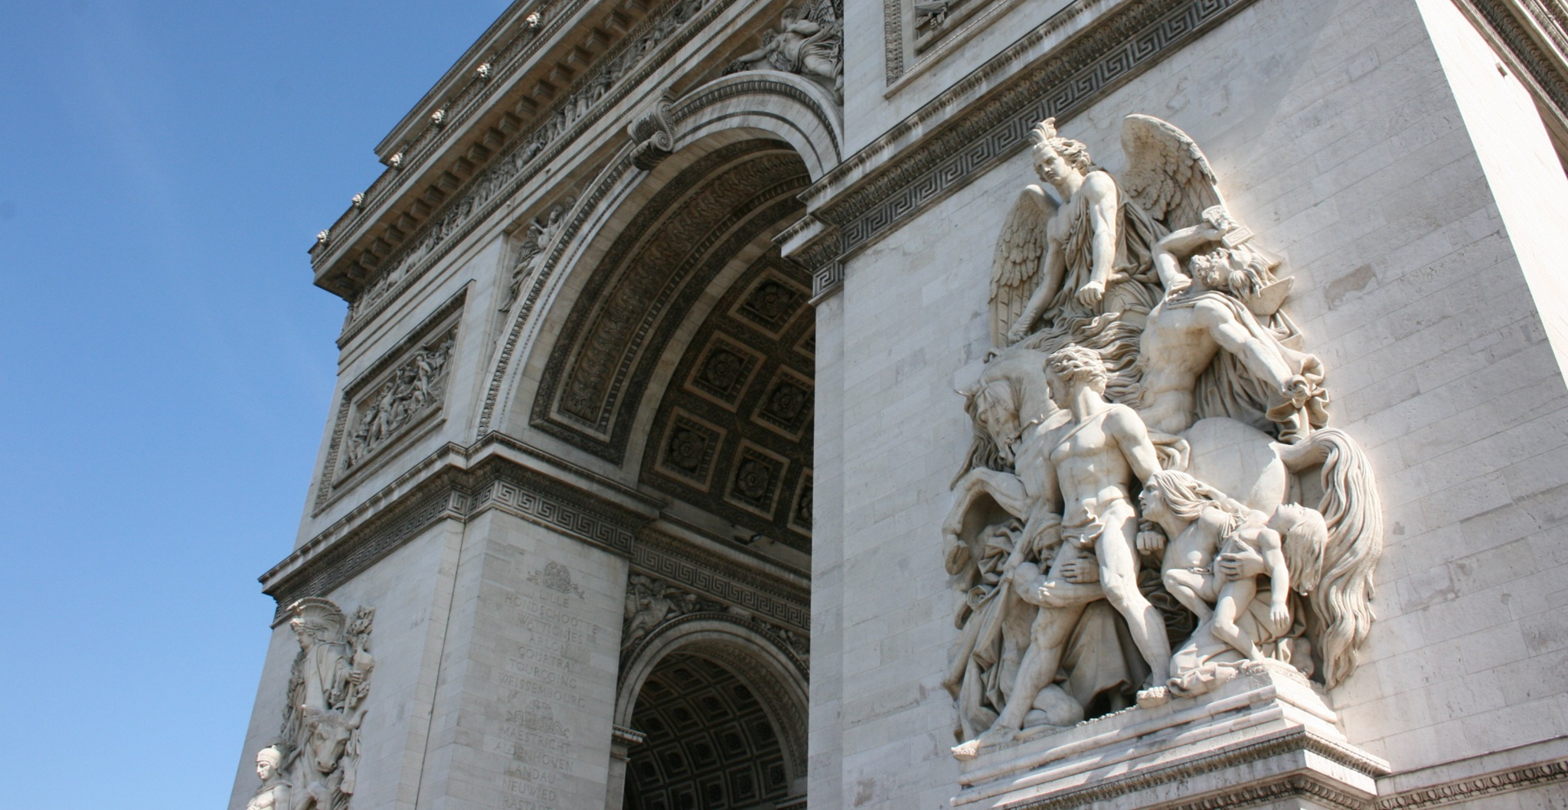
01.
INTRODUCTION

Slide 4
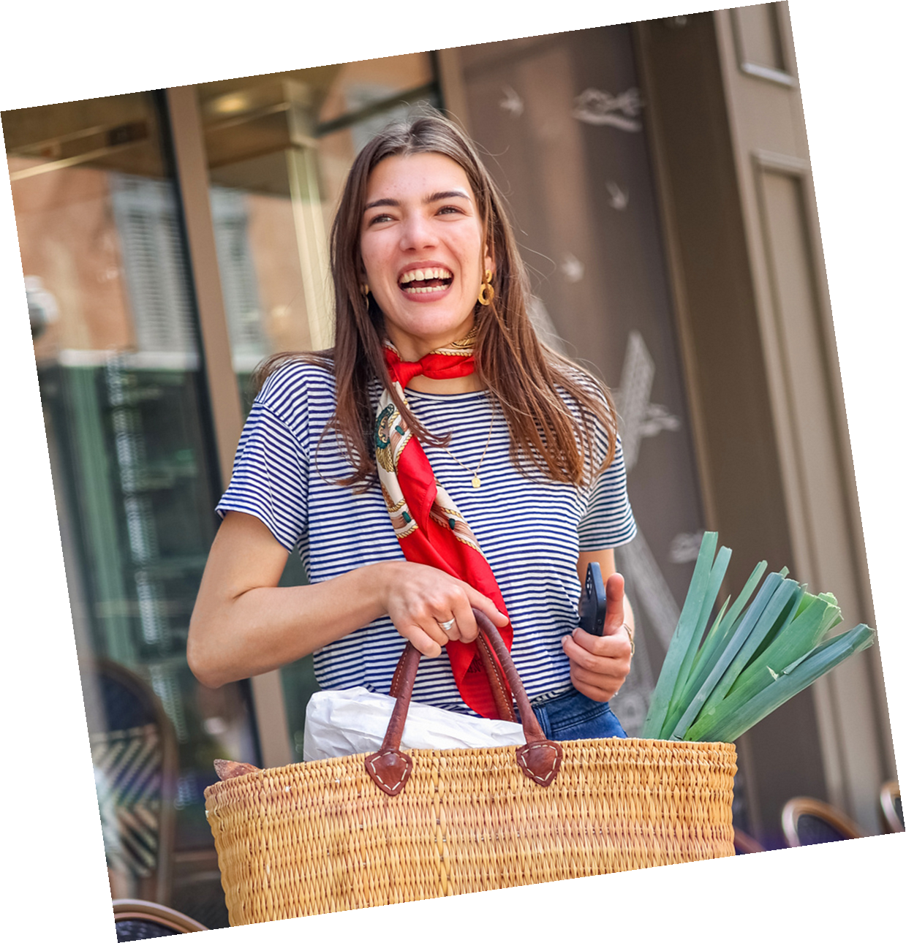
BONJOUR!
and Welcome to Our
Paris-Themed Presentation!
In this journey, we will explore the timeless charm and vibrant modernity of Paris. From its iconic landmarks to its rich cultural tapestry, Paris offers an unparalleled experience that captivates the hearts of millions.

Slide 5
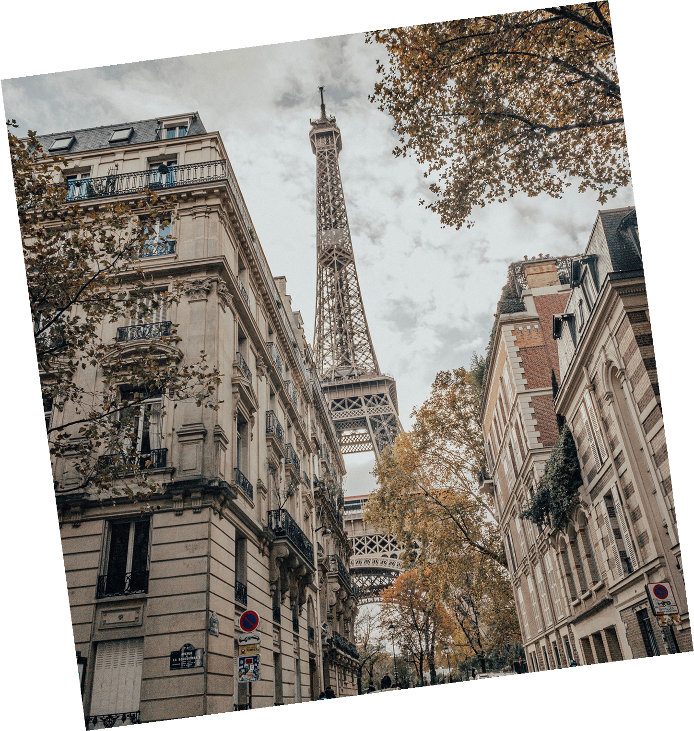
THE
MAGICAL
PARIS
Whether you're a history buff, a foodie, or a fashionista, Paris has something thrilling for everyone. We'll take you on a whirlwind tour of chic boutiques, mouthwatering patisseries, and cutting-edge galleries. Discover the hidden gems and hotspots that make Paris a hub of creativity and excitement. Let's dive into the pulse of this dynamic city and uncover what makes it a timeless favorite and a modern marvel.
Get Ready to Fall in Love with Paris!

Slide 6
02.
EXPLORING PARIS

Slide 7
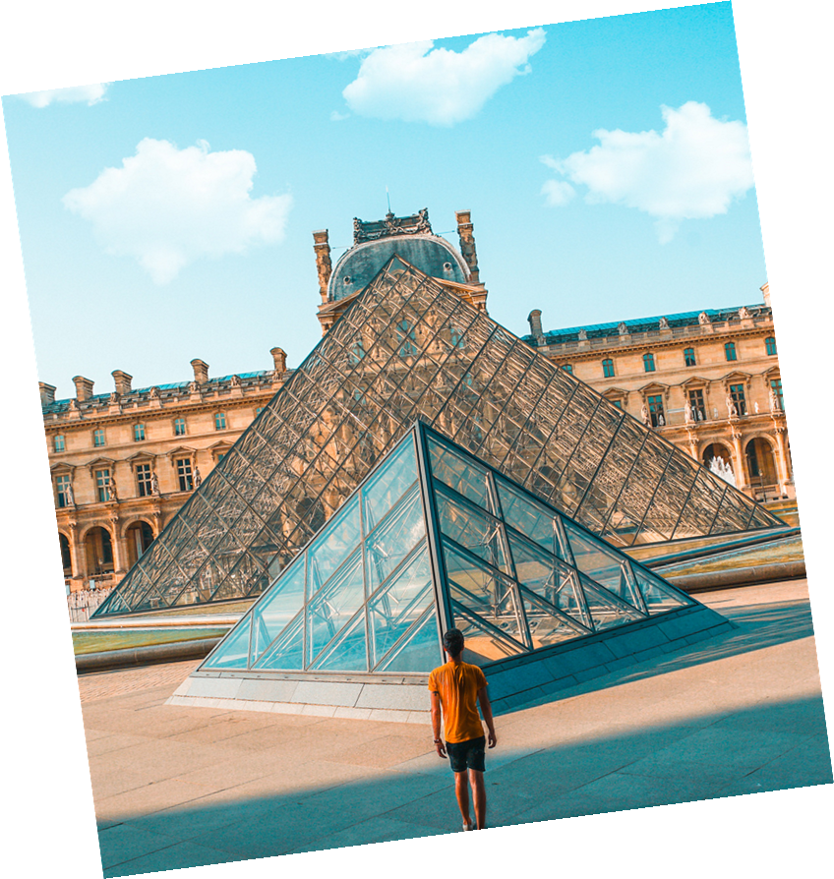
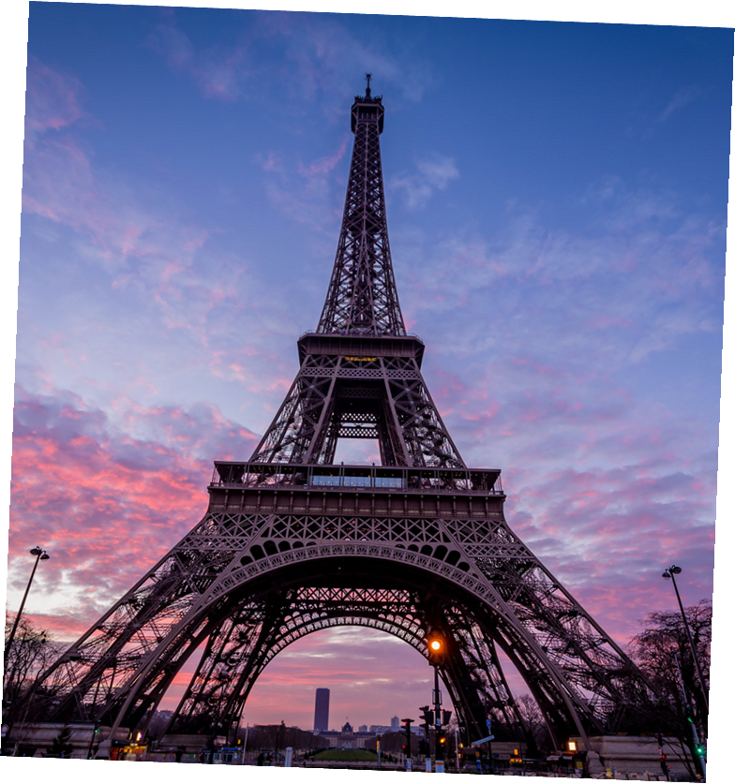
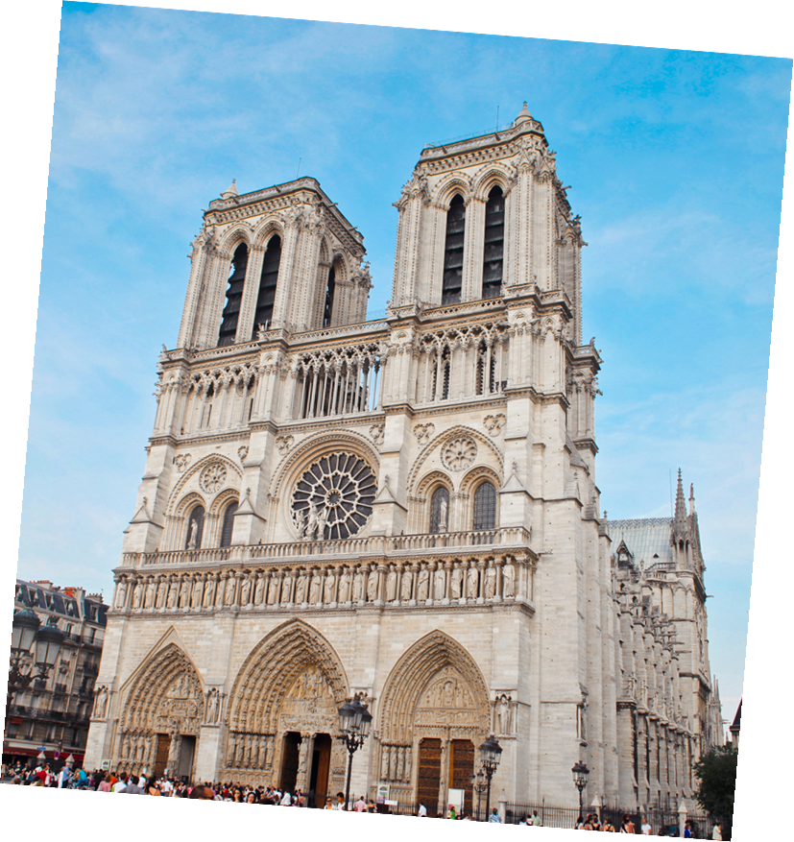
Main Point
Main Point
Main Point
Sed quam purus, egestas et volutpat ac, tempus sit amet arcu. Quisque id fermentum leo, et imperdiet enim. Fusce eget imperdiet elit, vitae mollis nisl. Sed eu dapibus nibh, in luctus ex.
Sed quam purus, egestas et volutpat ac, tempus sit amet arcu. Quisque id fermentum leo, et imperdiet enim. Fusce eget imperdiet elit, vitae mollis nisl. Sed eu dapibus nibh, in luctus ex.
Sed quam purus, egestas et volutpat ac, tempus sit amet arcu. Quisque id fermentum leo, et imperdiet enim. Fusce eget imperdiet elit, vitae mollis nisl. Sed eu dapibus nibh, in luctus ex.

Slide 8
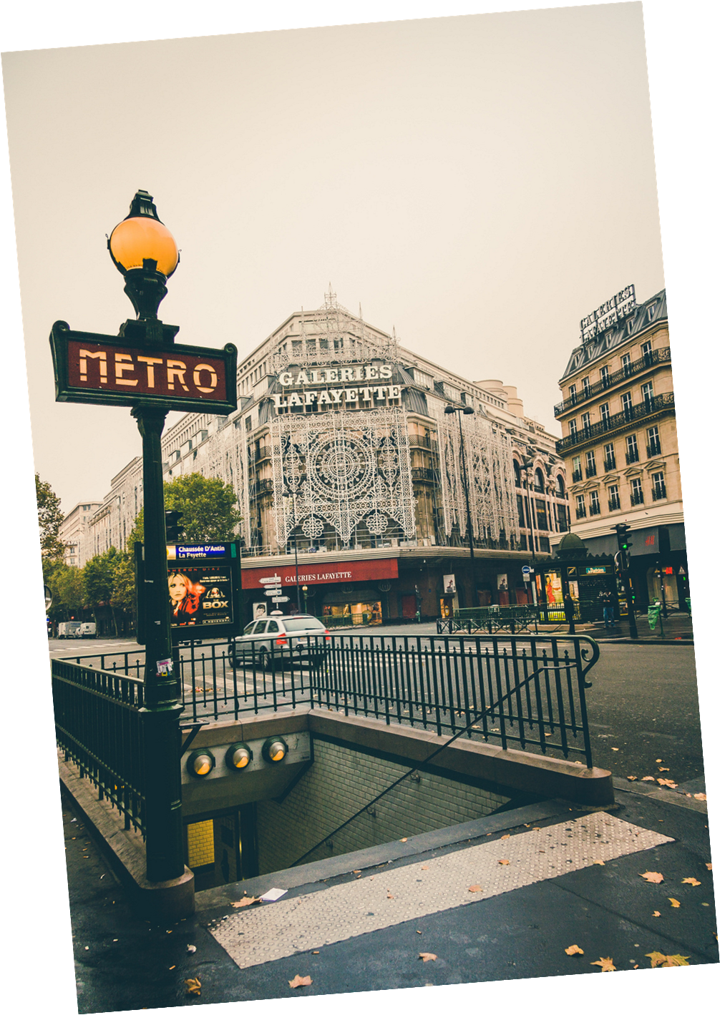
Main Point:
Suspendisse nec rhoncus ex, eget dolor. Duis iaculis nec ante vestibulum convallis.
Main Point:
Suspendisse nec rhoncus ex, eget dolor. Duis iaculis nec ante vestibulum convallis.
Main Point:
Suspendisse nec rhoncus ex, eget dolor. Duis iaculis nec ante vestibulum convallis.
The iconic Paris Metro signs, designed by Hector Guimard, are inspired by the Art Nouveau movement.
Main Point:
Suspendisse nec rhoncus ex, eget dolor. Duis iaculis nec ante vestibulum convallis.

Slide 9
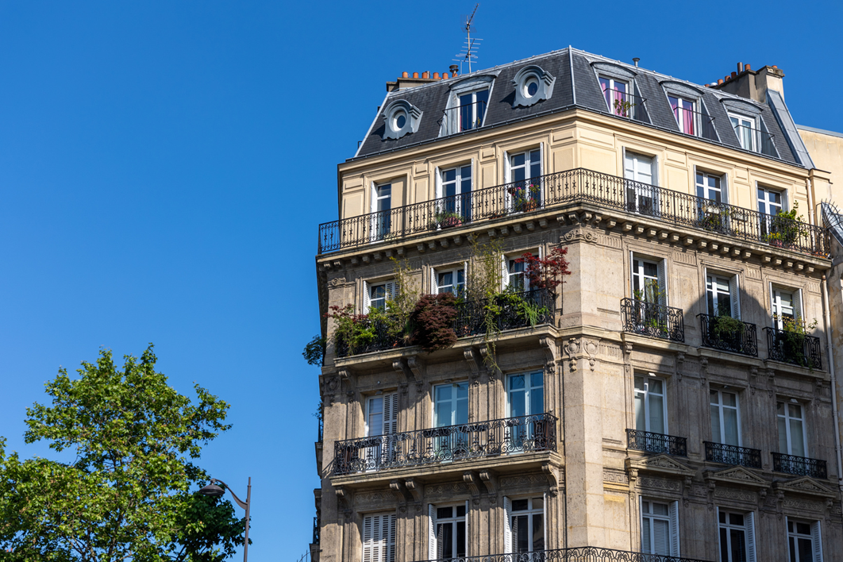
CHARMING NEIGHBORHOODS
Discover the unique charm of Paris' diverse neighborhoods. Montmartre, with its bohemian vibe, is a haven for artists and home to the stunning Sacré-Cœur Basilica. The narrow, winding streets are lined with quaint cafés and galleries, capturing the spirit of old-world Paris. This neighborhood's artistic heritage and panoramic views make it a must-visit.
The Latin Quarter is renowned for its lively atmosphere, narrow streets, and the prestigious Sorbonne University, making it a vibrant cultural and intellectual hub. Together, these neighborhoods showcase the eclectic and enchanting essence of Paris.

Slide 10
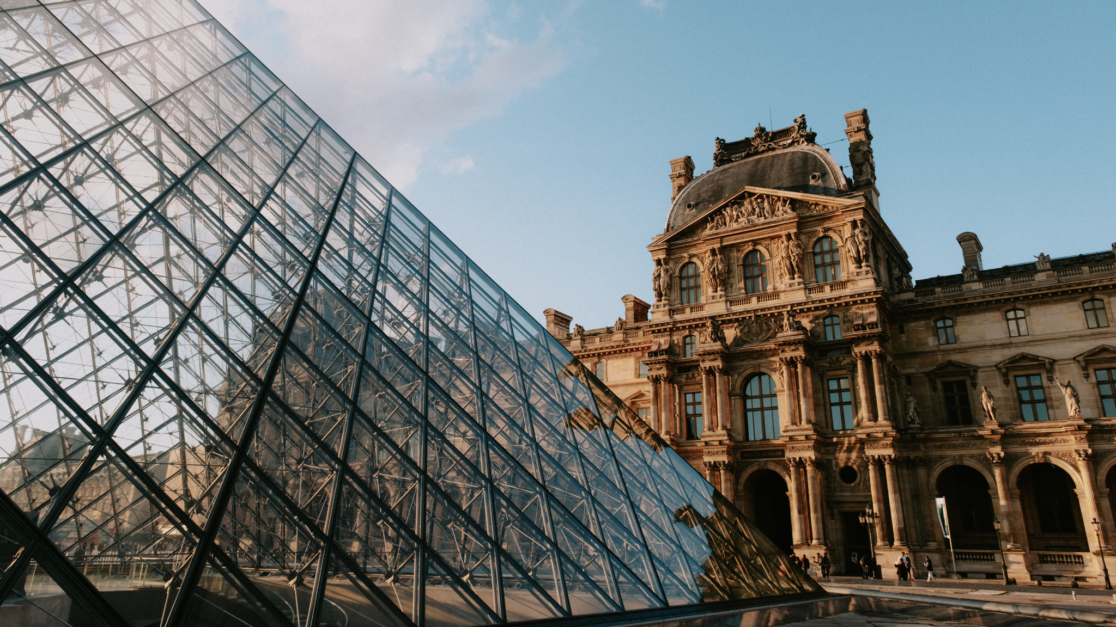
03.
CULTURAL HIGHLIGHTS

Slide 11
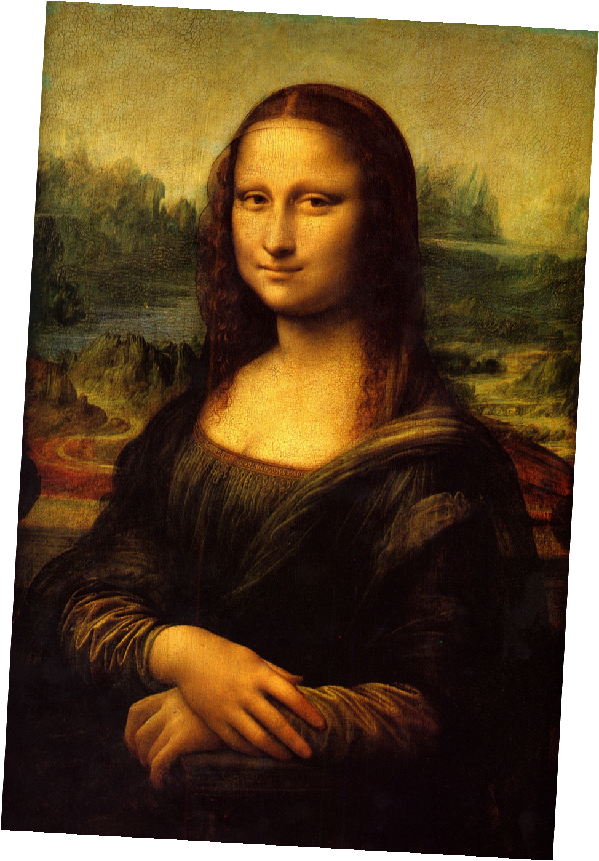
THE LOUVRE MUSEUM
A Treasure Trove of Art and History
The Louvre Museum, a former royal palace, is the world's largest art museum and a historic monument in Paris. Housing over 38,000 works of art, including the Mona Lisa and the Venus de Milo, it attracts millions of visitors each year.
The museum's stunning architecture, featuring the iconic glass pyramid entrance, seamlessly blends the old with the new. A visit to the Louvre offers a journey through centuries of art and history, making it a must-see cultural highlight in Paris.

Slide 12
FRENCH CUISINE
French cuisine is renowned worldwide for its flavors, techniques, and presentation. From the delicate pastries of patisseries to the rich, savory dishes of bistros, Paris offers a culinary adventure for every palate.
Croissant
Ratatouille
Soufflé
A buttery, flaky pastry that is a quintessential part of the French breakfast, representing the artistry of French baking.
A Provençal vegetable stew made with tomatoes, zucchini, eggplant, and bell peppers, celebrating the simplicity and freshness of ingredients.
A light, airy dish that can be either savory or sweet, exemplifying the sophisticated techniques of
French cooking.

Slide 13
PARISIAN FASHION
Fashion Capital
Chic Street Style
Paris is the epicenter of global fashion, boasting renowned designers and iconic fashion houses like Chanel, Dior, and Louis Vuitton.
Parisian street style exudes a chic and effortless elegance, with locals effortlessly blending classic and contemporary fashion trends.
Fashion Weeks
Couture Havens
The city's biannual Fashion Weeks set trends and showcase cutting-edge designs that reverberate throughout the fashion world.
From the prestigious boutiques along the Champs-Élysées to the trendy shops in the Marais district, Paris offers the latest in haute couture.

Slide 14
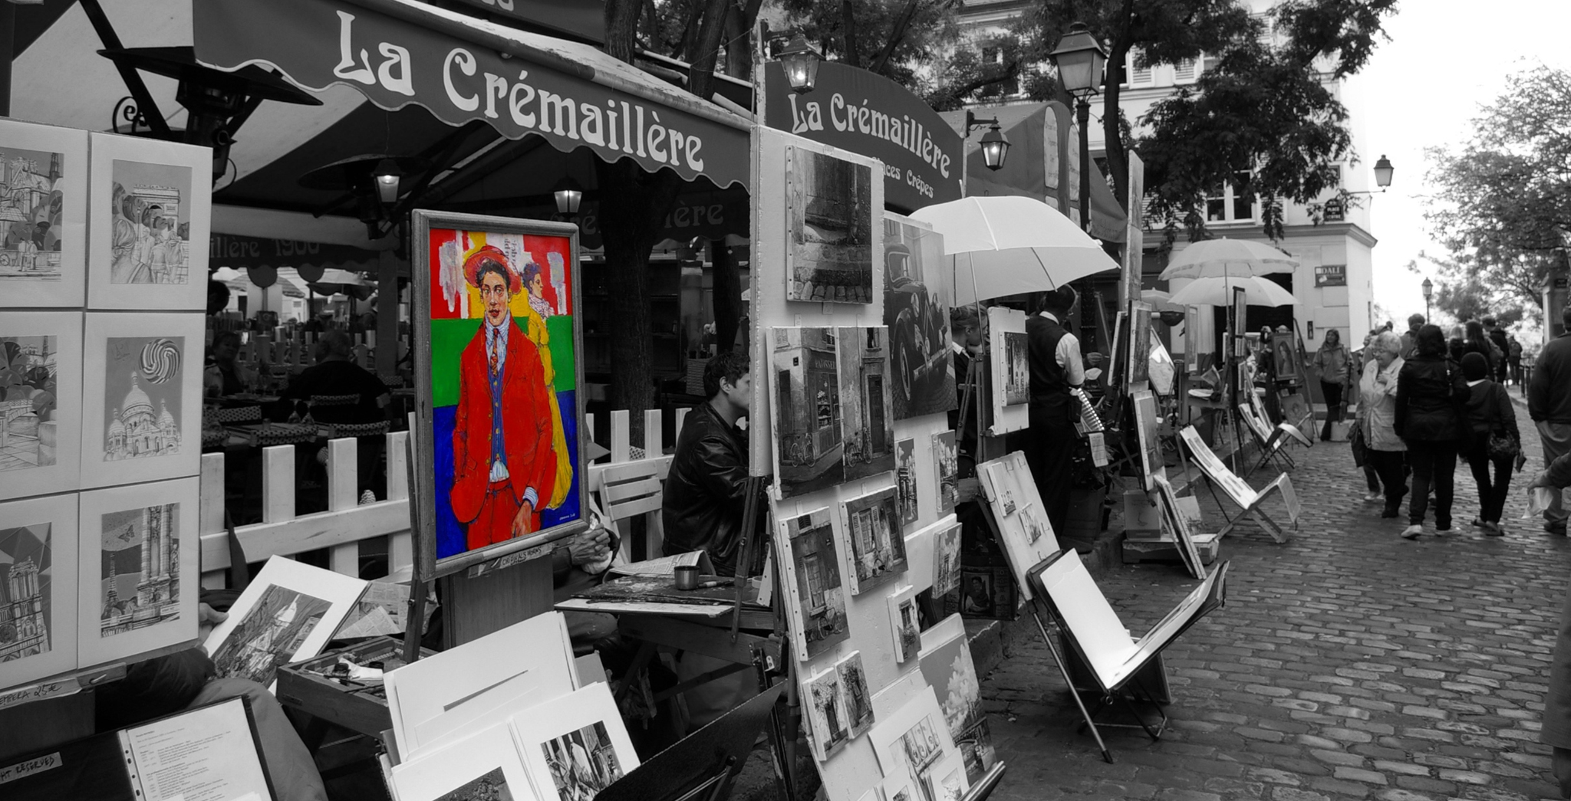
04.
ROMANTIC PARIS

Slide 15
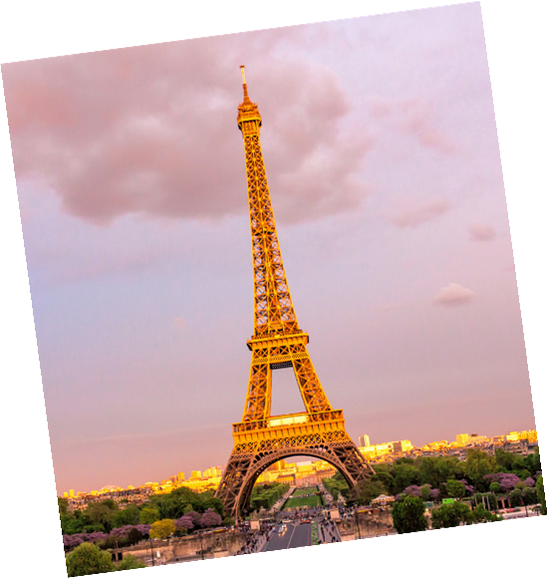
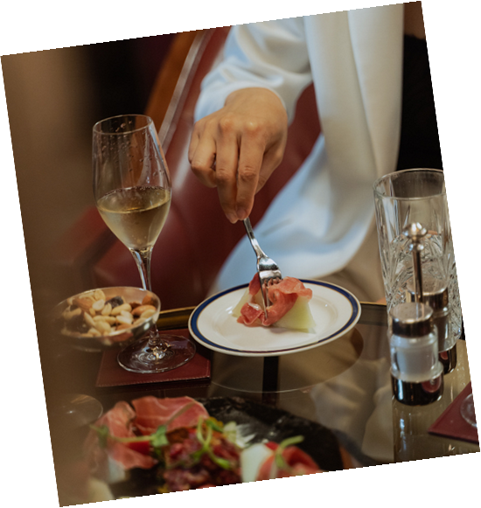
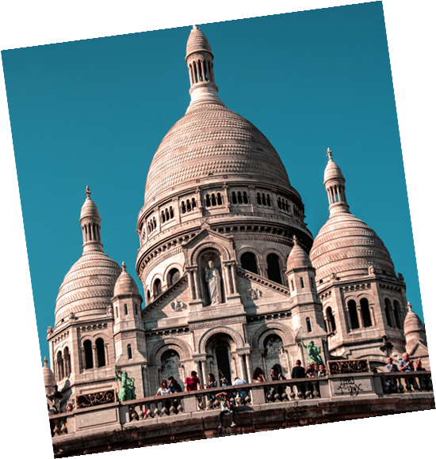
CITY OF LOVE
Paris is famously known as the City of Love,
offering an enchanting backdrop for romantic getaways and heartfelt moments.
Parisian Icons
Intimate Dining
Iconic Landmarks
From the Eiffel Tower to the Seine River, Paris is dotted with iconic landmarks that evoke romance and passion.
Indulge in intimate dinners at charming bistros, where candlelit ambiance creates unforgettable moments for couples.
Wander hand in hand through picturesque neighborhoods like Montmartre,

Slide 16
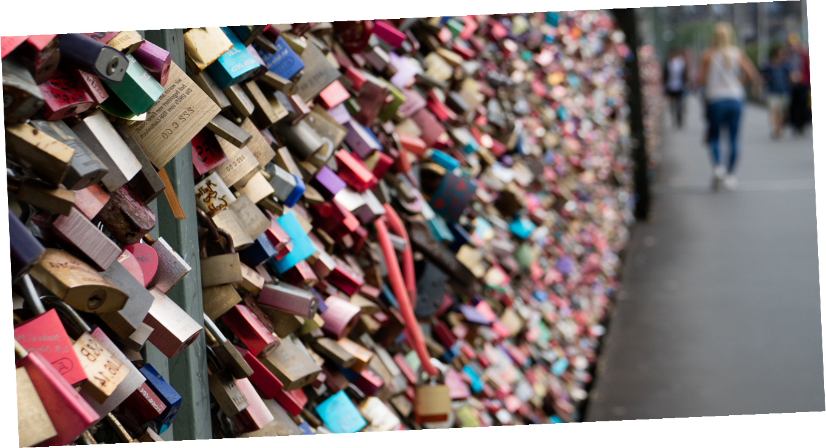
Symbol of Eternal Love
<3
The bridges of Paris, adorned with thousands of love locks, symbolize everlasting love and commitment between couples.
Pont des Arts
The Pont des Arts bridge was once a popular spot for lovers to attach padlocks as a symbol of their affection until the weight of the locks became too heavy.
LOVE LOCK BRIDGES
Pont de l'Archevêché
Couples still flock to the Pont de l'Archevêché bridge, near Notre-Dame Cathedral, to inscribe their names on locks and throw the keys into the Seine River.

Slide 17
RESOURCE PAGE
Use these design resources in your Canva Presentation.
Fonts
Design Elements
This presentation template
uses the following free fonts:
TITLES:
MONTSERRAT
HEADERS:
PETIT FORMAL SCRIPT
BODY COPY:
MONTSERRAT
You can find these fonts online too.
Colors
#0F129C
#F83A04
#FEACF8
DON'T FORGET TO DELETE THIS PAGE BEFORE PRESENTING.

Slide 18
CREDITS
This presentation template is free for everyone to use thanks to the following:
for the presentation template
Pexels, Pixabay
for the photos
Happy designing!

