Slide 1
Spirit of Life
Organization
ISANG MAPAYAPANG
UNDAS
Mag-alay ng dasal at magtirik ng kandila para sa mga yumao nating mahal sa buhay.

Slide 2
Spirit of Life
Organization
Nov 1 & 2 2024
ISANG MAPAYAPANG
UNDAS
Mag-alay ng dasal at magtirik ng kandila para sa mga yumao nating mahal sa buhay.

Slide 3
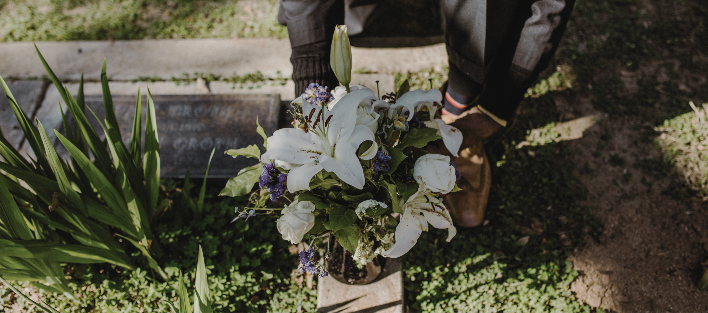
Isang Mapayapang
UNDAS
May your prayers be heard

Slide 4
RESOURCES
Use these design resources in your Canva Presentation.
Fonts
Design Elements
This presentation template
uses the following free fonts:
TITLES AND HEADER:
Cardo
BODY COPY:
Alegreya
You can find these fonts online too.
Colors

Slide 5
CREDITS
This design template is free for
everyone to use thanks to the following:
PEXELS AND PIXABAY
for the presentation template
For the photos
HAPPY DESIGNING!

