Slide 1
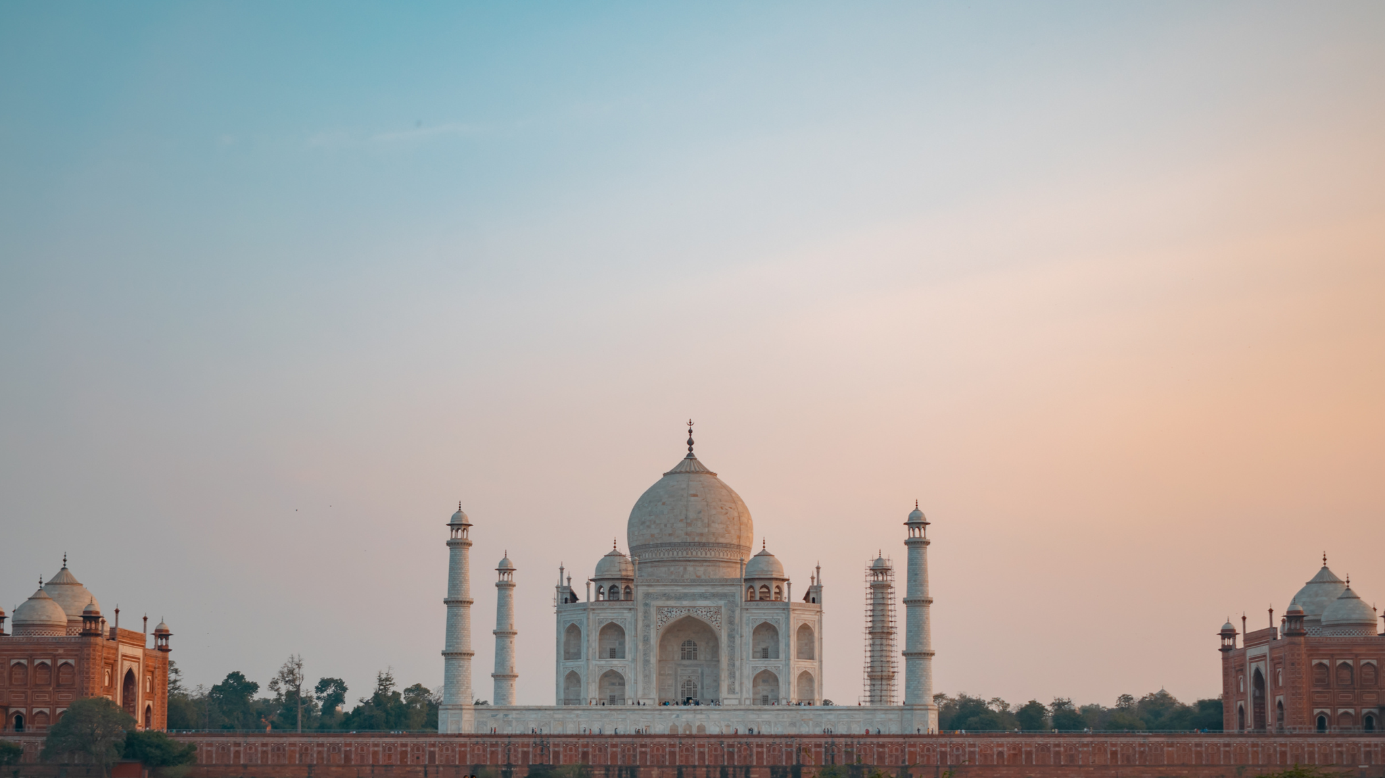
UNIVERSITY NAME
Ancient Indian
History
THESIS DEFENSE
PRESENTATION
Student
Name:
September
2025
NAME LASTNAME

Slide 2
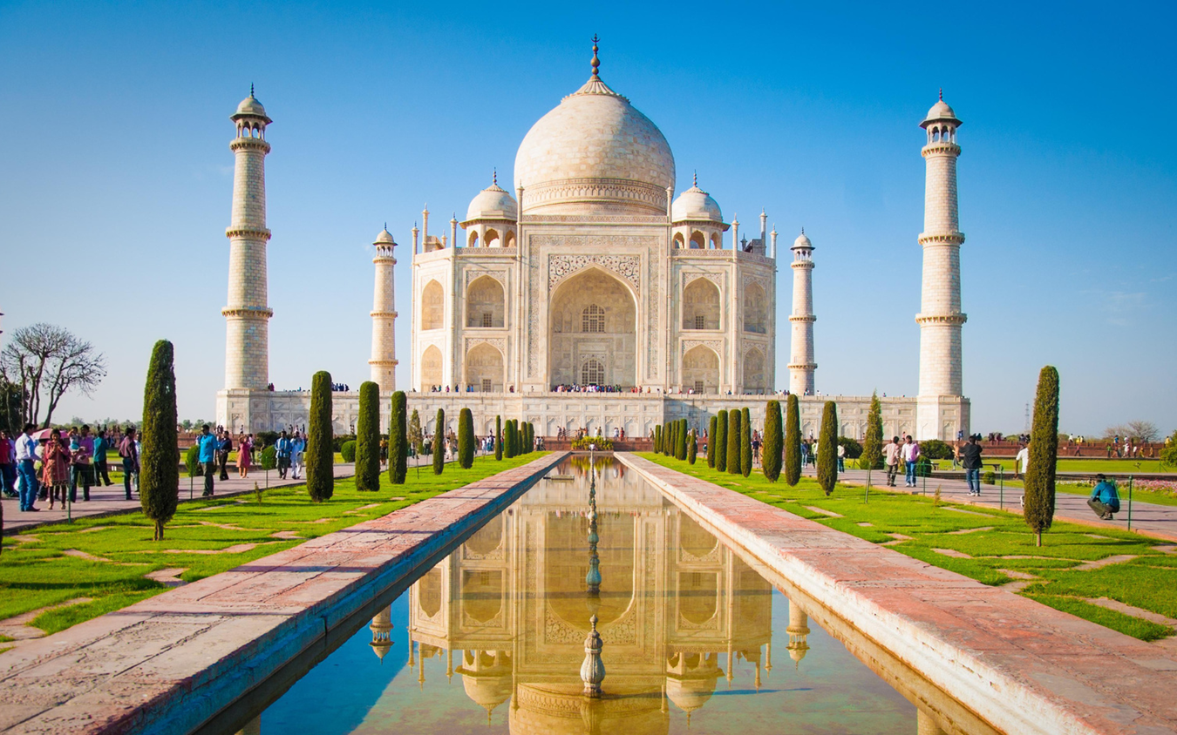
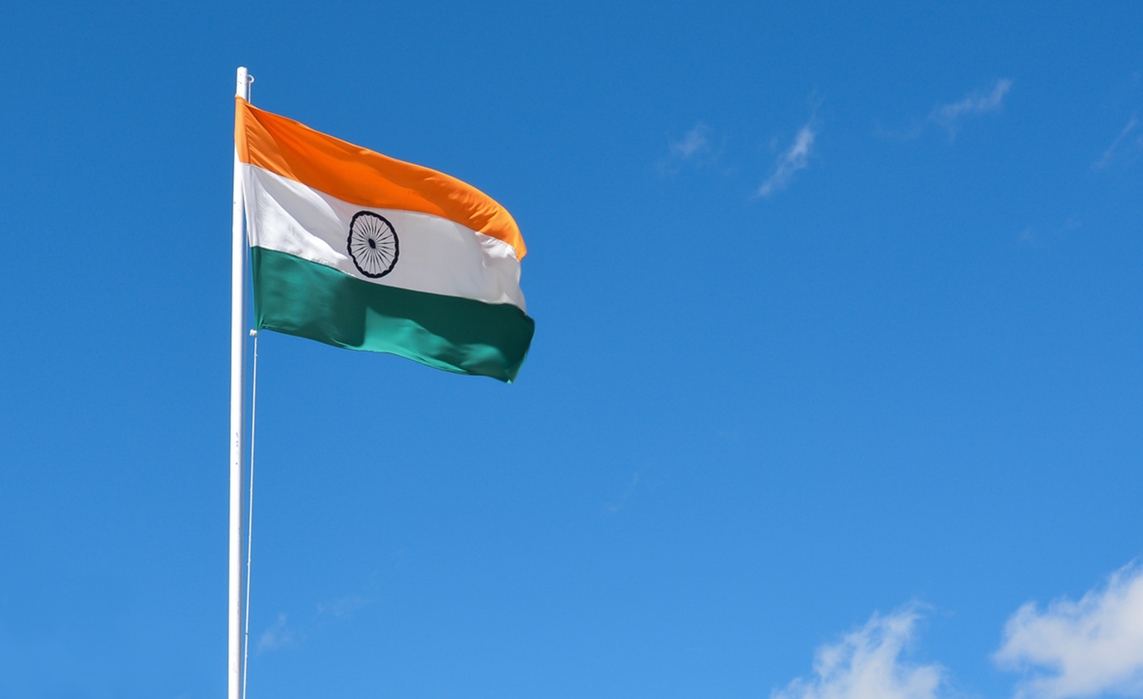
Hello & welcome to presentation
NEXT
WELCOME MESSAGE
Presentations are communication tools that can be used as demonstrations, lectures, speeches, reports, and more. It is mostly presented before an audience.
LETS GET STARTED

Slide 3
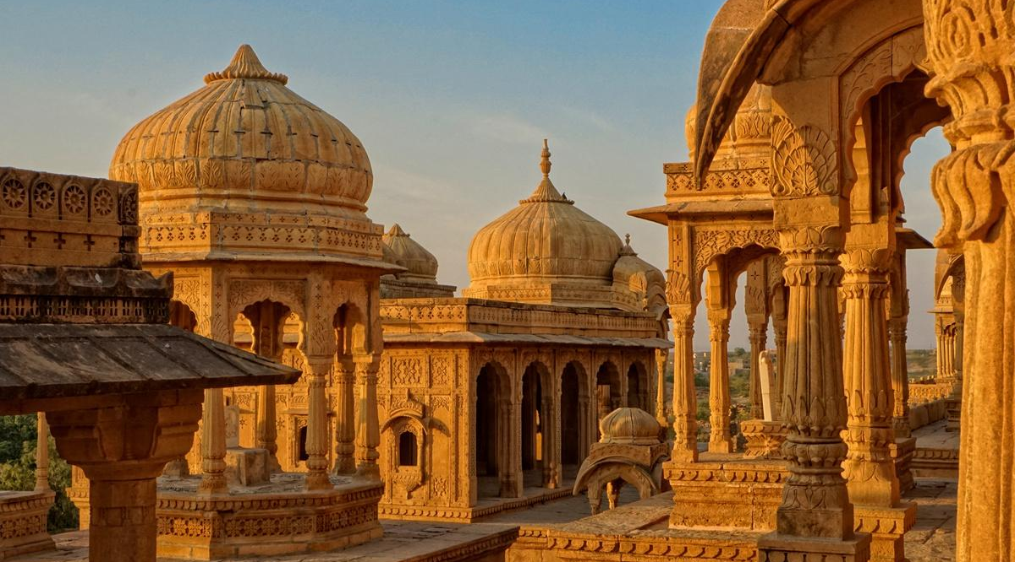
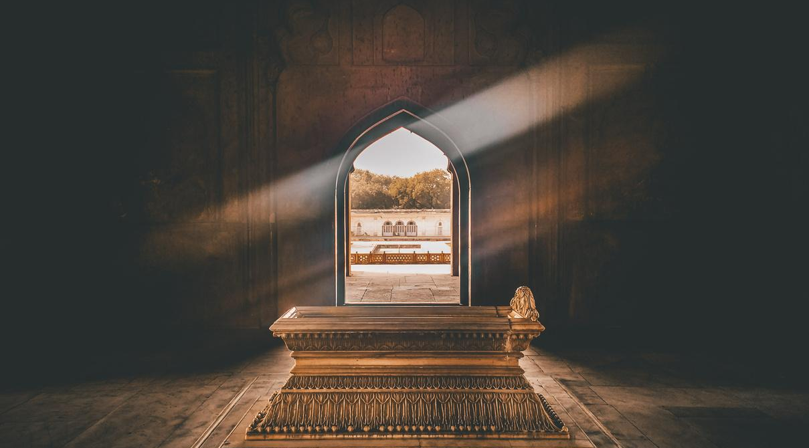
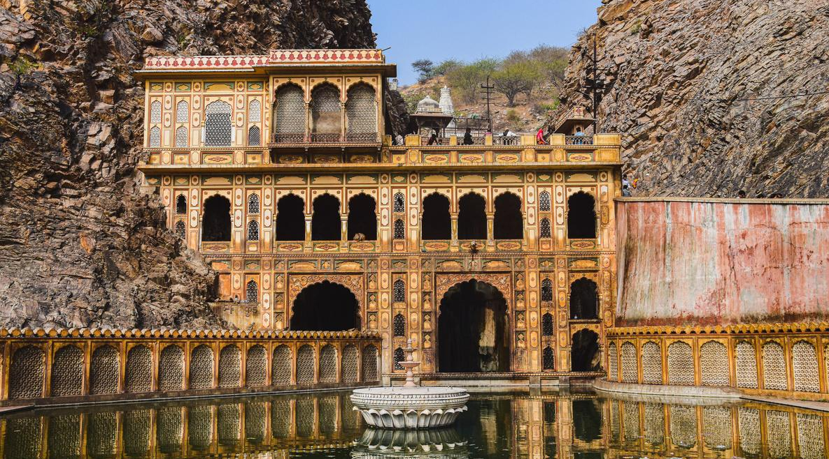
Early Civilizations
NEXT
ADD A MAIN POINT
ADD A MAIN POINT
ADD A MAIN POINT
Advances in medicine, astronomy, and metallurgy with scholars like Aryabhata making significant contributions.
Innovations such as the development of the Ayurvedic medical system and sophisticated surgical techniques were notable.
Period's scientific achievements laid the groundwork for future developments in various fields.

Slide 4
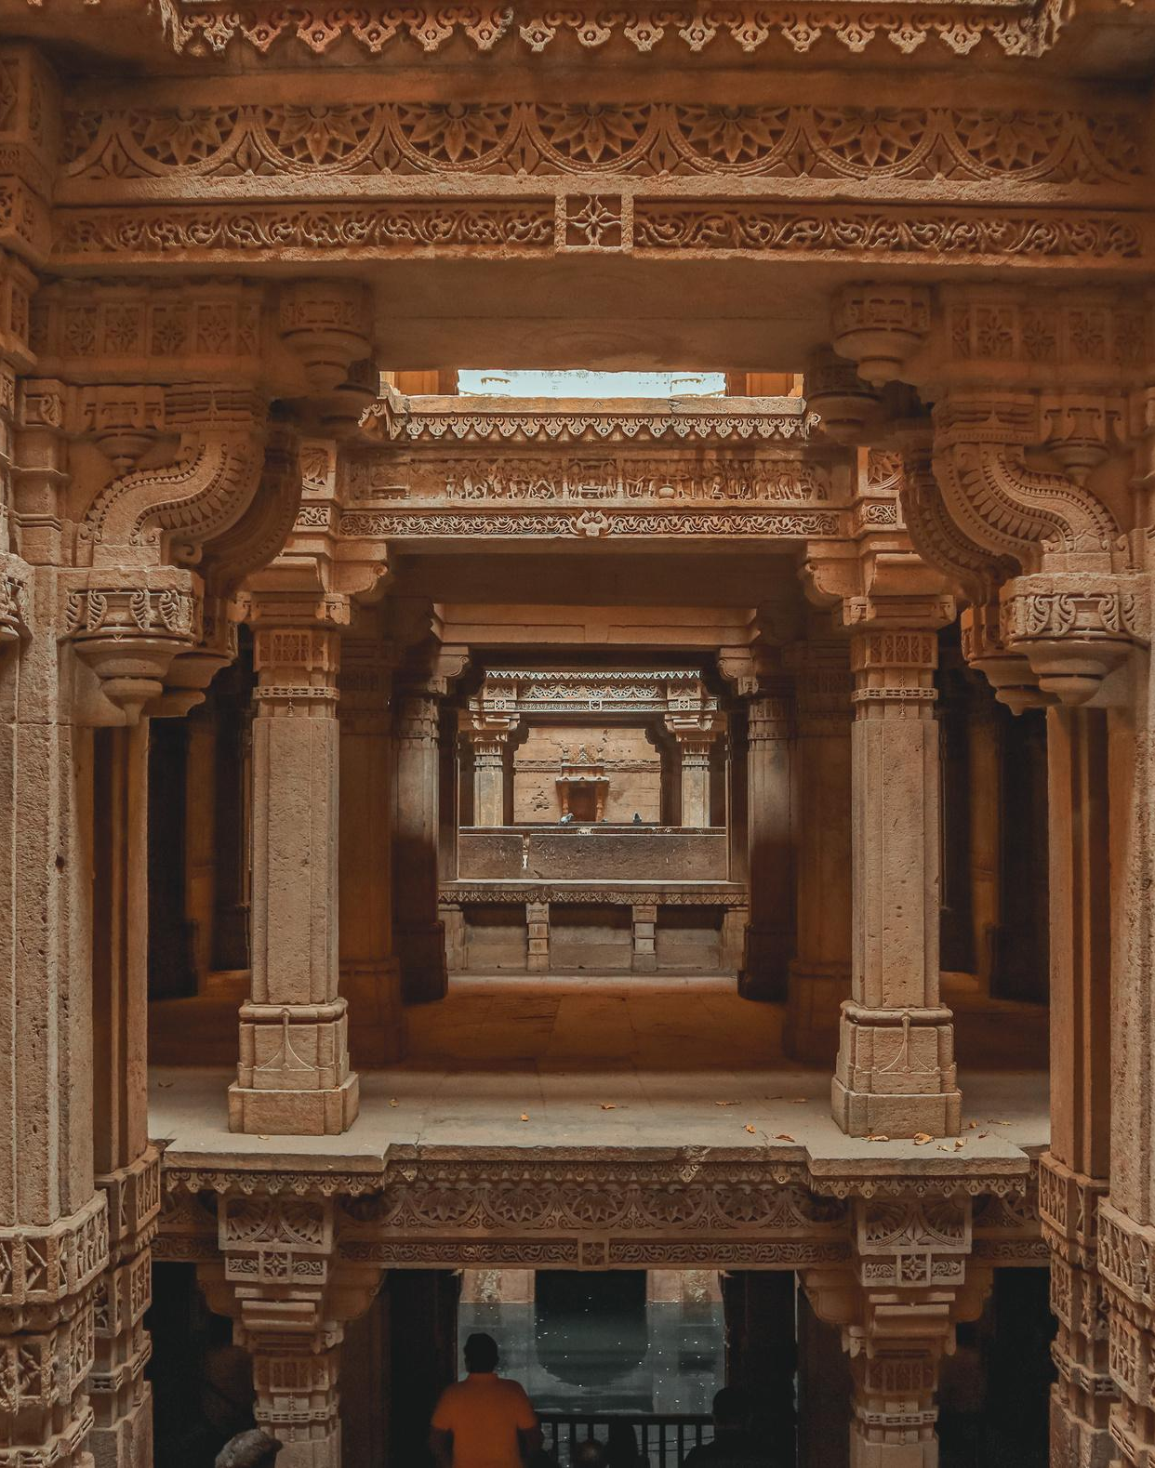
Overview
Introduction
01
Problem
02
Literary Review
03
Theoretical Framework
04
NEXT
Objectives
05
Hyphotesis
06
Implementation
07
Methodology
08
Results
09

Slide 5
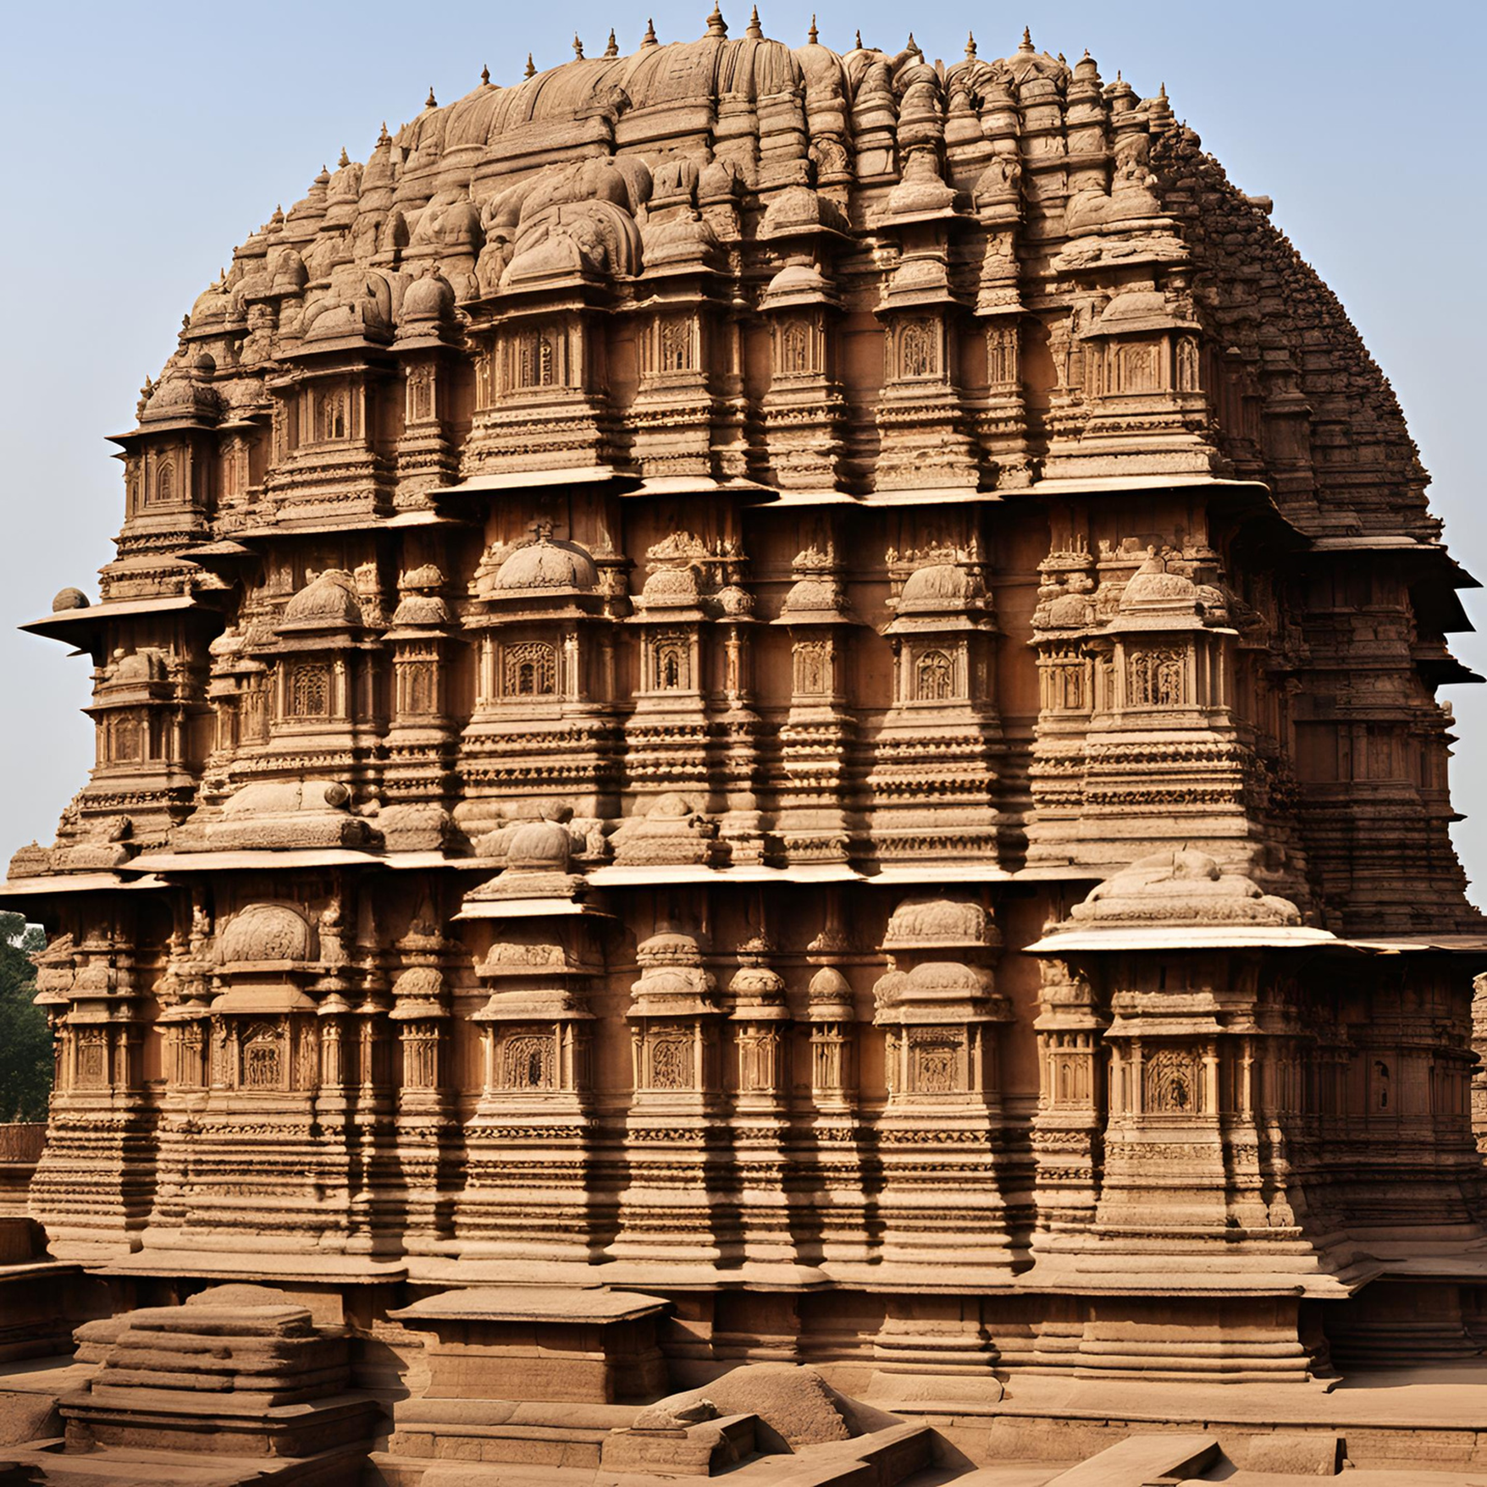
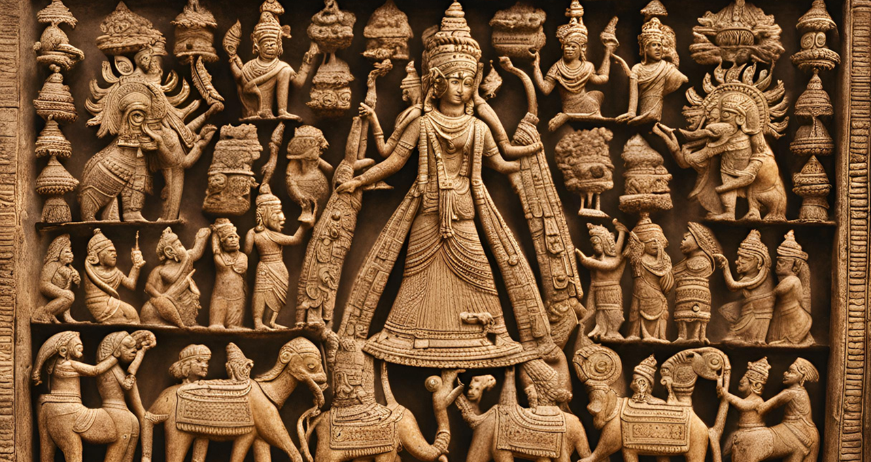
Image Gallery
Advances in medicine, astronomy, and metallurgy with scholars like Aryabhata making significant contributions.
NEXT
NEXT

Slide 6
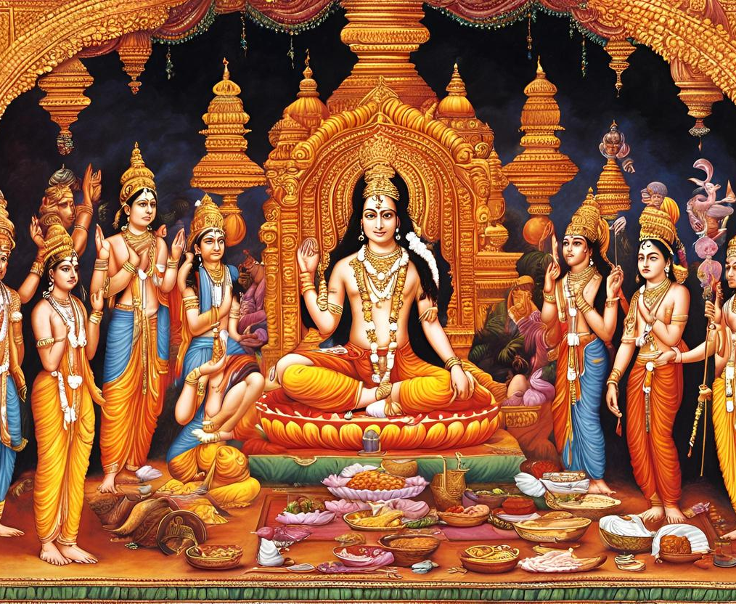
The Vedic Period
Following the decline of the Indus Valley Civilization, the Vedic Period (1500-500 BCE) marked significant developments in Indian culture and religion. The arrival of the Indo-Aryans introduced the Sanskrit language and the composition of the Vedas, ancient texts that form the basis of Hinduism.
MAIN
POINT
NEXT
This era saw the rise of powerful kingdoms, the establishment of social structures like the caste system, and the early philosophical and religious ideas that continue to influence Indian society.
MAIN
POINT

Slide 7
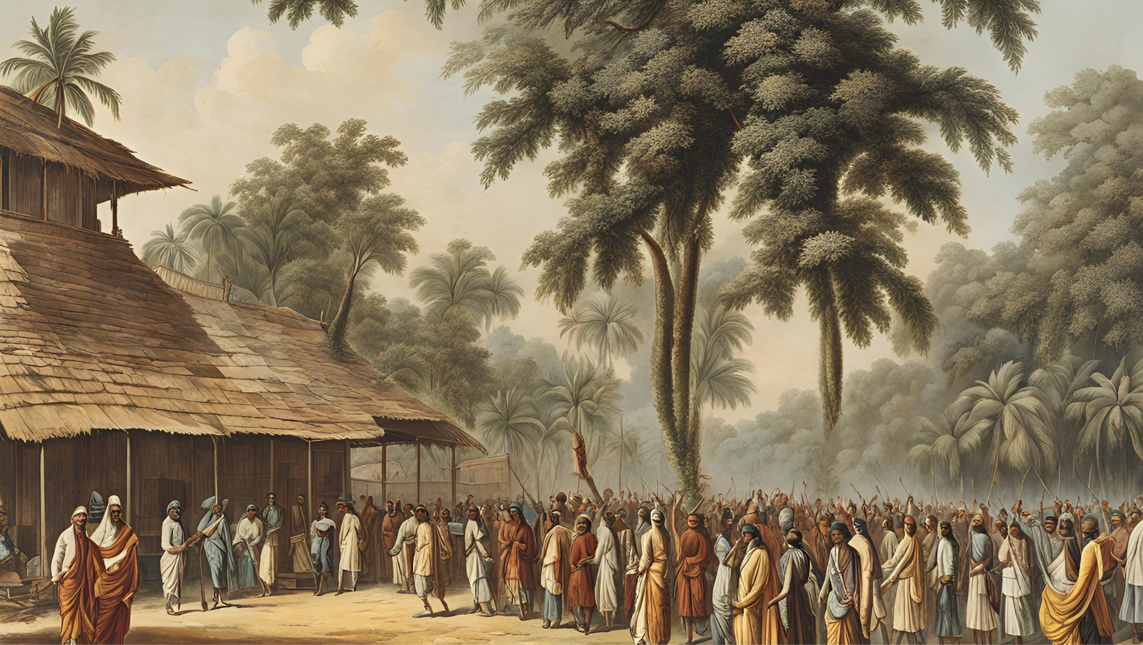
ADD A MAIN POINT
Elaborate on a personal detail you want to share.
Add a Timeline Page
ADD A MAIN POINT
NEXT
Elaborate on a personal detail you want to share.
ADD A MAIN POINT
Elaborate on a personal detail you want to share.

Slide 8
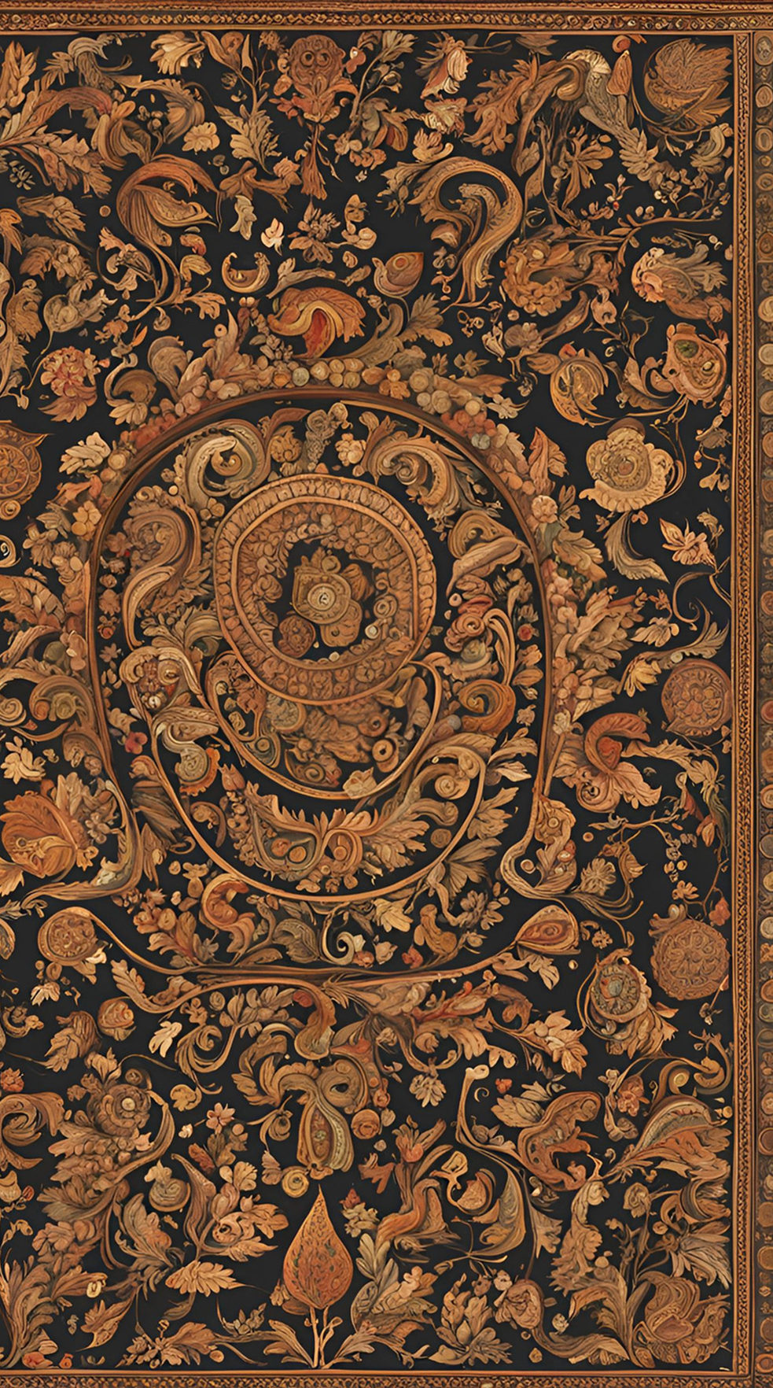
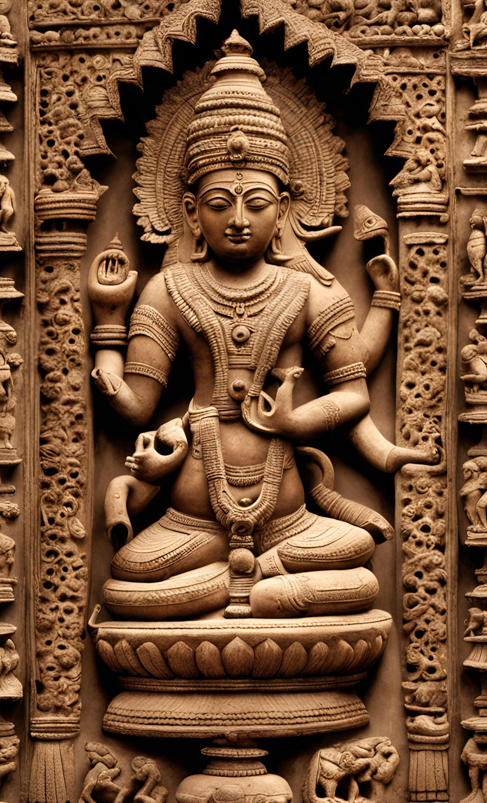
The Maurya Empire (322-185 BCE) was the first large empire to unify most of the Indian subcontinent.
Maurya Empire
Founded by Chandragupta Maurya, the empire reached its zenith under Emperor Ashoka, who is renowned for his conversion to Buddhism.
NEXT
The Maurya administration was known for its efficient governance, extensive infrastructure, art, culture, and religion.

Slide 9
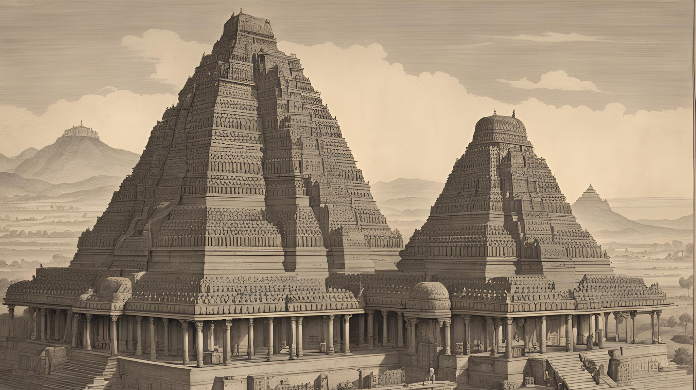
The Gupta Empire
GOLDEN AGE OF INDIA
The Gupta Empire (circa 320-550 CE) is often referred to as the Golden Age of India due to its remarkable achievements in arts, sciences, and literature. Prominent literary works, such as Kalidasa's plays and poetry, flourished during this time.
NEXT
CULTURAL AND ECONOMIC PROSPERITY
The Guptas promoted Hinduism while also supporting Buddhism and Jainism, fostering a rich cultural and religious environment. Trade and commerce thrived, with extensive networks connecting India to the Mediterranean, Southeast Asia, and China.
TECHNOLOGICAL INNOVATIONS
Advances in medicine, astronomy, and metallurgy characterized this era, with scholars like Aryabhata making significant contributions. The Gupta period's scientific achievements laid the groundwork for future developments in various fields.

Slide 10
The Delhi Sultanate
Art And Design '50 Year 2023
01
02
03
ESTABLISHMENT AND EXPANSION
CULTURAL
SYNTHESIS
MILITARY DEVELOPMENTS
NEXT
The Delhi Sultanate (1206-1526 CE) marked a significant period of Muslim rule in India, beginning with the establishment of the Mamluk Dynasty by Qutb-ud-din Aibak. Over the centuries, five major dynasties ruled, expanding their territories and influence across the Indian subcontinent. The Sultanate played a crucial role in shaping the region's political landscape.
During the Delhi Sultanate, a remarkable cultural synthesis occurred as Persian, Turkish, and Indian traditions intermingled. This era saw the flourishing of Indo-Islamic architecture, with iconic structures like the Qutub Minar and Alai Darwaza. Literature, art, and music also evolved, blending Persian and Indian styles, contributing to a rich cultural heritage.
The Delhi Sultanate introduced significant administrative and military reforms, including the establishment of a centralized bureaucracy and a standing army. Innovations in governance, such as the Iqta system, streamlined revenue collection and land management. These developments laid the groundwork for future administrative practices in the region.
Thesis Defense

Slide 11
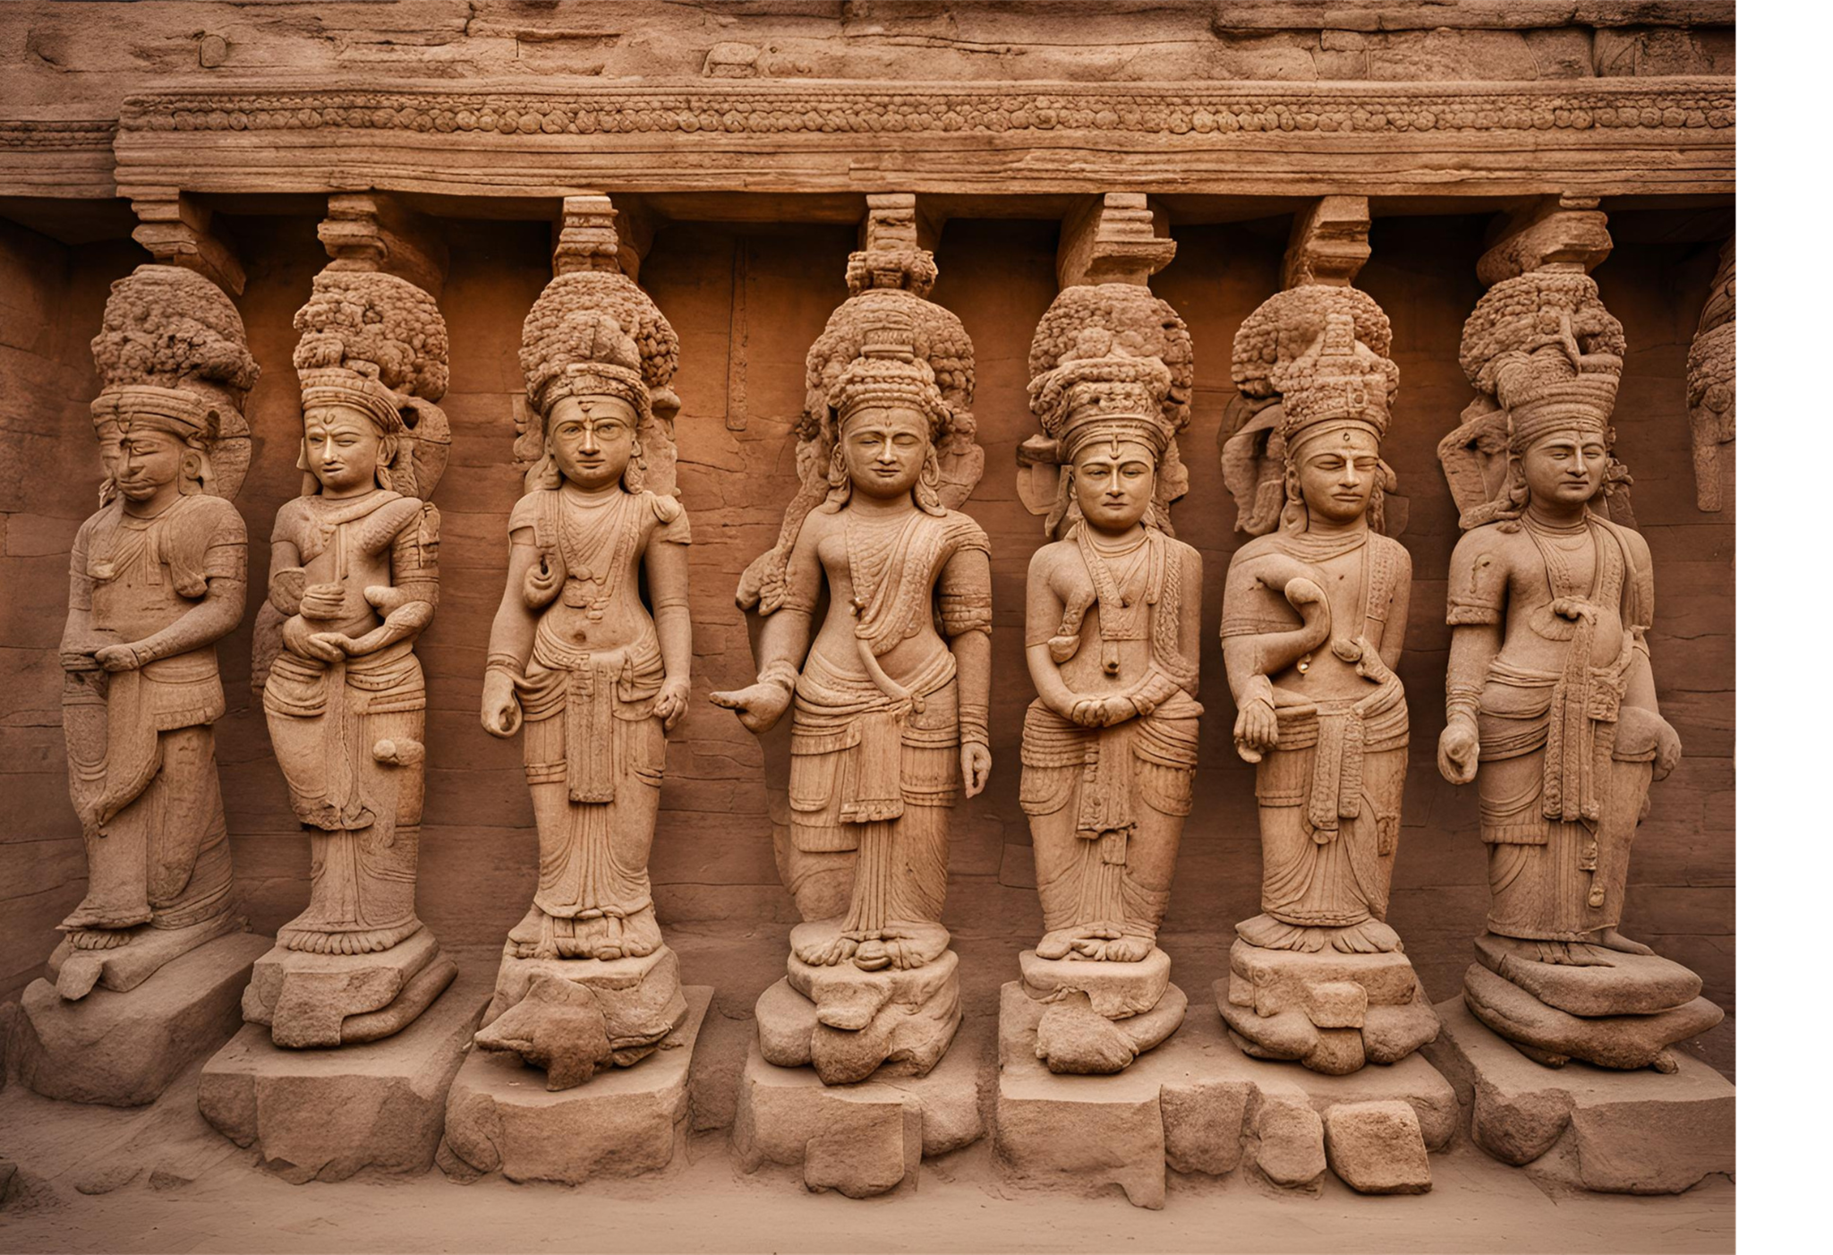
Add a Section Header
NEXT

Slide 12
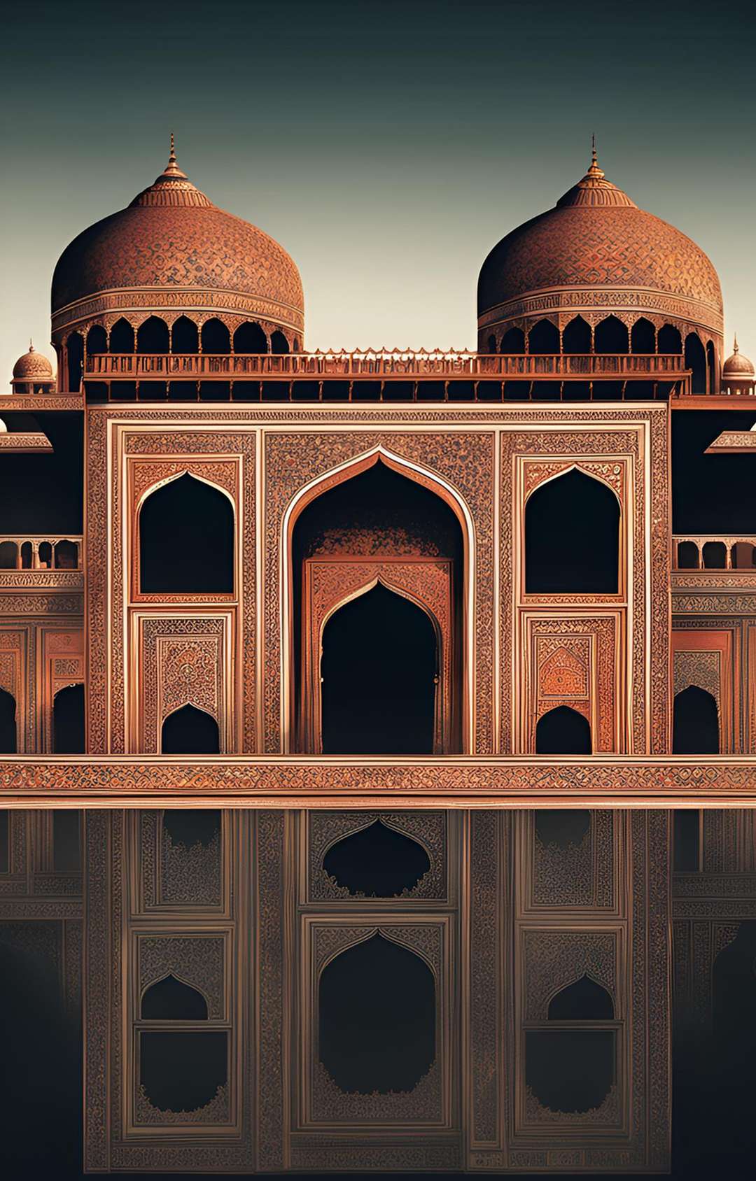
FOUNDATION AND EXPANSION
ADMINISTRATIVE REFORMS
Founded by Babur in 1526 after defeating Ibrahim Lodi at the Battle of Panipat.
Efficient land revenue and military administration system implemented by Akbar.
GOLDEN AGE OF CULTURE
RELIGIOUS POLICIES
Known for iconic structures like the Taj Mahal, Red Fort, and Fatehpur Sikri.
Akbar's policy of religious tolerance and integration, including the abolition of the jizya tax on non-Muslims.
NEXT
The Mughal Empire
ECONOMIC PROSPERITY
DECLINE
Flourishing trade, both internal and external, leading to economic prosperity and growth.
Decline began with the weak successors of Aurangzeb, leading to administrative inefficiency.

Slide 13
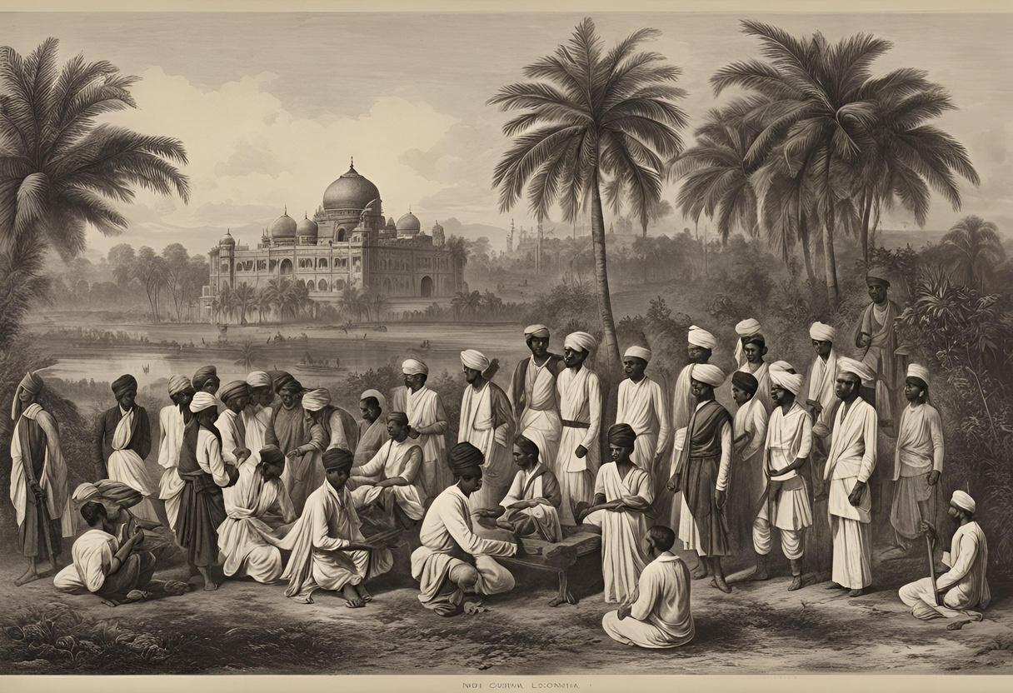
The Colonial Period
Art And Design '50 Year 2023
NEXT
BRITISH EAST INDIA COMPANY
Initial Presence: The British East India Company arrived in the early 17th century, initially focusing on trade before expanding political control.
Colonial Control: The Battle of Plassey in 1757 marked the start of British dominance, leading to the establishment of the British Raj.
RISE OF INDIAN NATIONALISM
Nationalist Movements: Leaders like Mahatma Gandhi and movements like the Quit India Movement mobilized millions against British rule.
Independence: These efforts culminated in India’s independence in 1947, ending British colonial rule and starting a new era for the nation.

Slide 14
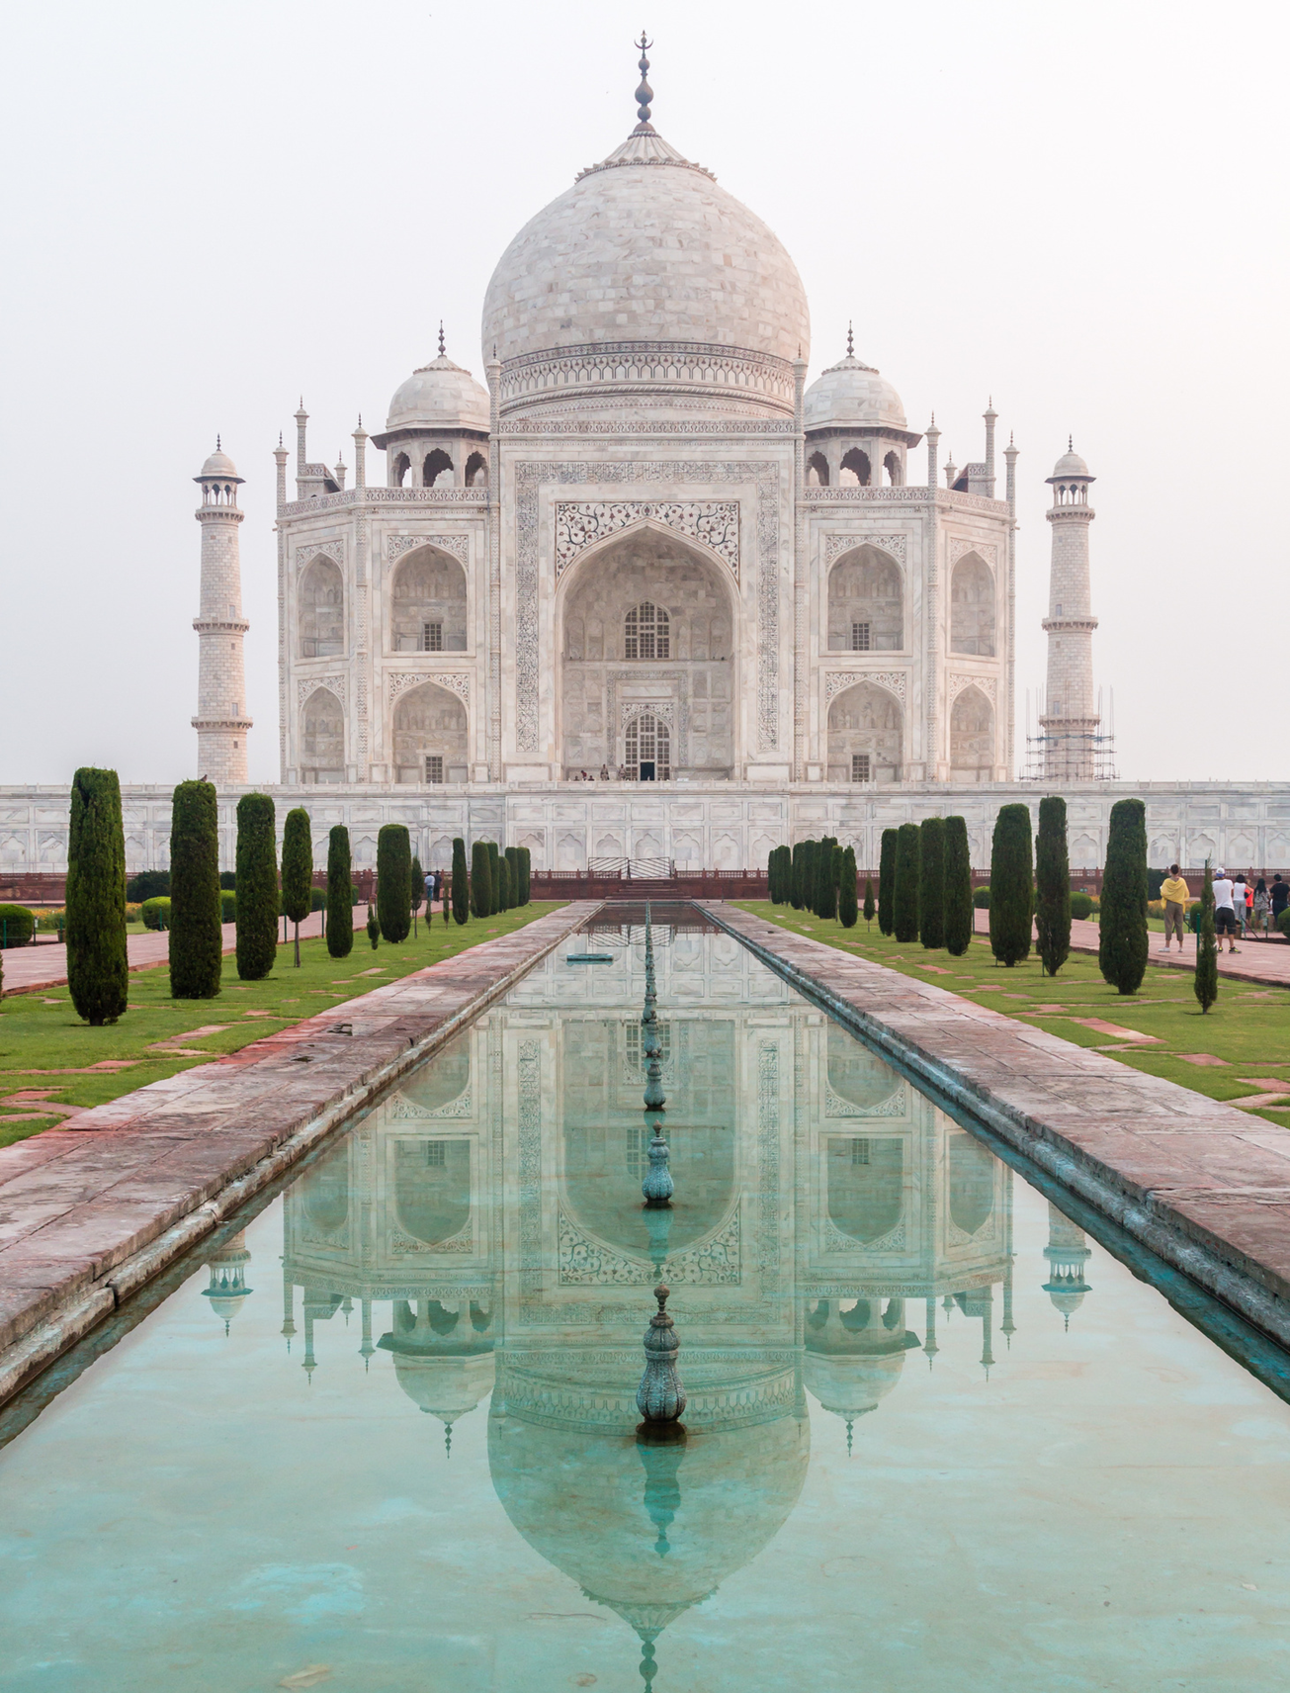
Modern India
EMERGENCE AND DEVELOPMENT
Since gaining independence in 1947, India has emerged as the world's largest democracy, undergoing significant political, economic, and social transformations. The nation embarked on ambitious development plans, focusing on industrialization, agriculture, and technology. Landmark events such as the Green Revolution and economic liberalization in the 1990s spurred growth and modernization. Despite challenges India has made remarkable progress in various fields, becoming a key player on the global stage. Today, it continues to strive for inclusive growth, social justice, and sustainable development while preserving its rich cultural heritage.
NEXT

Slide 15
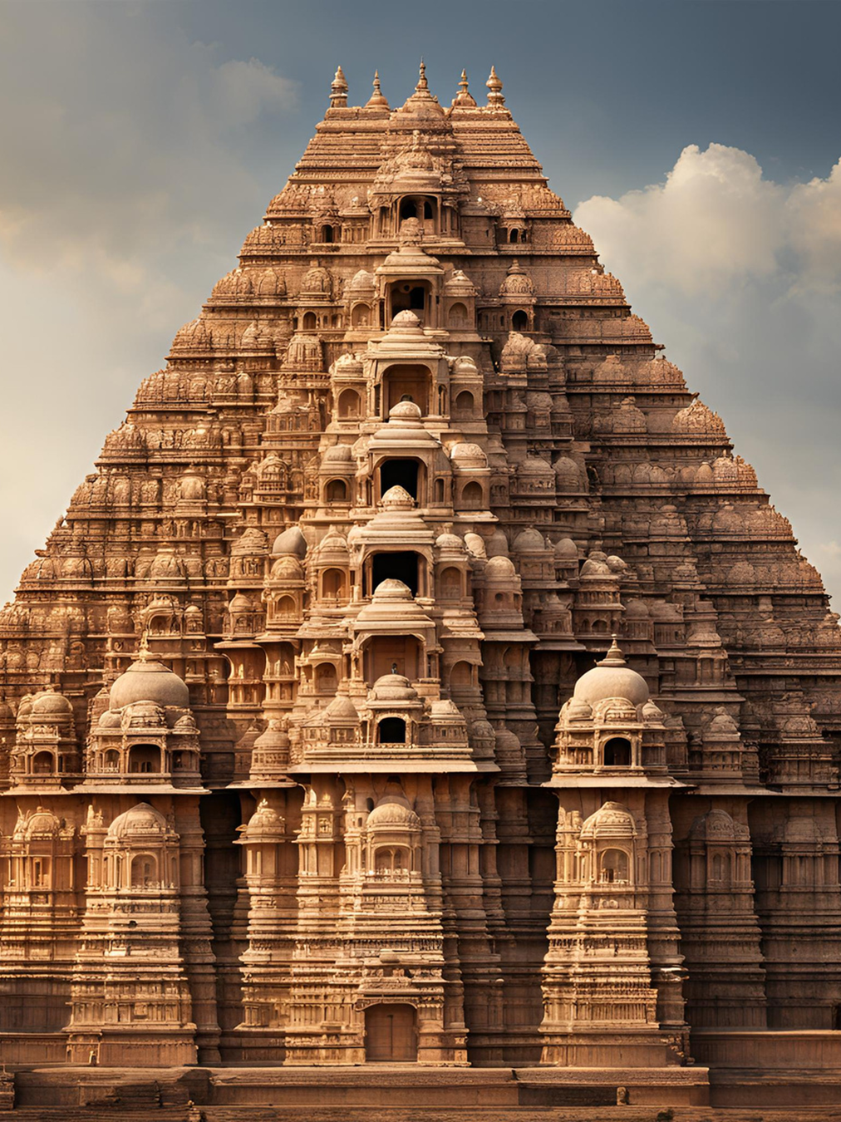
Write an original statement or inspiring quote
NEXT
— Include a credit, citation, or supporting message

Slide 16
About Me!
NAME SURNAME
NEXT
I'm Rain, and I'll be sharing with you my beautiful ideas. Follow me at @reallygreatsite to learn more.

Slide 17
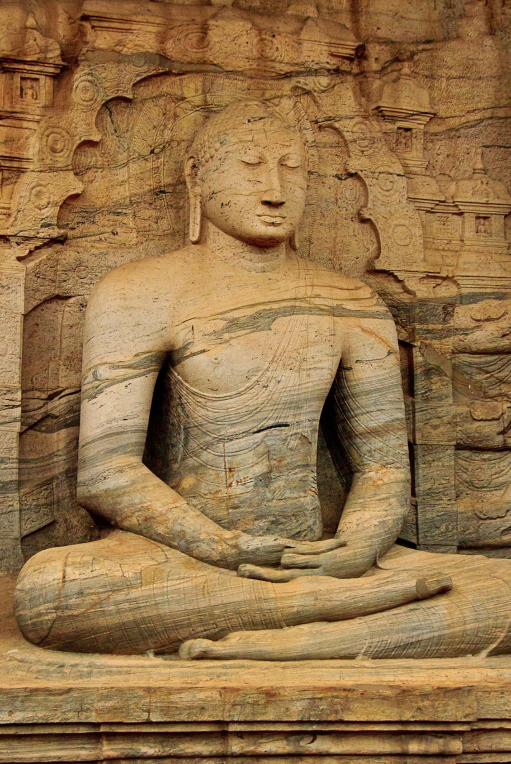
Thank You!
Thank you for taking the time to explore this presentation on Ancient Indian History. The rich and diverse history of India has shaped its present and will continue to influence its future. We hope this journey through India’s past has provided valuable insights and a deeper appreciation of its cultural heritage. If you have any questions or would like to discuss further, please feel free to reach out.

Slide 18
Resource Page
Use these design resources in your Canva Presentation.
Fonts
Design Elements
This presentation template
uses the following free fonts:
TITLES:
OPEN SANS BOLD
HEADERS:
OPEN SANS
BODY COPY:
OPEN SANS
You can find these fonts online too.
Colors
#FFFFFF
#ED7843
#000000
DON'T FORGET TO DELETE THIS PAGE BEFORE PRESENTING.

Slide 19
Credits
This presentation template is free for everyone to use thanks to the following:
for the presentation template
Pexels, Pixabay
for the photos
Happy designing!

