Slide 1
WEST TRAVE UNIVERSITY
November 2030
IMPORTANCE OF INVESTMENT
Keynote by Prof. Louisa Mae Moore

Slide 2
Overview
Introduction to investing
Importance of investing early
The magic of compound interest
How much should you invest?
Investment options for beginners
Importance of diversification

Slide 3
Introduction to investing
Investing involves putting your money into assets with the expectation that they’ll grow and generate income over time.
Types of investment include:
Stocks
Bonds
Hedge funds

Slide 4
Importance of investing early
Much longer
recovery period
Increased time
value of money
Improved risk
taking ability
Investing early makes it possible to make up for any loss on investment.
Investments made at an early age can lead to compounding returns.
Early exposure to market variability builds resilience and boosts confidence in taking risks.

Slide 5
The magic of compound interest
Compound interest is interest earned on your original money (principal) and the interest that accumulates over time.
It lets you earn interest on the interest!

Slide 6
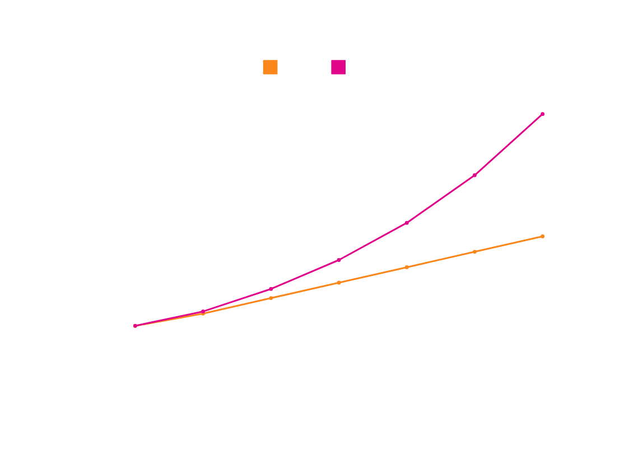
Simple vs. compound interest
A chart showing the difference between
simple and compound interests
Amount
Compound interest grows faster because it earns interest on both the principal amount and the accumulated interest. On the other hand, simple interest grows steadily as it is based only on the principal amount.
Number of years

Slide 7
How much should you invest?
Consider using the 50/30/20 rule to break down your budget and identify how much you should allocate for savings and investing.
Emergency fund
Investments
Retirement
Subscriptions
Hobbies
Travel and vacations
Groceries
Utilities
Transportation
Rent

Slide 8
Investment options for beginners
Index funds
Corporate bonds
Dividend-paying stocks
Begin with low- or medium-risk investments to achieve steady growth and maintain stability before trying high-risk options.
Medium
Savings account
Treasury bonds and bills
Money market accounts
Individual stocks
Real Estate Investment Trusts (REITs)
Cryptocurrencies
Low
High
Safest
Riskiest
Risk meter

Slide 9
Importance of diversification
Spreading your investments into different classes helps manage risk.
Multiple growth opportunities
Protection against market downturns
Better
long-term performance
Different assets grow at different rates and economic cycles.
Assets from different locations and industries respond differently to economic downturns.
Possibility of more consistent potential returns over time

Slide 10
“An investment in knowledge always pays the best interest.”
— Benjamin Franklin

Slide 11
Key points
Investing involves buying assets to generate income or earn high interest rates.
Investing early allows you to recover quickly from losses, grow your funds' value, and build financial resilience.
Compound interest lets you earn interest on your interest, helping your money grow faster than simple interest.
The 50/30/20 rule is a great starting point for deciding how much to invest and save.
Begin with low- to medium-risk investments before exploring higher-risk options.
Diversifying your portfolio helps manage and balance investment risks.

Slide 12
Setting realistic financial goals
Create a financial plan that includes your current income or allowance sources, your short- and long-term financial goals, and strategies to achieve those goals.

Slide 13
Got questions?
Email
hello@reallygreatsite.com
Phone
123-456-7890

Slide 14
Resource Page
Use these in your presentation. Delete or hide this page before presenting.
Fonts
Design Elements / Icons
This presentation template
uses the following free fonts:
TITLES:
DM Sans Bold
BODY TEXT:
DM Sans Regular
You can find these fonts online too.
Colors
#FFFFFF
#D9D9D9
#ED7843
#E0058B
#000000

Slide 15
Credits
This presentation template is free for everyone to use, thanks to the following:
for this presentation template
Pexels, Pixabay, Sketchify
for the photos, graphics, and elements
Happy designing!

