Slide 1
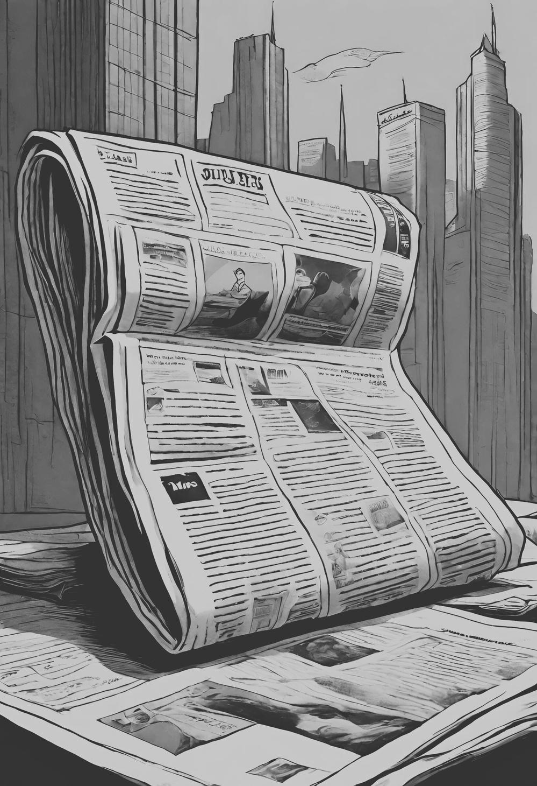
BRIEF HISTORY OF
PRINT MAKING
Printmaking is a visual art form involving the creation of images on a surface, typically paper, fabric, or another substrate, through various techniques that enable multiple reproductions of the same image. The process generally involves transferring an image from a prepared surface, called a matrix or plate, onto another surface, such as paper or fabric, using ink or pigment.
200AD | WOODBLOCK PRINTING
1041 | MOVEABLE TYPE
The invention of woodblock printing dated back to 200AD and was evolutionary! The design was hand-carved into a woodblock and then coated in ink and pressed onto the desired material. This was the first time in history a design could be created and quickly replicated.
Moveable Print was created by Pi Sheng in Song Dynasty China. This was very similar in many ways to the woodblock printing; however, instead of being fixed and unchangeable like the woodblock, you could move around the pieces and place them in the desired order.
1440 | THE PRINTING PRESS
1796 | LITHOGRAPHY
In 1450 Johannes Gutenberg a goldsmith and inventor returned to Mainz Germany with his perfected printing machine. The Gutenberg Press. He replaced the wood with metal printing pieces and incorporated the techniques of movable print.
The Lithography technique is one that is still commonly used today! Invented in 1796 by a German actor and author Alois Senefelder as a cheap method of publishing theatrical works. Lithography revolves around the relationship between oil and water which repel each other.
1843 | THE ROTARY PRESS
1875 | OFFSET PRINTING
Although initially created in 1843, in 1847 Richard March Hoe patented and put into commercial use his innovation of the printing press. The Rotary Press. This press used a cylinder on which the images to be printed were curved around increases the productivity and speed of the machine.
In the 150 years offset printing has been around, the process remains almost unchanged and for this reason, still stands as the most popular method of print for modern-day printers. This works by transferring the ink from a metal plate to a rubber blanket onto the final printed surface.
1910 | SCREEN PRINTING
1951 | INKJET PRINTING
Also invented in China During the Song Dynasty between 960-1279ad. Using a mesh stencil, the ink is pushed through onto the textile/ chosen printed surface underneath. However, this method did not take off in Europe until 1910 when silk stock became more widely available.
The world’s first inkjet printer was invented by Ichiro Endo, who worked for Canon in Japan. It took away the direct contact with ink and paper, and instead sprayed the ink through jets. This made printers more widely available, and they began appearing in offices across the world.
1969 | LASER PRINTING
1991 | DIGITAL PRINT
This advancement produced higher quality images, by passing a laser beam back and forth over a negatively charged cylinder within the printer. It then collects the electronically charged powered ink to transfer the image to paper.
The development of digital print made it possible to print straight from a digital file without blankets or plates. It usually refers to professional printing where small-run jobs from desktop publishing are printed using large-format and/or high-volume laser or inkjet printers.

Slide 2
RESOURCE PAGE
  Use these design resources in your Canva Presentation.
Fonts
Colors
This presentation template
uses the following free fonts:
TITLES:
Anton
BODY COPY:
Arimo
#F0E7D7
#15130D
#FF2E00
You can find these fonts online too.

Slide 3

CREDITS
This presentation template is free for everyone to use
  thanks to the following:
  for the presentation template
Pexels, Pixabay
  for the photos
  HAPPY DESIGNING!

