Slide 1



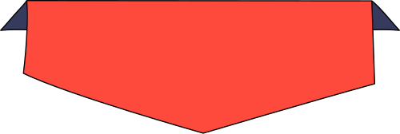

Operations with Integers
for High School

Slide 2


How to Use This Presentation
Google Slides
PowerPoint
Canva
Click on the "Google Slides" button below this presentation preview. Make sure to sign in to your Google account. Click on "Make a copy." Start editing your presentation.
Alternative: Click on the "Share" button on the top right corner in Canva and click on "More" at the bottom of the menu. Enter "Google Drive" in the search bar and click on the GDrive icon to add this design as a Google slide in your GDrive.
Click on the "PowerPoint" button below this presentation preview. Start editing your presentation.
Alternative: From Canva template file, Click on the "Share" button on the top right corner in Canva and click on "More" at the bottom of the menu. Enter "PowerPoint" in the search bar and click on the PowerPoint icon to download.
Click on the "Canva" button under this presentation preview. Start editing your presentation. You need to sign in to your Canva account.

Slide 3


Lesson Outline
Commutative Property
Associative Property
  Addition
  Multiplication
  Addition
  Multiplication

Slide 4
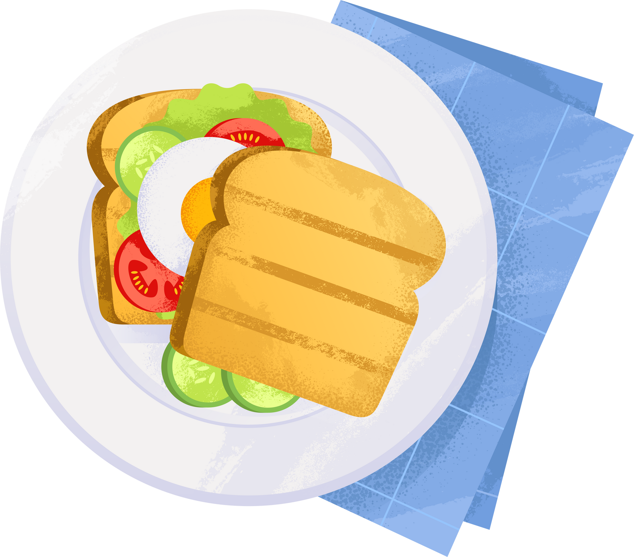
Springboard Question
  Does a
  bacon,
  lettuce
  and tomato sandwich
  taste the same as a
  tomato,
  lettuce
  and bacon sandwich?

Slide 5
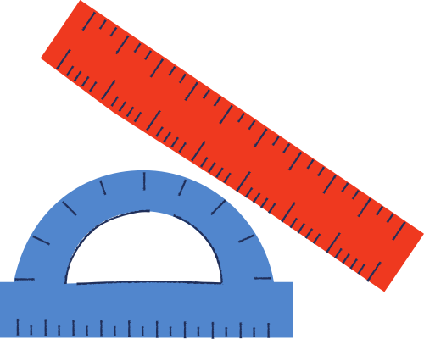

Learning Outcomes
By the end of the lesson, you'll be able to:
  differentiate commutative from associative property
  apply commutative and associative properties in integer operations

Slide 6

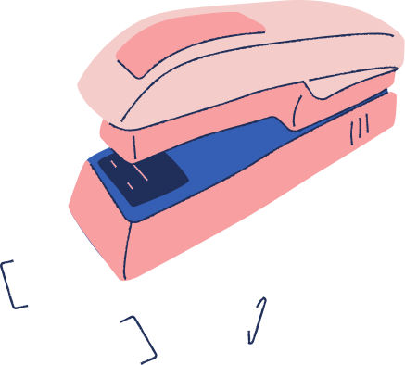








Commutative Property
It states that rearranging the numbers does not affect the sum or product of numbers.
  It applies to
  but not to
  addition
  multiplication
  subtraction
  division

Slide 7
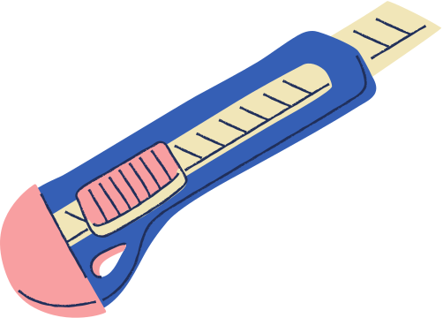



a × b = b × a
Commutative Property of Multiplication
Rotating the grids below doesn't affect their areas.
  2 × 7 is the same as saying 7 × 2
  5 × 8 is the same as saying 8 × 5

Slide 8

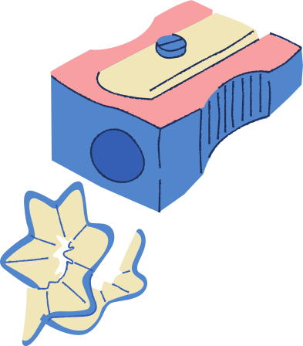

Commutative Property of Addition
a + b = b + a
2
4
6
9
5
What is the sum if you add them
  starting from the left most digit?
What is the sum if you add them
  starting from the right most digit?

Slide 9




Associative Property of Addition
a + (b + c) = (a + b) + c
  (A)
  (B)
  Add up all red fruits first, then add the bananas.
  Add bananas and strawberries together, then add the apples.
  Did the total number of fruits change?

Slide 10



Try These!
  Use the commutative property to find the missing numbers.
Addition
Multiplication
−3 + 9 = 9 +
16 × 15 × 13 = 15 ×
× 16
−4 + (−10) =
+ (−4)
21 × (−250) = (-250) ×
15 + 19 = 19 +
24 × 50 = 50 ×

Slide 11
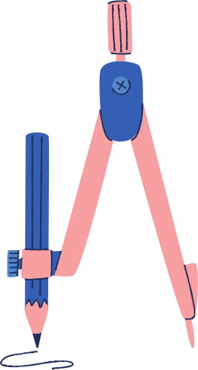

Associative Property
It states that changing the grouping of the numbers using parentheses does not affect the sum and product of numbers.
  It applies to
  but not to
  addition
  multiplication
  subtraction
  division

Slide 12


Associative Property of Multiplication
a × (b × c) = (a × b) × c
  Example:
  5 × (2 × 4)
5
2
4
  What are the different ways you can rearrange these numbers to get the same product?

Slide 13
Try This!
  Use the associative property to determine whether the equations below are true or false. Drag each equation to the corresponding column.
True
False
−5 × (2 × 7) = (−5 × 2) × 7
−8 × (7 × 4)= (−8 × 7) × 4
90 ÷ 6 ÷ (−3) = 90 ÷ (6 ÷ (−3))
(−2 + 4) + 6 = (−2) + [4 + 6]

Slide 14





Lesson Check
  Group the sticky notes correctly under the two headings:
Commutative
Associative
3 × 9 × 2
and
9 × 2 × 3
27 + 4 + 9
and
9 + 27 + 4
related to rearranging the numbers
3 × (6 × 8)
and
6 × (3 × 8)
99 + (1 + 100)
and
1 + (100 + 99)
related to grouping of the numbers

Slide 15

Assignment
Read about the distributive property.
  How does it differ from the commutative and associative properties? Does it apply to all operations: addition, subtraction, multiplication, and division?
Share what you learned with the
  class tomorrow.

Slide 16
Resource
Page
  Use these design resources in your
  Canva Presentation.
  This presentation template uses the following free fonts:
  Titles: Bungee
  Headers: Caveat Brush
  Body Copy: Bai Jamjuree
  You can find these fonts online too. Happy designing!
  Don't forget to delete this page
  before presenting.

Slide 17


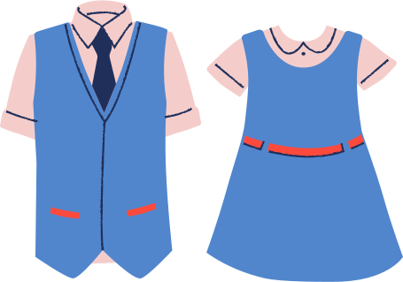
This presentation template is free for everyone to use thanks to the following:
  SlidesCarnival for the presentation template
  Pexels for the photos
Happy designing!

