Slide 1

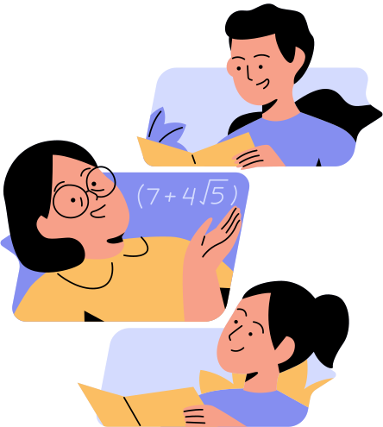
RATIONAL VS.
IRRATIONAL
NUMBERS
Exploring sets within the real number system

Slide 2
HOW TO USE THIS PRESENTATION
Google Slides
PowerPoint
Canva
  Click on the "Google Slides" button below this presentation preview. Make sure to sign in to your Google account. Click on "Make a copy." Start editing your presentation.
  Alternative: Click on the "Share" button on the top right corner in Canva and click on "More" at the bottom of the menu. Enter "Google Drive" in the search bar and click on the GDrive icon to add this design as a Google slide in your GDrive.
  Click on the "PowerPoint" button below this presentation preview. Start editing your presentation.
  Alternative: From Canva template file, Click on the "Share" button on the top right corner in Canva and click on "More" at the bottom of the menu. Enter "PowerPoint" in the search bar and click on the PowerPoint icon to download.
  Click on the "Canva" button under this presentation preview. Start editing your presentation. You need to sign in to your Canva account.

Slide 3


LESSON OUTLINE
  The Real Number System
  Rational and Irrational Numbers
  Checkpoint Task
  Irrational Numbers on a Number Line

Slide 4



Group 1 | Group 2 | Group 3 | Group 4
1 | -5 | 1/2
2 | -8 | 3/4
3 | -12 | 5 2/5 | 0.1434.....
CAN YOU THINK OF A WAY TO MAKE 2 GROUPS OUT OF THESE 4 SETS OF NUMBERS?
2

Slide 5

LEARNING OUTCOMES
  Recall the set of numbers in the real number system.
  Differentiate between rational and irrational numbers.
  Plot irrational numbers on a number line.

Slide 6
THE REAL
NUMBER SYSTEM
REAL NUMBERS
It is a group of numbers that includes both rational and irrational numbers.
RATIONAL
IRRATIONAL

Slide 7

IRRATIONAL
Group 1 | Group 2 | Group 3 | Group 4
1 | -5 | 1/2
2 | -8 | 3/4
3 | -12 | 5 2/5 | 0.1434.....
RATIONAL AND IRRATIONAL NUMBERS
2
RATIONAL

Slide 8
CHECKPOINT TASK
  Can you differentiate between rational and irrational numbers?
  Circle the rational numbers and box the irrational numbers.
√
64
-0.12
1.618....
5.00
√
12
0

Slide 9

RATIONAL NUMBERS
  Numbers that can be expressed as a ratio of two integers
3
1
1
8
25
3 =
0.333... =
0.10 =
-8 = -
25 %
=
1
3
10
1
100
Whole
Numbers
Decimals
that repeat
Decimals that end in 0
Negative
integers
Percentages

Slide 10
IRRATIONAL NUMBERS
Numbers that cannot be expressed as a ratio of two integers
= 3.14...
0.1434
√
2
pi
Non-terminating and
non-repeating decimals
Square root of non-perfect square

Slide 11
IRRATIONAL NUMBERS
ON A NUMBER LINE
  The location of irrational numbers can be approximated on a number line using its decimal expansion.
0.1434... is greater than 0 but less than 1, and it is closer to 0.
√
√
12 is equal to 3.464... which means that it is between 3 and 4.
0.1434...
12 = 3.464101
0
1
2
3
4
5
6
7
8
9
10
11

Slide 12



TRY THESE!
  Plot pi and the golden ratio on the number line by moving the circles!
0
1
2
3
4
5
6
7
8
9
10
11

Slide 13

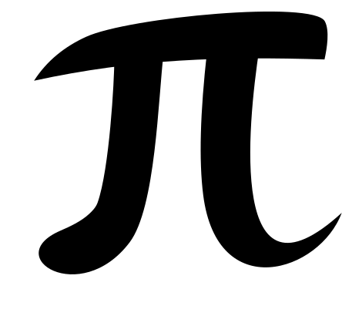

WHERE DO WE USE PI AND THE GOLDEN RATIO?

Slide 14

REFERENCE
  MathSpace. 1.01 The real number system. https://mathspace.co/textbooks/syllabuses/
  Syllabus-1157/topics/Topic-21903/subtopics/
  Subtopic-279877. Accessed 23 June 2023

Slide 15

RESOURCE
PAGE
  Use these design resources
  in your Canva Presentation.
  This presentation template
  uses the following free fonts:
  Titles: Oswald
  Headers: Oleo Script
  Body Copy: Nunito
  You can find these fonts
  online too. Happy designing!
  Don't forget to delete this
  page before presenting.

Slide 16

THIS PRESENTATION TEMPLATE IS FREE FOR EVERYONE TO USE THANKS TO THE FOLLOWING:
  SlidesCarnival for the presentation template
  Pexels for the photos
HAPPY DESIGNING!

